Slide 1
RDF Resource Description Framework
Pedro Szekely
University of Southern California/ISI
slide by Pedro Szekely

Slide 2
Semantic Web Layer Cake
slide by Pedro Szekely

Slide 3
Unicode
slide by Pedro Szekely

Slide 4
Why Unicode?
http://site.com/Македонски.html
http://site.com/Μία_Σελίδα
http://www.中国政府.政务.cn
slide by Pedro Szekely
Notes:
Μία_Σελίδα = One Page
Македонски = Macedonian
政务 = Government Affairs?
中国政府 = Government of China?
THE STATE COUNCIL THE PEOPLE'S REPUBLIC OF CHINA ?

Slide 5
Unicode
Unicode is a computing industry standard for the consistent encoding, representation and handling of text expressed in most of the world's writing systems.
… the latest version of Unicode consists of a repertoire of more than 110,000 characters covering over 100 scripts
Wikipedia
slide by Pedro Szekely
Notes:
Unicode V7.0 June 2014, 123 scripts 113,021 characters – JL

Slide 6
URI
slide by Pedro Szekely

Slide 7
URL: Uniform Resource Locator
A reference to an Internet resource
URL
Web Server
Document
(Resource)
slide by Pedro Szekely

Slide 8
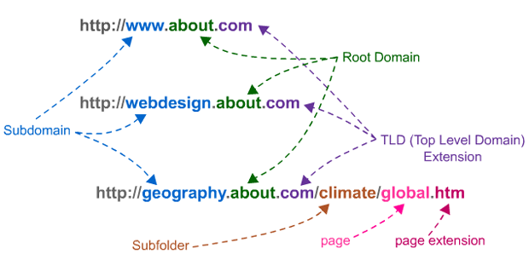
URL: Uniform Resource Locator
http://www.seomoz.org/blog/subfolders-root-domains-linkscape-update-more
slide by Pedro Szekely

Slide 9
URL vs URI
URI
URL
URN
locators
names
like person's street address
like a person's name
method for finding it
item's identity
slide by Pedro Szekely
Notes:
URN identifies an item and a URL provides a method for finding it.

Slide 10
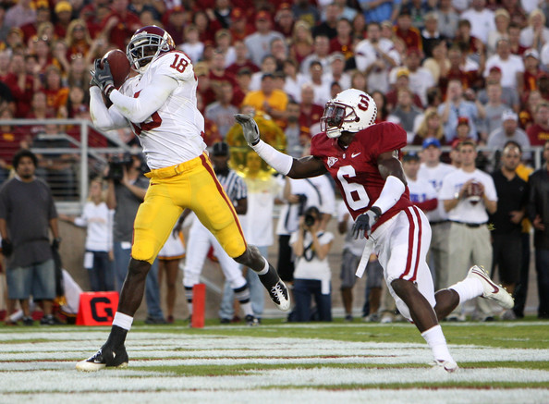
Can USC Have a URI?
slide by Pedro Szekely

Slide 11
Can USC Have a URI?
http://dbpedia.org/page/University_of_Southern_California
slide by Pedro Szekely

Slide 12
Things can have URIs
slide by Pedro Szekely

Slide 13
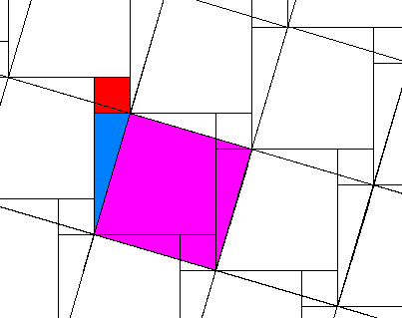
Can the Pythagoras Theorem Have a URI?
slide by Pedro Szekely

Slide 14
Can the Pythagoras Theorem Have a URI?
http://www.freebase.com/view/en/pythagorean_theorem
slide by Pedro Szekely

Slide 15
Ideas can have URIs
slide by Pedro Szekely

Slide 16
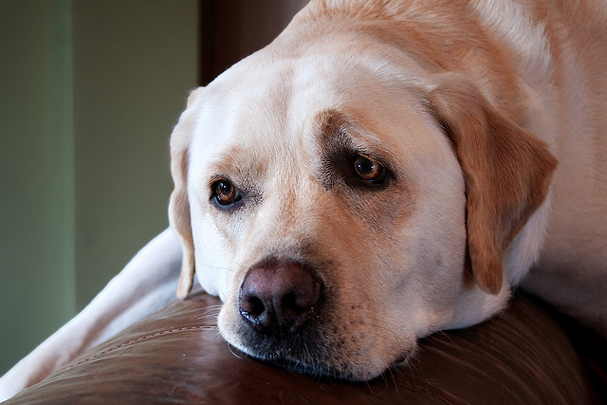
My Dog: Can He Have a URI?
slide by Pedro Szekely

Slide 17
My Dog: Can He Have a URI?
http://szekelys.com/diego
slide by Pedro Szekely

Slide 18
It does not have to be “important” to have a URI
slide by Pedro Szekely

Slide 19
Namespaces
slide by Pedro Szekely

Slide 20
Are These the Same?
<Bookstore>
<Book>
<Author>John Doe</Author>
<Title>Introduction to XML</Title>
<Publisher>XYZ</Publisher>
</Book>
</Bookstore>
<http://amazon.com/store/Bookstore>
<http://amazon.com/store/Book>
<http://amazon.com/store/Author>John Doe</http://amazon.com/store/Author>
<http://amazon.com/store/Title>Introduction to XML</http://amazon.com/store/Title>
<http://amazon.com/store/Publisher>XYZ</http://amazon.com/store/Publisher>
</http://amazon.com/store/Book>
</http://amazon.com/store/Bookstore>
<http://barnesandnoble.com/store/Bookstore>
<http://barnesandnoble.com/store/Book>
<http://barnesandnoble.com/store/Author>John Doe</http://barnesandnoble.com/store/Author>
<http://barnesandnoble.com/store/Title>Introduction to XML</http://barnesandnoble.com/store/Title>
<http://barnesandnoble.com/store/Publisher>XYZ</http://barnesandnoble.com/store/Publisher>
</http://barnesandnoble.com/store/Book>
</http://barnesandnoble.com/store/Bookstore>
slide by Pedro Szekely

Slide 21
Namespaces
XML namespaces are used for providing uniquely named elements and attributes in an XML document
Wikipedia
xmlns="http://amazon.com/store"
slide by Pedro Szekely

Slide 22
Using a Namespace Declaration
<http://amazon.com/store/Bookstore>
<http://amazon.com/store/Book>
<http://amazon.com/store/Author>John Doe</http://amazon.com/store/Author>
<http://amazon.com/store/Title>Introduction to XML</http://amazon.com/store/Title>
<http://amazon.com/store/Publisher>XYZ</http://amazon.com/store/Publisher>
</http://amazon.com/store/Book>
</http://amazon.com/store/Bookstore>
=
<Bookstore xmlns=“http://amazon.com/store”>
<Book>
<Author>John Doe</Author>
<Title>Introduction to XML</Title>
<Publisher>XYZ</Publisher>
</Book>
</Bookstore>
slide by Pedro Szekely

Slide 23
Default and Prefix Namespaces
<http://amazon.com/store/Bookstore>
<http://amazon.com/store/Book>
<http://amazon.com/store/Author>John Doe</http://amazon.com/store/Author>
<http://amazon.com/store/Title>Introduction to XML</http://amazon.com/store/Title>
<http://amazon.com/store/Publisher>XYZ</http://amazon.com/store/Publisher>
</http://amazon.com/store/Book>
</http://amazon.com/store/Bookstore>
=
<Bookstore xmlns=“http://amazon.com/store”>
<Book>
<Author>John Doe</Author>
<Title>Introduction to XML</Title>
<Publisher>XYZ</Publisher>
</Book>
</Bookstore>
=
<am:Bookstore xmlns:am=“http://amazon.com/store”>
<am:Book>
<am:Author>John Doe</am:Author>
<am:Title>Introduction to XML</am:Title>
<am:Publisher>XYZ</am:Publisher>
</am:Book>
</am:Bookstore>
slide by Pedro Szekely

Slide 24
Default and Prefix Namespaces
<am:Bookstore
xmlns:am=“http://amazon.com/store”
xmlns:bn=http://barnesandnoble.com/store>
<am:Book>
<am:Author>John Doe</am:Author>
<bn:Author>Jane Doe</bn:Author>
<am:Title>Introduction to XML</am:Title>
<am:Publisher>XYZ</am:Publisher>
</am:Book>
</am:Bookstore>
If elements were defined within a global scope,
it would be a problem to
combine elements from multiple documents
slide by Pedro Szekely

Slide 25
XML
slide by Pedro Szekely

Slide 26
eXtensible Markup Language
HTML specifies how to display data
fixed
set of tags
<h2>Nonmonotonic Reasoning</h2>
<i>by <b>V. Marek</b> and <b>M. Truszczynski</b></i><br>
Springer 1993<br>
ISBN 0387976892
XML specifies data
extensible
set of tags
<book>
<title>Nonmonotonic Reasoning</title>
<author>V. Marek</author>
<author>M. Truszczynski</author>
<publisher>Springer</publisher>
<year>1993</year>
<ISBN>0387976892</ISBN>
</book>
slide by Pedro Szekely

Slide 27
Design of XML
Tags can be used to indicate the meaning of data
No fixed set of markup tags: new tags can be defined
Underlying data model is a tree structure
Actually XML can represent graphs via IDs and IDREFs, but it’s a bit cumbersome
XML provides a common exchange format
W3C Recommendation:
http://www.w3.org/TR/REC-xml/

Slide 28
Merging Problem in XML
Document 1
<Bookstore xmlns=“http://amazon.com”>
<Book id=“2”>
<Publisher>Springer</Publisher>
</Book>
<Book id=“1”>
<Publisher>ACM</Publisher>
</Book>
</Bookstore>
Merged Document
<Bookstore xmlns=“http://amazon.com”>
<Book id=“1”>
<Author>John</Author>
<Title>Introduction to XML</Title>
<Publisher>ACM</Publisher>
</Book>
<Book id=“2”>
<Author>Susan</Author>
<Title>Advanced</Title>
<Publisher>Springer</Publisher>
</Book>
</Bookstore>
Document 2
<Bookstore xmlns=“http://amazon.com”>
<Book id=“1”>
<Author>John</Author>
<Title>Introduction to XML</Title>
</Book>
<Book id=“2”>
<Author>Susan</Author>
<Title>Advanced</Title>
</Book>
</Bookstore>
… is difficult
slide by Pedro Szekely

Slide 29
Does XML Represent Meaning?
John is an instructor for CS101
<instructor name=“John”>
<teaches>CS 101</teaches>
<instructor>
<course name=“CS101”>
<instructor> John </instructor>
<course>
Opposite nesting, same information!
based on slide from Jose Luis Ambite
slide by Pedro Szekely
Notes:
Tree structure does not represent relationships in a natural form -- JLA

Slide 30
Does XML Represent Meaning?
John is an instructor for CS101
<instructor name=“John”>
<teaches>CS 101</teaches>
<instructor>
<course name=“CS101”>
<instructor> John </instructor>
<course>
hasInstructor inverseOf teaches
∀C,I hasInstructor(C,I) ↔ teaches(I,C)
range(hasInstructor) = Person
∀C,I hasInstructor(C,I) → Person(I)
based on slide from Jose Luis Ambite
slide by Pedro Szekely
Notes:
Limited capabilities to represent semantics. XMLSchema provides structural information, but more is needed. -- JLA

Slide 31
Meaning of Data in XML?
…
<Book>
<Author>John</Author>
<Title>Introduction to XML</Title>
<Publisher>ACM</Publisher>
<Country>USA</Country>
</Book>
…
What is the meaning of Country?
… where the book is sold?
… where it is published?
… where the author lives?
… ???
slide by Pedro Szekely
Notes:
How would we add more information to the document? -- JLA

Slide 32
XML Schema
The purpose of a schema is to
define a class of XML documents, and so the term "instance document" is often used to
describe an XML document
that conforms to a particular schema
http://www.w3.org/TR/xmlschema-0/
a syntax checker
slide by Pedro Szekely

Slide 33
Example
Defining the USAddress Type
<xsd:complexType name="USAddress" >
<xsd:sequence>
<xsd:element name="name" type="xsd:string"/>
<xsd:element name="street" type="xsd:string"/>
<xsd:element name="city" type="xsd:string"/>
<xsd:element name="state" type="xsd:string"/>
<xsd:element name="zip" type="xsd:decimal"/>
</xsd:sequence>
<xsd:attribute name="country" type="xsd:NMTOKEN" fixed="US"/>
</xsd:complexType>
… must have specific elements
… in a specific order
… filled with specific types of data
slide by Pedro Szekely

Slide 34
XML Schema by Example
<?xml version="1.0"?>
<xsd:schema xmlns:xsd=“http://www.w3.org/2001/XMLSchema”
targetNamespace="http://www.books.org"
xmlns=http://www.books.org>
<xsd:element name="Bookstore">
<xsd:complexType>
<xsd:sequence>
<xsd:element ref="Book" minOccurs="1" maxOccurs="unbounded"/>
</xsd:sequence>
</xsd:complexType>
</xsd:element>
<xsd:element name="Book">
<xsd:complexType>
<xsd:sequence>
<xsd:element ref="Title" minOccurs="1" maxOccurs="1"/>
<xsd:element ref="Author" minOccurs="1" maxOccurs=“unbounded”/>
<xsd:element ref="Date" minOccurs="1" maxOccurs="1"/>
<xsd:element ref="ISBN" minOccurs="1" maxOccurs="1"/>
<xsd:element ref="Publisher" minOccurs="1" maxOccurs="1"/>
</xsd:sequence>
</xsd:complexType>
</xsd:element>
<xsd:element name="Title" type="xsd:string"/>
<xsd:element name="Author" type="xsd:string"/>
<xsd:element name="Date" type="xsd:Date"/>
<xsd:element name="ISBN" type="xsd:integer"/>
<xsd:element name="Publisher" type="xsd:string"/>
</xsd:schema>
“Bookstore” is a complex Type
A sequence of 1 or more “Book” elements
When referring to another
Element, use “ref”
Notice the use of more
meaningful data types

Slide 35
XML Schema Primitive Types
string
boolean
decimal
float
double
duration
dateTime
time
date
gYearMonth
gYear
gMonthDay
gDay
gMonth
hexBinary
base64Binary
anyURI
Qname
NOTATION
useful in RDF
slide by Pedro Szekely
Notes:
gXXX periods of time in the Gregorian calendar – JLA
http://www.w3.org/TR/2001/REC-xmlschema-2-20010502/#gYearMonth

Slide 36
Resource Description Framework
slide by Pedro Szekely

Slide 37
The Resource Description Framework (RDF)
is a language for
representing information about resources
in the World Wide Web
http://www.w3.org/TR/rdf-primer/
slide by Pedro Szekely

Slide 38
Resource Description Framework
Intended for representing metadata about Web resources, such as the title, author, and modification date
of a Web document
… also be used to represent information about
things that can be identified on the Web,
even when they cannot be directly retrieved on the Web
examples include information about items available from on-line shopping facilities (e.g., prices and availability)
slide by Pedro Szekely

Slide 39
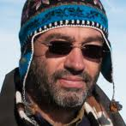
Represent Resources Using URIs
That guy has first name “Pedro”
http://szekelys.com/family#pedro
http://xmlns.com/foaf/0.1/firstName
“Pedro”
slide by Pedro Szekely

Slide 40
Represent Information as Triples
http://xmlns.com/foaf/0.1/firstName
http://szekelys.com/family#pedro
“Pedro”
Subject
The resource being described
Predicate
A property of the resource
Object
The value of the property
slide by Pedro Szekely

Slide 41
Use Namespaces
http://szekelys.com/family#pedro
http://xmlns.com/foaf/0.1/firstName
“Pedro”
http://szekelys.com/family#pedro
foaf:firstName
“Pedro”
slide by Pedro Szekely

Slide 42
RDF Graphs
foaf:Person
rdf:type
http://szekelys.com/family#pedro
foaf:firstName
foaf:homepage
“Pedro”
http://isi.edu/~szekely
A directed labelled graph
slide by Pedro Szekely

Slide 43
RDF Graphs
Kinds of things
foaf:Person
rdf:type
Real world objects
http://szekelys.com/family#pedro
foaf:firstName
Literals
foaf:homepage
“Pedro”
Properties of things
http://isi.edu/~szekely
slide by Pedro Szekely

Slide 44
Mix Vocabularies
schema:Person
foaf:Person
rdf:type
rdf:type
http://szekelys.com/family#pedro
foaf:firstName
“Pedro”
foaf:homepage
schema:spouse
http://isi.edu/~szekely
http://szekelys.com/family#claudia
slide by Pedro Szekely

Slide 45
Why Use URIs?
URIs look cool
slide by Pedro Szekely

Slide 46
Why Use URIs?
URIs look cool
Precisely identify resources
Avoid confusion among different “Wang Wei”
Precisely identify properties
E.g., name of a company or name of a person
Provide information about properties
Look them up on the web
slide by Pedro Szekely

Slide 47
XML vs RDF
John is an instructor for CS101
<instructor name=“John”>
<teaches>CS 101</teaches>
<instructor>
<course name=“CS101”>
<instructor> John </instructor>
<course>
XML
ex:isTeacherOf
RDF
usc-people:prof-01
usc-course:cs-101
foaf:name
ex:name
ex:hasInstructor
“John”
“CSC-101”
slide by Pedro Szekely

Slide 48
RDF Syntaxes
XML
Leverages XML tools
Hard for humans to read
N3, Turtle
Terse RDF Triple Language
Human readable format
Works with software too
N-Triples
Subset of turtle, supports streaming
Standard for large RDF dumps
RDFa
Allows embedding RDF in HTML pages
JSON-LD
RDF in JSON
slide by Pedro Szekely

Slide 49
RDF in XML Syntax
<?xml version="1.0"?>
<rdf:RDF xmlns:rdf="http://www.w3.org/1999/02/22-rdf-syntax-ns#"
xmlns:foaf="http://xmlns.com/foaf/0.1/">
<rdf:Description rdf:about="http://szekelys.com/family#pedro">
<foaf:firstName>Pedro</foaf:firstName>
<foaf:homepage rdf:resource="http://isi.edu/~szekely"/>
</rdf:Description>
</rdf:RDF>
Pedro’s homepage is "http://isi.edu/~szekely"
slide by Pedro Szekely

Slide 50
RDF in XML Syntax
It’s an XML document
<?xml version="1.0"?>
<rdf:RDF xmlns:rdf="http://www.w3.org/1999/02/22-rdf-syntax-ns#"
xmlns:foaf="http://xmlns.com/foaf/0.1/">
<rdf:Description rdf:about="http://szekelys.com/family#pedro">
<foaf:firstName>Pedro</foaf:firstName>
<foaf:homepage rdf:resource="http://isi.edu/~szekely"/>
</rdf:Description>
</rdf:RDF>
Pedro’s homepage is "http://isi.edu/~szekely"
slide by Pedro Szekely

Slide 51
RDF in XML Syntax
Here comes some RDF
<?xml version="1.0"?>
<rdf:RDF xmlns:rdf="http://www.w3.org/1999/02/22-rdf-syntax-ns#"
xmlns:foaf="http://xmlns.com/foaf/0.1/">
<rdf:Description rdf:about="http://szekelys.com/family#pedro">
<foaf:firstName>Pedro</foaf:firstName>
<foaf:homepage rdf:resource="http://isi.edu/~szekely"/>
</rdf:Description>
</rdf:RDF>
Pedro’s homepage is "http://isi.edu/~szekely"
slide by Pedro Szekely

Slide 52
RDF in XML Syntax
Namespace declarations
<?xml version="1.0"?>
<rdf:RDF xmlns:rdf="http://www.w3.org/1999/02/22-rdf-syntax-ns#"
xmlns:foaf="http://xmlns.com/foaf/0.1/">
<rdf:Description rdf:about="http://szekelys.com/family#pedro">
<foaf:firstName>Pedro</foaf:firstName>
<foaf:homepage rdf:resource="http://isi.edu/~szekely"/>
</rdf:Description>
</rdf:RDF>
Pedro’s homepage is "http://isi.edu/~szekely"
slide by Pedro Szekely

Slide 53
RDF in XML Syntax
Subject
<?xml version="1.0"?>
<rdf:RDF xmlns:rdf="http://www.w3.org/1999/02/22-rdf-syntax-ns#"
xmlns:foaf="http://xmlns.com/foaf/0.1/">
<rdf:Description rdf:about="http://szekelys.com/family#pedro">
<foaf:firstName>Pedro</foaf:firstName>
<foaf:homepage rdf:resource="http://isi.edu/~szekely"/>
</rdf:Description>
</rdf:RDF>
Pedro’s homepage is "http://isi.edu/~szekely"
slide by Pedro Szekely

Slide 54
RDF in XML Syntax
Predicate
<?xml version="1.0"?>
<rdf:RDF xmlns:rdf="http://www.w3.org/1999/02/22-rdf-syntax-ns#"
xmlns:foaf="http://xmlns.com/foaf/0.1/">
<rdf:Description rdf:about="http://szekelys.com/family#pedro">
<foaf:firstName>Pedro</foaf:firstName>
<foaf:homepage rdf:resource="http://isi.edu/~szekely"/>
</rdf:Description>
</rdf:RDF>
Pedro’s homepage is "http://isi.edu/~szekely"
slide by Pedro Szekely

Slide 55
RDF in XML Syntax
Value
<?xml version="1.0"?>
<rdf:RDF xmlns:rdf="http://www.w3.org/1999/02/22-rdf-syntax-ns#"
xmlns:foaf="http://xmlns.com/foaf/0.1/">
<rdf:Description rdf:about="http://szekelys.com/family#pedro">
<foaf:firstName>Pedro</foaf:firstName>
<foaf:homepage rdf:resource="http://isi.edu/~szekely"/>
</rdf:Description>
</rdf:RDF>
Pedro’s homepage is "http://isi.edu/~szekely"
slide by Pedro Szekely

Slide 56
RDF in XML Syntax
Subject
Predicate
Value
<?xml version="1.0"?>
<rdf:RDF xmlns:rdf="http://www.w3.org/1999/02/22-rdf-syntax-ns#"
xmlns:foaf="http://xmlns.com/foaf/0.1/">
<rdf:Description rdf:about="http://szekelys.com/family#pedro">
<foaf:firstName>Pedro</foaf:firstName>
<foaf:homepage rdf:resource="http://isi.edu/~szekely"/>
</rdf:Description>
</rdf:RDF>
Pedro’s homepage is "http://isi.edu/~szekely"
slide by Pedro Szekely

Slide 57
RDF in XML Syntax
“Pedro”
http://szekelys.com/family#pedro
foaf:firstName
<?xml version="1.0"?>
<rdf:RDF xmlns:rdf="http://www.w3.org/1999/02/22-rdf-syntax-ns#"
xmlns:foaf="http://xmlns.com/foaf/0.1/">
<rdf:Description rdf:about="http://szekelys.com/family#pedro">
<foaf:firstName>Pedro</foaf:firstName>
<foaf:homepage rdf:resource="http://isi.edu/~szekely"/>
</rdf:Description>
</rdf:RDF>
slide by Pedro Szekely

Slide 58
RDF in XML Syntax
foaf:Person
rdf:type
“Pedro”
http://szekelys.com/family#pedro
foaf:firstName
<?xml version="1.0"?>
<rdf:RDF xmlns:rdf="http://www.w3.org/1999/02/22-rdf-syntax-ns#"
xmlns:foaf="http://xmlns.com/foaf/0.1/">
<foaf:Person rdf:about="http://szekelys.com/family#pedro">
<foaf:firstName>Pedro</foaf:firstName>
<foaf:homepage rdf:resource="http://isi.edu/~szekely"/>
</foaf:Person>
</rdf:RDF>
slide by Pedro Szekely

Slide 59
<?xml version="1.0"?>
<rdf:RDF xmlns:rdf="http://www.w3.org/1999/02/22-rdf-syntax-ns#"
xmlns:foaf=http://xmlns.com/foaf/0.1/>
<foaf:Person rdf:about="http://szekelys.com/family#pedro">
<foaf:firstName>Pedro</foaf:firstName>
<foaf:homepage rdf:resource="http://isi.edu/~szekely"/>
</foaf:Person>
</rdf:RDF>
<?xml version="1.0"?>
<rdf:RDF xmlns:rdf=…
xmlns:foaf=…
<foaf:Person rdf:about=
"http://szekelys.com/family#pedro">
<foaf:firstName>Pedro</foaf:firstName>
</foaf:Person>
</rdf:RDF>
<?xml version="1.0"?>
<rdf:RDF xmlns:rdf=…
xmlns:foaf=…
<foaf:Person rdf:about=
"http://szekelys.com/family#pedro">
<foaf:homepage rdf:resource="http://isi.edu/~szekely"/>
</foaf:Person>
</rdf:RDF>
+
slide by Pedro Szekely

Slide 60
RDF Syntaxes
XML
Leverages XML tools
Hard for humans to read
N3, Turtle
Terse RDF Triple Language
Human readable format
Works with software too
N-Triples
Subset of turtle, supports streaming
Standard for large RDF dumps
RDFa
Allows embedding RDF in HTML pages
slide by Pedro Szekely

Slide 61
N3 and Turtle Syntaxes
foaf:Person
rdf:type
“Pedro”
http://szekelys.com/family#pedro
foaf:firstName
@prefix rdf: <http://www.w3.org/1999/02/22-rdf-syntax-ns#> .
@prefix foaf: <http://xmlns.com/foaf/0.1/> .
<http://szekelys.com/family#pedro> foaf:firstName “Pedro” .
<http://szekelys.com/family#pedro> rdf:type foaf:Person .
Each triple ends with a dot
slide by Pedro Szekely

Slide 62
More Complex Structures

Slide 63
English
“USC/ISI’s address is
4676 Admiralty Way, Marina del Rey, CA 90292”
RDF
usc:isi
schema:address
“4676 Admiralty Way, Marina del Rey, CA 90292”
.
In what city is USC/ISI located?
Find all universities in California
slide by Pedro Szekely

Slide 64
English
“USC/ISI’s address is
4676 Admiralty Way, Marina del Rey, CA 90292”
RDF
usc:isi
schema:address
“4676 Admiralty Way, Marina del Rey, CA 90292”
.
How to represent nested structures?
slide by Pedro Szekely

Slide 65
Represents the address of USC/ISI
usc:isi
schema:address
schema:addressCountry
“USA”
schema:streetAddress
schema:addressRegion
“4676 Admiralty Way”
schema:addressLocality
“CA”
schema:postalCode
“Marina del Rey”
“90292”
slide by Pedro Szekely

Slide 66
English
“USC/ISI’s address is
4676 Admiralty Way, Marina del Rey, CA 90292”
RDF
usc:isi schema:address usc:isi-address .
usc:isi-address
schema:addressCountry “USA” ;
schema:addressRegion “CA”;
schema:addressLocality “Marina del Rey” ;
schema:postalCode “90292” ;
schema:streetAddress “4676 Admiralty Way” .
slide by Pedro Szekely

Slide 67
We minted a URI for USC/ISI’s address
usc:isi schema:address usc:isi-address .
usc:isi-address
schema:addressCountry “USA” ;
schema:addressRegion “CA”
schema:addressLocality “Marina del Rey” ;
schema:postalCode “90292” ;
schema:streetAddress “4676 Admiralty Way” .
… but sometimes we don’t want to mint URIs
slide by Pedro Szekely

Slide 68
Blank Nodes
Blank node
prefix is “_”
usc:isi schema:address _:isi-address .
_:isi-address
schema:addressCountry “USA” ;
schema:addressRegion “CA” ;
schema:addressLocality “Marina del Rey” ;
schema:postalCode “90292” ;
schema:streetAddress “4676 Admiralty Way” .
… can be improved …
slide by Pedro Szekely

Slide 69
What If I Don’t Know the URI?
English
“Pedro Szekely lives in Los Angeles”
Blank node
RDF
_:pedro
foaf:firstName “Pedro” ;
foaf:lastName “Szekely” ;
foaf:mbox “szekely1401@gmail.com” ;
schema:addressLocality “Los Angeles” .
… is this useful? … maybe
A blank node is essentially a skolem symbol
slide by Jose Luis Ambite, based on slide by Pedro Szekely

Slide 70
Typed Literals
Compact blank node syntax
gn:bogota weather:event [
weather:temperature “10” ;
weather:date ”18 June 2012”
] .
… what is the meaning of the strings?
… how do I specify numbers?
… how about dates?
… how do I specify 10 degrees centigrade?
slide by Pedro Szekely

Slide 71
Typed Literals
gn:bogota weather:event [
weather:temperature “10”^^<http://www.w3.org/2001/XMLSchema#integer> ;
weather:date ”18 June 2012” ;
] .
URI specifies the type
slide by Pedro Szekely

Slide 72
Typed Literals
gn:bogota weather:event [
weather:temperature “10”^^<http://www.w3.org/2001/XMLSchema#integer> ;
weather:date ”18 June 2012” ;
weather:date ”2012-06-18”^^xsd:date ;
] .
URI from the XML Schema namespace are popular
… No set of predefined types defined in RDF
… Software that consumes RDF must process types
… XSD types commonly used
slide by Pedro Szekely

Slide 73
Containers and Collections
slide by Pedro Szekely

Slide 74
Bag, Sequence, Alternative
Kinds of containers
Elements, can be URI or literal
rdf:Bag
rdf:Seq
rdf:Alt
rdf:_1
<…>
rdf:_2
<…>
rdf:type
<…>
rdf:_nnn
“…”
Properties for storing
elements in containers
Container, often a blank node
slide by Pedro Szekely
Notes:
rdf:_nnn where nnn is a positive integer without leading zeros (https://www.w3.org/TR/rdf-schema/#ch_containervocab)

Slide 75
Bag Example
“Three papers that Sue published”
exstaff:Sue exterms:publication _:z .
_:z rdf:type rdf:Bag .
_:z rdf:_1 ex:AnthologyOfTime .
_:z rdf:_2 ex:ZoologicalReasoning .
_:z rdf:_3 ex:GravitationalReflections .
slide by Pedro Szekely

Slide 76
What’s the Difference?
exstaff:Sue exterms:publication ex:AnthologyOfTime .
exstaff:Sue exterms:publication ex:ZoologicalReasoning .
exstaff:Sue exterms:publication ex:GravitationalReflections .
exstaff:Sue exterms:publication _:z .
_:z rdf:type rdf:Bag .
_:z rdf:_1 ex:AnthologyOfTime .
_:z rdf:_2 ex:ZoologicalReasoning .
_:z rdf:_3 ex:GravitationalReflections .
Order not
important
exstaff:Sue exterms:publication _:z .
_:z rdf:type rdf:Seq .
_:z rdf:_1 ex:AnthologyOfTime .
_:z rdf:_2 ex:ZoologicalReasoning .
_:z rdf:_3 ex:GravitationalReflections .
Order
important
slide by Pedro Szekely
Notes:
https://www.w3.org/TR/rdf-schema/#ch_containervocab

Slide 77
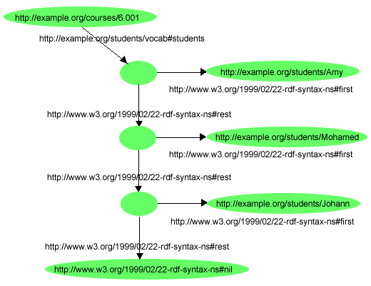
List
RDF Collection:
group containing only the specified members
represented as a List structure
First
Rest
<?xml version="1.0"?>
<rdf:RDF xmlns:rdf="http://www.w3.org/1999/02/22-rdf-syntax-ns#"
xmlns:s="http://example.org/students/vocab#">
<rdf:Description rdf:about="http://example.org/courses/6.001">
<s:students rdf:parseType="Collection">
<rdf:Description rdf:about="http://example.org/students/Amy"/>
<rdf:Description rdf:about="http://example.org/students/Mohamed"/>
<rdf:Description rdf:about="http://example.org/students/Johann"/>
</s:students>
</rdf:Description>
</rdf:RDF>
slide by Jose Luis Ambite

Slide 78
Containers vs Collections
RDF philosophy
Open World
Closed World
Incomplete information
Complete Information
There are things I don’t know
If I don’t know it, it does not exist
Scales to the whole Web
Does not scale
Containers
Collections
open world sets
closed world sets
slide by Pedro Szekely

Slide 79
Reification
slide by Pedro Szekely

Slide 80
Why Do We Need Reification?
English
“On June 19 2012, Claudia said that
Pedro’s email address is szekely1401@gmail.com”
RDF
<http://szekelys.com/family#pedro> foaf:mbox <szekely1401@gmail.com>
Correct?
…………………..… No!
We need to make a statement about a statement
slide by Pedro Szekely

Slide 81
Reification
English
“On June 19 2012, Claudia said that
Pedro’s email address is szekely1401@gmail.com”
RDF
_:s rdf:type rdf:Statement .
_:s rdf:subject <http://szekelys.com/family#pedro> .
_:s rdf:predicate foaf:mbox .
_:s rdf:object <szekely1401@gmail.com> .
_:s dcterms:date “2012-06-19”^^xsd:date .
_:s dcterms:creator <http://uniandes.edu.co/faculty#claudiaj> .
slide by Pedro Szekely, Jose Luis Ambite

Slide 82
Problems With Reification
RDF 1
_:s rdf:type rdf:Statement .
_:s rdf:subject <http://szekelys.com/family#pedro> .
_:s rdf:predicate foaf:mbox .
_:s rdf:object <szekely1401@gmail.com> .
_:s dcterms:date “2012-06-19”^^xsd:date .
_:s dcterms:creator <http://uniandes.edu.co/faculty#claudiaj> .
RDF 2
<http://szekelys.com/family#pedro> foaf:mbox <szekely1401@gmail.com>
RDF 1 implies RDF 2?
…..… No!
slide by Pedro Szekely, Jose Luis Ambite

Slide 83
Problems With Reification
_:s rdf:subject <http://szekelys.com/family#pedro> .
_:s rdf:predicate foaf:mbox .
_:s rdf:object <szekely1401@gmail.com> .
_:s dcterms:date “2012-06-19”^^xsd:date .
_:s dcterms:creator <http://uniandes.edu.co/faculty#claudiaj> .
Needs 3 times more triples
Most software cannot reason with it
Nice idea that does not work well!
Use sparingly, often there is a better way
slide by Pedro Szekely

Slide 84
Views of RDF statements and documents
An RDF statement can be viewed as:
A triple (subject, predicate, object): s p o .
A piece of a labeled graph:
A piece of XML code: <s> <p> o </p> <s>
A binary predicate in logic: p(s, o)
Thus an RDF document can be viewed as:
A set of triples
A directed labeled graph (semantic net)
An XML document
A set of logical facts
p
S
O
slide by Jose Luis Ambite

Slide 85
RDF Syntax
slide by Pedro Szekely

Slide 86
RDF Syntaxes
Original, still used, but others becoming more popular
XML
Leverages XML tools
Hard for humans to read
N3, Turtle
Terse RDF Triple Language
Human readable format
Works with software too
N-Triples
Subset of turtle, supports streaming
Standard for large RDF dumps
RDFa
Allows embedding RDF in HTML pages
slide by Pedro Szekely

Slide 87
Turtle Syntax
http://www.w3.org/TR/2011/WD-turtle-20110809/
slide by Pedro Szekely

Slide 88
Turtle URIs aka IRI
URIs are in <>
Absolute
<http://example.org/path/>
<http://example.org/path/#fragment>
</path>
<#fragment>
<>
Relative
to the
base
document
slide by Pedro Szekely

Slide 89
Turtle Prefixes (Namespaces)
Empty prefix
@prefix foo: <http://example.org/ns#> .
@prefix : <http://other.example.org/ns#> .
foo:bar foo: : .
:bar : foo:bar .
Expands to
http://example.org/ns#bar http://example.org/ns http://other.example.org/ns .
slide by Pedro Szekely

Slide 90
Turtle Literals
Strings in ""
"a string”
"""a string """
"""a string
with newlines
"""
or write them in """
… so you can break them in multiple lines
slide by Pedro Szekely

Slide 91
Turtle Literals
"That Seventies Show"
"That Seventies Show"@en
"Cette Série des Années Soixante-dix"@fr
"Cette Série des Années Septante"@fr-be
"mylexicaldata"^^<http://example.org/my/datatype>
"""10"""^^xsd:decimal
language tag
data type
Kinds of literals:
- untyped (“London” equivalent to “London”^^xsd:string)
- language tag
- data type (with a URI)
slide by Pedro Szekely

Slide 92
Turtle Blank Nodes
Blank nodes
Examples
_:me
_:a1234
[]
_:me foaf:firstName “Pedro” .
_:me foaf:lastName “Szekely” .
[] foaf:firstName “Pedro” .
[] foaf:lastName “Szekely” .
two blank nodes
[ foaf:firstName “Pedro” ;
foaf:lastName “Szekely” ;
]
slide by Pedro Szekely

Slide 93
Turtle Base URI
RDF document stored at http://isi.edu/szekely/example.rdf
</path>
<#fragment>
<>
</path>
<http://isi.edu/szekely/example/path>
<#fragment>
<http://isi.edu/szekely/example/#fragment>
<>
<http://isi.edu/szekely/example>
slide by Pedro Szekely

Slide 94
Turtle Base URI
# this is a complete turtle document
# In-scope base URI is the document URI at this point
<a1> <b1> <c1> .
@base <http://example.org/ns/> .
# In-scope base URI is http://example.org/ns/ at this point
<a2> <http://example.org/ns/b2> <c2> .
@base <foo/> .
# In-scope base URI is http://example.org/ns/foo/ at this point
<a3> <b3> <c3> .
@prefix : <bar#> .
:a4 :b4 :c4 .
@prefix : <http://example.org/ns2#> .
:a5 :b5 :c5 .
<a2> is <http://example.org/ns/a2>
<a3> is <http://example.org/ns/foo/a3>
:a4 is <http://example.org/ns/foo/bar#a4>
:a5 is <http://example.org/ns2#a5>
slide by Pedro Szekely

Slide 95
Turtle “Type” Shortcut
You can write:
<http://szekelys.com/family#pedro> <http://www.w3.org/1999/02/22-rdf-syntax-ns#type> foaf:Person .
You can abbreviate it to:
<http://szekelys.com/family#pedro> rdf:type foaf:Person .
Or even better:
<http://szekelys.com/family#pedro> a foaf:Person .
slide by Pedro Szekely

Slide 96
Turtle Literals Revisited
Integers:
Floating Point:
Booleans:
-5
0
1
10
+1
0.0
1.0
1.234567890123456789
-5.0
1.3e2
10e0
-12.5e10
true
false
Integers the hard way:
Booleans the hard way:
"-5"^^xsd:integer
"10"^^<http://www.w3.org/2001/XMLSchema#integer>
"true"^^xsd:boolean
Floating point the hard way:
"1.3e2"^^xsd:double
"-5.0"^^<http://www.w3.org/2001/XMLSchema#decimal>
slide by Pedro Szekely

Slide 97
Turtle Triple Abbreviations
:subject :predicate :object-1 .
:subject :predicate :object-2 .
:subject :predicate :object-1, :object-2 .
:subject :predicate-1 :object-1 .
:subject :predicate-2 :object-2 .
:subject
:predicate-1 :object-1 ;
:predicate-2 :object-2 .
slide by Pedro Szekely

Slide 98
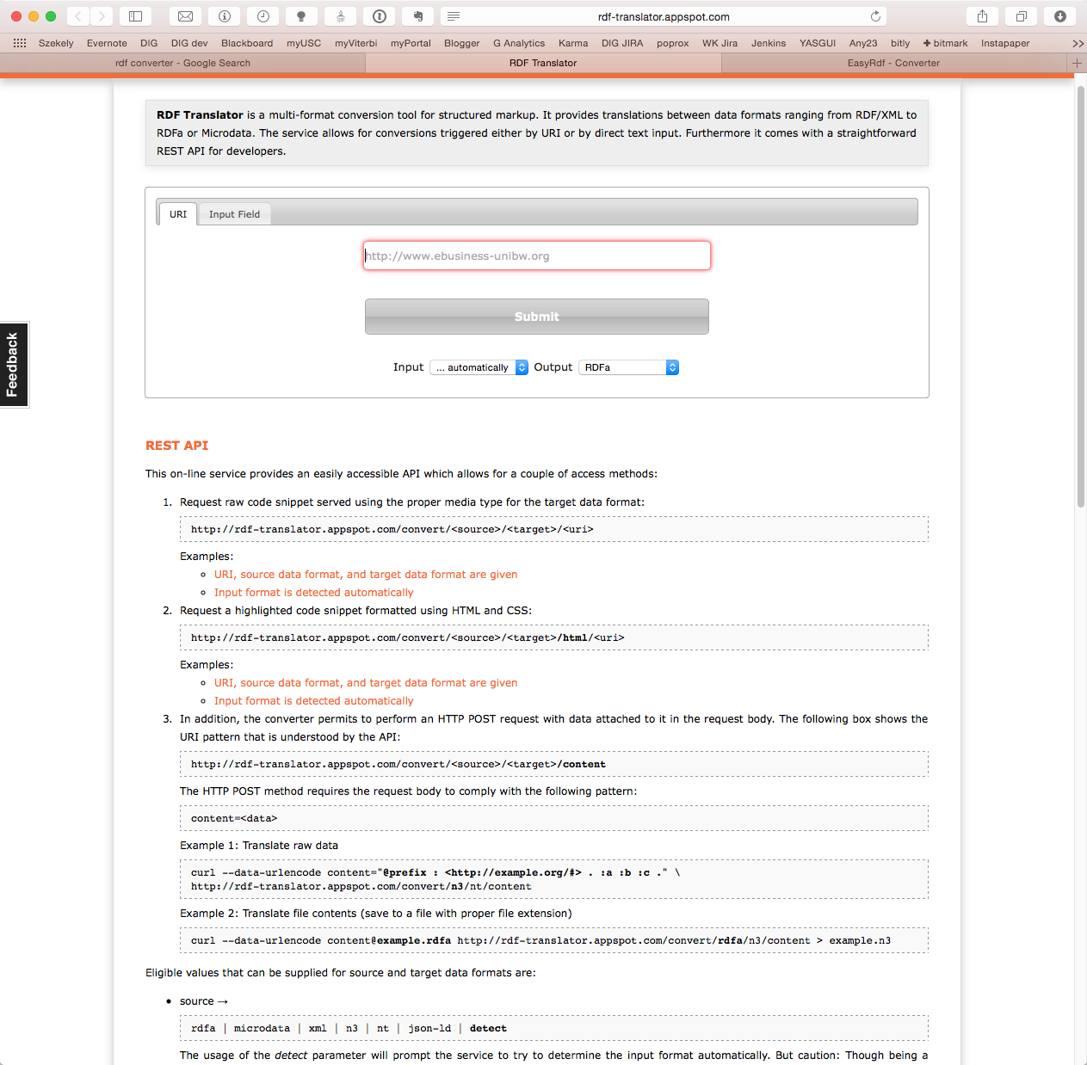
RDF Converter
http://rdf-translator.appspot.com
slide by Pedro Szekely

Slide 99
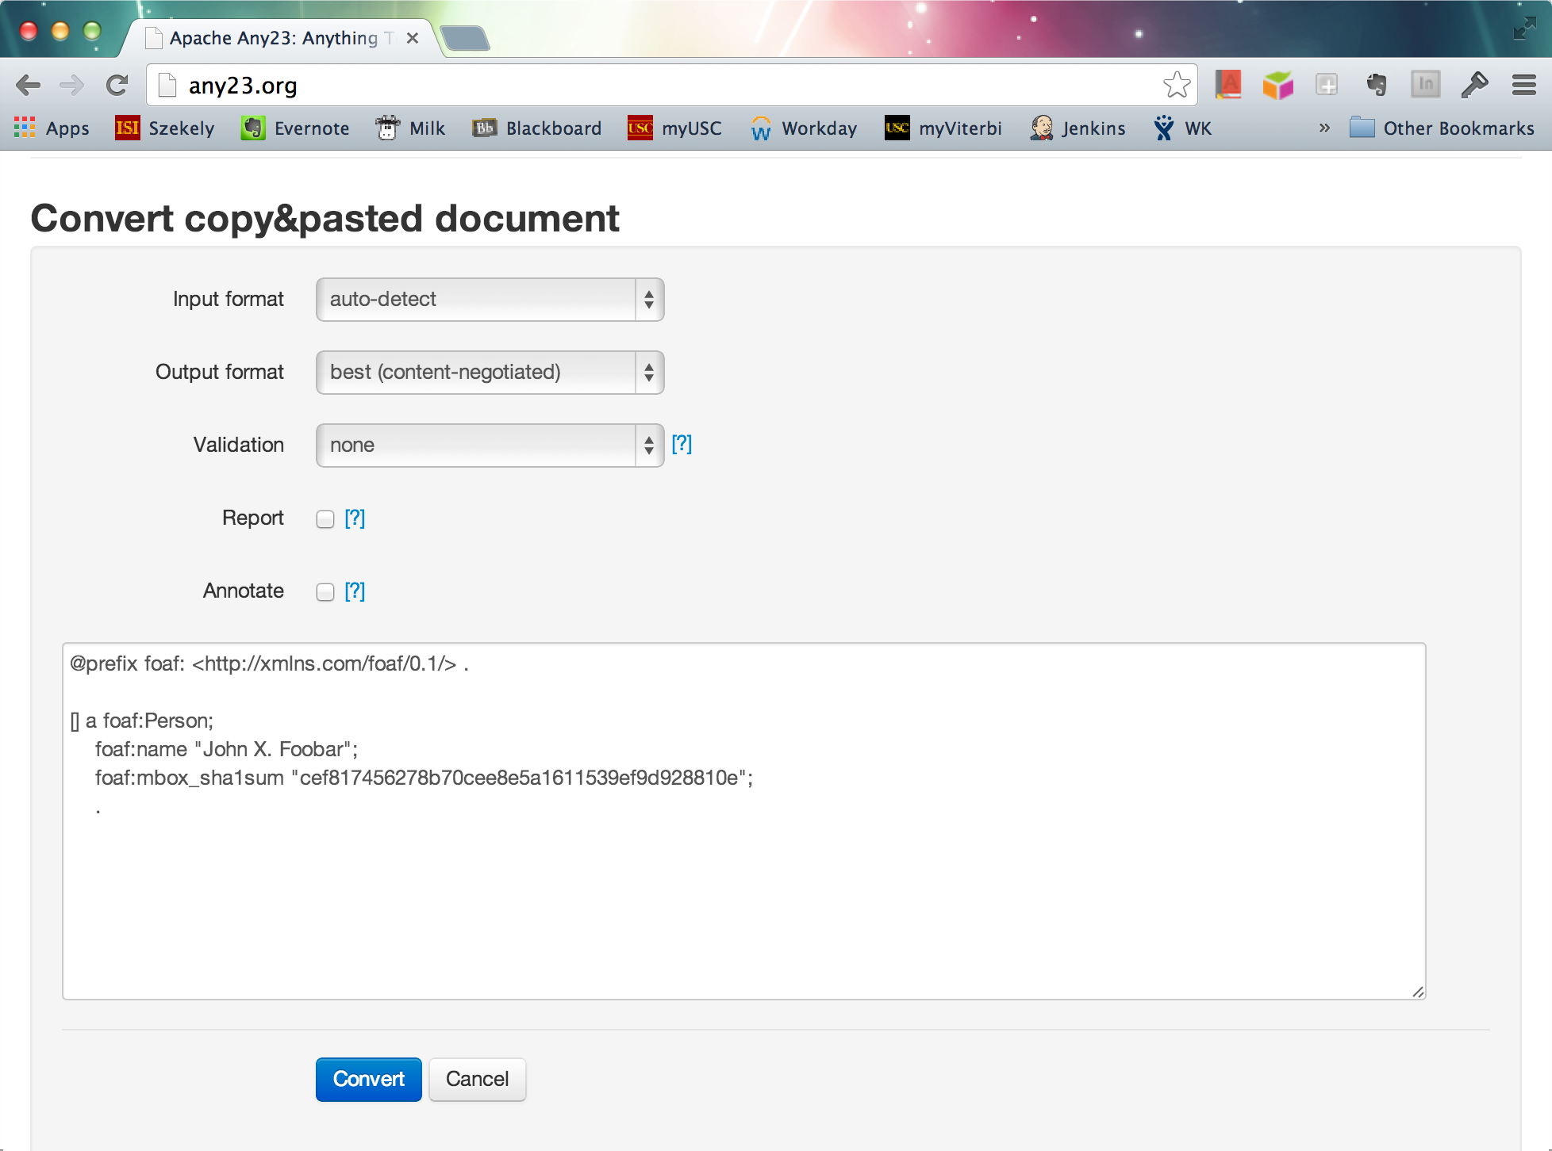
RDF Converter
[CHECK]
http://any23.org/
slide by Pedro Szekely

Slide 100
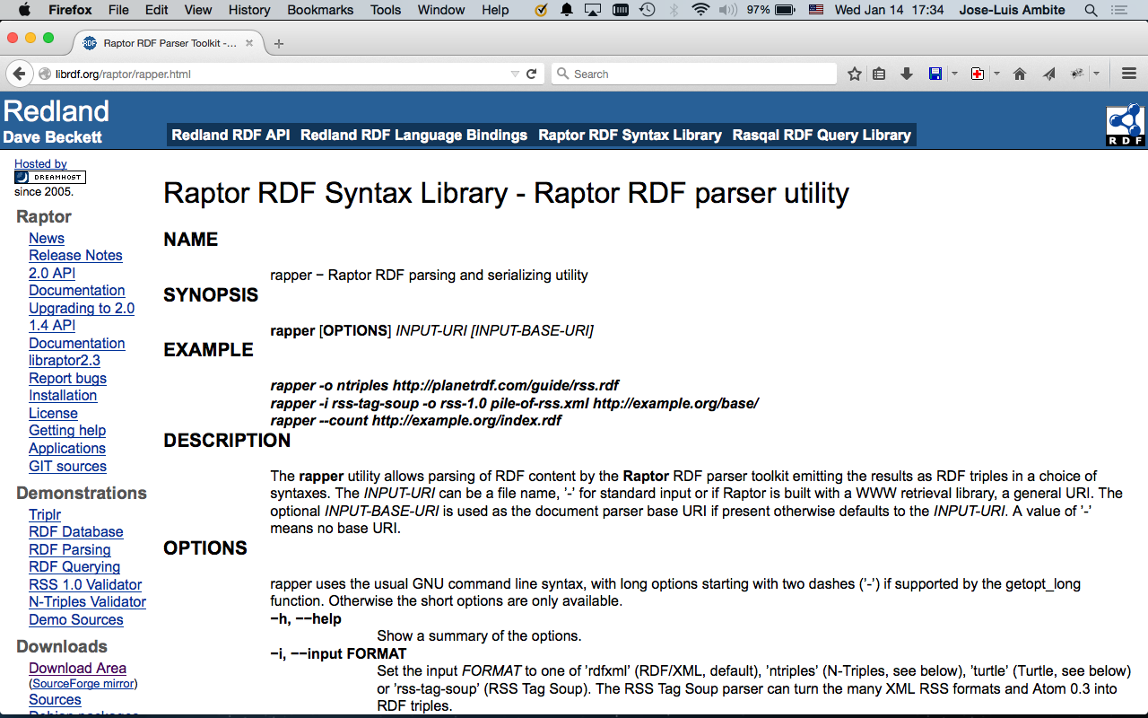
s1.dx = e.dx

