Slide 1
RDF Schema
Jose Luis Ambite
University of Southern California/ISI
slide by Pedro Szekely

Slide 2
RDF Review 1
Unicode
Standard for encoding international characters
URI
String of standardized form to uniquely identify resources
URL: http://www.example.org
URN: urn:isbn:0-123-45678-9
IRI: international variant of URI (with unicode)
XML
So that we have a common syntax for Semantic Web
XML schema
Define types, e.g., USAddress, for a particular set of XML documents, e.g., Invoices
slide by Wensheng Wu

Slide 3
RDF Review 2
Namespace
So that we can have different markup vocabularies in one document
RDF (Resource Description Framework)
Was used to represent metadata of Web resources
E.g., title, author, modification date
Generally, a graph representation of any resources
Triple: subject-predicate-object
Subject predicate are URIs, object can be URI or Literal
Anyone can define vocabulary of terms
slide by Wensheng Wu

Slide 4
RDF Review 3
FOAF (friend of a friend)
Terms for describing people and Social Web
Classes: e.g., Person, OnlineAccount
Properties: e.g., name, homepage, accountname
Using FOAF
RDF predefines some classes (e.g., rdf:Property) and properties (e.g., rdf:type)
Ex:DavidSmith
foaf:givenName
David
Ex:DavidSmith
rdf:type
foaf:Person
slide by Wensheng Wu

Slide 5
RDF Serialization: RDF/XML
ex:DavidSmith
foaf:givenName
David
<rdf:RDF xmlns:rdf=“http://www.w3.org/1999/02/22-rdf-syntax-ns#”
xmlns:ex=http://www.example.org/person#>
<rdf:Description rdf:about=“http://www.example.org/person#DavidSmith”>
<foaf:givenName>David</foaf:givenName>
</rdf:Description>
</rdf:RDF>
slide by Wensheng Wu
Notes:
http://www.w3.org/1999/02/22-rdf-syntax-ns#Description
description

Slide 6
RDF Serialization: Turtle
Terse RDF triple language
RDF in compact text format
ex:DavidSmith
foaf:givenName
David
@prefix ex: <http://www.example.org/person#>
ex:DavidSmith foaf:givenName “David”.
slide by Wensheng Wu
Notes:
http://www.w3.org/1999/02/22-rdf-syntax-ns#Description
description

Slide 7
Semantic Web Layer Cake
slide by Pedro Szekely

Slide 8
RDF Schema

Slide 9
RDF Schema (RDFS)
RDF Schema is the language for defining
RDF knowledge bases
Constraints on valid RDF graphs
using the RDF inference rules:
triples implied by the triples you have
(tuple-generating dependencies!)
slide by Jose Luis Ambite

Slide 10
RDF Schema Main Constructs
Class
rdfs:Class
Instance of a Class
rdf:type
Taxonomy of classes
rdfs:subClassOf
Taxonomy of properties
rdfs:subPropertyOf
Domain and range of properties
rdfs:domain, rdfs:range
Class1
rdfs:subClassOf
rdf:type
Class2
Instance1
slide by Wensheng Wu, Jose Luis Ambite

Slide 11
Classes and their Instances
We must distinguish between
Concrete “things” (individual objects) in the domain: John, CSCI548, USC, etc.
Sets of individuals sharing some properties (classes): Professors, Courses, Universities, etc.
Individual objects that belong to a class are referred to as instances of that class
RDF states the relationship between instances and classes using rdf:type
USC rdf:type University

Slide 12
RDF Schema Vocabulary
xmlns:rdfs="http://www.w3.org/2000/01/rdf-schema#"
Classes
Properties
Utility Properties
rdfs:Resource
rdfs:Class
rdfs:Literal
rdfs:Datatype
rdf:XMLLiteral
rdf:Property
rdfs:range
rdfs:domain
rdf:type
rdfs:subClassOf
rdfs:subPropertyOf
rdfs:label
rdfs:comment
rdfs:seeAlso
rdfs:isDefinedBy
rdf:value
slide by Pedro Szekely

Slide 13
rdfs:Resource
All things described by RDF are called resources, and are instances of the class rdfs:Resource
slide by Jose Luis Ambite, Pedro Szekely

Slide 14
rdfs:Class
the class of resources that are RDF classes
rdfs:Class is a resource
rdfs:Class is an instance of rdfs:Class
slide by Pedro Szekely

Slide 15
rdfs:Literal, rdfs:Datatype
class rdfs:Literal is the class of primitive literal values such as strings and integers
typed literals
class rdfs:Datatype is the class of typed literals
rdfs:Datatype rdfs:subClassOf rdfs:Literal
Ex: “7”^^xsd:int ,
“2002-10-10T17:00:00Z”^^xsd:datetime
slide by Jose Luis Ambite, Pedro Szekely

Slide 16
Notation and Conventions
Things that are Classes
subclass
relationship
Class
instance
relationship
Instance
“Literal”
Class
Things that are literals
Things that are instances
slide by Jose Luis Ambite, Pedro Szekely

Slide 17
Meaning of Subclass
instances of A
A
B
instances of B
slide by Pedro Szekely

Slide 18
Meaning of Subclass
A
B
if B is a subclass of A,
the instances of B are a subset of the instances of A
slide by Pedro Szekely

Slide 19
Class Hierarchies
Classes can be organized in hierarchies
A is a subclass of B if every instance of A is also an instance of B
the set of instances of A is a subset of the set of instances of B
In logic: ∀x A(x) → B(x)
B is a superclass of A
A subclass graph need not be a tree
A class may have multiple superclasses

Slide 20
rdfs:subClassOf
rdfs:Property
rdfs:Class
rdfs:subClassOf
C2
C1 rdfs:subClassOf C2 .
C1
slide by Pedro Szekely

Slide 21
rdfs:subClassOf
rdfs:Property
rdfs:Class
rdfs:subClassOf
C2
C1 rdfs:subClassOf C2 .
C1
x a C1 .
x a C2 .
x a C2 .
x a C1 .
slide by jose Luis Ambite, Pedro Szekely

Slide 22
rdfs:subClassOf
rdfs:Property
rdfs:Class
rdfs:subClassOf
C2
C1 rdfs:subClassOf C2 .
C1
x a C1 .
x a C2 .
x a C2 .
x a C1 .
slide by jose Luis Ambite, Pedro Szekely

Slide 23
rdfs:subClassOf is transitive
rdfs:Class
C1 rdfs:subClassOf C2 .
C2 rdfs:subClassOf C3 .
C3
C1 rdfs:subClassOf C3 .
C2
C1
x a C1 .
x a C2 .
x a C3 .
slide by Jose Luis Ambite,

Slide 24
The Story So Far
rdfs:Resource
rdfs:Class
rdfs:Literal
rdfs:Datatype
slide by Pedro Szekely

Slide 25
rdfs:Property
the class of resources that are RDF properties
rdfs:Resource
rdfs:Class
rdfs:Literal
rdfs:Property
rdfs:Datatype
slide by Pedro Szekely

Slide 26
rdfs:Property
the class of resources that are RDF properties
rdfs:Property
P
x
y
A RDF property asserts a relationship
between
two resources or
a resource and a literal
slide by Jose Luis Ambite

Slide 27
rdfs:domain, rdfs:range
rdfs:Property
rdfs:Property
C1
C2
P
rdfs:domain
rdfs:range
x
y
States that all
subjects of a property
must be instances of a
given class
States that all
objects of a property
must be instances of a
given class
rdfs:domain and rdfs:range are instances of rdfs:property
slide by Jose Luis Ambite, Pedro SzekelyJ

Slide 28
Semantics of rdfs:domain
P rdfs:domain C .
rdfs:Class
rdfs:Property
implies
C
P
x P y .
x
y
implies
x rdf:type C .
slide by Jose Luis Ambite, Pedro Szekely

Slide 29
Semantics of rdfs:range
P rdfs:range C .
rdfs:Class
rdfs:Property
C
implies
P
x P y .
x
y
implies
y rdf:type C .
slide by Jose Luis Ambite, Pedro Szekely

Slide 30
rdfs:domain, rdfs:range Example
foaf:based_near a rdf:Property;
rdfs:domain foaf:Person;
rdfs:range wgs84:SpatialThing .
ex:pedro foaf:based_near dbpedia:Los_Angeles .
implies
ex:pedro rdf:type foaf:Person .
dbpedia:Los_Angeles rdf:type wgs84:SpatialThing .
slide by Jose Luis Ambite, Pedro Szekely

Slide 31
Multiple rdfs:domain, rdfs:range
P rdfs:domain C1 .
P rdfs:domain C2 .
x P y .
x rdf:type C1 .
x rdf:type C2 .
slide by Pedro Szekely

Slide 32
rdfs:subPropertyOf
rdfs:Property
P1 rdfs:subPropertyOf P2 .
rdfs:subPropertyOf
x P1 y .
x P2 y .
x P2 y .
x P1 y .
Transitive
slide by Jose Luis Ambite, Pedro Szekely

Slide 33
Multiple Inferences
P1 rdfs:subPropertyOf P2 .
x P1 y .
x P2 y .
P2 rdfs:domain C .
x a C .
slide by Jose Luis Ambite, Pedro Szekely

Slide 34
rdfs:label, rdfs:comment
rdfs:label is an instance of rdf:Property
used to provide a human-readable version of a resource's name
every resource should have a label
in multiple languages
because browsers show the label when they show a resource
slide by Pedro Szekely

Slide 35
rdfs:label, rdfs:comment
rdfs:label is an instance of rdf:Property
used to provide a human-readable version of a resource's name
every resource should have a label
in multiple languages
because browsers show the label when they show a resource
rdfs:comment is an instance of rdf:Property
used to provide a human-readable description of a resource
slide by Pedro Szekely

Slide 36
rdfs:seeAlso
rdfs:seeAlso is an instance of rdf:Property
used to indicate a resource that might provide additional information about the subject resource
slide by Pedro Szekely

Slide 37
rdfs:seeAlso
<http://schema.rdfs.org/all> a owl:Ontology;
dct:title "The schema.org terms in RDFS+OWL"@en;
dct:description "This is a conversion of the terms defined at schema.org to RDFS and OWL."@en;
foaf:page <http://schema.rdfs.org/>;
rdfs:seeAlso <http://schema.org/>;
rdfs:seeAlso <http://github.com/mhausenblas/schema-org-rdf>;
dct:hasFormat <http://schema.rdfs.org/all.ttl>;
dct:hasFormat <http://schema.rdfs.org/all.rdf>;
dct:hasFormat <http://schema.rdfs.org/all.nt>;
dct:hasFormat <http://schema.rdfs.org/all.json>;
dct:hasFormat [
dct:hasPart <http://schema.rdfs.org/all-classes.csv>;
dct:hasPart <http://schema.rdfs.org/all-properties.csv>;
];
dct:source <http://schema.org/>;
dct:license <http://schema.org/docs/terms.html>;
dct:valid "2012-06-16"^^xsd:date;
.
slide by Pedro Szekely

Slide 38
rdfs:isDefinedBy
rdfs:isDefinedBy is an instance of rdf:Property
a subproperty of rdf:seeAlso
used to indicate a resource defining the subject resource
this property may be used to indicate an RDF vocabulary in which a resource is described
slide by Pedro Szekely

Slide 39
Example
… from the schema.org vocabulary definition
schema:ContactPage a rdfs:Class;
rdfs:label "Contact Page"@en;
rdfs:comment "Web page type: Contact page."@en;
rdfs:subClassOf schema:WebPage;
rdfs:isDefinedBy <http://schema.org/ContactPage>;
.
schema:cookTime a rdf:Property;
rdfs:label "Cook Time"@en;
rdfs:comment """The time it takes to actually cook the dish, in ISO 8601 duration format. """@en;
rdfs:domain schema:Recipe;
rdfs:range schema:Duration;
rdfs:isDefinedBy <http://schema.org/Recipe>;
.
slide by Pedro Szekely

Slide 40
Summary of Properties in RDF(S)
Defined in RDF
rdf:type, rdf:value
Defined in RDFS
rdfs:domain, rdfs:range
rdfs:subClassOf, rdfs:subPropertyOf
rdfs:label, rdfs:comment, rdfs:seeAlso, rdfs:definedBy
All these are instances of rdf:Property
slide by Wensheng Wu

Slide 41
Summary of Properties in RDF(S)
Property | Relates | Domain (rdfs:domain) | Range (rdfs:range)
rdfs:domain | Restricts subjects | ? | ?
rdfs:range | Restricts objects | ? | ?
rdfs:subPropertyOf | Subproperty | ? | ?
rdfs:subClassOf | Subclass of | ? | ?
rdf:type | Instance of | ? | ?
rdfs:range
Animal
hasChild
rdfs:domain
rdfs:subPropertyOf
subClassOf
subClassOf
hasSon
Dog
Person
rdf:type
rdf:type
rdf:type
Max
Abel
Adam
hasSon

Slide 42
Summary of Properties in RDF(S)
Property | Relates | Domain (rdfs:domain) | Range (rdfs:range)
rdfs:domain | Restricts subjects | rdfs:Property | rdfs:Class
rdfs:range | Restricts objects | rdfs:Property | rdfs:Class
rdfs:subPropertyOf | Subproperty | rdfs:Property | rdfs:Property
rdfs:subClassOf | Subclass of | rdfs:Class | rdfs:Class
rdf:type | Instance of | rdfs:Resource | rdfs:Class
rdfs:range
Animal
hasChild
rdfs:domain
rdfs:subPropertyOf
subClassOf
subClassOf
hasSon
Dog
Person
rdf:type
rdf:type
rdf:type
Max
Abel
Adam
hasSon
slide by Wensheng Wu

Slide 43
RDFS Entailment
If the antecedent triple/s hold, you can assert the consequent triple:
Resource typing
(?x rdf:type ?c) → (?c rdf:type rdfs:Class)
(?x ?p ?y) → (?p rdf:type rdf:Property)
Transitivity
(?c1 rdfs:subClassOf ?c2) ^ (?c2 rdfs:subclassOf ?c3) → (?c1 rdfs:subClassOf ?c3)
(?p1 rdfs:subPropertyOf ?p2) ^ (?p2 rdfs:subPropertyOf ?p3) → (?p1 rdfs:subPropertyOf ?p3)
Inheritance
(?x rdf:type ?c1) ^ (?c1 rdfs:subClassOf ?c2) → (?x rdf:type ?c2)
(?x ?p1 ?y) ^ (?p1 rdfs:subPropertyOf ?p2) → (?x ?p2 ?y)
Domain/Range typing
(?x ?p ?y) ^ (?p rdfs:domain ?c) → (?x rdf:type ?c)
(?x ?p ?y) ^ (?p rdfs:range ?c) → (?y rdf:type ?c)
TGDs!

Slide 44
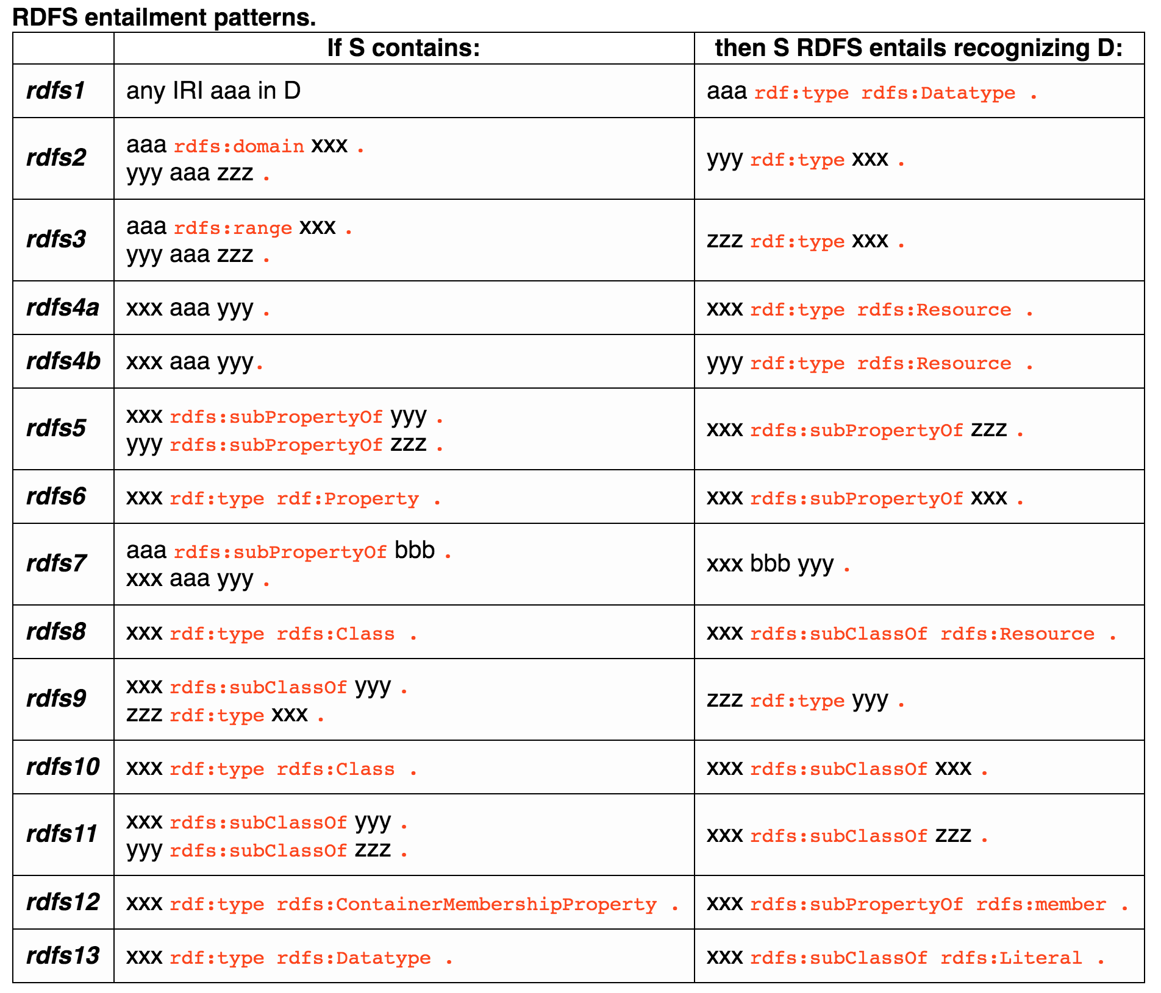

Slide 45
RDF Schema Example (Triples Notation)
ex:MotorVehicle rdf:type rdfs:Class .
ex:PassengerVehicle rdf:type rdfs:Class .
ex:Van rdf:type rdfs:Class .
ex:Truck rdf:type rdfs:Class .
ex:MiniVan rdf:type rdfs:Class .
ex:PassengerVehicle rdfs:subClassOf ex:MotorVehicle .
ex:Van rdfs:subClassOf ex:MotorVehicle .
ex:Truck rdfs:subClassOf ex:MotorVehicle .
ex:MiniVan rdfs:subClassOf ex:Van .
ex:MiniVan rdfs:subClassOf ex:PassengerVehicle .
MotorVehicle is an instance of rdfs:Class
PassengerVehicle is a subclass of MotorVehicle
Multiple Inheritance

Slide 46
RDF Schema (RDF/XML notation)
<rdf:RDF xml:lang="en"
xmlns:rdf="http://www.w3.org/1999/02/22-rdf-syntax-ns#"
xmlns:rdfs="http://www.w3.org/2000/01/rdf-schema#">
<rdf:Description rdf:ID="MotorVehicle">
<rdf:type rdf:resource="http://www.w3.org/2000/01/rdf-schema#Class"/>
<rdfs:subClassOf rdf:resource="http://www.w3.org/2000/01/rdf-schema#Resource"/>
</rdf:Description>
<rdf:Description rdf:ID="PassengerVehicle">
<rdf:type rdf:resource="http://www.w3.org/2000/01/rdf-schema#Class"/>
<rdfs:subClassOf rdf:resource="#MotorVehicle"/>
</rdf:Description>
<rdf:Description rdf:ID="Truck">
<rdf:type rdf:resource="http://www.w3.org/2000/01/rdf-schema#Class"/>
<rdfs:subClassOf rdf:resource="#MotorVehicle"/>
</rdf:Description>
</RDF>
RDF Schema Namespace
An rdf:ID attribute names a new resource
(“Resource” is the
top level class )
PassengerVehicle is a
subclass of MotorVehicle

Slide 47
RDF Schema Example (cont..)
<rdf:Description rdf:ID="Van">
<rdf:type rdf:resource="http://www.w3.org/2000/01/rdf-schema#Class"/>
<rdfs:subClassOf rdf:resource="#MotorVehicle"/>
</rdf:Description>
<rdf:Description rdf:ID="MiniVan">
<rdf:type rdf:resource="http://www.w3.org/2000/01/rdf-schema#Class"/>
<rdfs:subClassOf rdf:resource="#Van"/>
<rdfs:subClassOf rdf:resource="#PassengerVehicle"/>
</rdf:Description>
<rdf:Description rdf:ID="registeredTo">
<rdf:type rdf:resource="http://www.w3.org/1999/02/22-rdf-syntax-ns#Property"/>
<rdfs:domain rdf:resource="#MotorVehicle"/>
<rdfs:range rdf:resource="#Person"/>
</rdf:Description>
<rdf:Description rdf:ID=“price">
<rdf:type rdf:resource="http://www.w3.org/1999/02/22-rdf-syntax-ns#Property"/>
<rdfs:domain rdf:resource="#MotorVehicle "/>
<rdfs:domain rdf:resource="#Book "/>
<rdfs:range rdf:resource="http://www.w3.org/2000/03/example/classes#Number"/>
</rdf:Description>
Multiple Inheritance
Domain of a property
Range of a property
Multiple Domains

