Slide 1
RDFa & JSON-LD
Jose Luis Ambite
University of Southern California/ISI
slide by Pedro Szekely

Slide 2
RDFa: Resource Description Framework – in – attributes
Plain XHTML
<p>
In his latest book
<cite>Wikinomics</cite>,
<span>Don Tapscott</span>
explains deep changes in technology,
demographics and business.
The book is due to be published in
<span>October 2006</span>.
</p>
Browser
shows
In his latest book Wikinomics, Don Tapscott explains deep changes in technology, demographics and business. The book is due to be published in October 2006.
slide by Pedro Szekely

Slide 3
RDFa: Namespaces
namespace declaration
<p xmlns:dc="http://purl.org/dc/elements/1.1/">
In his latest book
<cite>Wikinomics</cite>,
<span>Don Tapscott</span>
explains deep changes in technology,
demographics and business.
The book is due to be published in
<span>October 2006</span>.
</p>
Browser
shows
In his latest book Wikinomics, Don Tapscott explains deep changes in technology, demographics and business. The book is due to be published in October 2006.
slide by Pedro Szekely

Slide 4
RDFa: Resources
Resource declaration
<p xmlns:dc="http://purl.org/dc/elements/1.1/”
about="http://www.example.com/books/wikinomics">
In his latest book
<cite>Wikinomics</cite>,
<span>Don Tapscott</span>
explains deep changes in technology,
demographics and business.
The book is due to be published in
<span>October 2006</span>.
</p>
Browser
shows
In his latest book Wikinomics, Don Tapscott explains deep changes in technology, demographics and business. The book is due to be published in October 2006.
slide by Pedro Szekely

Slide 5
RDFa: Property
property declaration
<p xmlns:dc="http://purl.org/dc/elements/1.1/”
about="http://www.example.com/books/wikinomics">
In his latest book
<cite property="dc:title">Wikinomics</cite>,
<span>Don Tapscott</span>
explains deep changes in technology,
demographics and business.
The book is due to be published in
<span>October 2006</span>.
</p>
Browser
shows
In his latest book Wikinomics, Don Tapscott explains deep changes in technology, demographics and business. The book is due to be published in October 2006.
slide by Pedro Szekely

Slide 6
RDFa: Property
<p xmlns:dc="http://purl.org/dc/elements/1.1/”
about="http://www.example.com/books/wikinomics">
In his latest book
<cite property="dc:title">Wikinomics</cite>,
<span>Don Tapscott</span>
explains deep changes in technology,
demographics and business.
The book is due to be published in
<span>October 2006</span>.
</p>
RDF-enabled computer sees:
http://www.example.com/books/wikinomics
dc:title
“Wikinomics”
slide by Pedro Szekely

Slide 7
What’s the Difference?
<p xmlns:dc="http://purl.org/dc/elements/1.1/”
about="http://www.example.com/books/wikinomics">
In his latest book
<cite property="dc:title">Wikinomics</cite>,
<span>Don Tapscott</span>
…
</p>
<p xmlns:dc="http://purl.org/dc/elements/1.1/”
about="http://www.example.com/books/wikinomics">
In his latest book
<cite property=“title">Wikinomics</cite>,
<span>Don Tapscott</span>
…
</p>
slide by Pedro Szekely

Slide 8
What’s the Difference?
<p xmlns:dc="http://purl.org/dc/elements/1.1/”
about="http://www.example.com/books/wikinomics">
In his latest book
<cite property="dc:title">Wikinomics</cite>,
<span>Don Tapscott</span>
…
</p>
<p xmlns:dc="http://purl.org/dc/elements/1.1/”
about="http://www.example.com/books/wikinomics">
In his latest book
<cite property=“title">Wikinomics</cite>,
<span>Don Tapscott</span>
…
</p>
what does title mean?
slide by Pedro Szekely

Slide 9
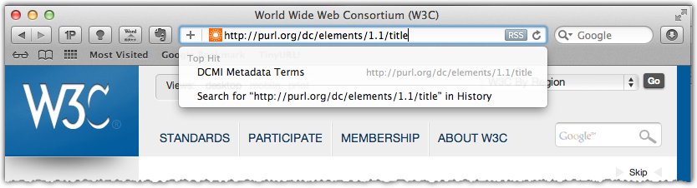
I Can Look Up the Meaning on the Web
<p xmlns:dc="http://purl.org/dc/elements/1.1/”
about="http://www.example.com/books/wikinomics">
In his latest book
<cite property="dc:title">Wikinomics</cite>,
<span>Don Tapscott</span>
…
</p>
slide by Pedro Szekely

Slide 10
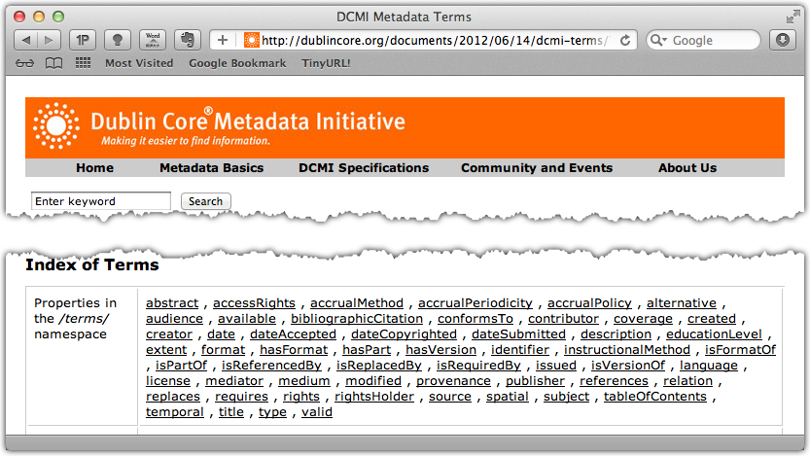
I Can Look Up the Meaning on the Web
slide by Pedro Szekely

Slide 11
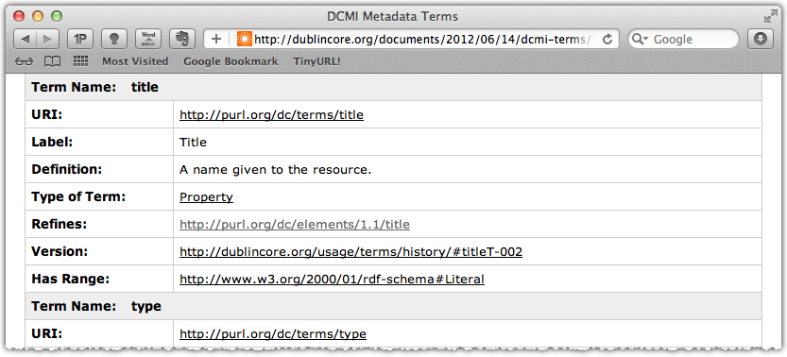
I Can Look Up the Meaning on the Web
Humans can look up what it means
slide by Pedro Szekely

Slide 12
curl -H "Accept: application/rdf+xml" http://dublincore.org/2012/06/14/dcelements#title
curl -H "Accept: text/html" http://dublincore.org/2012/06/14/dcelements#title

Slide 13
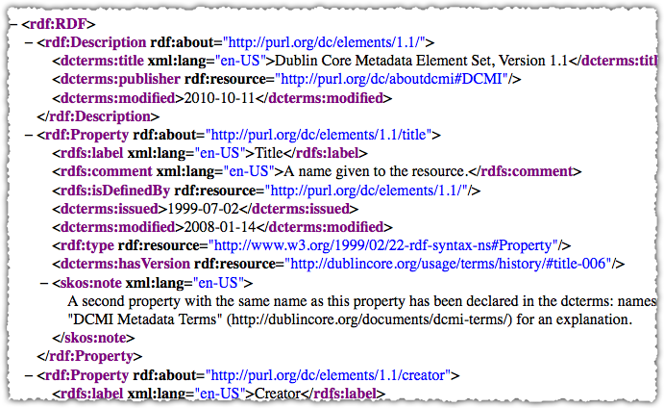
Computers Can Look It Up Too
slide by Pedro Szekely

Slide 14
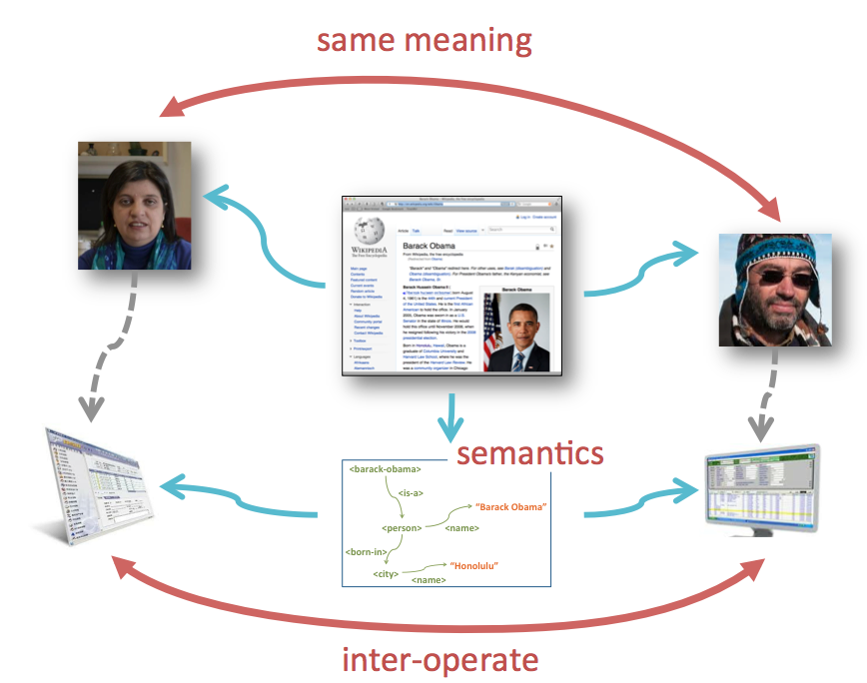
What’s the Big Deal?
Claudia, Pedro & the computers can all agree on the meaning of
dc:title
slide by Pedro Szekely

Slide 15
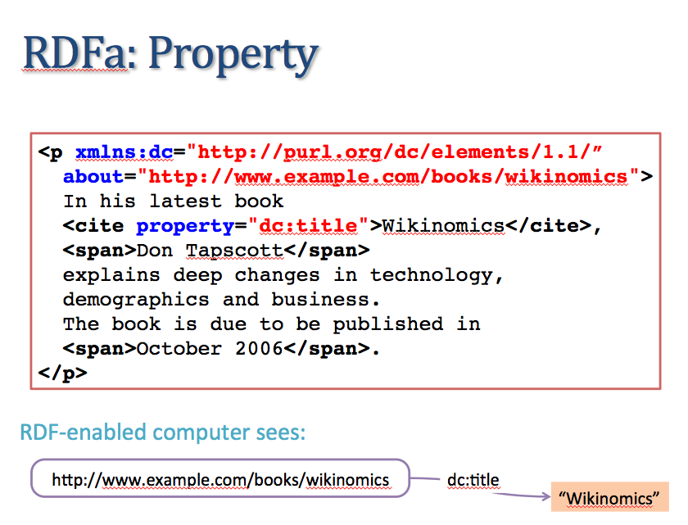
Where Were We?
slide by Pedro Szekely

Slide 16
What’s Wrong Here?
<p xmlns:dc="http://purl.org/dc/elements/1.1/”
about="http://www.example.com/books/wikinomics">
In his latest book
<cite property="dc:title">Wikinomics</cite>,
<span property="dc:creator">Don Tapscott</span>
explains deep changes in technology,
demographics and business.
The book is due to be published in
<span property="dc:date”>October 2006</span>.
</p>
Not a computer understandable date
e.g., an xsd:date
slide by Pedro Szekely

Slide 17
RDFa: Content Attribute
<p xmlns:dc="http://purl.org/dc/elements/1.1/”
about="http://www.example.com/books/wikinomics">
In his latest book
<cite property="dc:title">Wikinomics</cite>,
<span property="dc:creator">Don Tapscott</span>
explains deep changes in technology,
demographics and business.
The book is due to be published in
<span property="dc:date”
content="2006-10-01”
datatype=“xsd:date”>October 2006</span>.
</p>
slide by Pedro Szekely

Slide 18
RDFa: Resource Description Framework – in – attributes
XHTML
+
RDFa
<p xmlns:dc="http://purl.org/dc/elements/1.1/”
about="http://www.example.com/books/wikinomics">
In his latest book
<cite property="dc:title">Wikinomics</cite>,
<span property="dc:creator">Don Tapscott</span>
explains deep changes in technology,
demographics and business.
The book is due to be published in
<span property="dc:date”
content="2006-10-01”
datatype=“xsd:date”>October 2006</span>.
</p>
Extracted
RDF
@prefix dc: http://purl.org/dc/elements/1.1/ .
<http://www.example.com/books/wikinomics>
dc:title ”Wikinomics”@en ;
dc:creator ”Don Tapscott”@en ;
dc:date "2006-10-01”^^xsd:date .
Browser
shows
In his latest book Wikinomics, Don Tapscott explains deep changes in technology, demographics and business. The book is due to be published in October 2006.
slide by Pedro Szekely

Slide 19
More RDFa

Slide 20
RDFa: vocab and typeof
Define default vocabulary for an HTML element
<div vocab="http://xmlns.com/foaf/0.1/">
<ul>
<li typeof="Person">
<a href="http://example.com/bob/">Bob</a>
</li>
<li typeof="Person">
<a href="http://example.com/eve/">Eve</a>
</li>
</ul>
</div>
Nested elements don’t need
vocabulary URI
slide by Pedro Szekely

Slide 21
RDFa: property and href
<div vocab="http://xmlns.com/foaf/0.1/">
<ul>
<li typeof="Person">
<a property=“homepage” href="http://example.com/bob/">Bob</a>
</li>
<li typeof="Person">
<a property=“homepage” href="http://example.com/eve/">Eve</a>
</li>
</ul>
</div>
When href is present, it supplies the value for the property
slide by Pedro Szekely

Slide 22
RDFa: Using Extra Span Tags
<div vocab="http://xmlns.com/foaf/0.1/">
<ul>
<li typeof="Person">
<a property="homepage" href="http://example.com/bob/">
<span property="name">Bob</span></a>
</li>
<li typeof="Person">
<a property="homepage" href="http://example.com/eve/">
<span property="name">Eve</span></a>
</li>
</ul>
</div>
Need a span tag to contain the
property=“name” tag of my friends
slide by Pedro Szekely

Slide 23
Putting It All Together
<div vocab="http://xmlns.com/foaf/0.1/" typeof="Person”>
<p>
<span property="name">Alice Birpemswick</span>,
Email: <a property="mbox”
href="mailto:alice@example.com”>alice@example.com</a>,
Phone: <a property="phone"
href="tel:+1-617-555-7332">+1 617.555.7332</a>
</p>
<ul>
<li property="knows" typeof="Person">
<a property="homepage" href="http://example.com/bob/">
<span property="name">Bob</span></a>
</li>
<li property="knows" typeof="Person">
<a property="homepage" href="http://example.com/eve/">
<span property="name">Eve</span></a>
</li>
</ul>
</div>
RDF properties: e.g., phone
RDF objects: e.g., Eve
slide by Pedro Szekely

Slide 24
Resulting RDF
<div vocab="http://xmlns.com/foaf/0.1/" typeof="Person”>
<p>
<span property="name">Alice Birpemswick</span>,
Email: <a property="mbox”
href="mailto:alice@example.com”>alice@example.com</a>,
Phone: <a property="phone"
href="tel:+1-617-555-7332">+1 617.555.7332</a>
</p>
<ul>
<li property="knows" typeof="Person">
<a property="homepage href="http://example.com/bob/">
<span property="name">Bob</span></a>
</li>
<li property="knows" typeof="Person">
<a property="homepage" href="http://example.com/eve/">
<span property="name">Eve</span></a>
</li>
</ul>
</div>
[ a foaf:Person ;
foaf:name “Alice” ;
foaf:mbox <mailto:alice@example.com> ;
foaf:phone <tel:+1-617-555-7332> ;
foaf:knows [
a foaf:Person ;
foaf:homepage <http://example.com/bob/> ;
foaf:name “Bob”
] ;
foaf:knows [
a foaf:Person ;
foaf:homepage <http://example.com/eve/> ;
foaf:name “Eve”
] ;
]
slide by Pedro Szekely

Slide 25
Facebook OpenGraph
RDF used by the “Like” button
<html>
<head prefix="og: http://ogp.me/ns#" >
...
<meta property="og:title" content="The Trouble with Bob" />
<meta property="og:type" content="text" />
<meta property="og:image" content="http://example.com/alice/ugly.jpg" />
...
</head>
<body>
...
</body>
</html>
slide by Pedro Szekely

Slide 26
RDFa: rel Attribute
<div vocab="http://xmlns.com/foaf/0.1/" resource="#me">
<ul>
<li property="knows" resource="http://example.com/bob/#me" typeof="Person">
<a property="homepage" href="http://example.com/bob/"><span property="name">Bob</span></a>
</li>
<li property="knows" resource="http://example.com/eve/#me" typeof="Person">
<a property="homepage" href="http://example.com/eve/"><span property="name">Eve</span></a>
</li>
</ul>
</div>
rel looks down for values
<div vocab="http://xmlns.com/foaf/0.1/" resource="#me">
<ul rel="knows">
<li resource="http://example.com/bob/#me" typeof="Person">
<a property="homepage" href="http://example.com/bob/"><span property="name">Bob</span></a>
</li>
<li resource="http://example.com/eve/#me" typeof="Person">
<a property="homepage" href="http://example.com/eve/"><span property="name">Eve</span></a>
</li>
</ul>
</div>
slide by Pedro Szekely

Slide 27
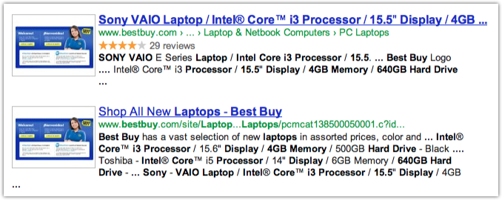
Benefits of RDFa
Navigation bar (from RDFa?)
Reviews from RDFa
Google understands the page content
slide by Pedro Szekely

Slide 28

<div class="rating"
typeof="v:Review-aggregate"
about="#review_3505047">
<span
property="v:itemreviewed"
content=""></span>
<span rel="v:rating">
<span typeof="v:Rating">
<img src="http://images.bestbuy.com/BestBuy_US/images…/>
<span
property="v:rating"
datatype="xsd:string”>4.0</span> of
<span property="v:best">5</span>
<span
property="v:count"
datatype="xsd:string"
content="30">
</span>
(<a class="customer-review"
href="#tabbed-customerreviews">30 reviews</a>)
</span>
</span>
</div>
slide by Pedro Szekely

Slide 29
https://developers.google.com/structured-data/
http://www.slideshare.net/rvguha/sem-tech2014c?qid=48f28aa3-bb59-4e1d-937c-5bbb2e89e896&v=qf1&b=&from_search=3
slide 30

Slide 30
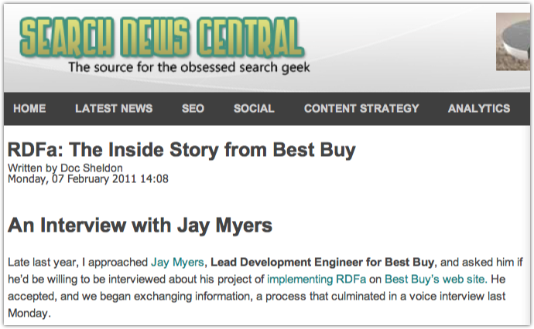
http://searchnewscentral.com/20110207129/Technical/rdfa-the-inside-story-from-best-buy.html
slide by Pedro Szekely

Slide 31
Who Uses RDFa?
RDFa is the fastest growing data markup format on the Web, and is used on more than 430 million web pages.
It accounts for roughly 3.6% of the all of the Web pages on the Internet.
How much did RDFa grow last year? 510% (2010)
… will show even stronger growth as people start to realize the search engine advantage that RDFa gives web content publishers.
http://rdfa.info/2011/01/26/rdfa-grows/
slide by Pedro Szekely

Slide 32
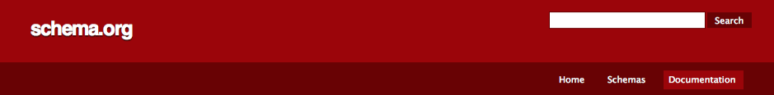

“You use the schema.org vocabulary, along with the microdata format, to add information to your HTML content.”
non-RDFa microdata even though
RDF vocabulary was defined
<div
itemscope
itemtype="http://schema.org/Movie">
<h1 itemprop="name">Avatar</h1>
<span>Director:
<span itemprop="director">James Cameron</span>
(born August 16, 1954)
</span>
<span itemprop="genre">Science fiction</span>
<a href="../movies/avatar-theatrical-trailer.html"
itemprop="trailer">Trailer</a>
</div>
slide by Pedro Szekely
http://schema.org/

Slide 33
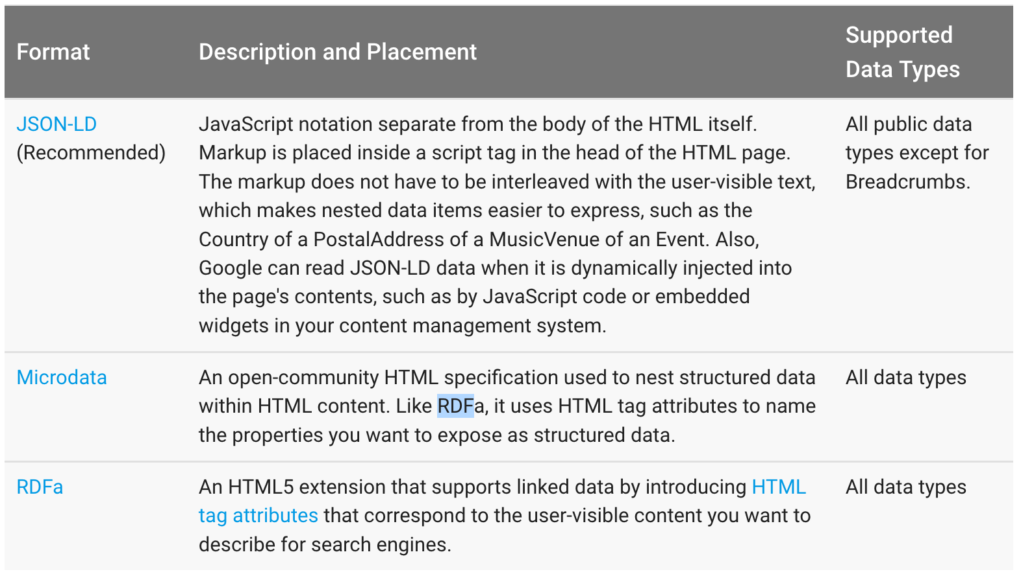
Google accepts JSON-LD and RDFa
https://developers.google.com/search/docs/guides/intro-structured-data# structured-data-guidelines
slide by Jose Luis Ambite

Slide 34
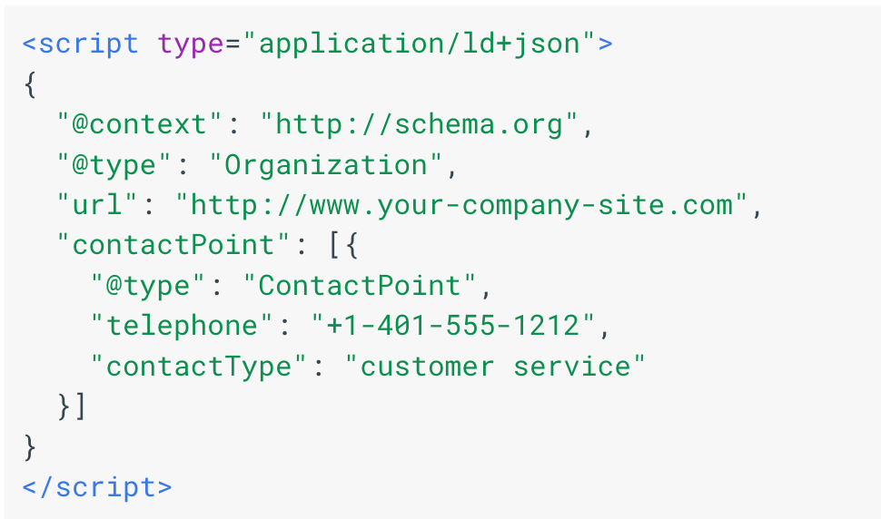
JSON-LD
https://developers.google.com/search/docs/guides/intro-structured-data# structured-data-guidelines
slide by Jose Luis Ambite

Slide 35
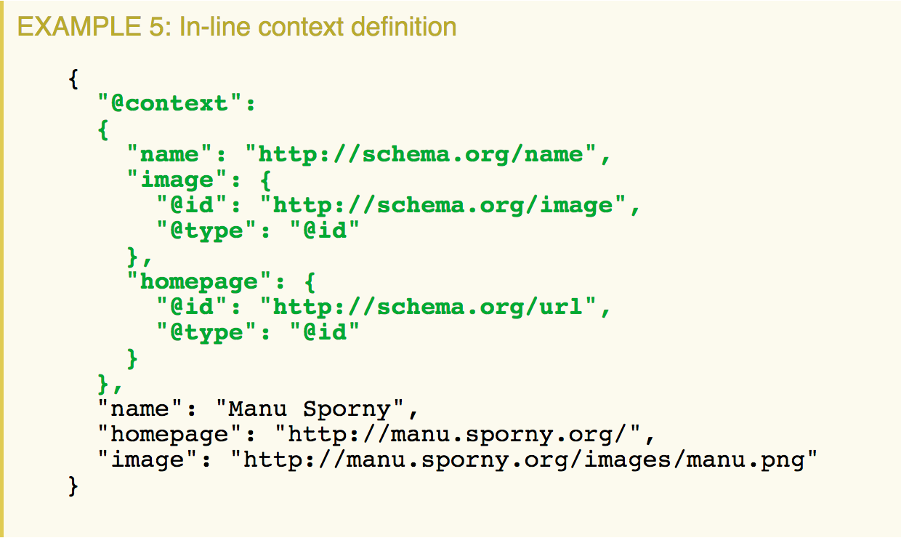
JSON-LD
https://www.w3.org/TR/json-ld/
slide by Jose Luis Ambite

Slide 36
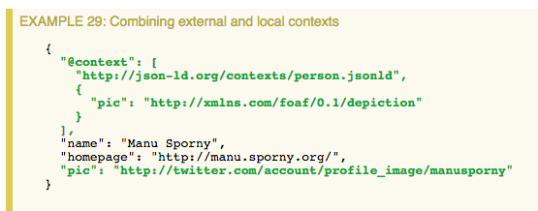
JSON-LD
https://www.w3.org/TR/json-ld/
slide by Jose Luis Ambite

Slide 37
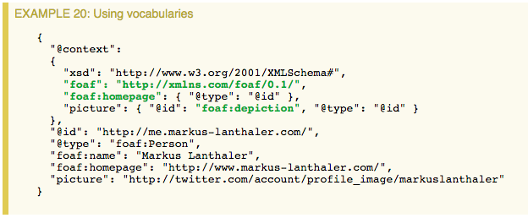
JSON-LD

Slide 38
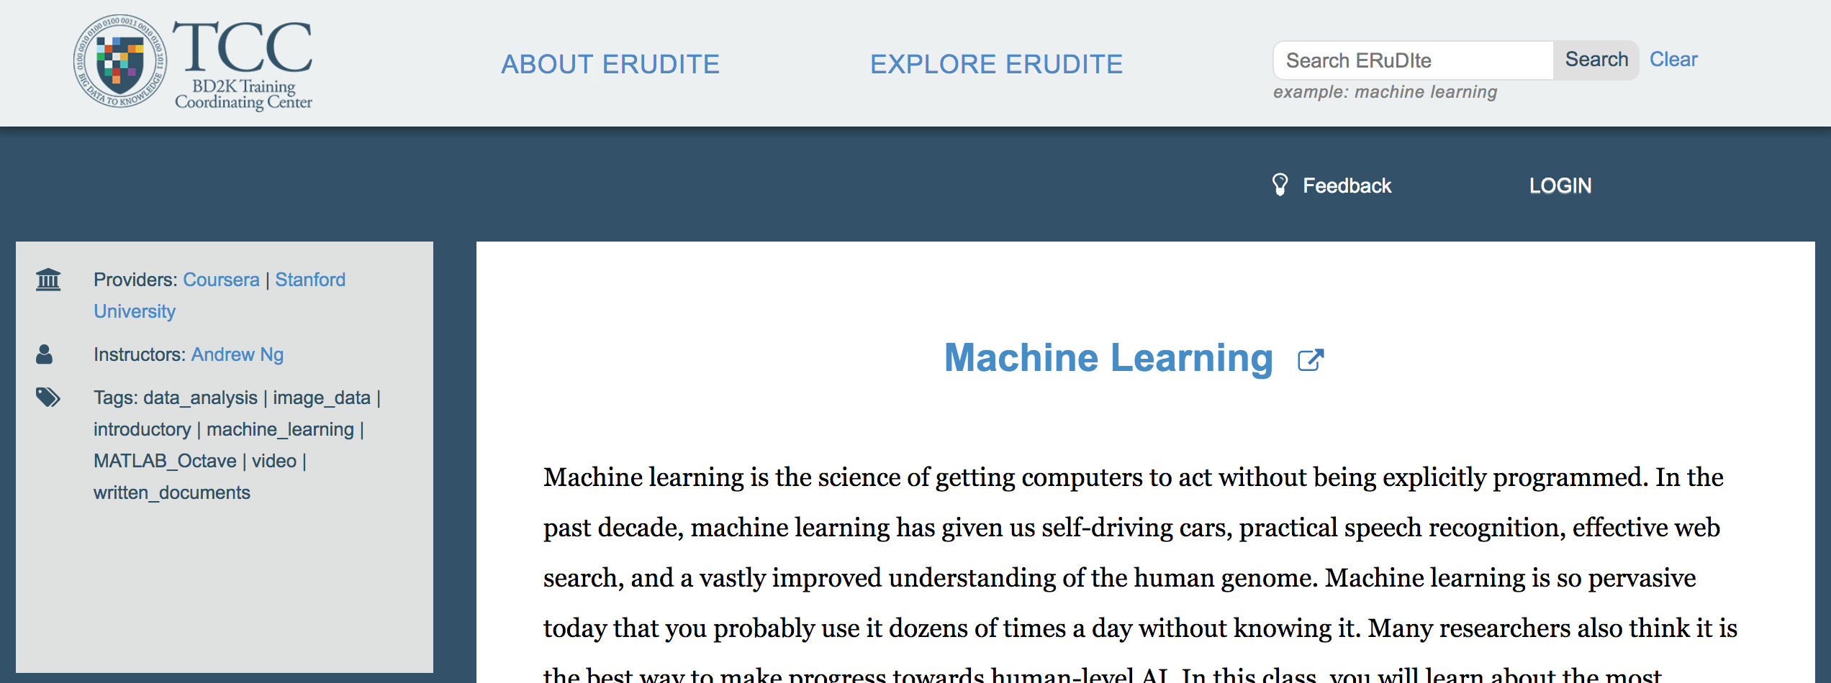
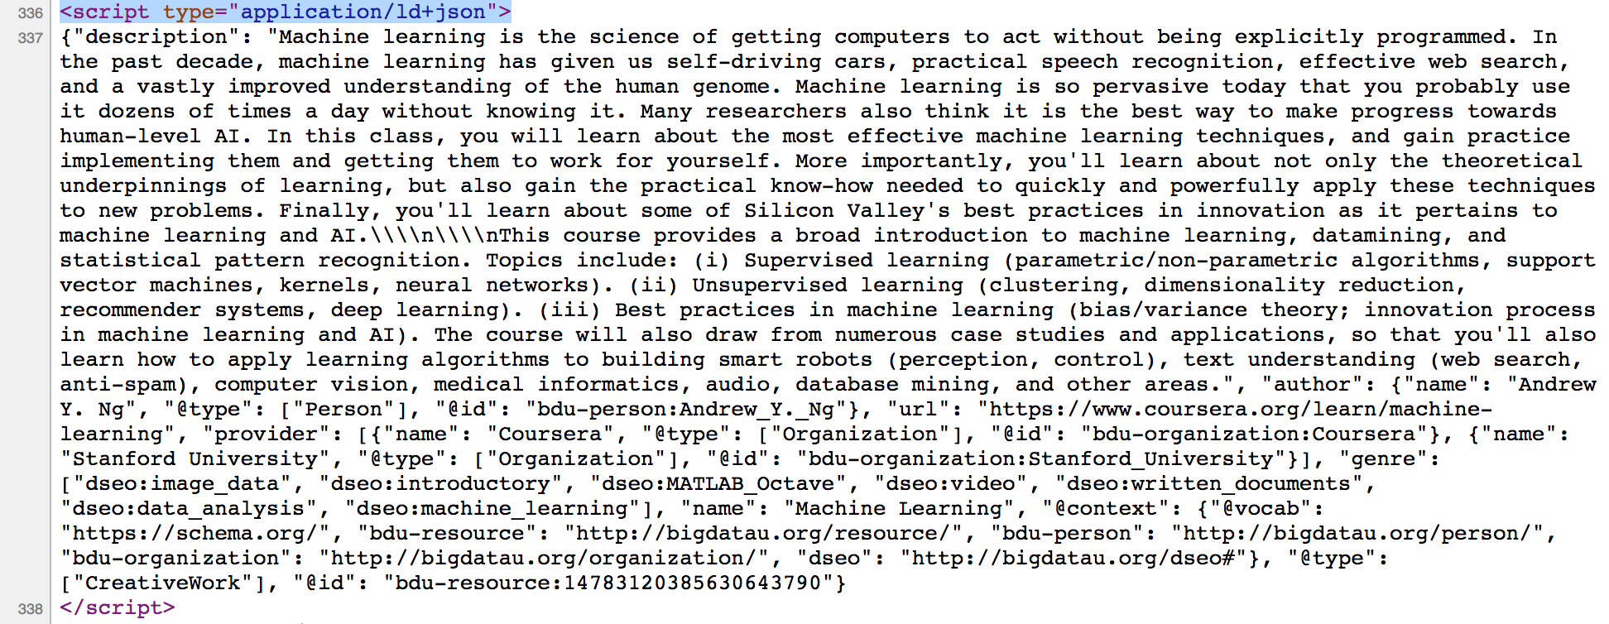
JSON-LD in bigdatau.org
[~12,000 of these JSON-LD snippets]

