Slide 1
SPARQL
Pedro Szekely
Jose Luis Ambite
University of Southern California
slide by Pedro Szekely, Jose Luis Ambite

Slide 2
SPARQL: Query Language for RDF
SPARQL is based on matching graph patterns
The simplest graph pattern is the triple pattern :
like an RDF triple, but with the possibility of a variable instead of an RDF term in the subject, predicate, or object positions
Combining triple patterns gives a basic graph pattern, where exact match to a graph is needed to satisfy pattern
A basic graph pattern is essentially a conjunctive query
SPARQL: W3C recommendation
http://www.w3.org/TR/rdf-sparql-query/
https://www.w3.org/TR/sparql11-overview/
Triple Store: RDF data management systems
Efficient RDF storage and retrieval
Some use relational database backends: Virtuoso, OWLIM
SPARQL is used to query Triple Stores

Slide 3
Architecture of Semantic Web Applications
slide by Pedro Szekely

Slide 4







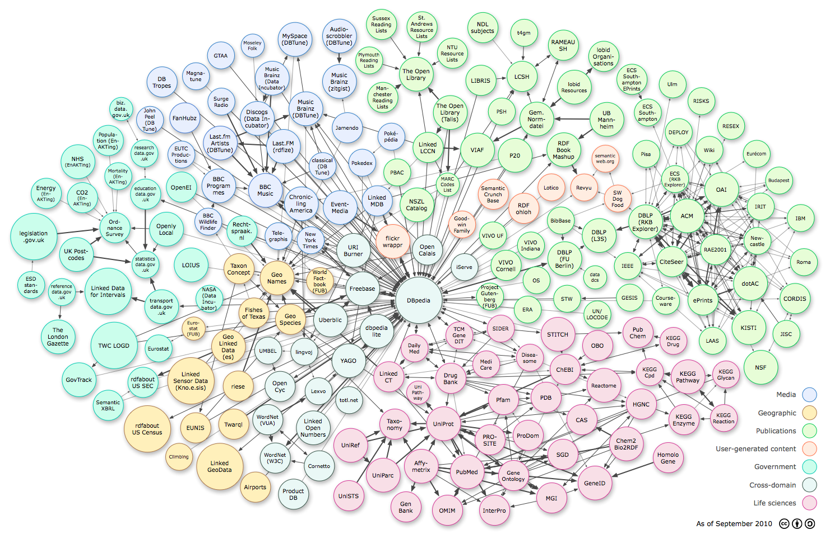





Motivation: Music!
Analysis & Mining Module
RDFa
Visualization Module
Application
Access
SPARQL Endpoint
Publishing
Vocabulary Mapping
Interlinking
Cleansing
Integrated Dataset
LD Dataset
Physical Wrapper
LD Wrapper
D2R Transf.
LD Wrapper
Data acquisition
RDF/ XML
Streaming providers
Downloads
Musical Content
Metadata
Other content

Slide 5
Basic SPARQL
slide by Pedro Szekely

Slide 6
SPARQL
http://www.w3.org/TR/sparql11-query/
SELECT
ASK
Get data
Yes/No questions
CONSTRUCT
DESCRIBE
Create RDF
Get some information
slide by Pedro Szekely
slide by Pedro Szekely

Slide 7
SPARQL Query
Data:
dbpedia: The_Beatles
foaf:made
foaf:made
foaf:made
dbpedia: Help!_(album)
dbpedia: Abbey_Road
dbpedia: Let_It_Be
rdfs:label
rdfs:label
rdfs:label
"Help!"
"Abbey Road"
"Let It Be"

Slide 8
SPARQL Query
Data:
dbpedia: The_Beatles
foaf:made
foaf:made
foaf:made
dbpedia: Help!_(album)
dbpedia: Abbey_Road
dbpedia: Let_It_Be
rdfs:label
rdfs:label
rdfs:label
"Help!"
"Abbey Road"
"Let It Be"
Results:
Graph pattern:
?album
dbpedia:Help!_(album)
dbpedia:Abbey_Road
dbpedia:Let_It_Be
dbpedia: The_Beatles
foaf:made
?album

Slide 9
SPARQL Query
Main idea: Pattern matching
Queries describe sub-graphs of the queried graph
Graph patterns are RDF graphs specified in Turtle syntax, which contain variables (prefixed by either “?” or “$”)
Sub-graphs that match the graph patterns yield a result
dbpedia: The_Beatles
foaf:made
?album

Slide 10
Simple Query
Data
<http://example.org/book/book1>
<http://purl.org/dc/elements/1.1/title>
"SPARQL Tutorial" .
Query
SELECT ?title
WHERE
{
<http://example.org/book/book1>
<http://purl.org/dc/elements/1.1/title>
?title .
}
Result
title
"SPARQL Tutorial"
slide by Pedro Szekely
http://www.w3.org/TR/sparql11-query/

Slide 11
Multiple Matches
Data
@prefix foaf: <http://xmlns.com/foaf/0.1/> .
_:a foaf:name "Johnny Lee Outlaw" .
_:a foaf:mbox <mailto:jlow@example.com> .
_:b foaf:name "Peter Goodguy" .
_:b foaf:mbox <mailto:peter@example.org> .
_:c foaf:mbox <mailto:carol@example.org> .
Query
PREFIX foaf: <http://xmlns.com/foaf/0.1/>
SELECT ?name ?mbox
WHERE
{ ?x foaf:name ?name .
?x foaf:mbox ?mbox }
Result
name | mbox
"Johnny Lee Outlaw" | <mailto:jlow@example.com>
"Peter Goodguy" | <mailto:peter@example.org>
slide by Pedro Szekely
http://www.w3.org/TR/sparql11-query/

Slide 12
But you’ve seen this before …
Basic Graph Pattern Queries are Conjunctive Queries !
Data
@prefix foaf: <http://xmlns.com/foaf/0.1/> .
_:a foaf:name "Johnny Lee Outlaw" .
_:a foaf:mbox <mailto:jlow@example.com> .
_:b foaf:name "Peter Goodguy" .
_:b foaf:mbox <mailto:peter@example.org> .
_:c foaf:mbox <mailto:carol@example.org> .
Query
PREFIX foaf: <http://xmlns.com/foaf/0.1/>
SELECT ?name ?mbox
WHERE
{ ?x foaf:name ?name .
?x foaf:mbox ?mbox }
q(N, M) <-- foaf:name(X,N) ^ foaf:mbox(X,M)
Result
name | mbox
"Johnny Lee Outlaw" | <mailto:jlow@example.com>
"Peter Goodguy" | <mailto:peter@example.org>
slide by Jose Luis Ambite
http://www.w3.org/TR/sparql11-query/

Slide 13
Blank Nodes
Data
@prefix foaf: <http://xmlns.com/foaf/0.1/> .
_:a foaf:name "Alice" .
_:b foaf:name "Bob" .
Query
PREFIX foaf: <http://xmlns.com/foaf/0.1/>
SELECT ?x ?name
WHERE { ?x foaf:name ?name }
Result
x | name
_:c | “Alice”
_:d | “Bob
slide by Pedro Szekely
http://www.w3.org/TR/sparql11-query/

Slide 14
BIND: Creating Values with Expressions
Data
@prefix foaf: <http://xmlns.com/foaf/0.1/> .
_:a foaf:givenName "John" .
_:a foaf:surname "Doe" .
Query
PREFIX foaf: <http://xmlns.com/foaf/0.1/>
SELECT ?name
WHERE {
?P foaf:givenName ?G ;
foaf:surname ?S
BIND(CONCAT(?G, " ", ?S) AS ?name)
}
Result
name
“John Doe”
slide by Pedro Szekely
http://www.w3.org/TR/sparql11-query/

Slide 15
FILTER (selection):
Restricting the Value of Strings
Data
@prefix dc: <http://purl.org/dc/elements/1.1/> .
@prefix : <http://example.org/book/> .
@prefix ns: <http://example.org/ns#> .
:book1 dc:title "SPARQL Tutorial" .
:book1 ns:price 42 .
:book2 dc:title "The Semantic Web" .
:book2 ns:price 23 .
Query
PREFIX foaf: <http://xmlns.com/foaf/0.1/>
PREFIX dc: <http://purl.org/dc/elements/1.1/>
SELECT ?title
WHERE { ?x dc:title ?title
FILTER regex(?title, "^SPARQL")
}
Result
title
"SPARQL Tutorial"
slide by Pedro Szekely, Jose Luis Ambite
http://www.w3.org/TR/sparql11-query/

Slide 16
FILTER (selection):
Restricting Numeric Values
Data
@prefix dc: <http://purl.org/dc/elements/1.1/> .
@prefix : <http://example.org/book/> .
@prefix ns: <http://example.org/ns#> .
:book1 dc:title "SPARQL Tutorial" .
:book1 ns:price 42 .
:book2 dc:title "The Semantic Web" .
:book2 ns:price 23 .
Query
PREFIX dc: <http://purl.org/dc/elements/1.1/>
PREFIX ns: <http://example.org/ns#>
SELECT ?title ?price
WHERE { ?x ns:price ?price .
FILTER (?price < 30.5)
?x dc:title ?title . }
Result
title | price
"The Semantic Web" | 23
"SPARQL Tutorial"
too expensive
slide by Pedro Szekely, Jose Luis Ambite
http://www.w3.org/TR/sparql11-query/

Slide 17
Namespaces: PREFIX, BASE
Query
PREFIX dc: <http://purl.org/dc/elements/1.1/>
SELECT ?title
WHERE { <http://example.org/book/book1> dc:title ?title }
URIs in angle brackets as <http://…>
Query
PREFIX dc: <http://purl.org/dc/elements/1.1/>
PREFIX : <http://example.org/book/>
SELECT ?title
WHERE { :book1 dc:title $title }
Empty prefix
Query
BASE <http://example.org/book/>
PREFIX dc: <http://purl.org/dc/elements/1.1/>
SELECT ?title
WHERE { <book1> dc:title ?title }
Define BASE: no need to write long URIs
slide by Pedro Szekely
http://www.w3.org/TR/sparql11-query/

Slide 18
Blank Nodes
Query
Fragment
?x a :Class1 .
[ a :appClass ] :p "v" .
Short form
Query
Fragment
?x rdf:type :Class1 .
_:b0 rdf:type :appClass .
_:b0 :p "v" .
Long form
http://www.w3.org/TR/sparql11-query/

Slide 19
Graph Patterns
Basic Graph Patterns
a set of triple patterns must match
Group Graph Pattern: {}
a set of graph patterns must all match
Optional Graph patterns: OPTIONAL
additional patterns may extend the solution
Alternative Graph Pattern: UNION
two or more possible patterns are tried
Patterns on Named Graphs: GRAPH
patterns are matched against named graphs
slide by Pedro Szekely, Jose Luis Ambite
http://www.w3.org/TR/sparql11-query/

Slide 20
Group Graph Patterns
Query
PREFIX foaf: <http://xmlns.com/foaf/0.1/>
SELECT ?name ?mbox
WHERE {
?x foaf:name ?name .
?x foaf:mbox ?mbox .
}
One basic graph pattern
Query
PREFIX foaf: <http://xmlns.com/foaf/0.1/>
SELECT ?name ?mbox
WHERE { { ?x foaf:name ?name . }
{ ?x foaf:mbox ?mbox . }
}
Two group graph patterns
[Same solutions]
slide by Pedro Szekely
http://www.w3.org/TR/sparql11-query/
Notes:
https://www.w3.org/2001/sw/DataAccess/rq23/#GroupPatterns

Slide 21
Scope of Filters
Query
Fragment
{ ?x foaf:name ?name .
?x foaf:mbox ?mbox .
FILTER regex(?name, "Smith")
}
=
Query
Fragment
{ FILTER regex(?name, "Smith")
?x foaf:name ?name .
?x foaf:mbox ?mbox .
}
=
Query
Fragment
{ ?x foaf:name ?name .
FILTER regex(?name, "Smith")
?x foaf:mbox ?mbox .
}
Scope is whole group where filter appears
slide by Pedro Szekely, Jose Luis Ambite
http://www.w3.org/TR/sparql11-query/
Notes:
Filter applies equally to each example, since it’s in same group

Slide 22
Optional Pattern Matching
Data
@prefix foaf: <http://xmlns.com/foaf/0.1/> .
@prefix rdf: <http://www.w3.org/1999/02/22-rdf-syntax-ns#> .
_:a rdf:type foaf:Person .
_:a foaf:name "Alice" .
_:a foaf:mbox <mailto:alice@example.com> .
_:a foaf:mbox <mailto:alice@work.example> .
_:b rdf:type foaf:Person .
_:b foaf:name "Bob" .
Query
PREFIX foaf: <http://xmlns.com/foaf/0.1/>
SELECT ?name ?mbox
WHERE { ?x foaf:name ?name .
OPTIONAL { ?x foaf:mbox ?mbox }
}
Result
name | mbox
”Alice" | <mailto:alice@example.com>
”Alice” | <mailto:alice@work.example>
“Bob”
slide by Pedro Szekely
http://www.w3.org/TR/sparql11-query/
Notes:
Analogous to outer join (though the formal semantics are different)

Slide 23
Multiple Optional Graph Patterns
Data
@prefix foaf: <http://xmlns.com/foaf/0.1/> .
_:a foaf:name "Alice" .
_:a foaf:homepage <http://work.example.org/alice/> .
_:b foaf:name "Bob" .
_:b foaf:mbox <mailto:bob@work.example> .
Query
PREFIX foaf: <http://xmlns.com/foaf/0.1/>
SELECT ?name ?mbox ?hpage
WHERE { ?x foaf:name ?name .
OPTIONAL { ?x foaf:mbox ?mbox } .
OPTIONAL { ?x foaf:homepage ?hpage }
}
Result
name | mbox | hpage
”Alice" |  | <http://work.example.org/alice/>
“Bob” | <mailto:bob@work.example>
slide by Pedro Szekely
http://www.w3.org/TR/sparql11-query/

Slide 24
UNION
Data
@prefix dc10: <http://purl.org/dc/elements/1.0/> .
@prefix dc11: <http://purl.org/dc/elements/1.1/> .
_:a dc10:title "SPARQL Query Language Tutorial" .
_:a dc10:creator "Alice" .
_:b dc11:title "SPARQL Protocol Tutorial" .
_:b dc11:creator "Bob" .
_:c dc10:title "SPARQL" .
_:c dc11:title "SPARQL (updated)" .
Query
PREFIX dc10: <http://purl.org/dc/elements/1.0/>
PREFIX dc11: <http://purl.org/dc/elements/1.1/>
SELECT ?title
WHERE { { ?book dc10:title ?title } UNION
{ ?book dc11:title ?title }
}
Result
title
"SPARQL Protocol Tutorial"
"SPARQL"
"SPARQL (updated)"
"SPARQL Query Language Tutorial"
slide by Pedro Szekely
http://www.w3.org/TR/sparql11-query/

Slide 25
FILTER NOT EXISTS
?x1 | ?x2 | ?x3
FILTER
testing whether a pattern exists in the data,
given the bindings already determined by the query pattern
FILTER
FILTER
MINUS
Graph Pattern MINUS Graph Pattern
?x1 | ?x2 | ?y1
?x1 | ?x2 | ?z1 | ?z2
evaluates both its arguments, then removes solutions in the left-hand side that are compatible with the solutions on the right-hand side
https://www.w3.org/TR/sparql11-query/#neg-notexists-minus

Slide 26
Negation: Absence of a Pattern
Data
@prefix : <http://example/> .
@prefix rdf: <http://www.w3.org/1999/02/22-rdf-syntax-ns#> .
@prefix foaf: <http://xmlns.com/foaf/0.1/> .
:alice rdf:type foaf:Person .
:alice foaf:name "Alice" .
:bob rdf:type foaf:Person .
Query
PREFIX rdf: <http://www.w3.org/1999/02/22-rdf-syntax-ns#>
PREFIX foaf: <http://xmlns.com/foaf/0.1/>
SELECT ?person
WHERE
{
?person rdf:type foaf:Person .
FILTER NOT EXISTS { ?person foaf:name ?name }
}
Result
person
<http://example/bob>
slide by Pedro Szekely
http://www.w3.org/TR/sparql11-query/
Notes:
Better read FILTER NOT EXIST as KEEP IF pattern does not exist

Slide 27
Negation: Removing Possible Solutions
@prefix : <http://example/> .
@prefix foaf: <http://xmlns.com/foaf/0.1/> .
:alice foaf:givenName "Alice" ;
foaf:familyName "Smith" .
:bob foaf:givenName "Bob" ;
foaf:familyName "Jones" .
:carol foaf:givenName "Carol" ;
foaf:familyName "Smith" .
Query
PREFIX : <http://example/>
PREFIX foaf: <http://xmlns.com/foaf/0.1/>
SELECT DISTINCT ?s
WHERE {
?s ?p ?o .
MINUS {
?s foaf:givenName "Bob" .
}
}
Data
Result
s
<http://example/carol>
<http://example/alice>
http://www.w3.org/TR/sparql11-query/
slide by Pedro Szekely
See section 8.3
Notes:
Removes from the triples ?s ?p ?o those that have a subject ?s with givenName equal to Bob

Slide 28
FILTER vs MINUS, Example 1
Query “FILTER”
Data
SELECT *
{
?s ?p ?o .
FILTER NOT EXISTS { ?x ?y ?z }
}
@prefix : <http://example/> .
:a :b :c .
Result “FILTER”
s | p | o
slide by Pedro Szekely
http://www.w3.org/TR/sparql11-query/
Notes:
The FILTER NOT EXIST query says keep ?s ?p ?o if there is no triple ?x ?y ?z. Since there is a triple (?x ?y ?z) = (:a :b :c) , then nothing is kept. Thus the empty answer.

Slide 29
FILTER vs MINUS, Example 1
Query “FILTER”
Data
SELECT *
{
?s ?p ?o .
FILTER NOT EXISTS { ?x ?y ?z }
}
@prefix : <http://example/> .
:a :b :c .
Result “FILTER”
s | p | o
Query “MINUS”
SELECT *
{
?s ?p ?o .
MINUS
{ ?x ?y ?z }
}
No shared variables!
Result “MINUS”
s | p | o
<http://example/a> | <http://example/b> | <http://example/c>
slide by Pedro Szekely, Jose Luis Ambite
http://www.w3.org/TR/sparql11-query/
Notes:
The minus query says remove from (?s ?p ?o) the triples (?x ?y ?z) , but since there are no shared variables nothing is removed.

Slide 30
FILTER vs MINUS, Example 2
Query “FILTER”
Data
PREFIX : <http://example/>
SELECT *
{
?s ?p ?o .
FILTER NOT EXISTS { :a :b :c }
}
SELECT *
{
?s ?p ?o
FILTER NOT EXISTS { ?x ?y ?z }
@prefix : <http://example/> .
:a :b :c .
Result “FILTER”
s | p | o
slide by Pedro Szekely
http://www.w3.org/TR/sparql11-query/
Notes:
The FILTER NOT EXIST query says keep (?s ?p ?o) if there is no triple (:a :b :c). Since there is a triple (:a :b :c) in the DB , then nothing is kept. Thus the empty answer.

Slide 31
FILTER vs MINUS, Example 2
Query “FILTER”
Data
PREFIX : <http://example/>
SELECT *
{
?s ?p ?o
FILTER NOT EXISTS { :a :b :c }
}
@prefix : <http://example/> .
:a :b :c .
Result “FILTER”
s | p | o
Query “MINUS”
PREFIX : <http://example/>
SELECT *
{
?s ?p ?o .
MINUS { :a :b :c }
}
No shared variables!
Result “MINUS”
s | p | o
<http://example/a> | <http://example/b> | <http://example/c>
slide by Pedro Szekely
http://www.w3.org/TR/sparql11-query/
Notes:
In the MINUS query, there are no shared variables (the second part of the MINUS has no variables!). So nothing is removed.

Slide 32
Brain Teaser: Inner Filter
Data
@prefix : <…
:a :p 1 .
:a :q 1 .
:a :q 2 .
:b :p 3.0 .
:b :q 4.0 .
:b :q 5.0 .
Query “FILTER”
PREFIX : <http://example.com/>
SELECT * WHERE {
?x :p ?n .
FILTER NOT EXISTS {
?x :q ?m .
FILTER(?n = ?m)
}
}
Result “FILTER”
x | n
<http://example.com/b> | 3.0
slide by Pedro Szekely
http://www.w3.org/TR/sparql11-query/

Slide 33
Brain Teaser: Inner Filter
Data
@prefix : <…
:a :p 1 .
:a :q 1 .
:a :q 2 .
:b :p 3.0 .
:b :q 4.0 .
:b :q 5.0 .
Query “FILTER”
PREFIX : <http://example.com/>
SELECT * WHERE {
?x :p ?n .
FILTER NOT EXISTS {
?x :q ?m .
FILTER(?n = ?m)
}
}
Result “FILTER”
x | n
<http://example.com/b> | 3.0
Query “MINUS”
PREFIX : <http://example/>
SELECT * WHERE {
?x :p ?n .
MINUS {
?x :q ?m .
FILTER(?n = ?m)
}
}
Result “MINUS”
x | n
<http://example.com/b> | 3.0
<http://example.com/a> | 1
slide by Pedro Szekely, Jose Luis Ambite
http://www.w3.org/TR/sparql11-query/
Notes:
FILTER query says keep ?x :p ?n if there not exist a triple ?x :q ?m where ?n = ?m. :b satisfies that, but not :a.
The scope of the FILTER ?n=?m is the one of the FILTER NOT EXIST which includes the ?n in (?x :p ?n). However in the MINUS, the scope of FILTER ?n=?m is the enclosing group { ?x :q ?m . FILTER(?n = ?m) } where ?n is not defined.
“with MINUS, the FILTER inside the pattern does not have a value for ?n and it is always unbound” so nothing is removed

Slide 34
Property Paths
Query
Fragment
{ :book1 dc:title|rdfs:label ?displayString }
Alternatives: Match one or both possibilities
Query
Fragment
{
?x foaf:mbox <mailto:alice@example> .
?x foaf:knows/foaf:name ?name .
}
Sequence: Find the name of any people that Alice knows.
Query
Fragment
{
?x foaf:mbox <mailto:alice@example> .
?x foaf:knows/foaf:knows/foaf:name ?name .
}
Sequence: Find the names of people 2 "foaf:knows" links away.
Query
Fragment
{
?x foaf:mbox <mailto:alice@example> .
?x foaf:knows+/foaf:name ?name .
}
Arbitrary length match:
Find the names of all the people that can be reached from Alice by “foaf:knows”:
slide by Pedro Szekely, Jose Luis Ambite
http://www.w3.org/TR/sparql11-query/

Slide 35
Property Path Semantics
{
?x foaf:mbox <mailto:alice@example> .
?x foaf:knows/foaf:knows/foaf:name ?name .
}
=
{
?x foaf:mbox <mailto:alice@example> .
?x foaf:knows ?a1 .
?a1 foaf:knows ?a2 .
?a2 foaf:name ?name .
}
=
{
?x foaf:mbox <mailto:alice@example> .
?x foaf:knows [ foaf:knows [ foaf:name ?name ]] .
}
slide by Pedro Szekely
http://www.w3.org/TR/sparql11-query/

Slide 36
Property Paths (2)
Query
Fragment
{ ?x foaf:mbox <mailto:alice@example> .
?x foaf:knows/foaf:knows ?y .
FILTER ( ?x != ?y )
?y foaf:name ?name }
Filtering duplicates
(because someone Alice knows may also know Alice)
Query
Fragment
{ ?x foaf:knows/^foaf:knows ?y .
FILTER(?x != ?y) }
Inverse Path Sequence: Find all the people who know someone ?x knows.
Query
Fragment
{ ?x foaf:knows ?gen1 .
?y foaf:knows ?gen1 .
FILTER(?x != ?y) }
Inverse Path Sequence: (same query as previous)
slide by Pedro Szekely, Jose Luis Ambite
http://www.w3.org/TR/sparql11-query/

Slide 37
BIND: Assigning to Variables
Data
@prefix dc: <http://purl.org/dc/elements/1.1/> .
@prefix : <http://example.org/book/> .
@prefix ns: <http://example.org/ns#> .
:book1 dc:title "SPARQL Tutorial" .
:book1 ns:price 42 .
:book1 ns:discount 0.2 .
:book2 dc:title "The Semantic Web" .
:book2 ns:price 23 .
:book2 ns:discount 0.25 .
Query
PREFIX dc: <http://purl.org/dc/elements/1.1/>
PREFIX ns: <http://example.org/ns#>
SELECT ?title ?price
{ ?x ns:price ?p .
?x ns:discount ?discount
BIND (?p*(1-?discount) AS ?price)
FILTER(?price < 20)
?x dc:title ?title .
}
Result
title | price
"The Semantic Web” | 17.25
slide by Pedro Szekely
http://www.w3.org/TR/sparql11-query/

Slide 38
Aggregation
Data
@prefix : <http://books.example/> .
:org1 :affiliates :auth1, :auth2 .
:auth1 :writesBook :book1, :book2 .
:book1 :price 9 .
:book2 :price 5 .
:auth2 :writesBook :book3 .
:book3 :price 7 .
:org2 :affiliates :auth3 .
:auth3 :writesBook :book4 .
:book4 :price 7 .
Query
PREFIX : <http://books.example/>
SELECT (SUM(?lprice) AS ?totalPrice)
WHERE {
?org :affiliates ?auth .
?auth :writesBook ?book .
?book :price ?lprice .
}
GROUP BY ?org
HAVING (SUM(?lprice) > 10)
Bindings
?org | ?auth | ?book | ?1price
:org1 | :auth1 | :book1 | 9
:org1 | :auth1 | :book2 | 5
:org1 | :auth2 | :book3 | 7
:org2 | :auth3 | :book4 | 7
21
7
slide by Pedro Szekely
http://www.w3.org/TR/sparql11-query/

Slide 39
Aggregation
Query
PREFIX : <http://books.example/>
SELECT (SUM(?lprice) AS ?totalPrice)
WHERE {
?org :affiliates ?auth .
?auth :writesBook ?book .
?book :price ?lprice .
}
GROUP BY ?org
HAVING (SUM(?lprice) > 10)
Bindings
?org | ?auth | ?book | ?1price
:org1 | :auth1 | :book1 | 9
:org1 | :auth1 | :book2 | 5
:org1 | :auth2 | :book3 | 7
:org2 | :auth3 | :book4 | 7
21
7
Result
totalPrice
21
slide by Pedro Szekely
http://www.w3.org/TR/sparql11-query/

Slide 40
Aggregation
Data
@prefix : <http://books.example/> .
:org1 :affiliates :auth1, :auth2 .
:auth1 :writesBook :book1, :book2 .
:book1 :price 9 .
:book2 :price 5 .
:auth2 :writesBook :book3 .
:book3 :price 7 .
:org2 :affiliates :auth3 .
:auth3 :writesBook :book4 .
:book4 :price 7 .
Query
PREFIX : <http://books.example/>
SELECT (SUM(?lprice) AS ?totalPrice)
WHERE {
?org :affiliates ?auth .
?auth :writesBook ?book .
?book :price ?lprice .
}
GROUP BY ?org
HAVING (SUM(?lprice) > 10)
Result
totalPrice
21
slide by Pedro Szekely
http://www.w3.org/TR/sparql11-query/

Slide 41
Subqueries
Data
@prefix : <http://people.example/> .
:alice :name "Alice", "Alice Foo", "A. Foo" .
:alice :knows :bob, :carol .
:bob :name "Bob", "Bob Bar", "B. Bar" .
:carol :name "Carol", "Carol Baz", "C. Baz" .
Query
PREFIX : <http://people.example/>
SELECT ?y ?minName
WHERE {
:alice :knows ?y .
{
SELECT ?y (MIN(?name) AS ?minName)
WHERE {
?y :name ?name .
} GROUP BY ?y
}
}
Result
y | minName
??? | ???
??? | ???
??? | ???
slide by Pedro Szekely, Jose Luis Ambite
http://www.w3.org/TR/sparql11-query/

Slide 42
Subqueries
Data
@prefix : <http://people.example/> .
:alice :name "Alice", "Alice Foo", "A. Foo" .
:alice :knows :bob, :carol .
:bob :name "Bob", "Bob Bar", "B. Bar" .
:carol :name "Carol", "Carol Baz", "C. Baz" .
Query
PREFIX : <http://people.example/>
SELECT ?y ?minName
WHERE {
:alice :knows ?y .
{
SELECT ?y (MIN(?name) AS ?minName)
WHERE {
?y :name ?name .
} GROUP BY ?y
}
}
slide by Pedro Szekely, Jose Luis Ambite
http://www.w3.org/TR/sparql11-query/

Slide 43
Subqueries
Data
@prefix : <http://people.example/> .
:alice :name "Alice", "Alice Foo", "A. Foo" .
:alice :knows :bob, :carol .
:bob :name "Bob", "Bob Bar", "B. Bar" .
:carol :name "Carol", "Carol Baz", "C. Baz" .
Bindings
Query
?y | ?name
:alice | "Alice"
:alice | "Alice Foo"
:alice | "A. Foo"
:bob | "Bob"
:bob | "Bob Bar"
:bob | "B. Bar"
:carol | "Carol"
:carol | "Carol Baz"
:carol | "C. Baz"
SELECT ?y (MIN(?name) AS ?minName)
WHERE {
?y :name ?name .
} GROUP BY ?y
Result
y | minName
:alice | "A. Foo"
:bob | ”B. Bar”
:carol | "C. Baz”
slide by Pedro Szekely
http://www.w3.org/TR/sparql11-query/

Slide 44
Subqueries
Data
@prefix : <http://people.example/> .
:alice :name "Alice", "Alice Foo", "A. Foo" .
:alice :knows :bob, :carol .
:bob :name "Bob", "Bob Bar", "B. Bar" .
:carol :name "Carol", "Carol Baz", "C. Baz" .
Query
PREFIX : <http://people.example/>
SELECT ?y ?minName
WHERE {
:alice :knows ?y .
{
SELECT ?y (MIN(?name) AS ?minName)
WHERE {
?y :name ?name .
} GROUP BY ?y
}
}
Subquery Result
y | minName
:alice | "A. Foo"
:bob | "B. Bar”
:carol | "C. Baz”
slide by Pedro Szekely, Jose Luis Ambite
http://www.w3.org/TR/sparql11-query/

Slide 45
Subqueries
Data
@prefix : <http://people.example/> .
:alice :name "Alice", "Alice Foo", "A. Foo" .
:alice :knows :bob, :carol .
:bob :name "Bob", "Bob Bar", "B. Bar" .
:carol :name "Carol", "Carol Baz", "C. Baz" .
Query
y
:bob
:carol
Subquery Result
PREFIX : <http://people.example/>
PREFIX : <http://people.example/>
SELECT ?y ?minName
WHERE {
:alice :knows ?y .
{
SELECT ?y (MIN(?name) AS ?minName)
WHERE {
?y :name ?name .
} GROUP BY ?y
}
}
Subquery Result
y | minName
:alice | "A. Foo"
:bob | "B. Bar”
:carol | "C. Baz”
slide by Pedro Szekely, Jose Luis Ambite
http://www.w3.org/TR/sparql11-query/

Slide 46
Subqueries
Query
PREFIX : <http://people.example/>
SELECT ?y ?minName
WHERE {
:alice :knows ?y .
{
SELECT ?y (MIN(?name) AS ?minName)
WHERE {
?y :name ?name .
} GROUP BY ?y
}
}
Return a name (the one with the lowest sort order) for all the people that know Alice and have a name.
Subquery Result
Subquery Result
Result
y
:bob
:carol
y | minName
:alice | "A. Foo"
:bob | "B. Bar”
:carol | "C. Baz”
y | minName
:bob | "B. Bar"
:carol | "C. Baz"
=
JOIN
slide by Pedro Szekely, Jose Luis Ambite
http://www.w3.org/TR/sparql11-query/

Slide 47
Subqueries
Data
@prefix : <http://people.example/> .
:alice :name "Alice", "Alice Foo", "A. Foo" .
:alice :knows :bob, :carol .
:bob :name "Bob", "Bob Bar", "B. Bar" .
:carol :name "Carol", "Carol Baz", "C. Baz" .
Query
PREFIX : <http://people.example/>
SELECT ?y ?minName
WHERE {
:alice :knows ?y .
{
SELECT ?y (MIN(?name) AS ?minName)
WHERE {
?y :name ?name .
} GROUP BY ?y
}
}
Result
y | minName
:bob | "B. Bar"
:carol | "C. Baz"
slide by Pedro Szekely, Jose Luis Ambite
http://www.w3.org/TR/sparql11-query/

Slide 48
RDF Dataset =
default graph
+ named graph 1
+ named graph 2
+ …
… the SPARQL queries seen so far target the default graph
slide by Pedro Szekely

Slide 49
Specifying Datasets Explicitly
default graph
named graph 1
named graph 2
SELECT ?x ?y
FROM <http://example.org/a>
FROM <http://example.org/b>
FROM NAMED <http://example.org/c>
FROM NAMED <http://example.org/d>
WHERE …
Default graph = “RDF merged” graphs in FROM clauses
RDF merge = union N-triples, renaming blank nodes to not conflict
slide by Pedro Szekely, Jose Luis Ambite
Notes:
The graphs in the FROM clauses are “RDF merged” (i.e., union their N-triples, renaming blank nodes as needed so that they are not inadvertently equated).

Slide 50
RDF Datasets
Default Graph
@prefix dc: <http://purl.org/dc/elements/1.1/> .
<http://example.org/bob> dc:publisher "Bob" .
<http://example.org/alice> dc:publisher "Alice" .
Provenance
Named Graph 1: http://example.org/bob
@prefix foaf: <http://xmlns.com/foaf/0.1/> .
_:a foaf:name "Bob" .
_:a foaf:mbox <mailto:bob@oldcorp.example.org> .
Graphs can be merged
Named Graph 2: http://example.org/alice
@prefix foaf: <http://xmlns.com/foaf/0.1/> .
_:a foaf:name "Alice" .
_:a foaf:mbox <mailto:alice@work.example.org> .
[Note that blank nodes _:a represent different objects in each of the named graphs!]
slide by Pedro Szekely, Jose Luis Ambite
http://www.w3.org/TR/sparql11-query/
Notes:
Note that blank nodes _:a represent different objects in each of the named graphs!

Slide 51
Separate graphs enable you to reason about who said what and when
(provenance)
slide by Pedro Szekely

Slide 52
Provenance Reasoning
Default Graph
prefixes omitted to save space
g:graph1 dc:publisher "Bob" .
g:graph1 dc:date "2004-12-06"^^xsd:date .
g:graph2 dc:publisher "Bob" .
g:graph2 dc:date "2005-01-10"^^xsd:date .
Named Graph 1
RDF collected on 2004-12-06
_:a foaf:name "Alice" .
_:a foaf:mbox <mailto:alice@work.example> .
_:b foaf:name "Bob" .
_:b foaf:mbox <mailto:bob@oldcorp.example.org> .
Named Graph 2
RDF collected on 2005-01-10
_:a foaf:name "Alice" .
_:a foaf:mbox <mailto:alice@work.example> .
_:b foaf:name "Bob" .
_:b foaf:mbox <mailto:bob@newcorp.example.org> .
slide by Pedro Szekely
http://www.w3.org/TR/sparql11-query/

Slide 53
g:graph1 dc:publisher "Bob" .
g:graph1 dc:date "2004-12-06"^^xsd:date .
g:graph2 dc:publisher "Bob" .
g:graph2 dc:date "2005-01-10"^^xsd:date .
Default Graph
_:a foaf:name "Alice" .
_:a foaf:mbox <mailto:alice@work.example> .
_:b foaf:name "Bob" .
_:b foaf:mbox <mailto:bob@oldcorp.example.org> .
Named Graph 1
_:a foaf:name "Alice" .
_:a foaf:mbox <mailto:alice@work.example> .
_:b foaf:name "Bob" .
_:b foaf:mbox <mailto:bob@newcorp.example.org> .
Named Graph 2
?
Result
name | mbox | date
“Bob” | <mailto:bob@oldcorp.example.org> | "2004-12-06"^^xsd:date
“Bob” | <mailto:bob@newcorp.example.org> | "2005-01-10"^^xsd:date
slide by Pedro Szekely
http://www.w3.org/TR/sparql11-query/

Slide 54
g:graph1 dc:publisher "Bob" .
g:graph1 dc:date "2004-12-06"^^xsd:date .
g:graph2 dc:publisher "Bob" .
g:graph2 dc:date "2005-01-10"^^xsd:date .
Default Graph
_:a foaf:name "Alice" .
_:a foaf:mbox <mailto:alice@work.example> .
_:b foaf:name "Bob" .
_:b foaf:mbox <mailto:bob@oldcorp.example.org> .
Named Graph 1
Named Graph 2
_:a foaf:name "Alice" .
_:a foaf:mbox <mailto:alice@work.example> .
_:b foaf:name "Bob" .
_:b foaf:mbox <mailto:bob@newcorp.example.org> .
PREFIX foaf: <http://xmlns.com/foaf/0.1/>
PREFIX dc: <http://purl.org/dc/elements/1.1/>
SELECT ?name ?mbox ?date
FROM NAMED <http://example.org/alice>
FROM NAMED <http://example.org/bob>
WHERE
{ ?g dc:publisher ?name ;
dc:date ?date .
GRAPH ?g
{ ?person foaf:name ?name ; foaf:mbox ?mbox }
}
from Default Graph
from
Named Graphs
slide by Pedro Szekely, Jose Luis Ambite
http://www.w3.org/TR/sparql11-query/

Slide 55
g:graph1 dc:publisher "Bob" .
g:graph1 dc:date "2004-12-06"^^xsd:date .
g:graph2 dc:publisher "Bob" .
g:graph2 dc:date "2005-01-10"^^xsd:date .
Default Graph
_:a foaf:name "Alice" .
_:a foaf:mbox <mailto:alice@work.example> .
_:b foaf:name "Bob" .
_:b foaf:mbox <mailto:bob@oldcorp.example.org> .
Named Graph 1
Named Graph 2
_:a foaf:name "Alice" .
_:a foaf:mbox <mailto:alice@work.example> .
_:b foaf:name "Bob" .
_:b foaf:mbox <mailto:bob@newcorp.example.org> .
PREFIX foaf: <http://xmlns.com/foaf/0.1/>
PREFIX dc: <http://purl.org/dc/elements/1.1/>
SELECT ?name ?mbox ?date
FROM NAMED <http://example.org/alice>
FROM NAMED <http://example.org/bob>
WHERE
{ ?g dc:publisher ?name ; dc:date ?date .
GRAPH ?g
{ ?person foaf:name ?name ; foaf:mbox ?mbox }
}
from Default Graph
from
Named Graphs
name | mbox | date
"Bob" | <mailto:bob@oldcorp.example.org> | "2004-12-06"^^xsd:date
"Bob" | <mailto:bob@newcorp.example.org> | "2005-01-10"^^xsd:date
slide by Pedro Szekely, Jose Luis Ambite
http://www.w3.org/TR/sparql11-query/

Slide 56
Take the following four named graphs...
<http://grapha.com> = { <a1> <p> <a2> . }
<http://graphb.com> = { <b1> <p> <b2> . }
<http://graphc.com> = { <c1> <p> <c2> . }
<http://graphd.com> = { <d1> <p> <d2> . }
SELECT ?s WHERE { ?s <p> ?o }
will often give <a1>, <b1>, <c1>, <d1>, but this depends on what the default graph is implicitly defined as.
http://answers.semanticweb.com/questions/11509/what-is-the-difference-between-from-and-from-named

Slide 57
Take the following four named graphs...
<http://grapha.com> = { <a1> <p> <a2> . }
<http://graphb.com> = { <b1> <p> <b2> . }
<http://graphc.com> = { <c1> <p> <c2> . }
<http://graphd.com> = { <d1> <p> <d2> . }
SELECT ?s WHERE { ?s <p> ?o }
will often give <a1>, <b1>, <c1>, <d1>, but this depends on what the default graph is implicitly defined as.
FROM <http://grapha.com>
SELECT ?s WHERE { ?s <p> ?o }
should give <a1>.
http://answers.semanticweb.com/questions/11509/what-is-the-difference-between-from-and-from-named

Slide 58
Take the following four named graphs...
<http://grapha.com> = { <a1> <p> <a2> . }
<http://graphb.com> = { <b1> <p> <b2> . }
<http://graphc.com> = { <c1> <p> <c2> . }
<http://graphd.com> = { <d1> <p> <d2> . }
SELECT ?s WHERE { ?s <p> ?o }
will often give <a1>, <b1>, <c1>, <d1>, but this depends on what the default graph is implicitly defined as.
FROM <http://grapha.com>
SELECT ?s WHERE { ?s <p> ?o }
should give <a1>.
FROM NAMED <http://grapha.com>
SELECT ?s WHERE { ?s <p> ?o }
should give nothing
http://answers.semanticweb.com/questions/11509/what-is-the-difference-between-from-and-from-named

Slide 59
Take the following four named graphs...
<http://grapha.com> = { <a1> <p> <a2> . }
<http://graphb.com> = { <b1> <p> <b2> . }
<http://graphc.com> = { <c1> <p> <c2> . }
<http://graphd.com> = { <d1> <p> <d2> . }
SELECT ?s WHERE { ?s <p> ?o }
will often give <a1>, <b1>, <c1>, <d1>, but this depends on what the default graph is implicitly defined as.
FROM <http://grapha.com>
SELECT ?s WHERE { ?s <p> ?o }
should give <a1>.
FROM NAMED <http://grapha.com>
SELECT ?s WHERE { ?s <p> ?o }
should give nothing.
FROM <http://grapha.com>
FROM <http://graphb.com>
FROM NAMED <http://graphc.com>
FROM NAMED <http://graphd.com>
SELECT ?s WHERE { ?s <p> ?o }
should give <a1>, <b1>.
http://answers.semanticweb.com/questions/11509/what-is-the-difference-between-from-and-from-named

Slide 60
Take the following four named graphs...
<http://grapha.com> = { <a1> <p> <a2> . }
<http://graphb.com> = { <b1> <p> <b2> . }
<http://graphc.com> = { <c1> <p> <c2> . }
<http://graphd.com> = { <d1> <p> <d2> . }
SELECT ?s WHERE { ?s <p> ?o }
will often give <a1>, <b1>, <c1>, <d1>, but this depends on what the default graph is implicitly defined as.
FROM <http://grapha.com>
SELECT ?s WHERE { ?s <p> ?o }
should give <a1>.
FROM NAMED <http://grapha.com>
SELECT ?s WHERE { ?s <p> ?o }
should give nothing.
FROM <http://grapha.com>
FROM <http://graphb.com>
FROM NAMED <http://graphc.com>
FROM NAMED <http://graphd.com>
SELECT ?s WHERE { ?s <p> ?o }
should give <a1>, <b1>.
FROM <http://grapha.com>
FROM <http://graphb.com>
FROM NAMED <http://graphc.com>
FROM NAMED <http://graphd.com>
SELECT ?s WHERE { GRAPH ?g { ?s <p> ?o }}
should give <c1>, <d1>.
http://answers.semanticweb.com/questions/11509/what-is-the-difference-between-from-and-from-named

Slide 61
Take the following four named graphs...
<http://grapha.com> = { <a1> <p> <a2> . }
<http://graphb.com> = { <b1> <p> <b2> . }
<http://graphc.com> = { <c1> <p> <c2> . }
<http://graphd.com> = { <d1> <p> <d2> . }
SELECT ?s WHERE { ?s <p> ?o }
will often give <a1>, <b1>, <c1>, <d1>, but this depends on what the default graph is implicitly defined as.
FROM <http://grapha.com>
SELECT ?s WHERE { ?s <p> ?o }
should give <a1>.
FROM NAMED <http://grapha.com>
SELECT ?s WHERE { ?s <p> ?o }
should give nothing.
FROM <http://grapha.com>
FROM <http://graphb.com>
FROM NAMED <http://graphc.com>
FROM NAMED <http://graphd.com>
SELECT ?s WHERE { ?s <p> ?o }
should give <a1>, <b1>.
FROM <http://grapha.com>
FROM <http://graphb.com>
FROM NAMED <http://graphc.com>
FROM NAMED <http://graphd.com>
SELECT ?s WHERE { GRAPH ?g { ?s <p> ?o }}
should give <c1>, <d1>.
FROM <http://grapha.com>
FROM NAMED <http://graphb.com>
SELECT ?s WHERE {
GRAPH <http://grapha.com> { ?s <p> ?o }}
should give nothing. ...etc.
http://answers.semanticweb.com/questions/11509/what-is-the-difference-between-from-and-from-named

Slide 62
Controlling the Output
SELECT ?name
WHERE { ?x foaf:name ?name ; :empId ?emp }
ORDER BY ?name DESC(?emp)
Ordering the solutions
PREFIX foaf: <http://xmlns.com/foaf/0.1/>
SELECT DISTINCT ?name
WHERE { ?x foaf:name ?name }
Eliminating duplicates
SELECT ?name
WHERE { ?x foaf:name ?name }
ORDER BY ?name
LIMIT 5
OFFSET 10
Selecting a range of results
(ex: 10-14)
slide by Jose Luis Ambite , Pedro Szekely
http://www.w3.org/TR/sparql11-query/
Notes:
OFFSET not useful if not sorted. Last query shows 5 rows after the 10 rows, ie, rows 10 to 15

Slide 63
SPARQL
SELECT
ASK
Get data
Yes/No questions
CONSTRUCT
DESCRIBE
Create RDF
Get some information
slide by Pedro Szekely
http://www.w3.org/TR/sparql11-query/

Slide 64
SELECT vs CONSTRUCT
Result: table of bindings
SELECT
x | n
<http://example.com/b> | 3.0
<http://example.com/a> | 1
Result: RDF
@prefix vcard: <http://www.w3.org/2001/vcard-rdf/3.0#> .
_:v1 vcard:N _:x .
_:x vcard:givenName "Alice" .
_:x vcard:familyName "Hacker" .
_:v2 vcard:N _:z .
_:z vcard:givenName "Bob" .
_:z vcard:familyName "Hacker" .
CONSTRUCT
slide by Pedro Szekely
http://www.w3.org/TR/sparql11-query/

Slide 65
Query Form: CONSTRUCT
Data:
dbpedia: The_Beatles
foaf:made
foaf:made
foaf:made
dbpedia: Help!_(album)
dbpedia: Abbey_Road
dbpedia: Let_It_Be
rdfs:label
rdfs:label
rdfs:label
‘Help!’
‘Abbey Road’
‘Let It Be’
Query:
Result:
dbpedia: The_Beatles
CONSTRUCT {
?album dc:creator dbpedia:The_Beatles .}
WHERE {
dbpedia:The_Beatles foaf:made ?album .}
dc:creator
dc:creator
dc:creator
dbpedia: Let_It_Be
dbpedia: Help!_(album)
dbpedia: Abbey_Road

Slide 66
Query Form: CONSTRUCT
Subsets of results
It is possible to combine the query with solution modifiers (ORDER BY, LIMIT, OFFSET)
Query:
Create the dc:creator descriptions for the 10 most recent albums and their tracks recorded by ‘The Beatles’.
PREFIX dbpedia: <http://dbpedia.org/resource/>
PREFIX foaf: <http://xmlns.com/foaf/0.1/>
PREFIX music-ont: <http://purl.org/ontology/mo/>
PREFIX dc: <http://purl.org/dc/elements/1.1/>
CONSTRUCT {
?album dc:creator dbpedia:The_Beatles .
?track dc:creator dbpedia:The_Beatles .}
WHERE {
dbpedia:The_Beatles foaf:made ?album .
?album music-ont:track ?track ;
dc:date ?date .
} ORDER BY DESC(?date)
LIMIT 10

Slide 67
Query Form: CONSTRUCT
Assigning Variables
The value of an expression can be added to a solution mapping by binding a new variable (which can be further used and returned)
The BIND form allows to assign a value to a variable from a BGP
Query:
Calculate the duration of the tracks from ms to s, and store the value using the dbpedia-ont:runtime property .
PREFIX dbpedia: <http://dbpedia.org/resource/>
PREFIX foaf: <http://xmlns.com/foaf/0.1/>
PREFIX music-ont: <http://purl.org/ontology/mo/>
PREFIX dbpedia-ont: <http://dbpedia.org/ontology/>
CONSTRUCT { ?track dbpedia-ont:runtime ?secs .}
WHERE {
dbpedia:The_Beatles foaf:made ?album .
?album music-ont:track ?track .
?track music-ont:duration ?duration .
BIND((?duration/1000) AS ?secs) .}
Notes:
Use of BIND ends the preceding basic graph pattern (BGP).
The variable introduced by the BIND clause must not have been used in the group graph pattern up to the point of use in BIND.

Slide 68
CONSTRUCTing a Graph
Data
_:a foaf:givenname "Alice" .
_:a foaf:family_name "Hacker" .
_:b foaf:firstname "Bob" .
_:b foaf:surname "Hacker" .
Query
PREFIX foaf: <http://xmlns.com/foaf/0.1/>
PREFIX vcard: <http://www.w3.org/2001/vcard-rdf/3.0#>
CONSTRUCT { ?x vcard:N _:v .
_:v vcard:givenName ?gname .
_:v vcard:familyName ?fname }
WHERE {
{ ?x foaf:firstname ?gname } UNION { ?x foaf:givenname ?gname } .
{ ?x foaf:surname ?fname } UNION { ?x foaf:family_name ?fname } .
}
Result Data
@prefix vcard: <http://www.w3.org/2001/vcard-rdf/3.0#> .
_:v1 vcard:N _:x .
_:x vcard:givenName "Alice" .
_:x vcard:familyName "Hacker" .
_:v2 vcard:N _:z .
_:z vcard:givenName "Bob" .
_:z vcard:familyName "Hacker" .
Convert from
“foaf”
to
“vcard”
slide by Pedro Szekely
http://www.w3.org/TR/sparql11-query/

Slide 69
CONSTRUCTing a Graph
Query
PREFIX foaf: <http://xmlns.com/foaf/0.1/>
PREFIX vcard: <http://www.w3.org/2001/vcard-rdf/3.0#>
CONSTRUCT { ?x vcard:N _:v .
_:v vcard:givenName ?gname .
_:v vcard:familyName ?fname }
WHERE {
{ ?x foaf:firstname ?gname } UNION { ?x foaf:givenname ?gname } .
{ ?x foaf:surname ?fname } UNION { ?x foaf:family_name ?fname } .
}
st-TGD
vcard:N(x v) ^ vcard:givenName(v n1) ^ vcard:familyName(v n2) <--
fn(x n1) ^ sn(x n2)
fn(x n1) <-- foaf:firstname(x n1)
fn(x n1) <-- foaf:givenname(x n1)
sn(x n2) <-- foaf:surname(x n2)
sn(x n2) <-- foaf:family_name(x n2)
Convert from “foaf” to “vcard”
slide by Jose Luis Ambite
http://www.w3.org/TR/sparql11-query/

Slide 70
Query Form: ASK
Namespaces are added with the ‘PREFIX’ directive
Statement patterns that make up the graph are specified between brackets (“{}”)
Query:
Results:
Is Paul McCartney member of ‘The Beatles’?
PREFIX dbpedia: <http://dbpedia.org/resource/>
PREFIX dbpedia-ont: <http://dbpedia.org/ontology/>
ASK WHERE { dbpedia:The_Beatles dbpedia-ont:bandMember
dbpedia:Paul_McCartney.}
true
Query:
Results:
Is Elvis Presley member of ‘The Beatles’?
PREFIX dbpedia: <http://dbpedia.org/resource/>
PREFIX dbpedia-ont: <http://dbpedia.org/ontology/>
ASK WHERE { dbpedia:The_Beatles dbpedia-ont:bandMember
dbpedia:Elvis_Presley.}
false

Slide 71
Executing SPARQL Queries

Slide 72
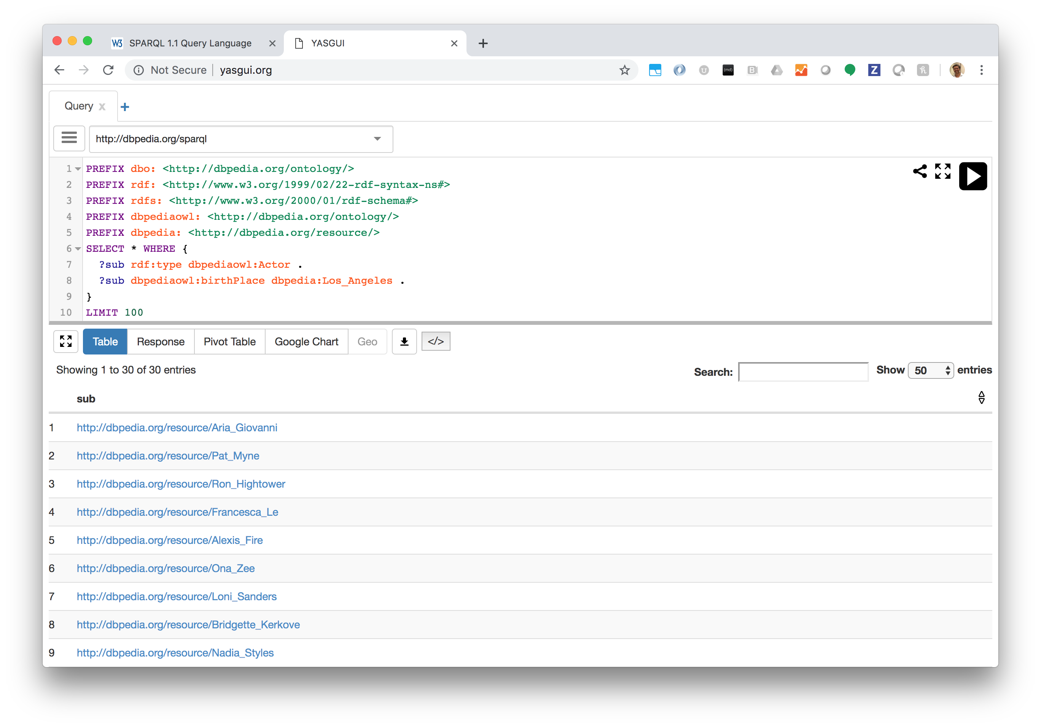
http://yasgui.org

Slide 73
Example Query
PREFIX rdf: <http://www.w3.org/1999/02/22-rdf-syntax-ns#>
PREFIX rdfs: <http://www.w3.org/2000/01/rdf-schema#>
PREFIX dbpediaowl: <http://dbpedia.org/ontology/>
PREFIX dbpedia: <http://dbpedia.org/resource/>
# People born in Bogota
SELECT * WHERE {
?sub a dbpediaowl:Person .
?sub dbpediaowl:birthPlace <http://dbpedia.org/resource/Bogot%C3%A1>
} LIMIT 100

Slide 74
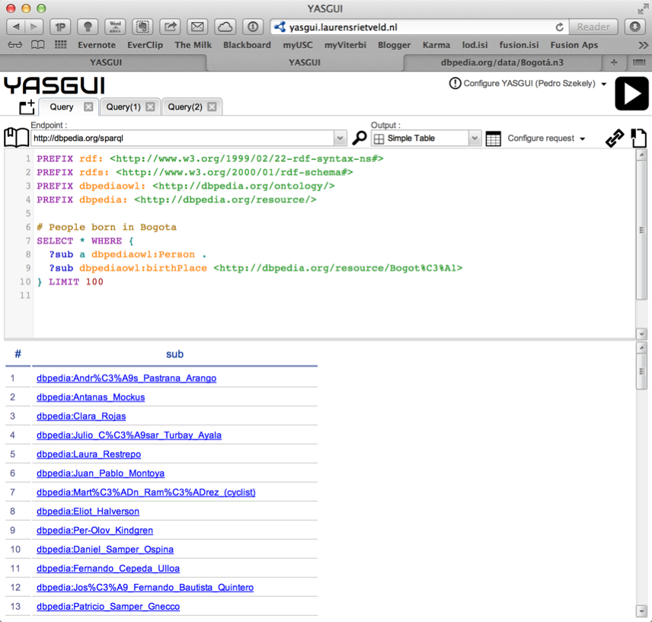

Slide 75
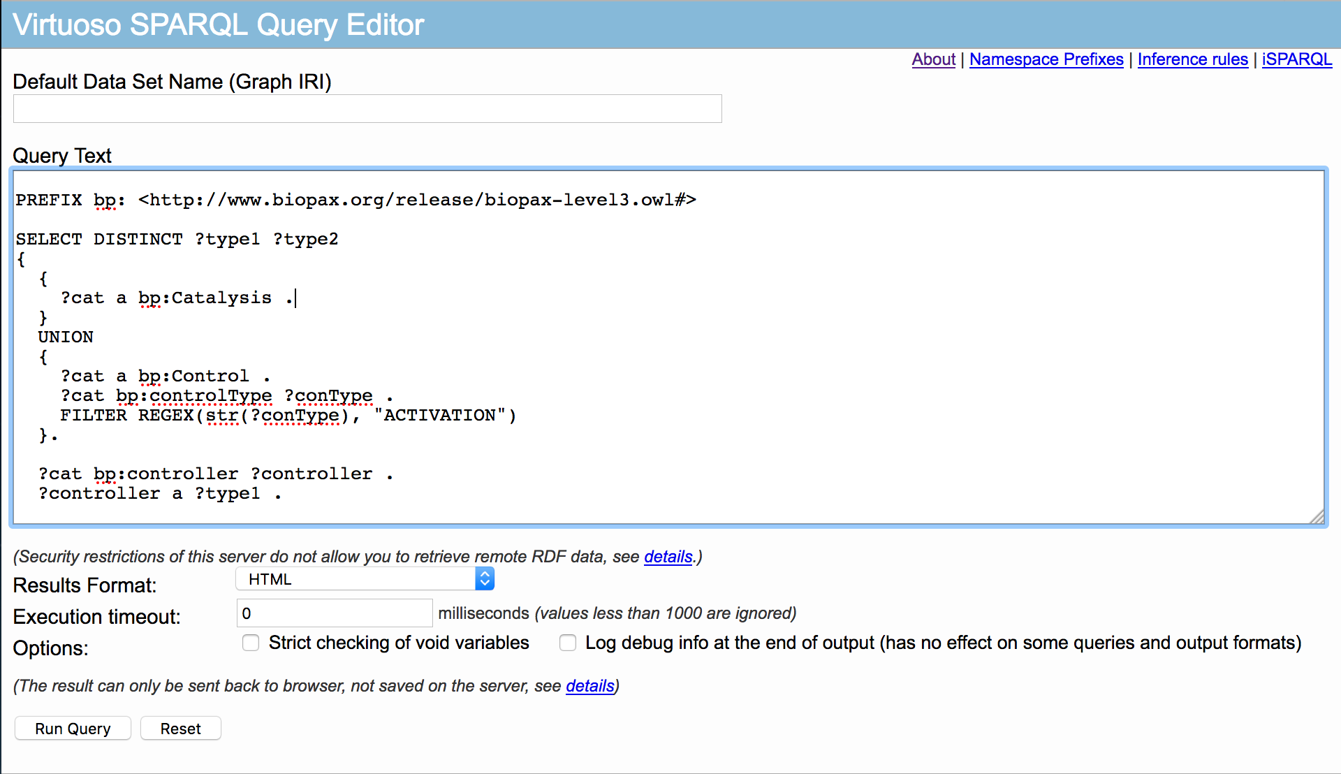
SPARQL endpoint (Virtuoso): https://rdf.pathwaycommons.org/sparql/

Slide 76
Awesome SPARQL Query: Pathway Commons

Slide 77
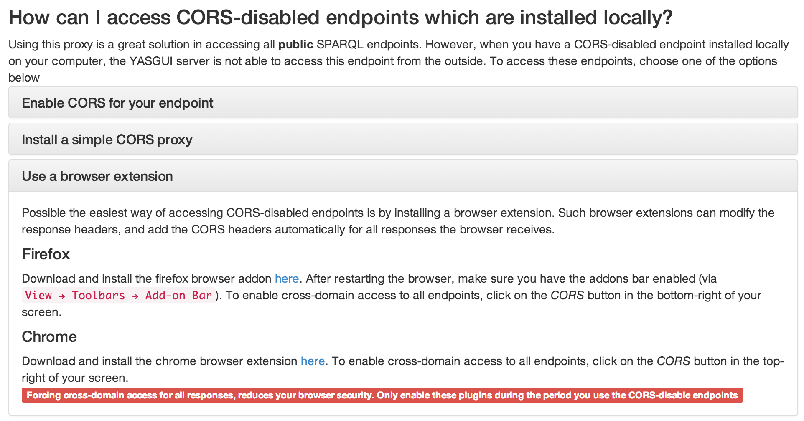
https://chrome.google.com/webstore/detail/allow-control-allow-origi/nlfbmbojpeacfghkpbjhddihlkkiljbi

Slide 78
SPARQL 1.1 Federated Query Extension
Available at SPARQL endpoint: http://people.example.org/sparql
@prefix foaf: <http://xmlns.com/foaf/0.1/> .
@prefix : <http://example.org/> .
:people15 foaf:name "Alice" .
:people16 foaf:name "Bob" .
:people17 foaf:name "Charles" .
:people18 foaf:name "Daisy" .
Available at local file: http://example.org/myfoaf.rdf
<http://example.org/myfoaf/I> <http://xmlns.com/foaf/0.1/knows> <http://example.org/people15> .
Query
Result
PREFIX foaf: <http://xmlns.com/foaf/0.1/>
SELECT ?name
FROM <http://example.org/myfoaf.rdf>
WHERE {
<http://example.org/myfoaf/I> foaf:knows ?person .
SERVICE <http://people.example.org/sparql> {
?person foaf:name ?name . } }
name
“Alice”

Slide 79
SPARQL 1.1 Federated Query Extension
Available at SPARQL endpoint: http://people.example.org/sparql
@prefix foaf: <http://xmlns.com/foaf/0.1/> .
@prefix : <http://example.org/> .
:p15 foaf:name "Alice" . :p16 foaf:name "Bob" .
:p17 foaf:name "Carl" . :p17 foaf:interest :AI .
Available at SPARQL endpoint: http://people2.example.org/sparql
@prefix foaf: <http://xmlns.com/foaf/0.1/> .
@prefix : <http://example.org/> .
:p15 foaf:knows :p18 . :p18 foaf:name "Mike" .
:p17 foaf:knows :p19 . :p19 foaf:name "Daisy" .
Query
PREFIX foaf: <http://xmlns.com/foaf/0.1/>
SELECT ?name ?int ?known
WHERE {
SERVICE <http://people.example.org/sparql> {
?person foaf:name ?name .
OPTIONAL {
?person foaf:interest ?int .
SERVICE <http://people2.example.org/sparql> {
?person foaf:knows ?known . } } } }
Result
person | int | known
"Alice"
"Bob"
"Carl" | :AI | :p19
Notes:
Depending on engine results may be fully qualified URIs, instead of using prefixes.

