Slide 1
Schema Matching and Mapping
Jose Luis Ambite
University of Southern California
[based on slides by Anhai Doan, by Doan, Halevy & Ives, and by Atzeni]

Slide 2
Outline
Problem definition, challenges, and overview
Schema matching
Matchers
Combining match predictions
Enforcing domain constraints
Match selector
Reusing previous matches
Many-to-many matches
Schema mapping

Slide 3



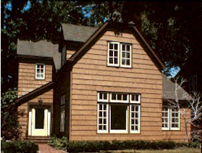
Motivation: Data Integration
Find houses with
2 bedrooms
priced under
200K
realestate.com
homeseekers.com
homes.com
Notes:
Here is a simple example of data integration. Consider Professor Brown. He was recently a faculty candidate. He has jumped through all hoops, and now has been offered a job at this university. Now he’s busy teaching and doing research. But because he just moved here,he’s also looking to buy a house.
Now, he wants to find houses with 2 bedrooms and priced under 300K. Naturally, he turns to the Web to find this information. But he discovers that there are many many sources on the Web which provide house listings. He realizes that he has to go to EACH of these sources, query the sources individually, then combine the answers to obtain the desired information. He realizes to his horror that this would take hours and hours of his valuable time.
So, the problem of finding houses for new professors, together with some other less important problems such as integrating data at enterprises, has generated a lot of research in databases on developing data integration systems. Such systems would allow Professor Brown to obtain the desired information in only seconds, instead of hours.

Slide 4

Architecture of Data Integration System
Find houses with 2 bedrooms
priced under 200K
mediated schema
source schema 1
source schema 2
source schema 3
realestate.com
homeseekers.com
homes.com
Notes:
Here is the architecture of a data integration system over three real-estate sources on the Web. The system has a mediated schema, which describes the real-estate domain, and the source schemas, which describe the content of the sources.
Now, instead of interacting with EACH individual source, Professor Brown can simply pose his query in the mediated schema. The system will take the query, translate it into queries in source schemas, then execute those queries at the sources. It then combines the answeres returned from the sources, to produce the desired answer to the query of Professor Brown.
So, such data integration systems are very compelling, because they will significantly boost the productivity of new professors. BUT, building such systems are still very difficult today. In particular, to build such a sytem, we must specify the SEMANTIC MAPPINGS between the mediated schema and the source schemas, so that the system can translate queries at the mediated-schema level to source-schema level. Today, such semantic mappings are still created manually, in a very costly process. So the focus of this talk is on AUTOMATICALLY LEARNING THESE MAPPINGS.

Slide 5
Schema Mappings
Global-as-View (GAV): Φs(X,Y) → g(X)
Mediator relation defined as a view over source relations
s1(ID,Title,Director,Year) ^ s3(ID,Review) → review(Title,Year,Review)
Local-as-View (LAV): s(X) → ∃Y Φg(X,Y)
Source relation defined as view over mediator relations
s1(id, title, year, director) → Movie(title,year,director,genre) ^ American(director) ^ year ≥1960 ^ genre = 'Comedy
General (GLAV, st-tgd): Φ_{S}(X,Y) → ∃Z Ψ_{G}(X,Z)
s1(id, title, year, director) ^ s2(id, review) → Movie(title,year,director,genre) ^ American(director) ^ year ≥1990 ^ genre = 'Comedy’ ^ hasReview(title, review)

Slide 6
Semantic Matches between Schemas
Mediated-schema
price agent-name address
1-1 match
complex match
homes.com
listed-price contact-name city state
320K Jane Brown Seattle WA
240K Mike Smith Miami FL
Notes:
However, before doing that, lets get a better feel for the problem by defining it in more details. For simplicity, lets assume that both the mediated schema and source schemas use the RELATIONAL REPRESENTATION. For example, here’s a mediated schema in the real-estate domain, with elements price, agent-name, and address. And here’s the source homes.com, which exports house listings in this relational table, each row in this table corresponds to a house listing. Throughout the talk, we color elements of the mediated schema in red, and elements of source schemas in blue.
Now, given a mediated schema and a source schema, the schema-matching problem is to find semantic mappings between the elements of the two schemas. The simplest type of mapping is 1-1 mappings, such as price to listed-price, and agent-name to contact-name. BUT 1-1 mappings make up only a portion of semantic mappings in practice. There are also a lot of complex mappings such as address is the concatenation of city and state, or number of bathrooms is the number of full baths plus number of half baths. In this talk, we shall focus first on finding 1-1 mappings, then on finding complex mappings.

Slide 7
Exploit Multiple Types of Information
realestate.com
listed-price contact-name contact-phone office comments
$250K James Smith (305) 729 0831 (305) 616 1822 Fantastic house
$320K Mike Doan (617) 253 1429 (617) 112 2315 Great location
homes.com
If use only names
contact-agent matches either contact-name or contact-phone
If use only data values
contact-agent matches either contact-phone or office
If use both names and data values
contact-agent matches contact-phone
sold-at contact-agent extra-info
$350K (206) 634 9435 Beautiful yard
$230K (617) 335 4243 Close to Seattle
Notes:
Here’s an example to illustrate our approach. Consider a mediated schema with elements price, agent-name, agent-phone, and so on.
To apply LSD, first the user selects a few sources to be the training sources. In this case, the user selects a single source, realestate.com [POINT]. Next, the user manually specifies the 1-1 mappings between the schema of this source and the mediated schema. These mappings are the five green arrows right here [POINT], which say that listed-price matches price, contact-name matches agent-name, and so on.
Once the user has shown LSD these 1-1 mappings, there are many different types of information that LSD could learn from, in order to construct hypotheses on how to match schema elements. For example, LSD could learn from the names of schema elements. Knowing that office matches office-phone, it may construct the hypothesis [POINT] that if the word ”office" occurs in the name of a schema element, then that element is likely to be office-phone.
LSD could also learn from the data values. Because comments matches description, LSD knows that these data values here [POINT] are house descriptions. It could then examine them to learn that house descriptions frequently contain words such as fantastic, great, and beautiful. Hence, it may construct the hypothesis [POINT] that if these words appear frequently in the data values of an element, then that element is likely to be house descriptions.
LSD could also learn from the characteristics of value distributions. For example, it can look at the average value of this column [POINT], and learn that if the average value is in the thousands, then the element is more likely to be price than the number of bathrooms. And so on.
Now, consider the source homes.com, with these schema elements [POINT] and these data values [POINT]. LSD can apply the learned hypotheses to the schema and the data values, in order to predict semantic mappings. For example, because the words "beautiful" and "great" appear frequently in these data values, LSD can predict that "extra-info" matches "description”.
... and the solution to this is MULTI-STRATEGY LEARNING [PAUSE]

Slide 8
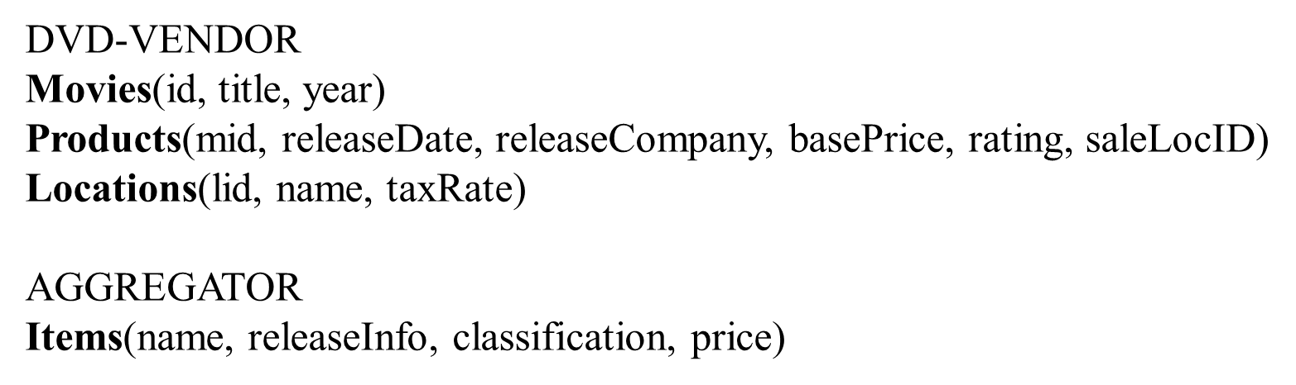
Semantic Matches
Semantic match: relates elements of schema S to elements of schema T without specifying in detail (SQL) the exact nature of relationship
One-to-one matches
Movies.title = Items.name
Products.rating = Items.classification
One-to-many matches
Items.price = Products.basePrice * (1 + Locations.taxRate)
m.address = concat(s1.city, s1.state)
Many-to-many
s.address(s.num, s.name, s.citystate) ~~> m.address(concat(s.num, s.name) as s.street, split(citystate)$1 as city, split(citystate)$2 as state)

Slide 9
Schema Mappings
Schema matchings are not enough
need schema mappings (GLAV rules)
Example:
CREATE VIEW Items AS
SELECT title AS name, releaseDate AS releaseInfo, rating AS classification, basePrice * (1 + taxRate) AS price FROM Movies m, Products p, Locations l WHERE m.id = p.mid AND p.saleLocID = l.lid
Items(T,D,R,P) ← Movies(I,T,Y) ^ Products(I,D, C,BP,R,L) ^ Locations(L,N,X) ^ plus(1, X, S) ^ mult(BP, S, P)

Slide 10
Relationship between Schema Matching and Mapping
To create source description:
start by creating semantic matches,
then elaborate matches into mappings
Why start with semantic matches?
Easier to learn or to elicit from designers
price = basePrice * (1 + taxRate) based on domain knowledge, or function learning program
Break long process in the middle and allow designer to verify and correct the matches, reduce complexity of overall process
Why the need to elaborate matches into mappings?
Matches specify relationships, but cannot be used to obtain data
Need schema mappings (SQL queries, st-TGDs) to get data:
SELECT (basePrice * (1 + taxRate)) AS price FROM Product, Location WHERE Product.saleLocID = Location.lid

Slide 11
Schema Mapping is Ubiquitous
Fundamental problem in numerous applications
Databases
data integration
data exchange / warehousing
semantic query processing
model management
peer data management
AI/Knowledge Representation
knowledge base/ontology merging, ontology alignment, ...
Web
e-commerce: matching product catalogs
marking up web forms using (Semantic Web) ontologies
linking ontologies of linked data
Notes:
But first lets take a step back and ask, if you are not buying a house, why should you care about this problem. The answer is that you should, because it is a fundamental problem in many areas and in numerous applications. Given any domain, if you ask two persons to describe it, they will almost certainly use different terminologies. Thus any application that involves more than one such description must establish semantic mappings between them, in order to have INTEROPERABILITY.
As a consequence, variations of this problem arises everywhere. It has been a long standing problem in databases and is becoming increasingly critical. It arises in AI, in the context of ontology merging and information gathering on the Internet. It arises in e-commerce, as the problem of matching catalogs. It is also a fundamental problem in the context of the Semantic Web, which tries to add more structure to the Web by marking up data using ontologies. There we have the problem of matching ontologies.
Now, if this problem is so important, why has no one solved it? [REPLACE SLIDE]

Slide 12
Schema Matching/Mapping is Difficult
Schema matching and mapping systems must reconcile semantic heterogeneity between the schemas
Such semantic heterogeneity arise in many ways
same concept, but different names for tables and attributes
rating vs classification
multiple attributes in 1 schema relate to 1 attribute in the other
basePrice and taxRate relate to price
tabular organization of schemas can be quite different
one table in AGGREGATOR vs three tables in DVD-VENDOR
coverage and level of details can also differ significantly
DVD-VENDOR also models releaseDate and releaseCompany

Slide 13
Schema Matching/Mapping is Difficult
Why do we have semantic heterogeneity?
Schemas created by people with different knowledge and styles
Databases created for different purposes
Why reconciling semantic heterogeneity is hard
the semantics is not fully captured in the schemas/data
not adequately documented
schema creator has retired to Florida!
schema clues can be unreliable
same names => different entities: area => location or square-feet
different names => same entity: area or address => location
intended semantics can be subjective
house-style = house-description?
correctly combining the data is difficult
Multiple attributes map to one: price = basePrice * (1 + taxRate)
Standard is not a solution!
Small number of attributes, strong incentive to agree
Cannot be fully automated, needs user feedback!

Slide 14
Outline
Problem definition, challenges, and overview
Schema matching
Matchers
Combining match predictions
Enforcing domain constraints
Match selector
Reusing previous matches
Many-to-many matches
Schema mapping

Slide 15
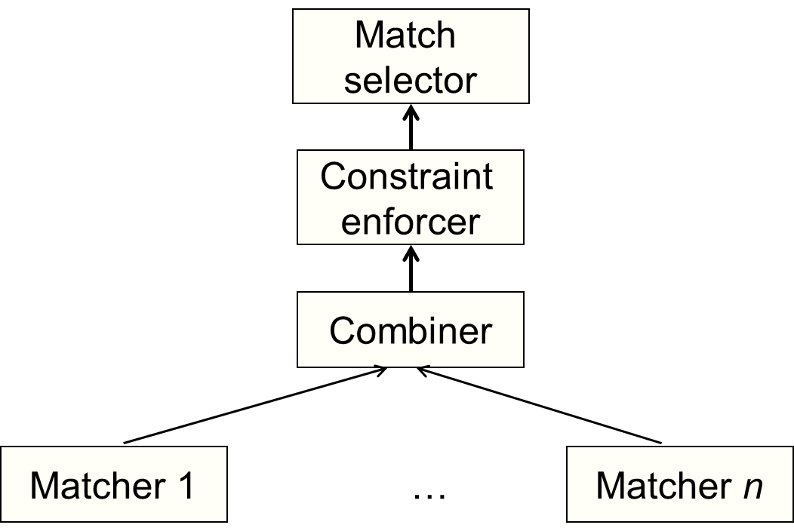
Matching System Architecture
sim → matches
filter(sim) → sim
c(sim₁, … sim_{n}) → sim
Schemas →
similarity matrix

Slide 16
Outline
Problem definition, challenges, and overview
Schema matching
Matchers
Combining match predictions
Enforcing domain constraints
Match selector
Reusing previous matches
Many-to-many matches
Schema mapping

Slide 17
Matchers
Schemas → Similarity Matrix
Input:
two schemas S and T, plus any possibly helpful auxiliary information (e.g., data instances, text descriptions)
Output:
similarity matrix that assigns to each element pair of S and T a number in [0,1] predicting whether the pair match
Numerous matchers have been proposed. Ex:
name matchers
data matchers

Slide 18
Variety of Schema Matching Approaches
Match algorithm can consider
Instance data – i.e., data contents
Schema information or metadata
Match can be performed on
Individual elements – e.g., attributes
Schema structure – combination of elements
Match algorithm can use
Language approaches – based on names or text descriptions
Constraint-based approaches – based on keys and relationships
Machine learning approaches – probabilistic description of data structure
Match may relate 1 or n elements of one schema to 1 or n elements of another schema

Slide 19
Name-Based Matchers
Use string matching techniques
Ex: edit distance, Jaccard, Soundex, etc.
Linguistic pre-processing
split on delimiters
e.g., saleLocID → sale, Loc, ID
expand known abbreviations or acronyms
loc → location, cust → customer
expand a string with synonyms / hyponyms
synonyms: Car ~ automobile, make ~ brand, cost ~ price
hyponyms: expand product into book, dvd, cd, …
remove stop words
in, at, and, a
sometimes stemming
products production ~> product

Slide 20
Instance-Based Matchers
When schemas come with data instances, these can be extremely helpful in deciding matches
Many instance-based matchers have been proposed
Some of the most popular
recognizers
use dictionaries, regexes, or simple rules
overlap matchers
examine the overlap of values among attributes
Classifiers
use machine learning techniques

Slide 21
Recognizers
Use dictionaries, regular expressions, or rules to recognize data values of certain kinds of attributes
Example attributes for which recognizers are well suited
country names, city names, US states, zip codes
person names (can use dictionaries of last and first names)
colors, rating (e.g., G, PG, PG-13, etc.)
phone, fax, social security numbers
genes, protein names

Slide 22
Schema Matching based on data values
Price | agent-name | City | State
$679K | Jane Fiedler | Los Angeles | CA
$905K | Jay Bellet | Los Angeles | CA
$850K | Chris Lee | Culver City | CA
$899K | Chris Lee | Culver City | CA
Listed-price | Contact-name | address
$755,000 | J. Smith | Los Angeles, CA
$849,000 | D. May | Venice, CA
$899,000 | D. May | Venice, CA
$710,000 | R. Chun | Los Angeles, CA
$935,000 | J. Smith | Los Angeles, CA
Exploit similarities in the instances to learn relationship between schema elements

Slide 23
Overlap Matchers
Typically applies to attributes whose values are drawn from some finite domain
e.g., movie ratings, movie titles, book titles, country names
Jaccard measure is commonly used to measure overlap of values
Example:
use Jaccard measure to build a data-based matcher between DVD-VENDOR and AGGREGATOR
AGGREGATOR.name refers to DVD titles, DVD-VENDOR.name refers to sale locations, DVD-VENDOR.title refers to DVD titles → low score for (name, name), high score for (name, title)

Slide 24
Classifiers
Build classifiers one schema and use them to classify elements of the other schema
Ex: Naïve Bayes, decision tree, rule learning, SVM
Common strategy
for each element t_{i} of schema T, train classifier C_{i} to recognize data instances of t_{i}
positive examples: data instances of t_{i}
negative examples: data instances of other elements of T
use classifier C_{i} to compute similarity between t_{i} and each element s_{j} of schema S
for each data instance of s_{j}, Ci produces score in [0,1] that is the confidence that the instance is indeed an instance of t_{i}
Aggregate confidence scores of instances of s_{j} (e.g., average) to return a single confidence score → similarity score between s_{j} and t_{i}

Slide 25
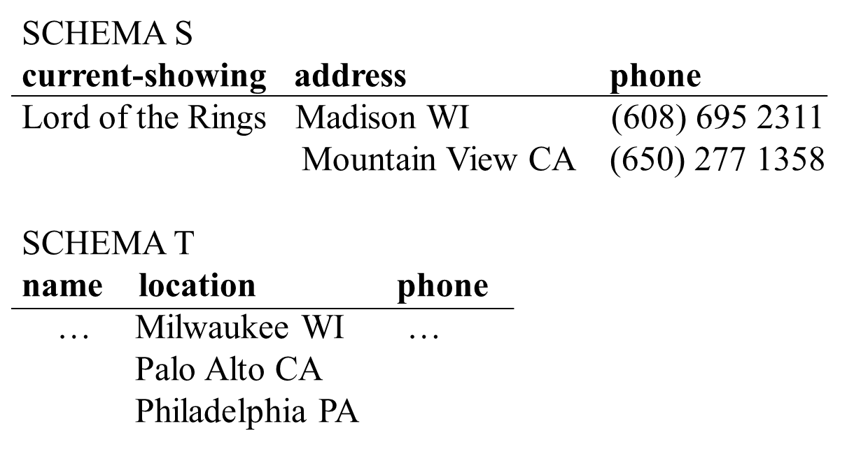
Using Classifiers: An Example
Assume we train a classifier with values of S.address as positive instances, and values from current-showing and phone as negative instances.
Applying the classifier to values of T.location, we get scores of 0.9, 0.7, and 0.5
→ return average score of 0.7 as similarity score between S.address and T.location

Slide 26
Outline
Problem definition, challenges, and overview
Schema matching
Matchers
Combining match predictions
Enforcing domain constraints
Match selector
Reusing previous matches
Many-to-many matches
Schema mapping

Slide 27
Matching System Architecture
sim → matches
filter(sim) → sim
c(sim₁, … sim_{n}) → sim
Schemas →
similarity matrix

Slide 28
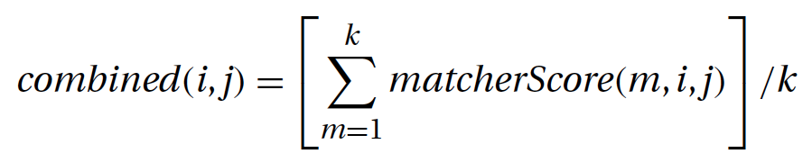
Combining Match Predictions
Combination functions
average combiner: when trust each matcher similarly
maximum combiner: trust a strong signal from matchers
minimum combiner: to be conservative
More complex types of combiners
use hand-crafted scripts
Ex: if s_{i} is address, then return score of the data-based matcher, otherwise return average score of all matchers
weighted-sum combiners
give weights to each matcher, according to its importance
combiner itself can be a learner
Learn weights from training data
Ex: decision tree, linear regression, logistic regression ...

Slide 29
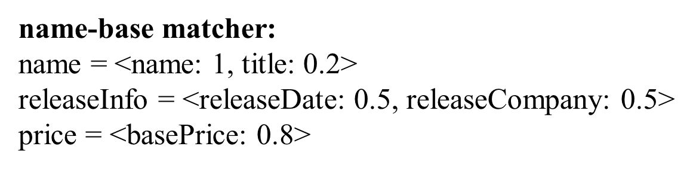
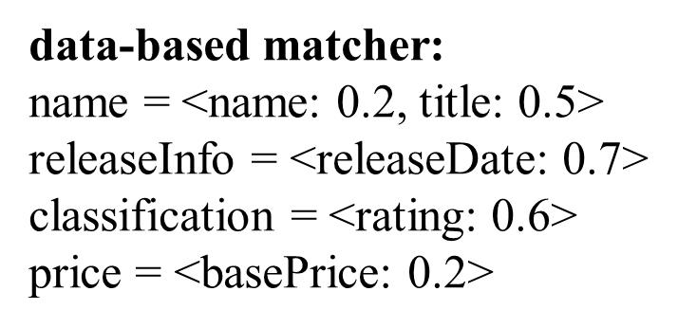
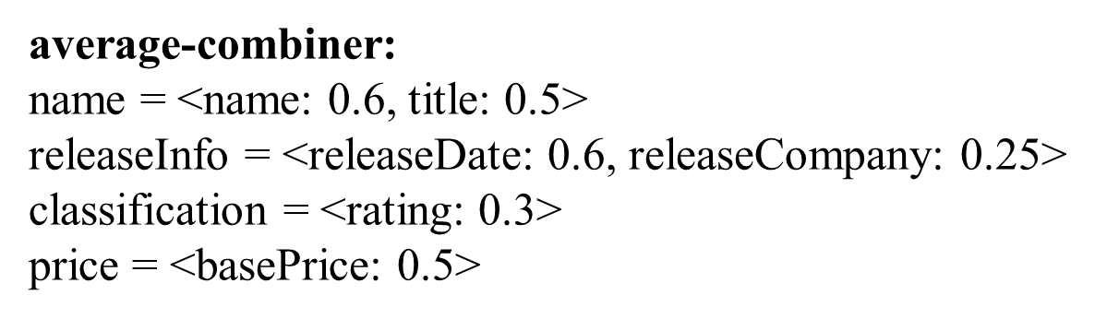
Example of Average Combiner
0.35>

Slide 30
Outline
Problem definition, challenges, and overview
Schema matching
Matchers
Combining match predictions
Enforcing domain constraints
Match selector
Reusing previous matches
Many-to-many matches
Schema mapping

Slide 31
Matching System Architecture
sim → matches
filter(sim) → sim
c(sim₁, … sim_{n}) → sim
Schemas →
similarity matrix

Slide 32
Enforcing Domain Constraints
Designer often has knowledge that can be naturally expressed as domain integrity constraints
Constraint enforcer exploits these to prune certain match combinations
searches through the space of all match combinations produced by the combiner
finds one combination with the highest aggregated confidence score that satisfies the constraints
Two kinds of constraints:
Hard constraints: must be enforced
Soft constraints: more heuristic, may be violated
Minimize cost of constraint violation
hard constraints: cost is infinite
soft constraints: cost can be any positive number

Slide 33
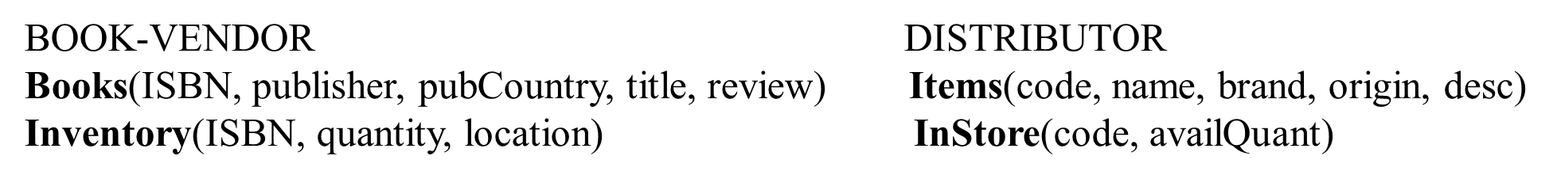
Example of Constraints
 | Constraint | Cost
c₁ | If A = Items.code, then A is a key (all distinct values) | ∞
c₂ | If A = Items.desc, then any random sample of 100 data instances of A must have an average length of at least 20 words | 1.5
c₃ | If A₁~B₁, A₂~B₂, and B₂ is next to B₁ in the schema, but A₂ is not next to A₁, then there is no A’ next to A₁ such that |sim(A’,B₂) – sim(A₂,B₂)| ≤ t for a small pre-specified t | 2
c₄ | If more than half of the attributes of Table U match those of Table V, then U = V | 1
Notes:
hard constraint : cost = ∞
c3: For example, suppose that A1 = publisher B1 = brand and A2 = location B2 = origin. Here B2 is next to B1, but A2 is not next to A1. Then the constraint states that there is no attribute A next to A1 (e.g., pubCountry) that also closely matches B2 (i.e., jsim.A,B2/􀀀sim.A2,B2/j for a small prespecified ). This is because if such A exists, we would rather match it, instead of A2,
to B2, to keep the matches of A1 and A2 close to one another.

Slide 34
Outline
Problem definition, challenges, and overview
Schema matching
Matchers
Combining match predictions
Enforcing domain constraints
Match selector
Reusing previous matches
Many-to-many matches
Schema mapping

Slide 35
Matching System Architecture
sim → matches
filter(sim) → sim
c(sim₁, … sim_{n}) → sim
Schemas →
similarity matrix

Slide 36
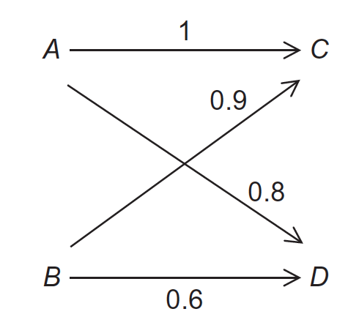
Match Selector
Selects matches from the similarity matrix
Thresholding: return element pairs with similarity above threshold
Given similarity matrix: name=<title: 0.5>, releaseInfo = <releaseDate:0.6>, classification = <rating: 0.3>, price = <basePrice: 0.5> , and threshold 0.5, return matches name~title, releaseInfo~release, and Dateprice~basePrice
Stable marriage:
Match is unstable if there are two couples Ai~Bj and Ak~Bm s.t. Ai and Bm want to be more with each other: sim(i,m)>sim(i, j) ^ sim(i,m) > sim(k,m)
Ex: A~D, B~C is unstable
sim(A,C) = 1 > sim(A,D) = 0.8 ^ sim(A,C) = 1 > sim(B,C) = 0.9
A~C, B~D stable
Maximize sum of scores
A~D, B~C
More complex strategies return the top few match combinations
Notes:
unstable marriage: A~D B~C . sim(A,C) = 1 > sim(A,D) = 0.8

Slide 37
Outline
Problem definition, challenges, and overview
Schema matching
Matchers
Combining match predictions
Enforcing domain constraints
Match selector
Reusing previous matches
Many-to-many matches
Schema mapping

Slide 38
Reusing Previous Matches
Schema matching tasks are often repetitive
Ex: keep matching new sources into the mediated schema
Can a schema matching system improve over time? Can it learn from previous experience?
Yes, use machine learning techniques
consider matching sources S₁, ..., S_{n} into a mediated schema G
manually match S₁, ..., S_{m} into G (where m << n)
system generalizes to predict matches for S_{m+1}, ..., S_{n}
use a technique called multi-strategy learning

Slide 39
Multi-Strategy Learning: Training Phase
Employ a set of learners L1, ..., Lk
each learner creates a classifier for an element e of the mediated schema G, from training examples of e
these training examples are derived using semantic matches between the training sources S1, ..., Sm and G
Typical learners: decision tree, naive bayes classifiers
Use a meta-learner to learn a weight w_{e,Li} for each element e of the mediated schema and each learner Li
these weights will be used later in the matching phase to combine the predictions of the learners Li

Slide 40
Multi-Strategy Learning: Decision Tree Learner
Example: Learning American phone numbers
Sample data: (608) 435-2322, 310-849-7394, 5549902
Features: “Does the string have 10 digits?”, “Does the string have 7 digits?”, “Is there a ‘(’ in position 1?”, “Is there a ‘)’ in position 5?”, and “Is there a ‘-’ in position 4?”
Decision Tree:
10 digits?
( in position 1?
7 digits?
) in position 5?
- in position 4?
-
+
-
+
-

Slide 41
Example of Training Phase
Mediated schema G has three attributes: e₁, e₂, e₃
Use two learners: Naive Bayes and Decision Tree
NB learner creates three classifiers: C_{e1,NB}, C_{e2,NB} , C_{e3,NB}
e.g., C_{e1,NB} will decide if a given data instance belongs to e₁
To train C_{e1,NB}, use training sources S₁, ..., S_{m}
suppose when matching these to G, we found that only two attributes a and b matches e₁
use data instances of a and b as positive examples
use data instances of other attributes of S₁, ..., S_{m} as negative examples
Training other classifiers proceeds similarly
Training meta-learner produces 6 weights:
w_{e1,NB}, w_{e1,DT}, w_{e2,NB}, w_{e2,DT ,}w_{e3,NB}, w_{e3,DT}

Slide 42
Training the MetaLearner (by example)
Goal: learn the weights: w_{e1,NB}, w_{e1,DT}, w_{e2,NB}, w_{e2,DT ,}w_{e3,NB}, w_{e3,DT}
Meta-learner applies learning method, such as linear regression, to training examples
Learning w_{e1,NB}, w_{e1,DT} for mediated-schema element e1
Intuitively, how good are NB and DT at predicting e1?
create training examples: { (d, p_{NB}, p_{DT} , p*) } where
d is a data instance from a training source,
p_{NB} and p_{DT} are the confidence scores of the naive Bayes learner and the decision tree learner, respectively, that d matches e1 (i.e., d is an instance of e1),
p* is 1 if d indeed matches e1 and 0 otherwise.
Apply linear regression to compute w_{e1,NB}, w_{e1,DT} that minimize the squared error:
Compute w_{e2,NB}, w_{e2,DT ,}w_{e3,NB}, w_{e3,DT} similarly

Slide 43
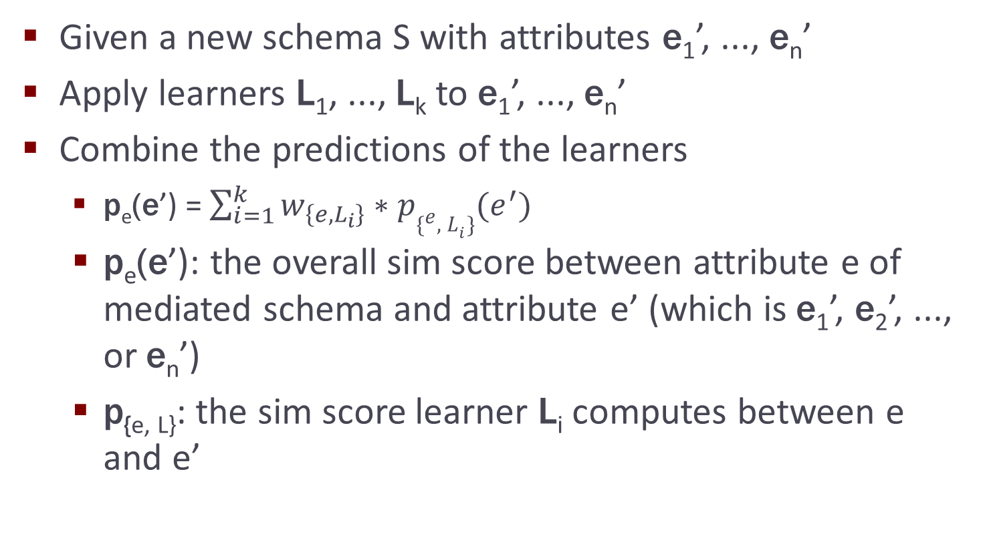
Multi-Strategy Learning: Matching Phase

Slide 44
Example of Matching Phase
Recall from the example of training phase
G has three attributes e₁, e₂, e₃; two learners NB and DT
with classifiers C_{e1,NB}, C_{e2,NB} , C_{e3,NB} and C_{e1,DT}, C_{e2,DT} , C_{e3,DT}
meta-learner has six weights w_{e1,NB}, w_{e1,DT}, ..., w_{e3,NB}, w_{e3,DT}
Let S be a new source with attributes e₁’ and e₂’
NB learner produces a 3*2 matrix of sim scores
p_{e1, NB}(e₁’), p_{e1, NB}(e₂’) [by classifier C_{e1, NB}]
p_{e2, NB}(e₁’), p_{e2, NB}(e₂’) [by classifier C_{e2, NB}]
p_{e3, NB}(e₁’), p_{e2, NB}(e₂’) [by classifier C_{e3, NB}]
DT learner produces a similar sim matrix
Meta-learner combines the predictions
p_{e1}(e₁’) = w_{e1, NB} * p_{e1, NB}(e₁’) + w_{e1, DT} * p_{e1, DT}(e₁’)

Slide 45
LSD (Learning Source Descriptions) [Doan, Domingos, Halevy, SIGMOD 2001]
1. User manually creates matches for a few sources
2. LSD learns from these matches
3. LSD predicts matches for remaining sources
Matching approach: Composite match with automatic combination of match results
Schema-level matchers
Names, schema tags in XMLs
Instance-level matchers
Trained during the preprocessing step to discover characteristic instance patterns and matching rules
Learned patterns and rules are applied to match other sources to the global schema

Slide 46
Outline
Problem definition, challenges, and overview
Schema matching
Matchers
Combining match predictions
Enforcing domain constraints
Match selector
Reusing previous matches
Many-to-many matches
Schema mapping

Slide 47
Many-to-Many Matching
Mediated-schema
price num-baths address
homes.com
listed-price agent-id full-baths half-baths city zipcode
320K 53211 2 1 Seattle 98105
240K 11578 1 1 Miami 23591
Consider matches between combinations of columns…
unlimited search space!
Key challenge: control the search

Slide 48
Search for Complex Matches
Employ specialized searchers:
Text searcher: concatenations of columns
Numeric searcher: arithmetic expressions
Date searcher: combine month/year/date
Evaluate match candidates:
Compare with learned models
Statistics on data instances
Typical heuristics

Slide 49
Example: Text Searcher
Find match candidates for address
Search in space of all concatenation matches over all string attributes
Mediated-schema
price num-baths address
homes.com
listed-price agent-id full-baths half-baths city zipcode
320K 532a 2 1 Seattle 98105
240K 115c 1 1 Miami 23591
concat(agent-id,city)
concat(agent-id,zipcode)
concat(city,zipcode)
532a Seattle
115c Miami
532a 98105
115c 23591
Seattle 98105
Miami 23591
Best match candidates for address
(agent-id,0.7), (concat(agent-id,city),0.75), (concat(city,zipcode),0.9)

Slide 50
Search
Search strategy
Beam search to handle large search space
Uses a scoring function to evaluate match candidate
Keep only k highest-scoring match candidates
Match evaluation
Score of match candidates approximates semantic distance between it and target attribute
E.g., concat(city, state) and agent-address
Uses machine-learning, statistics, heuristics
Termination based on diminishing returns
Diminishing return
Highest scores of beam search do not grow as quickly

Slide 51
iMap Searchers
Searcher | Space of candidates | Examples | Evaluation technique
Text | Text attributes of source schema | name=concat(first-name,last-name) | Naïve Bayes and beam search
Numeric | User supplied matches of past complex matches | list-price= price*(1+tax-rate) | Binning, KL divergence
Category | Attributes w/less than t distinct values | product-categories= product-types | KL divergence
Schema mismatch | Source attribute containing target schema info | fireplace=1 if house-desc has “fireplace” | KL divergence
Unit conversion | Physical quantity attributes | weigh-kg=2.2*lbs | Properties of distributions
Dates | Columns recognized as ontology nodes | birth-date=b-day/ b-month / b-year | Mapping into ontology

Slide 52
Empirical Evaluation
iMAP system
12 searchers
Four real-world domains
real estate, product inventory, cricket, financial wizard
target schema: 19 -- 42 elements, source schema: 32 -- 44
Accuracy: 43 -- 92%
Sample discovered matches
agent-name = concat(first-name,last-name)
area = building-area / 43560
discount-cost = (unit-price * quantity) * (1 - discount)
Dhamanka et. al. iMAP: Discovering Complex Semantic Matches between Database Schemas. SIGMOD-2004

Slide 53
Observations
Finding complex matches much harder than 1-1 matches!
require gluing together many components
e.g., num-rooms = bath-rooms + bed-rooms + dining-rooms + living-rooms
if missing one component => incorrect match
However, even partial matches are already very useful!
so are top-k matches => need methods to handle partial/top-k matches
Huge/infinite search spaces
domain knowledge plays a crucial role!
Matches are fairly complex, hard to know if they are correct
must be able to explain matches
Human must be fairly active in the loop
need strong user interaction facilities
Break matching architecture into multiple "atomic" boxes!

Slide 54
Outline
Problem definition, challenges, and overview
Schema matching
Matchers
Combining match predictions
Enforcing domain constraints
Match selector
Reusing previous matches
Many-to-many matches
Schema mapping

Slide 55
Finding Matches is only Half of the Job!
To translate data/queries, need mappings, not just matches
Schema S
Schema T
HOUSES
location price ($) agent-id
Atlanta, GA 360,000 32
Raleigh, NC 430,000 15
LISTINGS
area list-price agent-address agent-name
Denver, CO 550,000 Boulder, CO Laura Smith
Atlanta, GA 370,800 Athens, GA Mike Brown
AGENTS
id name city state fee-rate
32 Mike Brown Athens GA 0.03
15 Jean Laup Raleigh NC 0.04
Schema Mappings
area = SELECT location FROM HOUSES
agent-address = SELECT concat(city,state) FROM AGENTS
list-price = SELECT price * (1 + fee-rate) FROM HOUSES, AGENTS WHERE agent-id = id

Slide 56
Clio: Elaborating Matches into Mappings
Developed at U. of Toronto & IBM Almaden, 2000-2003
R Fagin, L Haas, M Hernández, RJ Miller, L Popa, Y Velegrakis. Clio: Schema Mapping Creation and Data Exchange. In Conceptual Modeling: Foundations and Applications, Springer 2009.
Given a match
list-price = price * (1 + fee-rate)
Refine it into a mapping
list-price = SELECT price * (1 + fee-rate) FROM houses FULL OUTER JOIN agents ON agent-id = id
Need to discover
the correct join path among tables, e.g., agent-id = id
the correct join type, e.g., full outer join? inner join?
Use heuristics to decide
when in doubt, ask users
sophisticated user interaction methods [VLDB-00, SIGMOD-01]

Slide 57
Multiple Join Paths
Address
id
Addr
Professor
id
name
salary
Personnel
Student
name
GPA
Yr
Sal
PayRate
Rank
HrRate
WorksOn
name
Proj
hrs
ProjRank
f1: PayRate.HrRate * WorksOn.hrs = Personnel.Sal.

Slide 58
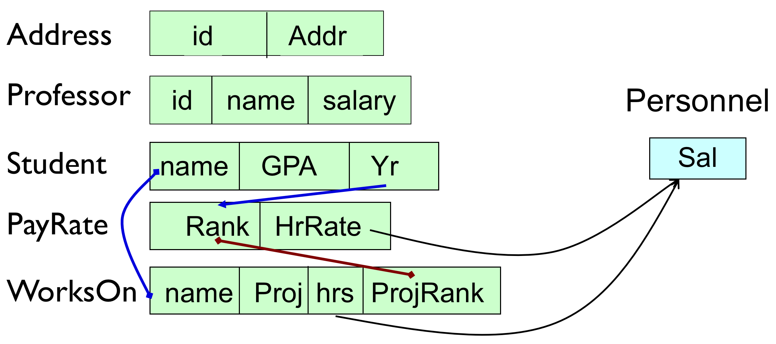
Two Possible Queries
select P.HrRate * W.hrs
from PayRate P, WorksOn W
where P.Rank = W.ProjRank
select P.HrRate * W.hrs
from PayRate P, WorksOn W, Student S
where W.Name=S.Name and S.Yr = P.Rank
(We could also consider the Cartesian product, but that seems intuitively wrong)

Slide 59
Two Sets of Decisions
What join paths to choose?
How to combine the results of the joins?
Underlying database-design principles:
Values in the source should appear in the target
They should only appear once
We should not lose information
Discover candidate join paths by:
following foreign keys
look at paths used in queries
paths discovered by mining data for joinable columns.
Select paths by:
Prefer foreign keys
Prefer ones that involve a constraint
Prefer smaller difference between inner and outer joins.

Slide 60
Horizontal partitioning
Address
id
Addr
Professor
id
name
salary
Personnel
Student
name
GPA
Yr
Sal
PayRate
Rank
HrRate
WorksOn
name
Proj
hrs
ProjRank
f2: Professor(Sal) → Personnel(Sal)

Slide 61
What Kind of Union?
select P.HrRate * W.hrs
from PayRate P, WorksOn W
where P.Rank = W.ProjRank
UNION ALL
select Sal
from Professor

Slide 62
Selecting Covers
Candidate cover: a minimal set of candidate sets (join paths) that covers all the input correspondences
Select best cover:
Prefer with fewest candidate paths
Prefer one that covers more attributes of target
Express mapping as union of candidate sets in selected cover.

Slide 63
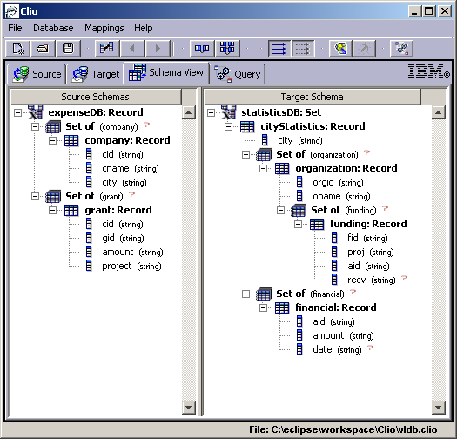
Features of Clio
Supports nested structures
Nested Relational Model & Constraints
Interactive discovery of attribute correspondence.
Interactive derivation of schema mappings.
Performs data exchange
Supports composition of schema mappings

Slide 64
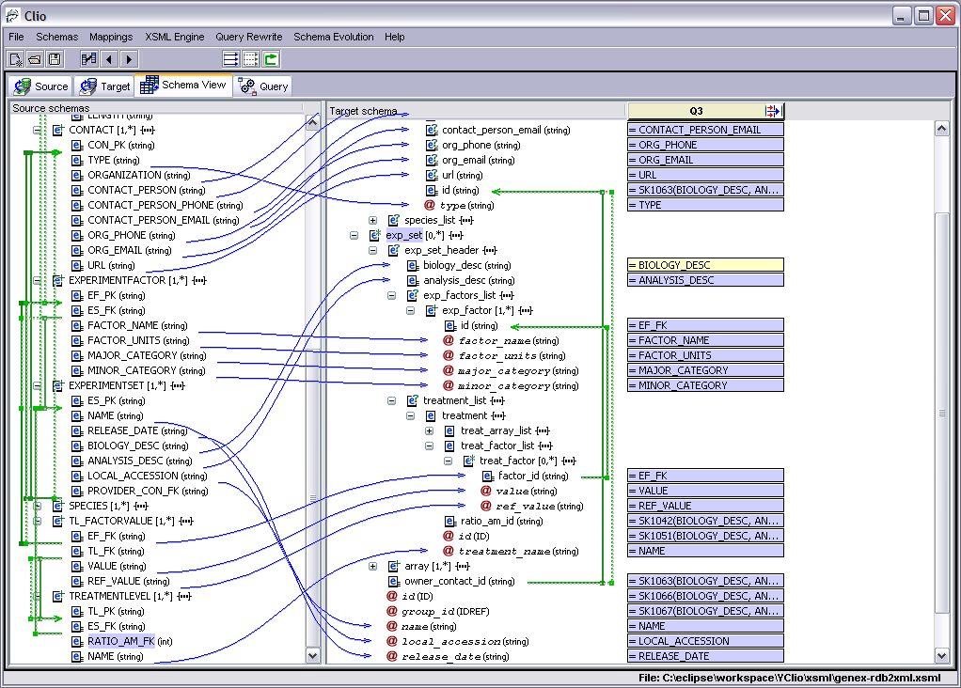

Slide 65
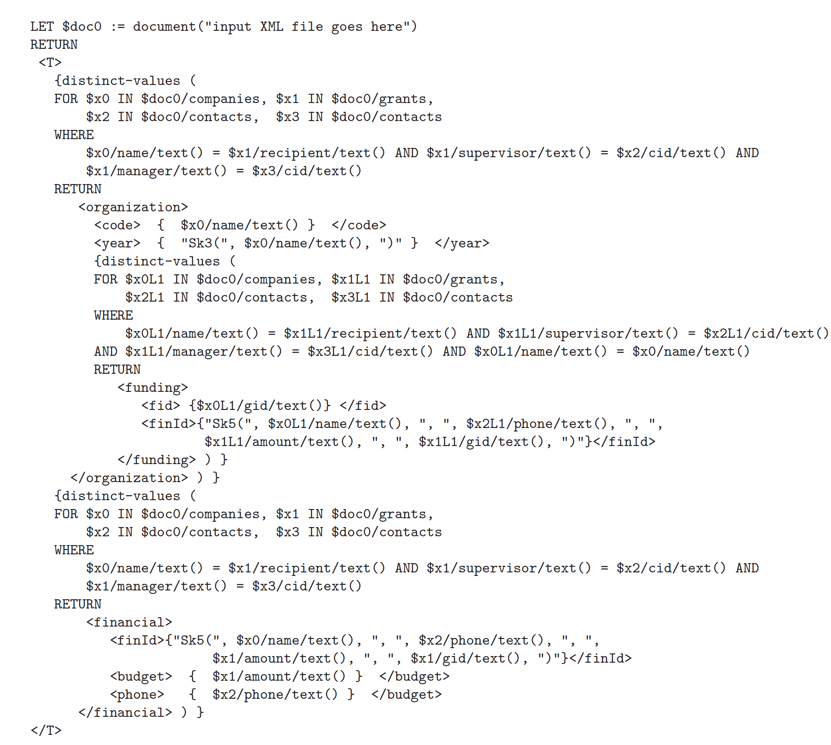

Slide 66
Summary
Schema matching:
Use multiple matchers and combine results
Learn from the past
Incorporate constraints and user feedback
From matching to mapping:
Search through possible queries
Principles from database design guide search
User interaction is key

Slide 67
Additional Slides (not for test)

Slide 68
Data integration and transformation 3. Data Exchange
Paolo Atzeni
Dipartimento di Informatica e Automazione
Università Roma Tre
28/10-4/11/2009

Slide 69
References
Ronald Fagin, Laura M. Haas, Mauricio Hernandez, Renee J. Miller, Lucian Popa, and Yannis Velegrakis "Clio: Schema Mapping Creation and Data Exchange" A.T. Borgida et al. (Eds.): Mylopoulos Festschrift, LNCS 5600, Springer-Verlag Berlin Heidelberg, 2009, pp. 198–236.
and other papers cited in it

Slide 70
Data exchange, a typical approach (the Clio project)
Schema Match
Mapping
generation
Source
schema
Target
schema
Query
generation

Slide 71
Simple example
Dept(Id,DeptName) Emp(Code,EmpName,Dept)
Employee(Id,Name,DeptId)
(with FK from DeptId to Dept.Id)
Assume we know that
Employee.Id corresponds to Code
Name corresponds to EmpName
DeptName corresponds to Dept
We would like to obtain a query that populates Emp
SELECT Id as Code, Name AS EmpName, DeptName AS Dept
FROM Employee JOIN Dept ON DeptId = Dept.Id

Slide 72
Better visualization
Employee
Id
Name
DeptId
Dept
Id
DeptName
Emp
Code
EmpName
Dept
We want to obtain
SELECT Id as Code, Name AS EmpName, DeptName AS Dept
FROM Employee JOIN Dept ON DeptId = Dept.Id
and not
SELECT Id as Code, Name AS EmpName, NULL AS Dept FROM Employee
UNION
SELECT NULL as Code, NULL AS EmpName, DeptName AS Dept FROM Dept
nor
SELECT Id as Code, NULL AS EmpName, NULL AS Dept FROM Employee
UNION
…

Slide 73
The main issue
How do we discover we should use a join and not one or two unions?
Attributes that appear together in a relation
Id,Name in the source and Code,EmpName in the target
The foreign key

Slide 74
Data exchange, another example
Address ( Id Addr )
Professor ( Id Name Sal )
Student ( Name GPA Yr )
Personnel ( Id Name Sal Addr )
PayRate ( Rank HrRate )
WorksOn ( Name Proj Hrs ProjRank )
Foreign keys
between the two Id
between ProjRank and Rank
between the two Name

Slide 75
Data exchange, example
Address ( Id Addr )
Professor ( Id Name Sal )
Student ( Name GPA Yr )
Personnel ( Id Name Sal Addr )
PayRate ( Rank HrRate )
WorksOn ( Name Proj Hrs ProjRank )
Assume we are given correspondences, which involve functions:
Usually identity
PayRate(HrRate)*WorksOn(Hrs) → Personnel(Sal)

Slide 76
Data exchange, example
Address ( Id Addr )
Professor ( Id Name Sal )
Student ( Name GPA Yr )
Personnel ( Id Name Sal Addr )
PayRate ( Rank HrRate )
WorksOn ( Name Proj Hrs ProjRank )
How do we combine HrRate and Hrs?
Via a join suggested by foreign keys
Foreign key between ProjRank and ProjRank suggests a join
Foreign keys over Name and between Yr and Rank suggest another

Slide 77
Heuristic
We have many correspondences
Group correspondences in such a way that each set contains at most one correspondence for each attribute in the target
We are interested in sets where the source attribute are either in the same relations or in relations whose join is meaningful

Slide 78
Partition the correspondences
Address ( Id Addr )
Professor ( Id Name Sal )
Student ( Name GPA Yr )
Personnel ( Id Name Sal Addr )
PayRate ( Rank HrRate )
WorksOn ( Name Proj Hrs ProjRank )
… and for each partition the joins are meaningful

Slide 79
The process, example
Address ( Id Addr )
Professor ( Id Name Sal )
Student ( Name GPA Yr )
Personnel ( Id Name Sal Addr )
PayRate ( Rank HrRate )
WorksOn ( Name Proj Hrs ProjRank )
SELECT P.Id, P.Name, P.Sal, A.Addr FROM Professor P, Address A
WHERE A.Id = P.Id
UNION ALL
SELECT NULL AS Id, S.Name, p.HrRate * W.Hrs, NULL AS Addr FROM PayRate P, Student S, WorksOn W WHERE W.Name = S.Name AND S.Yr = P.Rank

Slide 81
More complex example (with nesting)
Companies
Name
Address
Year
Grants
Gid
Recipient
Amount
Supervisor
Manager
Contacts
Cid
Email
Phone
Organizations
Code
Year
Fundings
FId
FinId
Finances
FinId
Budget
Phone
f1
Nested relation
f4
Organizations
f2
Code
Year
Fundings
FId
FinId
f3
HAL
301
302
SM
PH
303

Slide 82
Correspondences (given by a "schema matcher")
Companies
Name
Address
Year
Grants
Gid
Recipient
Amount
Supervisor
Manager
Contacts
Cid
Email
Phone
Organizations
Code
Year
Fundings
FId
FinId
Finances
FinId
Budget
Phone
v1
f1
v2
f4
v3
f2
f3
v4

Slide 83
Let us formalize correspondences
∀n,d,y Companies(n,d,y) →
∃y',F Organizations(n,y',F))
Companies
Name
Address
Year
Grants
Gid
Recipient
Amount
Supervisor
Manager
Contacts
Cid
Email
Phone
v1
v1
Organizations
Code
Year
Fundings
FId
FinId
Finances
FinId
Budget
Phone
f1
∀g,r,a,s,m Grants(g,r,a,s,m) →
∃c,y,F,f Organiz…(c,y,F)), F(g,f)
v2
v2
f4
∀g, r, a, s, m Grants(g,r,a,s,m) →
∃f,p Finances(f,a,p)
v3
v3
f2
f3
v4
∀c, e, p Contacts(c,e,p) →
∃f,b Finances(f,b,p)
v4

Slide 84
Correspondences alone are not enough
∀n,d,y Companies(n,d,y) →
∃y',F Organizations(n,y',F))
Companies
Name
Address
Year
Grants
GId
Recipient
Amount
Supervisor
Manager
Contacts
Cid
Email
Phone
v1
v1
Organizations
Code
Year
Fundings
FId
FinId
Finances
FinId
Budget
Phone
∀g,r,a,s,m Grants(g,r,a,s,m) →
∃c,y,F,f Organiz…(c,y,F)), F(g,f)
v2
v2
f1
∀g, r, a, s, m Grants(g,r,a,s,m) →
∃f,p Finances(f,a,p)
Organizations
Companies
f4
v3
v3
f2
Name
Address
Year
Code
Year
Fundings
HAL
NY
1920
FId
FinId
SM
Seattle
1984
f3
HAL
∀c, e, p Contacts(c,e,p) →
∃f,b Finances(f,b,p)
PH
SF
1957
Grants
v4
SM
v4
GId
Rec.t
Amt
PH
301
HAL
30
302
HAL
40
301
303
PH
30
302

Slide 85
More complex mappings are needed, representing associations
∀n,d,y,g,a,s,m Companies(n,d,y),
Grants(g,n,a,s,m) →
∃y',F,f Organizations(n,y',F)), F(g,f)
Companies
Name
Address
Year
Grants
GId
Recipient
Amount
Supervisor
Manager
Contacts
Cid
Email
Phone
v1
Organizations
Code
Year
Fundings
FId
FinId
Finances
FinId
Budget
Phone
Note: The "association" between companies and grants in the source is suggested by f1 (a foreign key)
v2
f1
∀g, r, a, s, m Grants(g,r,a,s,m) →
∃f,p Finances(f,a,p)
Organizations
Companies
f4
v3
v3
f2
Name
Address
Year
Code
Year
Fundings
HAL
NY
1920
FId
FinId
SM
Seattle
1984
HAL
∀c, e, p Contacts(c,e,p) →
∃f,b Finances(f,b,p)
f3
301
PH
SF
1957
Grants
v4
v4
302
GId
Rec.t
Amt
SM
301
HAL
30
302
HAL
40
PH
303
303
PH
30

Slide 86
Yet more complex
∀n,d,y,g,a,s,m Companies(n,d,y),
Grants(g,n,a,s,m) →
∃y',F,f, p
Organizations(n,y',F), F(g,f),
Finances(f,a,p)
Companies
Name
Address
Year
Grants
Gid
Recipient
Amount
Supervisor
Manager
Contacts
Cid
Email
Phone
v1
Organizations
Code
Year
Fundings
FId
FinId
Finances
FinId
Budget
Phone
f1
v2
Notes:
Three tuples are generated for each pair of related companies and grants
The mapping specifies that there exist an f, appearing in two places, without saying which its value should be
f4
v3
f2
f3
v4

Slide 87
A final issue
Companies
Name
Address
Year
Grants
Gid
Recipient
Amount
Supervisor
Manager
Contacts
Cid
Email
Phone
How do we obtain the phone to be put in finances?
Is it the supervisor's one or the manager's?
FKs suggest either (or even both)
Human intervention is needed to choose
v1
Organizations
Code
Year
Fundings
FId
FinId
Finances
FinId
Budget
Phone
f1
v2
f4
v3
f2
f3
v4

Slide 88
Various solutions in nested cases with possibily undesirable features
Organizations
Code
Year
Fundings
Companies
FId
FinId
Name
Address
Year
HAL
301
k1
HAL
NY
1920
302
k1
SM
Seattle
1984
PH
SF
1957
SM
PH
303
k1
Grants
GId
Rec.t
Amt
301
HAL
30
Finances
302
HAL
40
FinId
Budget
phone
303
PH
30
k1
30
k1
40
k1
30

Slide 89
A better solution
Organizations
Code
Year
Fundings
Companies
FId
FinId
Name
Address
Year
HAL
301
k1
HAL
NY
1920
302
k2
SM
Seattle
1984
PH
SF
1957
SM
PH
303
k3
Grants
GId
Rec.t
Amt
301
HAL
30
Finances
302
HAL
40
FinId
Budget
phone
303
PH
30
k1
30
k2
40
k3
30

Slide 90
A more verbose notation for mappings
∀n,d,y,g,a,s,m Companies(n,d,y),
Grants(g,n,a,s,m) →
∃y',F,f, p
Organizations(n,y',F)), F(g,f),
Finances(f,a,p)
Companies
Name
Address
Year
Grants
Gid
Recipient
Amount
Supervisor
Manager
Contacts
Cid
Email
Phone
v1
Organizations
Code
Year
Fundings
FId
FinId
Finances
FinId
Budget
Phone
f1
v2
foreach c in companies, g in grants
where c.name=g.recipient
exists o in organizations,
f in o.fundings,
i in finances
where f.finId = i.finId
with o.code = c.name
and f.fId = g.gId
and i.budget = g.amount
f4
v3
f2
f3
v4
query on the source
query on
the target
correspondences

Slide 91
The mapping as a source-to-target constraint
Q^{S}
foreach c in companies, g in grants
where c.name=g.recipient
exists o in organizations,
f in o.fundings,
i in finances
where f.finId = i.finId
with o.code = c.name
and f.fId = g.gId
and i.budget = g.amount
Q^{S}  Q^{T}
"the result of Q^{T} (over the target, projected as in the with-clause) must contain the result of Q^{S} (over the source, projected as in the with-clause)"
Companies
Name
Address
Year
Grants
Gid
Recipient
Amount
Supervisor
Manager
Contacts
Cid
Email
Phone
v1
Organizations
Code
Year
Fundings
FId
FinId
Finances
FinId
Budget
Phone
Q^{T}
f1
v2
f4
v3
f2
f3
v4

Slide 92
Syntax and restrictions
foreach x₁ in g₁, . . . , x_{n} in g_{n}
where B₁
exists y₁ in g'₁, . . . , y_{m} in g'_{m}
where B₂
with e₁ = e'₁ and . . . and e_{k} = e'_{k}
foreach c in companies, g in grants
where c.name=g.recipient
exists o in organizations,
f in o.fundings,
i in finances
where f.finId = i.finId
with o.code = c.name
and f.fId = g.gId
and i.budget = g.amount
x_{i} in g_{i} (generator)
x_{i} variable
g_{i} set (either the root or a set nested within it)
B₁ conjunction of equalities over the x_{i} variables
y_{i} in g'_{i}
B₂
similar
e₁ = e'₁ … equalities between a source expression and a target expression
Restrictions: See paper, page 210, lines 5+: "The mapping is well formed …"

Slide 93
Schema constraints
Referential integrity is essential in this approach as the basis for the discovery of "associations"
Given the nested model, they need a rather complex definition
So, two steps
Paths (primary paths and relative paths)
Nested referential integrity (NRI) constraints

Slide 94
Primary paths
Primary path (given a schema root R, that is a first level element in the schema):
x₁ in g₁, x₂ in g₂, …, x_{n} in g_{n}
where g₁ is an expression on R (just R?), g_{i} (for i ≥ 2) g₁ is an expression on x_{i-1}
Examples
c in companies
o in organizations
o in organizations, f in o.fundings

Slide 95
Relative paths
Primary path (given a schema root R, that is a first level element in the schema):
x₁ in g₁, x₂ in g₂, …, x_{n} in g_{n}
where g₁ is an expression on R (just R?), g_{i} (for i ≥ 2) g₁ is an expression on x_{i-1}
Relative path with respect to a variable x
x₁ in g₁, x₂ in g₂, …, x_{n} in g_{n}
where g₁ is an expression on x (just x?), g_{i} (for i ≥ 2) g₁ is an expression on x_{i-1}
Example
f in o.fundings

Slide 96
Nested referential integrity (NRI) constraints
foreach P₁ exists P₂ where B
P₁ is a primary path
P₂ is either a primary path or a relative path with respect to a variable in P₁
B is a conjunction of equalities between an expression on a variable of P₁ and an expression on a variable of P₂
Example
foreach o in organizations, f in o.fundings
exists i in finances
where f.finId = i.finId
Organizations
Code
Year
Fundings
FId
FinId
Finances
FinId
Budget
Phone
f4

Slide 97
The context
Companies
Name
Address
Year
Grants
Gid
Recipient
Amount
Supervisor
Manager
Contacts
Cid
Email
Phone
Organizations
Code
Year
Fundings
FId
FinId
Finances
FinId
Budget
Phone
v1
f1
v2
f4
v3
f2
f3
v4

Slide 98
Associations
from x₁ in g₁, x₂ in g₂, …, x_{n} in g_{n} [where B]
x_{i} in g_{i} generator (each expression may include variables defined in a previous generator)
B a conjunction of equalities (with variables and constants)
Examples
from c in contacts
from g in grants, c in companies, s in contacts, m in contacts where g.recipient = c.name and g.supervisor = s.cid and g.manager = m.cid

Slide 99
Associations
In the (flat) relational model, an association is a join (possibly with a selection)
from c in contacts
from g in grants, c in companies, s in contacts, m in contacts where g.recipient = c.name and g.supervisor = s.cid and g.manager = m.cid
Companies
Name
Address
Year
Grants
Gid
Recipient
Amount
Supervisor
Manager
Contacts
Cid
Email
Phone
f1
f2
f3

Slide 100
Dominance and union
A₂ dominates A₁ (A₁ ≤ A₂ ) if
the from and where clauses of A₁ are subsets of those of A₂ (after suitable renaming and with other technicalities)
Example
A_{2 :} from g in grants, c in companies, s in contacts, m in contacts where g.recipient = c.name and g.supervisor = s.cid and g.manager = m.cid
A_{1 :} from g in grants, c in companies where g.recipient = c.name
Union of associations:
Union of from and of where (with renamings if needed)

Slide 101
Useful associations
Organizations
Code
Year
Fundings
FId
FinId
Finances
FinId
Budget
Phone
Structural association:
from P with P primary path
from o in organizations, f in o.fundings
User association
Any association (specified by the user)
Logical association
An association obtained by "chasing" constraints (starting with a structural or a user association)
from o in organizations, f in o.fundings, i in finances where f.finId=i.finId
f4

Slide 102
Logical associations
Organizations
Code
Year
Fundings
FId
FinId
Finances
FinId
Budget
Phone
from o in organizations, f in o.fundings NO
from o in organizations, f in o.fundings, i in finances where f.finId=i.finId sì
from c in companies sì
from g in grants, c in companies where g.recipient = c.name NO
from g in grants, c in companies, s in contacts, m in contacts where g.recipient = c.name and g.supervisor = s.cid and g.manager = m.cid sì
f4
Companies
Name
Address
Year
Grants
Gid
Recipient
Amount
Supervisor
Manager
Contacts
Cid
Email
Phone
f1
f2
f3

Slide 103
The chase
Given as association, repeatedly applying a chase rule to the "current" association (initialed as the input one)
If there is a NRI constraint
foreach X exists Y where B
such that (this is a bit informal but intuitive) the "current" association contains X and does not contain a Y that satisfies B then add Y to the generators and B to the where clause
Example. If we start with
from g in grants
then we have to add various components and obtain
from g in grants, c in companies, s in contacts, m in contacts where g.recipient = c.name and g.supervisor = s.cid and g.manager = m.cid
If the NRIs are acyclic, then the chase terminates and the result does not depend on the order of application
Companies
Name
Address
Year
Grants
Gid
Recipient
Amount
Supervisor
Manager
Contacts
Cid
Email
Phone
f1
f2
f3

Slide 104
Mapping generation
Logical associations are meaningful combinations of correspondences
A set of correspondences can be interpreted together if there are two logical associations (one in the source and one in the target) that cover them
The algorithm for generating schema mappings
Finds maximal sets of correspondences that can be interpreted together
Compares pairs of logical association (one in the source and the other in the target)
Select a suitable set of pairs

Slide 105
Correspondences
<P;e> schema element (an attribute somewhere)
P primary path
e expression on the last variable of P
Examples
<c in companies; c.name>
<o in organizations, f in o.fundings; c.name>
Correspondence:
for each P^{S} exists P^{T} with e_{S}=e_{T}
with <P^{S}; e_{S} > and <P^{T}; e_{T}> schema elements
Example (v1)
for each c in companies exists o in organizations with c.name = o.code
Companies
Name
Address
Year
Grants
Gid
Recipient
Amount
Supervisor
Manager
Contacts
Cid
Email
Phone
f1
f2
f3

Slide 106
Correspondences, examples
Companies
Name
Address
Year
Grants
Gid
Recipient
Amount
Supervisor
Manager
Contacts
Cid
Email
Phone
Organizations
Code
Year
Fundings
FId
FinId
Finances
FinId
Budget
Phone
v1
f1
v2
f4
v3
f2
f3
v4
v1: for each o in companies exists o in organizations with c.name = o.code
v2: for each g in grants exists o in organizations , f in o.fundings with g.gId = f.fId
v3: for each g in grants exists i in finances, with g.amount= i.budget
v4: for each c in contacts exists i in finances with c.phone = i.phone

Slide 107
Correspondences and associations
A correspondence v : for each P^{S} exists P^{T} with e_{S}=e_{T} is covered by a pair of associations (on source and target, resp.) <A^{S} , A^{T}> if P^{S} ≤ A^{S} and P^{T} ≤ A^{T} with some renaming h, h' (on source and target, resp.)
We say that
there is a coverage of v by <A^{S} , A^{T}> via <h,h'>
the result of the coverage is h(e_{S} )=h'(e_{T} )

Slide 108
Clio mapping
Given
S, T source and target schemas
C set of correspndences
A Clio mapping:
for each A^{S} exists A^{T} with E
A^{S} A^{T} logical associations (on source and target, resp.)
E a conjunction of equalities:
for each correspondence v in C covered by <A^{S} , A^{T}> , E includes the equality h(e_{S} )=h(e_{T} ) which is the result of the coverage, for one of the coverages

Slide 109
Clio mapping, example
Companies
Name
Address
Year
Grants
Gid
Recipient
Amount
Supervisor
Manager
Contacts
Cid
Email
Phone
Organizations
Code
Year
Fundings
FId
FinId
Finances
FinId
Budget
Phone
v1
f1
v2
f4
v3
f2
f3
v4
from g in grants, c in companies, s in contacts, m in contacts
where g.recipient = c.name and g.supervisor = s.cid and g.manager = m.cid
from o in organizations, f in o.fundings, i in finances
where f.finId = i.finId
v1, v2, v3 are covered

Slide 110
Clio mapping, example
from g in grants, c in companies, s in contacts, m in contacts
where g.recipient = c.name and g.supervisor = s.cid and g.manager = m.cid
from o in organizations, f in o.fundings, i in finances
where f.finId = i.finId
for each g in grants, c in companies, s in contacts, m in contacts where g.recipient = c.name and g.supervisor = s.cid and g.manager = m.cid
exists o in organizations, f in o.fundings, i in finances where f.finId = i.finId
with c.name = o.code and g.gId = f. fId and g.amount = i.budget

Slide 111
Clio mappings, more
v4: for each c in contacts exists i in finances with c.phone = i.phone
for each g in grants, c in companies, s in contacts, m in contacts where g.recipient = c.name and g.supervisor = s.cid and g.manager = m.cid
exists o in organizations, f in o.fundings, i in finances where f.finId = i.finId
with c.name = o.code and g.gId = f. fId and g.amount = i.budget and m.phone = i.phone
for each g in grants, c in companies, s in contacts, m in contacts ….
and s.phone = i.phone

Slide 112
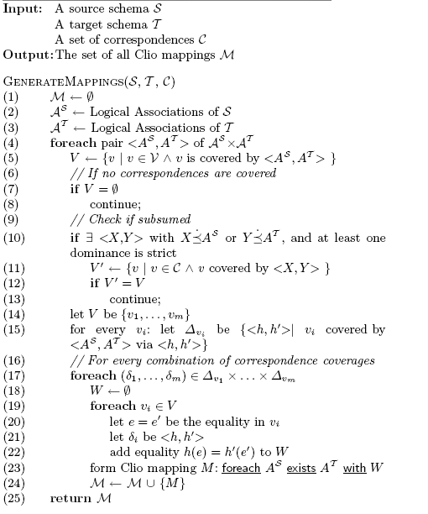
Mapping generation algorithm

Slide 113
Data Exchange
<statisticsDB>
{ FOR $x0 IN /expenseDB/grant, $x1 IN /expenseDB/project, $x2 IN /expenseDB/company
WHERE
$x2/cid/text() = $x0/cid/text()
$x0/project/text() = $x1/name/text()
RETURN
<cityStatistics>
{ FOR $x0L1 IN /expenseDB/grant, $x1L1 IN /expenseDB/project, $x2L1 IN /expenseDB/company
WHERE
$x2L1/cid/text() = $x0L1/cid/text()
$x0L1/project/text() = $x1L1/name/text()
$x2/city/text() = $x2L1/city/text()
RETURN
<organization>
<cid> { $x0L1/cid/text() } </cid>
<cname> { $x2L1/name/text() } </cname>
{
FOR $x0L2 IN /expenseDB/grant, $x1L2 IN /expenseDB/project, $x2L2 IN /expenseDB/company
WHERE
$x2L2/cid/text() = $x0L2/cid/text()
$x0L2/project/text() = $x1L2/name/text()
$x2L1/name/text() = $x2L2/name/text()
$x2L1/city/text() = $x2L2/city/text()
$x0L1/cid/text() = $x0L2/cid/text()
RETURN
<funding>
………………………………..
Notes:
The full xquery (which is for a simple relational schema with two relations source and only two levels of nesting in target) goes on for 3 powerpoint pages.
How many people in this room could write this xquery and get it right the first time????
We all understand _WHAT_ needs to be done, but it is much harder to figure out _HOW_
User tells Clio WHAT and Clio figures out the HOW!!

Slide 114
Query Generation
statDB: Set of Rcd
cityStat: Rcd
city
orgs: Set of Rcd
org: Rcd
cid
name
fundings: Set of Rcd
funding: Rcd
gid
proj
aid
financials: Set of Rcd
financial: Rcd
aid
date
amount
expenseDB: Rcd
companies: Set of Rcd
company: Rcd
cid
name
city
grants: Set of Rcd
grant: Rcd
cid
gid
amount
sponsor
project
M₂
= Sk₂[]
= Sk₁[name]
= Sk₃[name]
= Sk₄[name,gid,amt]
= Sk₄[name,gid,amt]
Correspondences map only into some of the atomic attributes
We use Skolem functions to control the creation of the other elements
sets (this controls how we group elements in the target)
atomic values (this enforces the integrity of the target)
Notes:
Note that we are assuming no key information.
If we know that cid and gid are key for grant in source, then Sk4 does not need amt in it

