Slide 1
Automatic Source Modeling
Jose Luis Ambite
University of Southern California
Based on slides by Mark Carman, Craig Knoblock and Kristina Lerman

Slide 2
The Problem
We need accurate semantic models of data sources in order to find, retrieve, and integrate the content
Building such models is time consuming, expensive, and error prone
Goal: automatically find and build semantic models of sources using already known models
Approach
Incrementally build models from partial data (e.g., web services, html forms, programs)
Model not just the fields but the source types and even the function of a source
Support rich source models that describe the contents of sources
[ Semantic model = schema mapping = st-TGD ]
slide by Craig Knoblock, Jose Luis Ambite

Slide 3
Overview
Learning Semantic Descriptions of Web Information Sources
Integrated approach to learning semantic definitions of a source
Needs to invoke the source
Learn Datalog description of the source: LAV mapping
Automatically Constructing Semantic Web Services from Online Sources
Deimos: End to end system for discovering and modeling sources
Uses system above to automatically discover semantic definitions of discovered sources

Slide 4
Mediators Require Source Descriptions
New service => no source definition!
Can we discover a definition automatically?
Orbitz Flight
Search
Mediator
lowestFare(“LAX”,“MXP”)
Query
Reformulated Query
Reformulated Query
United
Airlines
SELECT MIN(price)
FROM flight
WHERE depart=“LAX”
AND arrive=“MXP”
calcPrice(“LAX”,“MXP”,”economy”)
Reformulated Query
Qantas
Specials
Source Definitions:
Orbitz Flight Search
United Airlines
- Qantas Specials
Alitalia

Slide 5
Inducing Source Definitions by Example
source1($zip, lat, long) :-
centroid(zip, lat, long).
source2($lat1, $long1, $lat2, $long2, dist) :-
greatCircleDist(lat1, long1, lat2, long2, dist).
source3($dist1, dist2) :-
convertKm2Mi(dist1, dist2).
Known
Source 1
Known
Source 2
Known
Source 3
Step 1: classify input & output semantic types
New
Source 4
zipcode
distance
source4( $startZip, $endZip, separation)
[ Web services = Sources with binding patterns. Variables prefixed by $ are input variables ]

Slide 6
Inducing Source Definitions - Step 2
source1($zip, lat, long) :-
centroid(zip, lat, long).
source2($lat1, $long1, $lat2, $long2, dist) :-
greatCircleDist(lat1, long1, lat2, long2, dist).
source3($dist1, dist2) :-
convertKm2Mi(dist1, dist2).
Known
Source 1
Known
Source 2
Known
Source 3
source4($zip1, $zip2, dist):-
source1(zip1, lat1, long1),
source1(zip2, lat2, long2),
source2(lat1, long1, lat2, long2, dist2),
source3(dist2, dist).
Step 1: classify input & output semantic types
Step 2: generate plausible definitions
New
Source 4
source4($zip1, $zip2, dist):-
centroid(zip1, lat1, long1),
centroid(zip2, lat2, long2),
greatCircleDist(lat1, long1, lat2, long2, dist2),
convertKm2Mi(dist1, dist2).
source4( $zip1, $zip2, dist)

Slide 7
Inducing Source Definitions – Step 3
Step 1: classify input & output semantic types
Step 2: generate plausible definitions
Step 3: invoke service & compare output
source4($zip1, $zip2, dist):-
source1(zip1, lat1, long1),
source1(zip2, lat2, long2),
source2(lat1, long1, lat2, long2, dist2),
source3(dist2, dist).
source4($zip1, $zip2, dist):-
centroid(zip1, lat1, long1),
centroid(zip2, lat2, long2),
greatCircleDist(lat1, long1, lat2, long2, dist2),
convertKm2Mi(dist1, dist2).
match
$zip1 | $zip2 | dist (actual) | dist (predicted)
80210 | 90266 | 842.37 | 843.65
60601 | 15201 | 410.31 | 410.83
10005 | 35555 | 899.50 | 899.21

Slide 8
Searching for Definitions
Search space of conjunctive queries:
target(X) :- source1(X₁), source2(X₂), …
For scalability don’t allow negation or union
Perform Top-Down Best-First Search
Expressive Language
Sufficient for modeling
most online sources
First sample the New Source
Invoke target with set of random inputs;
Add empty clause to queue;
while (queue not empty)
v := best definition from queue;
forall (v’ in Expand(v))
if ( Eval(v’) > Eval(v) )
insert v’ into queue;
Then perform best-first search through space of candidate definitions

Slide 9
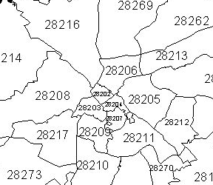
Invoking the Target
New
Source 5
Generate
Input Tuples:
<zip1, dist1>
Invoke
source5( $zip1, $dist1, zip2, dist2)
Invoke source with representative values
Try randomly generating input tuples:
Combine examples of each type
Use distribution if available
Input <zip1, dist1> | Output <zip2, dist2>
<07307, 50.94> | {<07097, 0.26>, <07030, 0.83>, <07310, 1.09>, ...}
<60632, 10874.2> | {}
Non-empty
Result
Randomly
Combined
Example
Values
Empty
Result

Slide 10
Invoking the Target
New
Source 5
Generate
Input Tuples:
<zip1, dist1>
Invoke
source5( $zip1, $dist1, zip2, dist2)
Invoke source with representative values
Try randomly generating input tuples:
Combine examples of each type
Use distribution if available
If only empty invocations result
Try invoking other sources to generate input
Continue until sufficient non-empty invocations result

Slide 11
Top-down Generation of Candidates
Start with empty clause & generate specialisations by
Adding one predicate at a time from set of sources
Checking that each definition is:
Not logically redundant
Executable (binding constraints satisfied)
New
Source 5
source5(_,_,_,_).
source5( $zip1,$dist1,zip2,dist2)
Expand
source5(zip1,_,_,_) :- source4(zip1,zip1,_).
source5(zip1,_,zip2,dist2) :- source4(zip2,zip1,dist2).
source5(_,dist1,_,dist2) :- <(dist2,dist1).
…

Slide 12
Best-first Enumeration of Candidates
Evaluate each clause produced
Then expand best one found so far
Expand high-arity predicates incrementally
New
Source 5
source5(zip1,_,zip2,dist2) :- source4(zip2,zip1,dist2).
Expand
source5(zip1,dist1,zip2,dist2) :- source4(zip2,zip1,dist2), source4(zip1,zip2,dist1).
source5(zip1,dist1,zip2,dist2) :- source4(zip2,zip1,dist2), <(dist2,dist1).
…

Slide 13
Evaluating Candidates
New
Source 5
Target
Tuples
invoke(target)
Compare
outputs
<Input Tuple>
Known
Source
Known
Source
Clause
Tuples
execute(clause)
Known
Source
Compare output of clause with that of target.
Average the results across different input tuples.

Slide 14
Evaluating Candidates II
Candidates may return multiple tuples per input
Need measure that compares sets of tuples!
Input <$zip1, $dist1> | Target Output <zip2, dist2> | Clause Output <zip2, dist2>
<60632, 874.2> | {} | {<60629, 2.15>, <60682, 2.27>, <60623, 2.64>, ..}
<07307, 50.94> | {<07097, 0.26>, <07030, 0.83>, <07310, 1.09>, ...} | {}
<28041, 240.46> | {<28072, 1.74>, <28146, 3.41>, <28138, 3.97>,…} | {<28072, 1.74>, <28146, 3.41>}
No Overlap
No Overlap
Overlap!

Slide 15
Approximating Equality
Allow flexibility in values from different sources
Numeric Types like distance
Error Bounds (eg. +/- 1%)
Nominal Types like company
String Distance Metrics (e.g. JaroWinkler Score > 0.9)
Complex Types like date
Hand-written equality checking procedures.
10.6 km ≈ 10.54 km
Google Inc. ≈ Google Incorporated
Mon, 31. July 2006 ≈ 7/31/06

Slide 16
Experiments – Setup
Problems:
25 target predicates involving real services
same domain model used for each problem
(70 Semantic Types and 37 Predicates)
35 known sources
System Settings:
Each target source invoked at least 20 times
Time limit of 20 minutes imposed
Inductive search bias:
Maximum clause length 7
Predicate repetition limit 2
Maximum variable level 5
Candidate must be executable
Only 1 variable occurrence per literal
Equality Approximations:
1% for distance, speed, temperature & price
0.002 degrees for latitude & longitude
JaroWinkler > 0.85 for company, hotel & airport
hand-written procedure for date.

Slide 17
Actual Learned Examples
1 GetDistanceBetweenZipCodes($zip0, $zip1, dis2):-
GetCentroid(zip0, lat1, lon2), GetCentroid(zip1, lat4, lon5),
GetDistance(lat1, lon2, lat4, lon5, dis10), ConvertKm2Mi(dis10, dis2).
2 USGSElevation($lat0, $lon1, dis2):-
ConvertFt2M(dis2, dis1), Altitude(lat0, lon1, dis1).
3 YahooWeather($zip0, cit1, sta2, , lat4, lon5, day6, dat7,tem8, tem9, sky10) :-
WeatherForecast(cit1,sta2,,lat4,lon5,,day6,dat7,tem9,tem8,,,sky10,,,),
GetCityState(zip0, cit1, sta2).
4 GetQuote($tic0,pri1,dat2,tim3,pri4,pri5,pri6,pri7,cou8,,pri10,,,pri13,,com15) :-
YahooFinance(tic0, pri1, dat2, tim3, pri4, pri5, pri6,pri7, cou8),
GetCompanyName(tic0,com15,,),Add(pri5,pri13,pri10),Add(pri4,pri10,pri1).
5 YahooAutos($zip0, $mak1, dat2, yea3, mod4, , , pri7, ) :-
GoogleBaseCars(zip0, mak1, , mod4, pri7, , , yea3),
ConvertTime(dat2, , dat10, , ), GetCurrentTime( , , dat10, ).
Distinguished forecast
from current conditions
current price = yesterday’s close + change

Slide 18
Experimental Results
Results for different domains:
Problem Domain | # of Problems | Avg. # of Candidates | Avg. Time (sec) | Attributes Learnt
geospatial | 9 | 136 | 303 | 84%
financial | 2 | 1606 | 335 | 59%
weather | 7 | 368 | 693 | 69%
hotels | 4 | 43 | 374 | 60%
cars | 2 | 68 | 940 | 50%

Slide 19
Next …
Automatically build semantic models for data and services available on the larger Web
Construct models of these sources that are sufficiently rich to support querying and integration
Current focus:
Build models for the vast amount of structured and semi-structured data available
Not just web services, but also form-based interfaces
E.g., Weather forecasts, flight status, stock quotes, currency converters, online stores, etc.
Learn models for information-producing web sources and web services

Slide 20
Integrated Approach
Start with an some initial knowledge of a domain
Sources and semantic descriptions of those sources
Automatically
Discover related sources
Determine how to invoke the sources
Learn the syntactic structure of the sources
Identify the semantic types of the data
Build semantic models of the source
Construct semantic web services

Slide 21
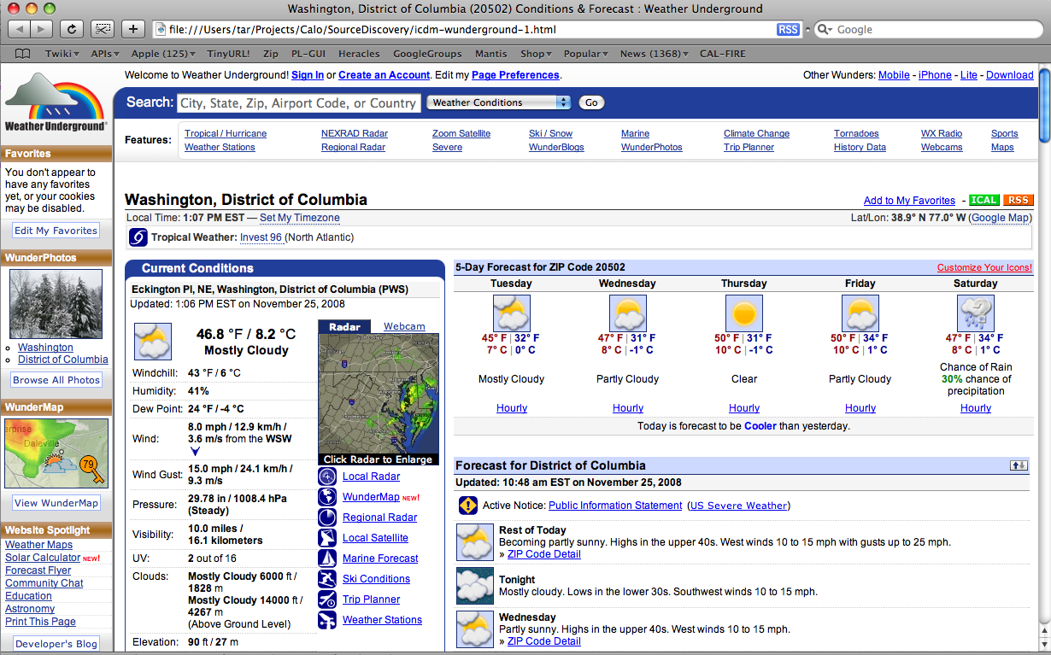
Seed Source

Slide 22
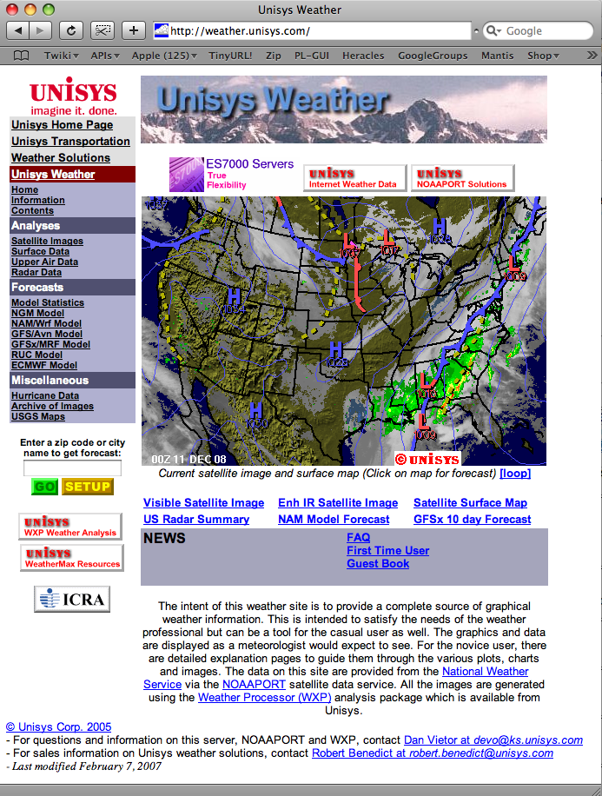
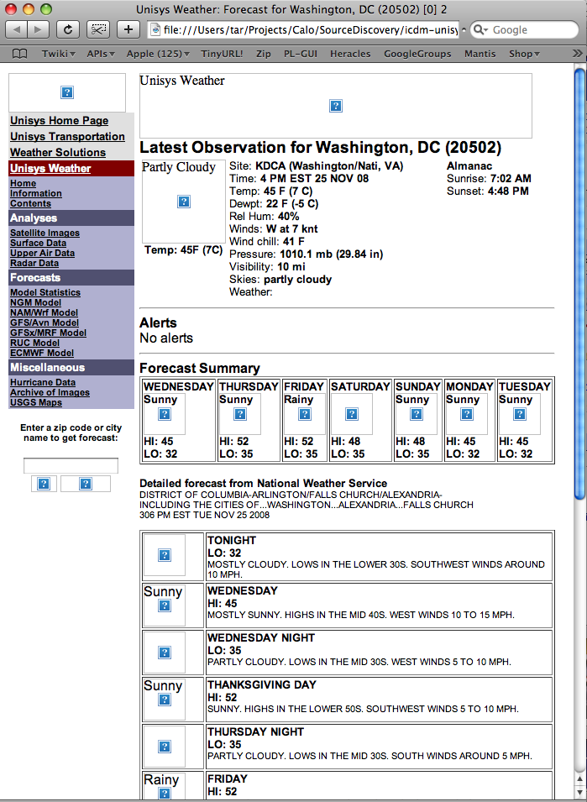
Automatically Discover and Build Semantic Web Services for Related Sources

Slide 23
Integrated Approach
discovery
unisys
Invocation &
extraction
anotherWS
Background knowledge
sample
input
values
“90254”
Seed URL
unisys
http://wunderground.com
unisys(Zip,Temp,…)
:-weather(Zip,…,Temp,Hi,Lo)
definition of known sources
sample values
patterns
domain
types
source
modeling
semantic
typing
unisys(Zip,Temp,Humidity,…)

Slide 24
Background Knowledge
discovery
unisys
Invocation &
extraction
anotherWS
Background knowledge
sample
input
values
“90254”
Seed URL
unisys
http://wunderground.com
unisys(Zip,Temp,…)
:-weather(Zip,…,Temp,Hi,Lo)
definition of known sources
sample values
patterns
domain
types
source
modeling
semantic
typing
unisys(Zip,Temp,Humidity,…)

Slide 25
Background Knowledege
Ontology of the inputs and outputs
e.g., TempF, Humidity, Zipcode;
Sample values for each semantic type
e.g., “88 F” for TempF, and “90292” for Zipcode
Domain input model
a weather source may accept Zipcode or City and State as input
Sample input values
Known sources (seeds)
e.g., http://wunderground.com
Source descriptions in Datalog or RDF
wunderground($Z,CS,T,F0,S0,Hu0,WS0,WD0,P0,V0,FL1,FH1,S1,FL2,FH2,S2, FL3,FH3,S3,FL4,FH4,S4,FL5,FH5,S5) :- weather(0,Z,CS,D,T,F0,_,_,S0,Hu0,P0,WS0,WD0,V0) weather(1,Z,CS,D,T,_,FH1,FL1,S1,_,_,_,_,_), weather(2,Z,CS,D,T,_,FH2,FL2,S2,_,_,_,_,_), weather(3,Z,CS,D,T,_,FH3,FL3,S3,_,_,_,_,_), weather(4,Z,CS,D,T,_,FH4,FL4,S4,_,_,_,_,_), weather(5,Z,CS,D,T,_,FH5,FL5,S5,_,_,_,_,_).

Slide 26
Source Discovery
discovery
unisys
Invocation &
extraction
anotherWS
Background knowledge
sample
input
values
“90254”
Seed URL
unisys
http://wunderground.com
unisys(Zip,Temp,…)
:-weather(Zip,…,Temp,Hi,Lo)
definition of known sources
sample values
patterns
domain
types
source
modeling
semantic
typing
unisys(Zip,Temp,Humidity,…)

Slide 27
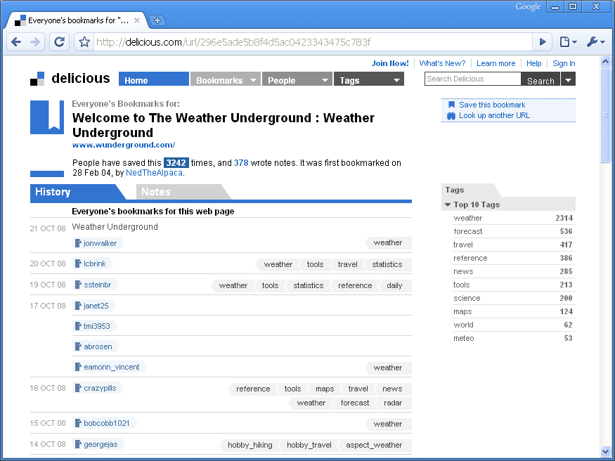
Source Discovery [Plangprasopchok and Lerman]
Leverage user-generated tags on the social bookmarking site del.icio.us to discover sources similar to the seed
Most common tags
User-specified tags
Notes:
27
Observation: sources providing similar functionality are annotated with “similar” tags

Slide 28
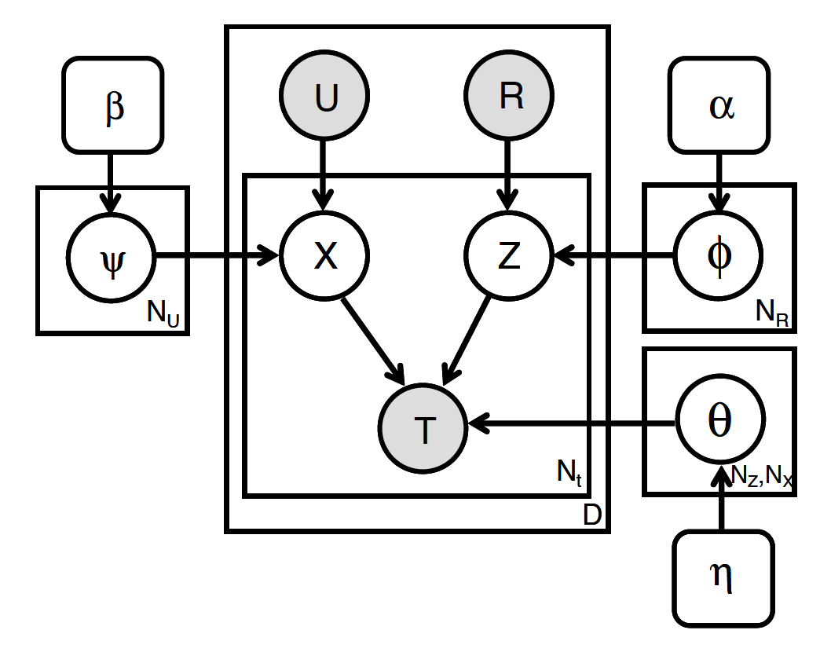
Exploiting Social Annotations for Resource Discovery
Resource discovery task : “given a seed source, find other most similar sources”
Gather a corpus of <user, source, tag> bookmarks from del.icio.us
Use probabilistic modeling to find hidden topics in the corpus
Rank sources by similarity to the seed within topic space
LDA
ITM Interest Topic Model
Seed source
Sources
Obtain Annotation
From Delicious
Probabilistic
Model
Users
Tags
Candidates
Source’s distribution
over concepts, p(z|r)
Rank sources by similarity to seed
Compute Source Similarity
Notes:
28
The items (seed item and other items here) could be web pages that take some inputs and return some outputs.
LDA baseline: ignore users: each resource is a “document” with tags as the “words”
Resource -> web resource such as web page that take some inputs and return some outputs.
After computing similarity score, we rank them and see if they are actually similar to the seed (by manually inspection if they take the same input types and return the same output types)

Slide 29
Source Invocation & Extraction
discovery
unisys
Invocation &
extraction
anotherWS
Background knowledge
sample
input
values
“90254”
Seed URL
unisys
http://wunderground.com
unisys(Zip,Temp,…)
:-weather(Zip,…,Temp,Hi,Lo)
definition of known sources
sample values
patterns
domain
types
source
modeling
semantic
typing
unisys(Zip,Temp,Humidity,…)

Slide 30
Target Source Invocation
To invoke the target source, we need to locate the form and determine the appropriate input values
Locate the form
Try different data type combinations as input
For weather, only one input - location, which can be zipcode or city/state
Submit Form
Keep successful invocations
Form Input
Notes:
30
Note: The paper describes the slightly older behavior where we stopped with the first “successful” invocation. We now will try all combinations and keep all successful invocations. This is a change in the system from when the paper was written.

Slide 31
Inducing Extraction Templates
Template: a sequence of alternating slots and stripes
stripes are the common substrings among all pages
slots are the placeholders for data
Induction: Stripes are discovered using the Longest Common Subsequence algorithm
Sample Page 1
Sample Page 2
<img src="images/Sun.png" alt="Sunny"><br>
<font face="Arial, Helvetica, sans-serif">
<small><b>Temp: 72F (22C)</b></small></font>
<font face="Arial, Helvetica, sans-serif">
<small>Site: <b>KSMO (Santa_Monica_Mu, CA)</b><br>
Time: <b>11 AM PST 10 DEC 08</b>
<img src="images/Clouds.png" alt="Cloudy"><br>
<font face="Arial, Helvetica, sans-serif">
<small><b>Temp: 37F (2C)</b></small></font>
<font face="Arial, Helvetica, sans-serif">
<small>Site: <b>KAGC (Pittsburgh/Alle, PA)</b><br>
Time: <b>2 PM EST 10 DEC 08</b>
Template
Slot
Induction
<img src="images/â.png" alt="â"><br>
<font face="Arial, Helvetica, sans-serif">
<small><b>Temp: â (â)</b></small></font>
<font face="Arial, Helvetica, sans-serif">
<small>Site: <b>â (â, â)</b><br>
Time: <b>â 10 DEC 08</b>
Stripe

Slide 32
Data Extraction with Templates [Gazen& Minton]
To extract data: Find data in slots by locating the stripes of the template on unseen page:
Unseen Page
Induced Template
<img src="images/Sun.png" alt="Sunny"><br>
<font face="Arial, Helvetica, sans-serif">
<small><b>Temp: 71F (21C)</b></small></font>
<font face="Arial, Helvetica, sans-serif">
<small>Site: <b>KCQT (Los_Angeles_Dow, CA)</b><br>
Time: <b>11 AM PST 10 DEC 08</b>
<img src="images/â.png" alt="â"><br>
<font face="Arial, Helvetica, sans-serif">
<small><b>Temp: â (â)</b></small></font>
<font face="Arial, Helvetica, sans-serif">
<small>Site: <b>â (â, â)</b><br>
Time: <b>â 10 DEC 08</b>
Extracted Data
Sun | Sunny | 71F | 21C | KCQT | Los_Angeles_Dow | CA | 11 AM PST

Slide 33
Semantic Typing
discovery
unisys
Invocation &
extraction
anotherWS
Background knowledge
sample
input
values
“90254”
Seed URL
unisys
http://wunderground.com
unisys(Zip,Temp,…)
:-weather(Zip,…,Temp,Hi,Lo)
definition of known sources
sample values
patterns
domain
types
source
modeling
semantic
typing
unisys(Zip,Temp,Humidity,…)

Slide 34
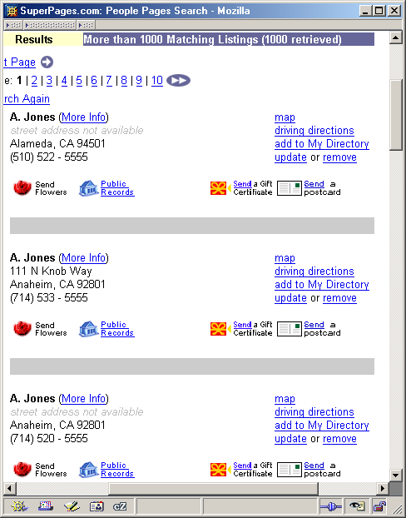
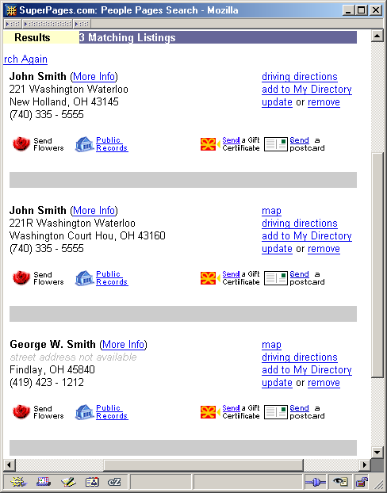
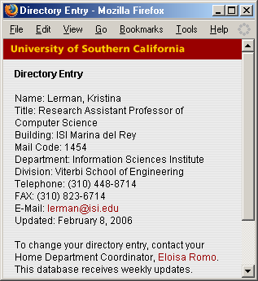
Semantic Typing [Lerman, Plangprasopchok, & Knoblock]
Idea: Learn a model of the content of data and use it to recognize new examples
:StreetAddress: :Email:
4DIG CAPS Rd ALPHA@ALPHA.edu
3DIG N CAPS Ave ALPHA@ALPHA.com
… …
:State: :Telephone:
CA (3DIG) 3DIG-4DIG
2UPPER +1 3DIG 2DIG 4DIG
… …
Background
knowledge
Patterns
learn
label
Notes:
34

Slide 35
Labeling New Data
patterns
:StreetAddress: :Email:
4DIG CAPS Rd ALPHA@ALPHA.edu
3DIG N CAPS Ave ALPHA@ALPHA.com
… …
:State: :Telephone:
CA (3DIG) 3DIG-4DIG
2UPPER +1 3DIG 2DIG 4DIG
… …
Use learned patterns to link new data to types in the ontology
Score how well patterns describe a set of examples
Number of matching patterns
How many tokens of the example match pattern
Specificity of the matched patterns
Output top-scoring types
Notes:
35

Slide 36
Source Modeling [Carman & Knoblock]
discovery
unisys
Invocation &
extraction
anotherWS
Background knowledge
sample
input
values
“90254”
Seed URL
unisys
http://wunderground.com
unisys(Zip,Temp,…)
:-weather(Zip,…,Temp,Hi,Lo)
definition of known sources
sample values
patterns
domain
types
source
modeling
semantic
typing
unisys(Zip,Temp,Humidity,…)

Slide 37
Inducing Source Definitions
source1($zip, lat, long) :-
centroid(zip, lat, long).
source2($lat1, $long1, $lat2, $long2, dist) :-
greatCircleDist(lat1, long1, lat2, long2, dist).
source3($dist1, dist2) :-
convertKm2Mi(dist1, dist2).
Known
Source 1
Known
Source 2
Known
Source 3
Step 1: classify input & output semantic types
New
Source 4
zipcode
distance
source4( $startZip, $endZip, separation)
4/10/19
Notes:
37

Slide 38
Generating Plausible Definition
source1($zip, lat, long) :-
centroid(zip, lat, long).
source2($lat1, $long1, $lat2, $long2, dist) :-
greatCircleDist(lat1, long1, lat2, long2, dist).
source3($dist1, dist2) :-
convertKm2Mi(dist1, dist2).
Known
Source 1
Known
Source 2
Known
Source 3
source4($zip1, $zip2, dist):-
source1(zip1, lat1, long1),
source1(zip2, lat2, long2),
source2(lat1, long1, lat2, long2, dist2),
source3(dist2, dist).
Step 1: classify input & output semantic types
Step 2: generate plausible definitions
New
Source 4
source4($zip1, $zip2, dist):-
centroid(zip1, lat1, long1),
centroid(zip2, lat2, long2),
greatCircleDist(lat1, long1, lat2, long2, dist2),
convertKm2Mi(dist1, dist2).
source4( $zip1, $zip2, dist)
4/10/19
Notes:
38

Slide 39
Invoke and Compare the Definition
Step 1: classify input & output semantic types
Step 2: generate plausible definitions
Step 3: invoke service & compare output
source4($zip1, $zip2, dist):-
source1(zip1, lat1, long1),
source1(zip2, lat2, long2),
source2(lat1, long1, lat2, long2, dist2),
source3(dist2, dist).
source4($zip1, $zip2, dist):-
centroid(zip1, lat1, long1),
centroid(zip2, lat2, long2),
greatCircleDist(lat1, long1, lat2, long2,dist2),
convertKm2Mi(dist1, dist2).
match
$zip1 | $zip2 | dist (actual) | dist (predicted)
80210 | 90266 | 842.37 | 843.65
60601 | 15201 | 410.31 | 410.83
10005 | 35555 | 899.50 | 899.21
4/10/19
Notes:
39

Slide 40
Example of a Learned Source Model for Weather Domain
Given a set of known sources and their descriptions
wunderground($Z,CS,T,F0,S0,Hu0,WS0,WD0,P0,V0) :- weather(0,Z,CS,D,T,F0,_,_,S0,Hu0,P0,WS0,WD0,V0)
convertC2F(C,F) :- centigrade2farenheit(C,F)
Learn a description of a new source in terms of the known sources
unisys($Z,CS,T,F0,C0,S0,Hu0,WS0,WD0,P0,V0) :- wunderground(Z,CS,T,F0,S0,Hu0,WS0,WD0,P0,V0), convertC2F(C0,F0)

Slide 41
Background Source Descriptions
wunderground( $Z,CS,T,F0,C0,S0,Hu0,WS0,WD0,P0,V0,FL1,FH1,S1,
FL2,FH2, S2,FL3,FH3,S3,FL4,FH4,S4,FL5,FH5,S5):-
Weather(_w0),hasForecastDay(_w0,0),hasZIP(_w0,Z), hasCityState(_w0,CS),hasTimeWZone(_w0,T), hasCurrentTemperatureFarenheit(_w0,F0), hasCurrentTemperatureCentigrade(_w0,C0), hasSkyConditions(_w0,S0),hasHumidity(_w0,Hu0), hasPressure(_w0,P0), hasWindSpeed(_w0,_ws1), WindSpeed(_ws1), hasWindSpeedInMPH(_ws1,WS0), hasWindDir(_ws1,WD0), hasVisibilityInMi(_w0,V0), Weather(_w1), hasForecastDay(_w1,1), hasZIP(_w1,Z), hasCityState(_w1,CS), hasLowTemperatureFarenheit(_w1,FL1), hasHighTemperatureFarenheit(_w1,FH1), hasSkyConditions(_w1,S1), …
convertC2F($C,F) :- centigrade2farenheit(C,F)

Slide 42
Target explained using background sources
unisys($Z,_,_,_,_,_,_,_,F9,_,C,_,F13,F14,Hu,_,F17,_,_,_,_,S22,_,S24, _,_,_,_,_,_,_,_,_,_,S35,S36,_,_,_,_,_,_,_,_,_) :-
wunderground(Z,_,_,F9,_,Hu,_,_,_,_,F14,F17,S24,_,_,S22,_,_, S35,_,_,S36,F13,_,_), convertC2F(C,F9)

Slide 43
Experimental Evaluation
Experiments in 5 domains
Flight – lookup the current status of a flight
Geospatial – map streeet addresses into lat/long coordinates
Weather – find the current and forecasted weather
Currency – convert between various currencies
Mutual Funds – look up current data on a mutual fund
Evaluation:
1) Can the system correctly learn a model for those sources that perform the same task
2) What is the precision and recall of the attributes in the model

Slide 44
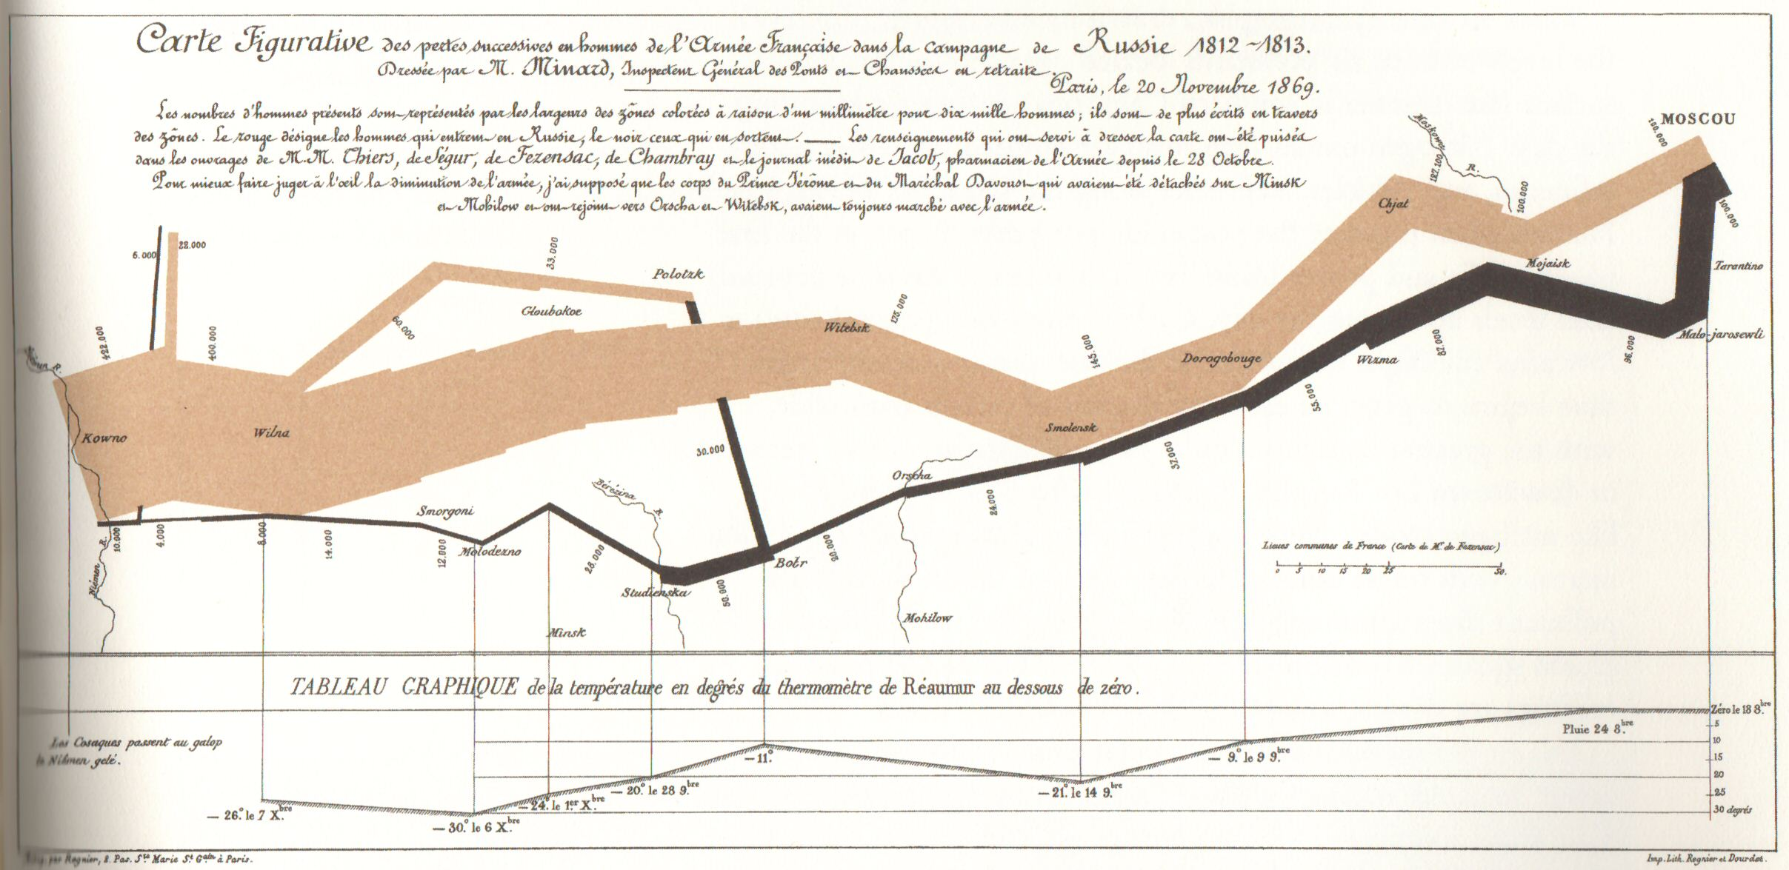
[Edward Tufte, The Visual Display of Quantitative Information ]

Slide 45
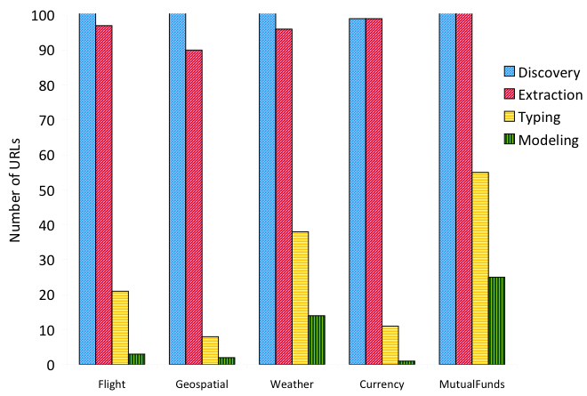
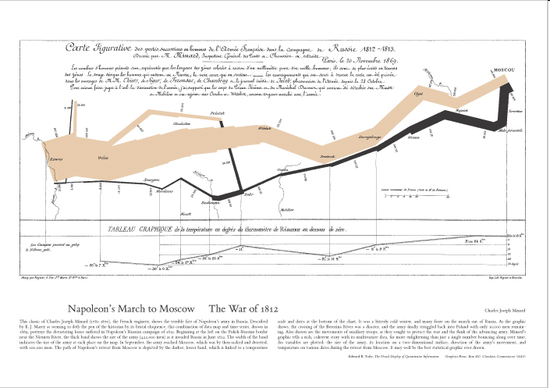
Candidate Sources after Each Step
Notes:
45

Slide 46
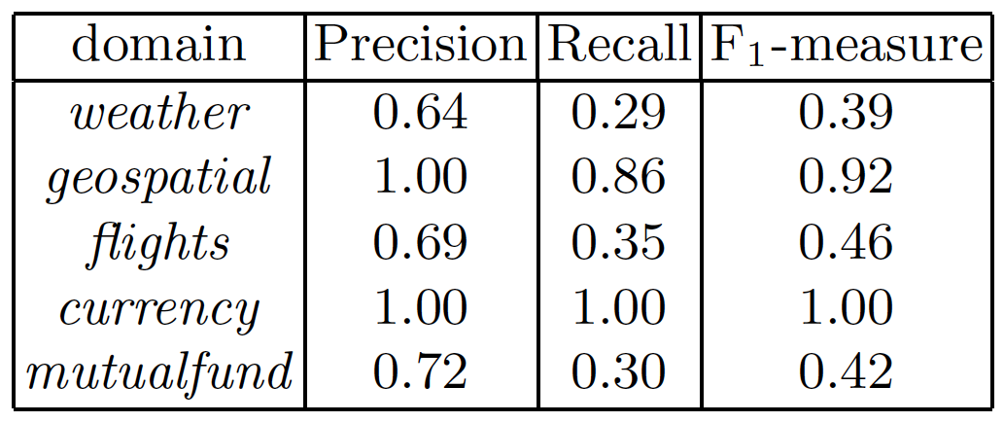
Evaluation of the Models
Notes:
46

Slide 47
Conclusions
Integrated approach to learning:
How to invoke a web service
The semantic types of the output
A definition of what the service does
Provides an approach to generate source descriptions for the Semantic Web
Little motivation for providers to annotate services
Instead we generate metadata automatically
Also provides an approach to automatically discover new sources of data

