Slide 2
2018학년도 1학기 산업수학 및 실습
A Mathematical Model of
Fetal Heart Circulation
6조
201410335 국승호
201513208 양다은
201710285 김희정
201710304 정창해

Slide 3



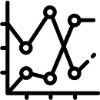

Index
STEP. 5
References
STEP. 3
Modeling
&
Analysis
STEP. 1
Introduction
STEP. 4
Results
&
Discussion
STEP. 2
Assumptions

Slide 4
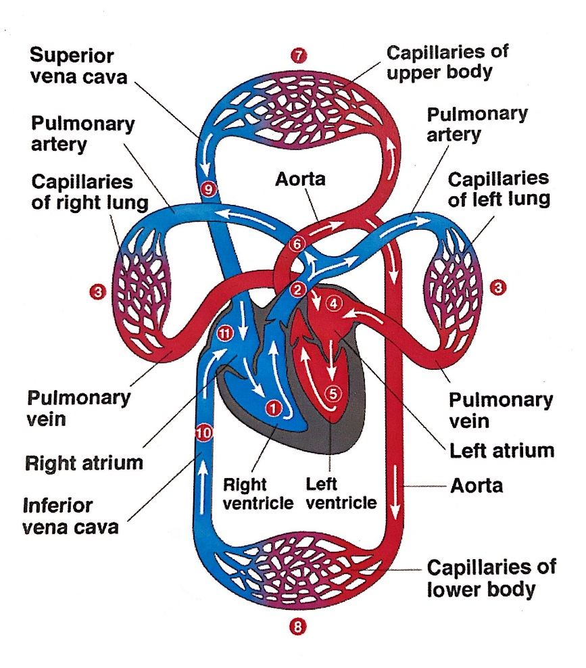
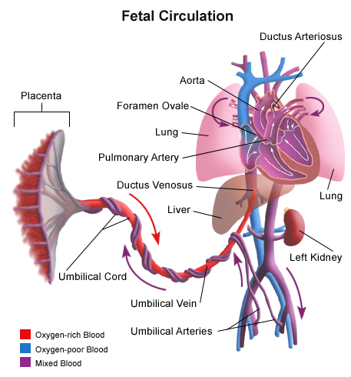
01
Introduction
출처 : Stanford Children’s Health

Slide 5
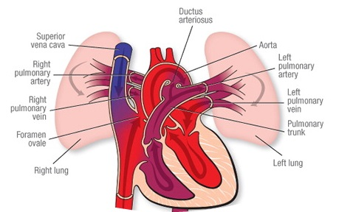
01
Introduction
출처 : American Heart Association

Slide 6
02
Assumptions
태아는 3kg이고 임신 37~38주차 상태이다.
피의 흐름에 관해서는 ohm’s law, volume conservation, compliance
3가지를 사용한다.
난원공을 통한 흐름은 우심방을 통하지 않고 바로 좌심방으로 가는 것으로
가정한다.
각 심방과 심실을 하나로 본다.
양과 인간의 태아의 심장 순환이 유사하다고 가정한다.

Slide 7
03
Modeling & Analysis
목표
태아의 심장 순환 모델 구축.

Slide 8
03
Modeling & Analysis
Compartments
FPL : fetal-side placenta
UV : umbilical vein
IVC : inferior vena cava
RA : right atrium
LA : left atrium
AA : ascending aorta
SVC : superior vena cava
PA : pulmonary artery
DA : descending aorta
UB : upper body
LB : lower body
BR : brain
HE : liver
IN : intestines
MY : myocardium
PV : pulmonary vein
참고 : F. J. Huikeshoven, I. D. Hope, G. G. Power, R. D. Gilbert and L. D. Longo. (1985)
Mathematical model of fetal circulation and oxygen delivery.

Slide 9
03
Modeling & Analysis
Parameters Compliance(ml/mmHg)
Parameter | 값 | Parameter | 값
AA | 0.07 | LB | 1.4
BR | 0.6 | MY | 0.25
DA | 0.14 | PA | 0.25
FPL | 1.4 | PV | 0.25
HE | 3.0 | RA | 1
IN | 0.25 | SVC | 0.1
IVC | 0.2 | UB | 0.9
LA | 1 | UV | 0.3
출처 : F. J. Huikeshoven, I. D. Hope, G. G. Power, R. D. Gilbert and L. D. Longo. (1985)
Mathematical model of fetal circulation and oxygen delivery.

Slide 10
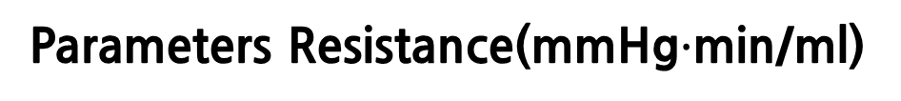
03
Modeling & Analysis
Parameters Resistance(mmHg$∙$min/ml)
Parameter | 값 | Parameter | 값
AA-BR | 0.6 | DA-IN | 0.577
AA-DA | 0.0067 | DA-LB | 0.144
AA-MY | 0.6 | FPL-UV | 0.0091
AA-UB | 0.125 | HE-IVC | 0.0086
BR-IVC | 0.7 | IN-HE | 0.116
BR-SVC | 0.08 | IVC-LA | 0.00357
DA-FPL | 0.053 | IVC-RA | 0.00204
DA-HE | 1.36 | LB-IVC | 0.0208
출처 : F. J. Huikeshoven, I. D. Hope, G. G. Power, R. D. Gilbert and L. D. Longo. (1985)
Mathematical model of fetal circulation and oxygen delivery.

Slide 11
03
Modeling & Analysis
Parameters Resistance(mmHg$∙$min/ml)
Parameter | 값 | Parameter | 값
LB-SVC | 0.15 | UB-SVC | 0.017
MY-RA | 0.17 | UV-HE | 0.027
PA-DA | 0.004 | UV-IVC | 0.0355
PA-PV | 0.412 | LA-AA | 0.0813
PV-LA | 0.122 | RA-PA | 0.0551
SVC-LA | 0.04
SVC-RA | 0.0029
UB-IVC | 0.15
출처 : F. J. Huikeshoven, I. D. Hope, G. G. Power, R. D. Gilbert and L. D. Longo. (1985)
Mathematical model of fetal circulation and oxygen delivery.

Slide 12
03
Modeling & Analysis
Parameters P(0)(mmHg)
Parameter | 값 | Parameter | 값
AA | 49.4 | LB | 10.0
BR | 9.9 | MY | 14.1
DA | 48.5 | PA | 51.6
FPL | 20 | PV | 14.5
HE | 8.1 | RA | 4.2
IN | 14.9 | SVC | 5.1
IVC | 5.1 | UB | 10.1
LA | 3.6 | UV | 15.1
출처 : F. J. Huikeshoven, I. D. Hope, G. G. Power, R. D. Gilbert and L. D. Longo. (1985)
Mathematical model of fetal circulation and oxygen delivery.

Slide 13















03
Modeling & Analysis
$R_{7}, Q_{7}$(t)
$R_{6}, Q_{6}$(t)
SVC
UB
AA
$R_{8}, Q_{8}$(t)
$R_{9}, Q_{9}$(t)
$R_{5}, Q_{5}$(t)
$R_{2}, Q_{2}$(t)
$R_{3}, Q_{3}$(t)
$R_{4}, Q_{4}$(t)
UV
IVC
RA
LA
$R_{10}, Q_{10}$(t)
$R_{15}, Q_{15}$(t)
FPL
LB
$R_{11}, Q_{11}$(t)
$R_{14}, Q_{14}$(t)
$R_{1}, Q_{1}$(t)
$R_{13}, Q_{13}$(t)
DA
PA
$R_{12}, Q_{12}$(t)
참고 : F. J. Huikeshoven, I. D. Hope, G. G. Power, R. D. Gilbert and L. D. Longo. (1985)
Mathematical model of fetal circulation and oxygen delivery.

Slide 14

03
Modeling & Analysis
C = $\frac{∆V}{∆P}$ = $\frac{ \frac{dV}{dt} }{ \frac{dP}{dt} }$
$⇨$ $\frac{dP}{dt}$ = $\frac{1}{C}$ $\frac{dV}{dt}$
= $\frac{1}{C}$ ($Q_{in} − Q_{out}$ )

Slide 15
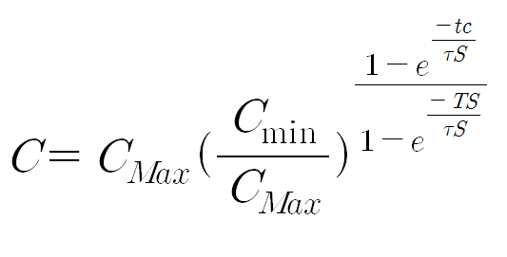
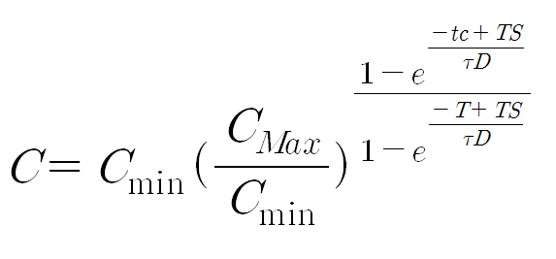

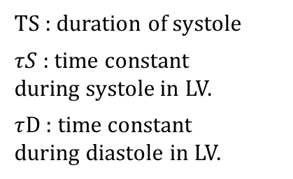
03
Modeling & Analysis
(tc<TS)
TS : duration of systole
$τS$ : time constant
during systole in LV.
$τ$D : time constant
during diastole in LV.
(tc$≥$TS)
출처 : Frank C. Hoppensteadt and Vharles S. Peskin.
Modeling and simulation in Medicine and the life sciences second edition

Slide 16

03
Modeling & Analysis
C4, C5(Max, min)
출처 : E. Jung. “Optimal Cardiopulmonary Resuscitation Technique Depending on Body Size”.
Applied Mathematics and Computation. (2012) pp.9615-9622

Slide 17

03
Modeling & Analysis
% dP1/dt
A(1,1) = C1 + dt *(1/R1 + 1/R2);
A(1,2) = -dt/R2;
A(1,3) = 0;
A(1,4) = 0;
A(1,5) = 0;
A(1,6) = 0;
A(1,7) = 0;
A(1,8) = 0;
A(1,9) = 0;
A(1,10) = -dt/R1;
A(1,11) = 0;

Slide 18
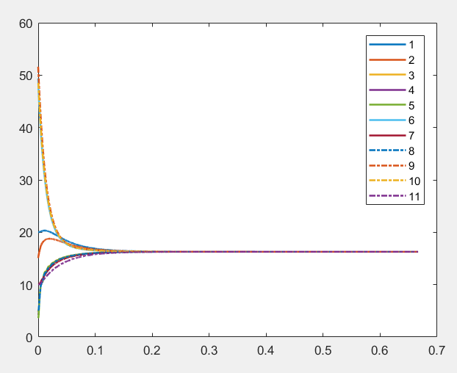
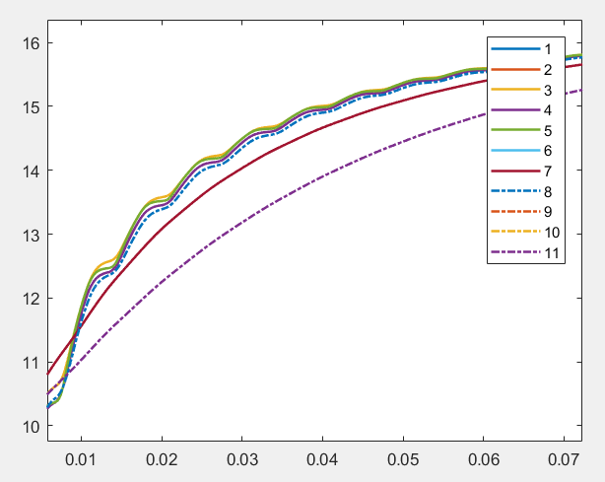
03
Modeling & Analysis

Slide 19
03
Modeling & Analysis
UB
AA
BR
MY
IN
PA
PV
DA
LB
FPL
HE
SVC
LB
RA
LA
IVC
HE LB UV

Slide 20
PA AA
DA
FPL
HE
IN
LB
BR
UB
UV
IVC
UB
RA
BR
SVC
RA
LA
참고 : F. J. Huikeshoven, I. D. Hope, G. G. Power, R. D. Gilbert and L. D. Longo. (1985)
Mathematical model of fetal circulation and oxygen delivery.

Slide 21
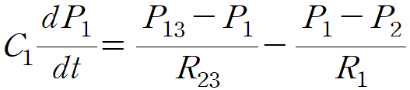
03
Modeling & Analysis
% dP1/dt
A(1,1) = C1 + dt * (1/R23 + 1/R1);
A(1,2) = -dt/R1;
A(1,3) = 0;
A(1,4) = 0;
A(1,5) = 0;
A(1,6) = 0;
A(1,7) = 0;
A(1,8) = 0;
A(1,9) = 0;
A(1,10) = 0;
A(1,11) = 0;
A(1,12) = 0;
A(1,13) = -dt/R23;
A(1,14) = 0;
A(1,15) = 0;
A(1,16) = 0;

Slide 22
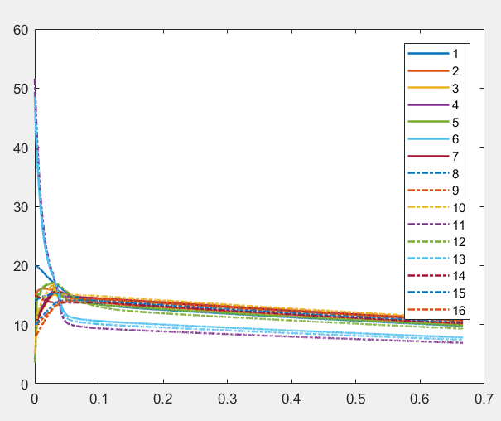
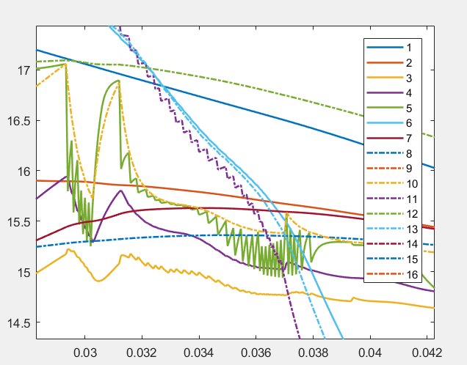
03
Modeling & Analysis

Slide 23
04
Results & Discussion
Parameter가 steady state에서의 자료
자료 한계
Compliance

Slide 24
05
References
F. J. Huikeshoven, I. D. Hope, G. G. Power, R. D. Gilbert and L. D. Longo. (1985) Mathematical model of fetal circulation and oxygen delivery. Am J Physiol Regulatory Integrative Comp Physiol 249 : pp. 192-202.
Frank C. Hoppensteadt and Vharles S. Peskin. (2001) Modeling and simulation in Medicine and the life sciences second edition. Springer-Verlag. p.46
E. Jung. “Optimal Cardiopulmonary Resuscitation Technique Depending on Body Size”. Applied Mathematics and Computation. (2012) pp.9615-9622
(이미지)
Stanford Children’s Health. “fetal circulatory system”, http://www.stanfordchildrens.org/en/topic/default?id=blood-circulation-in-the-fetus-and-newborn-90-P02362 (2018. 6. 4)
American Heart Association. “fetal circulation”, http://www.heart.org/HEARTORG/Conditions/CongenitalHeartDefects/SymptomsDiagnosisofCongenitalHeartDefects/Fetal-Circulation_UCM_315674_Article.jsp#.WxpcN9Uza70 (2018. 6. 8)

Slide 25
Thank you!

Slide 26
Q & A

