Slide 1
Mérés: loss_valid görbére

Slide 2
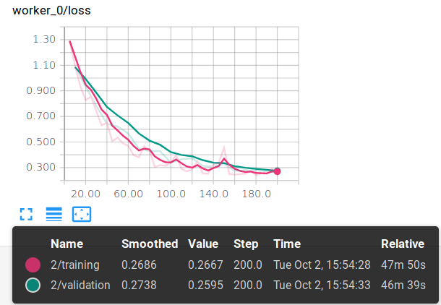
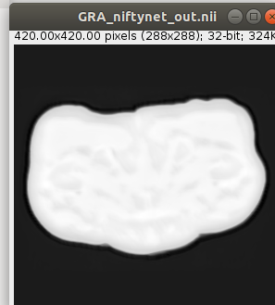
1 Training=12 (CHA..WEB) Validació=2 (NAR,RAN) Inference=1 (GRA) Iter_num=200 Training:0.26 Validation:0.25
scaling_percentage=(-10.0, 10.0) random_flipping_axes= 0,1
autocontext

Slide 3
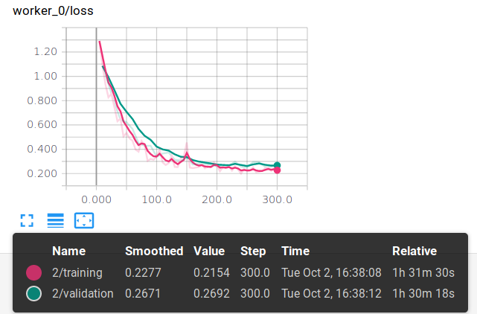
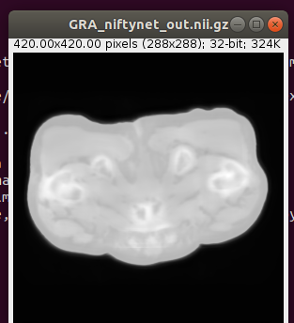
1 Training=12 Validació=2 Inference=1 (GRA) Iter_num=300 Training:0.21 Validation:0.26
scaling_percentage=(-10.0, 10.0) random_flipping_axes= 0,1
autocontext

Slide 4
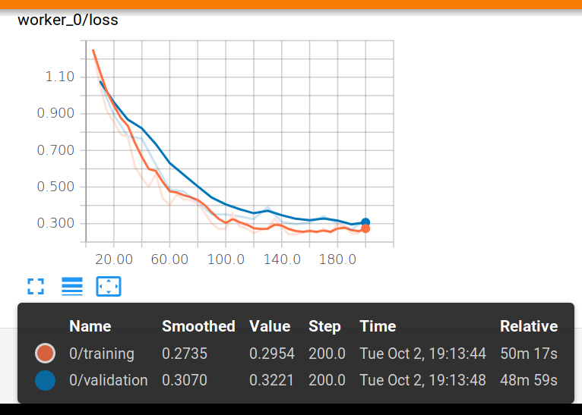
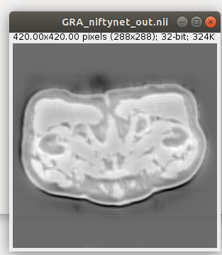
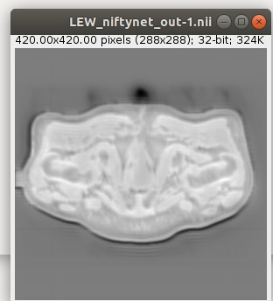
2 Training=11 Validáció=2 Inference=2 GRA,LEW Iter_num=200 Training: 0.29 Validation: 0.32
scaling_percentage=(-10.0, 10.0) random_flipping_axes= 0,1
autocontext

Slide 5
Training=11 Validáció=2 Inference=2 GRA,LEW Iter_num=200 Training: 0.29 Validation: 0.32
autocontext

Slide 6
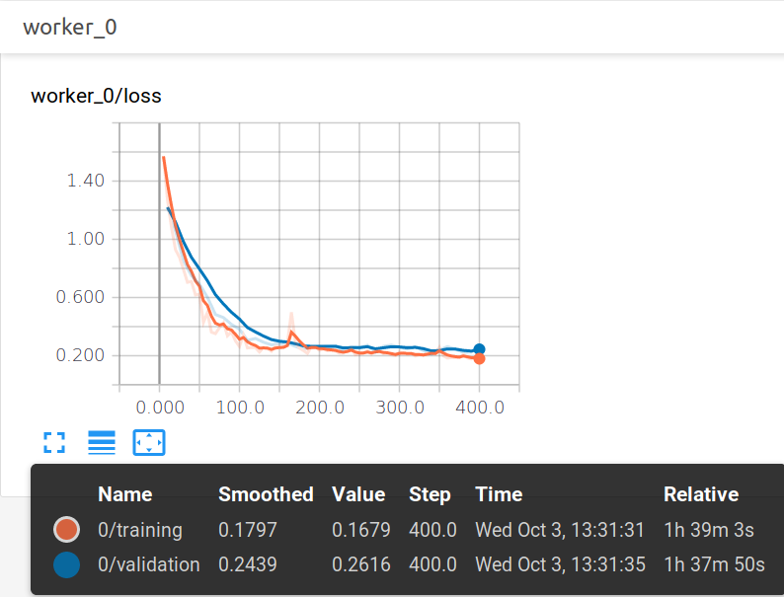
3 Training=12 Validáció=2 Inference=1 GRA,LEW Iter_num=400
scaling_percentage=(-20.0, 20.0) random_flipping_axes= 0,1
autocontext

Slide 7

4 Training=11 Validáció=2 Inference=2 GRA,LEW Iter_num=400
scaling_percentage=(-20.0, 20.0) random_flipping_axes= 0,1
autocontext

Slide 8
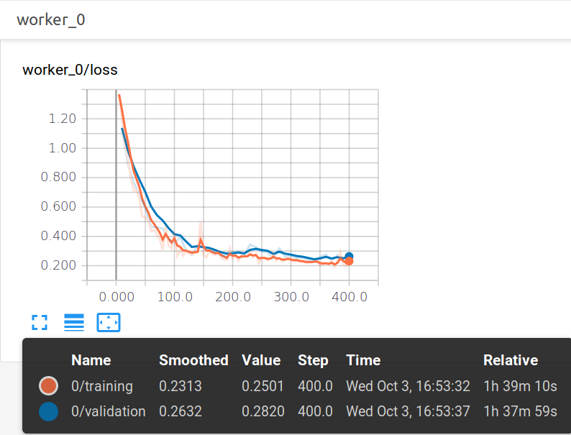
5 Training=12 Validáció=2 Inference=1 GRA Iter_num=400
scaling_percentage=(-30.0, 30.0) random_flipping_axes= 0,1
autocontext

Slide 9
6 Training=12 Validáció=2 Inference=2 GRA,LEW Iter_num=400
scaling_percentage=(-30.0, 30.0) random_flipping_axes= 0,1
autocontext

Slide 10
Training=11 Validáció=2 Inference=2 GRA,LEW Iter_num=200 Training: 0.29 Validation: 0.32
autocontext

