Slide 1
Century 4.0 to DailyDayCent
Cindy Keough
04/05/2010
Code changes
Parameter file changes
convert100 utility
Need more help?

Slide 2
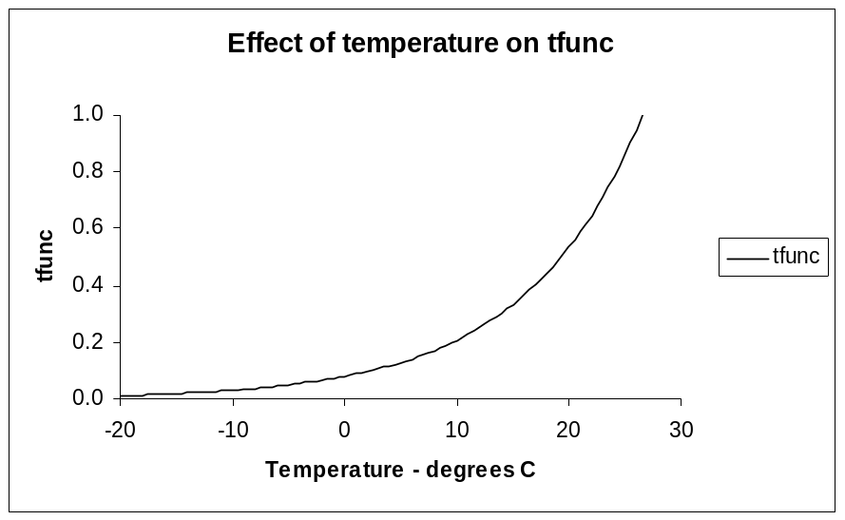
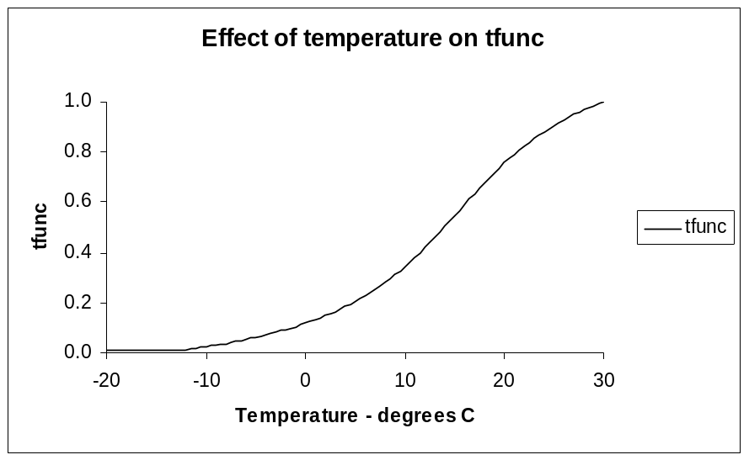
Code changes
All of the significant code modifications and changes to the input parameters in the *.100 and schedule files are documented in the DailyDayCent.Instructions.txt file.
Temperature Curve Change
DailyDayCent is computing the temperature effect on decomposition using an arctangent curve. Previous versions of the model used an exponential curve. An addition teff(*) parameter, teff(4), was added to the FIX.100 file to use for parameterizing the temperature curve.
Century 4.0
DailyDayCent

Slide 3
Change in calculation of non-symbiotic soil N fixation
Non-symbiotic soil N fixation is now being computed using annual evapotranspiration in place of precipitation. If the EPNFS(*) parameter values in the <site>.100 file are not modified to accommodate the new equation you will see a big difference in your simulations as the fixation will be very high when using Century 4.0 values for these parameters. The recommended values to use as a starting point for these parameters for a DailyDayCent simulation are:
EPNFS(1) - 30.0000
EPNFS(2) - 0.01000
Runoff now calculated
Runoff is now calculated and subtracted from the total water (precipitation + irrigation) before water is applied. The PRECRO and FRACRO parameters in the <site>.100 file control the amount of rainfall that is lost as runoff.

Slide 4
Phosphorus changes
When running a simulation with phosphorus (NELEM >= 2) a back flow calculation for flowing phosphorus from occluded P to secondary P has been added. An additional input parameter, PSECOC2, was added to the FIX.100 file to parameterize the calculation for this flow.
We have also implemented a check in the code to adjust the C/N ratio of leaves when simulating phosphorus so that the N/P ratio of the leaves does not exceed an observed critical value. The new MAXNP parameter in the TREE.100 file represents this critical value.

Slide 5
Dynamic carbon allocation
In the grassland/crop system the root to shoot carbon allocation can be computed using the Great Plains equation or as a function of soil water and soil nutrient functions. The input parameters in the CROP.100 file for controlling dynamic carbon allocation are FRTCINDX (0, 1, or 2), FRTC(1), FRTC(2), FRTC(3), FRTC(4), FRTC(5), CFRTCN(1), CFRTCN(2), CFRTCW(1), and CFRTCW(2).
In the tree system carbon is allocated to leaves and fine roots first. The allocation to leaves is based on forest type (DECID = 0, 1, or 2) and growing season. For deciduous trees growth occurs only between the months of leaf out and leaf drop. For deciduous and drought deciduous forests all of the C is allocated to leaves during the leaf out period. In tree growth periods that are not identified as leaf out periods carbon is allocated to fine roots first then to leaves, up to a optimum LAI based on large wood biomass. Any leftover C to be allocated after partitioning to leaves and fine roots is then distributed to the woody components, fine branches, coarse roots, and large wood, based on a normalizing of the carbon allocation fractions defined for the tree in the TREE.100 file, FCFRAC(3,*), FCFRAC(4,*), and FCFRAC(5,*). Potential tree production is now controlled by PRDX(2). The new input parameters in the TREE.100 file for controlling dynamic carbon allocation are TFRTCN(1), TFRTCN(2), TFRTCW(1), and TFRTCW(2).

Slide 6
Growing degree day submodel for cropping
If desired, plant growth can be set to occur using a growing degree day submodel. When using the growing degree day submodel the start and end of plant growth will be triggered based on phenology (soil surface temperature, air temperature, and thermal units) rather than hard wired to occur at a specific time by the schedule file.
The FRTCINDX, TMPGERM, DDBASE, TMPKILL, BASETEMP, MNDDHRV, and MXDDHRV parameters in the crop.100 file control the growing degree day submodel implementation.
The plant functional types that can be simulated using the growing degree day submodel are perennials, non-grain filling annuals, grain filling annuals, and grain filling annuals that require a vernalization period.
When simulating plant growth using the growing degree day submodel it will still be necessary to include FRST/PLTM, SENM/HARV events in your schedule file, however, the timing of these events will occur based on phenology.

Slide 7
Growing degree day submodel for cropping
If simulating a perennial a FRST will occur if the surface temperature is greater than or equal to TMPGERM for the current crop option and a FRST event was scheduled prior to the current simulation day. A SENM event will occur in one of two cases:
1) if the number of thermal units that have accumulated since the FRST event
are greater than or equal to DDBASE for the current crop option and a
SENM event was scheduled prior to the current simulation day
or
2) if the minimum temperature is less than or equal to TMPKILL for the current
crop option and a SENM event was scheduled prior to the current simulation
day.
If a FRST does not occur in a given simulation year then a SENM will not occur in that simulation year.

Slide 8
Growing degree day submodel for cropping
If simulating a non-grain filling annual, a grain filling annual, or a grain filling annual requiring a vernalization period a PLTM will occur if the surface temperature is greater than or equal to TMPGERM for the current crop option and a PLTM event was scheduled prior to the current simulation day. A HARV event will occur in one of two cases:
1) for crop type 4 if the number of thermal units that have accumulated
since the PLTM event are greater than or equal to DDBASE for the current
crop option and a HARV event was scheduled prior to the current simulation
day, for crop types 5 or 6 if the number of thermal units that have accumulated
since the PLTM event are greater than or equal DDBASE+MXDDHRV for the
current crop option and a HARV event was scheduled to occur prior to the
current simulation day or if the crop has reached anthesis (DDBASE) and
drought stress occurs and a HARV event was scheduled to occur prior to the
current simulation day
or
2) if the minimum temperature is less than or equal to TMPKILL for the current
crop option and a HARV event was scheduled prior to the current simulation
day.
If a PLTM does not occur in a given simulation year then a HARV will not occur
in that simulation year.

Slide 9
Growing degree day submodel for cropping
The triggering of a SENM/HARV event due to a killing frost (minimum temperature <= TMPKILL) will not occur until at least 1/2 of the thermal units for the current crop have been accumulated based on the DDBASE parameter value for the current crop.
When simulating an annual crop that requires a vernalization period the degree day accumulator will not start accumulating until the simulation has passed through the vernalization period. This will occur when the number of hours in the day is increasing (end of December in the northern hemisphere or end of June in the southern hemisphere).
Note: When using the growing degree day submodel a SENM or HARV event will automatically trigger a LAST event, therefore a LAST event should not be included when creating a schedule file for a plant that will be grown using the growing degree implementation.

Slide 10
Changes made when working with the savanna submodel
The SITPOT variable value is now dynamic and is computed as a function of annual precipitation. For tuning purposes the SITPOT parameter value read from the TREE.100 file for the current tree will be used as a multiplier on the computed SITPOT value.
Volatilization loss that occurs as a function of gross mineralization is affected by soil texture. The value for VLOSSG is computed as a function of soil texture based on clay content. For tuning purposes the VLOSSG parameter value as read from the FIX.100 file will be used as a multiplier on the computed VLOSSG value.
We have also modified the way that the tree basal area is being calculated. The recommended parameter setting for the BASFCT parameter in the TREE.100 file for use by the new equation is 1.0.
The VOLPL and VOLPLA output variables now include the N that is volatilized from excreted animal waste
In the grazing subroutine we are now calculating the amount of N that is volatilized from excreted faeces and urine. This volatilized N is added to the VOLPL and VOLPLA output variables.

Slide 11
Grazing change
The GRET(1) parameter from the GRAZ.100 file is no longer being used. The value for GRET(1) now being used in the model equations is calculated based on soil texture so that the fraction of consumed N that is returned is now a function of clay content.
Fire code changes for charcoal
There have been changes to fire code so that burning of dead fine branches and dead large wood occurs as a FIRE event rather than a TREM event. The carbon from the burning of aboveground material (live shoots, standing dead, and litter), the dead fine branches, and dead large wood can be returned to the system as charcoal in the passive SOM pool.
Removal, by burning, of dead fine branches and dead large wood will no longer be done with a TREM event but will occur as a result of a FIRE event. A TREM fire event (EVNTYP = 1) will burn only live leaves, live fine branches, and live large wood. A TREM cutting, windstorm or other non-fire event (EVNTYP = 0) will remove dead fine branches and dead large wood in the same manner as Century 4.0.
Bottom line, to burn all of the forest components in DailyDayCent you need to have both a FIRE and a TREM event in your schedule file.

Slide 12
pH effect on decomposition
A pH effect multiplier has been added to the decomposition equations. There are three equations used to simulate bacterial, fungi, and combination pH effects on decomposition flows. Bacterial pH effect on decomposition is computed for the SOM1C(2), METABC(1), and METABC(2) pools. Fungi pH effect on decomposition is computed for the SOM2C and SOM3C pools. The pH effect on decomposition for the SOM1C(1), STRUCC(1), STRUCC(2), WOOD1C, WOOD2C, and WOOD3C pools is computed as a combination effect.
The user also has the ability to simulate a shift in soil pH content if desired. This is implemented with a change in the schedule file. If the value for PHSYS as read from the schedule file is set to 1 then the next line in the schedule file contains the start year for the pH shift. The optional multipliers on pH, contained in the input file phscale.dat, are used to scale the amount of pH up or down as desired.

Slide 13
Potential production calculation change
Potential production is now taking into account the photo period effect on growth. In the fall, when the day length is decreasing, growth will slow down. The definitions for PRDX(1), CROP.100, and PRDX(2), TREE.100, have been changed. These parameters now represent the coefficient used when calculating the potential production as a function of solar radiation outside of the atmosphere.
Potential grass/crop production is now being computed in the same manner as potential forest production using an estimate for total production rather than estimating potential aboveground production only. The allocation of aboveground to belowground production for the grass/crop is now based on the fraction of root carbon rather than the root to shoot ratio.
We recommend using a value of 0.5 for PRDX(1) and PRDX(2) as a starting point when modifying Century 4.0 CROP.100/TREE.100 files for use with DailyDayCent.
Irrigation change
Irrigation will be allowed to occur even on days when the temperature is below freezing. This change was made to allow an irrigated system to reach anaerobic conditions even if the temperature is low.

Slide 14
Changes in snow routines
The snow submodel has been modified so that order of events for snow has been changed from accumulate, melt, sublimate to accumulate, sublimate, melt.
We have also added a solar radiation effect to the snow melt equation. This will require you to modify the value of TMELT(2) in your FIX.100 file from the value used by earlier versions of the model. We recommend using a default value of 0.002 for this parameter.
User specified temperatures for leaf out and leaf drop in deciduous trees
There have been two additional variables added to the TREE.100 file to allow the user to specify the temperature values for controlling leaf out, TMPLFS, and leaf drop, TMPLFF, for the specified tree. These temperature values are in degrees C.
Change in PET calculation
The PET calculation is now taking into account solar radiation outside of the atmosphere and an approximated cloud cover based on temperature range. As a result of this change the FWLOSS(4) parameter in the FIX.100 file needs to be rescaled. A default value of 0.8 is now recommended for this parameter.

Slide 15
Dynamic value for NLAYPG
The amount of soil water and mineral N, P, and S that is available for plant growth is now based on a dynamic NLAYPG value. Each crop and tree option will have a specific NLAYPG value assigned to them in the CROP.100 (CLAYPG) and TREE.100 (TLAYPG) files. Any time a crop and/or tree option is changed the value for NLAYPG will be recomputed. In a grassland system the value for NLAYPG will be based on the CLAYPG value read for the current crop option from the CROP.100 file. In a forest system the value for NLAYPG will be based on the TLAYPG value read for the current tree option from the TREE.100 file. In a savanna system the value for NLAYPG will be weighted based on the crop/grass LAI, tree LAI, and the CLAYPG and TLAYPG values.
The new NLAYPG value is also used for computing transpiration. Transpiration will occur from the top NLAPYG layers in the soil profile rather than from the full soil profile.
The NLAYPG value from the <site>.100 file is no longer being used.

Slide 16
Soil warming experiments can now be simulated
The soil surface temperature warming option allows the user to simulate experiments where the soil surface temperature is warmed without an increase in the minimum and maximum air temperature values.
Added an option to allow the use of scalars on the N inputs
The optional multiplier on N inputs can be used to scale the amount of fertilizer added through FERT events, the amount of atmospheric N deposition, or both.
Added an option to allow the use of scalars on the OMAD inputs
The optional multiplier on OMAD inputs can be used to scale the amount of organic matter added through OMAD events.
Added an option to allow the use of scalars on climate
The optional scalars on the weather file inputs can be used to simulate climate change scenarios. The scalars can be used for modifying maximum temperature, minimum temperature, maximum and minimum temperature, precipitation, or maximum and minimum temperature and precipitation. The temperature scalars are addends and the precipitation scalars are multipliers.

Slide 17
Fractional volume of rock used to modify field capacity and wilting point
The ROCK parameter has been added to the <site>.100 file and will be used for modifying the AFIEL(*) and AWILT(*) values when SWFLAG is not equal to 0. Set this parameter value to 0.0 to run a simulation with no rock effect on field capacity and wilting point values.
Automatic fertilization
Automatic fertilization was not working correctly in earlier versions of Century. Alister Metherell's modifications for the implementing the automatic fertilization option were added to DailyDayCent.
Maintenance respiration
In addition to heterotrophic respiration from decomposition, RESP(1), DailyDayCent includes submodels to simulate maintenance respiration. A user defined portion of net primary production, NPP, is allocated to the maintenance respiration pool. This pool supplies C for maintenance respiration for above and belowground plant compartments. Respiration for each plant compartment is a function of the mass of the compartment, soil or air temperature, and a user defined maximum respiration parameter.

Slide 18
More options added to fertilizer parameterizations
We have added the ability to simulate reduction factor on nitrification when fertilizing. A new parameter, NINHIB, added to the FERT.100 file represents a reduction factor on nitrification rates due to nitrification inhibitors added to the
site with the fertilizer. This parameter value is used as a multiplier in the calculation of the nitrification rate. A value of 1.0 for this parameter will have no effect on the nitrification rate. The reduction in nitrification rate will linger for one month after the fertilizer application.
Each fertilizer option in the FERT.100 file now has the fraction of NH4 and NO3 in the fertilzer defined. Two new parameters, FRAC_NH4 and FRAC_NH3, represent the fraction of NH4 (ammonium) and fraction of NH3 (nitrate) in the fertilzer respectively. The fraction of N fertilizer that is ammonimum and the fraction of N fertilizer that is nitrate values should sum to 1.0.

Slide 19
Optional input files for DailyDayCent
nscale.dat - The optional multipliers on N inputs contained in this file can be used to scale the amount of fertilizer added through FERT events, the amount of atmospheric N deposition, or both.
omadscale.dat - The optional multiplier on OMAD inputs contained in this file can be used to scale the amount of organic matter added through OMAD events.
phscale.dat - The optional multipliers that can be used to scale pH.
tmaxscale.dat - The optional addends that can be used to scale maximum temperature values.
tminscale.dat - The optional addends that can be used to scale minimum temperature values.
precscale.dat - The optional multiplier that can be used to scale precipitation values.
All of these files are organized in 13 columns. Column 1 is the simulation year. Columns 2 - 13 contain the scalars.

Slide 20
CROP.100 parameter file changes
The CROP.100 file used by DailyDayCent has 30 additional parameters.
CLAYPG
NO3PREF(1)
Parameters used in the new dynamic carbon allocation routines.
FRTCINDX FRTC(4) FRTC(5)
CFRTCN(1) CFRTCN(2)
CFRTCW(1) CFRTCW(2)
Parameters used in the new maintenance and growth respiration routines.
KMRSP(1) CKMRSPMX(1) CKMRSPMX(2) CKMRSPMX(3)
CGRESP(1) CGRESP(2) CGRESP(3)
Parameters used in the growing degree day implementation.
TMPGERM DDBASE TMPKILL
BASETEMP(1) MNDDHRV MXDDHRV
BASETEMP(2)
Parameters used in the som2 split routines.
FLIGNI(1,3) FLIGNI(2,3) CMIX
Parameters used in the juvenile/mature fine root split routines.
RDRJ RDRM RDSRFC MRTFRAC CMXTURN
Note: RDRJ has replaced RDR

Slide 21
FERT.100 parameter file changes
The FERT.100 file used by DailyDayCent has 4 additional parameters.
NINHIB
NINHTM
FRAC_NH4
FRAC_NO3
FIRE.100 parameter file changes
The FIRE.100 file used by DailyDayCent has 11 additional parameters and
3 parameters that have had their "names" changed.
FDFREM(3) FDFREM(4)
FRET(1,1) FRET(1,2) FRET(1,3) FRET(1,4)
FRET(2,1) FRET(2,2) FRET(2,3) FRET(2,4)
FRET(3,1) FRET(3,2) FRET(3,3) FRET(3,4)
NOTE: FRET(1,2) replaces FRET(1), FRET(1,3) replaces FRET(2), and FRET(1,4) replaces FRET(3).

Slide 22
FIX.100 parameter file changes
The FIX.100 file used by DailyDayCent has 22 additional parameters.
DEC5(1) P2CO2(1) PSECOC2 TEFF(4)
PCEMIC1(1,1) PCEMIC1(1,2) PCEMIC1(1,3)
PCEMIC1(2,1) PCEMIC1(2,2) PCEMIC1(2,3)
PCEMIC1(3,1) PCEMIC1(3,2) PCEMIC1(3,3)
VARAT21(1,1) VARAT21(1,2) VARAT21(1,3)
VARAT21(2,1) VARAT21(2,2) VARAT21(2,3)
VARAT21(3,1) VARAT21(3,2) VARAT21(3,3)
The following fix.100 parameters have been renamed:
DEC5 → DEC5(2) P2CO2 → P2CO2(2) PSECOC → PSECOC1
PCEMIC(1,1) → PCEMIC2(1,1) PCEMIC(1,2) →PCEMIC2(1,2)
PCEMIC(1,3) → PCEMIC2(1,3) PCEMIC(2,1) →PCEMIC2(2,1)
PCEMIC(2,2) → PCEMIC2(2,2) PCEMIC(2,3) →PCEMIC2(2,3)
PCEMIC(3,1) → PCEMIC2(3,1) PCEMIC(3,2) →PCEMIC2(3,2)
PCEMIC(3,3) → PCEMIC2(3,3) VARAT2(1,1) →VARAT22(1,1)
VARAT2(1,2) →VARAT22(1,2) VARAT2(1,3) →VARAT22(1,3)
VARAT2(2,1) →VARAT22(2,1) VARAT2(2,2) →VARAT22(2,2)
VARAT2(2,3) →VARAT22(2,3) VARAT2(3,1) →VARAT22(3,3)
VARAT2(3,2) →VARAT22(3,3) VARAT2(3,3) →VARAT22(3,3)

Slide 23
FIX.100 parameter file changes (continued)
DailyDayCent uses 4 coefficients in the equation for computing the temperature effect on decomposition. The TEFF(4) parameter is added to give us the additional coefficient required to parameterize the temperature equation.
The PET calculation is now taking into account solar radiation outside of the
atmosphere and an approximated cloud cover based on temperature range. As a
result of this change the FWLOSS[4] parameter in the FIX.100 file needs to be
rescaled.
Due to the changes in the snow melting equation the TMELT(*) parameters need to be rescaled. Recommended values are TMELT(1) = 0.0 and
TMELT(2) = 0.002.
The VLOSSG parameter is now dynamic and will be computed as a function of soil texture based on clay content. The VLOSSG parameter value read from the
FIX.100 file is used as a multiplier for tuning this equation.

Slide 24
TREE.100 parameter file changes
The TREE.100 file used by DailyDayCent has 15 additional parameters.
TLAYPG MAXNP
NO3PREF(2)
Parameters used in the new dynamic carbon allocation routines.
TFRTCN(1) TFRTCN(2)
TFRTCW(1) TFRTCW(2)
Parameters used in the new maintenance and growth respiration routines.
KMRSP(2)
FKMRSPMX(1) FKMRSPMX(2) FKMRSPMX(3)
FKMRSPMX(4) FKMRSPMX(5) FKMRSPMX(6)
FGRESP(1) FGRESP(2) FGRESP(3)
FGRESP(4) FGRESP(5) FGRESP(6)
Parameters used for phenology implementation.
TMPLFF TMPLFS WDGRWM
Parameters used in the som2 split routines.
TMIX
Parameters used in the juvenile/mature fine root split routines.
WDLIG(6) WOODDR(6) WRDSRFC WMRTFRAC TXMTURN

Slide 25
<site>.100 parameter file changes
There have been 8 parameters added to this file.
ROCK
PRECRO FRACRO
The following parameters have been added for the som2 split implementation.
SOM2CI(1,1) SOM2CI(1,2)
RCES2(1,1) RCES2(1,2) RCES2(1,3)
The following parameters have been renamed for the som2 split implementation.
SOM2CI(1) → SOM2CI(2,1)
SOM2CI(2) → SOM2CI(2,2)
RECES2(1) → RCES2(2,1)
RECES2(2) → RCES2(2,2)
RECES2(3) → RCES2(2,3)

Slide 26
*.sch (schedule file) changes
The user now has the option of adding comment lines to the top of a schedule file. All of the comment lines must start with a # character and must be stored at the top of the schedule file. There is no blank line permitted between the last comment line and the schedule file header line containing the start year information.
There are several new options that can be turned on/off via the schedule file header.
* shift soil pH
* simulate soil surface temperature warming experiments
* scale N additions, FERT and/or atmospheric N deposition
* scale OMAD additions
* scale climate inputs to simulate climate change scenarios
The scheduling of events is now being done using year and day of year rather than year and month. This means that events can be scheduled to occur on a give day of the year.
The calendar used for scheduling the events is for a non-leap year.

Slide 27
Example 4.0 Schedule file header
1 Starting year
2001 Last year
aridsl.100 Site file name
0 Labeling type
-1 Labeling year
-1.00 Microcosm
-1 CO2 Systems
3 Initial system
JRN Initial crop
THODR Initial tree
Example DailyDayCent schedule file header with all new options turned “on”/ “off”
# comment line 1 1 Starting year
# comment line 2 2001 Last year
1 Starting year aridsl.100 Site file name
2001 Last year 0 Labeling type
aridsl.100 Site file name -1 Labeling year
0 Labeling type -1.00 Microcosm
-1 Labeling year -1 CO2 Systems
-1.00 Microcosm 0 pH effect
-1 CO2 Systems -1 Soil warming
1 pH effect 0 N input scalar option
1990 0 OMAD input scalar option
1 Soil warming 0 Climate scalar option
1990 3 Initial system
0.5 JRN Initial crop
1 N input scalar option THODR Initial tree
1975
1 OMAD input scalar option
1975
5 Climate scalar option
1975
3 Initial system
JRN Initial crop
THODR Initial tree

Slide 28
Century 4.5 FIX.100 parameters that must be modified for use with DailyDayCent
ADEP(1) = 10.0
ADEP(2) = 20.0
ADEP(3) = 15.0
ADEP(4) = 15.0
ADEP(5) = 30.0
ADEP(6) = 30.0
ADEP(7) = 30.0
ADEP(8) = 30.0
ADEP(9) = 30.0
ADEP(10) = 30.0
ANEREF(3) = 1.0
FWLOSS(1) = 1.0
FWLOSS(2) = 1.0
FWLOSS(3) = 1.0
FWLOSS(4) = 0.8
IDEF = 1.0
MINLCH = 2.5
OMLECH(3) = 1.9 (< 2.0)
VLOSSE = 0.0
VLOSSG = 0.0

Slide 29
Century 4.5 <site>.100 parameters that must be modified for use with DailyDayCent
STORMF = 0.0
SWFLAG = 0.0

Slide 30
Notes on Production output variables
The growing season accumulator values for carbon production (ACRCIS(*), AFBCIS(*), AFRCIS(*), AGCACC, AGCISA(*), ALVCIS(*), ALWCIS(*), BGCACC, BGCISA(*), CRTACC, FBRACC, FCACC, FRTACC, PTAGC, PTBGC, RLVACC, RLWACC) and the growing season accumulator values for E uptake (EUPACC(*), EUPAGA(*), EUPBGA(*), and EUPPRT(*,*)) output for the simulation were being reset to 0.0 at the start of the growing season, when a FRST, PLTM, or TFST event occurred. These production output variables would seem to indicate that production was still occurring because the output variables were not set back to zero at the end of a growing season and would retain a constant value until the next FRST, PLTM or TFST event occurred. These accumulators are now being reset to 0.0 at the end of the simulation timestep in which a LAST or TLST event occurs, after the output for the timestep has been saved to the output file.
Century 4.0:
Accumulators reset to 0.0 on FRST, PLTM, or TFST and begin accumulation
DailyDayCent:
Accumulators begin accumulation on FRST, PLTM, or TFST
Accumulators reset to 0.0 on LAST or TLST after output written to file

Slide 31
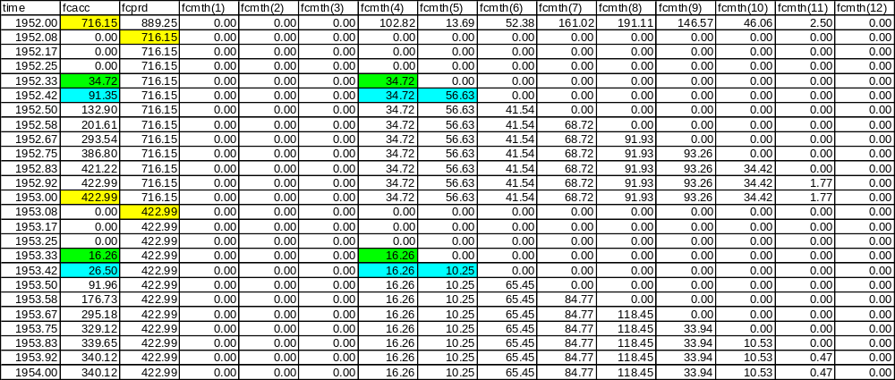
Notes on Production output variables (con’t)
The new growing season production variables, AGCPRD, BGCPRD, CRTPRD, EUPPRD(*), FBRPRD, FCPRD, FRTPRD, RLVPRD, and RLWPRD, are set equal to the value of their associated accumulator variable when a LAST or TLST occurs. These values can be used when examining yearly output to see the amount of production that occurred over the previously completed growing season. These growing season production variables will be set back to zero in January if no production has occurred over the previous 12 month period.

Slide 32
DailyDayCent new *.bin state variables:
CARBOSTG(1,1) CARBOSTG(1,2)
CARBOSTG(2,1) CARBOSTG(2,2)
DCARBOSTG(1) DCARBOSTG(2)
TLITTR(1,1) TLITTR(1,2)
TLITTR(2,1) TLITTR(2,2)
TOTSYSC TOTSYSE(1)
TOTSYSE(2) TOTSYSE(3)
DailyDayCent redefined *.bin state variables:
DEFAC → AGDEFAC
DEFAC → BGDEFAC

Slide 33
DailyDayCent new *.bin accumulator variables:
AGCMTH(12) AGCPRD ANNET CRTPRD
EUPPRD(1) EUPPRD(2) EUPPRD(3) FBRPRD
FCMTH(12) FCPRD FERTAC(1) FERTAC(2)
FERTAC(3) FERTPRD(1) FERTPRD(2) FERTPRD(3)
FERTMTH(12,1) FERTMTH(12,2) FERTMTH(12,3) N2OACC
N2OPRD N2OMTH(12) OMADAC OMADAE(1)
OMADAE(2) OMADAE(3) OMADMTE(12,1) OMADMTE(12,2)
OMADMTE(12,3) OMADMTH(12) OMADPRD OMADPRE(1)
OMADPRE(2) OMADPRE(3) OMADTOT OMAETOT(1)
OMAETOT(2) OMAETOT(3) RESPMTH(1) RESPMTH(2)
RLVPRD RLWPRD RUNOFF SRSPANN(1)
SRSPANN(2) SRSPMTH(1) SRSPMTH(2) STRMAC(1)
STRMAC(2) STRMAC(3) STRMAC(4) STRMAC(5)
STRMAC(6) STRMAC(7) STRMAC(8) TGZRTE(1)
TGZRTE(2) TGZRTE(3) VOLEAC VOLGAC
VOLPAC WD1C2(1) WD1C2(2) WD2C2(1)
WD2C2(2) WD3C2(1) WD3C2(2)
DailyDayCent redefined *.bin accumulator variables:
ADEFAC → AAGDEFAC
ADEFAC → ABGDEFAC

Slide 34
DailyDayCent new *.bin respiration variables:
ARSPMTH(1,1) ARSPMTH(1,2) ARSPMTH(2,1)
ARSPMTH(2,2) CAUTORESP(1) CAUTORESP(2)
CGRSPFLUX(1) CGRSPFLUX(2) CGRSPFLUX(2)
CMRSPFLUX(1) CMRSPFLUX(2) CMRSPFLUX(3)
DAUTORESP(1) DAUTORESP(2) DHETRESP
DSOILRESP FAUTORESP(1) FAUTORESP(2)
FGRSPFLUX(1) FGRSPFLUX(2) FGRSPFLUX(3)
FGRSPFLUX(4) FGRSPFLUX(5) FGRSPFLUX(6)
FMRSPFLUX(1) FMRSPFLUX(2) FMRSPFLUX(3)
FMRSPFLUX(4) FMRSPFLUX(5) FMRSPFLUX(6)
GRSPANN(1) GRSPANN(2) GRSPFLOW(1)
GRSPFLOW(2) GRSPMTH(1) GRSPMTH(2)
MRSPANN(1) MRSPANN(2) MRSPFLOW(1)
MRSPFLOW(2) MRSPMTH(1) MRSPMTH(2)

Slide 35
DailyDayCent new *.bin SOM2 variables:
DSOM2C(1) S2MNR(1,1) S2MNR(1,2) S2MNR(1,3)
SOM2C(1) SOM2CI(1,1) SOM2CI(1,2) SOM2E(1,1)
SOM2E(1,2) SOM2E(1,3)
DailyDayCent renamed *.bin SOM2 variables:
AS21C2 → AS12C AS2C2 → AS22C2
DSOM2C → DSOM2C(2) S21C2(1) → S12C2(1)
S21C2(2) → S12C2(2) S2C2(1) → S22C2(1)
S2C2(2) → S22C2(2) S2MNR(1) → S2MNR(2,1)
S2MNR(2) → S2MNR(2,2) S2MNR(3) → S2MNR(2,3)
SOM2C → SOM2C(2) SOM2C(1) → SOM2CI(2,1)
SOM2C(2) → SOM2CI(2,2) SOM2E(1) → SOM2E(2,1)
SOM2E(2) → SOM2E(2,2) SOM2E(3) → SOM2E(2,3)
DailyDayCent redefined *.bin SOM2 variables:
AS21C2
S21C2(1)
S21C2(2)

Slide 36
DailyDayCent new *.bin fine root split variables:
DBGLIVC DBGLIVCJ DBGLIVCM DELOE
DELOI DFROOTC DFROOTCJ DFROOTCM
DailyDayCent renamed *.bin SOM2 variables:
AFRCIS(1..2) → AFRCISJ(1..2) and AFRCISM(1..2)
BGCACC → BGCJACC and BGCMACC
BGCISA(1..2) → BGCISJA(1..2) and BGCISMA(1..2)
BGCMTH(1..12) → BGCJMTH(1..12) and BGCMMTH(1..12)
BGCPRD → BGCJPRD and BGCMPRD
BGLCIS(1) → BGLCISJ(1) and BGLCISM(1)
BGLCIS(2) → BGLCISJ(2) and BGLCISM(2)
BGLCN → BGLCNJ and BGLCNM
BGLIVC → BGLIVCJ and BGLIVCM
BGLIVE(1..3) → BGLIVEJ(1..3) and BGLIVEM(1..3)
FROOTC → FROOTCJ and FROOTCM
FROOTE(1..3) → FROOTEJ(1..3) and FROOTEM(1..3)
FRTACC → FRTJACC and FRTMACC
FRTCIS(1..3) → FRTCISJ(1..3) and FRTCISM(1..3)
FRTPRD → FRTJPRD and FRTMPRD

Slide 37
Get help
DailyDayCent.Instructions.txt
DailyDayCent_event100_Instructions.txt
Century 4 web site: http://www.nrel.colostate.edu/projects/century
  Century User’s Manual
  Century Tutorial
  Century Parameterization Workbook
  Century Curves Excel Spreadsheet
century@nrel.colostate.edu

