Slide 1
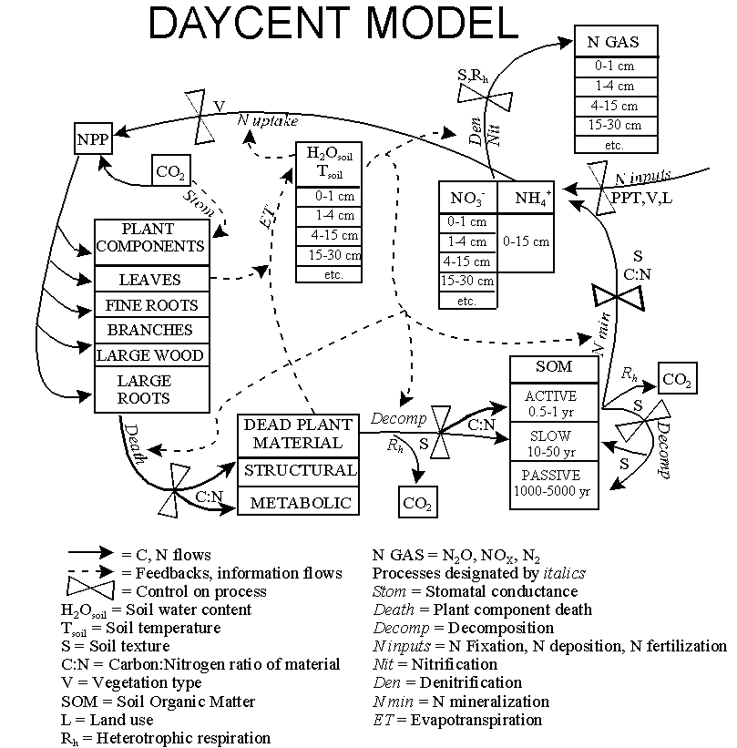
Flow diagram for DAYCENT.

Slide 2
DAYCENT_EVENT100
SCH
FILE
DAYCENT
BIN
FILE
DAYCENT_LIST100
LIS
FILE
DAILY
NFLUX
SUMMARY
CO2
MRESP
SOILN
SOILTAVG
SOILTMAX
SOILTMIN
STEMP_DX
WSWC
WATRBAL
WFLUX
WFPS
BIO
DEADC
LIVEC
SOILC
SYSC
DELS
GRESP
DN2LYR
DN2OLYR
DC_SIP.CSV
TGMONTH
YEAR_SUM
DAILY
WEATHER
SITEPAR
.IN
SOILS
.IN
OUTFILES
.IN
C14.
DAT
<SITE>
.100
CROP
.100
CULT
.100
FERT
.100
FIRE
.100
GRAZ
.100
HARV
.100
IRRI
.100
OMAD
.100
TREE
.100
TREM
.100
FIX
.100
DAYCENT_FILE100

Slide 3
Optional input files for DailyDayCent
nscale.dat - The optional multipliers on N inputs contained in this file can be used to scale the amount of fertilizer added through FERT events, the amount of atmospheric N deposition, or both.
omadscale.dat - The optional multiplier on OMAD inputs contained in this file can be used to scale the amount of organic matter added through OMAD events.
phscale.dat - The optional multipliers that can be used to scale pH.
tmaxscale.dat - The optional addends that can be used to scale maximum temperature values.
tminscale.dat - The optional addends that can be used to scale minimum temperature values.
precscale.dat - The optional multiplier that can be used to scale precipitation values.
All of these files are organized in 13 columns. Column 1 is the simulation year. Columns 2 - 13 contain the scalars.

Slide 4
Data requirements for running the DailyDayCent model
Type of system (grass, crop, savanna, forest)
Daily precipitation (cm)
Daily mean minimum temperature (degrees C)
Daily mean maximum temperatures (degrees C)
Site latitude and longitude (degrees)
Fraction sand, silt, and clay of the mineral soil, by layer (0.0-1.0)
Bulk density of the soil, by layer (g/cm^3)
Rooting depth and root distribution of the vegetation (in cm)
Best estimate of annual wet and dry N deposition
Productivity of vegetation (gC/m^2 per year or growing season)
C:N ratio of above- and belowground vegetation (split into leaves, branches, large wood, fine roots, and coarse roots for trees)
Root to shoot ratio of vegetation (or % allocation of production to leaves, branches, large wood, fine roots, and coarse roots for trees)
Lignin content of vegetation (above- and belowground for grasses; split into leaves, branches, large wood, fine roots, and coarse roots for trees)

Slide 5
Additional data requirements for running the DailyDayCent model
C in the soil organic matter in the top 20cm of soil
N in the soil organic matter in the top 20cm of soil
Do you want to include fire in your simulation of the system?
Is the system tilled?
Is fertilizer added (how many gN/m^2)
Do you want to simulate grazing?
What type of harvest is conducted?
How many cm of water are added through irrigation?
How much and what type of organic amendment is added (manure, fish meal, green manure)?
Is your system flooded at any point during the year?

Slide 6
Block scheduling notes
A block is a series of events which will repeat themselves, in sequence, until the ending time of the block is reached.
One year repeating sequence, e.g. continuous corn, scheduled to occur from years 1971-1990
  Year 1971, grow corn
  Year 1972, grow corn
  …
  Year 1990, grow corn
Two year repeating sequence, e.g. wheat/fallow, scheduled to occur from years 1965-2000
  Year 1965, grow wheat
  Year 1966, fallow
  Year 1967, grow wheat
  Year 1968, fallow
  …
  Year 1999, grow wheat
  Year 2000, fallow

Slide 7
Block scheduling notes, con’t
Five year repeating sequence, e.g. tall grass prairie with burn every 5 years, scheduled to occur from years 1971-2003
  Years 1971, 1972, 1973, 1974, grow grass
  Year 1975, burn scheduled
  Years 1976, 1977, 1978, 1979, grow grass
  Year 1980, burn scheduled
  ...
  Years 1996, 1997, 1998, 1999, grow grass
  Year 2000, burn scheduled
  Years 2001, 2002, 2003 , grow grass
Note that when a block ends prior to the end of the repeating sequence the events that were scheduled to occur in the years that fall outside the period in which the block was scheduled will not be simulated.

Slide 8
Block scheduling notes, con’t
100 year repeating sequence, e.g. forest with burn every 100 years, scheduled to occur from years 1-1990
This “could” be scheduled as a 100 year repeating block but it is easier to created two blocks:
  Block 1, one year repeating sequence of tree growth, scheduled to occur over 99 years
  Block 2, one year repeating sequence of forest fire, scheduled to occur over 1 year
Create the schedule file by alternating the use of these two blocks:
  Years 1-99, Block 1
  Year 100, Block 2
  Years 101-199, Block 1 renumbered as Block 3
  Year 200, Block 2 renumbered as Block 4
  …
  Years 1800-1899, Block 1 renumbered as Block 25
  Year 1900, Block 2 renumbered as Block 26
  Years 1901-1990, Block 1 renumbered as Block 27

Slide 9
DailyDayCent scheduling notes
The scheduling of events is now being done using year and day of year rather than year and month. This means that events can be scheduled to occur in the simulation on a given day of the year.
The calendar used for scheduling the events is for a non-leap year.
Although the events in the simulation are scheduled daily the schedule file is being read monthly. This can cause a problem if you have two or more events of the same type in scheduled to occur within any given month. After the first event is read the any subsequent events of the same type read for the month will overwrite the previously read event with the end result being only the last event for the given event type will occur within the simulation month.

Slide 10
DailyDayCent daily scheduling notes con’t
In the new daily scheduling scheme the following events will have effects that will continue over a 1 month period:
CULT - the multipliers for increased decomposition will be used for one month
EROD - enter the per week amount of erosion, this erosion loss will continue over a
one month period
GRAZ - grazing events will continue for a month and restrictions on production due
to grazing will be effect for one month
IRRI - the amount of specified irrigation will be applied weekly over a 1 month
period, the amount of irrigation that will be applied during a given week will
depend on the fraction of the month that the simulation week represents
SENM - no growth will occur in the one month period that follows the scheduled
senescence event
If more than one of these events is scheduled within a one month period the original unexpired event will be replaced by the new event and the new event's effects will linger as described above.

Slide 11
DailyDayCent daily scheduling notes con’t
When DailyDayCent reads the scheduling information from the schedule file it is assuming non-leap years. This can cause a problem when events are scheduled for the first day of the month for months following February. For example, events scheduled for days 182, 213, and 244, the first day of July (month 7), August (month 8) and September (month 9) respectively in a non-leap year, will occur in the last week of June (month 6), July (month 7), and August (month 8) respectively in a leap year. However, since we are assuming non-leap years when creating the schedule of events, day 182 is scheduled as occurring in July (month 7), day 213 is scheduled as occurring in August (month 8), and day 244 is scheduled as occurring in September (month 9) by the model when reading the schedule file. This causes a problem in the leap year because the event scheduled for day 182 is scheduled for month 7 but in the leap year day 182 occurs in month 6. Since we never meet the condition of day 182 occurring in month 6 in the leap year the event scheduled for this day does not occur in the leap year. To prevent this type of problem from occurring schedule your events for the second day of the month for months following February, 183, 214, or 245 in the example above. This day will occur in the first week of the month in both a leap year and a non-leap year.

Slide 12
A few DOS commands
cd - Change Directory, displays the name of or changes the current directory
dir - DIRectory listing, displays a list of files and subdirectories in a directory
Wildcards:
* → any arbitrary character string
? → any single character
copy - COPY target file to destination file, copies one or more files to another location
erase <filename> - deletes one or more files
del <filename> - deletes one or more files (same as erase)
help <command> - displays help information on that command

Slide 13
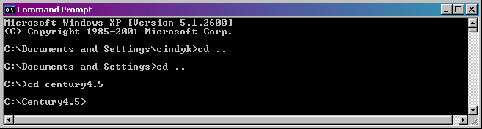
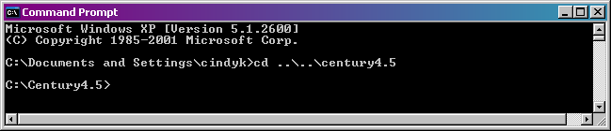
cd - Change Directory
cd .. → move up one level in the directory structure
cd century4.5 → move to a directory named century4.5
Using the \ character you can change more than one directory at a time

Slide 14
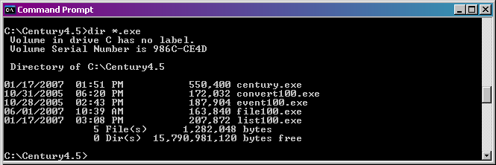
dir - DIRectory listing
dir and wildcards can be used together
dir *.exe → list all files in the current directory with .exe as the last 4 characters

Slide 15
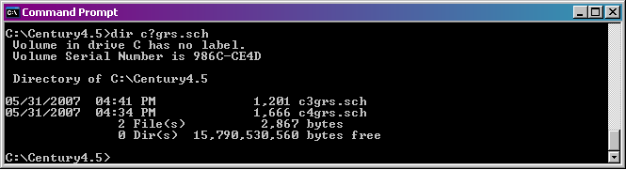
dir - DIRectory listing
? wildcard used with dir command
dir c?grs.sch → list all files in the current directory with c as the first character, grs.sch as the last 7 characters, with any one character in between

Slide 16
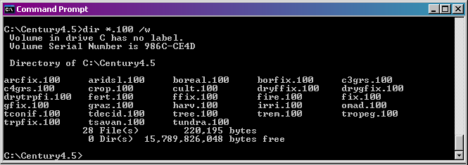
dir - DIRectory listing
switches can be used to change appearance of the display
/w switch → use wide list format
/p switch → pause after each screen full of information

Slide 17
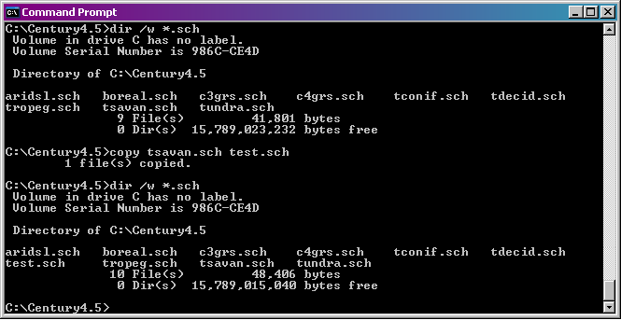
copy - COPY target file to destination file
copy <target file> <destination file>
For example, copy tsavan.sch to a file named test.sch

Slide 18
Command lines
DailyDayCent command line:
dailydaycent –s c3grs -n c3grs
The schedule file is named c3grs.sch and the binary output file created will be named c3grs.bin.
DailyDayCent_event100 command line when modifying an existing schedule file
dailydaycent_event100 –i c3grs
The c3grs.sch file will be opened and read into the grid. You can edit this schedule file as desired.
running DailyDayCent_list100 in batch mode:
dailydaycent_list100 c3grs c3grs outvars.txt
The c3grs.bin file that DailyDayCent created will read to extract the output for the variables listed in the outvars.txt file creating the c3grs.lis file which is an ASCII text file. The outvars.txt file is an ASCII text file that contains the list of output variables you want to extract from the binary file, one variable per line. The user creates the file with the list of output variables and the name for this file can be anything that you like.

Slide 19
Output file notes
Note that the output time values in the *.bin files are computed by adding the fraction of the year (month/12) to the simulation year such that:
Year Month Calculation *.bin file
---- ---------- ----------- ----------
1900 Jan = 0.08 1900 + 0.08 1900.08
1900 Feb = 0.17 1900 + 0.17 1900.17
1900 Mar = 0.25 1900 + 0.25 1900.25
1900 Apr = 0.33 1900 + 0.33 1900.33
1900 May = 0.42 1900 + 0.42 1900.42
1900 Jun = 0.50 1900 + 0.50 1900.50
1900 Jul = 0.58 1900 + 0.58 1900.58
1900 Aug = 0.67 1900 + 0.67 1900.67
1900 Sep = 0.75 1900 + 0.75 1900.75
1900 Oct = 0.83 1900 + 0.83 1900.83
1900 Nov = 0.92 1900 + 0.92 1900.92
1900 Dec = 1.00 1900 + 1.00 1901.00
1901 Jan = 0.08 1901 + 0.08 1901.08
etc.

Slide 20
Output file notes continued
Note that the monthly time values in the *.bin files are shifted by 1/12 from the DailyDayCent ASCII *.out output files such that:
*.out file *.bin file
---------- ----------
Jan - .00 Jan - .08
Feb - .08 Feb - .17
Mar - .17 Mar - .25
Apr - .25 Apr - .33
May - .33 May - .42
Jun - .42 Jun - .50
Jul - .50 Jul - .58
Aug - .58 Aug - .67
Sep - .67 Sep - .75
Oct - .70 Oct - .83
Nov - .83 Nov - .92
Dec - .92 Dec - 1.00

Slide 21
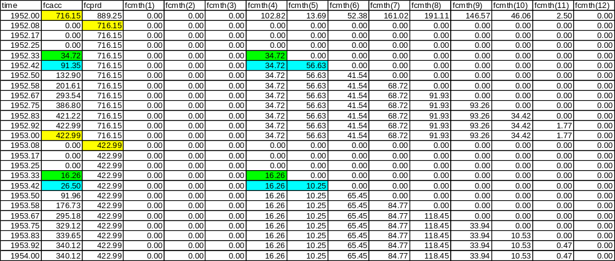
Notes on Production output variables
The new growing season production variables, AGCPRD, BGCJPRD, BGCMPRD, CRTPRD, EUPPRD(*), FBRPRD, FCPRD, FRTJPRD, FRTMPRD, RLVPRD, and RLWPRD, are set equal to the value of their associated accumulator variable when a LAST or TLST occurs. These values can be used when examining yearly output to see the amount of production that occurred over the previously completed growing season. These growing season production variables will be set back to zero in January if no production has occurred over the previous 12 month period.

Slide 22
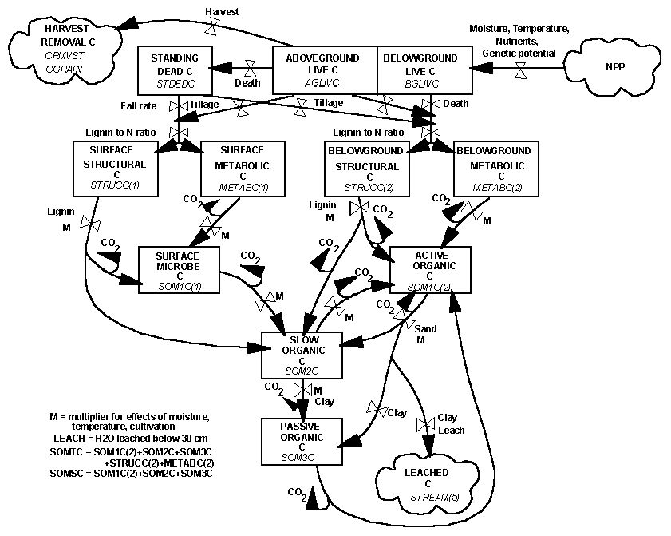
Flow diagram for the soil carbon submodel.

Slide 23
Gotcha’s
Incorrect units in climate file
Weather statistics in <site>.100 file do not match the weather data file being used
Too much/too little atmospheric N deposition
Soils.in/fix.100 layering structure mismatch
Cultivation event scheduled to occur prior to harvest event
Using a LAST event in a schedule file run with the growing degree day submodel
Neglecting to modify parameter values as necessary for Century 4.0 input files used for a DailyDayCent run
Leap year scheduling conflict

Slide 24
Analyzing model output
Check NPP for site. Reasons NPP may be too high or too low:
  Need adjustment to PRDX variable in CROP.100 and/or TREE.100.
  The temperature function used in the growth equations may be parameterized incorrectly, i.e., trying to grow a C3 grass using a C4 temperature curve. Check the PPDF(*) parameters in the CROP.100 and/or TREE.100 file.
  N deposition rates are too high or too low. Check WDFX output variable.
Once the NPP seems reasonable for the site go on to check other output values.

Slide 25
  Tricks of the Trade
  Excel Templates
  DOS batch files - DOS commands that are "batch" processed one after the other
@REM This batch file was created to run the example DailyDayCent simulations
@REM on the PC.
@REM Remove old output files
erase example.bin
erase example.lis
@REM Run the example simulation
erase example_log.txt
DailyDayCent -s example -n example > example_log.txt
DailyDayCent_list100 example example outvars.txt

Slide 26
Help me!
DailyDayCent.Instructions.txt
Century 4 web site: http://www.nrel.colostate.edu/projects/century
  Century User’s Manual
  Century Tutorial
  Century Parameterization Workbook
  Century Curves Excel Spreadsheet
century@nrel.colostate.edu

Slide 27
DailyDayCent Files included on distribution CD
DailyDayCent
  *.exe, DailyDayCent and support utility executables
  *.100, *.sch, and *.in input files for example DailyDayCent simulation
  *.def, definition files for *.100 parameter files
  run_DailyDayCent_example.bat, DOS batch file for running example simulation
  outvars.txt, list of selected output variables to extract from *.bin output file
  README.txt, documentation on example input file sites
  *.xls, example Excel template files for graphing simulation output
DayCent_Documentation
  Century4.0_to_DailyDayCent.ppt
  daily_weth_template.xls
  DailyDayCent_Instructions.txt
  DailyDayCent_event100_Instructions.txt
  DailyDayCent_Nuts_and_Bolts.ppt
  DailyDayCent_Step-by-Step.doc
  DayCent_Overview.ppt
  daycent_param_book.doc
  ForCent.ppt
  PhotoCent.ppt
  saxton.xls
  README.txt, short descriptions of the above files
DayCentCent_Publications_PDF_Files
  Selected DayCent reprints in PDF and Microsoft Word file format
  DayCent_reprints_PDF_bibliography.doc, publication references

