Slide 1
DAYCENT Model Overview, Testing and Application to Agroecosystems
S.J. DEL GROSSO, W.J. PARTON, D.S. OJIMA, A.R. MOSIER and C. KEOUGH

Slide 2
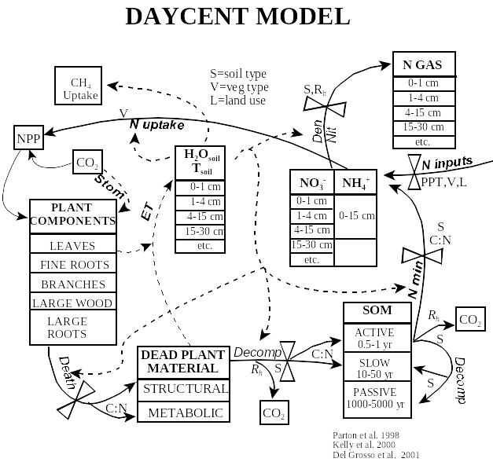

Slide 3
Improved NPP Submodel
Potential Growth
(CO₂,T,H₂O)
GRAIN
C,N,P,S
Crop
H₂O
Nutrients
Shading
SHOOT
C,N,P,S
SURFACE
LITTER
NPP
Tillage
Temp
H₂O
Phenology
Nutrient/H₂O stress
ROOT
C,N,P,S
SOIL
LITTER
Temp
H₂O
P_{G} = G_{pot}*F(light)*F(LAI)*F(Temp)*F(H₂O)
Del Grosso et al. in prep.

Slide 4
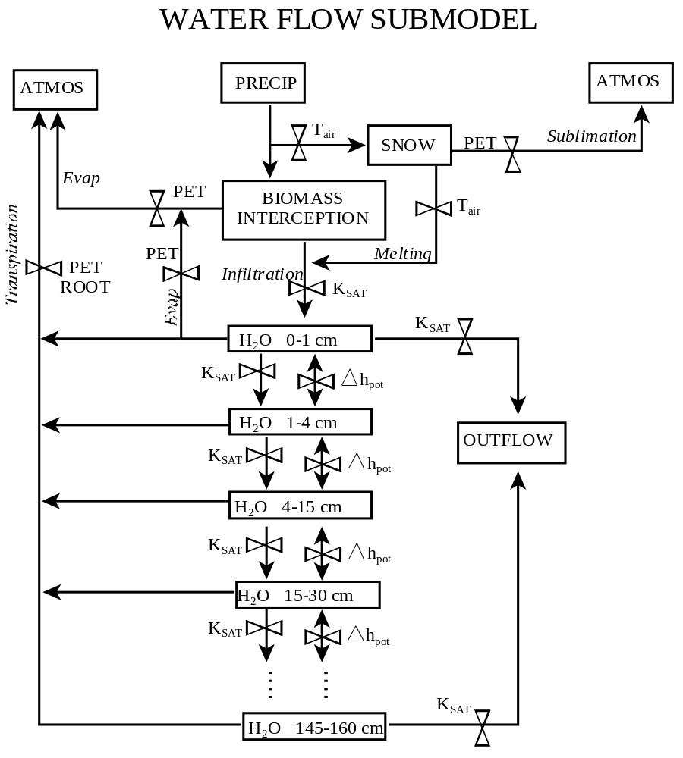

Slide 5
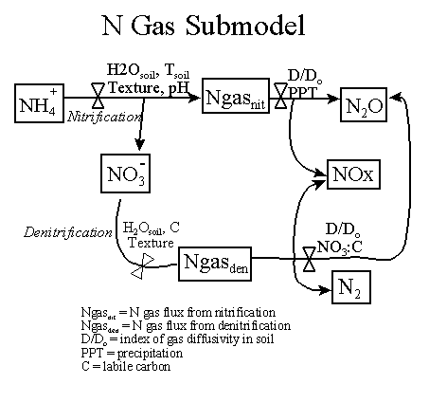

Slide 6
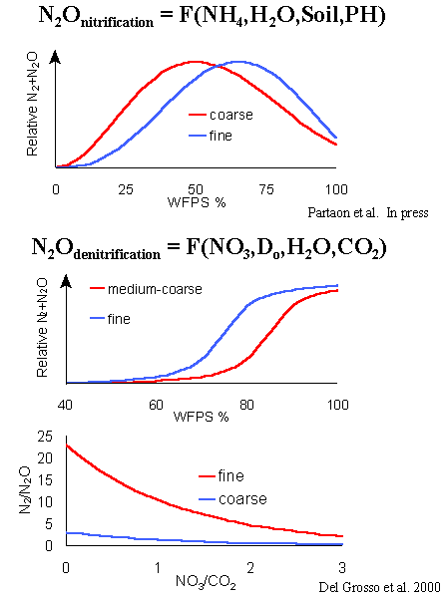
Parton et al. 2001

Slide 7
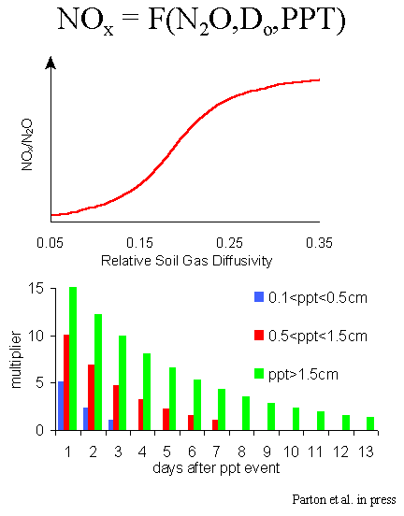
Parton et al. 2001

Slide 8
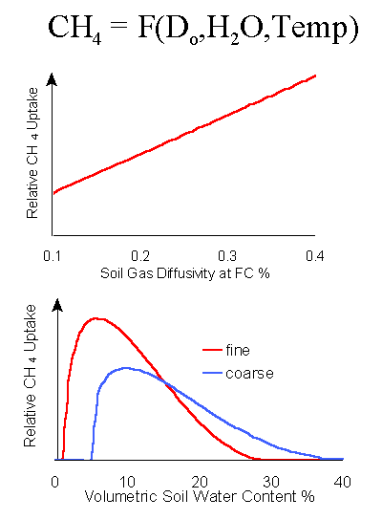
coarse
fine
Del Grosso et al. 2000

Slide 9
Recent Model Improvements
Variable effective plant rooting depth
PET = F(Lat, DOY, T_{avg}, T_{max} – T_{min})
Weekly scheduling of management events
Germination = F(T_{surface})
Harvest/Senescence = F(GDD, T_{surface})
Canopy absorption of NOx emitted from soil

Slide 10
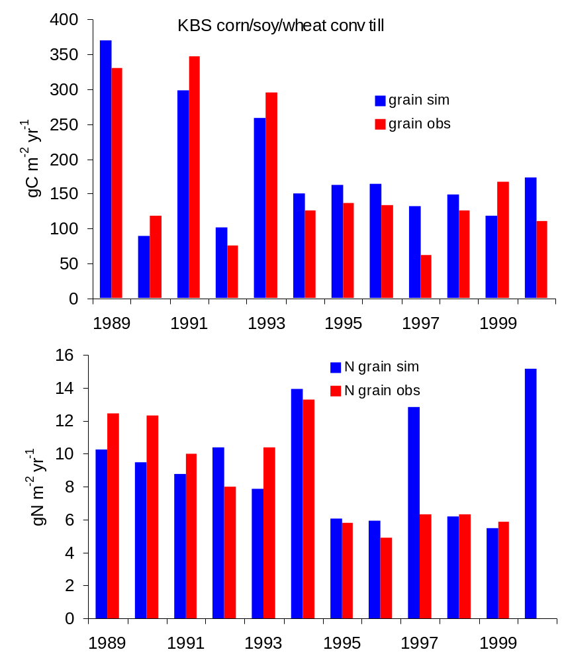

Slide 11
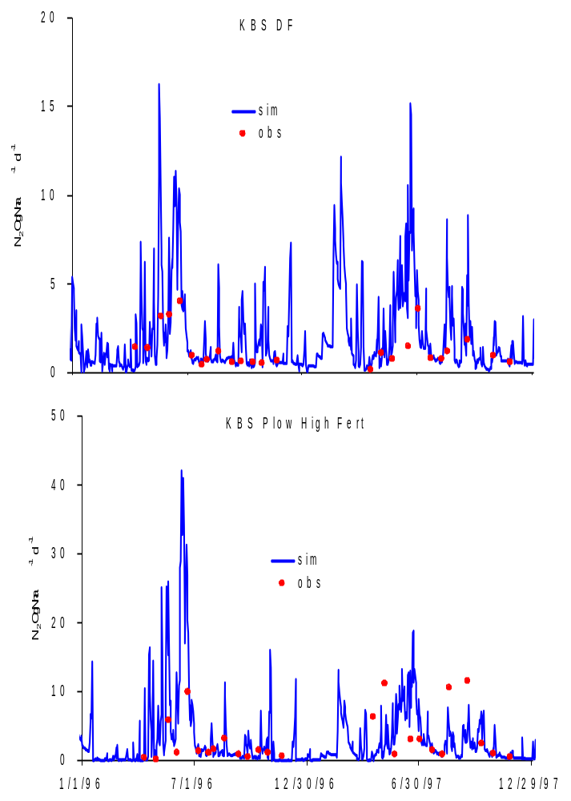

Slide 12
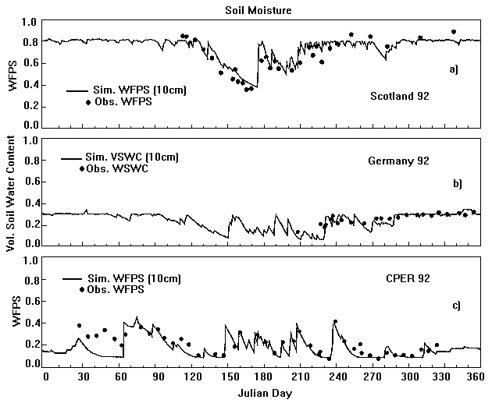

Slide 13
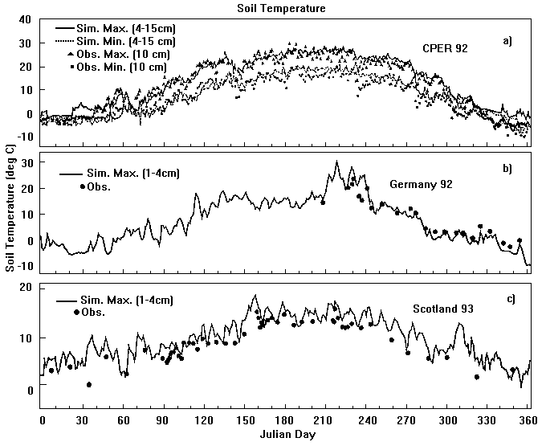

Slide 14
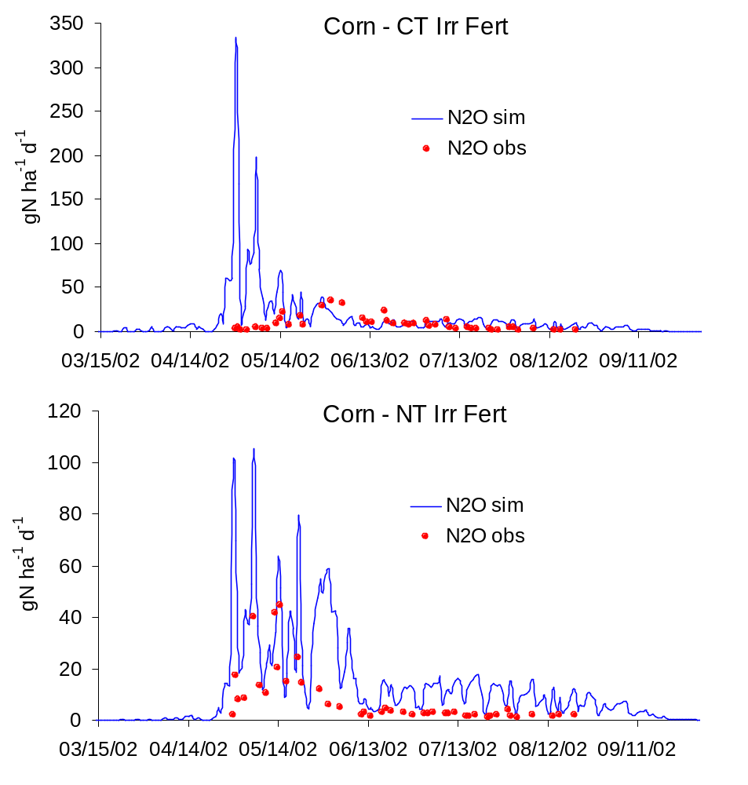
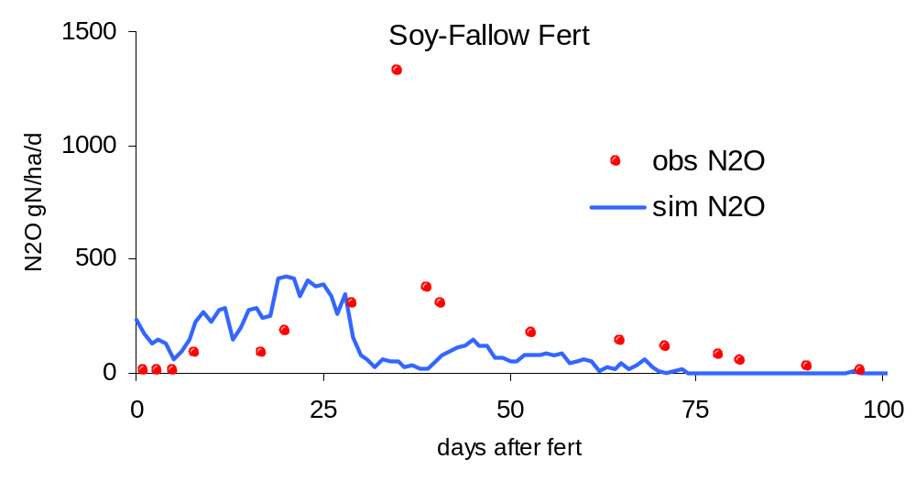

Slide 15
IPCC Emission Factor Calculations
Direct N₂O emissions
N_{cult} = 0.1 gN m⁻² yr⁻¹
N_{om} = N_{sludge} + N_{manure}
N₂O_{direct} = 1.25%*(N_{stuble} + N_{fert} + N_{om}) + N_{cult}
Indirect N₂O emissions
NH₃ + NOx = 0.1N_{fert}
N_{leach} = 0.3N_{fert}
N₂O_{indirect} = 0.01(NH₃ + NO_{x}) + 0.025N_{leach}
Notes:
For comparisons with the model and data for different sites

Slide 16
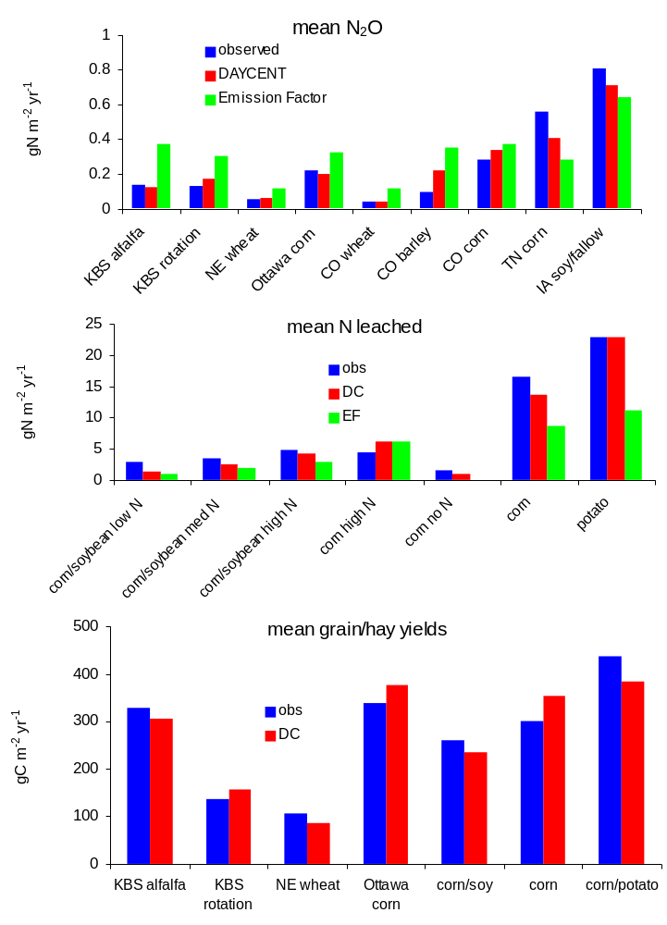

Slide 17
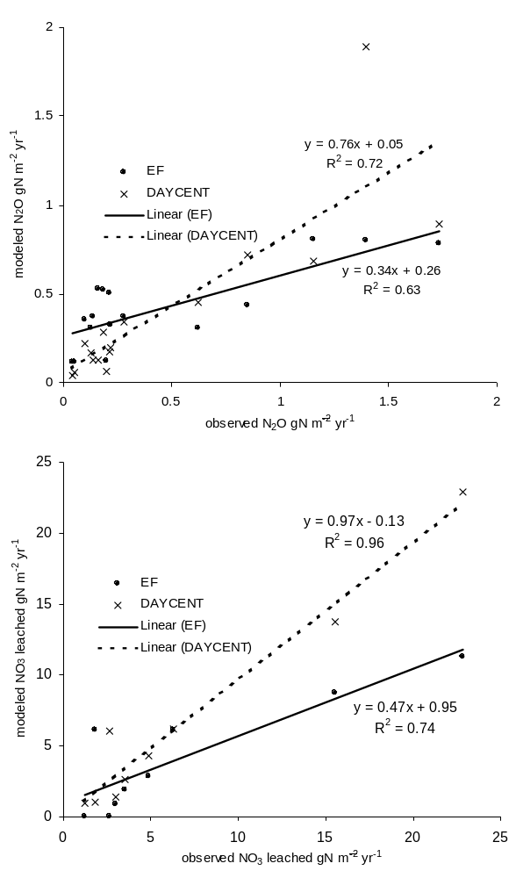
a)
b)
Fig4

Slide 18
National GHG Inventory
Bruce McCarl’s 63 regions
EPIC soils and daily climate data
Simulated dominant rotations for each region
Rain fed and irrigated
N fertilizer but no manure additions
Converted model output in gN₂O-N m⁻² to regional totals for the dominant crop rotations using state level planted acres reported by NASS

Slide 19
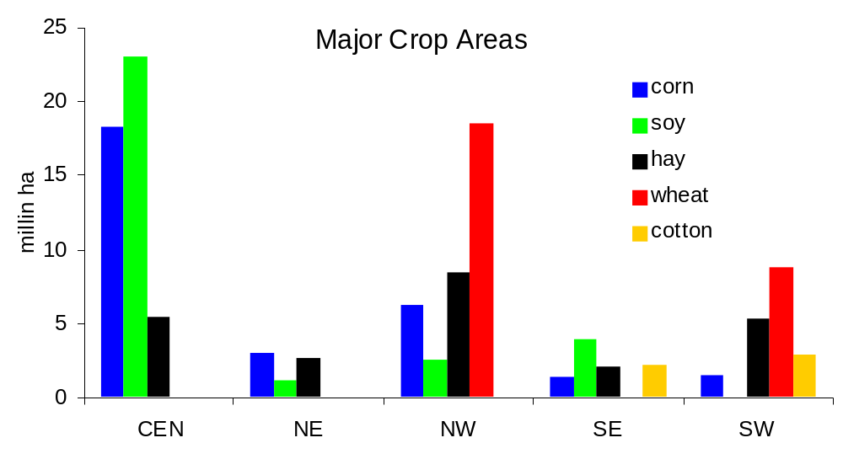

Slide 20
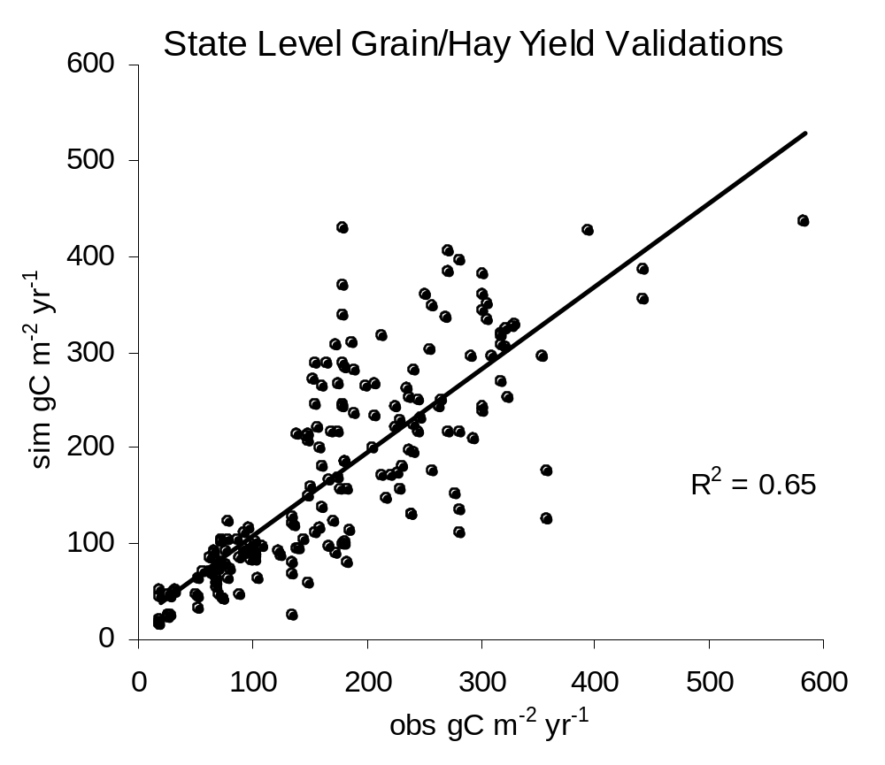
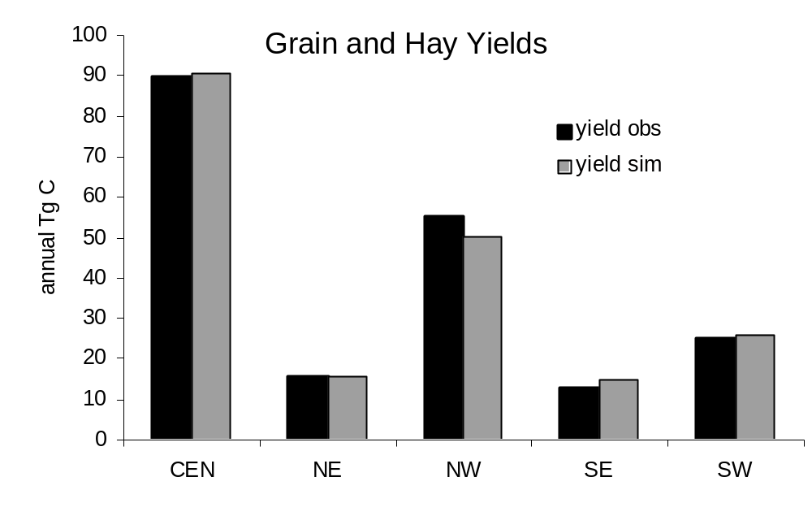
Regional Level Validations

Slide 21
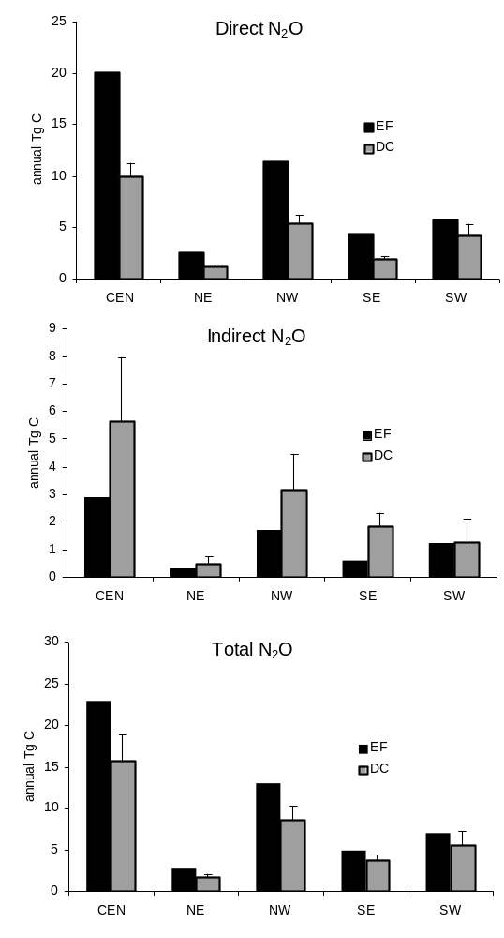
Simulated Regional N₂O Emissions

Slide 22
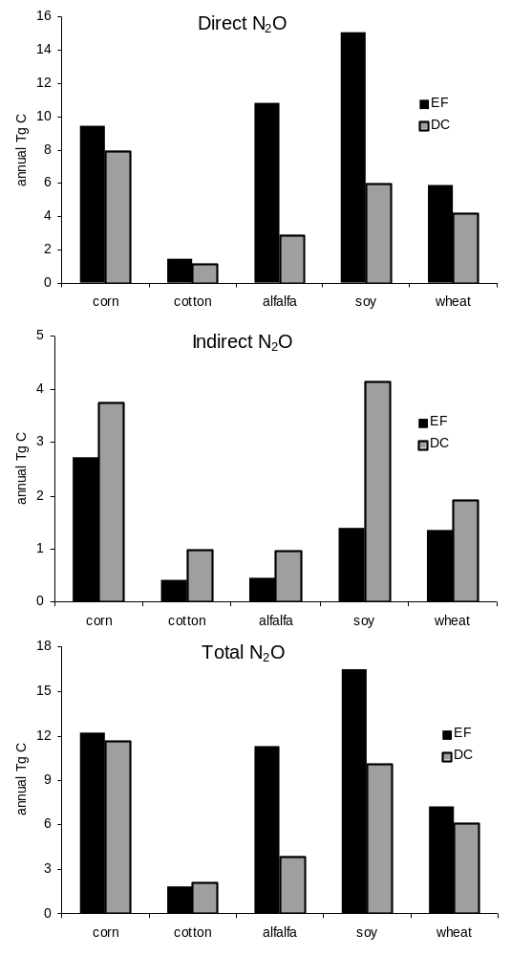
N₂O by Crop

Slide 23
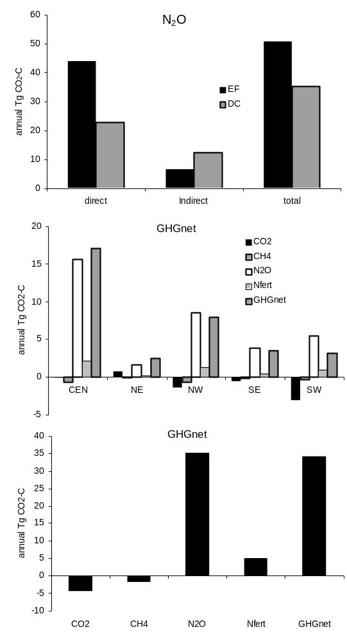
National N₂O and GHG_{net}

Slide 24
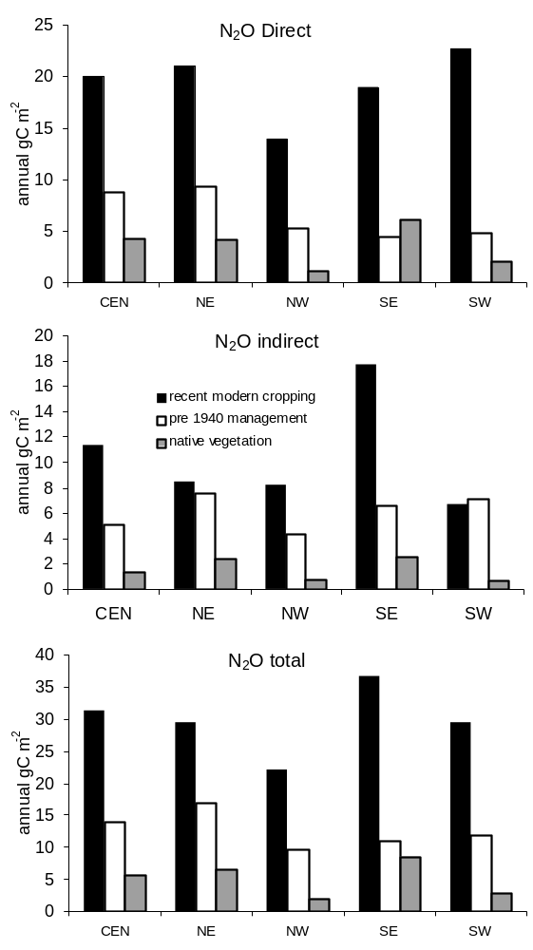
Area normalized N₂O

Slide 25
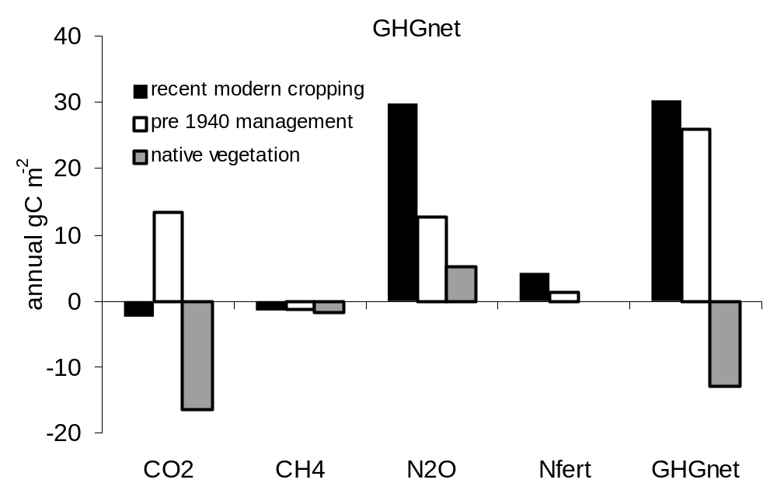
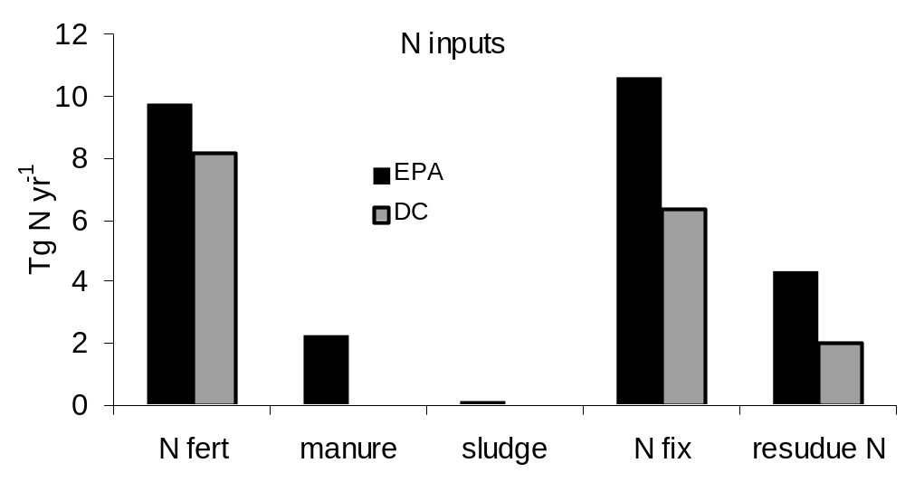
Area normalized GHGnet
EPA vs. DAYCENT N Inputs

Slide 26
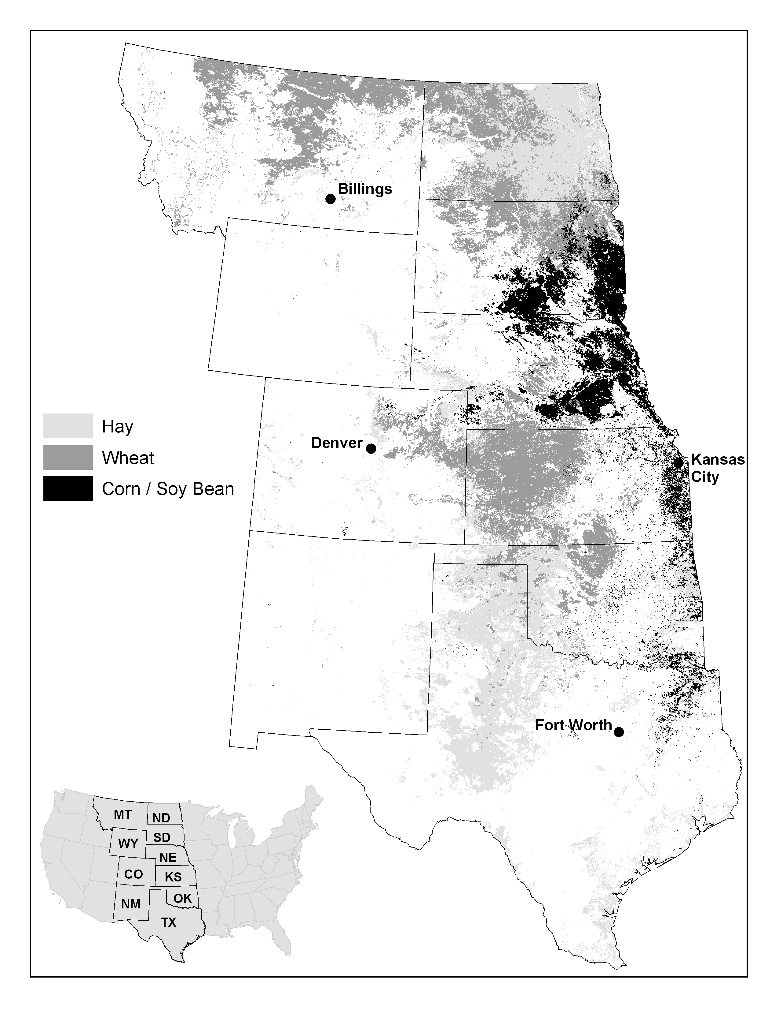

Slide 27
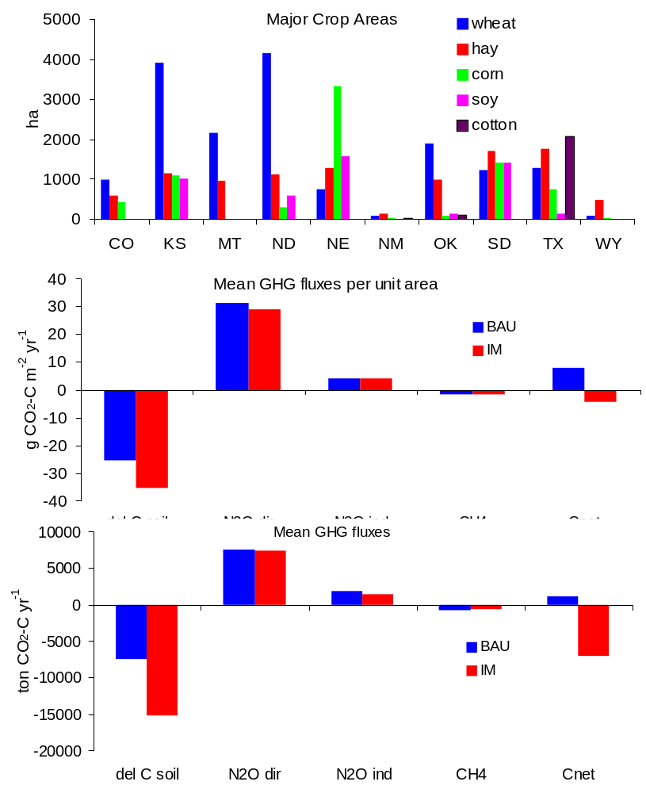

Slide 28
