Slide 1
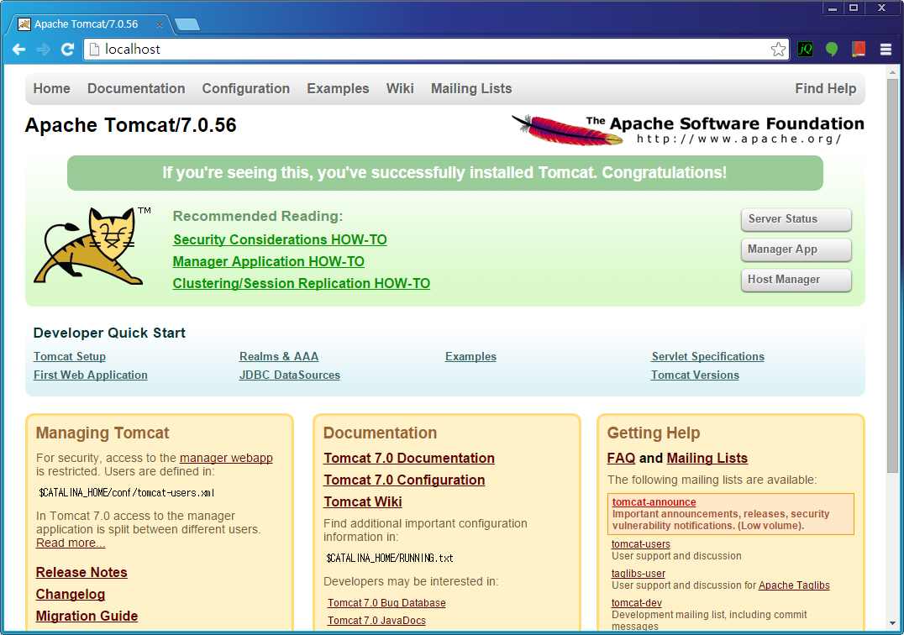
Tomcat 설치 및 실행
1. /usr/local/cafe24/tomcat8 에 설치
2. JAVA_HOME 환경 변수 세팅 확인
3. /usr/local/cafe24/tomcat8/conf/server.xml 다음 수정
4. 톰캣 실행
/usr/local/cafe24/tomcat8/bin/catalina start
5. 브라우저에서 http://192.168.1.x 로 접근하기
<Connector port="8080" URIEncoding="UTF-8" protocol="HTTP/1.1" connectionTimeout="20000" redirectPort="8443" />

Slide 2
Tomcat 설치
Tomcat Web Application Manager
1. /usr/local/cafe24/tomcat8/conf/tomcat-users.xml 수정
2. /usr/local/cafe24/tomcat8/webapps/manager/META-INF/context.xml 수정
<role rolename="manager"/>
<role rolename="manager-gui" />
<role rolename="manager-script" />
<role rolename="manager-jmx" />
<role rolename="manager-status" />
<role rolename="admin"/>
<user username="admin" password="manager" roles="admin,manager,manager-gui, manager-script, manager-jmx, manager-status"/>
<Context privileged= "true" antiResourceLocking= "false" docBase= "${catalina.home}/webapps/manager">
<Valve className= "org.apache.catalina.valves.RemoteAddrValve" allow= "^.*$" />
</Context>

Slide 3
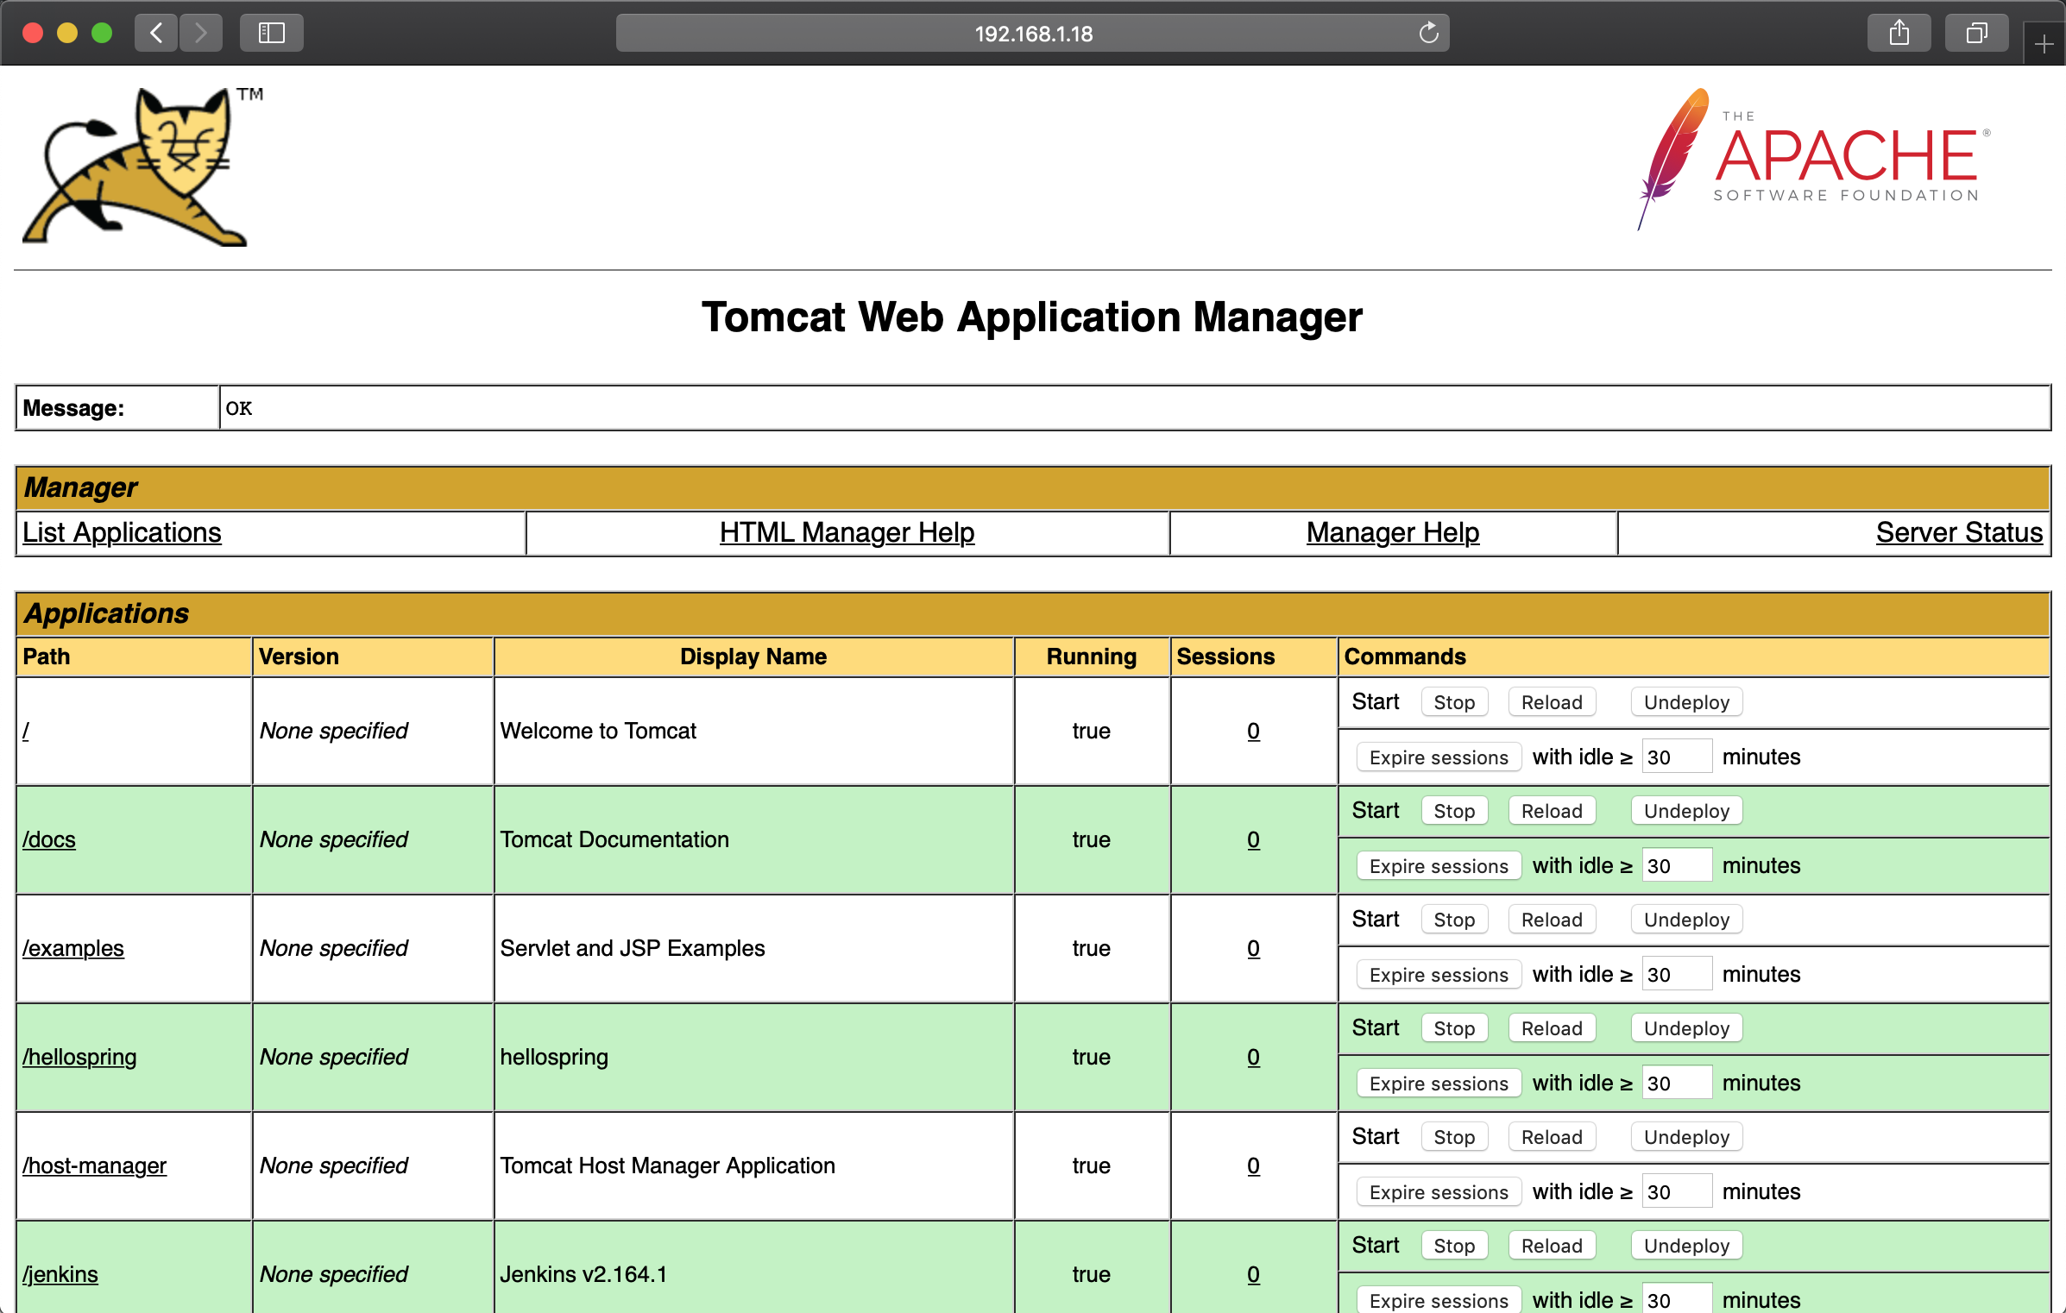
Tomcat 설치
Tomcat Web Application Manager
3. 톰캣 재실행
/usr/local/cafe24/tomcat8/bin/catalina stop
/usr/local/cafe24/tomcat8/bin/catalina start
4. Manager Web Application 접근확인
http://192.168.1.x/manager

Slide 4
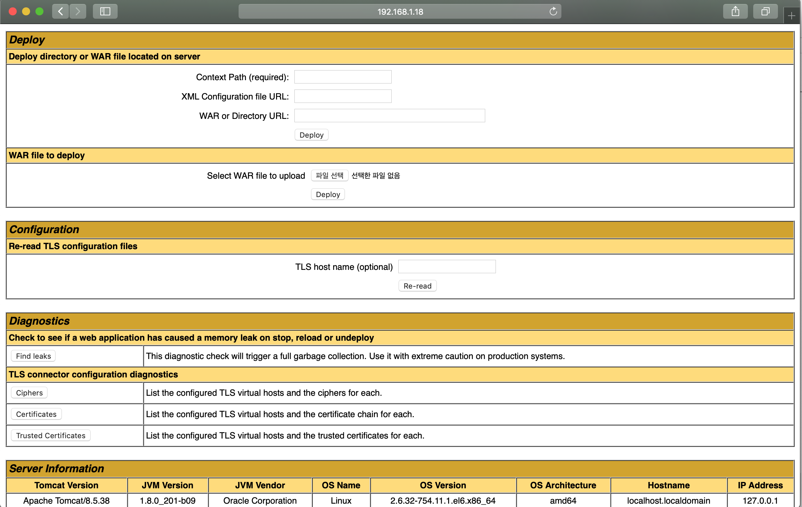
Tomcat 설치
helloworld Web Application 배포하기
1. helloworld.war 파일 업로드
2. http://192.168.1.x:8080/helloworld 로 접근하여 화면 확인

