Slide 1
Enhancing Self-Supervised Video Representations with HAF-STD Net: A Comparative Evaluation Against VLM for Action Recognition
A thesis submitted in partial fulfillment of the requirements for the degree of
Master of Information Technology (MIT)
Institute of Science and Technology (IoST)
Tribhuvan University
Submitted by:
Thesis Viva-Voce Presentation

Slide 2
Presentation Outline
1. Introduction & Background
2. Problem Statement & Research Gap
3. Objectives
4. Scope & Limitations
5. Literature Review
6. Methodology
7. Implementation Details
8. Results & Discussion
9. Conclusion & Future Recommendations
10. References

Slide 3
Introduction
Video understanding is one of the most challenging frontiers in computer vision, requiring models to capture both spatial features and complex temporal dynamics across frame sequences.
Action recognition — identifying human activities from video — has broad applications in sports analytics, surveillance, healthcare, and content-based retrieval.
Two fundamentally different paradigms have emerged for learning video representations:
  Self-Supervised Learning (SSL): Models learn from unlabeled video via pretext tasks (e.g., masked prediction in latent space).
  Vision-Language Models (VLMs): Models learn from paired image/video-text data using autoregressive objectives.
This thesis directly compares these paradigms using V-JEPA 2 (SSL, 654M params) vs. Qwen2.5-VL (VLM, 7B params) on video action recognition.

Slide 4
Problem Statement & Research Gap
Paradigm Comparison Gap:
  SSL encoders and VLMs are evaluated independently using different datasets and protocols. No controlled cross-paradigm comparison exists.
Granularity-Dependent Performance:
  How relative performance varies across fine-grained (FineGym) vs. coarse-grained (HMDB51) recognition has not been studied.
Representation Quality vs. Model Scale:
  V-JEPA 2 (654M) is ~10x smaller than Qwen2.5-VL (7B) — does model scale proportionally improve video representations?
Under-Utilization of Multi-Layer Features:
  Standard probing uses only last-layer features with global pooling, discarding rich hierarchical and temporal-frequency information.

Slide 5
Objectives
General Objective:
To conduct a rigorous comparative analysis of self-supervised and vision-language video representations for action recognition.
Specific Objectives:
1. To evaluate and compare V-JEPA 2 (SSL) and Qwen2.5-VL (VLM) representations across fine-grained (FineGym) and coarse-grained (HMDB51) tasks.
2. To design, implement, and evaluate HAF-STD Net (Hierarchical Adaptive Fusion with Spectral-Temporal Decomposition) — a novel classifier exploiting multi-layer latent representations from frozen self-supervised video encoders.

Slide 6
Scope and Limitations
Scope
Frozen-feature evaluation protocol comparing V-JEPA 2 vs. Qwen2.5-VL on two complementary benchmarks.
12 downstream classifiers: 5 classical ML + 6 neural network probes + novel HAF-STD Net.
Two datasets: FineGym (4-class fine-grained) and HMDB51 (51-class coarse-grained).
Limitations
Frozen-Feature Protocol: No backbone fine-tuning — isolates intrinsic feature quality only.
Quantization Protocol: Qwen2.5-VL features extracted using 4-bit NF4 quantization due to T4 GPU (16 GB VRAM) memory limits.
Temporal Resolution: V-JEPA 2 processed 8 frames vs. Qwen2.5-VL processed 4 frames.

Slide 7
Report Organization
Chapter 1 — Introduction: Background, problem statement, objectives, scope and limitations.
Chapter 2 — Literature Review: Theoretical framework, JEPA evolution, VLM paradigm, research gap.
Chapter 3 — Materials and Methods: Datasets, models, HAF-STD Net architecture, evaluation metrics.
Chapter 4 — Results and Discussion: Per-classifier results, comprehensive comparisons, result analysis.
Chapter 5 — Conclusion and Recommendations: Key findings, future work.

Slide 8
Literature Review — Theoretical Framework
Video action recognition has evolved from hand-crafted features (HOG, HOF, iDT) to deep 3D CNNs (C3D, I3D, SlowFast) to self-supervised Vision Transformers.
Self-Supervised JEPA Paradigm:
  I-JEPA → V-JEPA → V-JEPA 2 → V-JEPA 2.1: Progressive refinement of masked latent prediction for video.
Vision-Language Model Paradigm:
  VLMs (Qwen2.5-VL) connect visual encoders with autoregressive language decoders via visual instruction tuning.
Key Distinction:
  SSL features are visual-geometric (motion, spatial config). VLM features are linguistically-grounded (semantic categories). Their relative merit for discriminative video tasks is unknown.

Slide 9
Literature Review — Research Gap
Despite significant advances, the literature reveals critical gaps:
1. No controlled cross-paradigm comparison: SSL and VLM models are evaluated within their own paradigms using different benchmarks.
2. Granularity-dependent disparity unexplored: Whether SSL or VLM features generalize better across fine-grained vs. coarse-grained tasks is unknown.
3. Multi-layer depth and frequency information underutilized: Standard probing discards hierarchical features and temporal dynamics via global average pooling.
This thesis addresses all three gaps with a controlled empirical study and a novel HAF-STD Net architecture.

Slide 10
Methodology — Description
Description of Methodology:
The experimental pipeline follows a structured sequence:
Data Acquisition: FineGym (1,200 clips, 4 event classes via yt-dlp) and HMDB51 (6,754 clips, 51 action classes via HuggingFace Hub).
Frame Extraction: OpenCV VideoCapture with uniform temporal sampling, resized to 224×224.
Frozen Feature Extraction: V-JEPA 2 (float16+SDPA, 8 frames → 4 layers × T' × 1280) and Qwen2.5-VL (4-bit NF4, 4 frames → 3584-d hidden state pooling).
Feature Preprocessing: StandardScaler → PCA (95% variance retained) → 80/20 train/eval split.
Multi-Classifier Evaluation: 12 classifiers (5 sklearn + 6 PyTorch + HAF-STD Net) with comparative metrics.

Slide 11
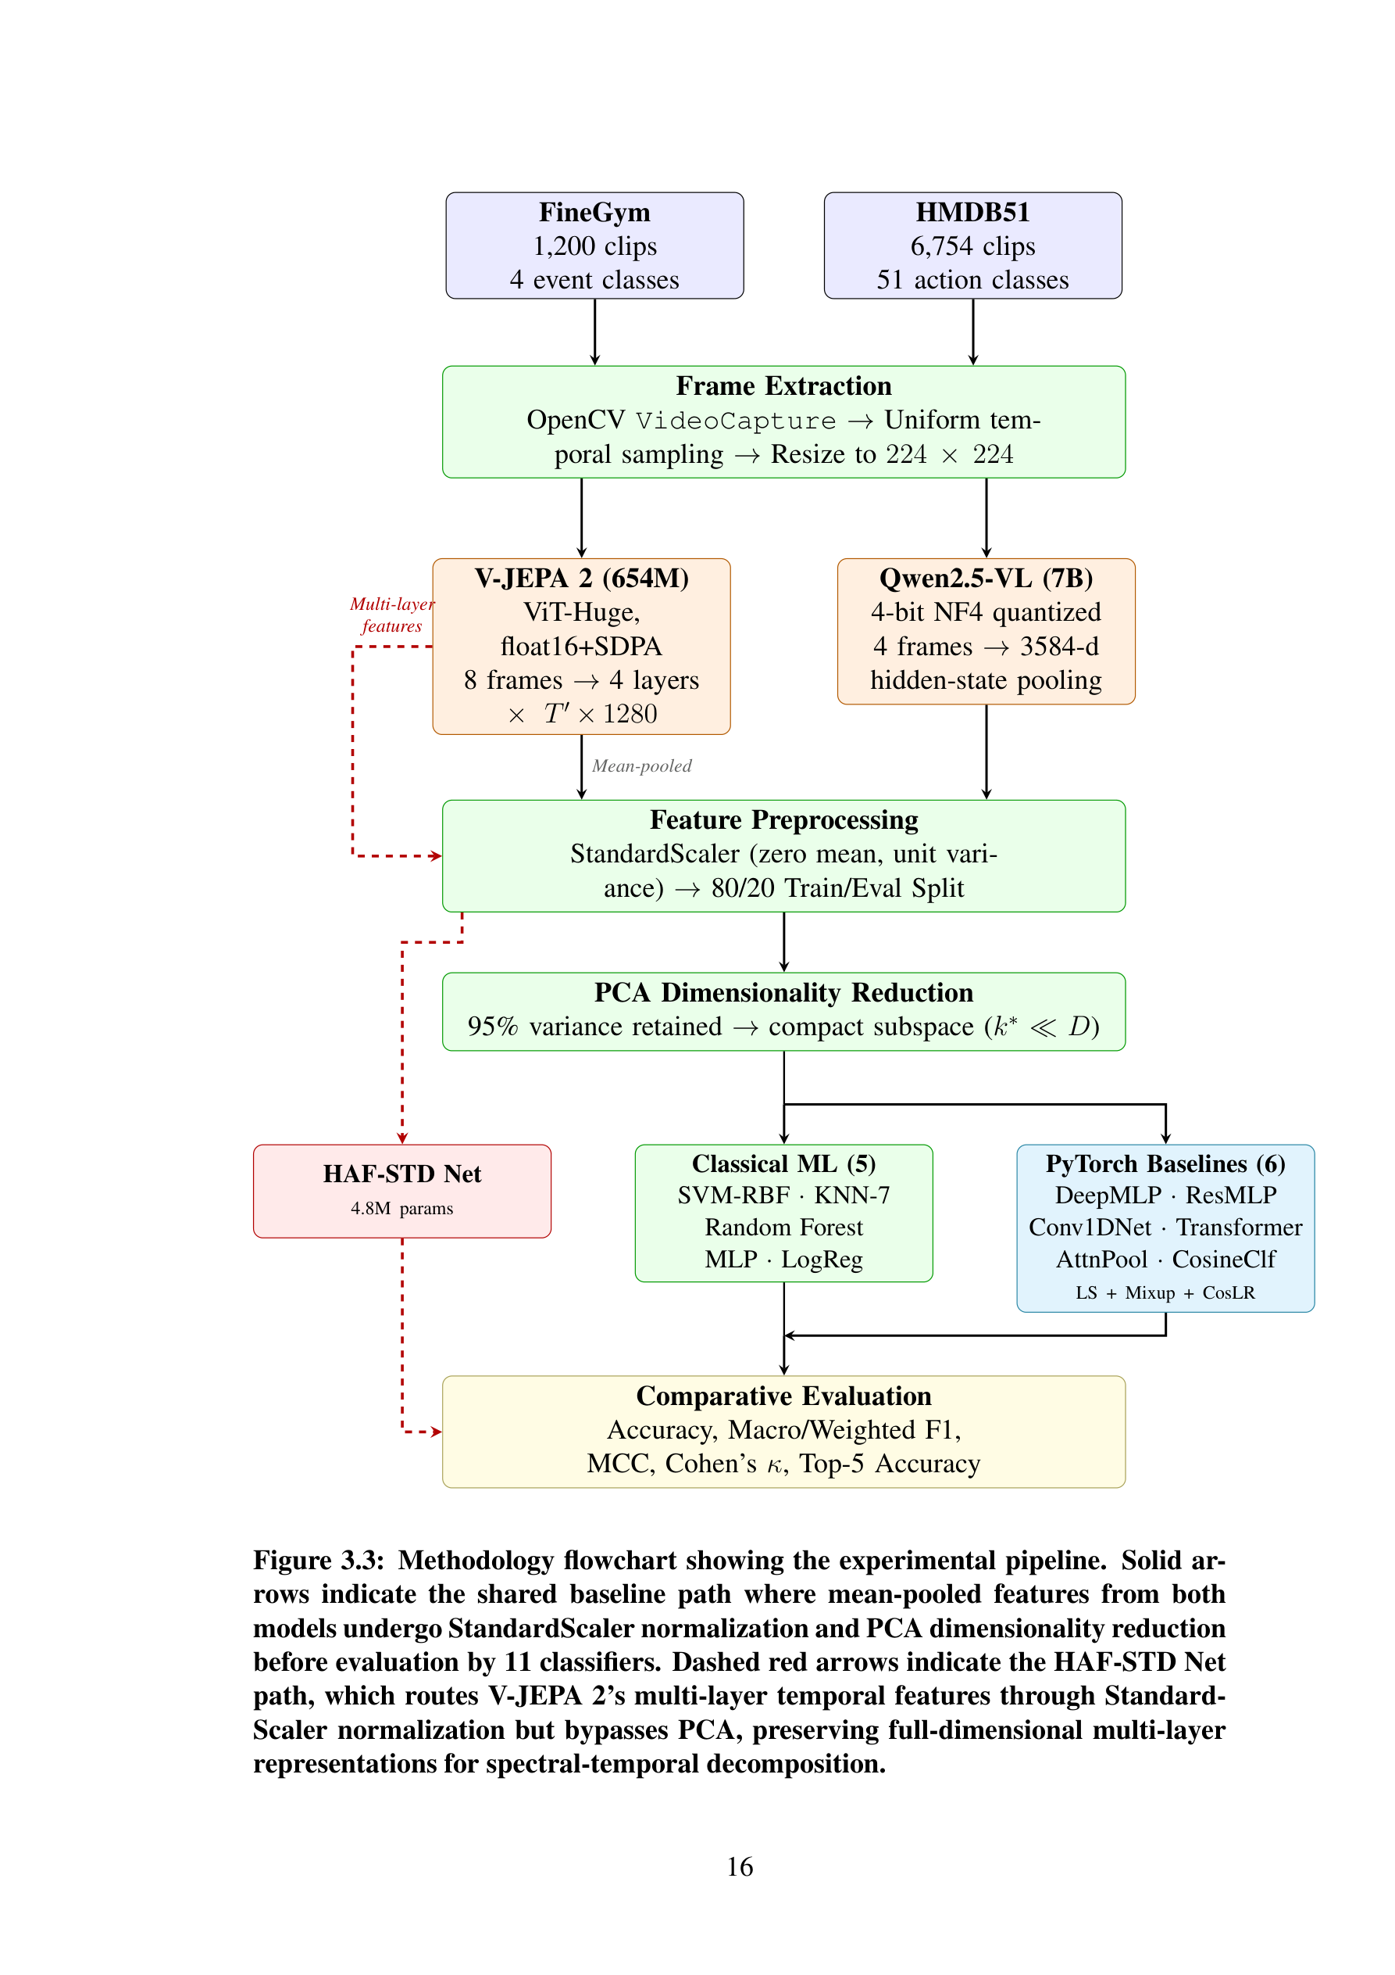
Methodology — Experimental Pipeline Flowchart
Figure: Methodology flowchart — solid arrows = shared baseline path (StandardScaler + PCA); dashed red arrows = HAF-STD Net path (StandardScaler normalization, bypasses PCA).

Slide 12
Foundation Models — V-JEPA 2 vs. Qwen2.5-VL
Specification | V-JEPA 2 | Qwen2.5-VL
Parameters | 654M | 7B
Architecture | ViT-Huge | Qwen2.5 + ViT
Paradigm | Self-Supervised (JEPA) | Autoregressive VLM
Pretraining | Masked latent prediction | Image-text + instruction tuning
Input Frames | 8 | 4
Feature Dimension | 1,280 | 3,584
Precision | float16 + SDPA | 4-bit NF4
Modality | Video only | Vision + Language

Slide 13
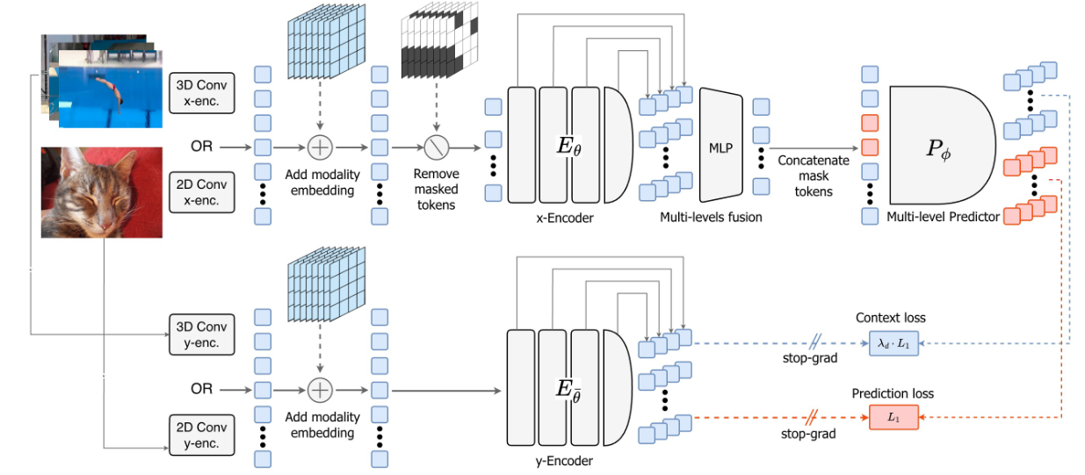
V-JEPA 2.1 — Self-Supervised Pretraining Architecture
Architecture of V-JEPA 2.1: dual x-Encoder/y-Encoder with multi-level fusion, mask-denoising prediction, and stop-gradient targets.

Slide 14
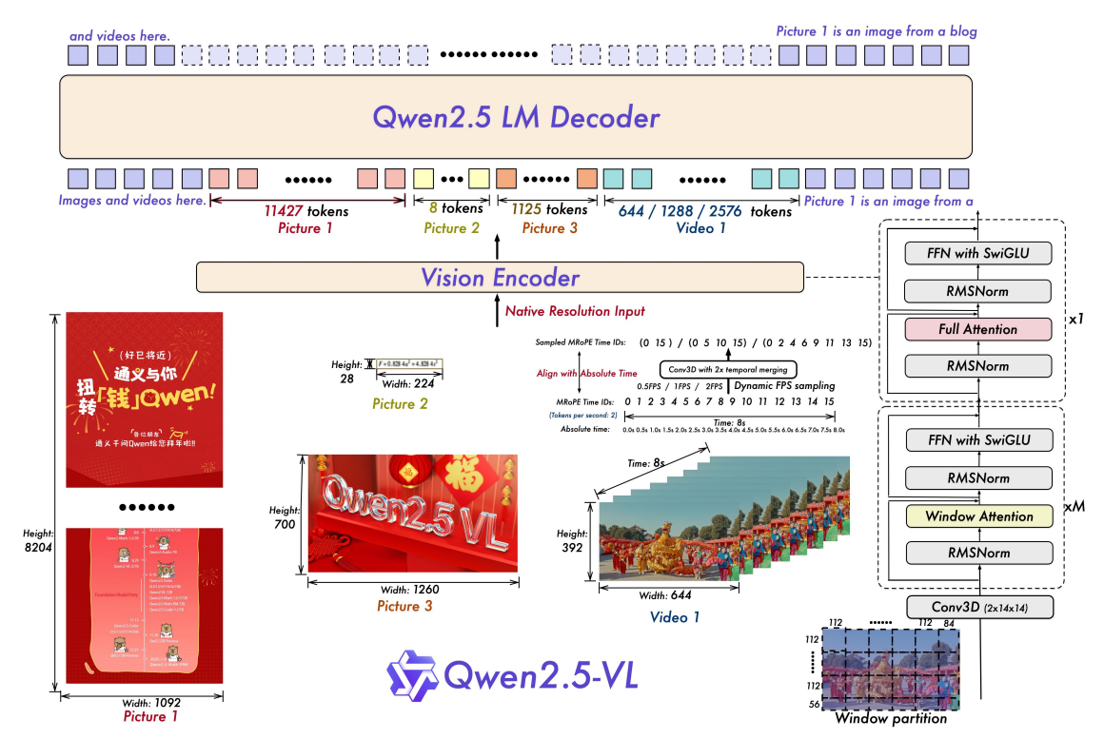
Qwen2.5-VL — Vision-Language Architecture
Qwen2.5-VL: Vision Encoder with Conv3D patch embedding + Qwen2.5 LM Decoder with MRoPE temporal alignment.

Slide 15
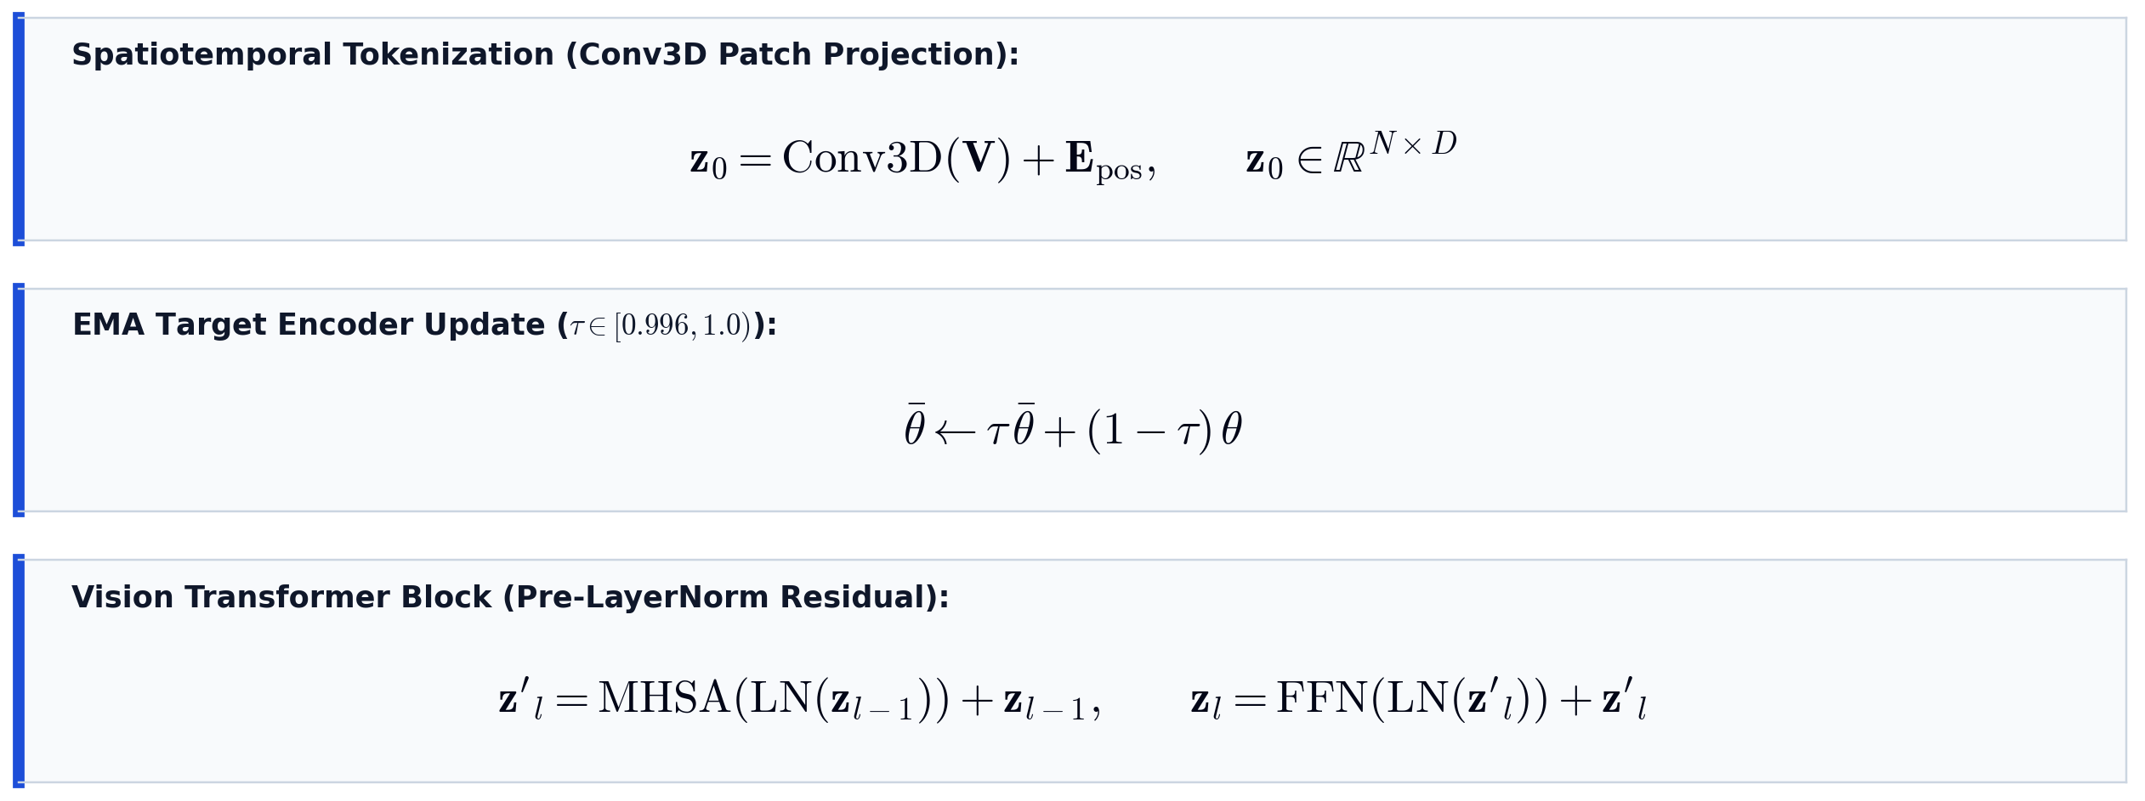
V-JEPA 2 — Mathematical Formulation
Patch tokenization, target encoder EMA update, and Vision Transformer block formulation

Slide 16
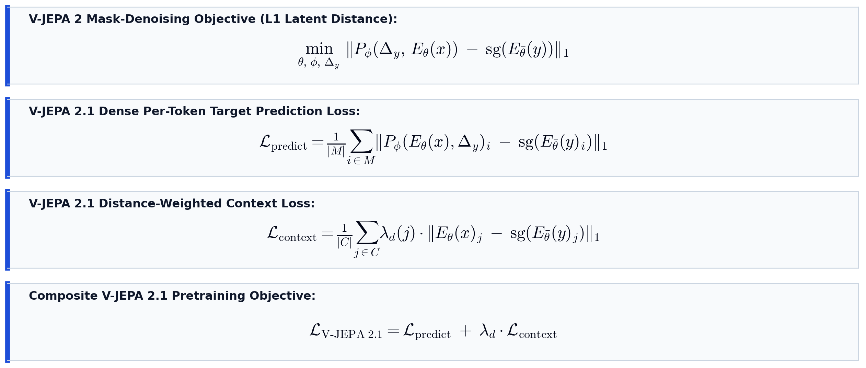
V-JEPA 2.1 — Training Objectives
Mask-denoising loss, dense per-token target prediction, and distance-weighted context loss

Slide 17
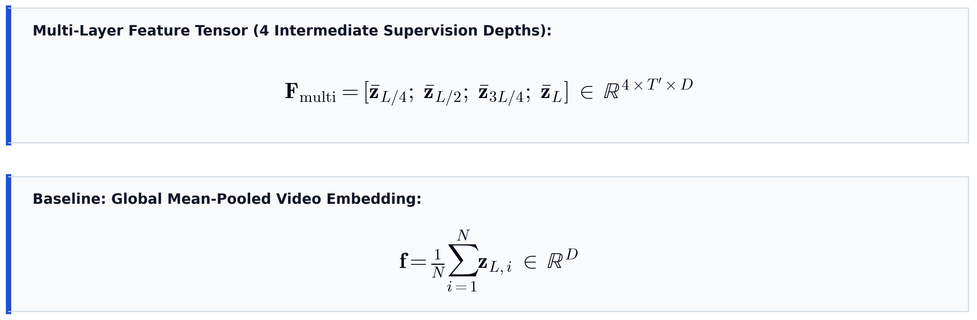
V-JEPA 2 — Multi-Layer Feature Extraction
Multi-layer intermediate representations (L/4, L/2, 3L/4, L) and global mean pooling

Slide 18
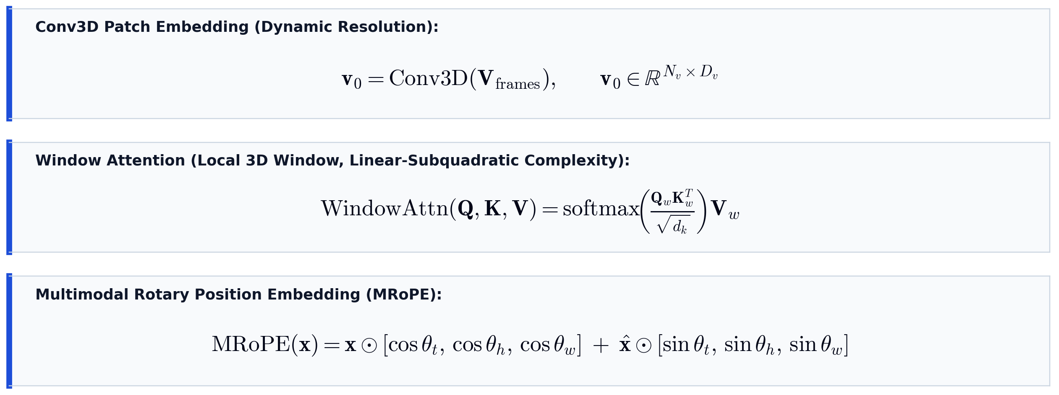
Qwen2.5-VL — Mathematical Formulation
Dynamic Conv3D patch projection, windowed attention, and Multimodal Rotary Position Embedding (MRoPE)

Slide 19
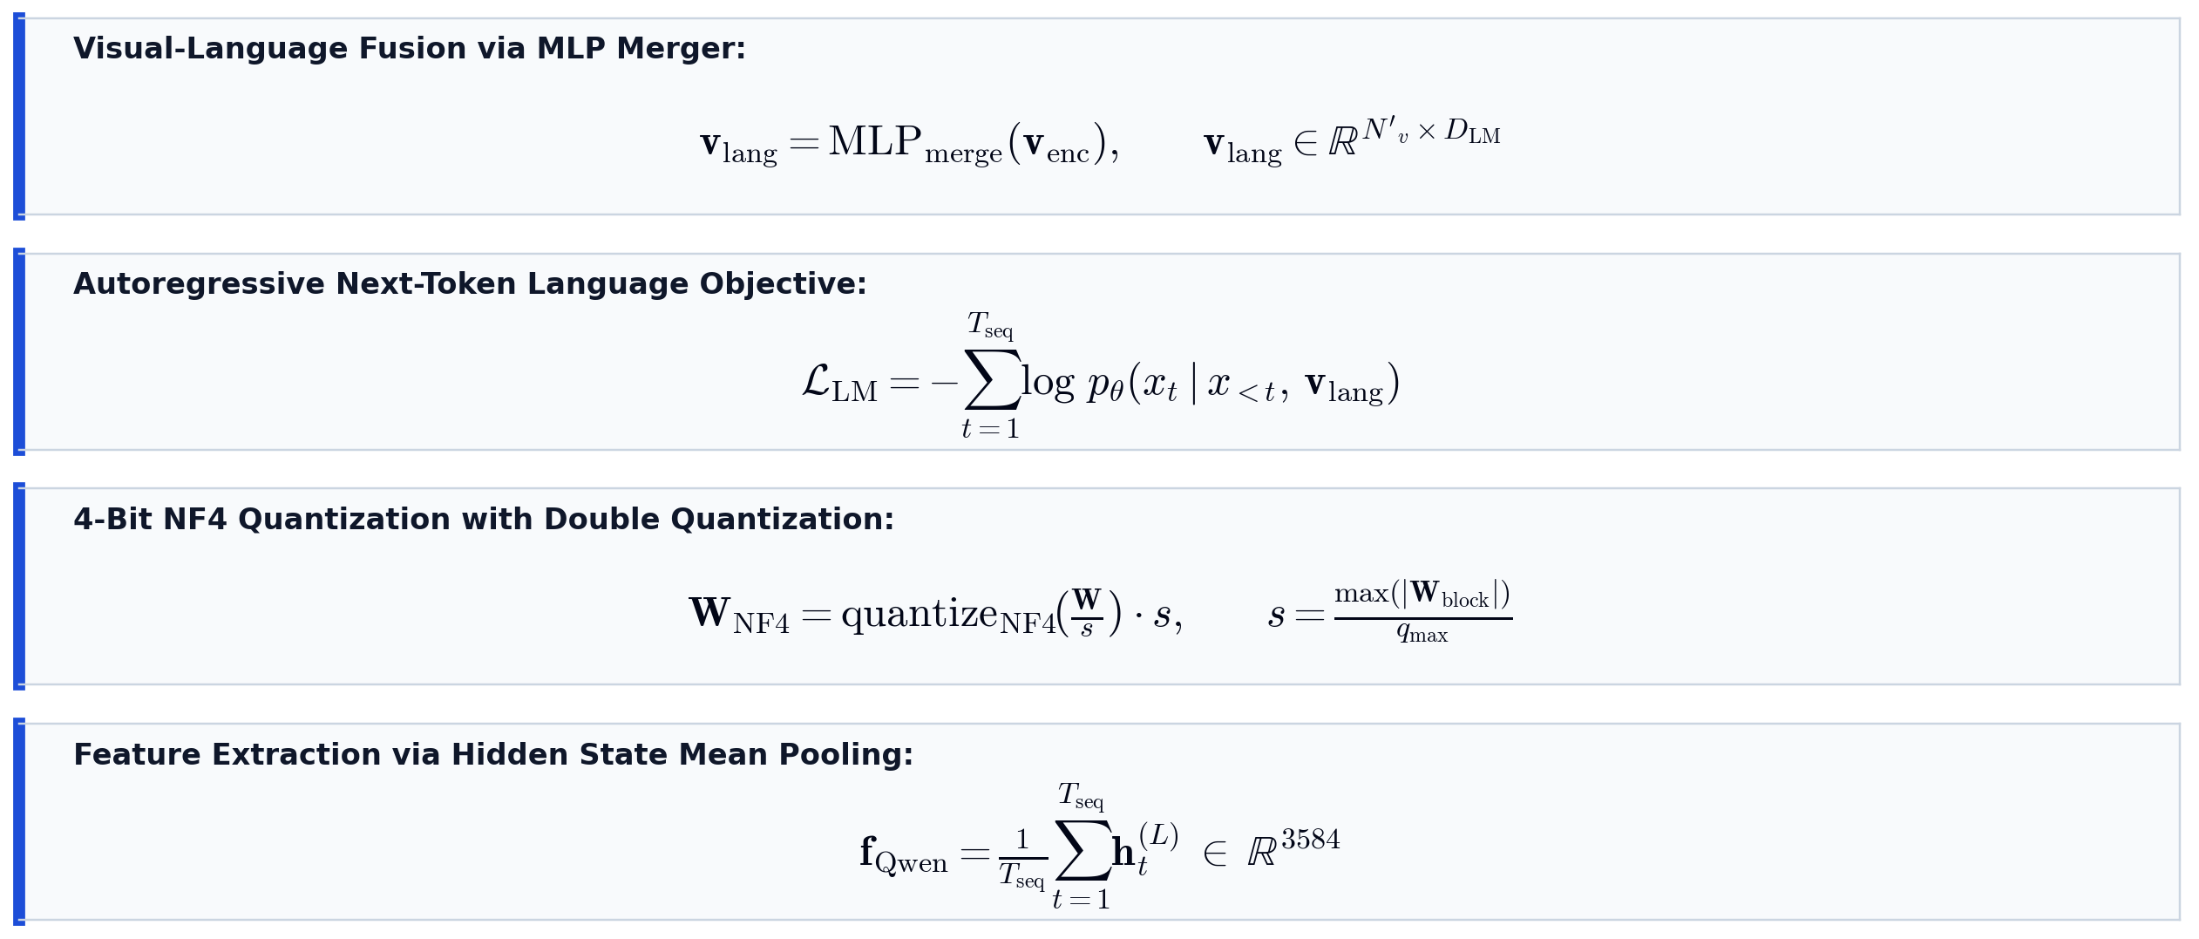
Qwen2.5-VL — Fusion & Feature Extraction
Visual-to-language MLP projection, autoregressive LM loss, NF4 quantization, and mean-pooled features

Slide 20
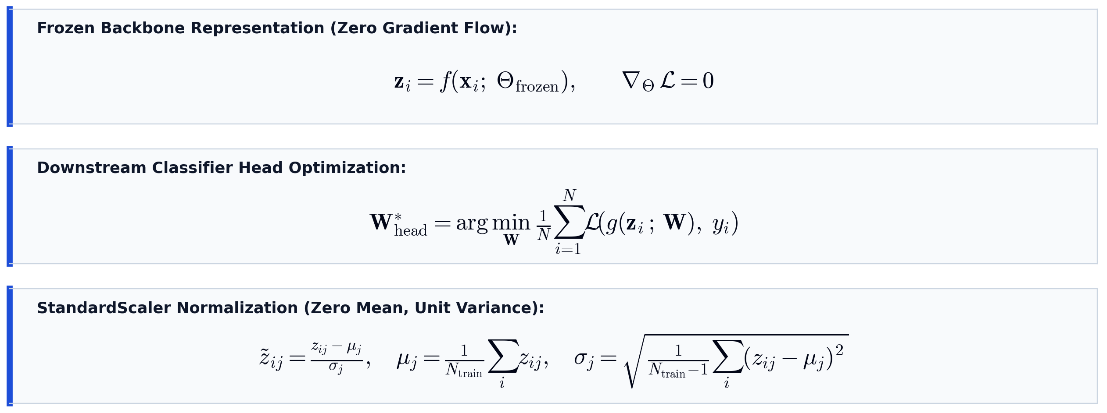
Frozen-Feature Protocol & Standardization
Strict frozen backbone constraint, downstream head optimization, and StandardScaler normalization

Slide 21
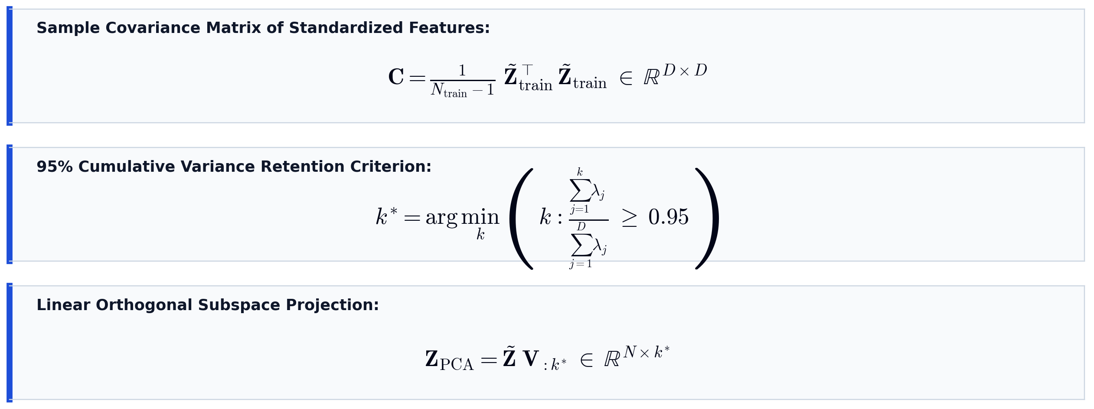
PCA Dimensionality Reduction
Sample covariance matrix decomposition, 95% cumulative variance retention threshold, and orthogonal projection

Slide 22
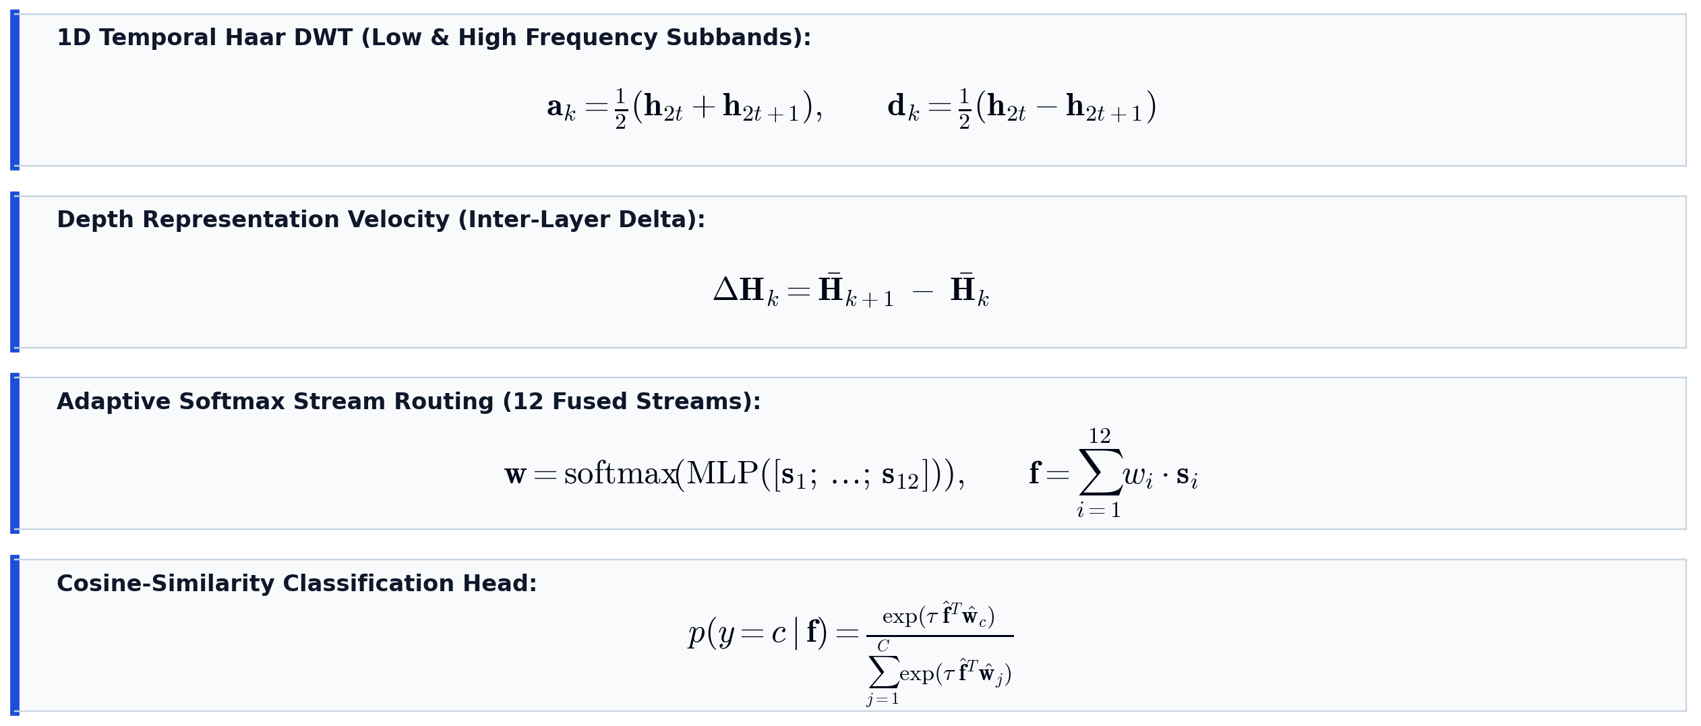
HAF-STD Net — Mathematical Formulation
Temporal Haar DWT wavelet decomposition, depth representation velocity, and adaptive softmax routing

Slide 23
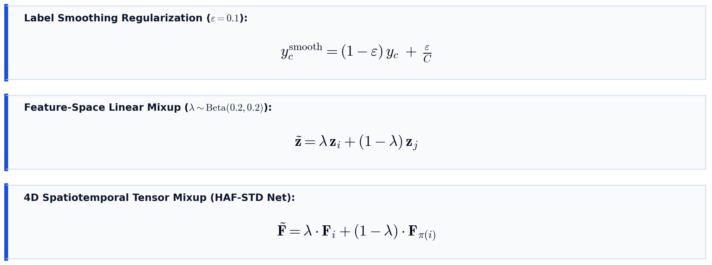
Training Techniques — Mathematical Formulation
Label smoothing regularization, feature-space linear mixup, and 4D spatiotemporal tensor mixup

Slide 24
Benchmark Datasets — Detailed Description
FineGym (Fine-Grained Gymnastics Benchmark):
  Event-level tier with 4 distinct gymnastics apparatus events: Balance Beam (BB), Floor Exercise (FX), Uneven Bars (UB), and Vault (VT).
  1,200 total event clips (balanced 300 clips per class) acquired via yt-dlp from high-frame-rate YouTube footage.
  Key characteristic: Homogeneous gym arena background eliminates spatial shortcuts — forces models to capture subtle body kinematics and rapid joint transitions.
HMDB51 (Coarse-Grained General Action Benchmark):
  Curated from commercial cinema and web videos covering 51 diverse human action categories (facial, general body motion, human-object interactions).
  6,754 video clips ingested directly from the Hugging Face Hub (jili5044/hmdb51).
  Key characteristic: High real-world intra-class variance with diverse camera viewpoints, cluttered backgrounds, lighting shifts, and occlusions.
Contrasting Task Granularity:
  Pairing FineGym (kinematic-focused) and HMDB51 (context-rich) provides a rigorous, dual-granularity testbed for representation quality.

Slide 25
Benchmark Datasets — Summary Comparison
Dataset Parameter | FineGym (Event-Level) | HMDB51
Task Granularity | Fine-grained (Gymnastics) | Coarse-grained (General)
Total Clips | 1,200 clips (300 / class) | 6,754 clips
Number of Classes | 4 event classes | 51 action classes
Data Source | YouTube via yt-dlp | Hugging Face Hub
Domain Context | Uniform arena environment | Diverse real-world settings
Primary Discriminative Cue | Subtle body kinematics | Broad motion & background context
Feature Dimension | 1,280 (V-JEPA 2) / 3,584 (Qwen) | 1,280 (V-JEPA 2) / 3,584 (Qwen)
Evaluation Split | 80% Train / 20% Test | 80% Train / 20% Test

Slide 26
HAF-STD Net — Novel Architecture (4.8M params)
Hierarchical Adaptive Fusion with Spectral-Temporal Decomposition Network — designed to exploit V-JEPA 2's multi-layer latent representations.
1. Spectral-Temporal Decomposition (Haar DWT):
  1D Haar Discrete Wavelet Transform on temporal axis at each encoder layer → separates low-frequency appearance stream from high-frequency motion stream.
2. Depth Representation Velocity:
  Inter-layer deltas between consecutive encoder layers capture how internal representations transform across depth — action-class dependent.
3. Adaptive Routing over Depth × Frequency:
  4 layers × 3 streams = 12 feature vectors. Input-dependent softmax routing learns optimal fusion. Classification via cosine similarity head with learnable temperature.

Slide 27
Frozen-Feature Protocol & Preprocessing
Frozen-Feature Protocol:
  Backbone model weights remain fixed (∇Θ = 0). Only downstream classifier weights are optimized, isolating intrinsic representation quality.
Feature Preprocessing:
  StandardScaler: Applied to all representations (zero mean, unit variance), including HAF-STD Net multi-layer tensors.
  PCA: Fitted on training split to retain 95% total variance; applied to baseline classifiers but bypassed by HAF-STD Net.
  Train/Eval Split: 80/20 stratified split.
Evaluation Metrics (7 total):
  Top-1 Accuracy, Macro F1, Weighted F1, Macro Precision & Recall, MCC (Matthews Correlation Coefficient), Cohen's Kappa, Top-5 Accuracy (HMDB51 only).

Slide 28
Classifier Architectures (12 Total)
Classical ML Classifiers (5 — sklearn):
  SVM-RBF (C=1.0), KNN-7, Random Forest (500 trees), MLP (512→256), Logistic Regression (L2)
PyTorch Neural Network Classifiers (6):
  DeepMLP (4-layer), ResMLP (residual skip connections), Conv1DNet, MiniTransformer (4-head), AttentionPoolMLP, CosineClassifier
Novel Architecture (1):
  HAF-STD Net — operates on multi-layer V-JEPA 2 features without PCA reduction
Training Techniques:
  Label Smoothing (ε=0.1), Feature-Space Mixup (α=0.2), Cosine Annealing LR (10⁻³→10⁻⁶), AdamW (λ=10⁻⁴), Early Stopping (15 epochs patience).

Slide 29
Implementation Details
Hardware: Kaggle — NVIDIA Tesla T4 GPU (15.6 GB VRAM), 2 vCPU, 13 GB RAM.
Software: Python 3.12, PyTorch 2.x, Transformers (HuggingFace), BitsAndBytes (NF4), scikit-learn, OpenCV.
Key Implementation Decisions:
  Sequential model loading (one at a time) for GPU memory management.
  Periodic checkpointing every 100–500 clips for crash recovery.
  HMDB51: Direct zip download via hf_hub_download (bypassed schema validation errors).
  FineGym: yt-dlp with temporal trimming for precise clip extraction.
Total execution time: ~210 minutes (both datasets, both models, all classifiers).

Slide 30
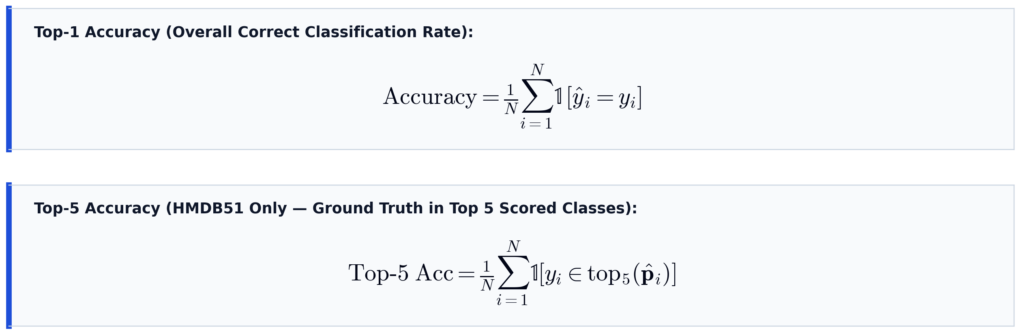
Evaluation Metrics — Accuracy
Top-1 overall classification accuracy and Top-5 relaxed multi-candidate accuracy for HMDB51

Slide 31
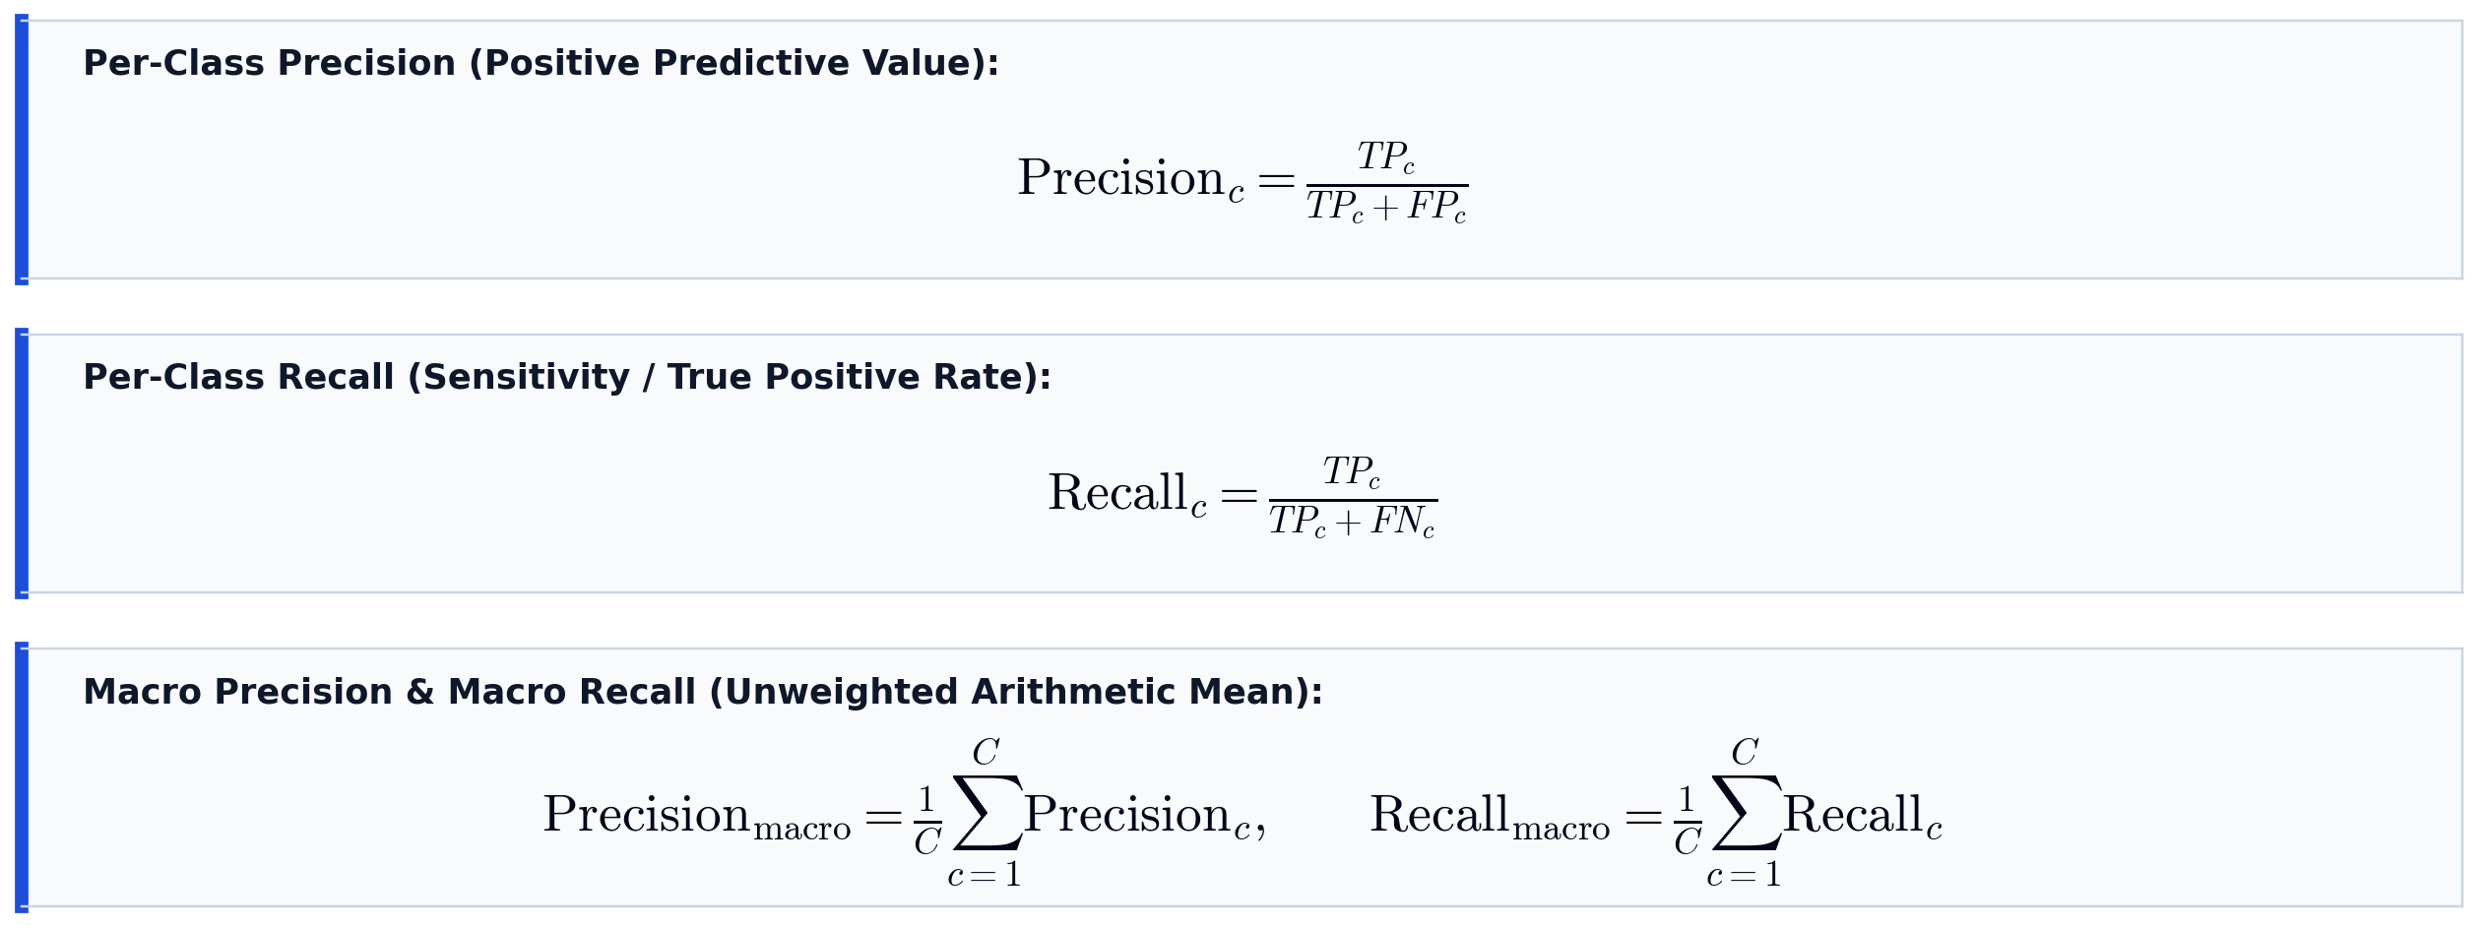
Evaluation Metrics — Precision & Recall
Per-class precision, per-class recall, and unweighted macro-averaged precision and recall

Slide 32
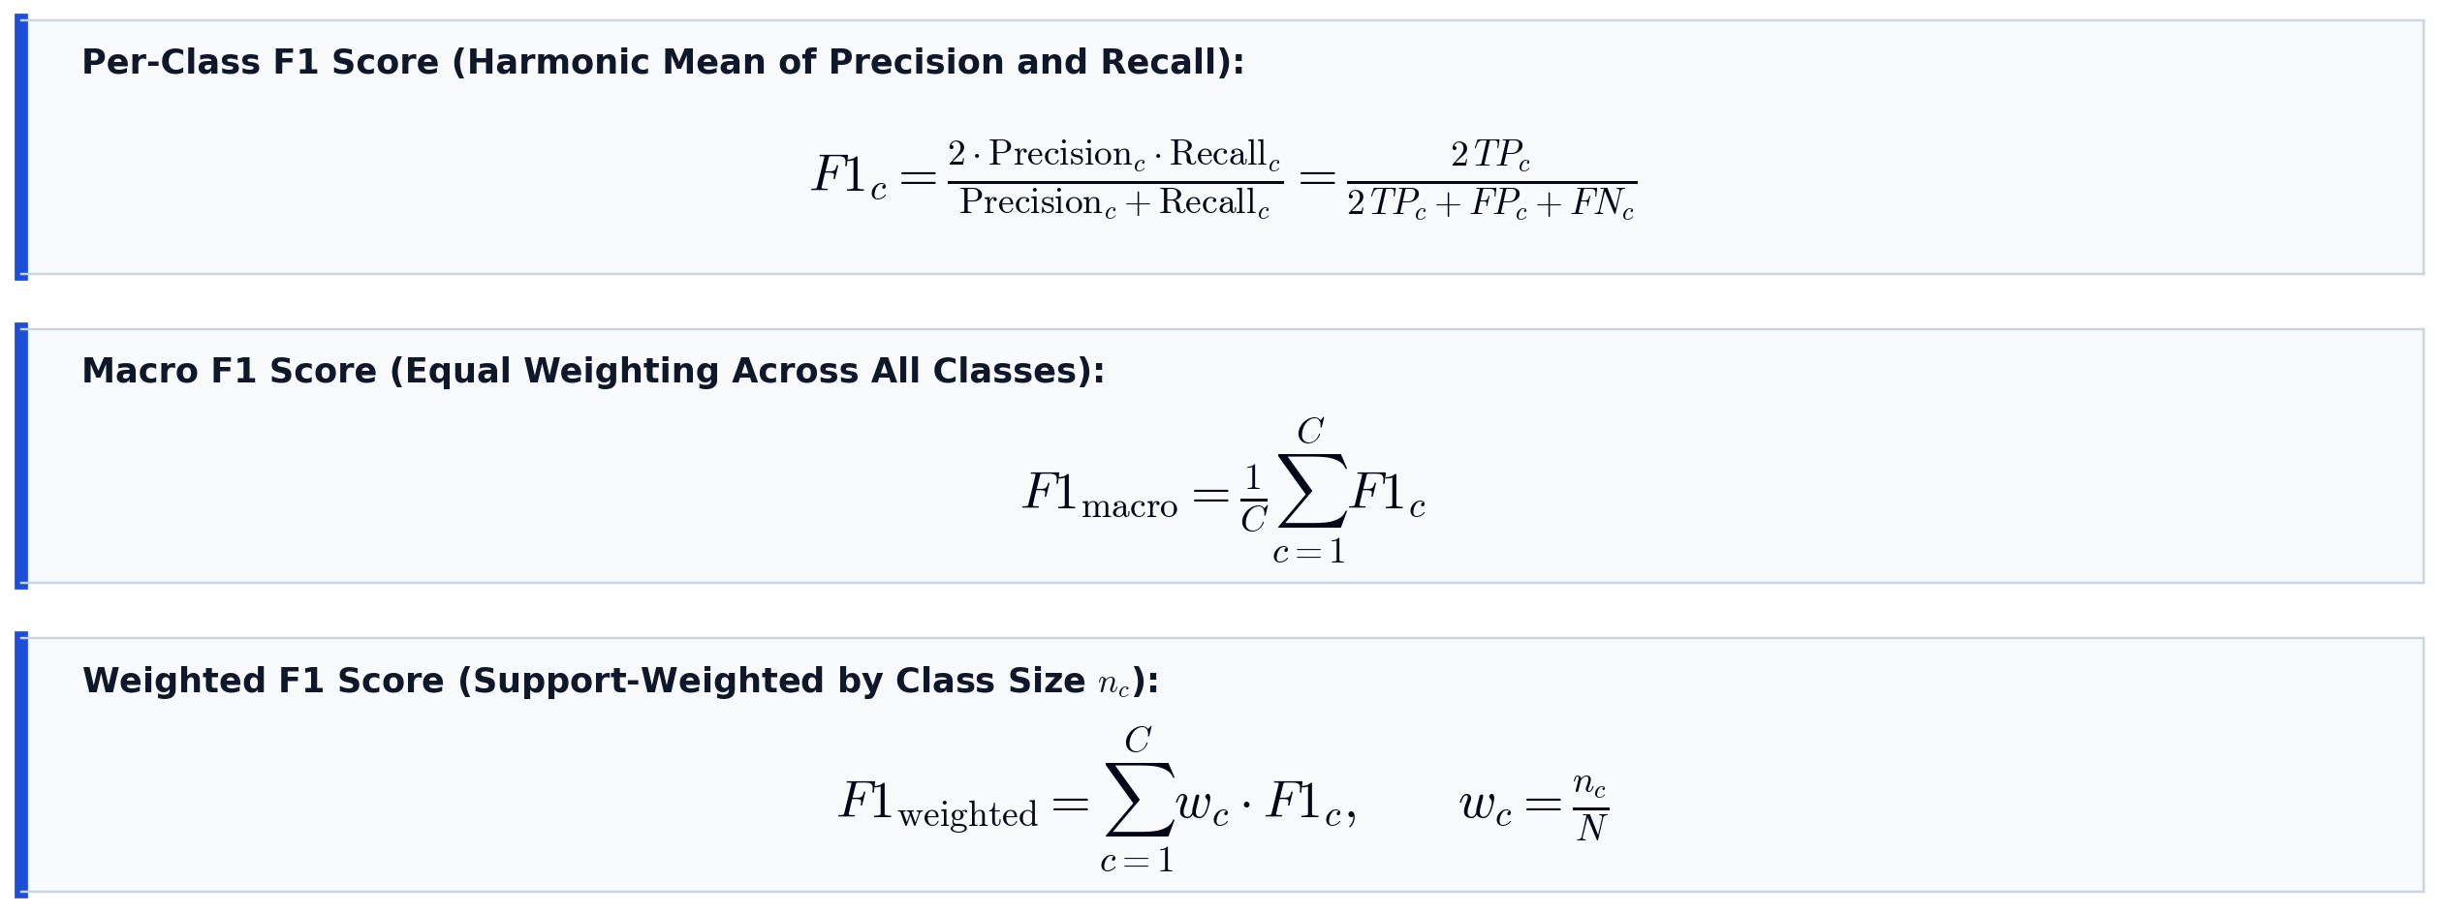
Evaluation Metrics — F1 Score
Per-class harmonic mean, unweighted macro F1 (equal class priority), and support-weighted F1

Slide 33
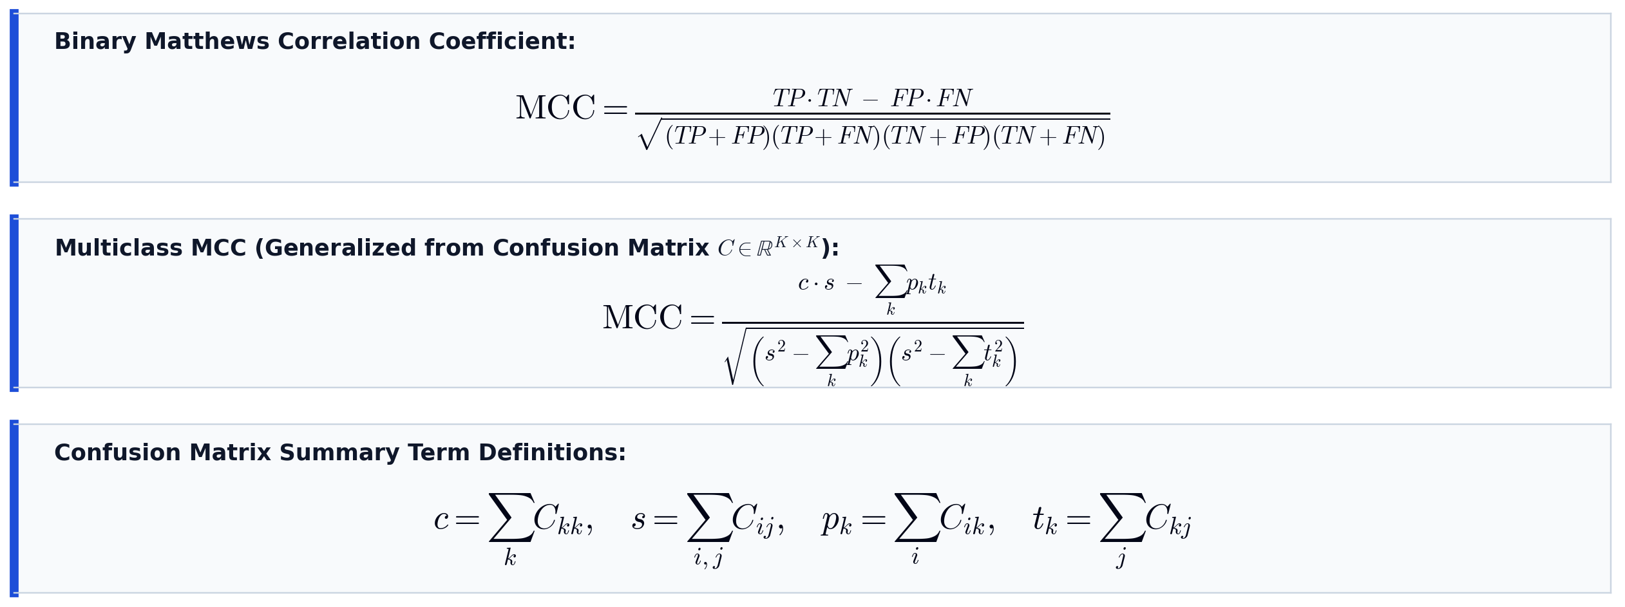
Evaluation Metrics — Matthews Correlation Coefficient (MCC)
Binary MCC and generalized multiclass MCC computed across all confusion matrix entries

Slide 34
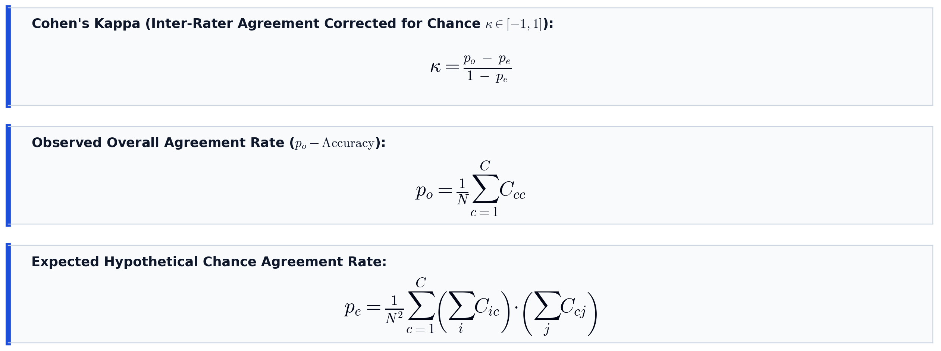
Evaluation Metrics — Cohen's Kappa (κ)
Chance-corrected inter-rater agreement statistic (observed agreement po vs expected chance agreement pe)

Slide 35
FineGym Results — V-JEPA 2 Features
Classifier | Type | Accuracy (%) | F1 Macro (%) | MCC
SVM-RBF | sklearn | 95.0 | 94.8 | 0.933
KNN-7 | sklearn | 72.5 | 71.2 | 0.633
Random Forest | sklearn | 86.7 | 86.3 | 0.822
MLP (sklearn) | sklearn | 90.8 | 90.2 | 0.878
LogReg | sklearn | 94.2 | 93.9 | 0.923
DeepMLP | PyTorch | 97.1 | 96.8 | 0.961
ResMLP | PyTorch | 97.9 | 97.5 | 0.972
Conv1DNet | PyTorch | 96.3 | 96.0 | 0.950
Transformer | PyTorch | 97.5 | 97.2 | 0.967
AttnPoolMLP | PyTorch | 93.3 | 93.0 | 0.911
CosineClf | PyTorch | 96.7 | 96.4 | 0.956
HAF-STD Net | PyTorch | 98.1 | 97.8 | 0.974

Slide 36
FineGym Results — Qwen2.5-VL Features
Classifier | Type | Accuracy (%) | F1 Macro (%) | MCC
SVM-RBF | sklearn | 72.7 | 73.4 | 0.643
KNN-7 | sklearn | 54.5 | 56.8 | 0.405
Random Forest | sklearn | 58.2 | 59.4 | 0.454
MLP (sklearn) | sklearn | 63.6 | 62.3 | 0.516
LogReg | sklearn | 83.6 | 82.5 | 0.785
*DeepMLP | PyTorch | 89.1 | 88.4 | 0.855
ResMLP | PyTorch | 83.6 | 82.9 | 0.791
Conv1DNet | PyTorch | 74.5 | 74.4 | 0.664
Transformer | PyTorch | 80.0 | 78.9 | 0.734
AttnPoolMLP | PyTorch | 60.0 | 59.5 | 0.471
CosineClf | PyTorch | 85.5 | 84.8 | 0.806

Slide 37
FineGym — Comprehensive Comparison (Best Classifiers)
Metric | V-JEPA 2 | Qwen2.5-VL
Accuracy (%) | 98.1 | 89.1
Precision macro (%) | 98.5 | 88.9
Recall macro (%) | 98.3 | 88.4
F1 macro (%) | 97.8 | 88.4
F1 weighted (%) | 98.5 | 88.9
MCC | 0.974 | 0.855
Cohen's Kappa | 0.974 | 0.854
Best Classifier | HAF-STD Net | DeepMLP
*Winner | V-JEPA 2 (+9.4% F1)

Slide 38
HMDB51 Results — V-JEPA 2 Features
Classifier | Type | Top-1 (%) | Top-5 (%) | F1 (%) | MCC
SVM-RBF | sklearn | 79.8 | 95.9 | 81.4 | 0.792
KNN-7 | sklearn | 69.9 | 91.0 | 70.0 | 0.691
Random Forest | sklearn | 70.6 | 91.8 | 73.4 | 0.706
MLP (sklearn) | sklearn | 79.3 | 95.4 | 80.3 | 0.788
LogReg | sklearn | 78.2 | 94.9 | 79.4 | 0.776
DeepMLP | PyTorch | 82.9 | 96.2 | 83.5 | 0.824
ResMLP | PyTorch | 82.9 | 94.4 | 83.6 | 0.824
Conv1DNet | PyTorch | 77.8 | 91.1 | 78.5 | 0.772
Transformer | PyTorch | 79.4 | 93.3 | 79.9 | 0.789
AttnPoolMLP | PyTorch | 75.4 | 93.0 | 75.4 | 0.747
CosineClf | PyTorch | 82.7 | 95.2 | 83.4 | 0.822
HAF-STD Net | PyTorch | 84.7 | 95.8 | 85.3 | 0.843

Slide 39
HMDB51 Results — Qwen2.5-VL Features
Classifier | Type | Top-1 (%) | Top-5 (%) | F1 (%) | MCC
SVM-RBF | sklearn | 73.6 | 91.9 | 75.3 | 0.729
KNN-7 | sklearn | 51.3 | 76.4 | 50.2 | 0.503
Random Forest | sklearn | 64.2 | 86.5 | 63.8 | 0.635
MLP (sklearn) | sklearn | 70.8 | 88.9 | 70.4 | 0.702
LogReg | sklearn | 73.6 | 91.9 | 75.3 | 0.729
*DeepMLP | PyTorch | 77.1 | 93.0 | 79.1 | 0.765
ResMLP | PyTorch | 76.7 | 90.2 | 77.6 | 0.760
Conv1DNet | PyTorch | 11.5 | 25.8 | 0.8 | 0.081
Transformer | PyTorch | 71.5 | 90.4 | 72.5 | 0.707
AttnPoolMLP | PyTorch | 71.9 | 91.1 | 73.6 | 0.712
CosineClf | PyTorch | 76.8 | 92.5 | 78.4 | 0.761

Slide 40
HMDB51 — Comprehensive Comparison (Best Classifiers)
Metric | V-JEPA 2 | Qwen2.5-VL
Top-1 Accuracy (%) | 84.7 | 77.1
Top-5 Accuracy (%) | 95.8 | 93.0
Precision macro (%) | 87.7 | 80.3
Recall macro (%) | 84.8 | 79.1
F1 macro (%) | 85.3 | 79.1
F1 weighted (%) | 84.5 | 77.3
MCC | 0.843 | 0.765
Cohen's Kappa | 0.842 | 0.765
Best Classifier | HAF-STD Net | DeepMLP
*Winner | V-JEPA 2 (+6.2% F1)

Slide 41
Result Analysis — Key Findings
1. V-JEPA 2 Consistently Outperforms Qwen2.5-VL
  Wins on every single metric on both FineGym and HMDB51. HAF-STD Net widens the gap: +9.4% F1 on FineGym, +6.2% F1 on HMDB51.
2. Performance Gap Depends on Task Granularity
  Fine-grained advantage (+9.4% F1) > Coarse-grained (+6.2% F1). V-JEPA 2's masked spatio-temporal prediction excels at discriminating subtle temporal motion patterns.
3. Parameter Efficiency: Task Specialization > Model Scale
  V-JEPA 2 (654M) delivers 7.6% higher accuracy on HMDB51 than Qwen2.5-VL (7B) with ~10× fewer parameters.
4. HAF-STD Net Effectiveness
  Best on both benchmarks. Only 4.8M params (0.7% of backbone). Intelligent probe design yields substantial gains at minimal cost.

Slide 42
Why Self-Supervised Representations Win
V-JEPA 2 (SSL) features are visual-geometric:
  Capture motion trajectories, spatial configurations, temporal dynamics.
  Masked spatio-temporal prediction forces the encoder to learn fine-grained temporal coherence.
Qwen2.5-VL (VLM) features are linguistically-grounded:
  Encode broad descriptive information (object identity, scene context).
  Linguistic grounding may sacrifice fine-grained visual distinctions lacking clear language labels.
Task specialization outweighs model scale:
  A video-native SSL architecture (654M) is more effective than a larger general-purpose VLM (7B) for action recognition.

Slide 43
Conclusion
Self-supervised video encoders produce superior temporal representations for action recognition compared to vision-language models.
Key Results:
  FineGym: V-JEPA 2 + HAF-STD Net → 98.1% accuracy, 97.8% F1, MCC = 0.974 vs. Qwen2.5-VL's 89.1% (+9.4% F1 gap).
  HMDB51: V-JEPA 2 + HAF-STD Net → 84.7% accuracy, 85.3% F1, MCC = 0.843 vs. Qwen2.5-VL's 77.1% (+6.2% F1 gap).
Key Contributions:
  First controlled cross-paradigm comparison of SSL vs. VLM under identical frozen-feature evaluation.
  Demonstrated task-specialized SSL (654M) substantially outperforms general-purpose VLM (7B) with ~10× fewer parameters.
  Proposed HAF-STD Net — best on both benchmarks, exploiting multi-layer depth + spectral-temporal decomposition + adaptive routing.

Slide 44
Future Recommendations
1. Extend evaluation to FineGym set-level (288 classes) and element-level (530 classes) for deeper granularity analysis.
2. Complement frozen-feature study with end-to-end fine-tuning to assess whether VLM features benefit more from task-specific adaptation.
3. Evaluate Qwen2.5-VL at full precision (float16) on higher-end GPUs to eliminate quantization as a potential confound.
4. Investigate fusing V-JEPA 2 temporal representations with Qwen2.5-VL semantic representations through cross-attention mechanisms.
5. Benchmark on specialized real-world domains: surgical video analysis, physiotherapy monitoring, fine-grained athletic motion analysis.

Slide 45
References
[1] Assran, M. et al. (2023). Self-supervised learning from images with a joint-embedding predictive architecture. CVPR.
[2] Bardes, A. et al. (2024). V-JEPA: Latent video prediction for visual representation learning.
[3] Assran, M. et al. (2025). V-JEPA 2: Self-supervised video models enable understanding of complex interactions. Meta AI.
[4] Murlabadia, S. et al. (2026). V-JEPA 2.1: Dense token prediction with hierarchical intermediate supervision.
[5] Bai, J. et al. (2025). Qwen2.5-VL technical report. Alibaba Cloud.
[6] Qwen Team (2025). Qwen3-VL: Advancing multimodal understanding.
[7] Bordes, F. et al. (2024). An introduction to vision-language modeling. Meta AI.
[8] Zhang, Z. et al. (2023). Vision-language models for vision tasks: A survey. IEEE TPAMI.
[9] Pathak, H. et al. (2026). A survey on efficient vision-language models.

Slide 46
Thank You!!!
Questions & Discussion

