Slide 1
Memory Testing
With T5773
Basic Advantest HW Overview
Basic SW settings

Slide 2
Memory Array
Y= 000
001
010
011
100
101
110
111
1
0
1
1
0
1
1
1
X=000
1
1
0
0
1
0
0
0
001
0
1
1
1
0
0
1
1
010
1
0
0
0
1
0
0
0
011
1
1
1
0
1
0
0
1
100
1
0
0
1
0
1
1
1
101
0
0
0
0
1
0
0
1
110
1
0
1
0
1
0
0
1
111
DQ0 - 3

Slide 3
Array Testing
Y= 000
001
010
011
100
101
110
111
1
0
1
1
0
1
☒
1
1
X=000
1
1
0
0
1
0
0
0
Fail List
X Y
001
0
1
1
1
☒
0
0
1
1
000 101
010
010 011
1
0
0
0
1
0
0
0
110 101
011
1
1
1
0
1
0
0
1
100
1
0
0
1
0
1
1
1
101
0
0
0
0
1
0
☒
0
1
110
1
0
1
0
1
0
0
1
111

Slide 4
Writing to DUT
ALPG
Data Generator
Address Generator
DUT
011010
Dr
Address
101001
Data
Dr
DUT Control Generator
010110
Dr
Control
Power
GND
PS

Slide 5
Reading from DUT
ALPG
Data Generator
100010
Address Generator
DUT
011010
SC
Dr
Address
Cp
HLLHLH
Data
DUT Control Generator
PPFPPFP
010110
Dr
Control
Power
GND
Fail Memory
& Counters
... X=010 Y=011 ...
Fail List
X Y
000 101
PS
010 011
110 101

Slide 6
DC / Parametric Testing
All tester pins connected to DC Unit
1 DC Unit / FuncBlock (x4 per Site)
PS Units each have their own parametric system
DC Matrix
DC Unit
DUT
VSIM
MVM
PS
PS
VSIM

Slide 7
Parametric & Functional Testing
ALPG
Data Generator
Address Generator
DUT
011010
Dr
Address
101001
Data
Dr
DUT Control Generator
010110
Dr
Control
Power
Tester Control
Vref
GND
Meas or
Force
DC Unit
PS

Slide 8
Sequential Data
Immediate Data insertion in pattern program
ALPG
UBM: 16KW /IO Drive / Capture / Exp Data
DBM: 1Gb (IOs) Drive / Exp Data
Data Generator
Immediate Data
100010
Address Generator
DUT
Immediate Data
011010
Dr
SC
Cp
HLLHLH
011010
DUT Control Generator
UBM
Drive
or
Capture
011010
P F P P F P P
011010
Sequence Control
DBM
Vector List
IO0, 1, 2, 3, …
0 1 1 0
0 1 0 0
: : : :

Slide 9
Signal Creation
011010
011010
3V
Set
Reset
Set
0V
10ns
35ns
45ns
ALPG
PDS
FC
DUT
A0
WE
CE
CH1
CH2
CH3
Dr
NRZ
RZO
XOR
::
DRE/CPE
CH1
TS
D0
HLHLLH
Cp
TG
SC
VO=3V,0V
VI=0.1V,2.9V
VIO
10ns
35ns
45ns
PPFPPFP
To Fail Memory & Counters

Slide 10
PPS & VIO: Level Settings
011010
011010
3V
Set
Reset
Set
0V
10ns
35ns
45ns
ALPG
PDS
FC
DUT
A0
WE
CE
CH1
CH2
CH3
Dr
NRZ
RZO
XOR
::
DRE/CPE
CH1
TS
D0
HLHLLH
Cp
TG
SC
VO=3V,0V
VI=0.1V,2.9V
VIO
PS
10ns
35ns
45ns
PPFPPFP
To Fail Memory & Counters

Slide 11
PPS & VIO: Level Settings
PPS: Device Power Supply
  Supply Level settings
    Set in KPowerSource
VIO: Voltage In/Out
  VIH setting for Drivers
    Set in KDriverInputVoltage
  VIL is fixed to 0V
  VOH setting for Comparators (single comparator)
    Set in KComparatorReferenceVoltage
  12 assignable Levels for each (VIH & VOH)
  Pin level selection done via KPin.set() arguments
Notes:
MAIN PROGRAM ELEMENTS
Explain Wave Format NRZB
NRZB Non Return to Zero Using an BCLK Edge.
/NRZB Complement Wave Form
I_x0008_f the wave form goes to a one in a cycle, then it is not
allowed to return to zero in the same cycle it went to a one or
Stayed at a one do to the data that was being formatted.
EXAMPLE:
XADD = IN1, NRZB, BCLK1, <X0-7>

Slide 12
Format Control: Waveforms
011010
011010
3V
Set
Reset
Set
0V
10ns
35ns
45ns
ALPG
PDS
FC
DUT
A0
WE
CE
CH1
CH2
CH3
Dr
NRZ
RZO
XOR
::
DRE/CPE
CH1
TS
D0
HLHLLH
Cp
TG
SC
VO=3V,0V
VI=0.1V,2.9V
VIO
10ns
35ns
45ns
PPFPPFP
To Fail Memory & Counters

Slide 13
Format Control: Waveforms
Formats: NRZ, RZn, FIXn
  NRZ: Non-Return to Zero
  (up to) 1 transition per cycle
  Pin Waveform selected via KPin.set() argument
Rate
ALPG Output
1
1
0
0
BCLK
CCLK
NRZB
NRZB
VIL = 0V
VIH = 3.6V
VIL = 0V
iNRZB
VIL = 0V
VIH = 3.6V
NRZC
iNRZC
Notes:
MAIN PROGRAM ELEMENTS
Explain Wave Format NRZB
NRZB Non Return to Zero Using an BCLK Edge.
/NRZB Complement Wave Form
I_x0008_f the wave form goes to a one in a cycle, then it is not
allowed to return to zero in the same cycle it went to a one or
Stayed at a one do to the data that was being formatted.
EXAMPLE:
XADD = IN1, NRZB, BCLK1, <X0-7>

Slide 14
Format Control: Waveforms
Formats: NRZ, RZn, FIXn
  NRZBC: Use BCLK for rising edge, CCLK for falling edge
  Still only (up to) 1 transition per cycle
Rate
ALPG Output
1
1
0
0
BCLK
CCLK
NRZBC
NRZB
VIL = 0V
VIH = 3.6V
VIL = 0V
iNRZBC
VIL = 0V
VIH = 3.6V
NRZCB
iNRZCB
Notes:
MAIN PROGRAM ELEMENTS
Explain Wave Format NRZB
NRZB Non Return to Zero Using an BCLK Edge.
/NRZB Complement Wave Form
I_x0008_f the wave form goes to a one in a cycle, then it is not
allowed to return to zero in the same cycle it went to a one or
Stayed at a one do to the data that was being formatted.
EXAMPLE:
XADD = IN1, NRZB, BCLK1, <X0-7>

Slide 15
Format Control: Waveforms
Formats: NRZ, RZn, FIXn
  RZO: Return to Zero on a One (Z=Zero; X=Don’t Care)
  2 transitions per cycle
Rate
ALPG Output
1
1
0
0
BCLK
CCLK
RZO
NRZB
iRZO
RZZ
iRZZ
RZX
iRZX
Notes:
MAIN PROGRAM ELEMENTS
Explain Wave Format NRZB
NRZB Non Return to Zero Using an BCLK Edge.
/NRZB Complement Wave Form
I_x0008_f the wave form goes to a one in a cycle, then it is not
allowed to return to zero in the same cycle it went to a one or
Stayed at a one do to the data that was being formatted.
EXAMPLE:
XADD = IN1, NRZB, BCLK1, <X0-7>

Slide 16
Format Control: Waveforms
Formats: NRZ, RZn, FIXn
  FIXL: Fixed Low; FIXH = Fixed High
  No transitions; No ALPG control
Rate
ALPG Output
1
1
0
0
BCLK
CCLK
FIXL
NRZB
VIL = 0V
FIXH
VIH = 3.6V
VIH = 3.6V
Notes:
MAIN PROGRAM ELEMENTS
Explain Wave Format NRZB
NRZB Non Return to Zero Using an BCLK Edge.
/NRZB Complement Wave Form
I_x0008_f the wave form goes to a one in a cycle, then it is not
allowed to return to zero in the same cycle it went to a one or
Stayed at a one do to the data that was being formatted.
EXAMPLE:
XADD = IN1, NRZB, BCLK1, <X0-7>

Slide 17
Timing Generator
011010
011010
3V
Set
Reset
Set
0V
10ns
35ns
45ns
ALPG
PDS
FC
DUT
A0
WE
CE
CH1
CH2
CH3
Dr
NRZ
RZO
XOR
::
DRE/CPE
CH1
TS
D0
HLHLLH
Cp
TG
SC
VO=3V,0V
VI=0.1V,2.9V
VIO
10ns
35ns
45ns
PPFPPFP
To Fail Memory & Counters

Slide 18
Timing Generator
Clock Edge Timings
  12 assignable Edges for each (BCLK & CCLK)
  16 Independent timing sets
  Timing values set in KDriverTimingEdge
  Pin timing edges selected via KPin.set() arguments
  TG also controls Strobe & DRE/CPE timings (covered later)
TS1
Rate = 20ns
BCLK1 = 0ns
CCLK1 = 10ns
TS2
Rate = 30ns
BCLK1 = 10ns
CCLK1 = 25ns
20ns
30ns
20ns
20ns
ALPG Output
1
1
0
0
BCLK1
CCLK1
NRZB
RZO
Notes:
MAIN PROGRAM ELEMENTS
Explain Wave Format NRZB
NRZB Non Return to Zero Using an BCLK Edge.
/NRZB Complement Wave Form
I_x0008_f the wave form goes to a one in a cycle, then it is not
allowed to return to zero in the same cycle it went to a one or
Stayed at a one do to the data that was being formatted.
EXAMPLE:
XADD = IN1, NRZB, BCLK1, <X0-7>

Slide 19
Timing Generator
TS1
Rate = 20ns
BCLK1 = 0ns
CCLK1 = 10ns
CCLK2 = 15ns
TS2
Rate = 30ns
BCLK1 = 10ns
CCLK1 = 25ns
CCLK2 = 20ns
20ns
30ns
20ns
20ns
ALPG Output
1
1
0
0
BCLK1
CCLK1
NRZB
CCLK2
Pin1:RZO
Pin2:RZO
Notes:
MAIN PROGRAM ELEMENTS
Explain Wave Format NRZB
NRZB Non Return to Zero Using an BCLK Edge.
/NRZB Complement Wave Form
I_x0008_f the wave form goes to a one in a cycle, then it is not
allowed to return to zero in the same cycle it went to a one or
Stayed at a one do to the data that was being formatted.
EXAMPLE:
XADD = IN1, NRZB, BCLK1, <X0-7>

Slide 20
IO Control
011010
011010
3V
Set
Reset
Set
0V
10ns
35ns
45ns
ALPG
PDS
FC
DUT
A0
WE
CE
CH1
CH2
CH3
Dr
NRZ
RZO
XOR
::
DRE/CPE
CH1
TS
D0
HLHLLH
Cp
TG
SC
VO=3V,0V
VI=0.1V,2.9V
VIO
10ns
35ns
45ns
PPFPPFP
To Fail Memory & Counters

Slide 21
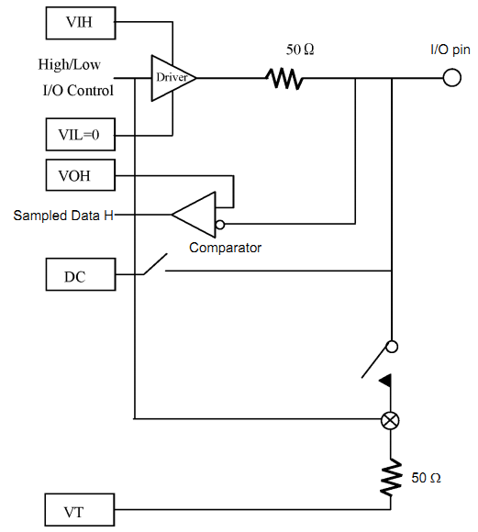
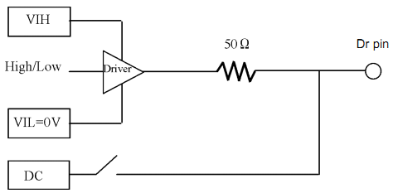
IO Control
IO Pins
DR Pins
No IO control necessary

Slide 22
DRE Waveforms
DRE: DRive Enable Signal
  RZ and NRZ available
  Pin Waveform selected via KPin.set() argument
20ns
30ns
20ns
20ns
DRE Signal
(from ALPG)
1
1
0
1
DREL1
DRET1
DRERZ
DRENRZ
DRENRZ
With DREL = DRET = 0
Notes:
MAIN PROGRAM ELEMENTS
Explain Wave Format NRZB
NRZB Non Return to Zero Using an BCLK Edge.
/NRZB Complement Wave Form
I_x0008_f the wave form goes to a one in a cycle, then it is not
allowed to return to zero in the same cycle it went to a one or
Stayed at a one do to the data that was being formatted.
EXAMPLE:
XADD = IN1, NRZB, BCLK1, <X0-7>

Slide 23
DRE Signals
DRE: DRive Enable Signal
  Controlled by pattern (ALPG)
  2 assignable DRE signals: DRE1, DRE2
  Set in KIoControlTiming constructor
  Assigned to Pin via KPin.set() argument
20ns
30ns
20ns
20ns
DRE Signals
(from ALPG)
DRE1
DRE2
1
0
0
1
0
1
0
1
DREL1
DRET2
Pin33: DRENRZ, DRE1
Pin33: DRERZ, DRE1
Pin34: DRERZ, DRE2
Notes:
MAIN PROGRAM ELEMENTS
Explain Wave Format NRZB
NRZB Non Return to Zero Using an BCLK Edge.
/NRZB Complement Wave Form
I_x0008_f the wave form goes to a one in a cycle, then it is not
allowed to return to zero in the same cycle it went to a one or
Stayed at a one do to the data that was being formatted.
EXAMPLE:
XADD = IN1, NRZB, BCLK1, <X0-7>

Slide 24
CPE Signals
CPE: ComParator Enable Signal
  Controlled by pattern (ALPG)
  4 assignable CPE signals: CPE1, CPE2, CPE3, CPE4
  Set in KComparatorStrobeTiming constructor
  Assigned to Pin via KPin.set() argument
20ns
30ns
20ns
20ns
CPE Signals
(from ALPG)
CPE1
CPE2
1
0
0
1
0
1
0
1
STRB1
STRB2
Pin33: STRB1, CPE1
Pin33: STRB2, CPE1
Pin34: STRB2, CPE2
Notes:
MAIN PROGRAM ELEMENTS
Explain Wave Format NRZB
NRZB Non Return to Zero Using an BCLK Edge.
/NRZB Complement Wave Form
I_x0008_f the wave form goes to a one in a cycle, then it is not
allowed to return to zero in the same cycle it went to a one or
Stayed at a one do to the data that was being formatted.
EXAMPLE:
XADD = IN1, NRZB, BCLK1, <X0-7>

Slide 25
Real-Time PDS
Cycle Palette Selection
ALPG
PDS
FC
A0
WE
CE
CH1
CH2
CH3
DRE/CPE
CH1
TS
D0
TG
SC
10ns
35ns
45ns

Slide 26
NAND Address Cycle Table
Device Assignment
DQ7
DQ6
DQ5
DQ4
DQ3
DQ2
DQ1
DQ0
1st
CA7
CA6
CA5
CA4
CA3
CA2
CA1
CA0
2nd
FL
FL
CA13
CA12
CA11
CA10
CA9
CA8
3rd
BA0
PA6
PA5
PA4
PA3
PA2
PA1
PA0
4th
BA8
BA7
BA6
BA5
BA4
BA3
BA2
BA1
5th
FL
BA15
BA14
BA13
BA12
BA11
BA10
BA9
Tester (PDS) Assignment
DQ7
DQ6
DQ5
DQ4
DQ3
DQ2
DQ1
DQ0
1st
Y7
Y6
Y5
Y4
Y3
Y2
Y1
Y0
2nd
FL
FL
Y13
Y12
Y11
Y10
Y9
Y8
3rd
X7
X6
X5
X4
X3
X2
X1
X0
4th
X15
X14
X13
X12
X11
X10
X9
X8
5th
FL
Z3
Z2
Z1
X19
X18
X17
X16

Slide 27
Tester Cycle Palette Assignments
DQ7
DQ6
DQ5
DQ4
DQ3
DQ2
DQ1
DQ0
CYP1
Y7
Y6
Y5
Y4
Y3
Y2
Y1
Y0
CYP2
FL
FL
Y13
Y12
Y11
Y10
Y9
Y8
CYP3
X7
X6
X5
X4
X3
X2
X1
X0
CYP4
X15
X14
X13
X12
X11
X10
X9
X8
CYP5
FL
Z2
Z1
Z0
X19
X18
X17
X16
CYP6
D7
D6
D5
D4
D3
D2
D1
D0
Data/Command Input

Slide 28
NAND Address Input Pattern
ADDRESS DEFINE
Y20-22 = Z0-2
XY = ZN
:
START #0
ST0: NOP TP2<#80 CE
NOP CYP6 CE WE CLE D<TP2 ;Prog Cmd
NOP CYP1 CE WE ALE ;1st Address Cycle
NOP CYP2 CE WE ALE ;2nd Address Cycle
NOP CYP3 CE WE ALE ;3rd Address Cycle
NOP CYP4 CE WE ALE ;4th Address Cycle
NOP TP2<#10 CYP5 CE WE ALE ;5th Address Cycle
JNI1 . CYP6 CE WE XB<XB+1 ;Data input
NOP CYP6 CE WE CLE D<TP2 ;Prog Confirm Cmd
FLGLI1 ST0 CYP1 CE RB ;Waiting for R/B
ST2: JNI2 ST0 CYP1 CE YB<YB+1 ;Next Page
JNI3 ST0 CYP1 CE YB<YB+1 ;Next Block
JNI4 ST0 CYP1 CE YB<0 Z<Z+1 ;Next Chip
STPS
CYP1
DQ7
DQ6
DQ5
DQ4
DQ3
DQ2
DQ1
DQ0
Y7
Y6
Y5
Y4
Y3
Y2
Y1
Y0
CYP2
FL
FL
Y13
X12
Y11
Y10
Y9
Y8
CYP3
X7
X6
X5
X4
X3
X2
X1
X0
CYP4
X15
X14
X13
X12
X11
X10
X9
X8
CYP5
FL
Z3
Z2
Z1
X19
X18
X17
X16
CYP6
D7
D6
D5
D4
D3
D2
D1
D0

Slide 29
NAND Address Input Pattern
SDEF DUMMY = CE
SDEF CMD = CE WE CLE CYP6 D<TP2
SDEF ADD1= CE WE ALE CYP1
SDEF ADD2= CE WE ALE CYP2
SDEF ADD3= CE WE ALE CYP3
SDEF ADD4= CE WE ALE CYP4
SDEF ADD5= CE WE ALE CYP5
:
START #0
ST0: NOP TP2<#80 DUMMY
NOP CMD ;Prog Cmd
NOP ADD1 ;1st Address Cycle
NOP ADD2 ;2nd Address Cycle
NOP ADD3 ;3rd Address Cycle
NOP ADD4 ;4th Address Cycle
NOP TP2<#10 ADD5 ;5th Address Cycle
JNI1 . DATAIN XB<XB+1 ;Data input
NOP CMD ;Prog Confirm Cmd
FLGLI1 ST0 POLLING ;Waiting for R/B
ST2: JNI2 ST0 DUMMY YB<YB+1 ;Next Page
JNI3 ST0 DUMMY YB<YB+1 ;Next Block
JNI4 ST0 DUMMY YB<0 Z<Z+1 ;Next Chip
STPS
CYP1
DQ7
DQ6
DQ5
DQ4
DQ3
DQ2
DQ1
DQ0
Y7
Y6
Y5
Y4
Y3
Y2
Y1
Y0
CYP2
FL
FL
Y13
X12
Y11
Y10
Y9
Y8
CYP3
X7
X6
X5
X4
X3
X2
X1
X0
CYP4
X15
X14
X13
X12
X11
X10
X9
X8
CYP5
FL
Z3
Z2
Z1
X19
X18
X17
X16
CYP6
D7
D6
D5
D4
D3
D2
D1
D0

Slide 30
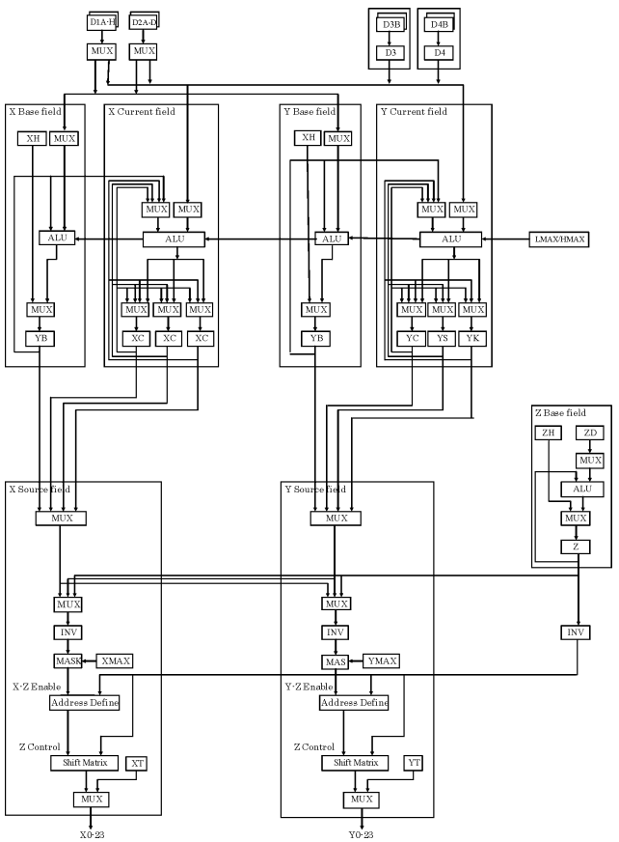
Z Output
Z0-23
X0-23
Y0-23

Slide 31
Z Output
Z output port does not extend through PDS. Therefore, the Z address must be routed through X or Y.
ALPG
X0-23
Y0-23
Z0-23
ADDRESS DEFINE
Y18-20 = Z0-2
XY = ZN
ADD DEF
X0-23
Y0-23
PDS
XY=Z or Z|XY
To Formatter

