Slide 1
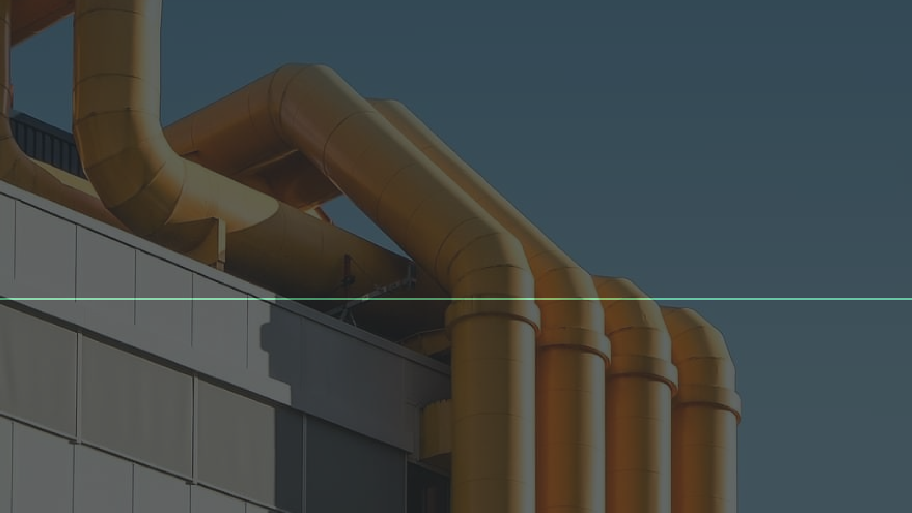
Beginning CI/CD Pipeline using GitHub!
Md. Minhazul Haque
https://beacloudpro.com/
28 February, 2021

Slide 2




Lead DevOps Engineer
LFCE, LFCS
About Me
Python Evangelist
Open Source Enthusiast

Slide 3


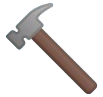


Agenda
What are CI/CD Pipelines?
Why do we need it? Github Actions Demo
Q&A

Slide 4
What are CI/CD Pipelines?

Slide 5
Full Form of CI/CD
Continuous Integration
Continuous Delivery (or Deployment or both)

Slide 6



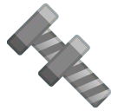



CI/CD Pipelines
A CI/CD pipeline is a series of steps
that must be
performed in order to deliver a new version of software.
A CI/CD pipeline introduces automation to improve the process of application development , particularly at the
integration delivery
and testing
and deployment
phases, as well as during
.

Slide 7
Elements of a CI/CD pipeline
Build - Compile the code
Test - Test features, measure coverage
Release - Deliver artifacts to repository
Deploy - Load the artifacts into production environment

Slide 8
Elements of a CI/CD pipeline
Build
Continuous Integration
Test
Release
Continuous Delivery/Deployment
Deploy

Slide 9
Why CI/CD Pipelines are important?

Slide 10
Importance of CI/CD pipelines
Reduce manual works for Ops team
More test coverage and fault detection Faster release and happy customer

Slide 11
Github Actions

Slide 12



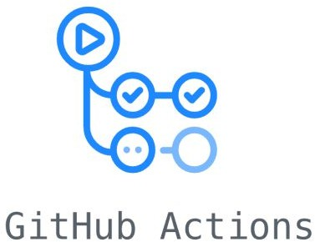
Git is a popular SCM (Source Code Management) tool
Github is a popular hosting service for Git and more
Github Actions are powerful automation tools provided by Github to meet all your CI/CD needs

Slide 13
Introduced in late 2018
YAML based
Community-driven
Runs Win, Linux, Mac
Attractive Pricing
Github Actions

Slide 14
Components of Github Actions
Event
Job
 | Step 1
 |  | Action
 | Step 2
 |  | Action
Build, Test, Deploy or anything
Push
Pull Request
...
Install nodejs and npm
Run npm build

Slide 15
name: My CI Workflow on:
push: jobs:
build:
runs-on: ubuntu-20.04 steps:
name: Clone repository uses: actions/checkout@v2
name: Set up Node.js
uses: actions/setup-node@v2
name: Install npm dependencies uses: npm install
name: Build artifacts run: npm run build
name: Archive artifacts
uses: actions/upload-artifact@v2 with:
name: demo path: dist
Demo Workﬂow File

Slide 16
name: My CI Workflow on:
push:
branches:
master
release/* tags:
- v1.* pull_request: branches:
main schedule:
Workﬂow Events
- cron: '0 0 * * *' workflow_dispatch:
...

Slide 17
name: My CI Workflow
...
jobs:
build:
runs-on: ubuntu-20.04 steps:
name: Clone repository uses: actions/checkout@v2
name: Set up Node.js
uses: actions/setup-node@v2
name: Install and build
run: npm install && npm run build deliver:
runs-on: ubuntu-20.04 steps:
name: Push to remote run: some-command
Workﬂow Jobs

Slide 18
name: My CI Workflow
...
jobs:
build-linux:
runs-on: ubuntu-20.04 steps:
name: Set up Node.js
uses: actions/setup-node@v2
name: Run commands run: npm run build
build-windows:
runs-on: windows-latest steps:
name: Set up .NET
uses: actions/setup-dotnet@v1
name: Run commands
run: dotnet build myawesomeproj
Workﬂow Steps and Actions

Slide 19
Demo
https://github.com/beacloudpro/github-cicd-demo

Slide 20

Q&A

