Slide 1
Docker & Kubernetes
Dongwon Kim, PhD
Big Data Tech. Lab
SK Telecom

Slide 2
Big Data Tech. Lab in SK telecom
Discovery Group
Predictive Maintenance Group
Manufacturing Solution Group
Groups making own solutions
Technology and Architecture Leading Group
Big data processing engine
Advanced analytics algorithms
Systematize service deployment and service operation on cluster
Docker
Kubernetes

Slide 3
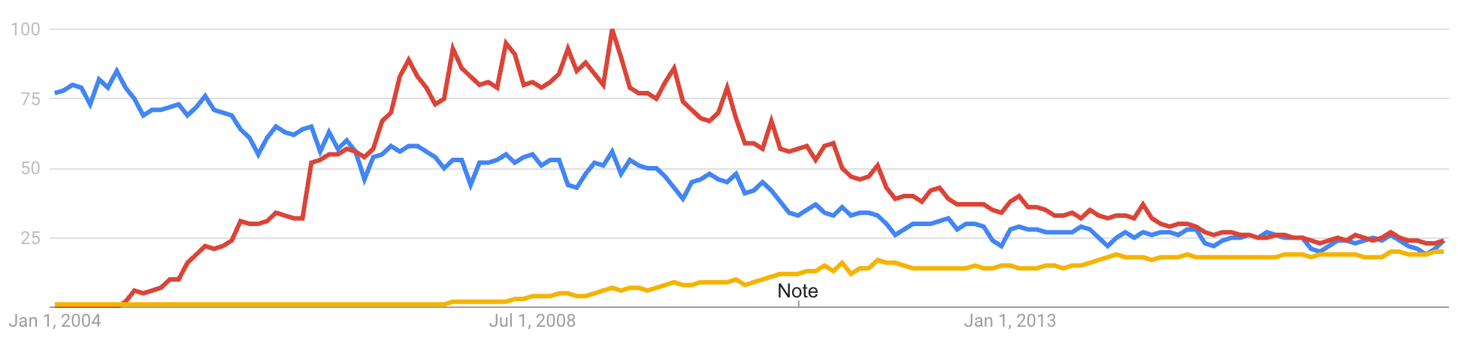
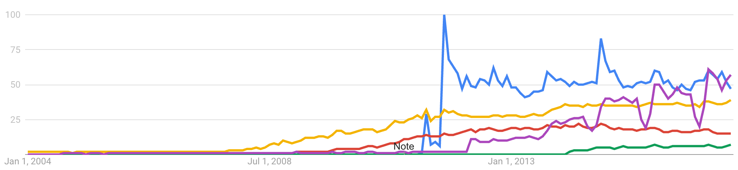
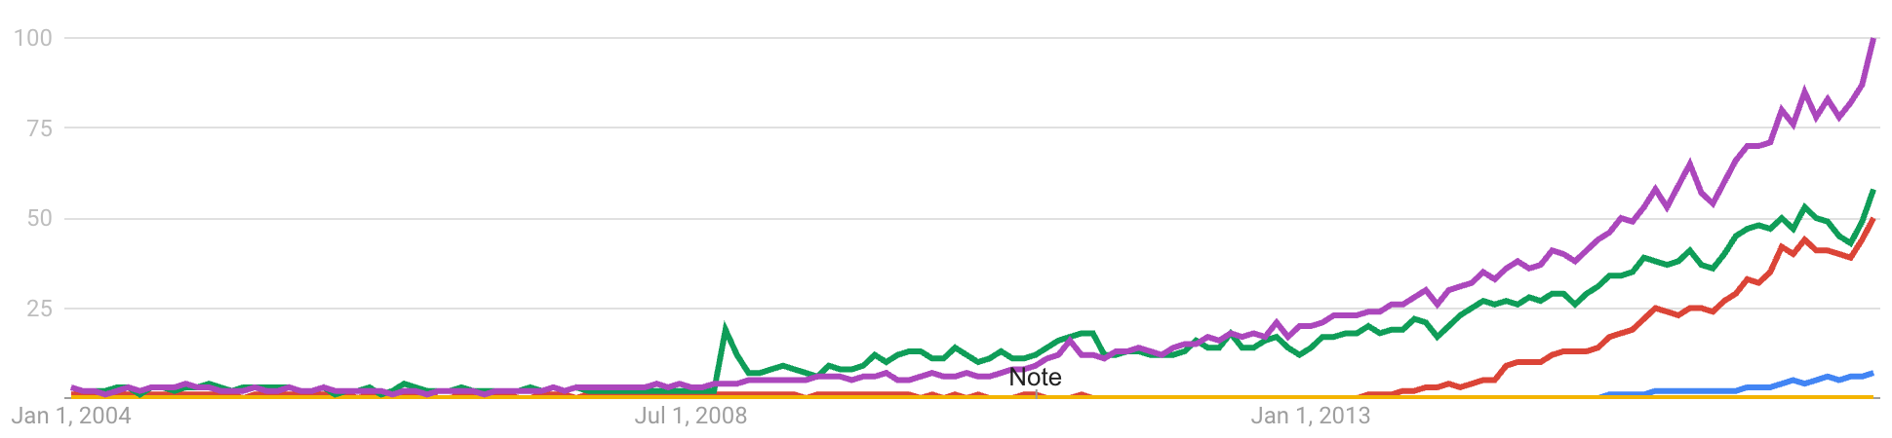
Prepare for an era of cloud with Docker and Kubernetes
* technology trend in USA (2004-2017)
Major technologies
Trend
Buy both SW & HW
Buy HW and DIY
Run your SW on cloud
ubuntu
oracle
cloud
Cloud services
for users
Ubiquitous cloud services
around us
icloud
google
drive
dropbox
one drive
Cloud technologies
for service providers
Enabling technologies
for custom cloud services
Amazon Web Service
Microsoft azure
Docker
Kubernetes

Slide 4
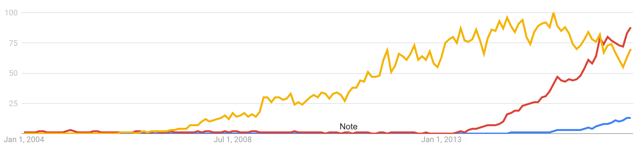
Overview & Conclusion
Docker to build portable software
Build your software upon Docker
Then distribute it anywhere (even on MS Azure and Amazon Web Service)
Kubernetes to orchestrate multiple Docker instances
Start using Docker and Kubernetes before too late!
Google has been using container technologies more than 10 years
Hadoop
Docker
Kubernetes
Popularity of Docker and Kubernetes
The Enterprise IT Adoption Cycle

Slide 5
Docker
Motivation
Enabling technologies for Docker
How to use Docker

Slide 6
Docker came to save us from the dependency hell
Docker
Dependency hell
Portable software

Slide 7
Dependency hell
Development
environment
Production
environment
Your program
Your program
Customer program
depends on
depends on
depends on
program1
v2
program2
v2
program3
v2
program1
v2
program2
v2
program3
v2
program1
v1
program2
v1
program3
v1
conflict!
Package manager
Package manager

Slide 8
Few choices left to you
Convince your customer (a.k.a. 甲)
Install all the dependencies manually (without the package manager)
Modify your program to make it depend v1

Slide 9
Use Docker for isolating your application
Docker container
Customer program
Your program
depends on
depends on
Package manager in host OS
Package manager in guest OS
program1
v1
program2
v1
program3
v1
program1
v2
program2
v2
program3
v2
Docker engine (daemon)
Host operating system
Linux kernel must be ≥3.10 (such as Ubuntu 14.04 and CentOS 7)

Slide 10
Virtual machines and docker containers
Virtual machines
Docker containers
Ubuntu
virtual machine
CentOS
virtual machine
Ubuntu-like
container
CentOS-like
container
App
App
App
App
Libraries
Libraries
Libraries
Libraries
apt
yum
apt
yum
Kernel
Device drivers
Kernel
Device drivers
Containers share the kernel in the host
Hypervisor
Docker engine
Host Operating System
Host Operating System
Kernel
Device drivers
Kernel
Device drivers

Slide 11
Linux namespaces – what makes isolated environments in a host OS
Six namespaces are enough to give an illusion of running inside a virtual machine
Container
Container
Container
pid
Process ID number space
(staring from 1)
net
Network devices
Network devices
IPv4, IPv6 stacks
Routing tables, Firewall
pid
net
pid
net
ipc
Various ipc objects
POSIX message queue
SystemV IPC objects (mq, sem, shm)
mnt
Mount points
(directory hierarchy)
ipc
mnt
ipc
mnt
uts
System identifiers
hostname
NIS domain name
user
Security-related identifiers
User IDs
Group IDs
uts
user
uts
user
Docker engine
Host Operating System

Slide 12
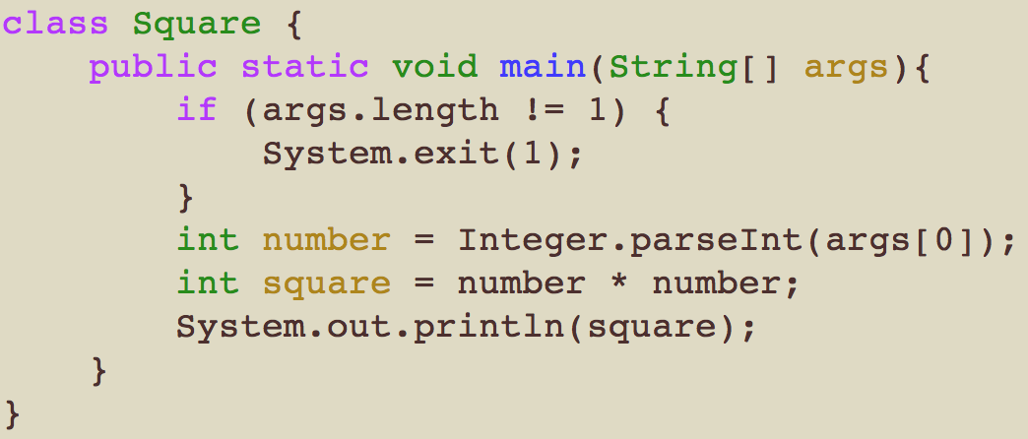
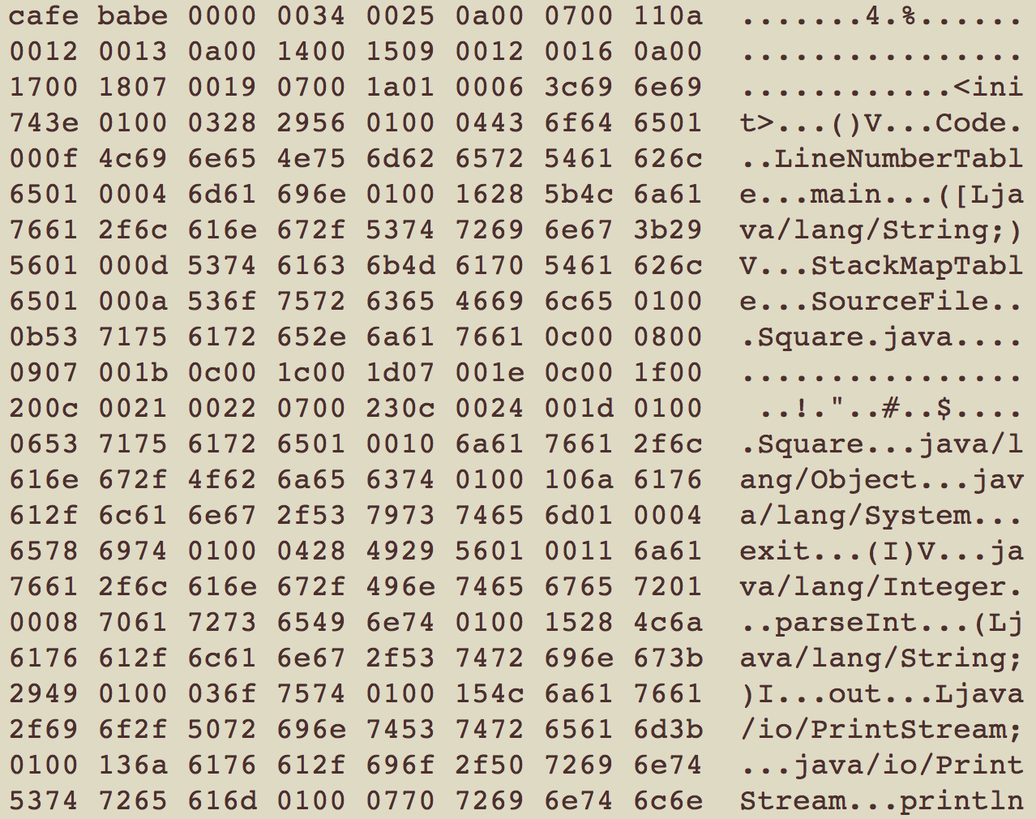
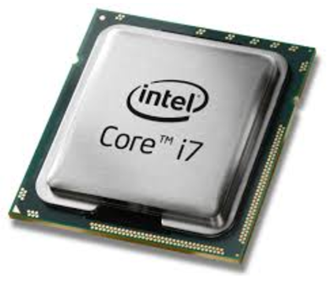
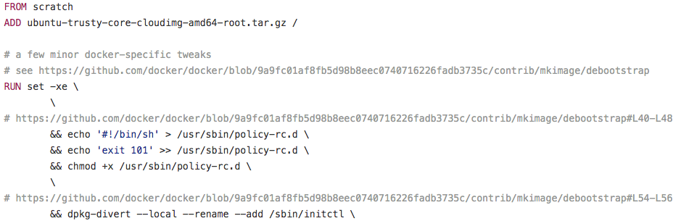
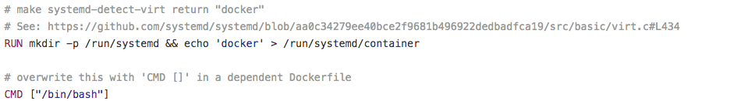
Analogy between program and docker
Source code
Byte/machine code
(read only)
Process
(read only)
stack
compile
execute
Program
heap
data
text
Dockerfile
Docker image
(read-only layers)
Docker container
(read-only layers + writable layer)
Docker
build
run

Slide 13
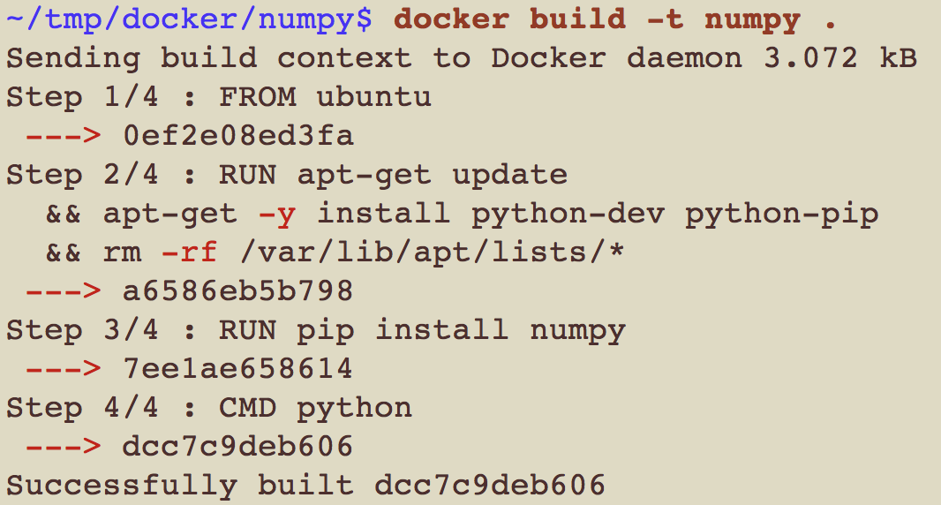
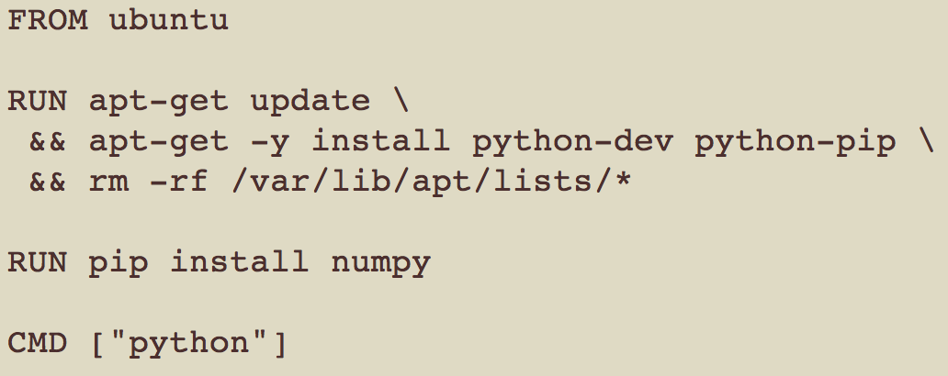
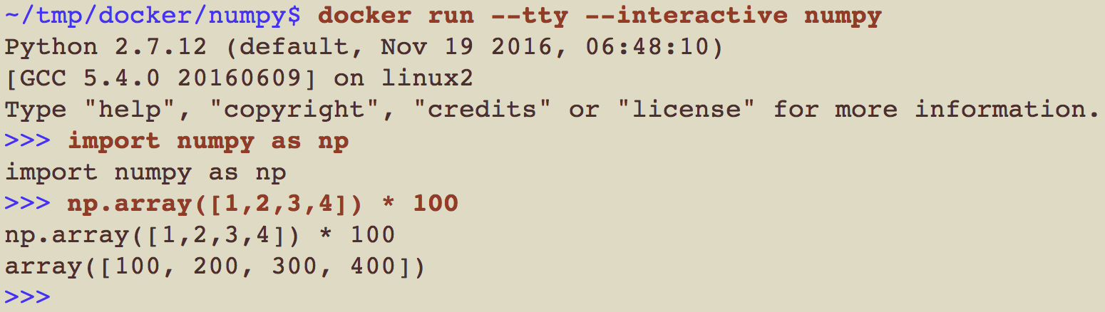
How to define an image and run a container from it?
Write Dockerfile
Specify to install python with pip on ubuntu
Tell pip to install numpy
2) Build an image from Dockerfile
Execute each line of Dockerfile to build an image
3) Execute a Docker container from the image

Slide 14
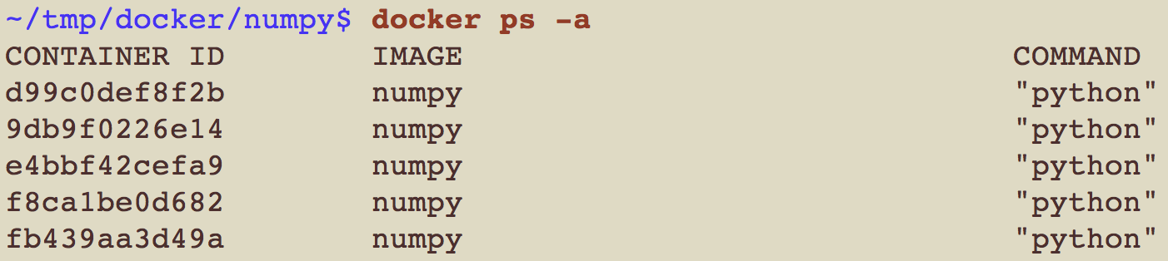
1 to N relationship between image and container
Execute five containers from an image
Q) Five containers take up 2,445MB (=489MB*5) in the host?
A) No due to image layering & sharing

Slide 15
Images consists of layers each of which is a set of files
Image
Dockerfile
Layer
Layer (pip install numpy)
Layer (apt-get install python-dev python-pip)
Base ubuntu image
Layer (files)
Layer (files)
Layer (files)
Instructions (FROM, RUN, CMD, etc) create layers
Base images (imported by “FROM”) also consist of layers
If a file exists in multiple layers, the one in the upper layer is seen

Slide 16
Docker container
A container is just a thin read/write layer
base images are not copied to containers
Copy-On-Write (COW)
When a file in the base image is modified,
copy the file to the R/W layer
and then modify the copied file

Slide 17
Image sharing between containers
ubuntu:15.04 image (~188MB) does not copied to all containers

Slide 18
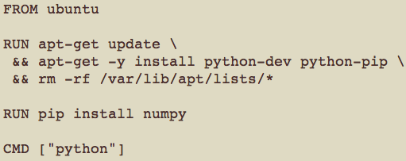
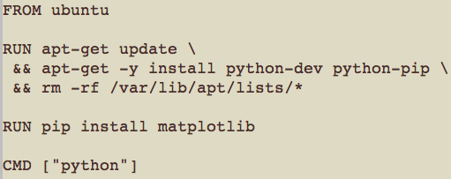
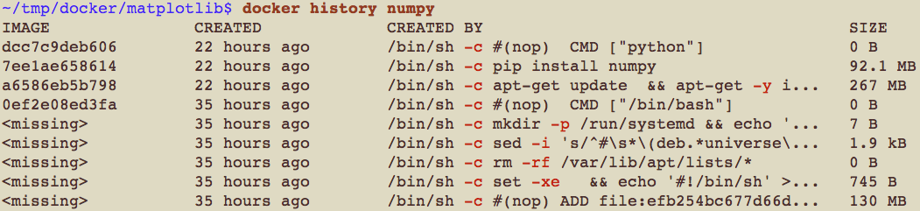
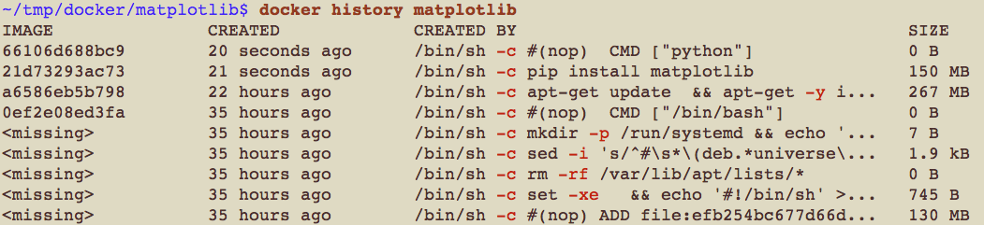
Layer sharing between images
If multiple Dockerfiles
start from the same base image
share a sequence of instructions (one RUN instruction in a below example)
numpy Dockerfile
matplotlib Dockerfile
, then docker engine automatically reuses existing layers

Slide 19
Example of stacking docker images
PdM container (cpu)
PdM container (gpu)
PdM engine
(librdkafka, avro, flask)
PdM engine
(librdkafka, avro, flask)
theano-cpu
(theano, keras)
theano-gpu (theano, keras)
theano compiles
its expression graphs into
CPU/GPU instructions
Kafka
container
Zookeeper
container
cuda
kafka
(with scala)
scipy
(numpy, scipy, matplotlib, ipython, jupyter, pandas, scikit-learn, h5py)
scipy libraries has nothing to do with GPU, so share it
zookeeper
python:2.7
official
openjdk:8
buildpack-deps:jessie
official
official
buildpack-deps contains essential tools to download/compile softwares
buildpack-deps:jessie-curl
official
buildpack-deps:jessie-scm
official
debian:jessie
jessie is the latest, stable Debian release
official
Zookeeper cluster
Kafka broker
PdM engine
zk
broker
Web server
zk
zk
broker
zk
zk
broker
Kafka
consumer
Kafka
producer

Slide 20
Enabling technologies for docker (wrap-up)
Linux namespaces (covered)
To isolate system resources
pid, net, ipc, mnt, uts, user
It makes a secure & isolate environment (like a VM)
Advanced multi-layer unification File System (covered)
Image layering & sharing
Linux control groups (not covered)
To track, limit, and isolate resources
CPU, memory, network, and IO
* https://mairin.wordpress.com/2011/05/13/ideas-for-a-cgroups-ui/

Slide 21
Docker topics not covered here
How to install Docker engine
What are the docker instructions other than FROM, RUN, and CMD
ENV / ADD / ENTRYPOINT / LABEL / EXPOSE / COPY / VOLUME / WORKDIR / ONBUILD
How to push local Docker images to docker hub
How to pull remote images from docker hub
...
Consult with https://docs.docker.com/engine/getstarted/

Slide 22
Kubernetes
Motivation
A motivating example

Slide 23
Disclaimer
The purpose of this section is to briefly explain Kubernetes without details
For a detailed explanation with the exact Kubernetes terminology, see the following slide
https://www.slideshare.net/ssuser6bb12d/kubernetes-introduction-71846110

Slide 24
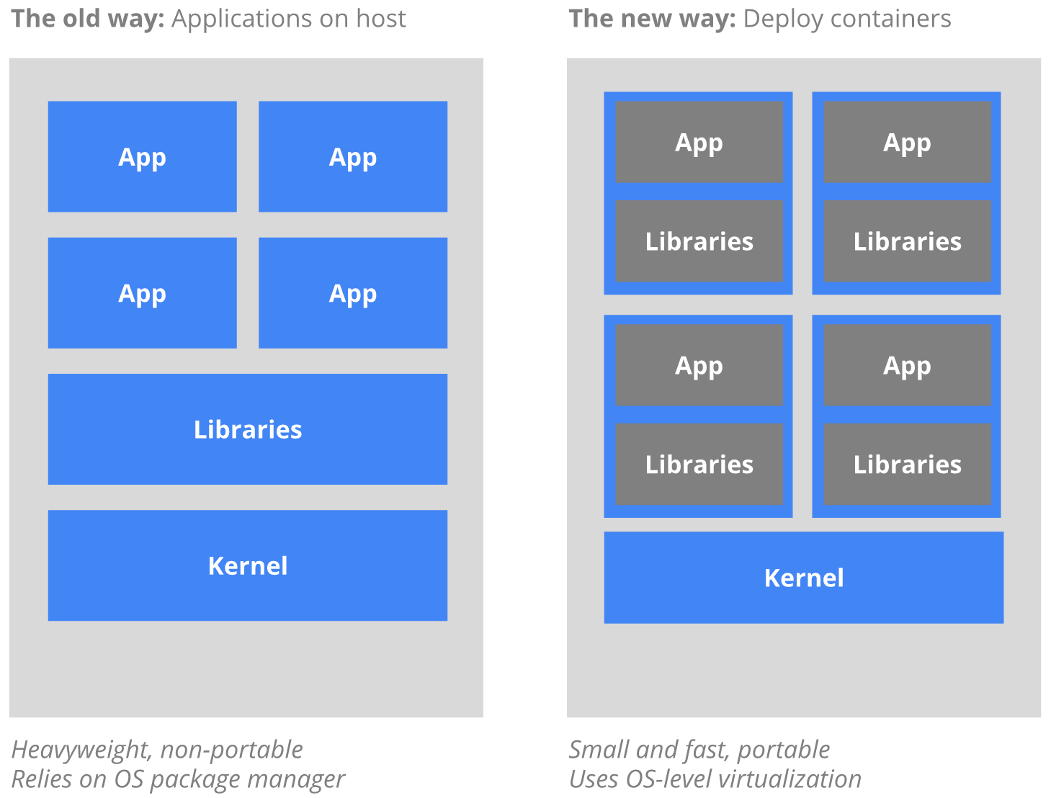
What is Kubernetes for?
Container-based virtualization
+ Container orchestration
To satisfy common needs in production
replicating application instances
naming and discovery
load balancing
horizontal auto-scaling
co-locating helper processes
mounting storage systems
distributing secrets
application health checking
rolling updates
resource monitoring
log access and ingestion
...
from the official site : https://kubernetes.io/docs/whatisk8s/

Slide 25
Why Docker with Kubernetes?
A mission of our group
Systematize service deployment and service operation on cluster
I believe that systematizing smth. is to minimize human efforts on smth.
How to minimize human efforts on service deployment?
Make software portable using a container technology
Docker (chosen for its maturity and popularity)
Rkt from CoreOS (alternative)
Build images and run containers anywhere
Your laptop, servers, on-premise clusters, even cloud
How to minimize human efforts on service operation?
Inform a container orchestration runtime of service specification
Kubernetes from Google (chosen for its maturity and expressivity)
Docker swarm from Docker
Define your specification and then the runtime operates your services as you wish

Slide 26
Kubernetes architecture
Service specification (written in yaml)
Execute a web-server image
Two replicas for LB & HA
3GB memory each
Server
REST API server with a K/V store
Scheduler
Find suitable machines for containers
Controller manager
Current state ➔ Desired state
Make changes if states go undesirable
Node agent
Node agent
Node agent
Ensure a specified
# of replicas running all the time
Docker engine
Docker engine
Docker engine
container
(3GB)
container
(3GB)
container
(3GB)

Slide 27
Web server example
Want to launch 3 replicas
for high availability and load balancing
node 1
node 2
node 3
webserver
webserver
webserver
a well-known address
How to achieve the followings?
Users must be unaware of the replicas
Traffic is evenly distributed to replicas
webserver
4bp80
webserver
6dk12
webserver
g1sdf
It’s a piece of cake with Kubernetes!

Slide 28
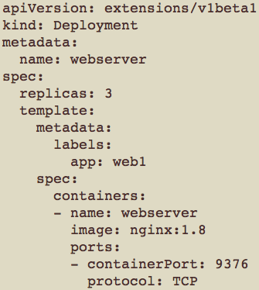
How to replicate your service instances
Specify your Docker image and a replication factor
using Deployment
Server
Node agent
Node agent
Node agent
node 1
node 2
node 3
Docker engine
Docker engine
Docker engine
Specify a common label
to group containers with different names
webserver
4bp80
webserver
6dk12
webserver
g1sdf
app=web1
app=web1
app=web1

Slide 29
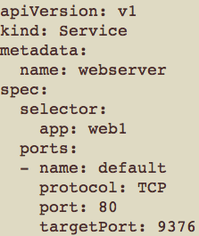
Define a service to do round-robin forwarding
External traffic
over internet
<ingress>
metatron:80
Server
<service>
webserver:80
Internal traffic
33%
33%
33%
node 1
node 2
node 3
webserver
4bp80
webserver
6dk12
webserver
g1sdf
app=web1
app=web1
app=web1
Kubernetes runs its own DNS server for name resolution
Kubernetes manipulates iptables on each node to proxy traffic

Slide 30
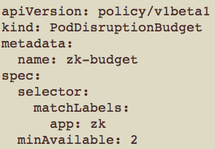

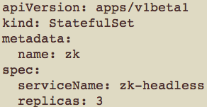
How to guarantee a certain # of running containers during maintenance
Define disruption budget
to specify requirement for
the minimum available containers
Drain node1
Operation is permitted
because allowed-disruptions=1
Drain node2
Operation not permitted
because allowed-disruptions=0
(Note that minAvailable=2)
3 replicas have to be running due to StatefulSet,
so try scheduling zk-0
on other nodes!
Kubernetes
Kubernetes
node1
node2
node3
node1
node2
node3
zk-0
zk-2
zk-3
zk-0
zk-2
zk-3
Containers
Containers
Containers
Containers
Containers
Containers
Volumes
Volumes
Volumes
Volumes
Volumes
Volumes
Oops!
cannot schedule zk-0
on node2 and node3
due to anti-affinity!
Hold on for a while
Please wait until
node1 is up and zk-0 is rescheduled!

Slide 31
PdM Kubernetes cluster
Statefulset
Statefulset
Zookeeper headless service
Kafka headless service
Pod
Pod
Pod
Pod
Pod
Pod
QuorumPeer
Main
QuorumPeer
Main
QuorumPeer
Main
Kafka
(broker)
Kafka
(broker)
Kafka
(broker)
2181
2888
3888
2181
2888
3888
2181
2888
3888
9092
9092
9092
Persistent
storage
PdM service
Pod (Deployment)
Kafka
consumer
Kafka
producer
PdM engine
Web
server
Attached volume
Volume
Ingress
rule
8080
80

Slide 32
Overview & Conclusion
Docker to build portable software
Build your software upon Docker
Then distribute it anywhere (even on MS Azure and AWS)
Kubernetes to orchestrate multiple Docker instances
Start using Docker and Kubernetes before too late!
Google has been using container technologies more than 10 years
Hadoop
Docker
Kubernetes
Popularity of Docker and Kubernetes
The Enterprise IT Adoption Cycle

Slide 33
the end

