Slide 1
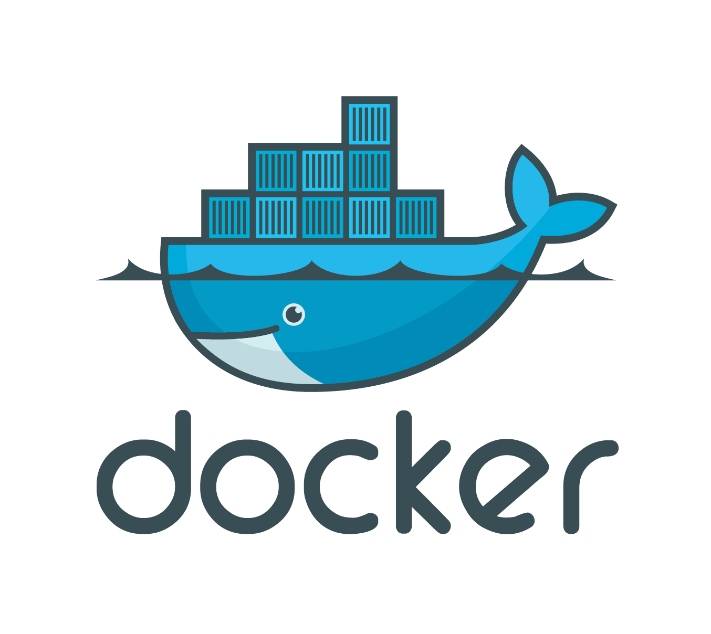
Docker Session III
Dockerfile

Slide 2
Discussion on
Dockerfile
Dockerfile commands
Dockerfile demo

Slide 3
Dockerfile
What is dockerfile?
Notes:
The Dockerfile is essentially the build instructions to build the image.

Slide 4
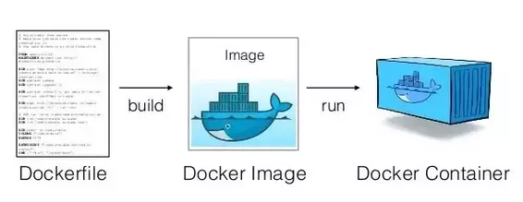
Docker Workflow

Slide 5
Dockerfile commands
FROM
RUN
ADD
COPY
EXPOSE
VOLUMN
CMD
ENTRYPOINT

Slide 6
FROM <base_image>
FROM scratch
FROM ruby:2.5.0
FROM node:6.0
Notes:
This instruction is used to set the base image.
How does this work?
Check image locally
Pull from docker hub
Size of scratch? 0B

Slide 7
MAINTAINER <name>
MAINTAINER Degenda SIvakoti <degendra@bajratechnologies.com>
Deprecated
Notes:
This instruction is used to set the base image.

Slide 8
RUN <command>
RUN apt-get install nodejs
RUN apt-get update && apt-get install nodejs postgresql nano curl

Slide 9
ADD <src> <dest>
ADD . .
ADD . /app/
ADD Gemfile /app/Gemfile

Slide 10
COPY <src> <dest>
COPY . /client
COPY package.json /client/package.json
Notes:
What is the difference between ADD and COPY?

Slide 11
ADD vs COPY
ADD has 2 extra capabilities (either or)
<src> can be url
Archive files will be automatically extracted.
Add https://google.com/images/a.png /app/images/a.png
Add file.tar.gz /app

Slide 12
GUESS
Add https://google.com/images/a.png /app/images/b.png
Add https://google.com/images/a.png /app/images/
Add https://google.com/images/a.tar.gz /app/
Add https://google.com/images/a.tar.gz /app/b.tar.gz

Slide 13
ANSWER
Add https://google.com/images/a.png /app/images/b.png
/app/images/b.png
Add https://google.com/images/a.png /app/images/
/app/images/a.png
Add https://google.com/images/a.tar.gz /app/
/app/a.tar.gz
Add https://google.com/images/a.tar.gz /app/b.tar.gz
/app/b.tar.gz

Slide 14
EXPOSE <port>
EXPOSE 80
Notes:
What is the difference between ADD and COPY?

Slide 15
ENV <key> <value>
ENV RAILS_ENV development
ENV GO_ENV production

Slide 16
ENV <key>=<value>
ENV RAILS_ENV=development GO_ENV=production
Difference between <key> <value> and <key>=<value>?
Notes:
Multiple layer and single layer

Slide 17
VOLUME [“/data”]
VOLUME /var/log
VOLUME /var/log /var/db
VOLUME [“/var/log”, “/var/db”]
Notes:
Used for persistent storage
You can use the VOLUME instruction to enable access to a location on the host system from a container.
Specify that a directory should be stored outside the union filesystem.
If is not set with docker run -v it will be created in /var/lib/docker/volumes
docker volume create my-vol
Docker volume ls

Slide 18
WORKDIR <path>
Mkdir /demo-app
WORKDIR /demo-app
PWD
/demo-app
Notes:
Current working directory
Relative path
Useful for RUN, CMD, ENTRYPOINT, COPY, ADD

Slide 19
SHELL & EXEC
Shell form
RUN <command>
RUN echo “Hello World!”
/bin/sh -c “echo ‘Hello World!’”
Exec form
RUN [“executable”, “param1”, “param2”]
RUN [“/bin/bash”, “-c”, “echo Hello World!”]

Slide 20
CMD
CMD [“executable”, “param1”, “param2”]
CMD [“param1”, “param2”]
CMD command param1 param2
CMD [“/usr/bin/tail”, “-f”, “/dev/null”]
Notes:
Ask form? Preferred exec form
Supply params for ENTRYPOINT
Shell form
There can only be one CMD instruction in a Dockerfile. If you list more than one CMD then only the last CMD will take effect.
The main purpose of a CMD is to provide defaults for an executing container. These defaults can include an executable, or they can omit the executable, in which case you must specify an ENTRYPOINT instruction as well.
Difference between RUN and CMD? The major difference between CMD and RUN is that CMD doesn’t execute anything during the build time.

Slide 21
ENTRYPOINT
ENTRYPOINT command param1 param2
ENTRYPOINT echo “Hello World!”
CMD [“Hello World!”]
ENTRYPOINT echo
ENTRYPOINT echo
Docker run <image_name> “Hello World”
Notes:
Ask for output for 2 and 3?

Slide 22
ENTRYPOINT Cont...
ENTRYPOINT command param1 param2
ENTRYPOINT echo “Hello World!”
CMD [“Hello World!”]
ENTRYPOINT echo //Hello World!
ENTRYPOINT echo
Docker run <image_name> “Hello World” //Hello World!

Slide 23
OTHERS
LABEL
USER
ONBUILD
Notes:
Do research on your own.

Slide 24
.dockerignore File
Similar to .gitignore
Useful when using ADD and COPY command
# comment
log/*
node_modules/*
Notes:
What is the purpose of .gitignore?

Slide 25
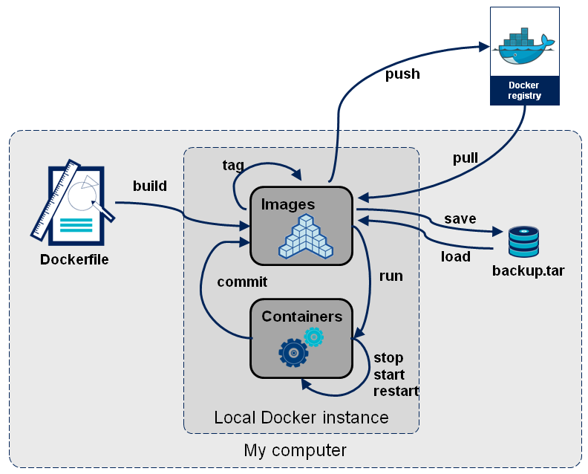
Docker Workflow Detailed

Slide 26
Build Context
Docker build .
Docker build -f <dockerfile_name> <build_context>
Docker run -d -p 8080:80 -v host/path:container/path <image_name> <commands>
Notes:
What is the purpose of .gitignore?

Slide 27
Dockerfile Demo
Finally!!!

Slide 28

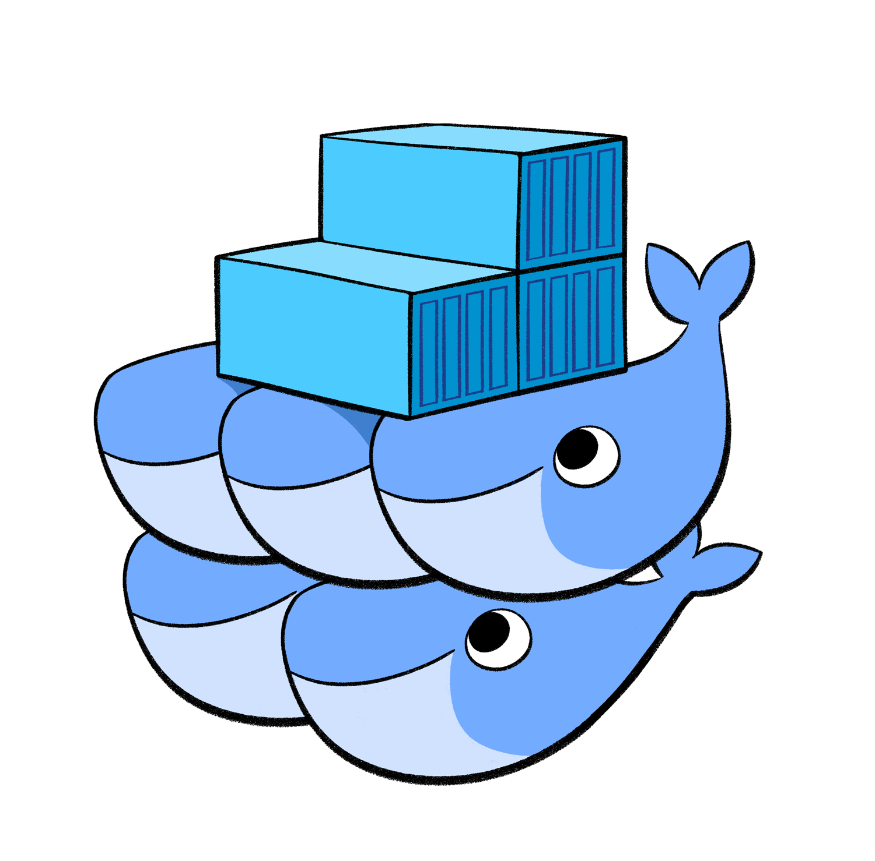
UPCOMING
Docker compose
Docker swarm
Notes:
Networking between two containers?

Slide 29
Queries???

Slide 30
Thank You!!!

