Slide 1



Slide 2





Helm Is The Package Manager For Kubernetes
Helm은 Kubernetes의 패키지 관리자입니다
≈
Apt

Slide 3







Kubernetes
Dev
QA
Prod

Slide 4



You Can Download And Run Helm For These Systems
다양한 OS별 실행파일을 지원

Slide 5


Slide 6
A Similar Command Line Experience
예전과 유사한 커맨드 라인
$ helm repo add stable https://kubernetes-charts.storage.googleapis.com/
$ helm search repo mariadb
NAME |  | CHART | VERSION | APP VERSION | DESCRIPTION
stable/mariadb |  | 7.1.0 |  | 10.3.20 | Fast, reliable, scalable, and easy to |  |  | use open-...
stable/phpmyadmin 4.2.4 4.9.2 phpMyAdmin is an mysql administration frontend
$ helm | install mymaria stable/mariadb
$ helm | list
NAME | NAMESPACE REVISION UPDATED |  |  |  |  | STATUS | CHART APP VERSION
mymaria | default 1 2019-11-27 14:10:55.216169 |  |  |  | -0500 EST | deployed | mariadb-7.1.0 10.3.20
$ helm uninstall mymaria

Slide 7
Namespaces!
네임 스페이스!
$ helm list
NAME NAMESPACE REVISION
UPDATED
STATUS
CHART
APP VERSION
mymaria | default | 1 | 2019-11-27 | 14:10:55.216169 | -0500 | EST | deployed | mariadb-7.1.0 | 10.3.20
$ helm ls | --all-namespaces
NAME | NAMESPACE REVISION |  | UPDATED |  |  |  | STATUS | CHART | APP VERSION
mymaria | default 1 |  | 2019-12-01 | 18:05:53.568566 | -0500 | EST | deployed | mariadb-7.1.0 | 10.3.20
mymaria2 $ helm ls | foo 1 –-namespace foo |  | 2019-12-01 | 18:06:12.520784 | -0500 | EST | deployed | mariadb-7.1.0 | 10.3.20
NAME | NAMESPACE REVISION |  | UPDATED |  |  |  | STATUS | CHART | APP VERSION
mymaria2 | foo 1 |  | 2019-12-01 | 18:06:12.520784 | -0500 | EST | deployed | mariadb-7.1.0 | 10.3.20
$ helm install –n foo myNewMaria stable/mariadb

Slide 8


Helm v2 Architecture Helm v2 아키텍처
Kubernetes API
Helm Client
Tiller

Slide 9
Helm v3 Architecture Helm v3 아키텍처
Helm Client
Kubernetes API

Slide 10
Helm v3 Architecture Helm v3 아키텍처
Helm Client
Kubernetes API
Uses normal user credentials
일반 사용자 인증 사용

Slide 11


Release information stored as Secret
Helm v3 Architecture Helm v3 아키텍처
in the namespace with the app by default 앱이 설치된 네임스페이스에 릴리즈 정보가 Secret 으로 저장 (기본 설정)
Helm Client
Kubernetes API

Slide 12
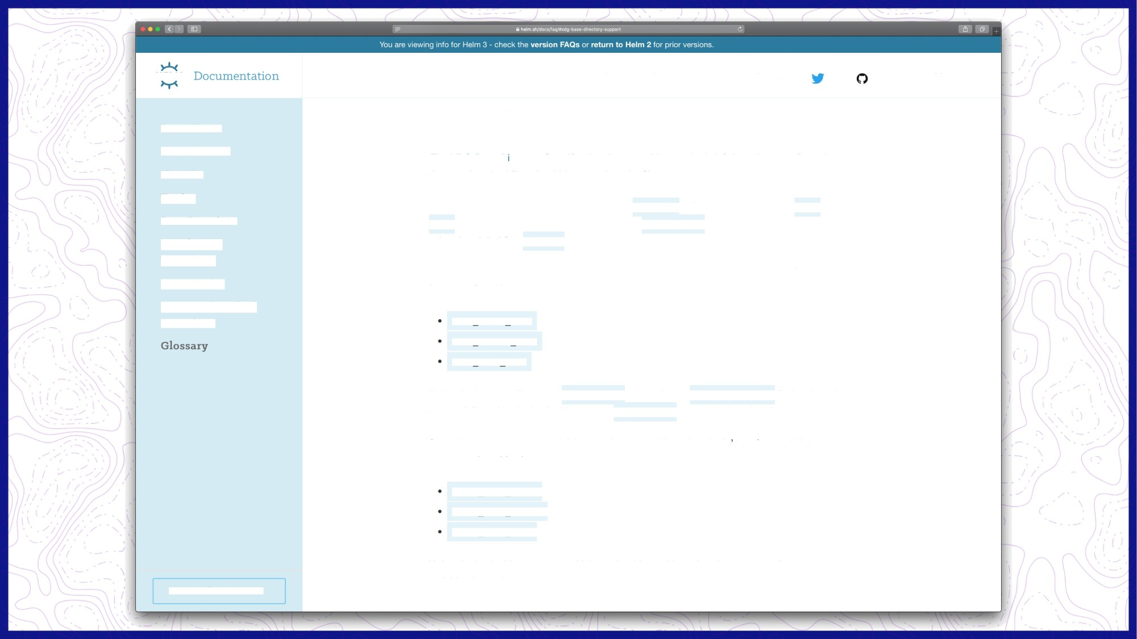
H ELM
G et Helm
B1og
D ocs
Charts
v3.o. o st able
G XD Base Directory Support
Docs Home
Introduction
The XDG Base D rectory Specification is a portable standard defining where configuration, data, and cached files should be stored on the filesystem.
How-To
Topics
In Helm 2, Helm stored all this information in -/ . helm (affectionately known as helm home ), which could be changed by setting the 4Hz£N Honz environment variable, or by using the global flag --home .
Best Practices
Developing Templates
In Helm 3, Helm now respects the following environment variables as per the XDG Base Directory Specification:
Community
Frequently Asked Questions
$XDG CAC HE HOFIE
$XDG CONFIG HOME
$XDG DATA HOME
Helm plugins are still passed $HELM EOuE as an alias to $xDC DA'IA HOI‹z for backwards compatibility with plugins looking to use $nEkM I4OME aS a scratchpad environment.
Several new environment variables are also passed in to the plugin s environment to accommodate this change:
$HEI M PA‘I'II CACHz for th e cache path
$HEI M PA’I'H CONE'IG fOr the config path
$HELM PATH DATA forthedata path
Helm plugins looking to support Helm 3 should consider using these new environment variables instead.
O Co nt ri bu t e t o D oc s

Slide 13
. . .
. . . .. .
- .
. › . . › -
•
• •
- -
' •
‘
helm.sh/helm/v3/pkg /D
directory helm.sh/he\m/v3/pkg v3.0.0
Published: Nov 12, 2019 I License: Apaohe-2.0 | Module: helm.sh/helm/v3
Doc Overview Subdirectories Versions Imports Imported By
Licenses
Path
action
Package action contains the logic for each action that Helm can perform.
chart
chart/loader
chartutil
Package chartutil contains tools for working with charts.
Package cli describes the operating environment for the Helm CLI.
cli/output cli/values
downloader
Package downloader provides a library for downloading charts.
engine
Package engine implements the Go template engine as a Tiller Engine.
gates
Package gates provides a general tool for working with experimental feature gates.
getter
Package getter provides a generalize tool for fetching data by scheme.
helmpath
Unless required by applicable law or agreed to in writing, software distributed under the License is distributed on an "AS IS" BASIS, WITHOUT WARRANTIES OR CONDITIONS OF ANY KIND, either express or implied.
helmpath/xdg
kube
kube/fake
Package fake implements various fake KubeClients for use in testing

Slide 14




3-way Strategic Merge Patches
3 방향 전략적 병합 패치
New Manifest
신규 매니페스트
Old Manifest
이전 매니페스트
Patch
패치
Live State
라이브 상태

Slide 15
3-way Strategic Merge Patches
3 방향 전략적 병합 패치
containers:
- name: server image: nginx:2.0.0
containers:
name: server image: nginx:2.0.0
name: my-injected-sidecar image: my-cool-mesh:1.0.0

Slide 16

Additions To Charts
차트내 신규 기능 추가
$ tree newChart newChart
├── Chart.yaml
├── charts
├── templates
│ ├── NOTES.txt
│ ├── _helpers.tpl
│ ├── deployment.yaml
│ ├── ingress.yaml
│ ├── service.yaml
│ ├── serviceaccount.yaml
│ └── tests
│ └── test-connection.yaml
└── values.yaml
apiVersion: apps/v1 kind: Deployment metadata:
name: {{ include "newChart.fullname" . }} labels:
{{- include "newChart.labels" . | nindent 4 }}
spec:
replicas: {{ .Values.replicaCount }}
...

Slide 17
apiVersion v2 For Helm 3 Helm 3 용 apiVersion v2
Chart.yaml
apiVersion: v2 name: mychart
description: A Helm chart for Kubernetes

Slide 18
Dependencies Now In Chart.yaml
현재: Chart.yaml의 종속성
Chart.yaml
apiVersion: v2 name: mychart
description: A Helm chart for Kubernetes
dependencies:
- name: mariadb
version: 5.x.x
repository: https://kubernetes-charts.storage.googleapis.com/ condition: mariadb.enabled
tags:
- database

Slide 19
Library Charts
Chart.yaml
apiVersion: v2 name: mychart
description: A Helm chart for Kubernetes type: library

Slide 20
JSON Schema Validation JSON 스키마 유효성 검사
values.schema.json
{
"$schema": "http://json-schema.org/draft-07/schema#", "properties": {
"addresses": {
"description": "List of addresses", "items": {
"properties": { "city": {
"type": "string"
},
...

Slide 21
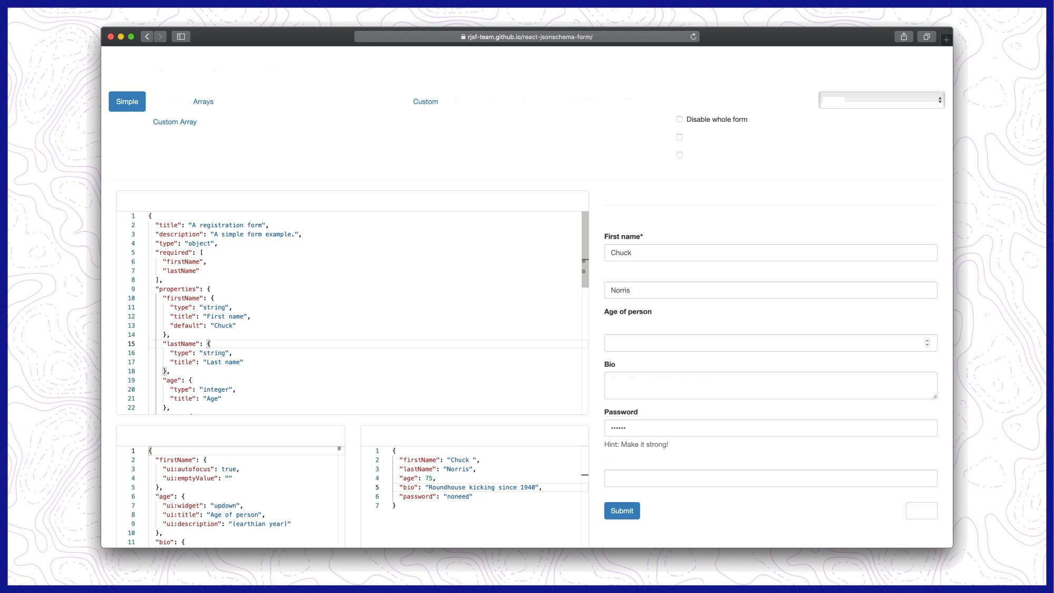
react-jsonschema-form
Nested Numbers Widgets Single Custom Object Alternatives Null fields Nullable ErrorSchema Defaults
Ordering References
Property dependencies
Errors Large
Schema dependencies
Date & time
Validation Files
Any Of One Of
0 Live validation
default
Additional Properties
Omit extra data
Live omit
JSONSchema
A registration form
A simple form example.
Last name”
(earthian year)
75
Roundhouse kicking since 1940
UlSchema
formData
Telephone
Share

Slide 22

Custom Resource Definitions (CRD)
$ tree ambassador/crds ambassador/crds
├── authservice.yaml
├── consulresolver.yaml
├── filter.yaml
├── filterpolicy.yaml
├── kubernetesendpointresolver.yaml
├── kubernetesserviceresolver.yaml
├── mapping.yaml
├── module.yaml
├── ratelimit.yaml
├── ratelimitservice.yaml
├── tcpmapping.yaml
├── tlscontext.yaml
└── tracingservice.yaml
$ tree -L 1 ambassador ambassador
├── CHANGELOG.md
├── Chart.yaml
├── OWNERS
├── README.md
├── ci
├── crds
├── templates
└── values.yaml

Slide 23
CRDs across Helm v2 and v3 Helm v2 및 v3의 CRD
For Helm v3 Use The crds Directory Helm v3의 경우 crds 디렉토리를 사용하십시오.
For Helm v2 Use A Template With crd-install Hook Helm v2의 경우 crd 설치 후크가있는 템플릿 사용
$ tree ambassador/crds ambassador/crds
├── authservice.yaml
├── consulresolver.yaml
├── filter.yaml
├── filterpolicy.yaml
├── kubernetesendpointresolver.yaml
├── kubernetesserviceresolver.yaml
├── mapping.yaml
├── module.yaml
├── ratelimit.yaml
├── ratelimitservice.yaml
├── tcpmapping.yaml
├── tlscontext.yaml
└── tracingservice.yaml
apiVersion: apiextensions.k8s.io/v1beta1 kind: CustomResourceDefinition metadata:
name: authservices.getambassador.io labels:
app.kubernetes.io/name: ambassador
annotations:
"helm.sh/hook": crd-install
...

Slide 24
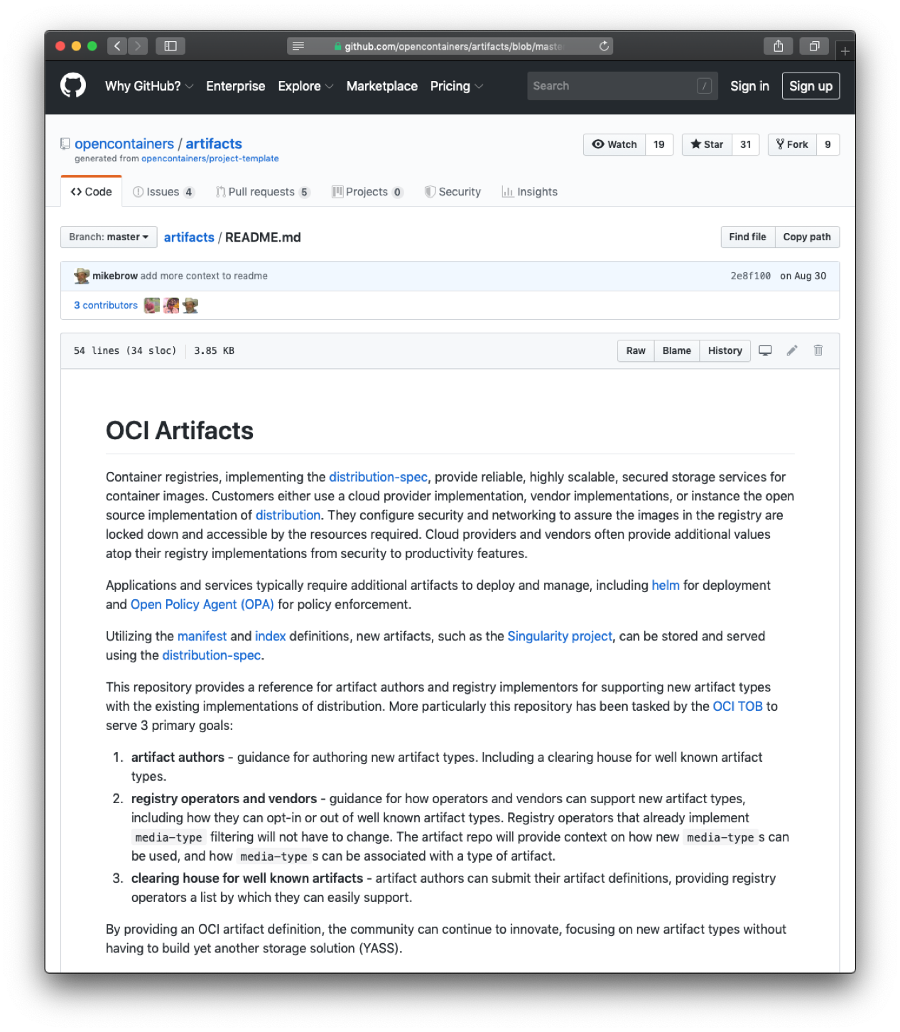
Helm Experiments (베타 기능)
> OCI Registries (OCI 레지스트리)
$ export HELM_EXPERIMENTAL_OCI=1
$ docker run -dp 5000:5000 --restart=always --name registry registry
$ helm chart save mychart localhost:5000/myrepo/mychart:1.2.3
ref: digest: size: name:
localhost:5000/myrepo/mychart:1.2.3 896935a875c8fe8f8b9b81e5862413de316f8da3d6d9a7e0f6f1e90f6204f551
2.7 KiB
mychart
version: 0.1.0
1.2.3: saved
$ helm chart list
REF | NAME | VERSION | DIGEST | SIZE | CREATED
localhost:5000/myrepo/mychart:1.2.3 | mychart | 0.1.0 | 896935a | 2.7 KiB | About a minute

Slide 25
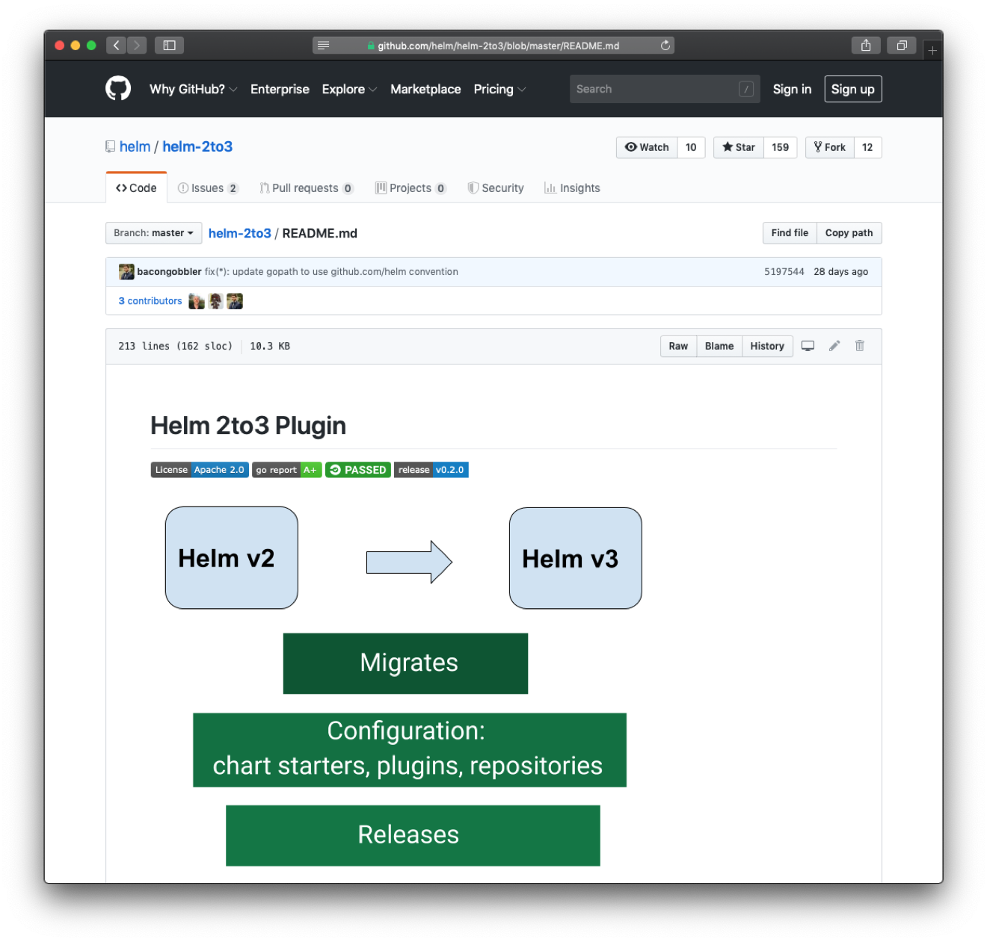
What about upgrading to Helm 3?
Helm 3으로 업그레이드는 어떻게 할 수 있나요?
After all, the storage format changed
$ | helm | plugin install https://github.com/helm/helm-2to3
$ | helm | 2to3 move config
$ | helm | 2to3 convert RELEASE
$ | helm | 2to3 cleanup
* Read the docs to learn about flags like --dry-run
--dry-run과 같은 플래그는 docs를 확인해주세요

Slide 26

Learn more: https://helm.sh
Read Docs: https://helm.sh/docs Source: https://github.com/helm/helm Mailing list: cncf-helm@lists.cncf.io
https://lists.cncf.io/g/cncf-helm

