Slide 1
Kubernetes & Google Kubernetes Engine (GKE)
by Akash Agrawal

Slide 2
Agenda

Slide 3
Agenda
Understanding Kubernetes
Traditional & Containerized App Deployment
Understanding Containers
Understanding Kubernetes
Kubernetes Fundamentals
Kubernetes Resources/Objects
Kubernetes Flow Diagram
Kubernetes Cluster Architecture

Slide 4
Agenda
Understanding Google Kubernetes Engine (GKE)
Understanding GKE
GKE Features

Slide 5
About Me

Slide 6
About Me
Google Developer Expert (on Google Cloud Platform Category)
11 years of experience in IT Industry
Worked with various clients like Sabre/Citi Bank/Goldman Sachs/L&T Infotech etc.
Currently I work as Independent Consultant (as Technical Adviser/Architect/Trainer) & Tech Evangelist

Slide 7
Understanding Kubernetes

Slide 8
Traditional & Containerized App Deployment
Traditional App Deployment
Problems with Traditional App Deployment
Containers & what problems does it solve
Kubernetes (Container Orchestrator) & what problems does it solve

Slide 9
Understanding Containers
Package your application/component & it’s dependencies
Container Runtimes : Docker / Rkt etc.
Focused around : Build / Ship / Run
Build: build container on local laptop manually or automate it through CI/CD Pipeline
Ship: ship through Container Registry e.g. Docker Hub/GCR etc.
Run: Run anywhere e.g. Cloud/On-Prem etc.

Slide 10
Understanding Kubernetes
Kubernetes is an Open Source system for Container Orchestration (Deployment/Management/Scaling)
Focused around:
Scheduling
Scaling (Manual / Auto)
Self Healing or Auto Repairing
...

Slide 11
Kubernetes Fundamentals
Kubernetes Cluster
Kubernetes Artifacts/Resources/Objects
Containerized Applications

Slide 12
Kubernetes Resources/Objects
Pod (Single/Multi Container Pod)
Service (ClusterIP/NodePort/LoadBalancer)
Controller Objects:
ReplicaSet
Deployment
StatefulSet
Job
...

Slide 13
Kubernetes Resources/Objects
Namespace
ConfigMap
Secret
Label & Selectors

Slide 14
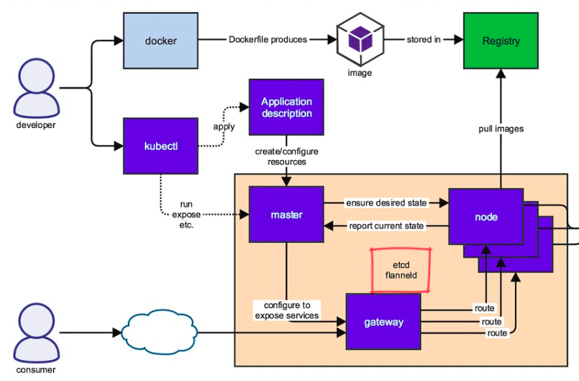

Slide 15
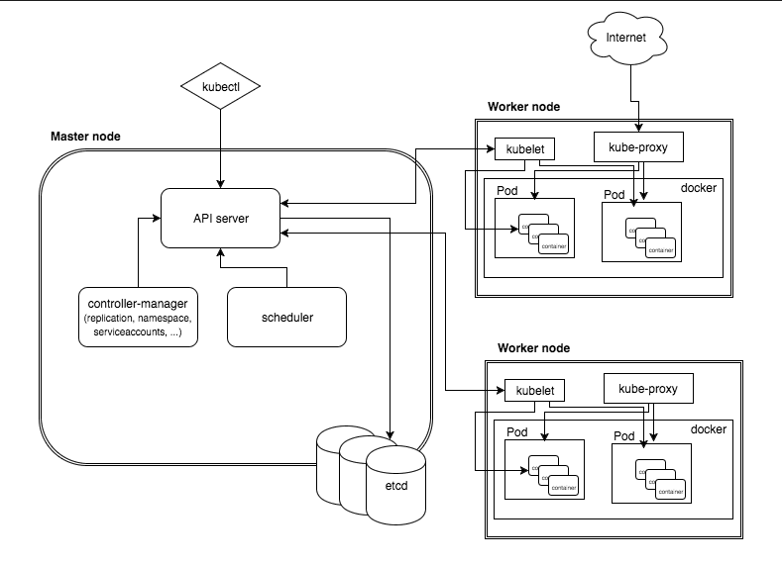

Slide 16
Kubernetes Cluster Architecture
Control Plane
Focused around managing Cluster & its State
Components:
Kube-apiserver
Etcd
Kube-controller-manager
Kube-scheduler

Slide 17
Kubernetes Cluster Architecture
Data Plane
Focused around managing individual Nodes & deployed Workloads
Components:
Kubelet
Kube-proxy
Container Runtime

Slide 18
Understanding Google Kubernetes Engine (GKE)

Slide 19
Understanding GKE
Managed Solution for Kubernetes on Google Cloud
Provides Reliable, Efficient & Secured way to run Kubernetes Clusters (on GCP)
Focused around:
Cluster Scaling
Self Healing or Auto Repairing of Nodes
Node Pools : CPU/GPU Pools
...

Slide 20
GKE Features
Features:
Fully Managed
Auto Scaling / Auto Upgrade / Auto Repair
Integration : IAM / StackDriver / VPC
Security, Compliance, Runs on Optimized OS (COS)
Accelerators Support : GPUs/TPUs
Various Cluster Topologies : Zonal Clusters / Regional Clusters
Workload Portability : On-Premises / Cloud
...

Slide 21
Look for:
Qwik Labs:
Kubernetes in Google Cloud: https://www.qwiklabs.com/quests/29
Kubernetes Solutions: https://www.qwiklabs.com/quests/45

Slide 22
Google Cloud Platform - Resources
Google Cloud Platform 101 (Cloud Next ‘19): https://www.youtube.com/watch?v=vmOMataJZWw
Google Cloud Developer Cheat Sheet: https://raw.githubusercontent.com/gregsramblings/google-cloud-4-words/master/Poster-medres.png
100+ announcements from Google Cloud Next ‘19: https://cloud.google.com/blog/topics/inside-google-cloud/100-plus-announcements-from-google-cloud-next19

Slide 23
Google Cloud Platform - Resources
Google Cloud Next ‘19 Sessions: https://www.youtube.com/playlist?list=PLIivdWyY5sqIXvUGVrFuZibCUdKVzEoUw
GCP Certification Resources: https://github.com/ddneves/awesome-gcp-certifications

Slide 24
Akash Agrawal
LinkedIn : akash-agrawal-58a97813
Twitter : @akkiagrawal29
Thanks

