Slide 1


Orchestrating containers on AWS
C O N 2 0 1
Liron Dor
Solutions Architect Manager Amazon Web Services
Dima Breydo Solutions Architect Amazon Web Services
Shimon Tolts
CTO & Co-Founder Datree
© 2019, Amazon Web Services, Inc. or its affiliates. All rights reserved.

Slide 2
Agenda
Microservices and containers
AWS container services Datree story and live demo
© 2019, Amazon Web Services, Inc. or its affiliates. All rights reserved.

Slide 3













When the impact of change is small, release velocity can increase
Monolith
Does everything
Microservices
Does one thing
© 2019, Amazon Web Services, Inc. or its affiliates. All rights reserved.

Slide 4










Monolith development lifecycle
developers services
delivery pipelines
build
test
release
monitor
© 2019, Amazon Web Services, Inc. or its affiliates. All rights reserved.

Slide 5









Microservice development lifecycle
developers services delivery pipelines
build test release
monitor
build
test
release
monitor
build
test
release
monitor
build
test
release
monitor
build
test
release
monitor
build
test
release
monitor
© 2019, Amazon Web Services, Inc. or its affiliates. All rights reserved.

Slide 6

Containers and Docker
A container is a standard unit of software that packages up code and all its dependencies so the application runs quickly and reliably from one computing environment to another.¹
App A
App B
App C
App D
Docker Engine
Operating System Server
¹ https://www.docker.com/resources/what-container
© 2019, Amazon Web Services, Inc. or its affiliates. All rights reserved.

Slide 7
Docker Image
Used to launch container
Instructions documented in Dockerfile
Image layer
Merge layers into single image
Image layer
References parent image layer
Image layer
Read-only template
Base Image
kernel
© 2019, Amazon Web Services, Inc. or its affiliates. All rights reserved.

Slide 8




Containers and Microservices
Do one thing, really well
Any app, any language
Isolated execution environment
Test and deploy same artifact
Faster startup
Container
Container
Container
Container
© 2019, Amazon Web Services, Inc. or its affiliates. All rights reserved.

Slide 9
Containers have become the standard for how to ship and run your application in the cloud
© 2019, Amazon Web Services, Inc. or its affiliates. All rights reserved.

Slide 10




























Manually downloading and launching containers by hand is inefficient and error prone
© 2019, Amazon Web Services, Inc. or its affiliates. All rights reserved.

Slide 11




















































Container orchestration
© 2019, Amazon Web Services, Inc. or its affiliates. All rights reserved.

Slide 12
© 2019, Amazon Web Services, Inc. or its affiliates. All rights reserved.

Slide 13





AWS Container Services landscape
MANAGEMENT
Deployment, scheduling, scaling & management of containerized applications
HOSTING
Where the containers run
IMAGE REGISTRY
Container image repository
© 2019, Amazon Web Services, Inc. or its affiliates. All rights reserved.

Slide 14








Kubernetes
Open source container management platform
Helps you run containers at scale
Gives you primitives for building
modern applications
© 2019, Amazon Web Services, Inc. or its affiliates. All rights reserved.

Slide 15






Amazon EKS architecture
Kubectl
mycluster.eks.amazonaws.com
VPC
AZ 1
AZ 2
AZ 3
EKS workers
Your AWS account
© 2019, Amazon Web Services, Inc. or its affiliates. All rights reserved.

Slide 16












Kubernetes control plane
VPC
Highly available and single tenant infrastructure
NLB
AZ-1
API Server ASG
Instances AZ-2
ELB
Etcd ASG
Instances
AZ-3
All “native AWS” components
Fronted by an NLB
© 2019, Amazon Web Services, Inc. or its affiliates. All rights reserved.

Slide 17
Amazon EKS features
Certified conformant
Integration with Elastic Load Balancing Managed updates
IAM authentication
© 2019, Amazon Web Services, Inc. or its affiliates. All rights reserved.

Slide 18




Amazon Elastic Container Service
A managed platform
ECS
Highly Scalable , Highly Performant Container
Management System
Cluster Management
Container Orchestration & Placement
Deep AWS Integration
© 2019, Amazon Web Services, Inc. or its affiliates. All rights reserved.

Slide 19


















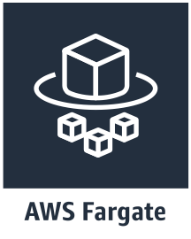




Amazon ECS key components
Task definition
Container
Container
Volume
Amazon Elastic Container Registry
Amazon Elastic Container Service (Amazon ECS)
Production cluster
Development cluster
Container instance
Container instance
Container instance
Container instance
Container instance
Container instance
© 2019, Amazon Web Services, Inc. or its affiliates. All rights reserved.

Slide 20
Amazon ECS features
Integration with Elastic Load Balancing
Service Discovery with AWS CloudMap Task level IAM support
Blue/Green Deployments with AWS CodeDeploy Windows Containers Compatibility
© 2019, Amazon Web Services, Inc. or its affiliates. All rights reserved.

Slide 21

































EC2 hosting
EC2 Instance
Choose your instance type
Connect to the instance
Persistent EBS storage Custom kernel modules
OS | Docker | ECS Agent
 | Agent
© 2019, Amazon Web Services, Inc. or its affiliates. All rights reserved.

Slide 22












“Just launch 10 copies of my container distributed across three availability zones and connect them to this load balancer”
X 10
© 2019, Amazon Web Services, Inc. or its affiliates. All rights reserved.

Slide 23







www.datree.io

Slide 24









Agenda
1
About me & datree.io
4
How do we deploy (technical)
2
What is Fargate TCO?
5
DEMO
3
Why did we choose to use Fargate
© 2018, Amazon Web Services, Inc. or its affiliates. All rights reserved.
www.datree.io
www.datree.io

Slide 25


About me
Shimon Tolts { age: 30,
title: “CTO & Co-Founder @ datree.io”, misc: [“AWS Community Hero”,“Gamer”]
}
© 2018, Amazon Web Services, Inc. or its affiliates. All rights reserved.
www.datree.io
www.datree.io

Slide 26

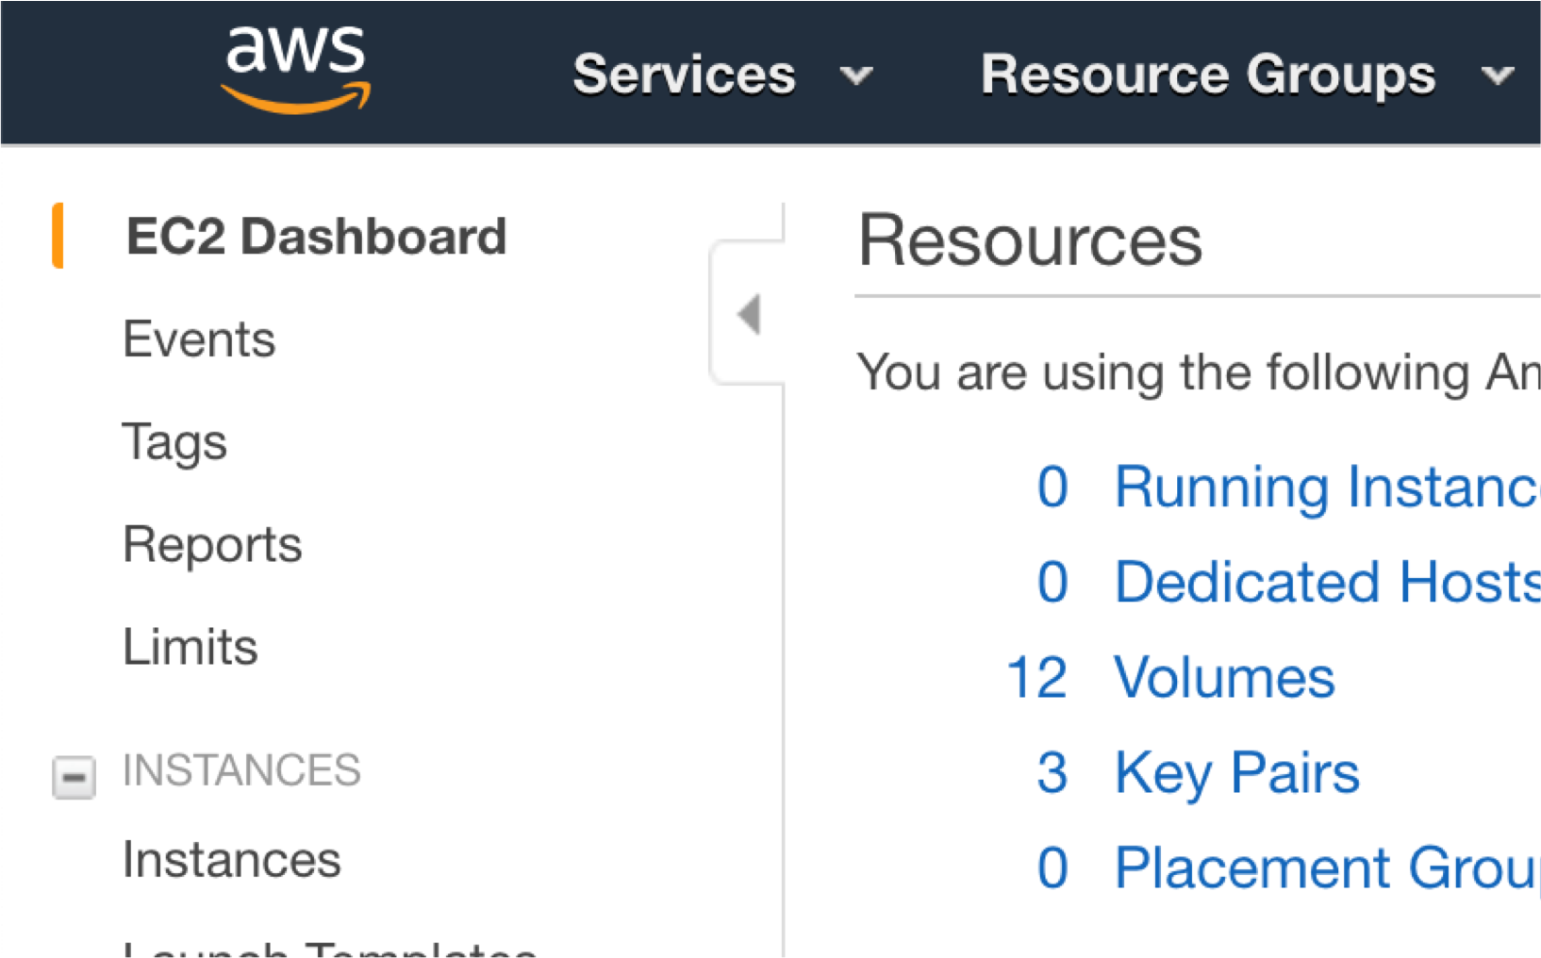
0 EC2 instances @ datree.io
© 2018, Amazon Web Services, Inc. or its affiliates. All rights reserved.
www.datree.io
www.datree.io

Slide 27

GitOps
Datree is a Policy Enforcement Platform for confident and compliant code.
© 2018, Amazon Web Services, Inc. or its affiliates. All rights reserved.
www.datree.io
www.datree.io

Slide 28
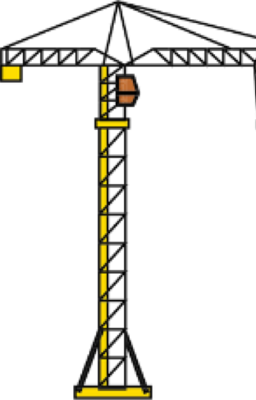

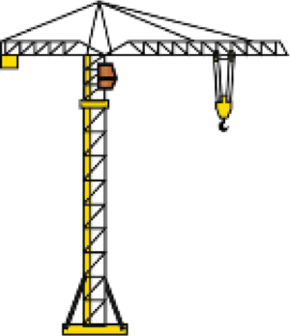

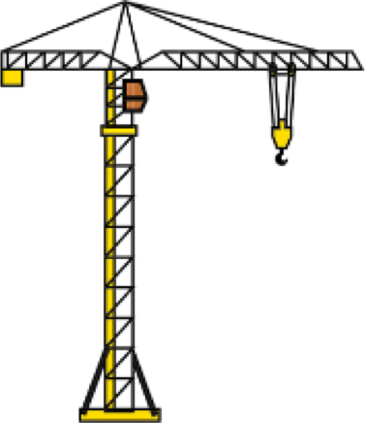







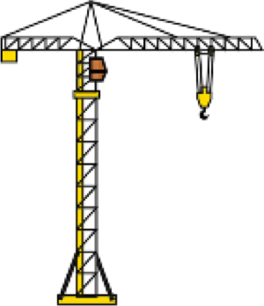



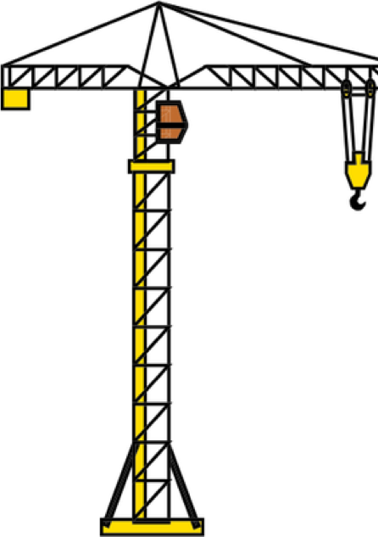





GitOps is the new normal
Developers have access to production
Code, build, test, package, release, configure, deploy and rollback your application with Git almost instantly
Build
Build
DEVELOPMENT
Deploy
PRODUCTION
Test
Deploy
Deploy
Test
© 2018, Amazon Web Services, Inc. or its affiliates. All rights reserved.
www.datree.io
www.datree.io

Slide 29

Datree connects with GitHub
Datree connects with GitHub to provide automatic policy compliance checks and insights for every code commit and pull request.
© 2018, Amazon Web Services, Inc. or its affiliates. All rights reserved.
www.datree.io
www.datree.io

Slide 30




Datree connects with GitHub
Set Code Policies
Create custom policies or choose from recommended defaults, and choose where they should be enforced.
Separate secret credentials from source code
Include .gitignore in every project
Link pull request title to a Jira ticket
Create custom policies…
© 2018, Amazon Web Services, Inc. or its affiliates. All rights reserved.
www.datree.io
www.datree.io

Slide 31
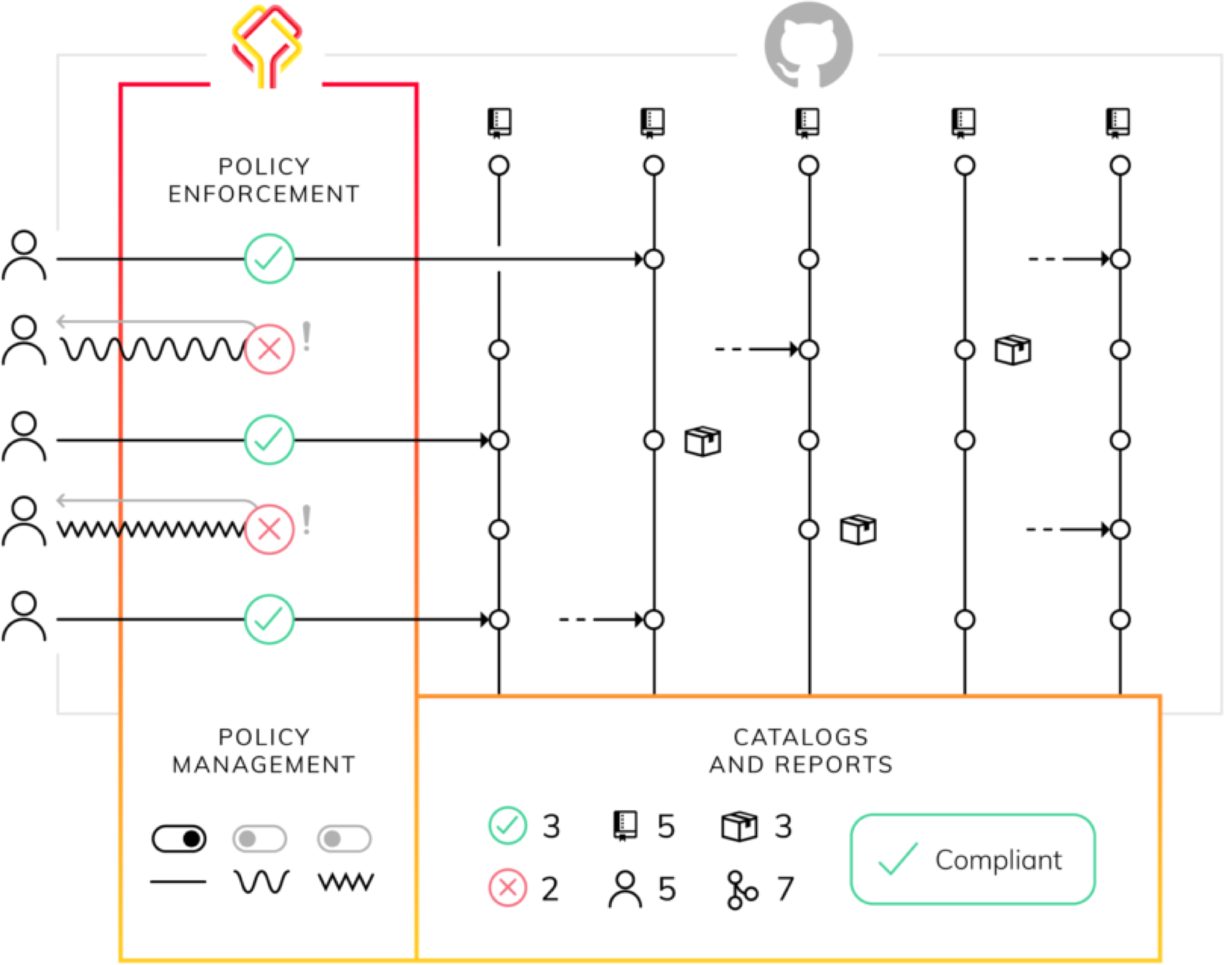

www.datree.io

Slide 32


Apples and oranges
! =
Amazon EC2
© 2018, Amazon Web Services, Inc. or its affiliates. All rights reserved.
www.datree.io
www.datree.io

Slide 33

Ops benefits
ECS-EC2
ECS-Fargate
AWS Monthly Fees
AWS Monthly Fees
System Administration
Security & Compliance
Scaling
© 2018, Amazon Web Services, Inc. or its affiliates. All rights reserved.
www.datree.io
www.datree.io

Slide 34


No more Amazon EC2 management
We no longer configure AMIs
Monitoring & logging is built in
© 2018, Amazon Web Services, Inc. or its affiliates. All rights reserved.
www.datree.io
www.datree.io

Slide 35

Operating system management
All of our code is packaged using Docker containers,
so we are ONLY responsible for what runs within our containers
No more:
Docker service updates
Linux Patching
ECS Agent updates
© 2018, Amazon Web Services, Inc. or its affiliates. All rights reserved.
www.datree.io
www.datree.io

Slide 36


Scaling
We no longer deal with scaling EC2 fleets
Taking care of bin packing our instance to run cost-effectively
© 2018, Amazon Web Services, Inc. or its affiliates. All rights reserved.
www.datree.io
www.datree.io

Slide 37

Compliance & security
Compliance and security are our top priorities
Out-of-the-box security as a service Fargate comes certified with
SOC 2 HIPAA PCI-DSS
© 2018, Amazon Web Services, Inc. or its affiliates. All rights reserved.
www.datree.io
www.datree.io

Slide 38

Building an icecream service
http://icecream.datree.io
A simple Node.js app
A web service using Koa.js
Serving icecream!
© 2018, Amazon Web Services, Inc. or its affiliates. All rights reserved.
www.datree.io
www.datree.io

Slide 39
Pipeline overview
Source code in GitHub
AWS Application Load Balancer
AWS ECS Fargate cluster
GitHub Actions workflow (CI/CD)
© 2018, Amazon Web Services, Inc. or its affiliates. All rights reserved.
www.datree.io
www.datree.io

Slide 40
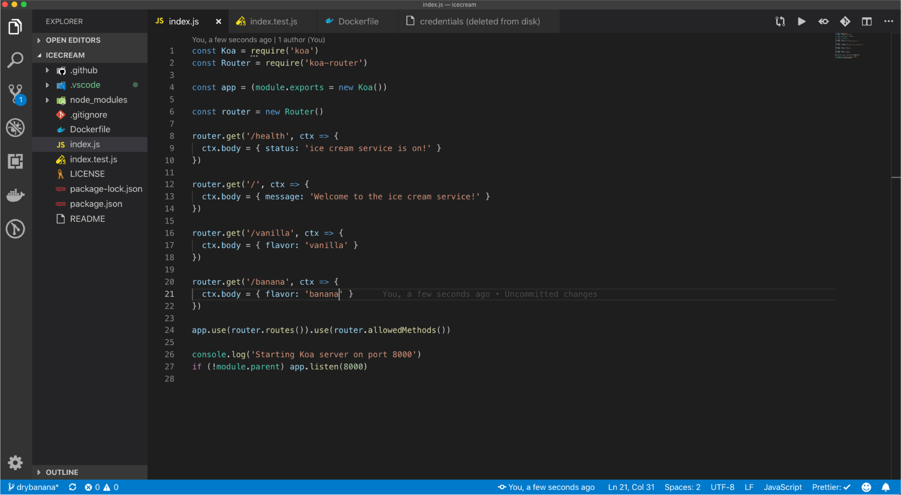
DEMO time
© 2018, Amazon Web Services, Inc. or its affiliates. All rights reserved.
www.datree.io
www.datree.io

Slide 41
ECS on EC2 vs. Fargate
10 GB disk space limit
Amazon EBS attaching is not available
No Spot Instances support
No instance type selection
(GPU/CPU/MEM
optimized)
No Reserved Instance pricing
© 2018, Amazon Web Services, Inc. or its affiliates. All rights reserved.
www.datree.io
www.datree.io

Slide 42

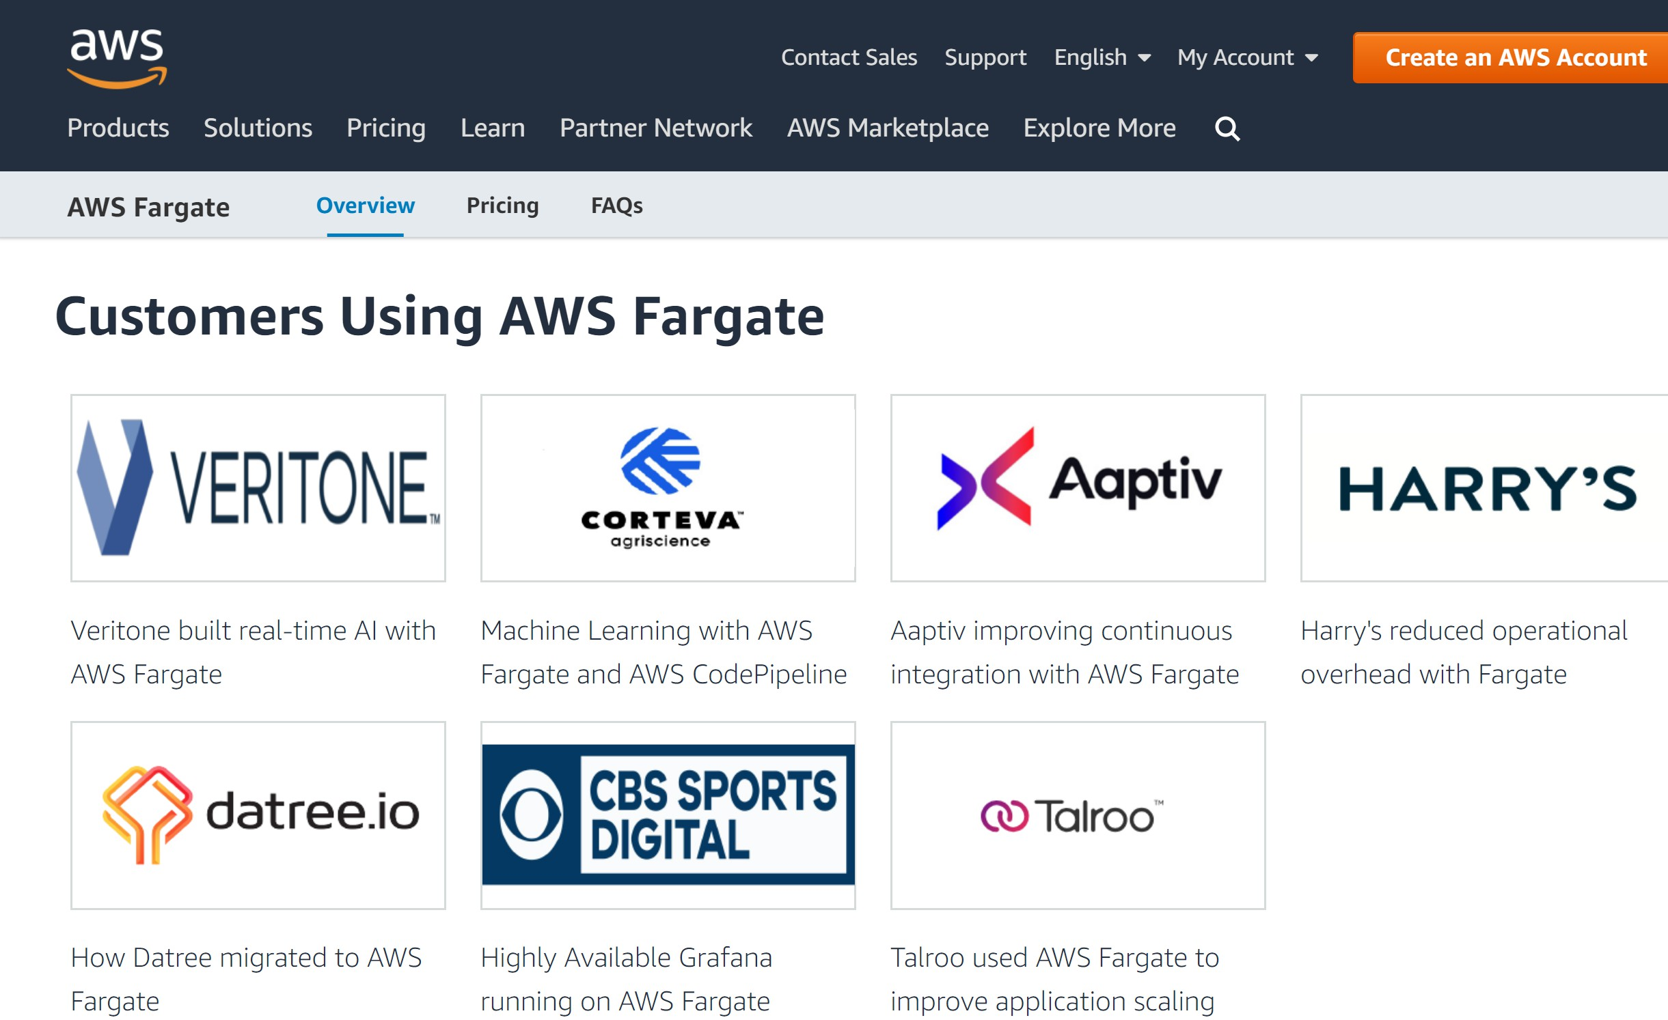
Open case study on AWS Fargate page
https://dtr.ee/fargate
© 2018, Amazon Web Services, Inc. or its affiliates. All rights reserved.
www.datree.io
www.datree.io

Slide 43
Resources
https://datree.io/blog/migrating-to-aws-ecs-fargate-in-production/
https://www.youtube.com/watch?v=rtk3rRdAZ6s&feature=youtu.be &t=1239
https://github.com/silinternational/ecs-deploy
© 2018, Amazon Web Services, Inc. or its affiliates. All rights reserved.
www.datree.io
www.datree.io

Slide 44
Related breakouts
14:10 Deep Dive on Amazon Elastic Container Service (ECS) Brent Langston
15:00 Mastering Amazon Elastic Container Service for Kubernetes (Amazon EKS) Kobi Biton, Chen Fisher
15:50 From Code to a running container Alexei Ledenev, Gal Marder
© 2019, Amazon Web Services, Inc. or its affiliates. All rights reserved.

Slide 45








Thank you!
http://bit.ly/2SJ6Md2
© 2019, Amazon Web Services, Inc. or its affiliates. All rights reserved.

