Slide 1
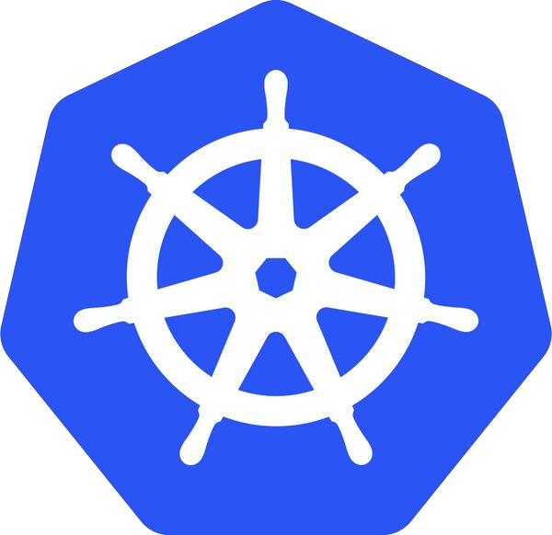
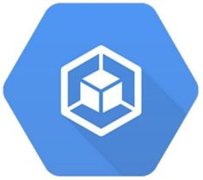

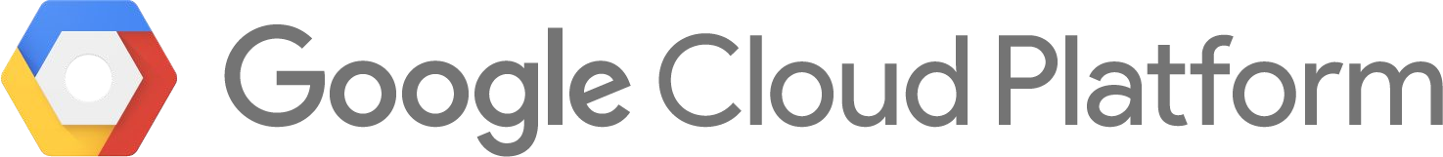
Containers, Kubernetes and Google Cloud
@meteatamel
Mete Atamel
Developer Advocate for Google Cloud

Slide 2
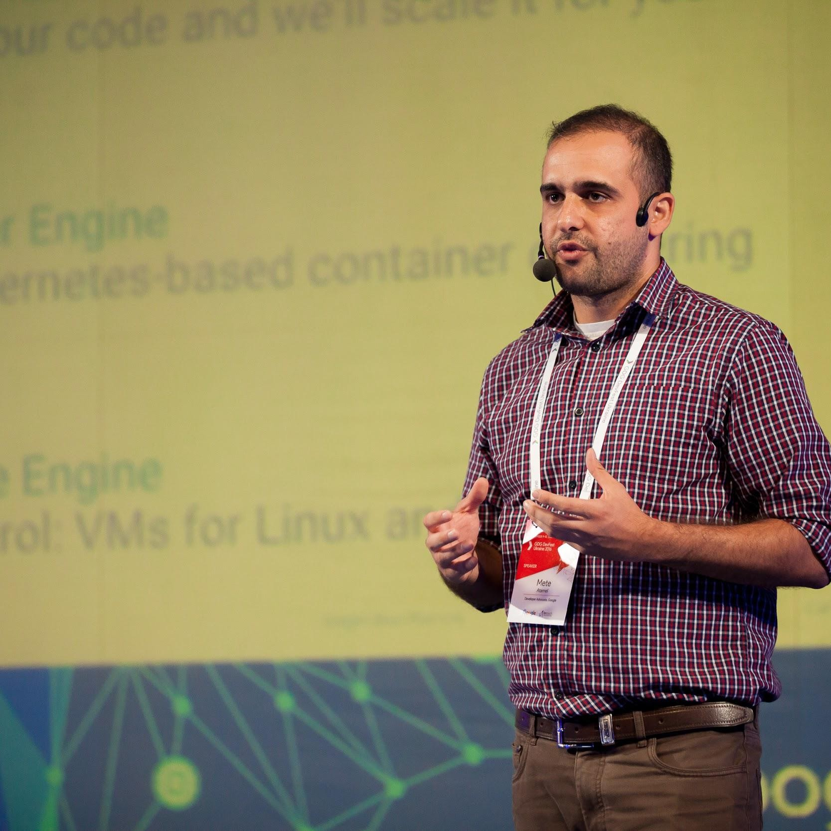
Mete Atamel
Developer Advocate for Google Cloud
@meteatamel atamel@google.com meteatamel.wordpress.com
Please send talk feedback: bit.ly/atamel
Confidential & Proprietary

Slide 3

@meteatamel
Software development is HARD!
And it is not getting any easier...
Confidential & Proprietary

Slide 4
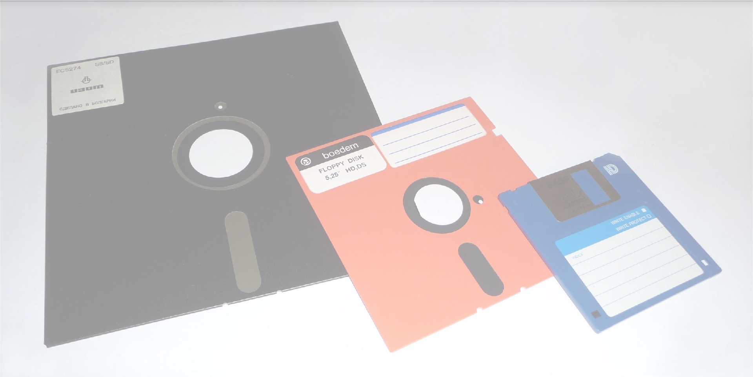
In the good old days
@meteatamel
This is all I had to care...
Life was good :-)
Image Source: Wikipedia

Slide 5
A lot happened since then
Internet
Web Servers
Databases
The Monolith
Mobile
App Servers
Cloud Computing
Microservices
Firewalls
Version Control
Caching
Machine Learning
Object Oriented Programming
Virtual Machines
Big Data
DevOps
IoT

Slide 6

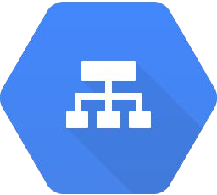







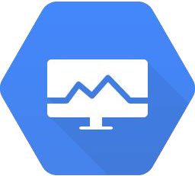
Nowadays
Load Balancer
REPLICATION
Load Balancer
Task Queues
ZONE A
ZONE B
Health Endpoint
Health Endpoint
Health Endpoint
Health Endpoint
Health Endpoint
Health Endpoint
Health Checker
Health Checker
Autoscaler

Slide 7
We haven’t even talked about
Maintaining code in different languages on different types of machines
Rolling out the new version of your code reliably
Rolling back to the old version if something goes wrong Managing configuration and secrets
Managing scripts that need to run on each machine

Slide 8

I just want to write some code to solve a real-world problem
@meteatamel

Slide 9






The reality
This is all I want to care
This is all I have to care
Load Balancer
REPLICATION
Load Balancer
Task Queues
What do we do?
ZONE A
ZONE B
Health Endpoint
Health Endpoint
Health Endpoint
Health Endpoint
Health Endpoint
Health Endpoint
Health Checker
Health Checker
Autoscaler

Slide 10
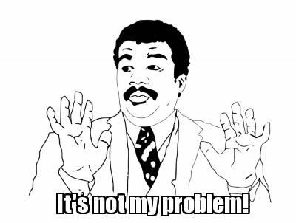
In the good old days
@meteatamel
Write your code, pass it to QA for testing, let operations team run it...

Slide 11
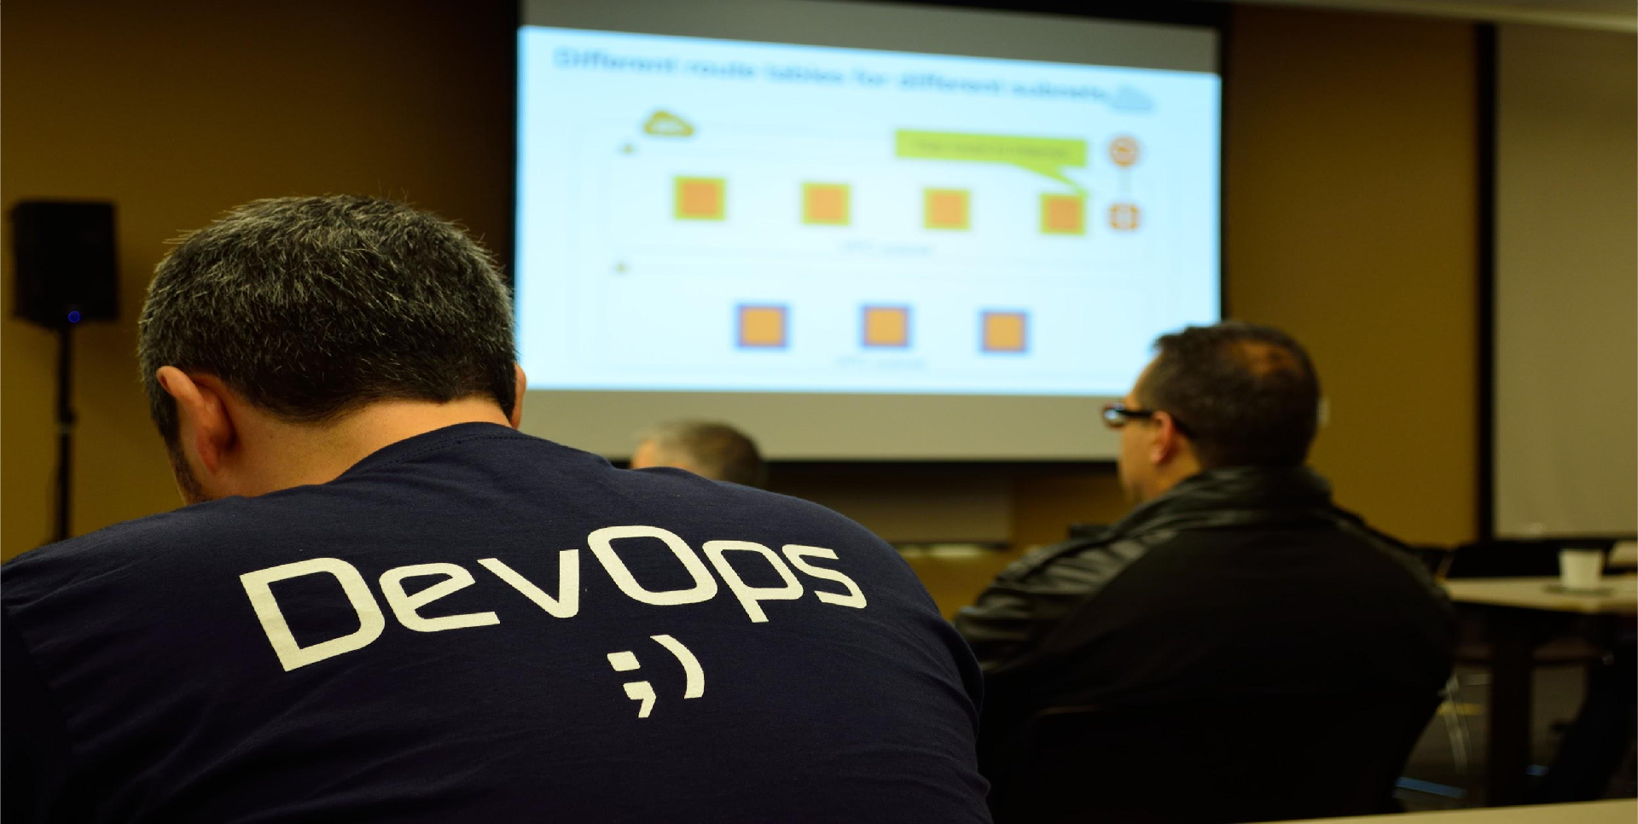
Nowadays, it is your problem
What do we do?
Google Cloud Platform

Slide 12

@meteatamel
You can write your code in any language and run
anywhere exactly the same way
Your app is optimally deployed somewhere and managed by someone. It just works!
There are no machines. All resources are
automatically provisioned on demand

Slide 13
Docker + Kubernetes + Cloud
Write your code in any language and run it anywhere exactly the same way
Containers (eg. Docker, Rkt)
Your app is optimally deployed and managed
Container Management Platforms (eg. Kubernetes, Docker Swarm, Mesos)
All the resources needed for your app is automatically provisioned per demand
Cloud Providers (eg. Google Cloud, AWS, Azure)

Slide 14
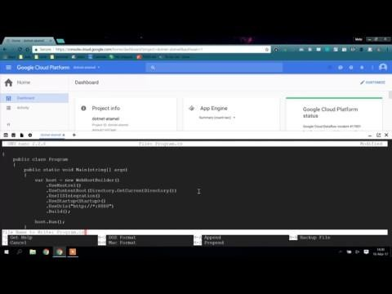
Demo: Simple Microservice
@meteatamel

Slide 15
Containers
@meteatamel

Slide 16
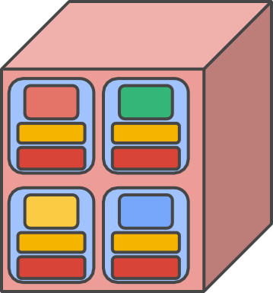
Why containers?
@meteatamel
app app
app app
app
libs kernel
app
libs kernel
app
libs
app
libs
app
libs
app
libs
libs kernel
app
libs kernel
app
libs kernel
kernel
Physical Machine
✕ No isolation
✕ Common libs
✕ Highly coupled Apps & OS
Virtual Machines
Containers
Isolation
No Common Libs
✕ Expensive and Inefficient
✕ Hard to manage
Isolation
No Common Libs
Less overhead
✕ Less Dependency on Host OS

Slide 17

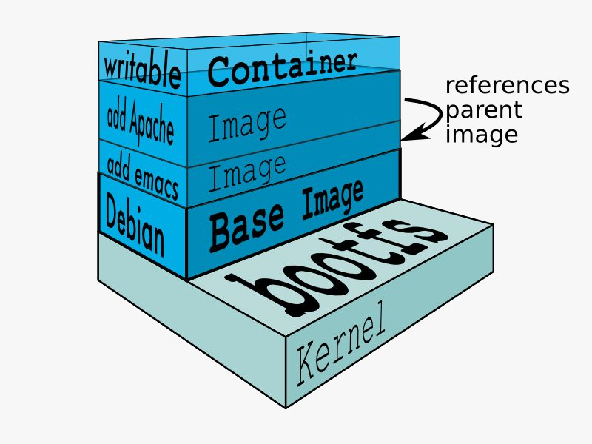
What is a container?
@meteatamel
Docker
A lightweight way to virtualize applications
Linux (or Windows) processes
Lightweight Hermetically sealed Isolated
Easily deployable Introspectable Composable

Slide 18
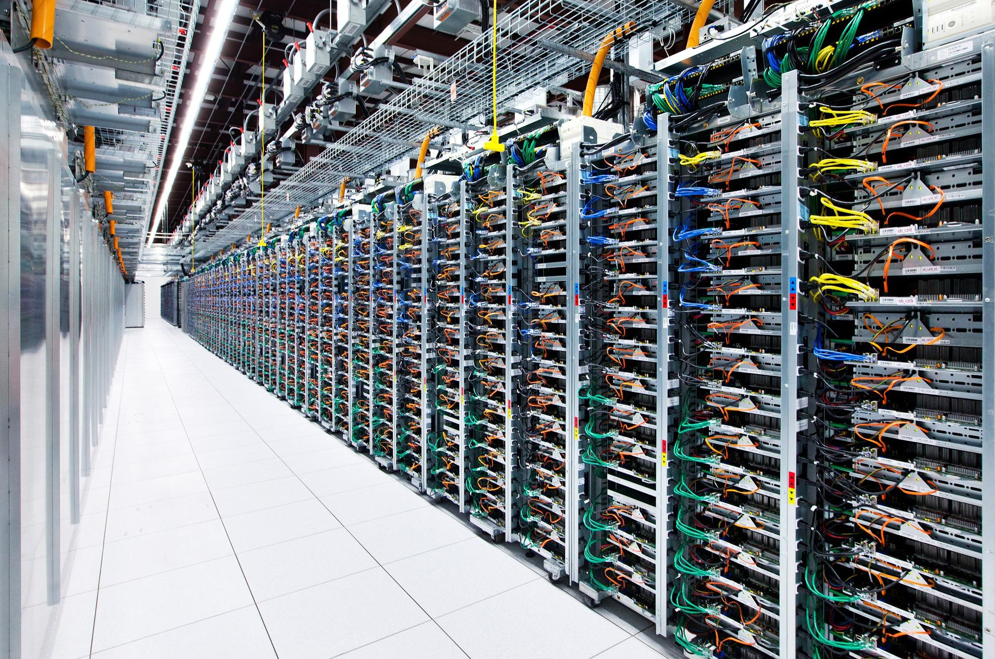
@meteatamel
Google has been developing and using containers to manage our applications for over 12 years.
Images by Connie Zhou

Slide 19
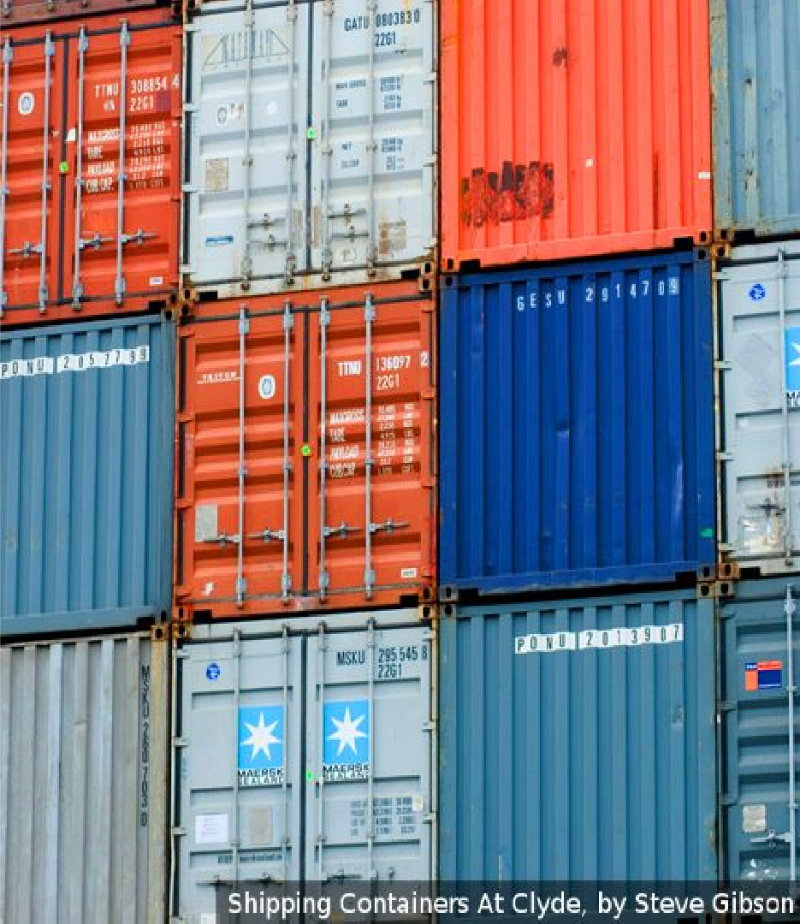
Everything at Google runs in containers
@meteatamel
Gmail, Web Search, Maps, ... MapReduce, batch, ...
GFS, Colossus, ...
Even Google’s Cloud Platform: our VMs run in containers!
We launch over 2 billion
containers per week
Google Cloud Platform

Slide 20
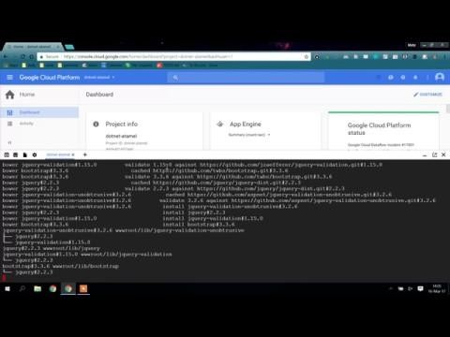
Demo: Containerised Microservice
@meteatamel

Slide 21
Containers not enough
@meteatamel
Containers help to create a lightweight and consistent environment for apps
But you still need to answer these questions:
Who takes care of redundancy?
Who takes care of resiliency?
Who scales up/down your app?
Who and how a new version of your app gets deployed?
Who rolls back to a previous version if something goes wrong?
Etc. etc. etc.

Slide 22
Kubernetes
@meteatamel

Slide 23
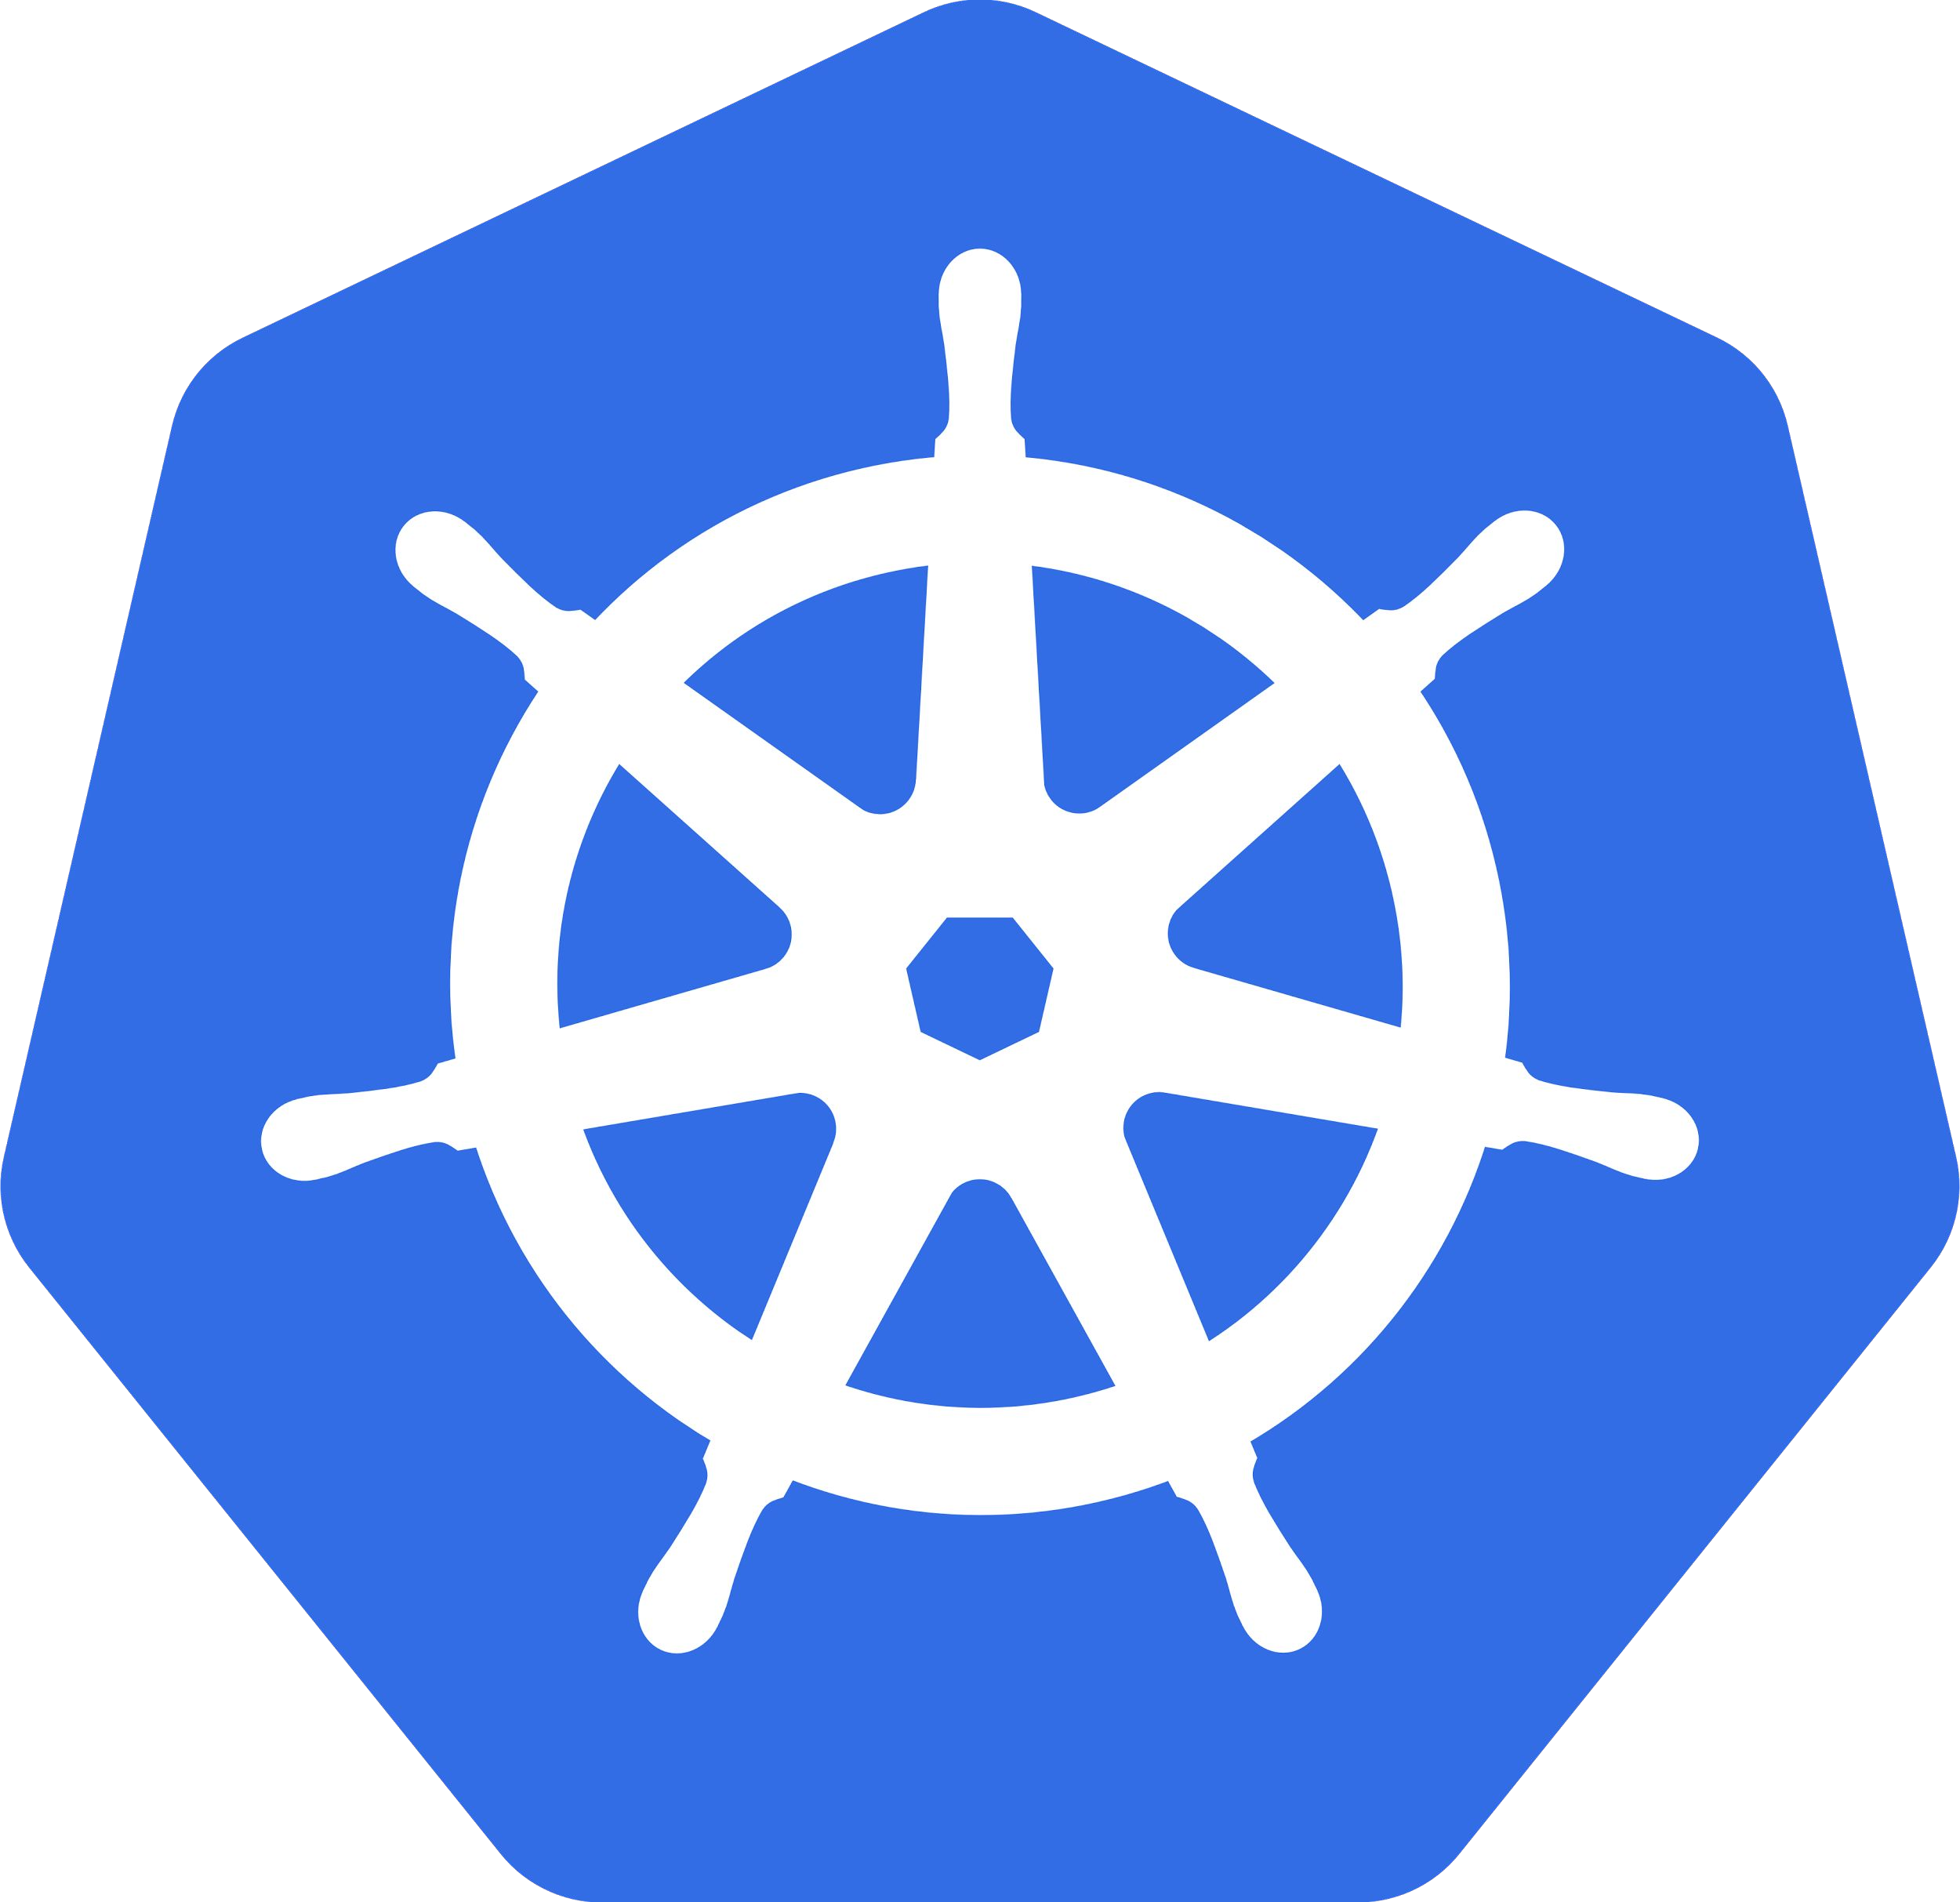
Kubernetes
@meteatamel
Greek for “Helmsman”; also the root of the words “governor” and “cybernetic”
Manages container clusters
Inspired and informed by Google’s experiences and internal systems (borg)
Supports multiple cloud and bare-metal environments
Supports multiple container runtimes
100% Open source, written in Go
Manage applications, not machines

Slide 24
The 10000 foot view
@meteatamel
kubelet
API
apiserver
etcd scheduler controllers
CLI
kubelet
UI
kubelet
users
master
nodes

Slide 25
All you really care about
@meteatamel
Container Cluster
API

Slide 26
Container clusters: A story in two parts
@meteatamel
Setting up the cluster
Choose a cloud: GCE, AWS, Azure, Rackspace, on-premises, ...
Choose a node OS: CoreOS, Atomic, RHEL, Debian, CentOS, Ubuntu, ...
Provision machines: Boot VMs, install and run kube components, ...
Configure networking: IP ranges for Pods, Services, SDN, ...
Start cluster services: DNS, logging, monitoring, ...
Manage nodes: kernel upgrades, OS updates, hardware failures...
Not the easy or fun part, but unavoidable
This is where things like Google Container Engine (GKE) really help

Slide 27
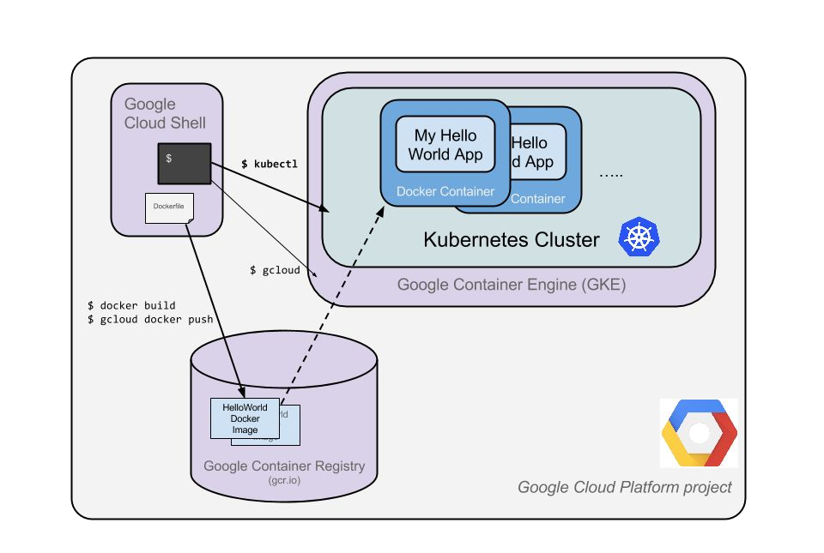
Kubernetes cluster on GKE
@meteatamel

Slide 28
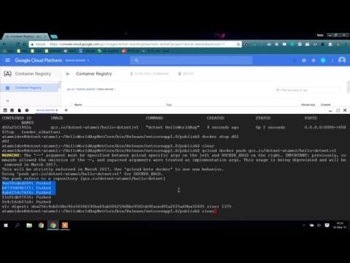
Demo: Create Kubernetes cluster
@meteatamel

Slide 29
Container clusters: A story in two parts
@meteatamel
Using the cluster
Run Pods & Containers
Replica Sets
Services
Volumes
This is the fun part!
A distinct set of problems from cluster setup and management Don’t make developers deal with cluster administration!
Accelerate development by focusing on the applications, not the cluster

Slide 30
Kubernetes Building Blocks
@meteatamel

Slide 31
Kubernetes Terminology
Deployment | ReplicaSet | DaemonSet
Pod | Liveness Probe | Job
Volume | Readiness Probe | StatefulSet
Label | Service | ConfigMap
Selector |  | Secret

Slide 32












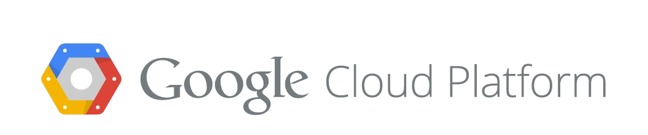
@meteatamel
Container cluster
microservice
Replication controller Replicas: 3
Service communication channel
Role: frontend
Env: prod
labels
Service
Blueprint “pod template”
Pods
Each pod containers one or more containers
Role: frontend
Role: frontend
Role: frontend
Env: prod
Env: prod
Env: prod
registry
containers
Nodes

Slide 33
Deployments: where everything starts
@meteatamel

Slide 34








Deployments
@meteatamel
A Deployment provides declarative updates for Pods and Replica Sets
Describe the desired state and the Deployment controller will change the actual state to the desired state at a controlled rate for you.
Deployment manages replica changes for you
stable object name
updates are configurable, done server-side
kubectl edit or kubectl apply
...

Slide 35
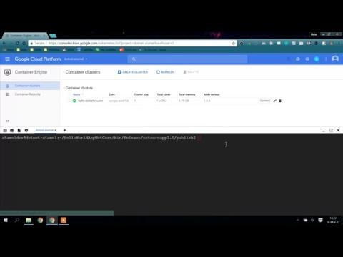
Demo: Create Deployment
@meteatamel

Slide 36
Kubernetes Terminology
Deployment | ReplicaSet | DaemonSet
Pod | Liveness Probe | Job
Volume | Readiness Probe | StatefulSet
Label | Service | ConfigMap
Selector |  | Secret

Slide 37
Pods and Volumes: Atom of scheduling
@meteatamel

Slide 38
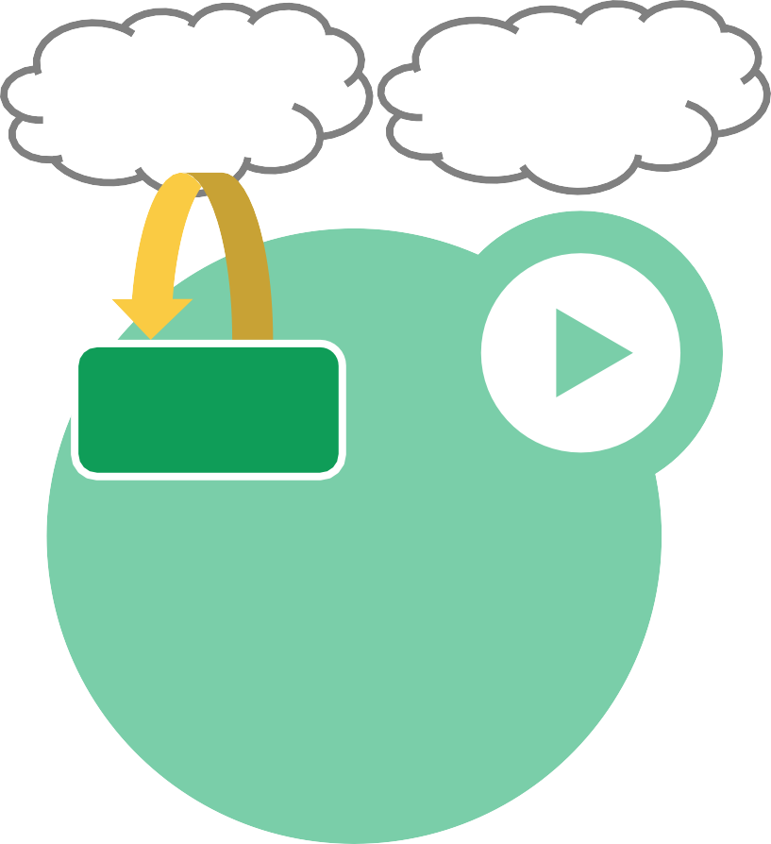

Pods
@meteatamel
Content Manager
Small group of containers & volumes
Tightly coupled
The atom of scheduling & placement Shared namespace
Consumers
File Puller
Web Server
share IP address & localhost
share IPC, etc.
Managed lifecycle
bound to a node, restart in place
can die, cannot be reborn with same ID
Volume
Example: data puller & web server
Pod

Slide 39
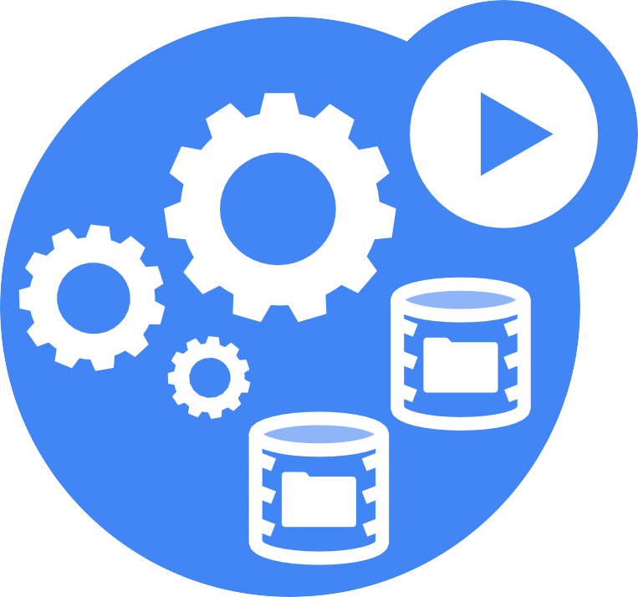
Volumes
@meteatamel
Pod-scoped storage
Support many types of volume plugins
Empty dir (and tmpfs)
Host path
Git repository
GCE Persistent Disk
AWS Elastic Block Store •
Azure File Storage
iSCSI
Flocker
NFS
vSphere
GlusterFS
Ceph File and RBD
Cinder FibreChannel
Secret, ConfigMap, DownwardAPI
Flex (exec a binary)
...

Slide 40
Kubernetes Terminology
Deployment | ReplicaSet | DaemonSet
Pod | Liveness Probe | Job
Volume | Readiness Probe | StatefulSet
Label | Service | ConfigMap
Selector |  | Secret

Slide 41
Labels & Selectors: Grouping
@meteatamel

Slide 42




Labels
@meteatamel
Arbitrary metadata
Attached to any API object Generally represent identity Queryable by selectors
think SQL ‘select ... where ...’
The only grouping mechanism
pods under a ReplicationController
pods in a Service
capabilities of a node (constraints)

Slide 43











Selectors
@meteatamel
App: MyApp
App: MyApp
Phase: prod
Phase: prod
Role: FE
Role: BE
App: MyApp
App: MyApp
Phase: test
Phase: test
Role: FE
Role: BE

Slide 44
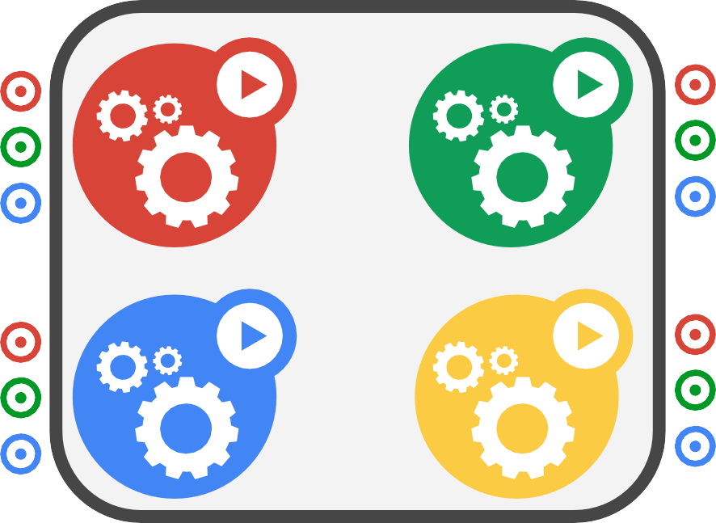
Selectors
@meteatamel
App: MyApp
App: MyApp
Phase: prod
Phase: prod
Role: FE
Role: BE
App: MyApp
App: MyApp
Phase: test
Phase: test
Role: FE
Role: BE
App = MyApp

Slide 45
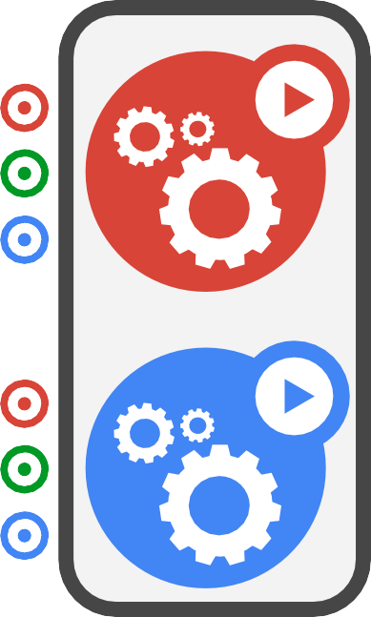
Selectors
@meteatamel
App: MyApp
App: MyApp
Phase: prod
Phase: prod
Role: FE
Role: BE
App: MyApp
App: MyApp
Phase: test
Phase: test
Role: FE
Role: BE
App = MyApp, Role = FE

Slide 46

Selectors
@meteatamel
App: MyApp
App: MyApp
Phase: prod
Phase: prod
Role: FE
Role: BE
App: MyApp
App: MyApp
Phase: test
Phase: test
Role: FE
Role: BE
App = MyApp, Role = BE

Slide 47

Selectors
@meteatamel
App: MyApp
App: MyApp
Phase: prod
Phase: prod
Role: FE
Role: BE
App: MyApp
App: MyApp
Phase: test
Phase: test
Role: FE
Role: BE
App = MyApp, Phase = prod

Slide 48

Selectors
@meteatamel
App: MyApp
App: MyApp
Phase: prod
Phase: prod
Role: FE
Role: BE
App: MyApp
App: MyApp
Phase: test
Phase: test
Role: FE
Role: BE
App = MyApp, Phase = test

Slide 49
Kubernetes Terminology
Deployment | ReplicaSet | DaemonSet
Pod | Liveness Probe | Job
Volume | Readiness Probe | StatefulSet
Label | Service | ConfigMap
Selector |  | Secret

Slide 50
Resiliency & Redundancy
@meteatamel

Slide 51
ReplicaSets: Big brother
@meteatamel
ReplicaSet
name = “my-rc”
selector = {“App”: “MyApp”}
template = { ... }
replicas = 4
A simple control loop
Runs out-of-process wrt API server
One job: ensure N copies of a pod
grouped by a selector
too few? start some
too many? kill some
How many?
Start 1 more
How many?
3
OK
4
Layered on top of the public Pod API
Replicated pods are fungible
No implied order or identity
* The evolution of ReplicationControllers
API Server

Slide 52
ReplicaSets
@meteatamel
ReplicaSet
#pods = 3
app = demo
color in (blue,grey)
Pod
Pod
Pod
app = demo color = blue
app = demo color = blue
app = demo color = grey
Behavior
Benefits
Keeps Pods running
Gives direct control of Pod #s
Grouped by Label Selector
Recreates Pods, maintains desired state
Fine-grained control for scaling
Standard grouping semantics

Slide 53
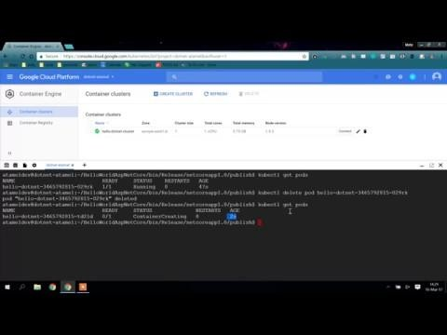
Demo: ReplicaSets
@meteatamel

Slide 54
Kubernetes Health Checks
@meteatamel

Slide 55

Health Check Philosophy
It’s your responsibility to let Kubernetes know whether your app is healthy or not!

Slide 56
Liveness Probes
Liveness Probes make sure your application is running
livenessProbe:
# an http probe httpGet:
path: /healthz port: 8080
initialDelaySeconds: 15
timeoutSeconds: 1
# wait 15 seconds after pod is started to check for health # wait 1 second for a response to health check

Slide 57
Readiness Probes
Readiness probes make sure your application is ready to serve traffic
readinessProbe:
# an http probe httpGet:
path: /readiness port: 8080
initialDelaySeconds: 20 # wait 20 seconds after pod is started to check for health timeoutSeconds: 5 # wait 5 second for a response to health check

Slide 58
Kubernetes Terminology
Deployment | ReplicaSet | DaemonSet
Pod | Liveness Probe | Job
Volume | Readiness Probe | StatefulSet
Label | Service | ConfigMap
Selector |  | Secret

Slide 59
Services
@meteatamel

Slide 60

Services
@meteatamel
Client
A logical grouping of pods that perform the same function (the Service’s endpoints)
grouped by label selector
Load balances incoming requests across constituent pods
Choice of pod is random but supports session affinity (ClientIP)
Gets a stable virtual IP and port
also a DNS name
VIP
Service
Label selector: type = FE
Pod
Container
type = FE
Pod
Container
type = FE
Pod
Container
type = FE

Slide 61
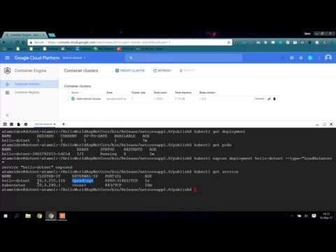
Demo: Services
@meteatamel

Slide 62
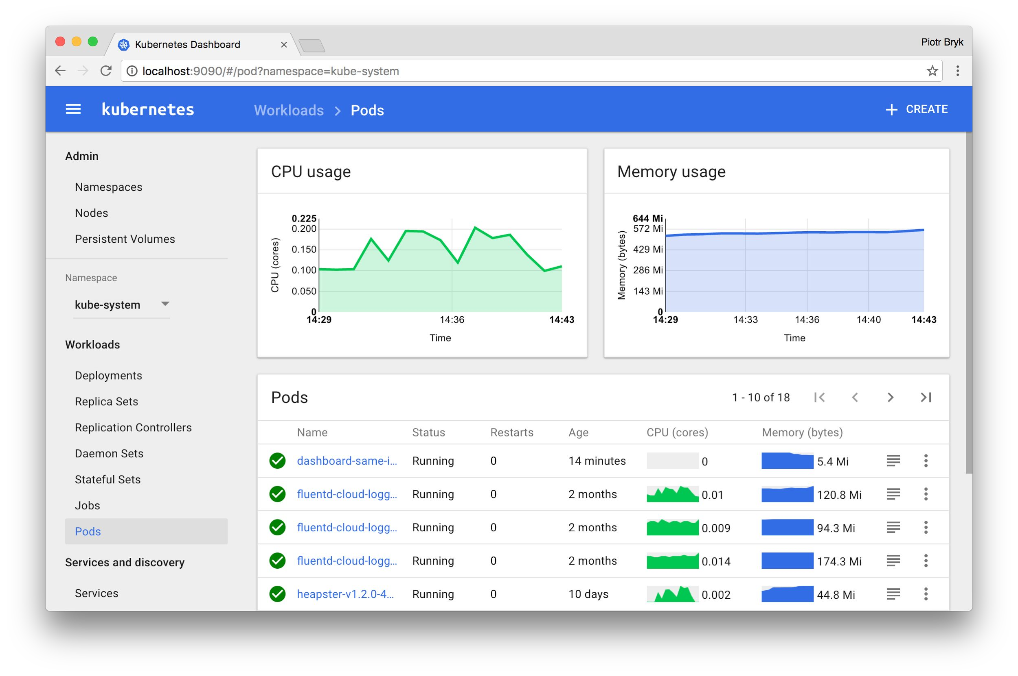
Kubernetes Dashboard
A general purpose, web-based UI to view/manage Kubernetes clusters

Slide 63
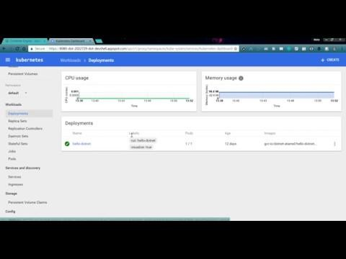
Demo: Kubernetes Dashboard

Slide 64
Kubernetes Terminology
Deployment | ReplicaSet | DaemonSet
Pod | Liveness Probe | Job
Volume | Readiness Probe | StatefulSet
Label | Service | ConfigMap
Selector |  | Secret

Slide 65
Scaling
@meteatamel

Slide 66
Scaling
@meteatamel
ReplicaSet version = v1 vtvyerprseio=nF=Ev1 #pods = 231
Pod
Pod
Pod
version= v1
version = v1 type = FE
version = v1 type = FE
type = FE
Service
name = frontend
Label selector: type = BE

Slide 67
Scaling
@meteatamel
ReplicaSet version = v1 vtvyerprseio=nF=Ev1 #pods = 241
Pod
Pod
Pod
Pod
version= v1
version = v1 type = FE
version = v1 type = FE
version = v1 type = FE
type = FE
Service
name = frontend
Label selector: type = BE

Slide 68

Demo: Scaling
@meteatamel

Slide 69
Rolling Update
@meteatamel

Slide 70









Rolling Update
@meteatamel
Service
- app: MyApp
ReplicaSet
name: my-app-v1
replicas: 3
selector:
app: MyApp
version: v1

Slide 71


Rolling Update
@meteatamel
Service
- app: MyApp
ReplicaSet
ReplicaSet
-
-
-
name: my-app-v1 replicas: 3 selector:
name: my-app-v2
replicas: 0
selector:
app: MyApp
version: v1
app: MyApp
version: v2

Slide 72



Rolling Update
@meteatamel
Service
- app: MyApp
ReplicaSet
ReplicaSet
-
-
-
name: my-app-v1 replicas: 3 selector:
name: my-app-v2
replicas: 1
selector:
app: MyApp
version: v1
app: MyApp
version: v2

Slide 73

Rolling Update
@meteatamel
Service
- app: MyApp
ReplicaSet
ReplicaSet
-
-
-
name: my-app-v1 replicas: 2 selector:
name: my-app-v2
replicas: 1
selector:
app: MyApp
version: v1
app: MyApp
version: v2

Slide 74



Rolling Update
@meteatamel
Service
- app: MyApp
ReplicaSet
ReplicaSet
-
-
-
name: my-app-v1 replicas: 2 selector:
name: my-app-v2
replicas: 2
selector:
app: MyApp
version: v1
app: MyApp
version: v2

Slide 75
Rolling Update
@meteatamel
Service
- app: MyApp
ReplicaSet
ReplicaSet
-
-
-
name: my-app-v1 replicas: 1 selector:
name: my-app-v2
replicas: 2
selector:
app: MyApp
version: v1
app: MyApp
version: v2

Slide 76


Rolling Update
@meteatamel
Service
- app: MyApp
ReplicaSet
ReplicaSet
-
-
-
name: my-app-v1 replicas: 1 selector:
name: my-app-v2
replicas: 3
selector:
app: MyApp
version: v1
app: MyApp
version: v2

Slide 77
Rolling Update
@meteatamel
Service
- app: MyApp
ReplicaSet
ReplicaSet
-
-
-
name: my-app-v1 replicas: 0 selector:
name: my-app-v2
replicas: 3
selector:
app: MyApp
version: v1
app: MyApp
version: v2

Slide 78
Rolling Update
@meteatamel
Service
- app: MyApp
ReplicaSet
name: my-app-v2
replicas: 3
selector:
app: MyApp
version: v2

Slide 79
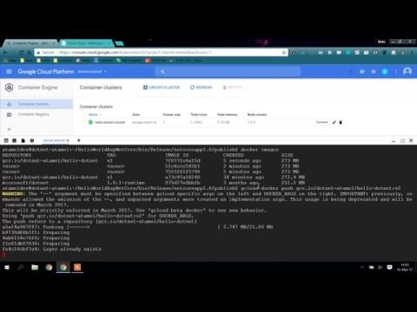
Demo: Rolling Update
@meteatamel

Slide 80
Canary Deployments
@meteatamel
ReplicaSet version = v1 type = BE #pods = 2
ReplicaSet version = v2 type = BE #pods = 1
Pod
Pod
Pod
version= v1
version = v1 type = BE
version = v2 type = BE
type = BE
Service
name = backend
Label selector: type = BE

Slide 81
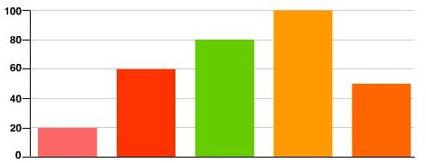
Autoscaling
@meteatamel
ReplicaSet name=locust role=worker #pods = 412
Pod
Pod
Pod
Pod
name=locust
role=worker
name=locust
role=worker
name=locust
role=worker
name=locust
role=worker
70% CPU
40% CPU
Scale
CPU Target% = 50
Heapster
> 50% CPU

Slide 82
DaemonSets
@meteatamel

Slide 83








DaemonSets
@meteatamel
Pod
Problem: how to run a Pod on every node?
or a subset of nodes
Similar to ReplicaSet
principle: do one thing, don’t overload
“Which nodes?” is a selector Use familiar tools and patterns

Slide 84
Jobs
@meteatamel

Slide 85



Jobs
@meteatamel
Run-to-completion, as opposed to run-forever
Express parallelism vs. required completions
Workflow: restart on failure
Build/test: don’t restart on failure
Aggregates success/failure counts Built for batch and big-data work
...

Slide 86
StatefulSets
@meteatamel

Slide 87



StatefulSets
@meteatamel
Goal: enable clustered software on Kubernetes
mysql, redis, zookeeper, ...
Clustered apps need “identity” and sequencing guarantees
stable hostname, available in DNS
an ordinal index
stable storage: linked to the ordinal & hostname
discovery of peers for quorum
startup/teardown ordering

Slide 88
ConfigMaps
@meteatamel

Slide 89
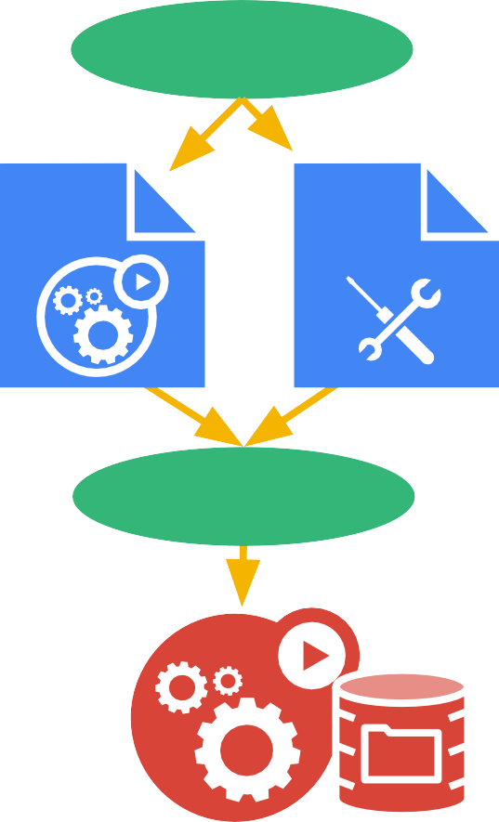
ConfigMaps
@meteatamel
API
Goal: manage app configuration
...without making overly-brittle container images
12-factor says config comes from the environment
Kubernetes is the environment
Manage config via the Kubernetes API
Inject config as a virtual volume into your Pods
Pod
Config Map
node
late-binding, live-updated (atomic)
also available as env vars

Slide 90
Secrets
@meteatamel

Slide 91
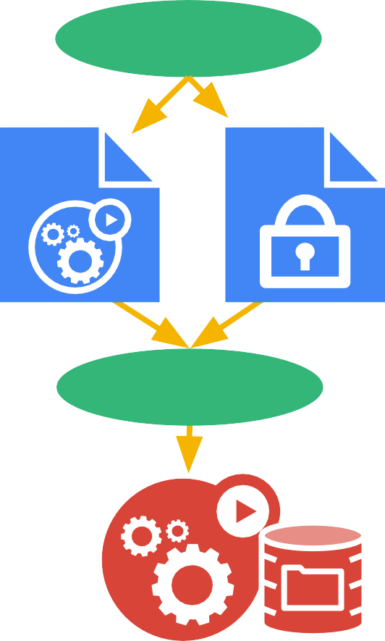
Secrets
@meteatamel
API
Goal: grant a pod access to a secured something
don’t put secrets in the container image!
12-factor says config comes from the environment
Kubernetes is the environment
Manage secrets via the Kubernetes API
Inject secrets as virtual volumes into your Pods
Pod
Secret
node
late-binding, tmpfs - never touches disk
also available as env vars

Slide 92
Kubernetes Terminology
Deployment | ReplicaSet | DaemonSet
Pod | Liveness Probe | Job
Volume | Readiness Probe | StatefulSet
Label | Service | ConfigMap
Selector |  | Secret

Slide 93
There is more!
@meteatamel
Confidential & Proprietary

Slide 94
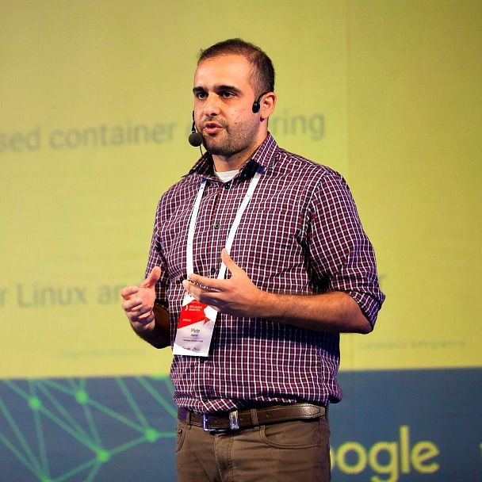

Thank You
Send talk feedback bit.ly/atamel
@meteatamel
kubernetes.io
Mete Atamel @meteatamel atamel@google.com
meteatamel.wordpress.com
cloud.google.com/container-engine
Confidential & Proprietary

