Slide 1
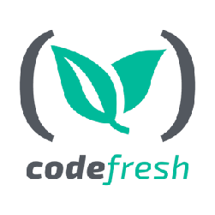
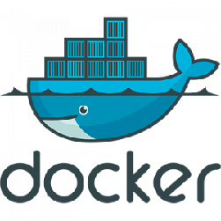
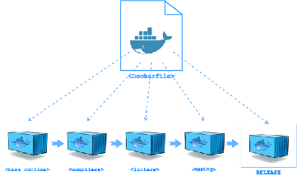
Docker multi-stage build
Using Docker multi-stage build to create advanced build pipelines

Slide 2
Docker build
•
Dockerfile - imperative DSL that defines build commands
•
Each docker build command generates ONE image layer
•
Complete docker build execution generates ONE Docker image

Slide 3
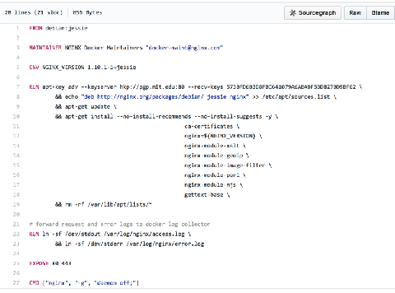
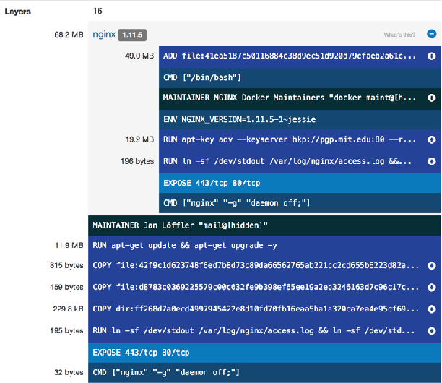
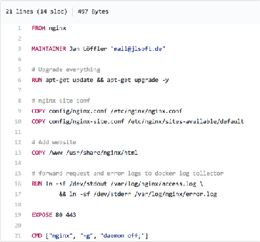
janloeffler/html-demo Image Layers
nginx Dockerfile
html-demo Dockerfile

Slide 4
Problem with Docker Build
Image we want Image we build
runtime
configuration
application
compilers, debuggers, …
linters, tests, profilers, …
code, build and test logs, …
runtime
configuration
application
x (4..10)

Slide 5
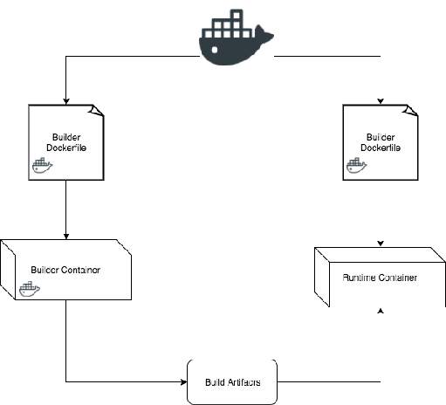
Docker Builder Pattern
•
2 Dockerfiles
1st for build tools
2nd for runtime Drawbacks
2+ Dockerfiles
Orchestration needed: Bash, make, YAML, …
•

Slide 6
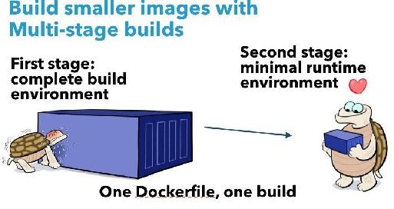
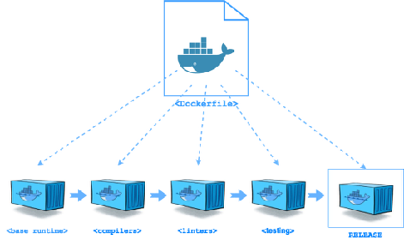
Docker multi-stage build
Benefits
One Dockerfile
One sytntax to learn
Same Build
Local and CI
Create multiple stages

Slide 7
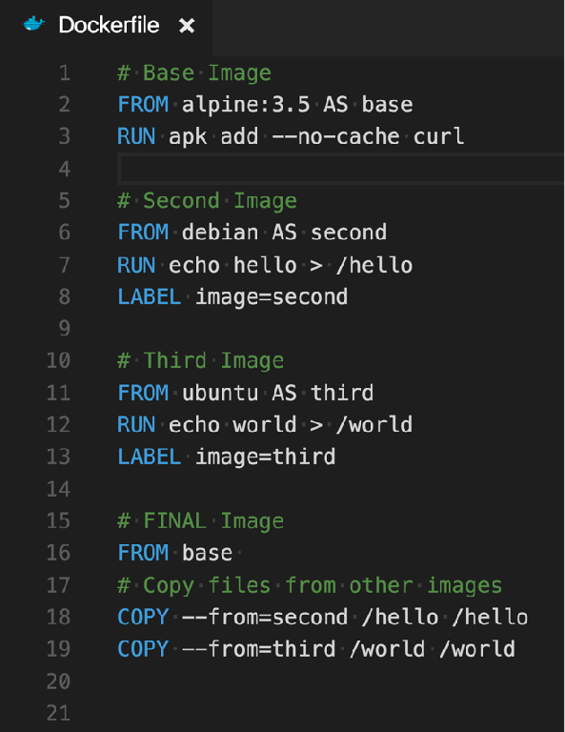
FROM: alpine:3.5
curl
FROM: ubuntu
/hello
FROM: debian
/world
FROM: base
/hello
/world

Slide 8

Node.js multi-stage build
https://github.com/codefreshdemo/demochat/tree/multistage
 | Builder (Alpine) | Runtime (Alpine)
 | Node.js | Node.js
 | App Modules | App Modules
 | Yarn (package) | Yarn (package)
 | Mocha (testing)
 | Eslint (linter)
Content | Newman (REST testing)
 | Gulp (automation)
 | nsp (security scanner)
 | Istanbul (coverage)
 | Python
 | gcc, g++, krb5-dev, …
Size | 568 MB | 112 MB

Slide 9

Go multi-stage build
https://github.com/gaia-adm/pumba/tree/multistage
Builder (Alpine)
Runtime (Alpine)
go 1.8
glide (package) cover (coverage) go test (testing) git
github-release (release) goveralls (coveralls.io) Bats (testing)
Bash
curl, openssl Docker CLI
pumba
Content
Size
427 MB
15 MB

Slide 10
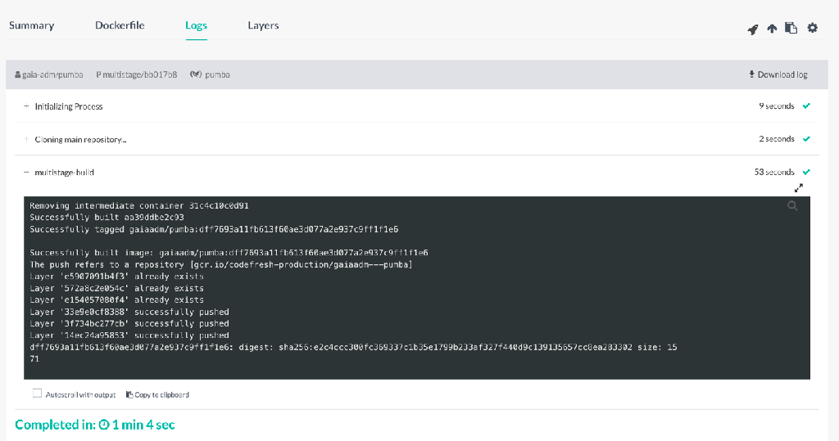
Docker multi-stage with codefresh.io

Slide 11
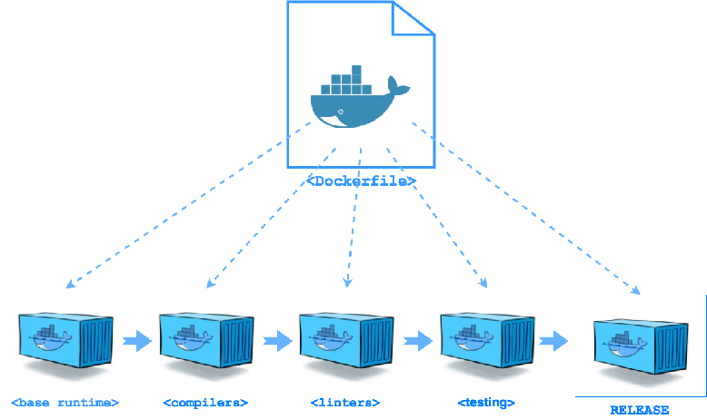
Multi-build Use Case
One Dockerfile
Many Docker images
serviceA:v1
serviceB:v2
serviceC:v1
serviceD:v1.1
$ label = “LABEL name=serviceA”
$ tag = “serviceA:v1”
$ docker tag $(docker history 224f4fee5ec1 | grep $label | awk '{print $1}') $tag

Slide 12
Docker Builder Pattern
•
Sign up for a free Codefresh account at - www.codefresh.io
•
Additional info on Docker Driven Development - www.codefresh.io/blog
•
Meetups & Webinars - www.codefresh.io/meetups
•
Twitter - @codefresh

Slide 13

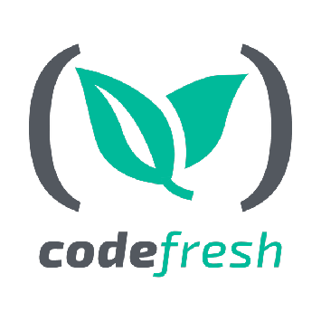
https://codefresh.io/blog/node_docker_multistage/

