Slide 1



fc9c97
2bd8b7
94a5a5

Slide 2
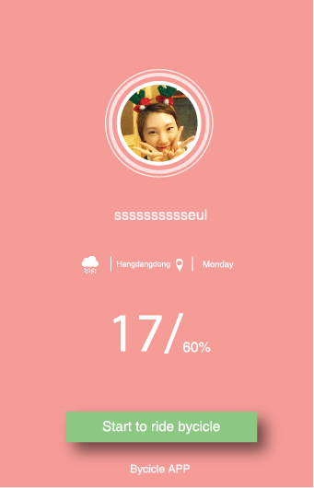
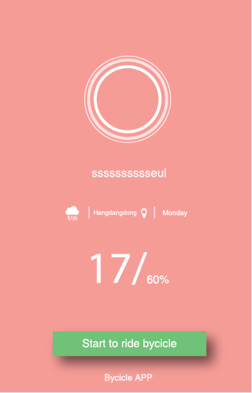
8cc582
70c177

Slide 3
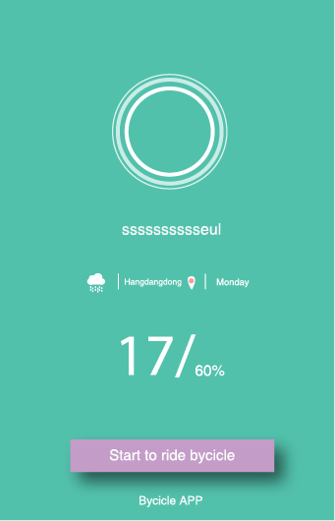
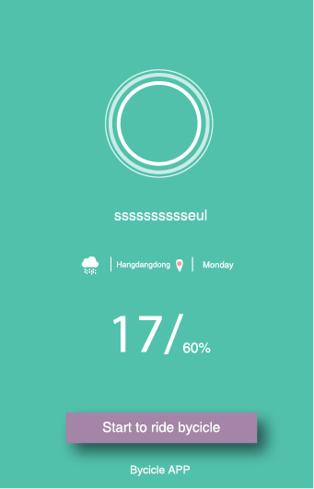
Ca9bdd
a385a8

Slide 4
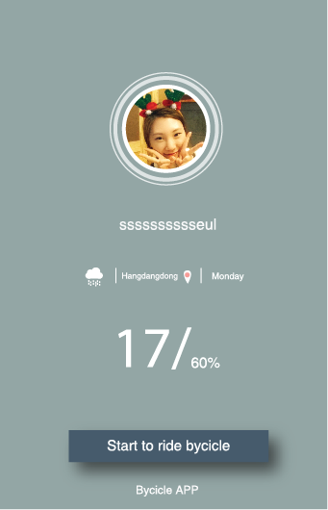
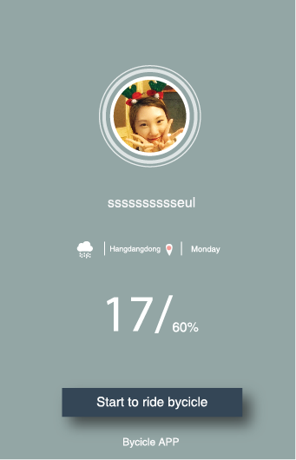
475b6b
344656

Slide 5
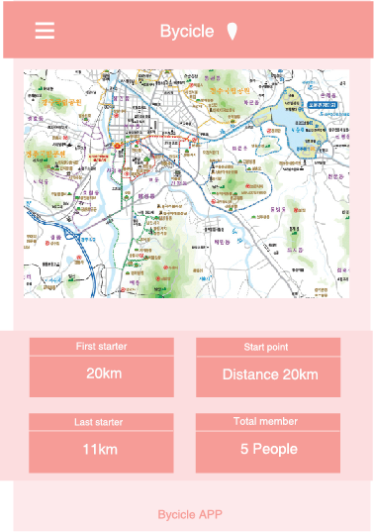
fc9c97
fde8e8
fcdddd
e84a3b

Slide 6
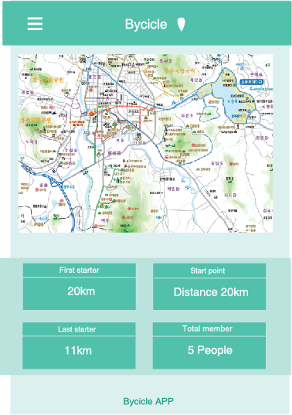
2bd8b7
dcf0ee
bbe2dd
1da186

Slide 7
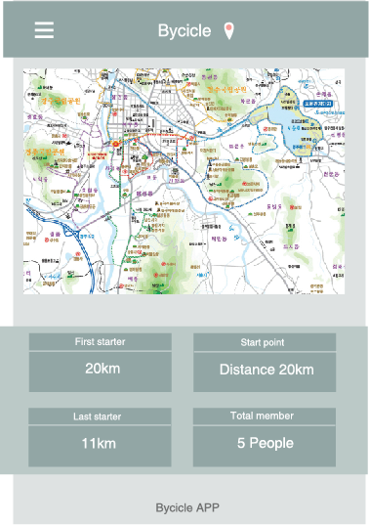
94a5a5
dee0df
bbc8c6
6f7070

Slide 8
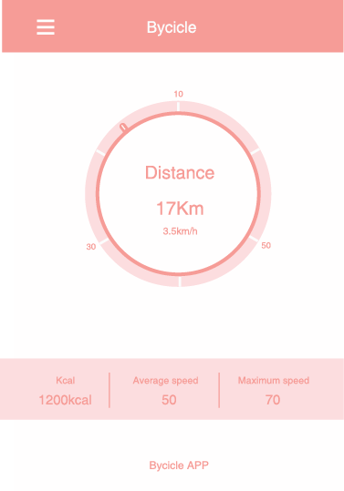
fc9c97
e95964
fde8e8
fcdddd
e84a3b

Slide 9
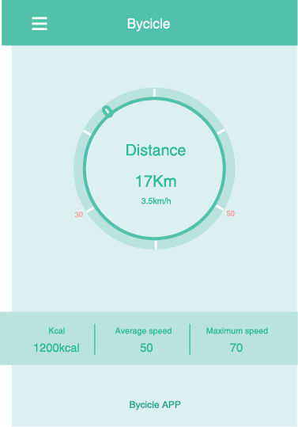
2bd8b7
34b994
dcf0ee
bbe2dd
1da186

Slide 10
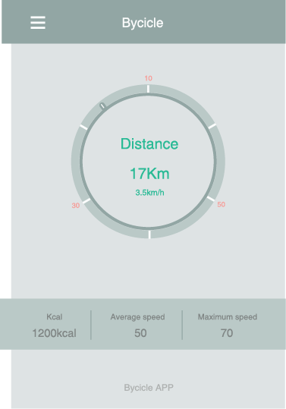
94a5a5
7f8482
dcf0ee
bbe2dd
6f7070

