Slide 1
Age of the Universe with Hubble Constant
.

Slide 2
Goal
To determine age of the universe.
Notes:
Our main goal is to determin age of the universe

Slide 3
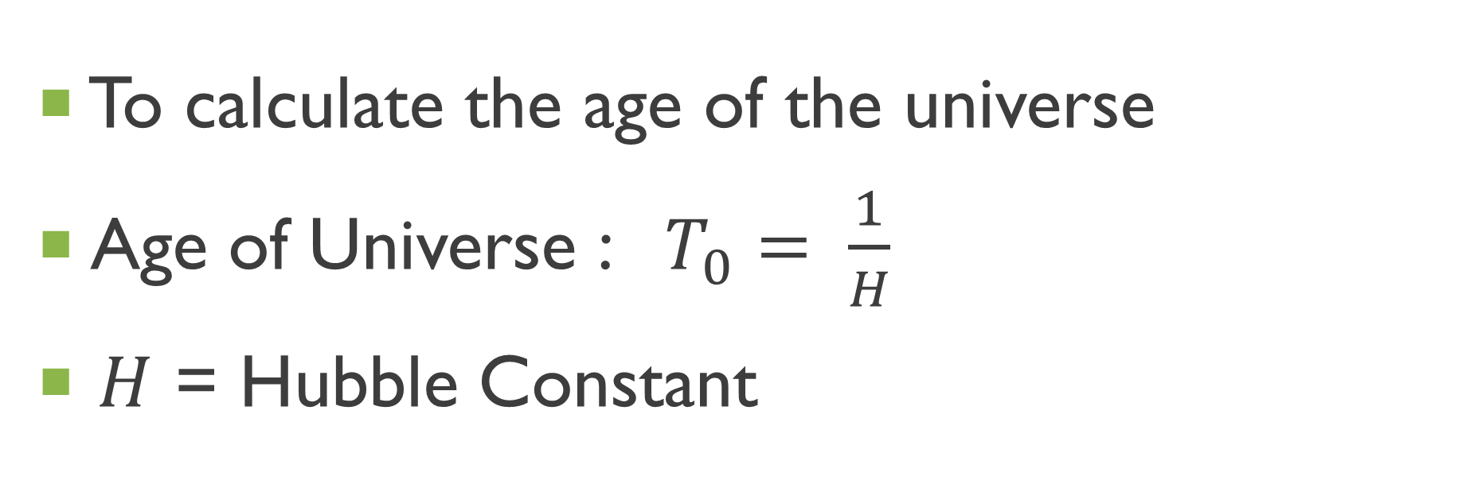
How?
To calculate the age of the universe
Age of Universe : $T_{0}= \frac{1}{H}$
$H$ = Hubble Constant
Notes:
First, to calculate the age of the universe, we used this formula.

Slide 4
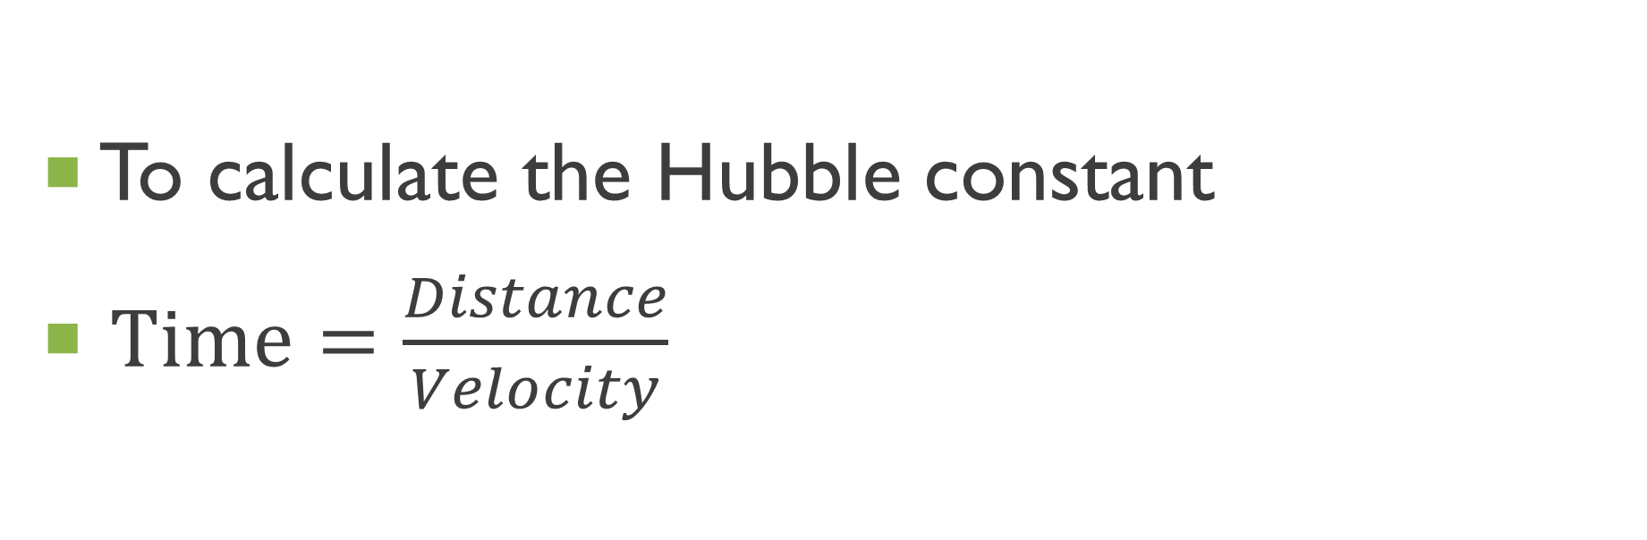
How?
To calculate the Hubble constant
$Time=\frac{Distance}{Velocity}$
Notes:
And for the Hubble constant, we used another formula that time is distance divided by velocity

Slide 5
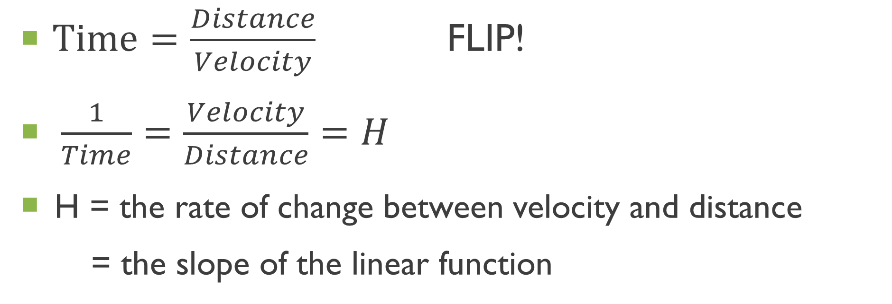
How?
$Time=\frac{Distance}{Velocity}$ FLIP!
$\frac{1}{Time}=\frac{Velocity}{Distance}=H$
H = the rate of change between velocity and distance
= the slope of the linear function
Notes:
If we flip the fractions here, velocity over distance value will be the Hubble constant that represents the rate of change between velocity and distance and also the slope of the linear function.

Slide 6
step
1. Find the linear relationship between distance and velocity
2. Find the slope of the linear function
3. Calculate the inverse of the slope
Notes:
Here is the overall steps we went through

Slide 7
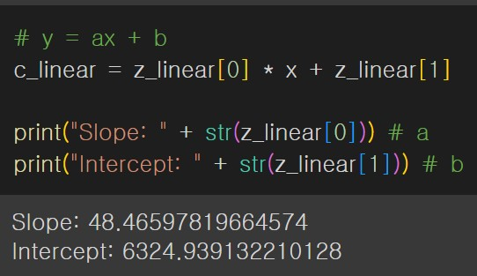
Step 1 linear relationship
Notes:
First we processed data and calculate the slope and the intercept with this code.

Slide 8
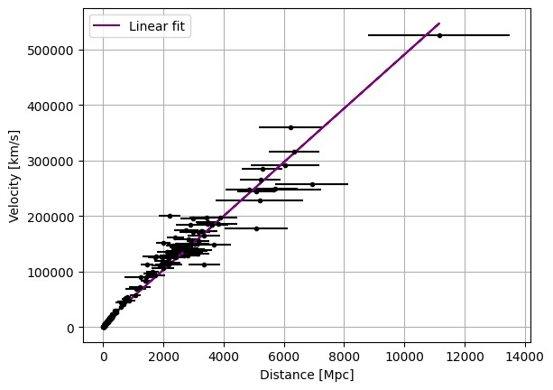
Step 1 linear relationship
Actual data with linear function
y = 49x + 6325
Unit:
Distance = Mpc
Velocity = km/s
Notes:
We made a plot with putting the data and the linear function together, as you can see on the screen.

Slide 9
Step 2 Slope
Actual data with linear function
y = 49x + 6325
Unit:
Distance = Mpc
Velocity = km/s
Notes:
And we got the slope value too.

Slide 10
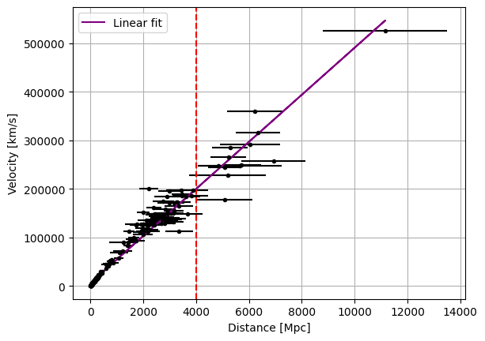
Step 1-1 linear relationship
Actual data with linear function
y = 49x + 6325
Unit:
Distance = Mpc
Velocity = km/s
Notes:
However, before we calculate the inverse of the slope value, we could identify that points in the yellow part is densed, while points in the blue circle is sparse.

Slide 11
Step 1-1 linear relationship
Data points are close to line = Low Variance
Data points are far from line = High Variance.
Higher variance lower reliability of estimated linear function!
Sparse
Dense
Notes:
As data points are closer to the line, the variance of data is lower, which this means our prediction based on this linear function will be closer to the actual parameter, the actual age of the universe. Since the blue part is sparse…..

Slide 12
Step 1-1 linear relationship
Now we separate into two parts
0 < distance <= 4000
4000 < distance
Notes:
We separated into two groups for more precise analysis. One is where the distance is up to 4000, and the other is where the distance is greater than 4000 megaparsec. And we tried to compare the two linear functions.

Slide 13
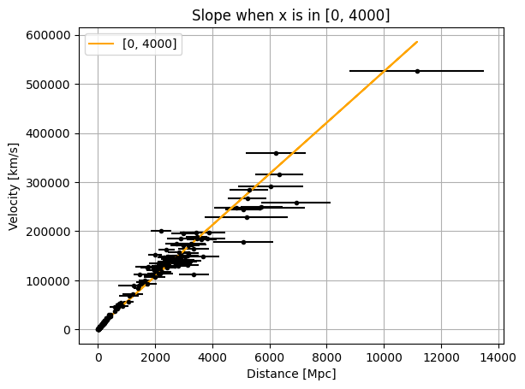
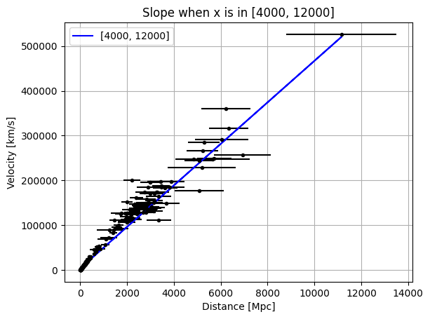
Step 1-1 linear relationships
Notes:
Here is the results we got

Slide 14
Step 2-1 Slopes
Y = 52x + 3900
Y = 46x + 4072
Notes:
Here is the linear functions from the two groups. They have different slope values.

Slide 15
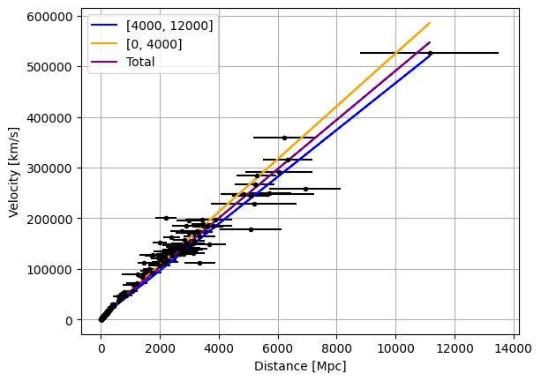
Step 2-1 Slopes
Blue Slope: 46
Purple Slope: 49
Orange Slope: 52
Notes:
So now we put all together: the separated groups and the orginal linear function we’ve showed before.
They have different values of slopes, but the sizes of the gaps are not significant.
In detail, we can see the slope when distance is less than 4000 megaparsec is steeper than the other. The rate of change in the velocity is lower when the distance increases.

Slide 16
Step 3 Age of Universe
1/46 = 21 Gyr
1/49 = 20 Gyr
1/52 = 19 Gyr
Unit:
Time = Gyr
One billion years
Notes:
These are the calculated ages, and there are no big differences to each other again.

Slide 17
Conclusion
There isn’t an evidence makes to question the linear function
Hence, we can assume the linear function is reliable enough to estimate the age of the universe.
The age of the universe is
20 Gyr

