Slide 1
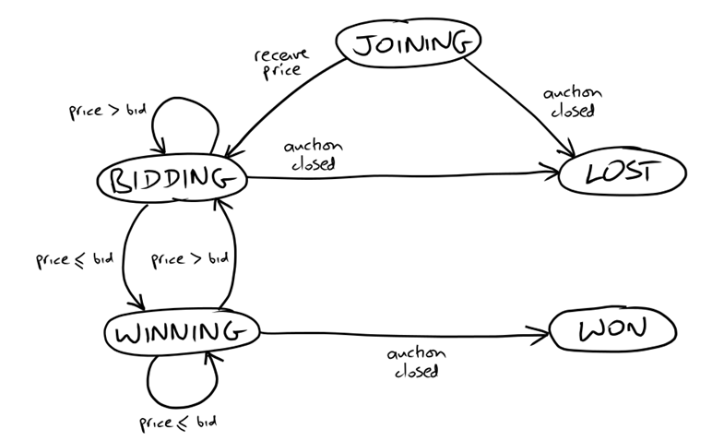
State Transition Diagram on Bidder

Slide 2
Message Flow While 3rd End-to-End Test Running
Auction
Sniper
JOIN
FakeAuction
House
PRICE
XMPP
BID
PRICE
CLOSE
JOIN: SOLVersion: 1.1; Command: JOIN;
PRICE: SOLVersion: 1.1; Event: PRICE; CurrentPrice: 192; Increment: 7; Bidder: Someone else;
BID: SOLVersion: 1.1; Command: BID; Price: 199;
CLOSE: SOLVersion: 1.1; Event: CLOSE;

Slide 3
Essential Use Case
Auction House
Auction Sniper
1. Start selling item
2. Join auction
Status updated to joining
Join command received
3. Report current price
(bidder: someone else)
Status updated to bidding
4. Bid higher than others
Bid command received
5. Report current price
(bidder: sniper)
Status updated to winning
7. Announce close
8. Close bidding
Status updated to won

