Slide 1
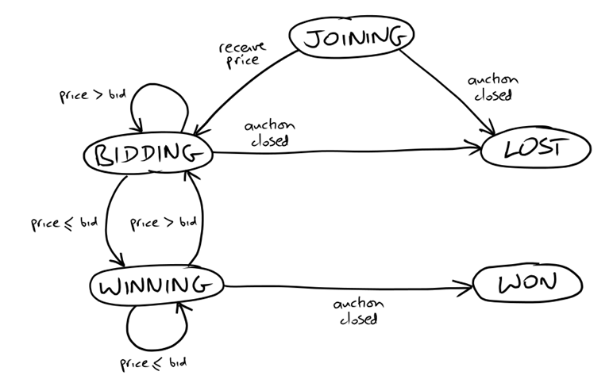
State Transition Diagram on Bidder
Test Infrastructure
Test Infrastructure
Application to Test
Application
Runner
Auction Sniper
Test
Fake
Auction
XMPP

Slide 2
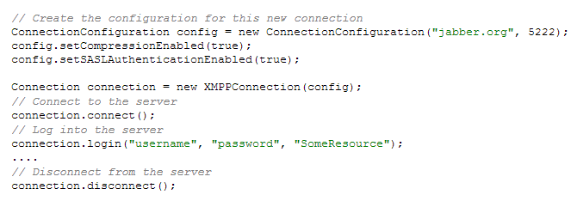
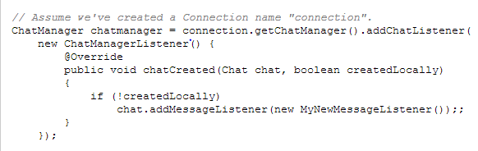
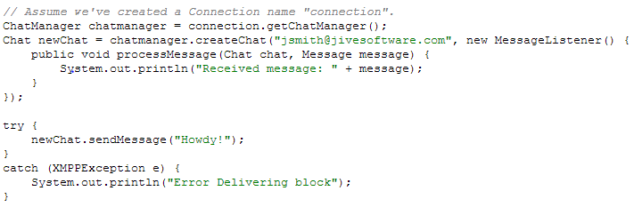
XMPP API
Connect and Disconnect
Incoming chat
Chat

