Slide 1
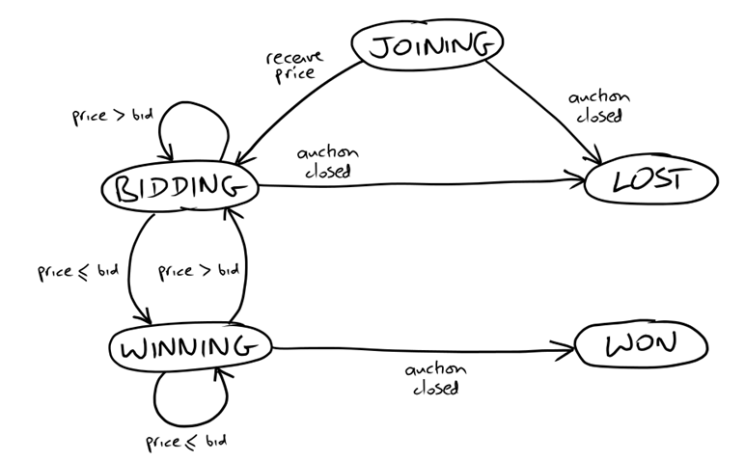
State Transition Diagram on Bidder
Test Infrastructure
Test Infrastructure
Application to Test
SniperRunner
Auction Sniper
Test
FakeAuction
House
XMPP

Slide 2
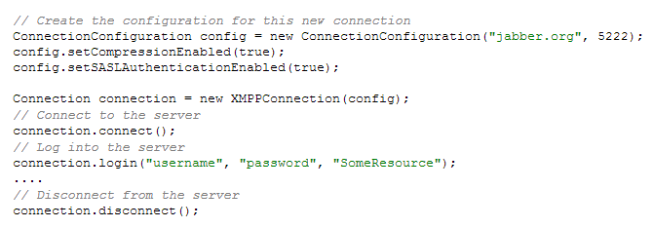
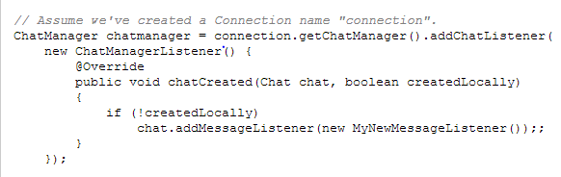
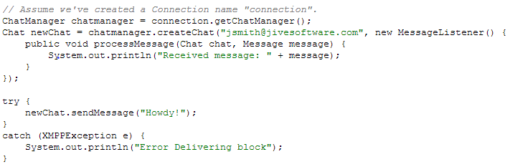
XMPP API
Connect and Disconnect
Incoming chat
Chat

