Slide 1
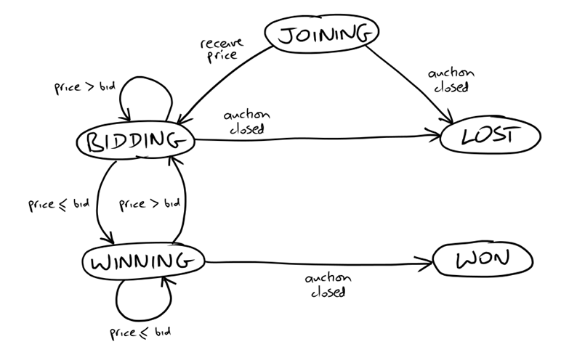
State Transition Diagram on Bidder
Message Flow While 2nd End-to-End Test Running
Auction
Sniper
XMPP
JOIN
FakeAuction
House
PRICE
BID
CLOSE
JOIN: SOLVersion: 1.1; Command: JOIN;
PRICE: SOLVersion: 1.1; Event: PRICE; CurrentPrice: 192; Increment: 7; Bidder: Someone else;
BID: SOLVersion: 1.1; Command: BID; Price: 199;
CLOSE: SOLVersion: 1.1; Event: CLOSE;

Slide 2
Single Responsibility
Message from Auction
Message
Listener
MainActivity
Anonymous
Message from Auction
Message
Listener
Auction
Message
Translator
Event
Listener
??

