Slide 1
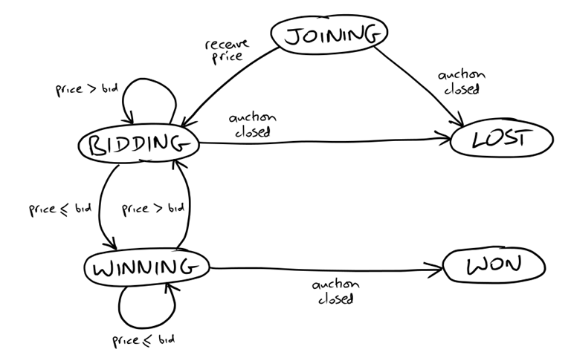
State Transition Diagram on Bidder
Message Flow While 2nd End-to-End Test Running
Auction
Sniper
XMPP
JOIN
FakeAuction
House
PRICE
BID
CLOSE
JOIN: SOLVersion: 1.1; Command: JOIN;
PRICE: SOLVersion: 1.1; Event: PRICE; CurrentPrice: 192; Increment: 7; Bidder: Someone else;
BID: SOLVersion: 1.1; Command: BID; Price: 199;
CLOSE: SOLVersion: 1.1; Event: CLOSE;

Slide 2
Single Responsibility
Who is responsible for message translator?
Message from Auction
Message
Listener
MainActivity
Anonymous
Message from Auction
Message
Listener
Auction
Message
Translator
Event
Listener
MainActivity
Too many works in MainActivity?
Event handling vs. Status handling
Message from Auction
Message
Listener
Auction
Message
Translator
Event
Listener
MainActivity
Message
Listener
Auction
Event
Listener
Sniper
Status
Listener
Message from Auction
Auction
Message
Translator
Auction
Event
Manager
Main
Activity

Slide 3
Single Responsibility
Is it proper that AuctionSniper has network related methods?
Message
Listener
Auction
Event
Listener
Sniper
Status
Listener
Message from Auction
Auction
Message
Translator
Auction
Event
Manager
Main
Activity
Message
Listener
Auction
Event
Listener
Sniper
Status
Listener
Message from Auction
Auction
Message
Translator
Auction
Event
Manager
Main
Activity
Auction
Network
Manager
Auction
Network
Listener

