Slide 1
MARKET ANALYSIS
AUTONOMOUS RIDE-HAILING
Scenario-Based Opportunity Assessment of the South Korean Market
September 2026
Jeonghyeon Lee
Full code, raw data, and chart visualization can be found in github.com/junghyori/Autonomous-Ride-Hailing-Korea-Market-Analysis

Slide 2
OVERVIEW
Where This Analysis Goes
01
Purpose
The problem this service would solve, and for whom, phase by phase.
02
Opportunity
Sizing the Korea market with a TAM → SAM → SOM framework.
03
Go-to-Market
A three-phase rollout sequenced by real demand and seasonality data.
04
Price Logic
A fare model that moves from adoption to monetization.
05
Open Questions
What isn't proven yet, and what we'd need to learn next.
Appendix — Data Sources & Methodology, Grid-Code Mapping, and Backup Charts
02
Full code, raw data, and every chart visualization can be found in github.com/junghyori/Autonomous-Ride-Hailing-Korea-Market-Analysis

Slide 3
01 · PURPOSE
The Problem, and Who Feels It First
Problem: Korea's taxi industry faces a rapidly aging driver base and a well-documented late-night supply crunch, concentrated in a capital region of roughly 26 million people.
Solution: Autonomous ride-hailing adds scalable, technology-driven capacity — deployed on high-demand, well-mapped routes — that fills the gap without depending on new human drivers.
WHY - DATA POINTS
75%
~26M
~14K
of Seoul’s 70K taxi drivers are aged 60 or older
people live across Seoul + Gyeonggi + Incheon
(the capital area)
Overall taxi complaints hit 14K in 2025
— the highest since 2022
Seoul (Private) Taxi Association data, 2025, via Asia Business Daily
Statistics Korea (KOSIS), 2025 regional population estimate
Seoul Metropolitan Government, Transportation Complaint Statistics
FOR WHOM — BY PHASE
Phase 1
Phase 2
Phase 3
Tech-savvy professionals, corporate travelers, and airport shuttle riders — predictable routes, controlled environments.
General urban commuters in core Seoul districts — Gangnam, Hongdae, Yeouido.
Mass-market commuters across the full capital corridor — Seoul ↔ Gyeonggi/Incheon.
03
Full code, raw data, and every chart visualization can be found in github.com/junghyori/Autonomous-Ride-Hailing-Korea-Market-Analysis

Slide 4
02 · OPPORTUNITY
Market Sizing: TAM → SAM → SOM
Grounded in Python-based analysis⁽¹⁾ of 2025 public taxi operations data from Korea's Ministry of Land, Infrastructure and Transport (국토교통부). Rides scale down from national volume to a realistic Year-1 pilot.
National Taxi Trips
All of Korea, 2025
1,053M Trips/yr
TAM — Capital Area Trips
TAM = Total Addressable Market.
Seoul + Gyeonggi + Incheon Annual Taxi Trips
(Data-Derived)
304M Trips/yr (29% of National)
SAM — AV Suitable Trips
SAM = Serviceable Addressable Market.
TAM × Addressable Share for AV Suitable Trips
(Assumption Bracket — see Open Questions)
30.4M – 106.5M Trips/yr (10–35%)
SOM – Year 1 (Pilot Rides)
SOM = Serviceable Obtainable Market.
Pilot Fleet × Trips/Vehicle/Day × Operating Days
(Assumption Bracket — see Open Questions)
270K – 3.3M Rides
Source: MOLIT TIMS, annual taxi-operating summary by municipality, 2025, via data.go.kr (dataset 15065131).
04
(1) Full code, raw data, and every chart visualization can be found in github.com/junghyori/Autonomous-Ride-Hailing-Korea-Market-Analysis

Slide 5
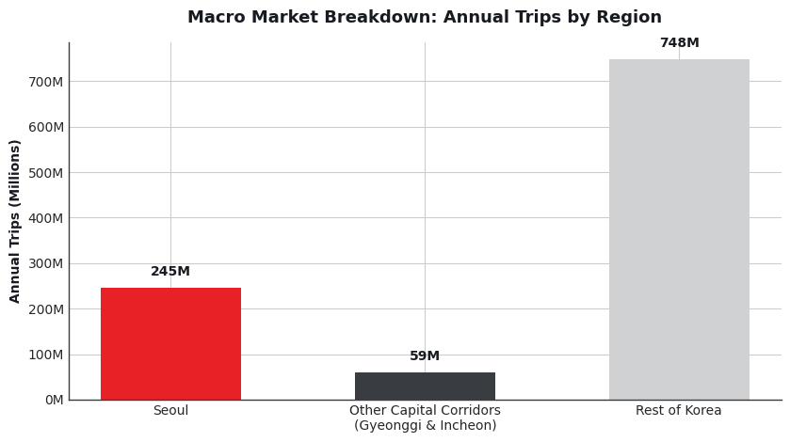
02 · OPPORTUNITY
Where National Taxi Demand Actually Sits
Seoul alone accounts for roughly a quarter of national taxi volume;
Adding Gyeonggi and Incheon brings the full capital area to ~29% of the country's annual trips — the geography this analysis treats as Total Addressable Market
Source: MOLIT TIMS annual taxi-operation summary by municipality, 2025, via data.go.kr (dataset 15065131).
05
Full code, raw data, and every chart visualization can be found in github.com/junghyori/Autonomous-Ride-Hailing-Korea-Market-Analysis

Slide 6
02 · OPPORTUNITY
Revenue Potential Across Scenarios
Scenario | SAM Share | Y1 Pilot Fleet | Y1 Rides (SOM) | Y1 Revenue (USD)
Low | 10% | 100 vehicles | 270K | $2.0–2.4M
Base | 20% | 300 vehicles | 1.4M | $10.2–12.2M
High | 35% | 500 vehicles | 3.3M | $24.8–29.8M
SAM (AV Suitable Market) Revenue Potential:
$275M (Low) – $550M (Base) – $963M (High)
at the realistic metered fare (≈KRW 12,200 / trip).
Revenue range reflects Phase 1 (KRW10,164 metered) → Phase 2 (KRW12,202 metered) fares
SOM assumes 10–20 trips/vehicle/day over 270–330 operating days
METHODOLOGY
Revenue (KRW) = Trips × Metered Fare/trip (₩10,164 Phase 1 / ₩12,202 Phase 2), based on ₩4,000 / ₩4,800 base fares (Phase 1 / Phase 2). USD = KRW ÷ ~1,350
See Slide 14 for detailed base-fare logic.
Sources: MOLIT TIMS, annual taxi-operating summary by municipality, 2025, via data.go.kr (dataset 15065131); Seoul Metropolitan Government official fare notice,
06
Full code, raw data, and every chart visualization can be found in github.com/junghyori/Autonomous-Ride-Hailing-Korea-Market-Analysis

Slide 7
03-A · GO-TO-MARKET / ANNUAL PLAN
3-Phase Rollout Plan
Each phase targets a specific user segment, corridor, and fleet scale — grounded in actual 2025 hub-level trip volumes and seasonality, building operational confidence before broadening. Demand evidence and detailed plan by each phase can be found from next slide.
Phase 1
Phase 2
Phase 3
Months 0–6
Months 6–12
Months 12+
Controlled Launch
Urban Expansion
Full Commercialization
ZONES
ZONES
ZONES
Pangyo Station + Incheon Airport T1/T2
Gangnam + Hongdae + Yeouido
Full capital corridor (Seoul-Gyeonggi/Incheon)
FLEET
FLEET
FLEET
100 vehicles
300 vehicles
500+ vehicles
FARE
FARE
FARE
KRW 10,164 / trip (−16.7% of metered)
KRW 12,202 / trip + 1.1–1.3x surge
Subscriptions & Passes + KRW 12,202
Predictable,
low-complexity routes with tolerant early adopters.
Highest-density Seoul corridors,
tests nightlife and B2B commuter use cases.
Mass-market scale-up with retention-oriented pricing.
See Slide 14 for detailed base-fare logic.
07
Full code, raw data, and every chart visualization can be found in github.com/junghyori/Autonomous-Ride-Hailing-Korea-Market-Analysis

Slide 8
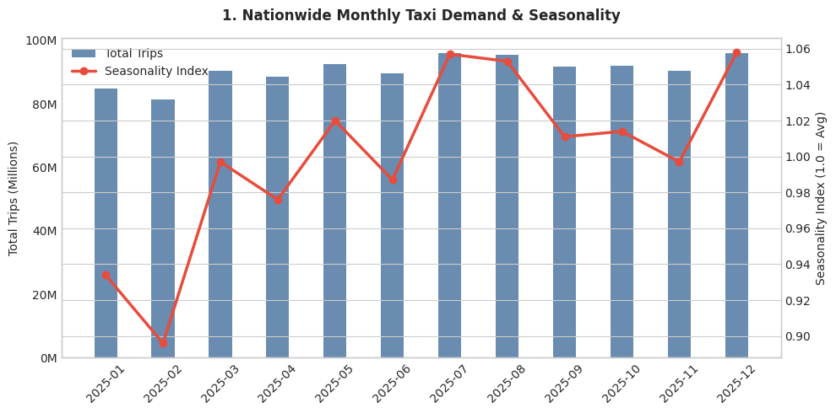
03-B · GO-TO-MARKET — DEMAND EVIDENCE
Nationwide Demand Shows Seasonal Rhythm
National taxi trip volume dips in February and rises through mid-year, peaking around the summer and again at year-end.
This rhythm sets the macro timing behind the rollout — e.g., the December peak used to maximize Phase 3 fleet utilization.
Source: MOLIT TIMS, 500m-grid monthly taxi operating statistics, 2025, via data.go.kr (dataset 15160181).
Seasonality index = month / annual monthly average.
08
Full code, raw data, and every chart visualization can be found in github.com/junghyori/Autonomous-Ride-Hailing-Korea-Market-Analysis

Slide 9
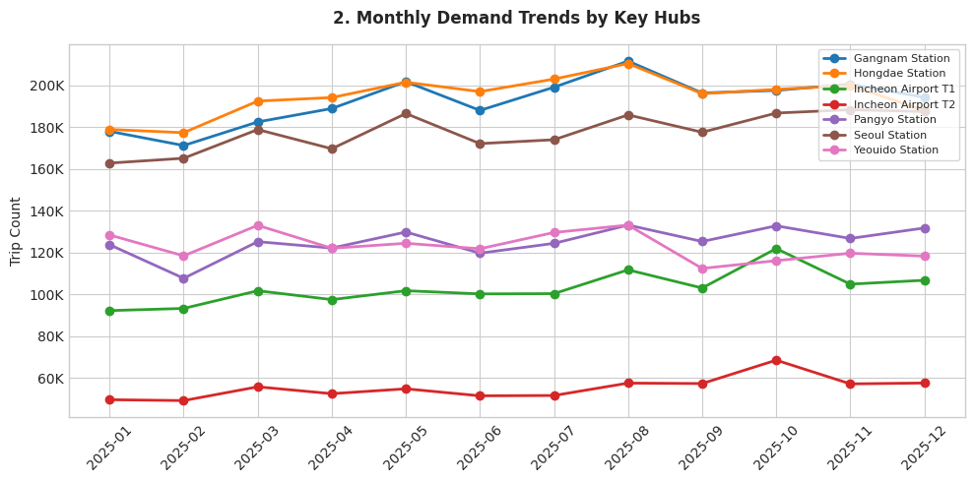
03-B · GO-TO-MARKET — DEMAND EVIDENCE
Hub-Level Volumes Set the Rollout Order
Gangnam and Hongdae carry the highest absolute trip volumes of the seven hubs studied — the core reason they anchor Phase 2.
Pangyo and the airport terminals run at a fraction of that volume, matching their role as a lower-risk Phase 1 proving ground.
Source: MOLIT TIMS, 500m-grid monthly taxi operating statistics, 2025, via data.go.kr (dataset 15160181).
Hub grid codes mapped per the Korea National Grid System — see Appendix.
09
Full code, raw data, and every chart visualization can be found in github.com/junghyori/Autonomous-Ride-Hailing-Korea-Market-Analysis

Slide 10
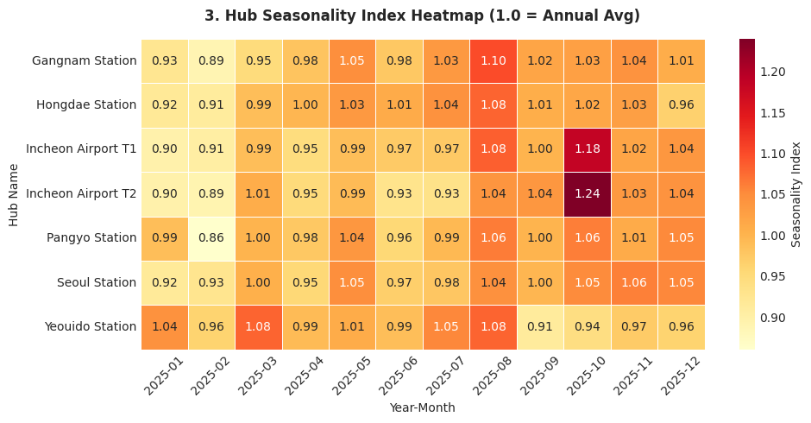
03-B · GO-TO-MARKET — DEMAND EVIDENCE
Seasonality Differs Hub by Hub
Incheon Airport T2 spikes to 1.24x in October (Chuseok travel), while Yeouido dips to 0.91x in September.
These hub-specific swings — not just the national average — drive the seasonal fleet-redeployment plan in Phase 3.
Source: MOLIT TIMS, 500m-grid monthly taxi operating statistics, 2025, via data.go.kr (dataset 15160181).
Index of 1.00 = that hub's own annual monthly average.
10
Full code, raw data, and every chart visualization can be found in github.com/junghyori/Autonomous-Ride-Hailing-Korea-Market-Analysis

Slide 11
03-C · GO-TO-MARKET — PHASE 1
Controlled Launch (Months 0–6)
Zones: Pangyo Station + Incheon Airport T1/T2 · Fleet: 100 vehicles · Fare: KRW 10,164 (−16.7% vs. KRW 12,202 metered baseline)
Pangyo Station
Incheon Airport T1 / T2
125K trips / month
T1: 103K · T2: 55K trips / month
Seasonality: Stable year-round (0.86–1.06 seasonality index)
Seasonality: Sharp Chuseok peak — T2 hits 1.24x in October;
winter dip Jan–Feb (0.89x)
PROS
PROS
Tech-savvy riders (IT cluster), predictable commute patterns, low traffic complexity.
Fixed origin-destination (terminal to city center), controlled roads,
high fare per long-distance trip.
CONS
CONS
Low absolute volume caps early revenue upside.
Seasonal spikes require flexible fleet sizing.
WHY FIRST
WHY FIRST
Low-risk proving ground for AV technology with tolerant early adopters.
High-value corridor with simple routing;
international travelers already have AV exposure.
Seasonality play: launch in March–April, as demand rises from the February trough, to build operational confidence before the summer peak.
11
Full code, raw data, and every chart visualization can be found in github.com/junghyori/Autonomous-Ride-Hailing-Korea-Market-Analysis

Slide 12
03-C · GO-TO-MARKET — PHASE 2
Urban Expansion (Months 6–12)
Zones: Gangnam + Hongdae + Yeouido · Fleet: 300 vehicles · Fare: KRW 12,202 + 1.1–1.3x mild surge
Gangnam Station
Hongdae Station
Yeouido Station
193K trips/mo — highest
195K trips/mo
123K trips/mo
Seasonality: Peak in August (1.10x)
Seasonality: Peak in August (1.08x)
Seasonality: Volatile — Mar 1.08x, Sep 0.91x
PROS
PROS
PROS
Highest demand density, premium rider mix (business / entertainment).
Comparable volume to Gangnam; strong nightlife demand.
Business district with regular weekday commute demand.
CONS
CONS
CONS
Complex traffic, narrow streets, high pedestrian density.
Late-night demand needs extended hours — safety/regulatory risk.
Sharp September dip tied to vacation season; lower weekend demand.
Seasonality play: time Phase 2 launch for May–June to capture the Jul–Aug summer peak (1.03–1.10 index) across all three hubs.
Volume across these hubs justifies fleet expansion once the tech is proven in Phase 1.
12
Full code, raw data, and every chart visualization can be found in github.com/junghyori/Autonomous-Ride-Hailing-Korea-Market-Analysis

Slide 13
03-C · GO-TO-MARKET — PHASE 3
Full Commercialization (Months 12+)
Zones: Full capital corridor (Seoul/Gyeonggi/Incheon) · Fleet: 500+ vehicles · Model: Subscriptions & Passes / Fare: KRW 12,202 + 1.1–1.3x mild surge
Seoul Station
Cross-Corridor Expansion
178K trips / month · steady (0.92–1.06 seasonality)
Gyeonggi / Incheon: 59.4M trips / year
Major transit interchange connecting KTX and subway — steady demand,
But congested pickup zones require multi-modal coordination.
Massive untapped volume with simpler suburban road conditions, offset by longer trip distances (higher per-trip cost) and sparse off-peak demand.
RETENTION & FLEET BALANCING
Retention: Monthly commuting passes (Pangyo ↔ Gangnam, Airport ↔ Seoul), fixed-route shuttles, and tiered/premium options. Seasonal balancing: Use the October airport surge (T2: 1.24x) and December national peak (1.06x) to maximize utilization; redeploy vehicles from Yeouido (Sep dip: 0.91x) to airport routes during Chuseok.
13
Full code, raw data, and every chart visualization can be found in github.com/junghyori/Autonomous-Ride-Hailing-Korea-Market-Analysis

Slide 14
04 · PRICE LOGIC
3-Phase Fare Progression
Anchored to a realistic metered fare (KRW 12,202/trip) — derived from actual Seoul trip data using the standard fare structure, not the KRW 4,800 base rate alone — pricing runs from penetration to monetization.
Phase 1 — Market Entry
Phase 2 — Stabilization
Phase 3 — Expansion & Retention
0–6 MONTHS
6–12 MONTHS
12+ MONTHS
KRW 10,164
KRW 12,202
Sub + KRW 12,202
−16.7% vs. metered fare
Full metered fare
Passes & tiers
SURGE / MODEL
SURGE / MODEL
SURGE / MODEL
Flat, no surge
Mild 1.1x–1.3x at peak / bad weather
Reach fare parity with standard taxis;
optimize fleet efficiency during peak windows.
Bundled / Tiered
Mild 1.1x–1.3x at peak / bad weather
Lower adoption barriers;
secure initial trial volume with upfront flat quotes that remove surcharge anxiety.
Maximize lifetime value with monthly passes,
fixed-route shuttle packages, and premium options for frequent riders.
METHODOLOGY
Phase 1 discount = 1 − (₩4,000 ÷ ₩4,800) = 16.7%, applied to the metered fare: ₩12,202 × (1−16.7%) = ₩10,164
Fare Structure : ₩4,800 base (first 1.6km) + ₩100/131m distance + ₩100/30sec time (below 15.72km/h) + night surcharge (22:00–04:00: +20–40%) → avg trip (8.8km, 19min) blends to ₩12,202
Source: Seoul Metropolitan Government official fare notice, news.seoul.go.kr/traffic/archives/1659.
14
Full code, raw data, and every chart visualization can be found in github.com/junghyori/Autonomous-Ride-Hailing-Korea-Market-Analysis

Slide 15
05 · OPEN QUESTIONS
What We Would Not Claim Yet
Regulatory & Legal
Consumer & Demand
Competitive Landscape
Realistic timeline for Level 4 AV permits on Seoul municipal roads
How insurance and liability would be structured, and at what premium
Actual willingness to ride driverless — stated vs. revealed preference gaps are large
Effect of monsoon season and winter ice on uptime and rider acceptance
How Kakao Mobility, Tmap, and taxi cooperatives would respond
Whether other AV operators are targeting the same corridors
Operational & Financial
Data Limitations
Labor & Union Opposition
Realistic per-vehicle cost (CAPEX + maintenance + monitoring) vs. driver labor
Achievable Year-1 utilization — our 10–20 trips/day range is assumed, not measured
Fleet scale (100–500 vehicles by Month 12) is faster than how Waymo scaled: ~3 years post-launch (Phoenix, 2020) to reach ~700 vehicles across two metro areas
2025 data reflects human-driven patterns; AV routing/demand may differ
Addressable share (10–35%) is an assumption bracket, not a regulatory assessment
MOLIT TIMS trip counts haven't been cross-validated against other published ridership benchmarks — treat absolute levels as directional
Korean taxi driver unions have organized large-scale protests against ride-hailing entrants before (e.g., Tada, 2019-2020)
No union response, stakeholder engagement, or driver-transition plan is modeled in this analysis
Regulatory timeline could shift materially if organized opposition escalates
15
Full code, raw data, and every chart visualization can be found in github.com/junghyori/Autonomous-Ride-Hailing-Korea-Market-Analysis

Slide 16
APPENDIX · SOURCES
Data Sources & Methodology
A. Primary Dataset — Taxi Operating Statistics
Ministry of Land, Infrastructure and Transport (MOLIT, 국토교통부) — Taxi Operation Information Management System (TIMS), via Korea’s Public Data Portal.
Two datasets are used:
Annual summary by municipality (dataset 15065131): data.go.kr/data/15065131
500m-grid monthly detail (dataset 15160181): data.go.kr/data/15160181
B. Taxi Fare Reference
Seoul standard taxi fare (₩4,800 base + distance/time/night surcharges), per an official Seoul Metropolitan Government notice. Revenue uses a derived metered fare (₩12,202/trip), not the ₩4,800 base rate alone: news.seoul.go.kr/traffic/archives/1659
C. Full Analysis Notebook — Every Figure, Formula & Code
This entire analysis — the raw data pull, every formula, every chart shown in this deck (and a few not shown), and the full Python code — is reproducible from the public Jupyter notebook: github.com/junghyori/Autonomous-Ride-Hailing-Korea-Market-Analysis
16
Full code, raw data, and every chart visualization can be found in github.com/junghyori/Autonomous-Ride-Hailing-Korea-Market-Analysis

Slide 17
APPENDIX · GRID CODE SYSTEM
How Grid Codes Map to Real Locations
The Korea National Grid System (KNGS, 국가지점번호) divides all of South Korea into 100 km × 100 km cells, each labeled with a two-character Korean syllable code (e.g., 다사,마라). Each 100 km cell is further divided into 500 m × 500 m sub-grids, indexed by a six-digit X/Y coordinate (e.g., 014078). A full code such as 다사014078 therefore uniquely identifies one 500 m × 500 m cell in Korea — the level of detail used to define each demand hub in this analysis.
Grid code | Mapped location | Hub used in this analysis
다사014078 | Incheon Int'l Airport Terminal 1 area (Yeongjong-do) | Incheon Airport T1
다사011083 | Incheon Int'l Airport Terminal 2 area (Yeongjong-do) | Incheon Airport T2
마라080162 | Gangnam / Sinnonhyeon Station area (Gangnam-gu, Seoul) | Gangnam Station
다사106101 | Hongik Univ. / Hapjeong Station area (Mapo-gu, Seoul) | Hongdae Station
다사116089 | Yeouido / National Assembly Station area (Yeongdeungpo-gu, Seoul) | Yeouido Station
마마003130 | Seoul Station / Gwanghwamun area (Jung-gu, Seoul) | Seoul Station
마라078158 | Seongnam, Gyeonggi-do (same 100km cell as Gangnam, SE of central Seoul) | Pangyo Station
Source: National Geographic Information Institute (NGII) grid-lookup service, map.ngii.go.kr, and the V-World national spatial data portal, map.vworld.kr.
17
Full code, raw data, and every chart visualization can be found in github.com/junghyori/Autonomous-Ride-Hailing-Korea-Market-Analysis

Slide 18
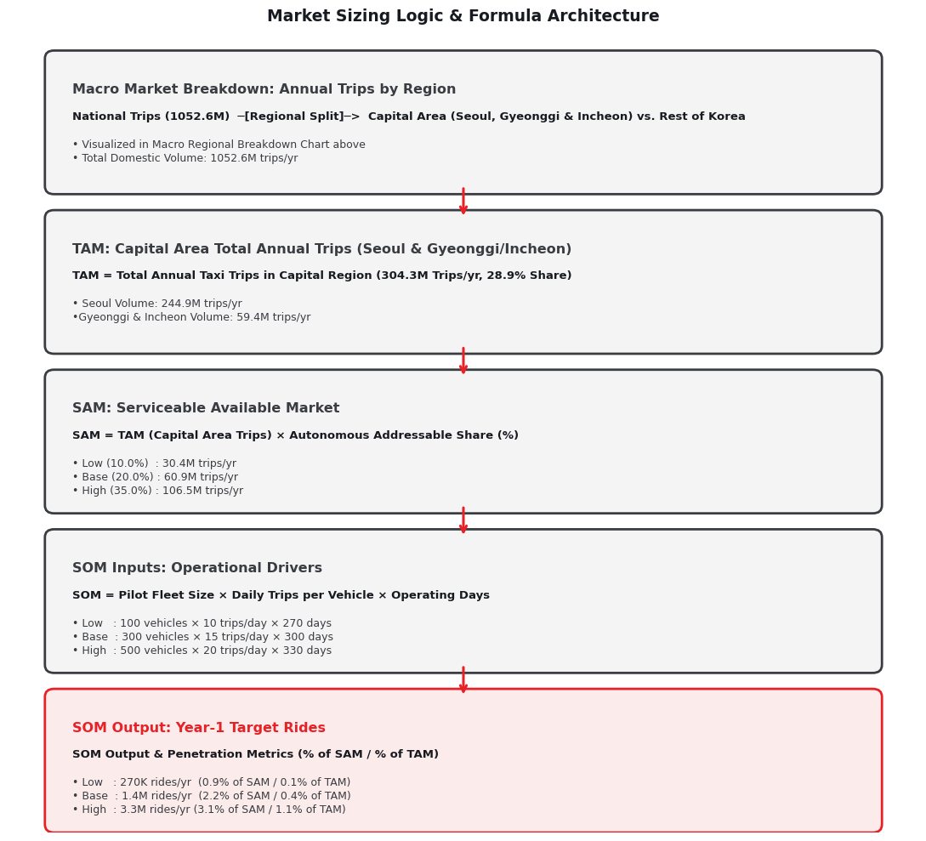
APPENDIX · BACKUP CHART
Full TAM → SAM → SOM Calculation Detail
Source: Reproduced directly from the analysis notebook; underlying figures from MOLIT TIMS, 2025, via data.go.kr.
19
Full code, raw data, and every chart visualization can be found in github.com/junghyori/Autonomous-Ride-Hailing-Korea-Market-Analysis

Slide 19
THANK YOU
Autonomous Ride-Hailing — Korea Market Opportunity
Full code, raw data, and chart visualization can be found in github.com/junghyori/Autonomous-Ride-Hailing-Korea-Market-Analysis

