Slide 1
Exchange Diary
A Shared Diary Android App Prototype
Junghyun Kim
CYBR 408

Slide 2
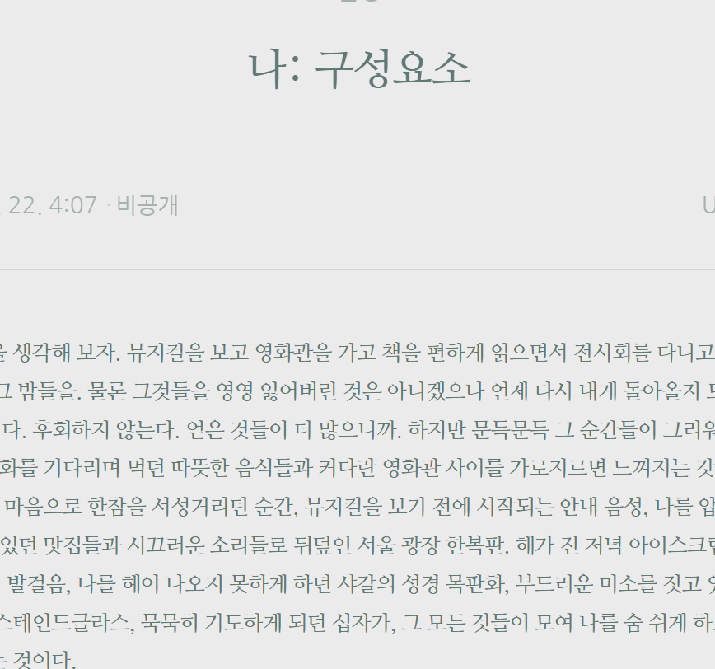
Project Idea
This project is different from public diary apps.
I wanted to focus on a more personal shared diary experience between two users.

Slide 3
Main Features
- Write diary entries
- View saved entries in a list
- Open entry detail pages
- Search entries
- Parse mood tags such as #mood:Happy
- Add emoji reactions
- Temporary 24-hour diary logic
- Prototype login and add-friend screens
- Slide-out drawer menu.

Slide 4
System Design
Main Screens: - Home Screen - Write Screen - Diary List Screen - Diary Detail Screen - Login Prototype Screen - Add Friend Prototype Screen
Main Structure: - model - screens - components - MainActivity navigation flow

Slide 5
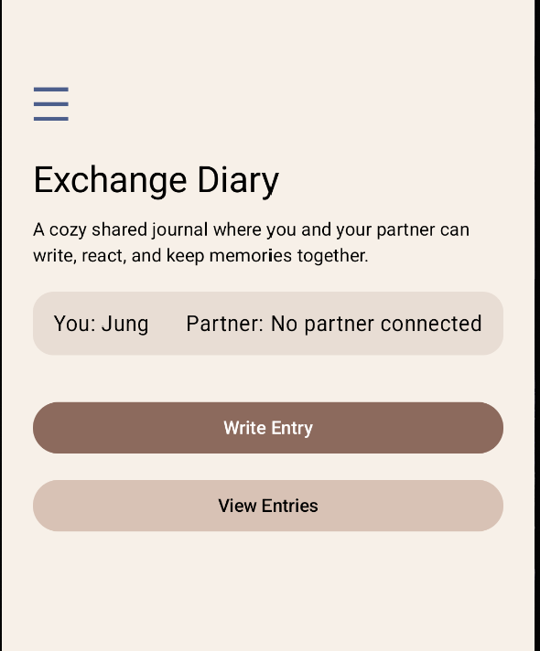
Computer Science Concepts Used
- Object-Oriented Programming
- Data Structures
- Iterative Programming
- Algorithms
- Parsing
- Software Engineering
- OS Concepts

Slide 6
Demo
1. Open the home screen
2. Show login and add-friend prototype pages
3. Write a diary entry
4. Add a mood tag
5. Save the entry
6. Search in the list
7. Open detail page
8. Add emoji reaction
9. Show temporary diary option

Slide 7
Limitations and Future Work
Current Limitations:
Future Work:
- No real backend - No real authentication - No real syncing - No persistent database
- Firebase integration - Real login - Real partner connection - Local storage with Room - Image/sticker support - Push notifications

Slide 8
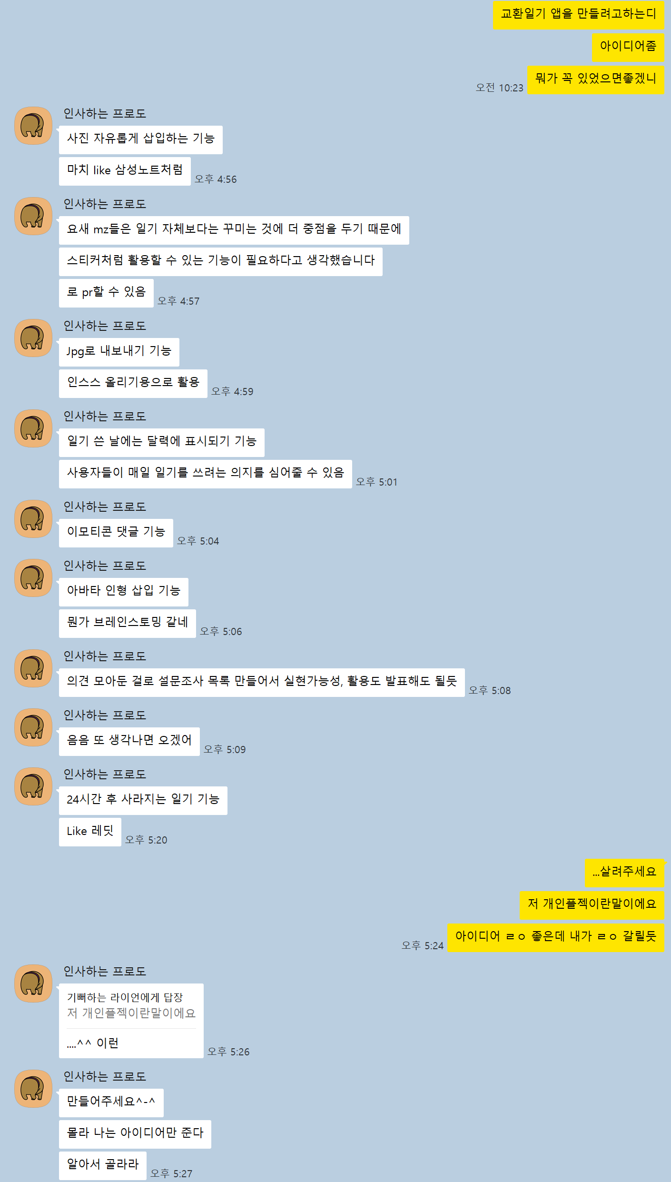
Future Work(2)
Me: I’m making a shared diary app for my final project. Any ideas?
Friend:
- free photo placement
- stickers
- JPG export
- calendar marks
- emoji comments
- avatar dolls
- disappearing diary entries
- changing app icon like Duolingo
Me: ...this is an individual project! I am fighting for my life
Friend: I only provide ideas. You deal with the consequences. Come on, CS nerds can do anything. :)
Me: I’m blocking you.

Slide 9
Thank you
Yeah! I’m free!
GitHub Repository: https://github.com/junghyun5/ExchangeDiary.git

