Slide 1
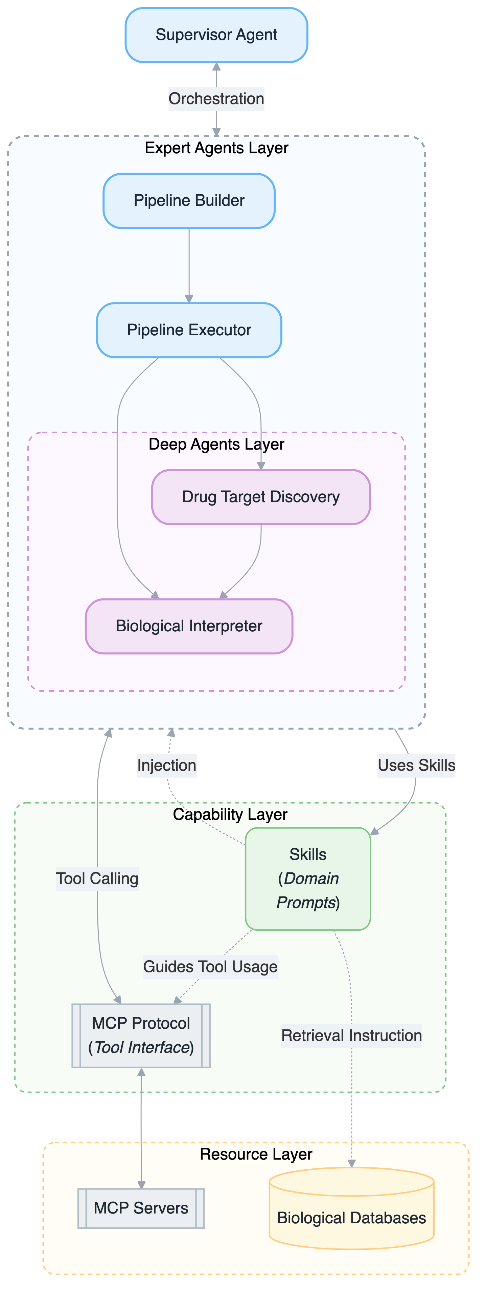
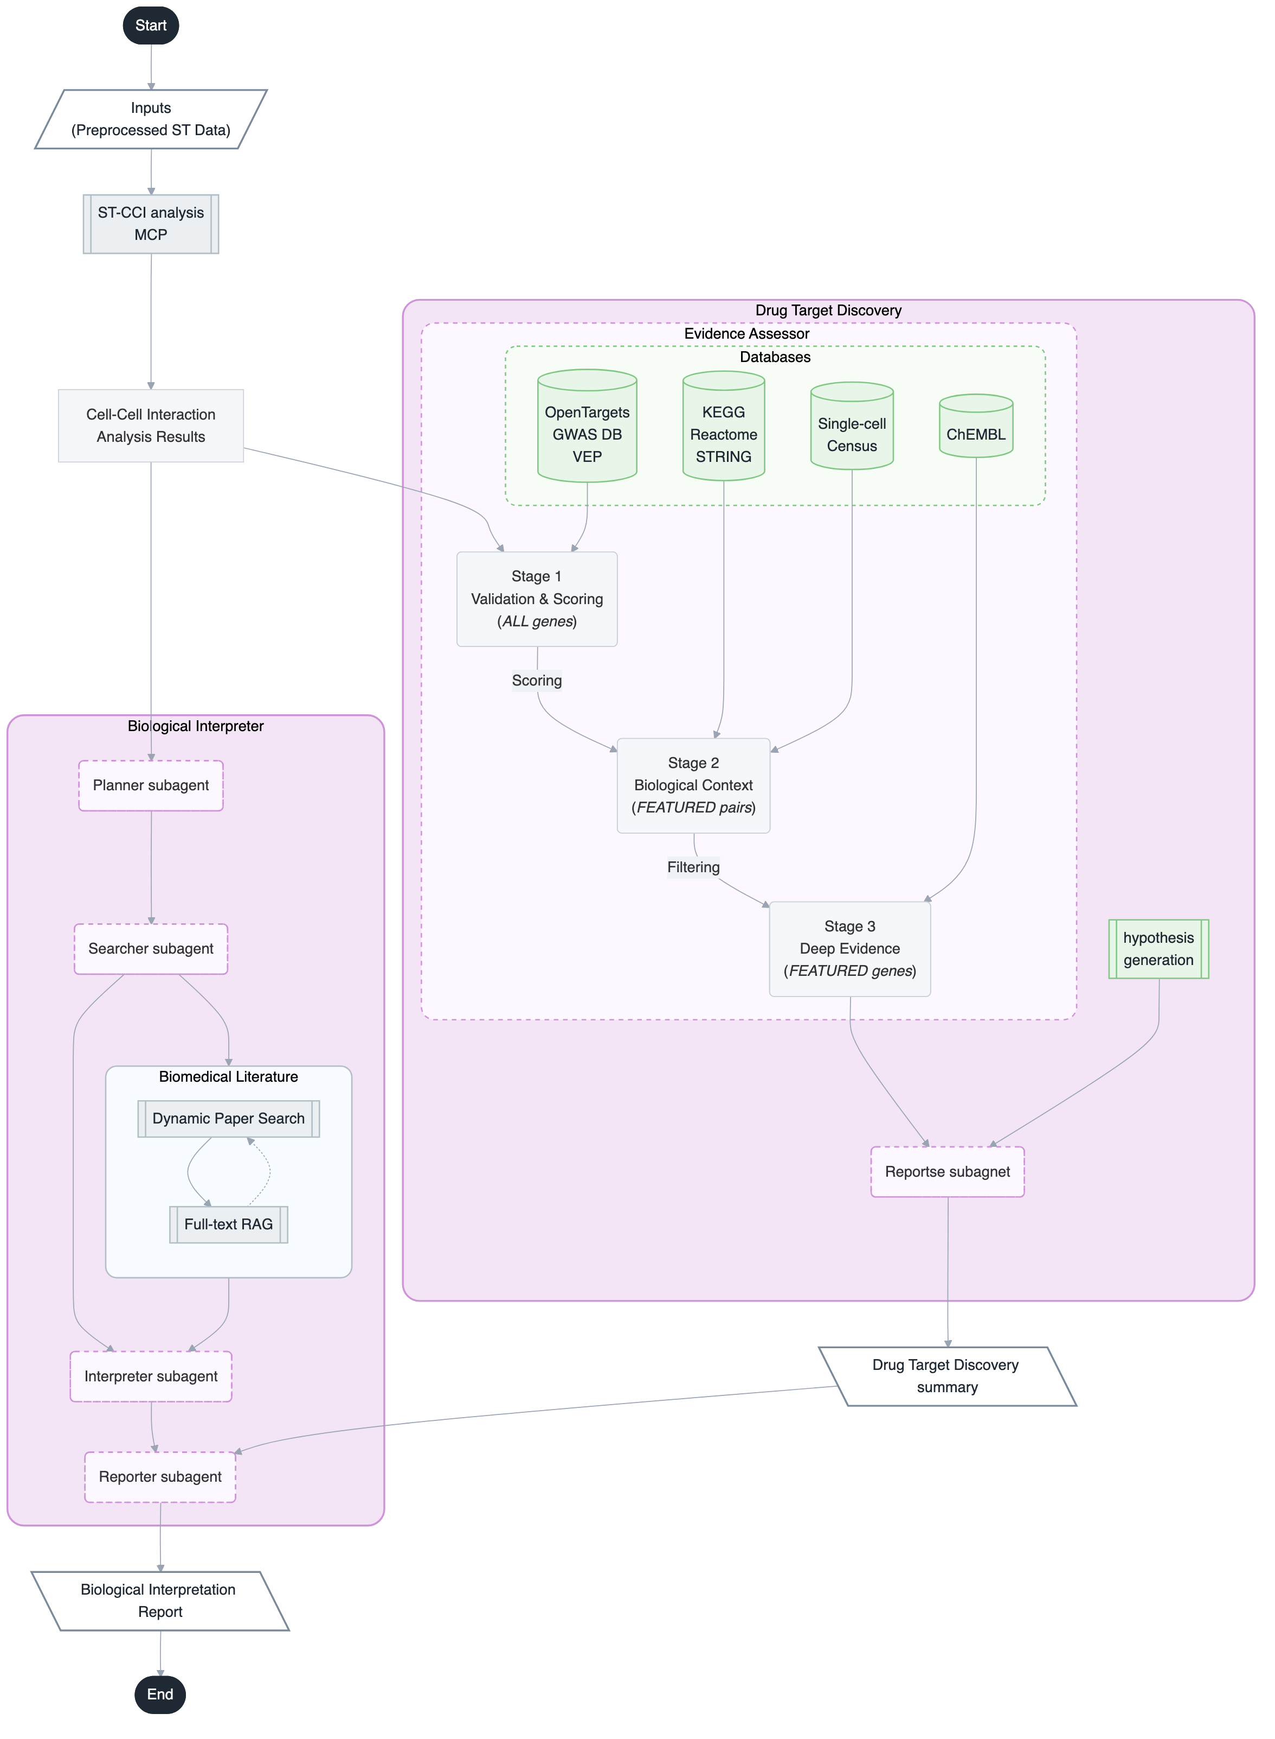
A
B
Fig 1
Fig 1
Notes:
Figure 1. DeepAgent: A deep multi-agent system for autonomous ST data and CCI analysis.
(A) Schematic overview of DeepAgent The system integrates ST data with single-cell reference data to perform ST data analysis, CCI analysis, and biological interpretation.
(B) Architecture of DeepAgent. A Supervisor Agent coordinates three Expert Agents (Pipeline builder, Pipeline Executor, and Biological interpreter). These agents interact with five MCP Servers via MCP Client: Article-download for literature download, MAST-RAG for literature retrieval, rMCPAgent for R function integration, SC-reference-selector for single-cell reference dataset selection, and ST-CCI for spatial CCI analysis.

Slide 2
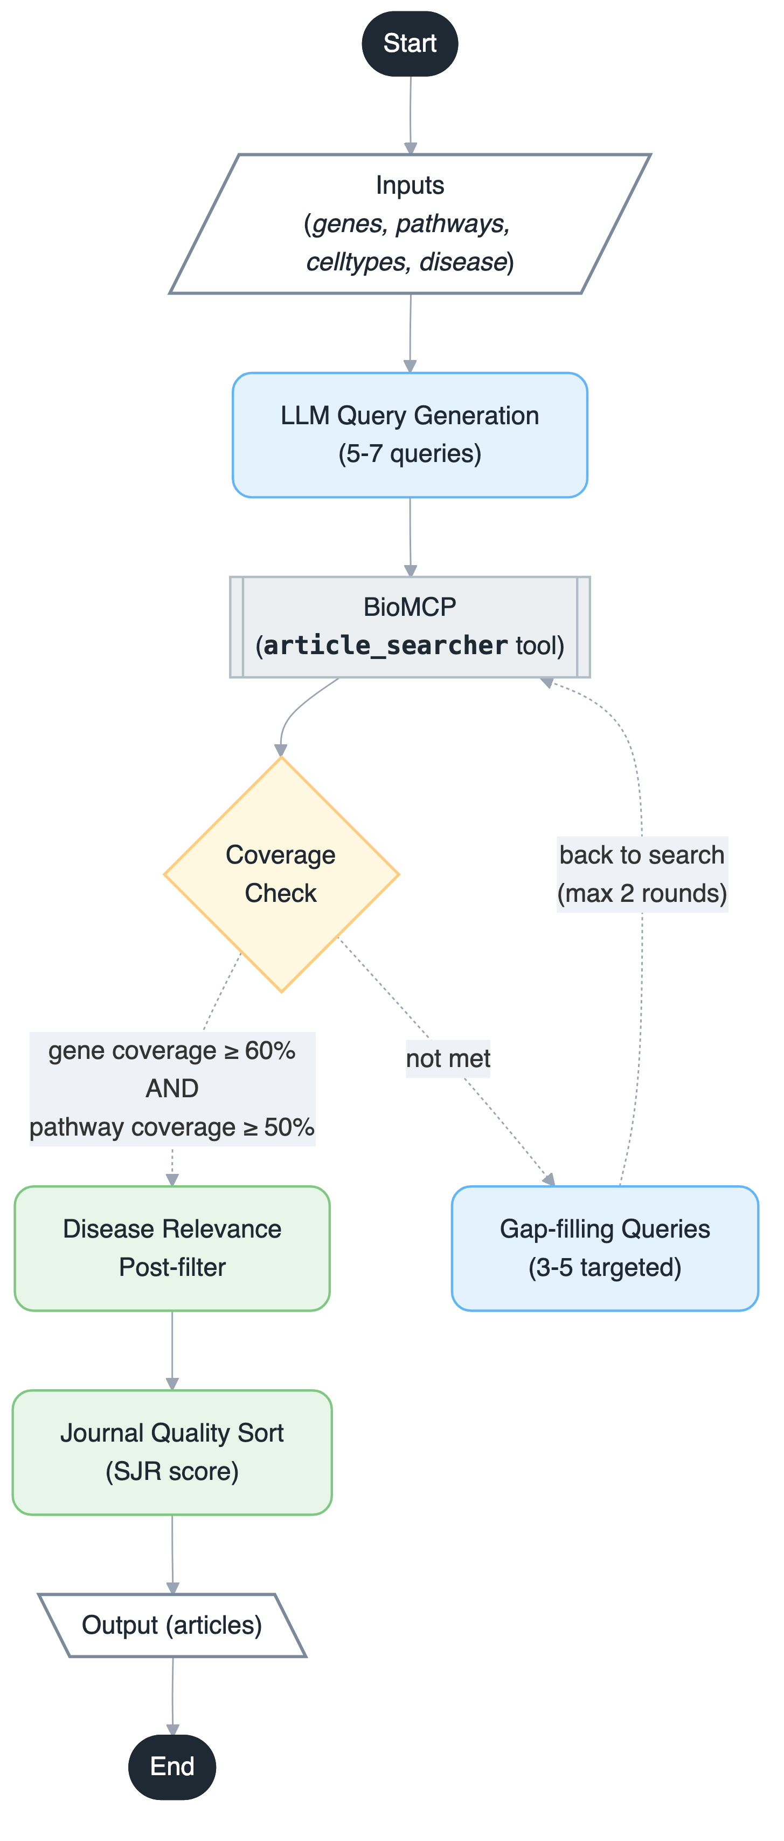
A
Fig. 2
Notes:
- 본문에 **통합 멀티패널 1개(Fig.Xa/b/c)**만 둡니다.
1. Panel a: fig_composite_cov_boxplot_case_mean.png
목적: “찾아내는 양(coverage) 자체가 baseline보다 충분히 높다”
2. Panel b: fig_contamination_boxplot_case_mean.png
목적: “질병 필터가 오염(할루시네이션성 문맥 미스매치)을 강하게 억제한다”
3. Panel c: fig_dynamic_repro_top10_vs_tail20_case_boxplot.png
목적: “Top-10은 안정적(재현성 높음), Tail-20은 다양성 유지”
왜 이 구성이 맞나
- a+b가 “정확도/안전성(무할루시네이션)”의 핵심 증거 사슬
- c가 “안전하게 찾은 결과가 반복 시 어떻게 동작하는지(안정성+탐색성)”를 보강
- 즉, “많이 찾기만 한 게 아니라, 오염을 통제하면서 핵심은 안정적”이라는 논리
흐름이 완성됩니다.
Supplement로 보내는 것
- fig_dynamic_repro_top10_vs_tail20_pair_violin_box.png
역할: case-level 결론을 pairwise(5700쌍)에서도 재확인하는 보강 증거
- 필요 시 fig_dynamic_repro_pairwise_violin_box.png(Jaccard vs Top-10) 추가
캡션 문구 핵심 프레임
- “Dynamic은 baseline 대비 높은 coverage를 유지하면서, disease filter로
contamination을 억제한다. 또한 반복 실행에서 Top-10 후보는 높은 일치도를
보이고, Tail-20은 상대적으로 다양한 후보를 제공한다.”

Slide 3
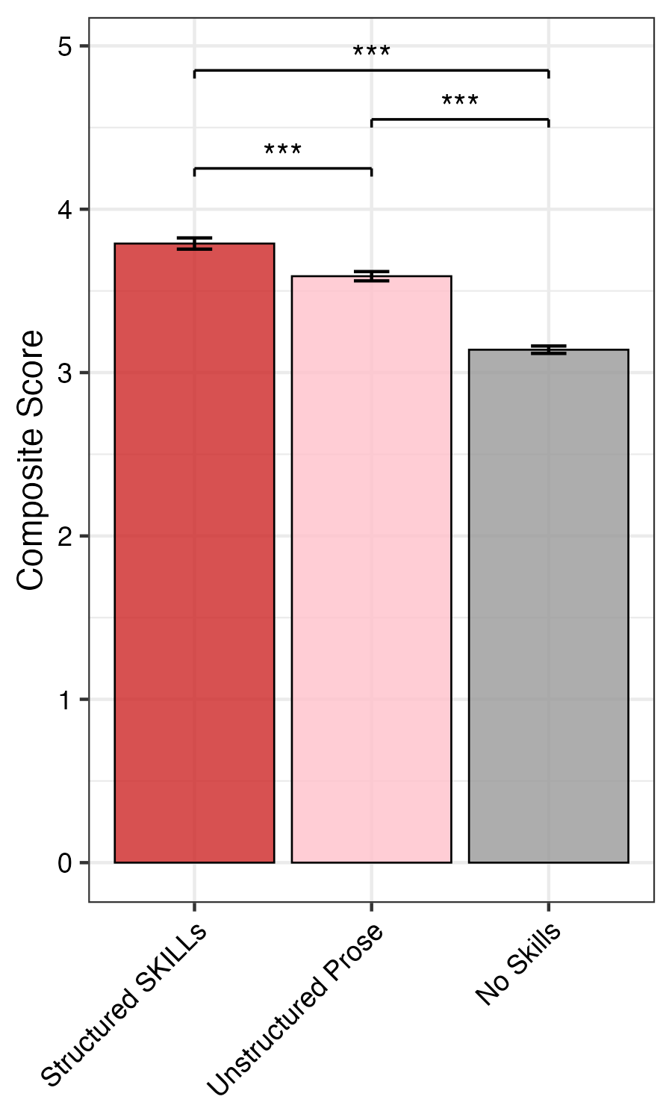
Fig. 3

Slide 4
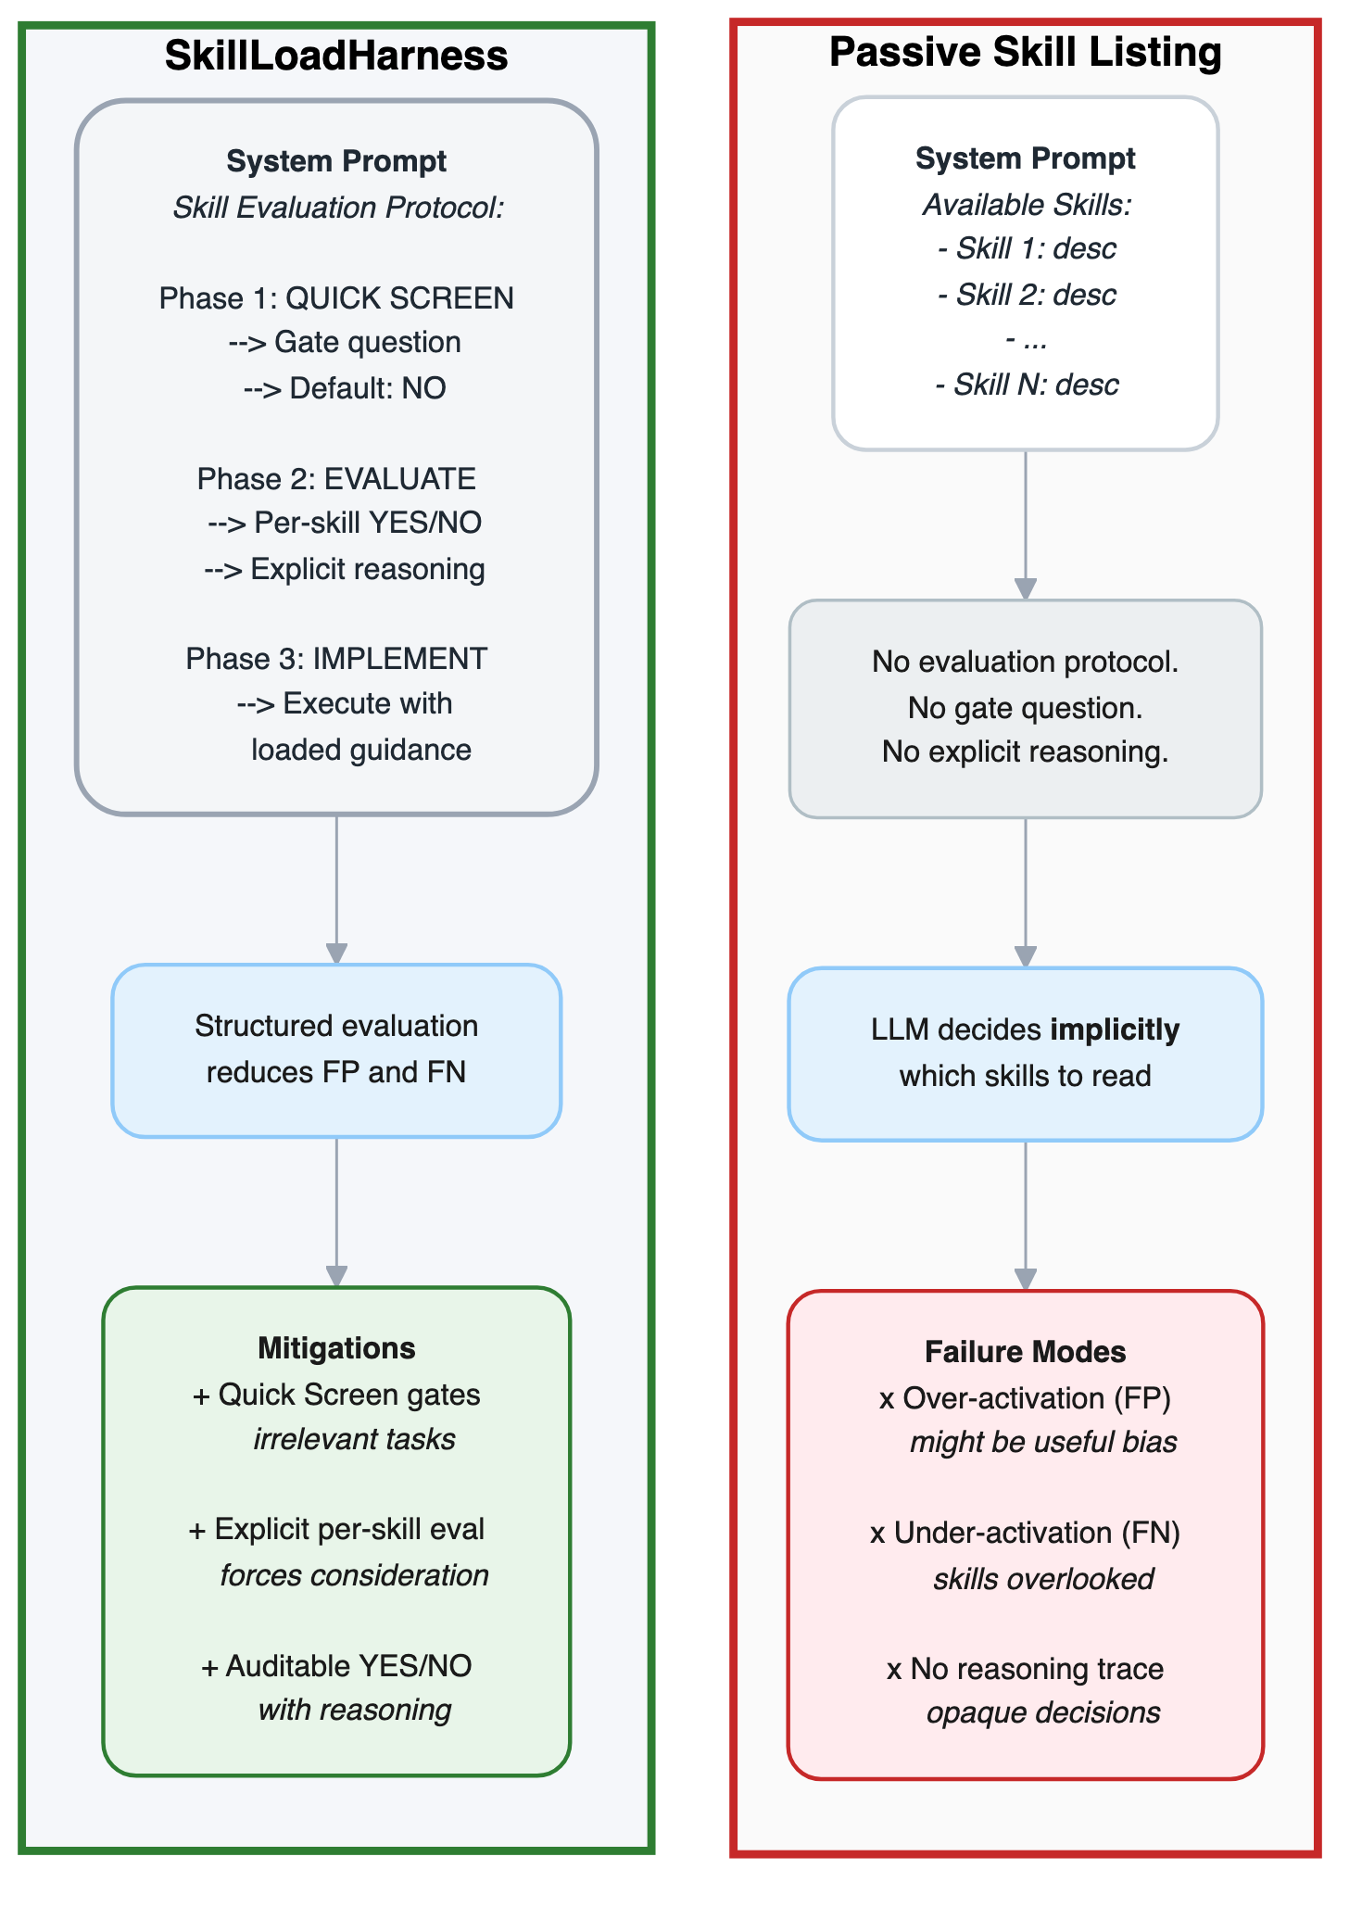
A
Fig. 4

Slide 5
Fig. 7

Slide 7
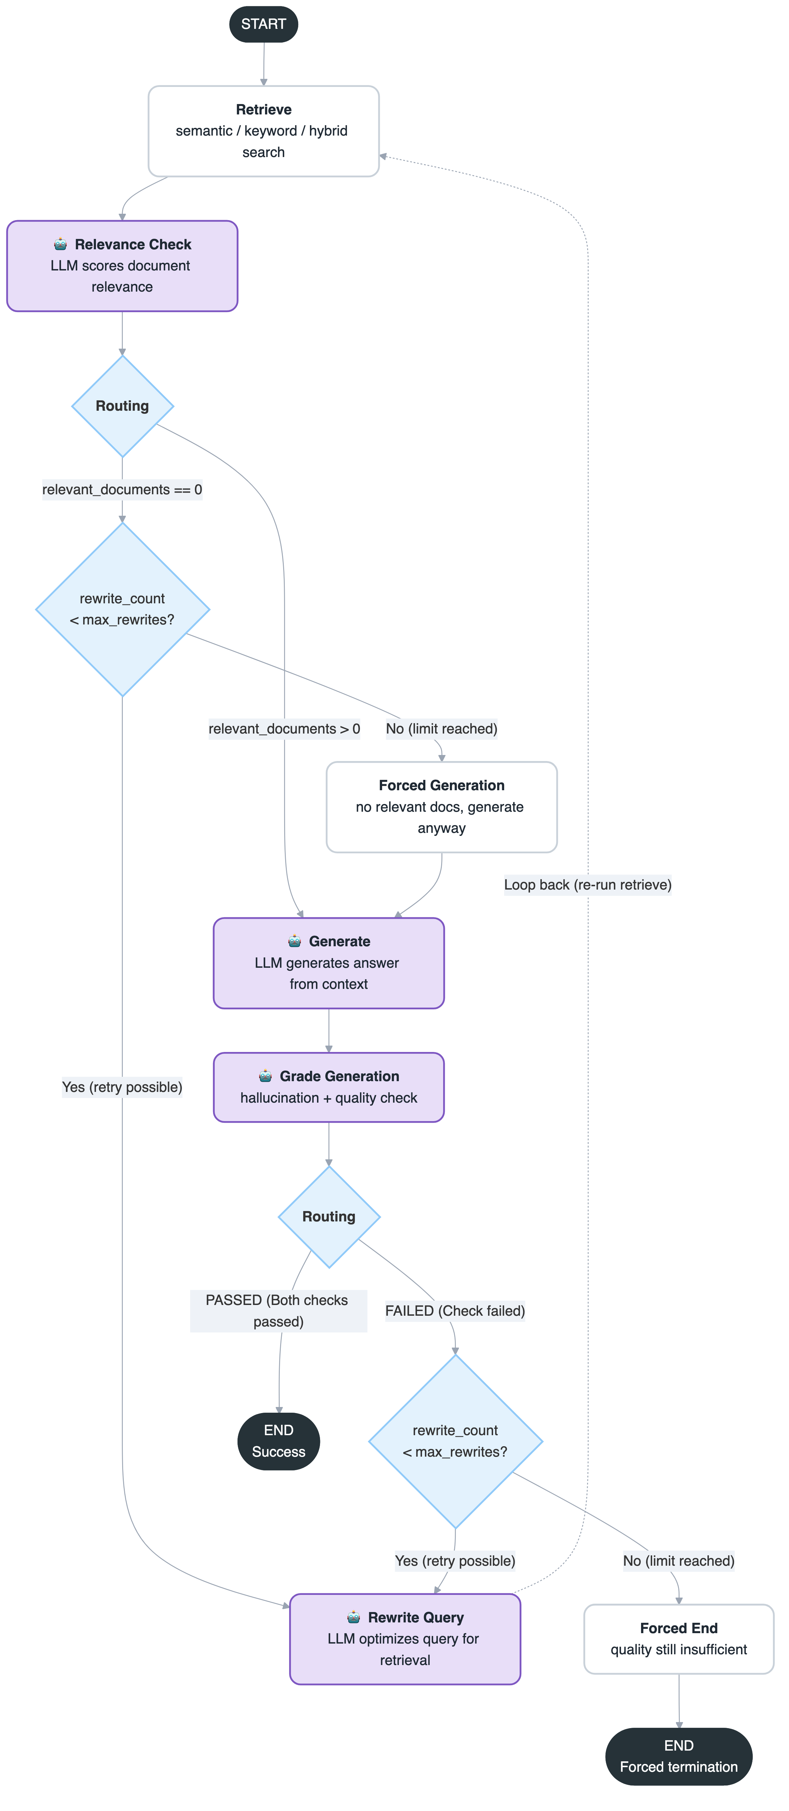
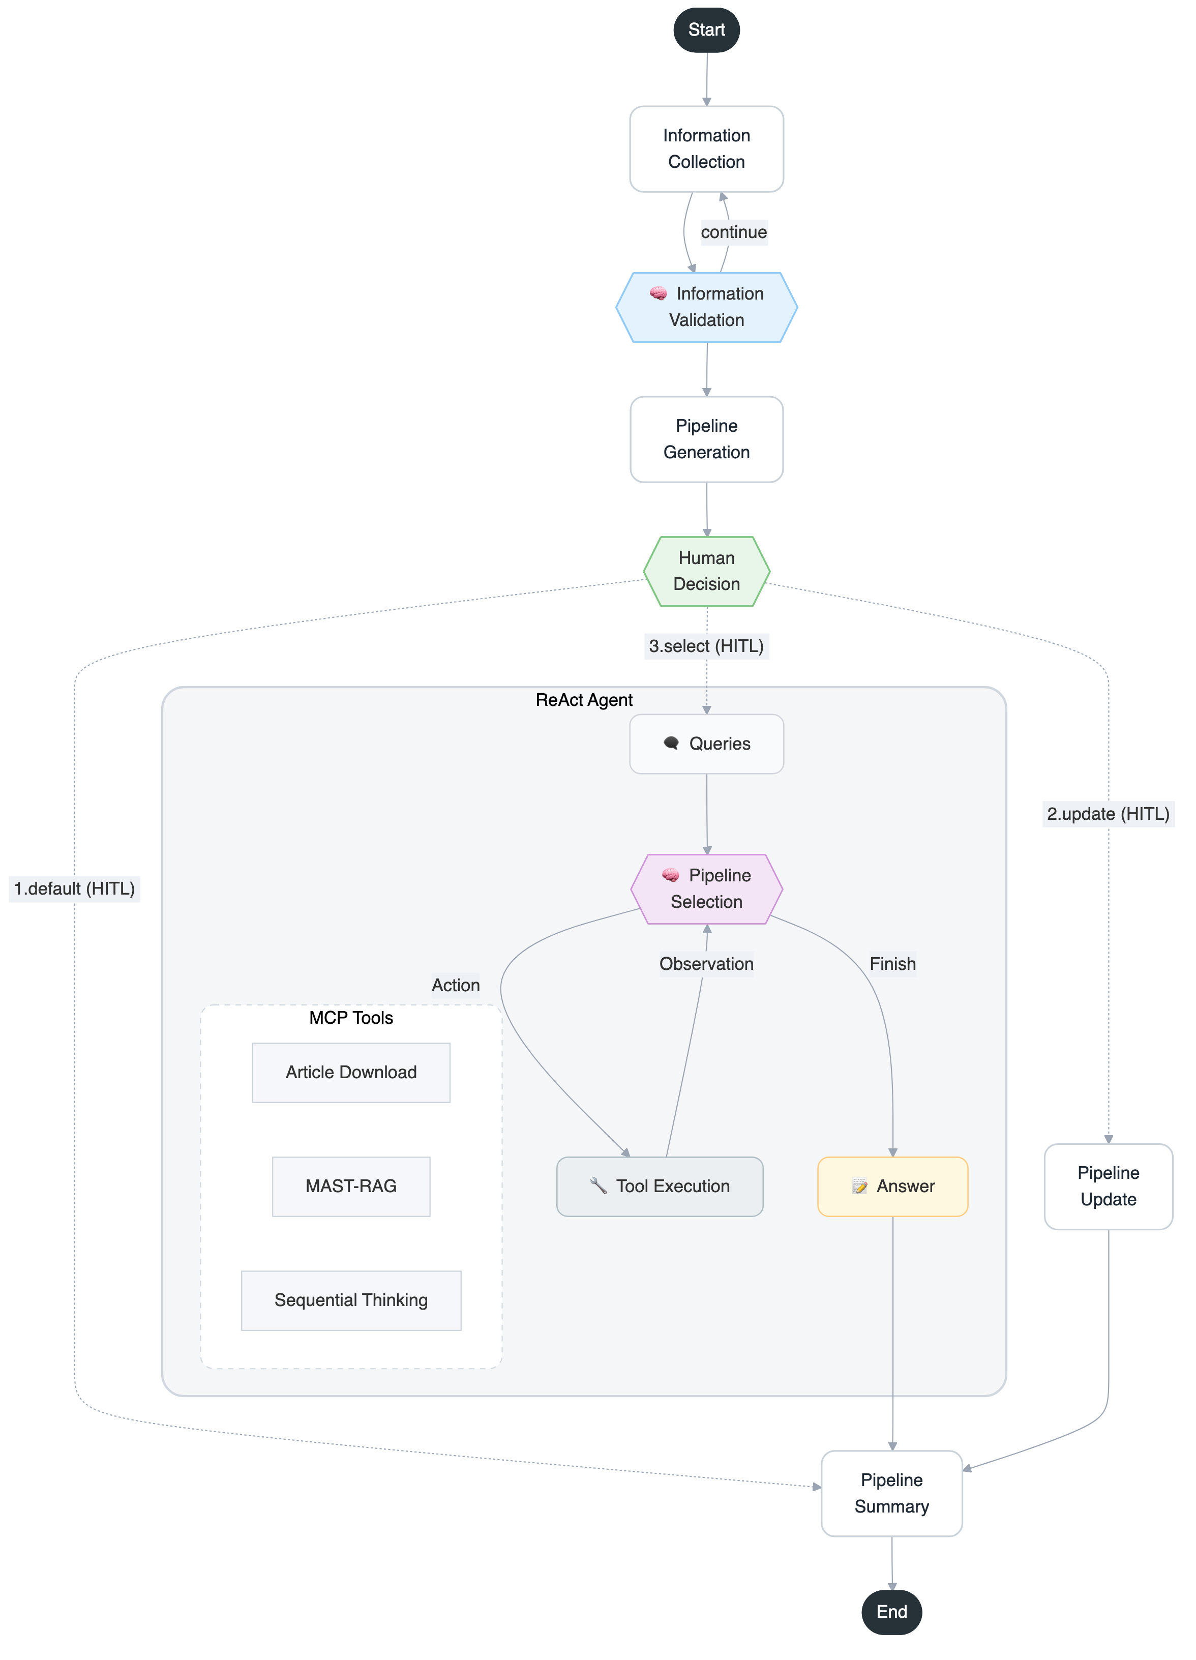
A
B
I need a pipeline for analyzing one breast cancer Visium sample on a Mac (CPU only), with spatial clustering or cell type analysis.
D
✅ Information Collection Complete!
Based on your inputs:
ST Technology: Visium (spot-based)
Disease: breast cancer
Species: human
Sample Count: 1
OS: Mac
Computing: CPU
I've generated the following default analysis pipeline:
📊 Pipeline Configuration:
Normalization: log
Cell Type Analysis: IRIS (deconvolution)
Spatial Clustering: IRIS
🧬 Spatial Transcriptomics Analysis Pipeline
📋 Pipeline Summary
log normalization → CARD (Deconvolution) → BayesSpace (Spatial clustering)
🔧 Step 1: Data Normalization
Tool: log normalization (e.g., Seurat::NormalizeData or base R log1p)
Purpose: Normalization
Language: R
Computational Requirements: CPU, minimal memory for a single Visium sample
why this tool: Log normalization is the standard preprocessing for Visium data and is compatible with all downstream R-based tools.
🔬 Step 2: Cell Type Analysis
Tool: CARD
Purpose: Deconvolution for spot-based data
Language: R
Computational Requirements: CPU, very low memory usage (CARD is 0.2–10% of the memory of alternatives)
why this tool: CARD is highly efficient, accurate, and specifically designed for spot-based (Visium) data. It is widely benchmarked, easy to use on Mac/CPU, and has been applied to human cancer datasets.
🔬 Step 3: Spatial Clustering
Tool: BayesSpace
Purpose: Spatial clustering
Language: R
Computational Requirements: CPU, moderate memory for a single sample
why this tool: BayesSpace is the gold standard for spatial clustering in Visium data, integrates seamlessly with R workflows, and is efficient on Mac/CPU. It is widely used in human cancer spatial transcriptomics.
📊 Computational Overview
Total RAM Required: Low to moderate (CARD is highly efficient; BayesSpace is moderate for a single sample)
GPU Required: No
Estimated Runtime: Under 1 hour for a single Visium sample on a modern Mac CPU
📚 Sources
CARD: "CARD.pdf" (see Supplementary Table 5, 6 for efficiency and memory benchmarks)
BayesSpace: "BayesSpace.pdf" (see Discussion and Methods for Visium/CPU compatibility)
IRIS: "IRIS.pdf" (alternative, but CARD/BayesSpace are more widely benchmarked)
SPOTlight: "SPOTlight.pdf" (alternative deconvolution)
Cell2Location: "Cell2Location.pdf" (alternative deconvolution)
CellCharter: "CellCharter.pdf" (alternative clustering)
GraphST: "GraphST.pdf" (alternative clustering)
This pipeline is optimal for your scenario: efficient, reproducible, and widely used in the field.
Human Input Required
Please choose one of the following options:
1️⃣ Default Pipeline - Proceed with the suggested pipeline
↳ Type: "1", "default" or "proceed"
2️⃣ Customize Pipeline - Modify specific components
↳ Type: "2", "custom" or "update"
3️⃣ Reference-based Pipeline - Use DeepMAST-RAG to find
methods from literature
↳ Type: "3", "reference" or "select"
What would you like to do?
Please provide your response:
Enter your response…
3.reference
C
Generate Query
What are the best deconvolution tools for Visium spot-based spatial transcriptomics data analysis?
Generate Multiple Queries
Which deconvolution methods are most effective for analyzing Visium spot-based spatial transcriptomics data?
Can you recommend top deconvolution tools suitable for Visium spatial transcriptomics spot data?
What are the leading software options for deconvolution in Visium spot-based spatial transcriptomics?
Which algorithms perform best for deconvolution of Visium spatial transcriptomics spot data?
What tools are commonly used for deconvolution in the analysis of Visium spot-based spatial transcriptomics datasets?
Fig. S1
Notes:
Figure 2. Pipeline builder agent autonomously constructs customized spatial transcriptomics analysis workflows.
(A) Detailed architecture of the Pipeline builder agent. The agent follows a sequential workflow including information collection, pipeline generation with Human in the loop (HITL).
(B) Example of the information collection process. The agent interacts with users to gather essential metadata including technology platform, sample details, computational resources, and analysis objectives required for pipeline construction.
(C) Knowledge-augmented pipeline selection using MAST-RAG. When users request reference-based pipelines, the agent generates multiple specific queries to retrieve optimal methods from the knowledge base.
(D) Output of the Pipeline builder agent. The generated pipeline provides a complete spatial transcriptomics analysis workflow including step-by-step procedures (data normalization, cell type deconvolution, spatial clustering).

Slide 8
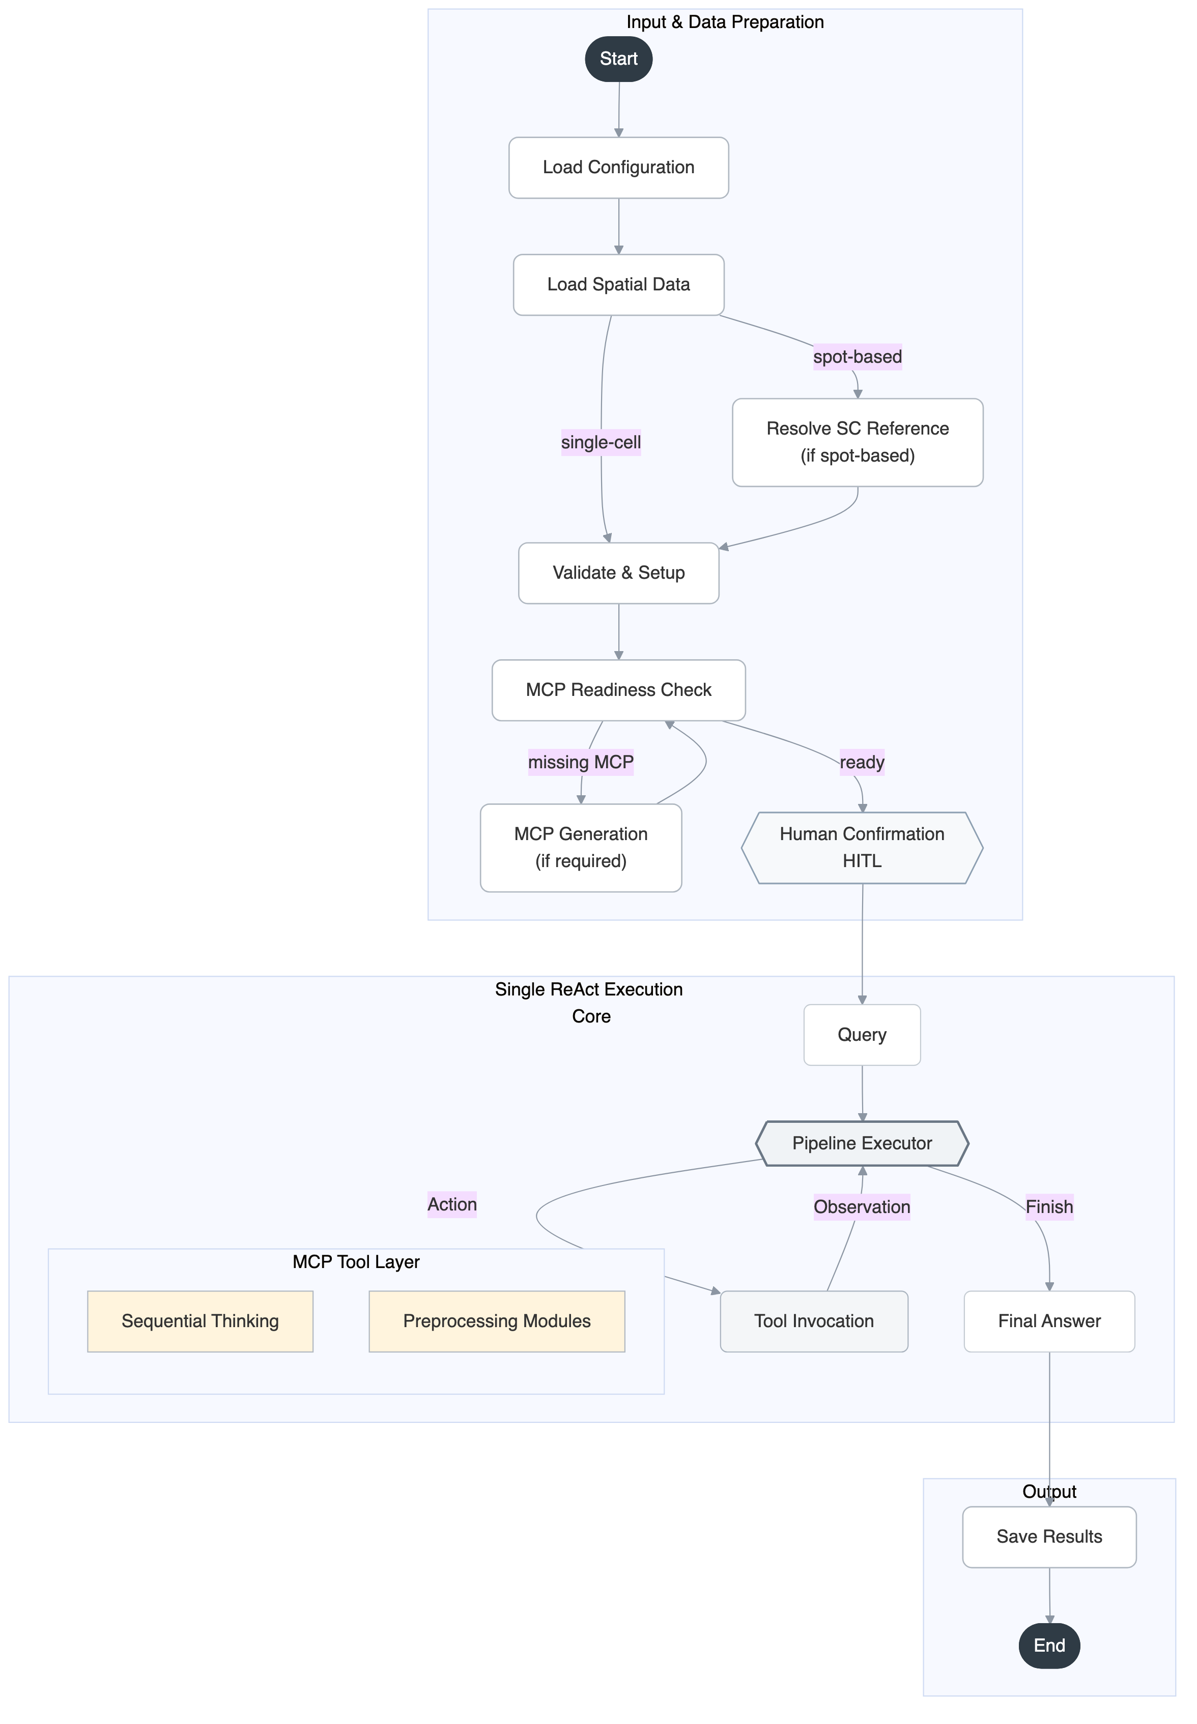
A
B
Sc reference selector
C
Rmcpagnet 실제결과
CARD 결과 추가
Fig. S2
Notes:
Figure 3. Pipeline Executor Agent executes spatial transcriptomics workflows.
(A) Detailed architecture of the Pipeline Executor Agent. The agent orchestrates the complete execution workflow including pipeline preparation, data loading (ST and single-cell reference data when needed), and automated execution through MCP Servers.
(B) TBD
(C) Schematic overview of rMCPAgent. The agent converts R functions into MCP servers through five sequential steps with workflow templates: input validation, data loading, workflow integration, error handling, and output validation. The processed workflows are then deployed as MCP servers for automated analysis.

Slide 9
Fig. S3

Slide 10
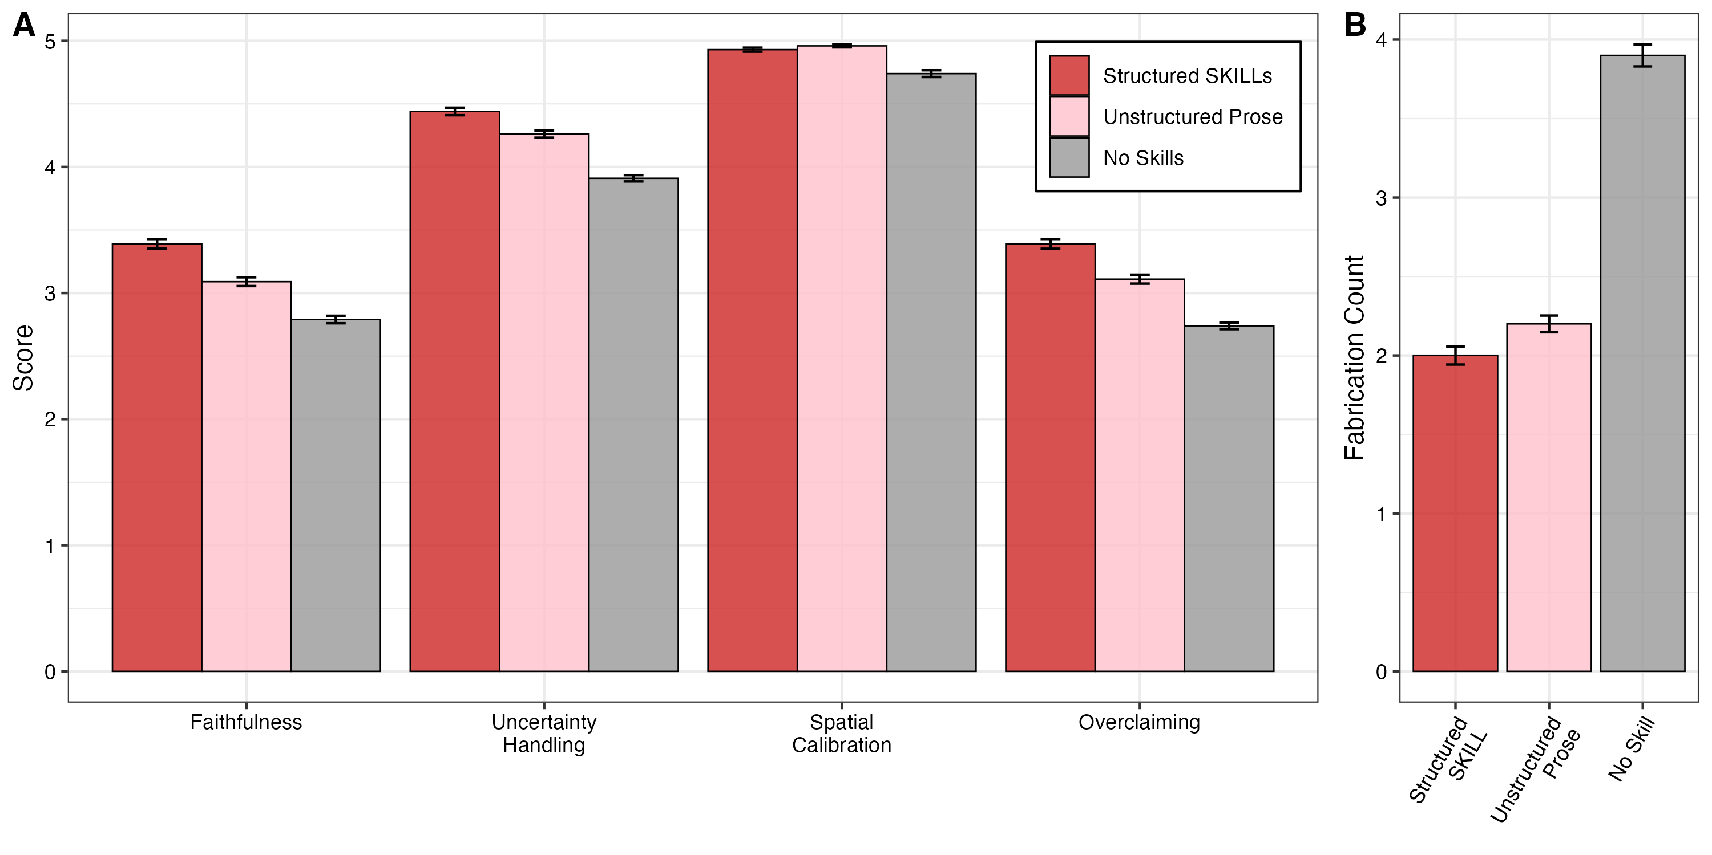
Fig. S2

Slide 11
논문검색 suppl
Fig. S2

Slide 12
Dynamic 논문검색
검색 디테일
Fig. S2

Slide 13
A
Database
Supervisor
Agent
CellxGene Census
KEGG/
Reactome
Expert Agents
STRING
Pipeline
builder
Pipeline
Executor
Biological interpreter
Skills
(Progreesive disclousure)
Drug
Target
OpenTargets
GWAS Catalog
Model Context Protocol
ChEMBL
MCP Server
Ensembl VEP
MAST-RAG
rMCPAgent
Dynamic
paper search
SC-reference-selector
ST-CCI
논문 검색
rmcpagnet
drug
skills
Progressive disclosure
Think – search- refelection
Fig 1
ST analysis tools
rMCPAgent
1. Input validation
2. Data loading
R functions
3. Workflow integration
MCP server
(.R file)
Workflow template
4.Error handling
YAML
5.Output
validation & MCP
Deconvolution.yaml
Spatial clustering.yaml
Fig 1

Slide 14
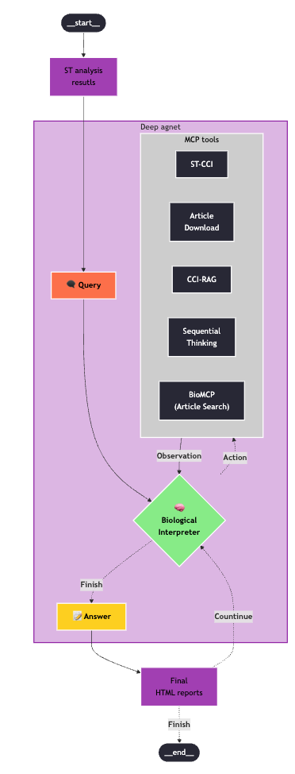
A
B
Part 1
Exploratory Analysis (Steps 1-5)
Part 3
1.Spatial Clustering Analysis
2.Cell Type Composition Analysis
3. Neighborhood Enrichment Analysis
4. Spatial Pathway Enrichment Analysis
5. Spatial Pathway-Celltype Relationship Analysis
Characterization and visualization
(Steps 10-11)
Biological interpretation
Biological interpretation
Biological interpretation
Biological interpretation
Biological interpretation
10. Visualization of Key LR Pairs
Select spatial cluster
Select pathway
11. Quantitative Analysis of Ligand-Receptor Interactions
Part 2
CCI analysis with NMF (Steps 6-9)
Summary
6. LR Interaction Screening (Moran’s R)
7. Intercellular Communication Patterns (NMF Analysis)
8. Pathway Enrichment of Intercellular Patterns
9. Cell Type-Specific SVGs analysis
Integrated Findings Across All Analyses
Clinical and Therapeutic Implications
Methodological Innovations and Strengths
Conclusions
Biological interpretation
Biological interpretation
Biological interpretation
Biological interpretation
Select Factor
Select pathway
Select LR pair
Fig. 4
Notes:
Figure 4. Biological Interpreter Agent performs autonomous spatial cell-cell interaction analysis.
(A) Detailed architecture of the Biological Interpreter Agent. The agent utilizes multiple MCP servers to perform automated biological interpretation with human-in-the-loop validation at critical decision points.
(B) Workflow of the ST-CCI MCP server. The analysis consists of three parts: Part 1 (Steps 1-5) performs exploratory spatial analysis. Part 2 (Steps 6-9) conducts cell-cell interaction analysis using non-negative matrix factorization (NMF) to identify ligand-receptor (LR) interaction patterns. Part 3 (Steps 10-11) provides characterization and visualization of key LR pairs with quantitative analysis. The workflow concludes with an integrated summary of findings, clinical and therapeutic implications, and methodological innovations.

