Slide 1
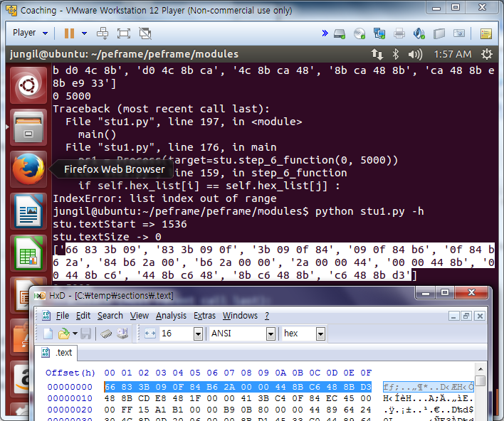
notepad.exe 파일을 .text 추출값 비교 between 준현 and 7zip
7zip에서 추출한 첫 번째 줄만 추출됨.

Slide 2
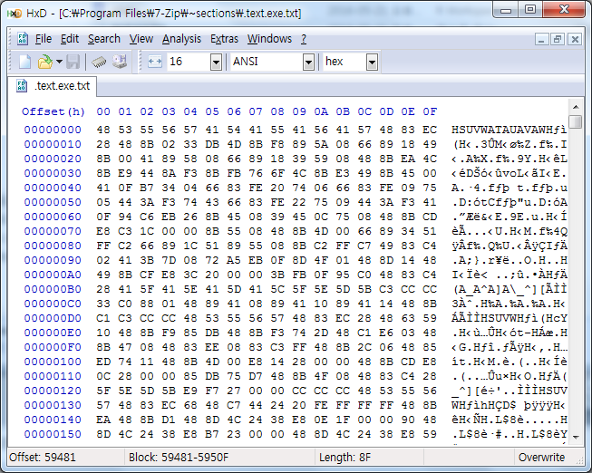
7zG.exe 파일을 .text 추출값 비교 between 7zip and 준현
어디까지 추출되었는지 알 수 없음.
['48 53 55 56', '53 55 56 57', '55 56 57 41', '56 57 41 54', '57 41 54 41', '41 54 41 55', '54 41 55 41', '41 55 41 56', '55 41 56 41', '41 56 41 57', '56 41 57 48', '41 57 48 83', '57 48 83 ec', '28 48 8b 02', '48 8b 02 33', '8b 02 33 db', '02 33 db 4d', '33 db 4d 8b', 'db 4d 8b f8', '4d 8b f8 89', '8b f8 89 5a', 'f8 89 5a 08', '89 5a 08 66', '5a 08 66 89', '08 66 89 18', '66 89 18 49', '8b 00 41 89', '00 41 89 58', '41 89 58 08', '89 58 08 66', '58 08 66 89', '08 66 89 18', '66 89 18 39', '89 18 39 59', '18 39 59 08', '39 59 08 48', '59 08 48 8b', '08 48 8b ea', '48 8b ea 4c', '8b e9 44 8a', 'e9 44 8a f3', '44 8a f3 8b', '8a f3 8b fb', 'f3 8b fb 76', '8b fb 76 6f', 'fb 76 6f 4c', '76 6f 4c 8b', '6f 4c 8b e3', '4c 8b e3 49', '8b e3 49 8b', 'e3 49 8b 45', '49 8b 45 00', '41 0f b7 34', '0f b7 34 04', 'b7 34 04 66', '34 04 66 83', '04 66 83 fe', '66 83 fe 20', '83 fe 20 74', 'fe 20 74 06', '20 74 06 66', '74 06 66 83', '06 66 83 fe', '66 83 fe 09', '83 fe 09 75', '05 44 3a f3', '44 3a f3 74', '3a f3 74 43', 'f3 74 43 66', '74 43 66 83', '43 66 83 fe', '66 83 fe 22', '83 fe 22 75', 'fe 22 75 09', '22 75 09 44', '75 09 44 3a', '09 44 3a f3', '44 3a f3 41', '0f 94 c6 eb', '94 c6 eb 26', 'c6 eb 26 8b', 'eb 26 8b 45', '26 8b 45 08', '8b 45 08 39', '45 08 39 45', '08 39 45 0c', '39 45 0c 75', '45 0c 75 08', '0c 75 08 48', '75 08 48 8b', '08 48 8b cd', 'e8 c3 1c 00', 'c3 1c 00 00', '1c 00 00 8b', '00 00 8b 55', '00 8b 55 08', '8b 55 08 48', '55 08 48 8b', '08 48 8b 4d', '48 8b 4d 00', '8b 4d 00 66', '4d 00 66 89', '00 66 89 34', '66 89 34 51', 'ff c2 66 89', 'c2 66 89 1c', '66 89 1c 51', '89 1c 51 89', '1c 51 89 55', '51 89 55 08', '89 55 08 8b', '55 08 8b c2', '08 8b c2 ff', '8b c2 ff c7', 'c2 ff c7 49', 'ff c7 49 83', 'c7 49 83 c4', '02 41 3b 7d', '41 3b 7d 08', '3b 7d 08 72', '7d 08 72 a5', '08 72 a5 eb', '72 a5 eb 0f', 'a5 eb 0f 8d', 'eb 0f 8d 4f', '0f 8d 4f 01', '8d 4f 01 48', '4f 01 48 8d', '01 48 8d 14', '48 8d 14 48', '49 8b cf e8', '8b cf e8 3c', 'cf e8 3c 20', 'e8 3c 20 00', '3c 20 00 00', '20 00 00 3b', '00 00 3b fb', '00 3b fb 0f', '3b fb 0f 95', 'fb 0f 95 c0', '0f 95 c0 48', '95 c0 48 83', 'c0 48 83 c4', '28 41 5f 41', '41 5f 41 5e', '5f 41 5e 41', '41 5e 41 5d', '5e 41 5d 41', '41 5d 41 5c', '5d 41 5c 5f', '41 5c 5f 5e', '5c 5f 5e 5d', '5f 5e 5d 5b', '5e 5d 5b c3', '5d 5b c3 cc', '5b c3 cc cc', '33 c0 88 01', 'c0 88 01 48', '88 01 48 89', '01 48 89 41', '48 89 41 08', '89 41 08 89', '41 08 89 41', '08 89 41 10', '89 41 10 89', '41 10 89 41', '10 89 41 14', '89 41 14 48', '41 14 48 8b', 'c1 c3 cc cc', 'c3 cc cc 48', 'cc cc 48 53', 'cc 48 53 55', '48 53 55 56', '53 55 56 57', '55 56 57 48', '56 57 48 83', '57 48 83 ec', '48 83 ec 28', '83 ec 28 48', 'ec 28 48 63', '28 48 63 59', '10 48 8b f9', '48 8b f9 85', '8b f9 85 db', 'f9 85 db 48', '85 db 48 8b', 'db 48 8b f3', '48 8b f3 74', '8b f3 74 2d', 'f3 74 2d 48', '74 2d 48 c1', '2d 48 c1 e6', '48 c1 e6 03', 'c1 e6 03 48', '8b 47 08 48', '47 08 48 83', '08 48 83 ee', '48 83 ee 08', '83 ee 08 83', 'ee 08 83 c3', '08 83 c3 ff', '83 c3 ff 48', 'c3 ff 48 8b', 'ff 48 8b 2c', '48 8b 2c 06', '8b 2c 06 48', '2c 06 48 85', 'ed 74 11 48', '74 11 48 8b', '11 48 8b 4d', '48 8b 4d 00', '8b 4d 00 e8', '4d 00 e8 14', '00 e8 14 28', 'e8 14 28 00', '14 28 00 00', '28 00 00 48', '00 00 48 8b', '00 48 8b cd', '48 8b cd e8', '0c 28 00 00', '28 00 00 85', '00 00 85 db', '00 85 db 75', '85 db 75 d7', 'db 75 d7 48', '75 d7 48 8b', 'd7 48 8b 4f', '48 8b 4f 08', '8b 4f 08 48', '4f 08 48 83', '08 48 83 c4', '48 83 c4 28', '5f 5e 5d 5b', '5e 5d 5b e9', '5d 5b e9 f7', '5b e9 f7 27', 'e9 f7 27 00', 'f7 27 00 00', '27 00 00 cc', '00 00 cc cc', '00 cc cc cc', 'cc cc cc 48', 'cc cc 48 53', 'cc 48 53 55', '48 53 55 56', '57 48 83 ec', '48 83 ec 68', '83 ec 68 48', 'ec 68 48 c7', '68 48 c7 44', '48 c7 44 24', 'c7 44 24 20', '44 24 20 fe', '24 20 fe ff', '20 fe ff ff', 'fe ff ff ff', 'ff ff ff 48', 'ff ff 48 8b', 'ea 48 8b d1', '48 8b d1 48', '8b d1 48 8d', 'd1 48 8d 4c', '48 8d 4c 24', '8d 4c 24 38', '4c 24 38 e8', '24 38 e8 0e', '38 e8 0e 1f', 'e8 0e 1f 00', '0e 1f 00 00', '1f 00 00 90', '00 00 90 48', '8d 4c 24 38', '4c 24 38 e8', '24 38 e8 b7', '38 e8 b7 23', 'e8 b7 23 00', 'b7 23 00 00', '23 00 00 48', '00 00 48 8d', '00 48 8d 4c', '48 8d 4c 24', '8d 4c 24 38', '4c 24 38 e8', '24 38 e8 59', '23 00 00 48', '00 00 48 63', '00 48 63 7d', '48 63 7d 08', '63 7d 08 48', '7d 08 48 8b', '08 48 8b df', '48 8b df 85', '8b df 85 ff', 'df 85 ff 74', '85 ff 74 2c', 'ff 74 2c 48', '74 2c 48 c1', 'e3 03 83 c7', '03 83 c7 ff', '83 c7 ff 48', 'c7 ff 48 83', 'ff 48 83 eb', '48 83 eb 08', '83 eb 08 48', 'eb 08 48 8b', '08 48 8b 45', '48 8b 45 00', '8b 45 00 48', '45 00 48 8b', '00 48 8b 34', '03 48 85 f6', '48 85 f6 74', '85 f6 74 10', 'f6 74 10 48', '74 10 48 8b', '10 48 8b 0e', '48 8b 0e e8', '8b 0e e8 92', '0e e8 92 27', 'e8 92 27 00', '92 27 00 00', '27 00 00 48', '00 00 48 8b', 'ce e8 8a 27', 'e8 8a 27 00', '8a 27 00 00', '27 00 00 85', '00 00 85 ff', '00 85 ff 75', '85 ff 75 d8', 'ff 75 d8 c7', '75 d8 c7 45', 'd8 c7 45 08', 'c7 45 08 00', '45 08 00 00', '08 00 00 00', '00 48 8d 4c', '48 8d 4c 24', '8d 4c 24 48', '4c 24 48 e8', '24 48 e8 f9', '48 e8 f9 1d', 'e8 f9 1d 00', 'f9 1d 00 00', '1d 00 00 90', '00 00 90 48', '00 90 48 8d', '90 48 8d 4c', '48 8d 4c 24', '28 e8 ee 1d', 'e8 ee 1d 00', 'ee 1d 00 00', '1d 00 00 90', '00 00 90 4c', '00 90 4c 8d', '90 4c 8d 44', '4c 8d 44 24', '8d 44 24 28', '44 24 28 48', '24 28 48 8d', '28 48 8d 54', '48 8d 54 24', '48 48 8d 4c', '48 8d 4c 24', '8d 4c 24 38', '4c 24 38 e8', '24 38 e8 35', '38 e8 35 fe', 'e8 35 fe ff', '35 fe ff ff', 'fe ff ff 84', 'ff ff 84 c0', 'ff 84 c0 74', '84 c0 74 33', 'c0 74 33 b9', '10 00 00 00', '00 00 00 e8', '00 00 e8 1b', '00 e8 1b 27', 'e8 1b 27 00', '1b 27 00 00', '27 00 00 48', '00 00 48 89', '00 48 89 84', '48 89 84 24', '89 84 24 98', '84 24 98 00', '24 98 00 00', '00 48 85 c0', '48 85 c0 74', '85 c0 74 0f', 'c0 74 0f 48', '74 0f 48 8d', '0f 48 8d 54', '48 8d 54 24', '8d 54 24 48', '54 24 48 48', '24 48 48 8b', '48 48 8b c8', '48 8b c8 e8', '8b c8 e8 69', '1e 00 00 eb', '00 00 eb 02', '00 eb 02 33', 'eb 02 33 c0', '02 33 c0 48', '33 c0 48 8b', 'c0 48 8b d0', '48 8b d0 48', '8b d0 48 8b', 'd0 48 8b cd', '48 8b cd e8', '8b cd e8 82', 'cd e8 82 2e', '03 00 83 7c', '00 83 7c 24', '83 7c 24 30', '7c 24 30 00', '24 30 00 74', '30 00 74 2a', '00 74 2a 48', '74 2a 48 8d', '2a 48 8d 54', '48 8d 54 24', '8d 54 24 28', '54 24 28 48', '24 28 48 8d', '4c 24 38 e8', '24 38 e8 34', '38 e8 34 1f', 'e8 34 1f 00', '34 1f 00 00', '1f 00 00 90', '00 00 90 48', '00 90 48 8b', '90 48 8b 4c', '48 8b 4c 24', '8b 4c 24 28', '4c 24 28 e8', '24 28 e8 fd', '26 00 00 90', '00 00 90 48', '00 90 48 8b', '90 48 8b 4c', '48 8b 4c 24', '8b 4c 24 48', '4c 24 48 e8', '24 48 e8 f2', '48 e8 f2 26', 'e8 f2 26 00', 'f2 26 00 00', '26 00 00 e9', '00 00 e9 6e', 'ff ff ff 48', 'ff ff 48 8b', 'ff 48 8b 4c', '48 8b 4c 24', '8b 4c 24 28', '4c 24 28 e8', '24 28 e8 e3', '28 e8 e3 26', 'e8 e3 26 00', 'e3 26 00 00', '26 00 00 90', '00 00 90 48', '00 90 48 8b', '4c 24 48 e8', '24 48 e8 d8', '48 e8 d8 26', 'e8 d8 26 00', 'd8 26 00 00', '26 00 00 90', '00 00 90 48', '00 90 48 8b', '90 48 8b 4c', '48 8b 4c 24', '8b 4c 24 38', '4c 24 38 e8', '24 38 e8 cd', '26 00 00 48', '00 00 48 83', '00 48 83 c4', '48 83 c4 68', '83 c4 68 5f', 'c4 68 5f 5e', '68 5f 5e 5d', '5f 5e 5d 5b', '5e 5d 5b c3', '5d 5b c3 48', '5b c3 48 55', 'c3 48 55 48', '48 55 48 83', 'ec 20 48 8b', '20 48 8b ea', '48 8b ea 48', '8b ea 48 8d', 'ea 48 8d 4d', '48 8d 4d 38', '8d 4d 38 e8', '4d 38 e8 be', '38 e8 be 8a', 'e8 be 8a 01', 'be 8a 01 00', '8a 01 00 48', '01 00 48 83', 'c4 20 5d c3', '20 5d c3 cc', '5d c3 cc cc', 'c3 cc cc cc', 'cc cc cc cc', 'cc cc cc cc', 'cc cc cc cc', 'cc cc cc cc', 'cc cc cc cc', 'cc cc cc 48', 'cc cc 48 55', 'cc 48 55 48', '48 55 48 83', 'ec 20 48 8b', '20 48 8b ea', '48 8b ea 48', '8b ea 48 8d', 'ea 48 8d 4d', '48 8d 4d 48', '8d 4d 48 e8', '4d 48 e8 9e', '48 e8 9e 8a', 'e8 9e 8a 01', '9e 8a 01 00', '8a 01 00 48', '01 00 48 83', 'c4 20 5d c3', '20 5d c3 cc', '5d c3 cc cc', 'c3 cc cc cc', 'cc cc cc cc', 'cc cc cc cc', 'cc cc cc cc', 'cc cc cc cc', 'cc cc cc cc', 'cc cc cc 48', 'cc cc 48 55', 'cc 48 55 48', '48 55 48 83', 'ec 20 48 8b', '20 48 8b ea', '48 8b ea 48', '8b ea 48 8d', 'ea 48 8d 4d', '48 8d 4d 28', '8d 4d 28 e8', '4d 28 e8 7e', '28 e8 7e 8a', 'e8 7e 8a 01', '7e 8a 01 00', '8a 01 00 48', '01 00 48 83', 'c4 20 5d c3', '20 5d c3 cc', '5d c3 cc cc', 'c3 cc cc cc', 'cc cc cc cc', 'cc cc cc cc', 'cc cc cc cc', 'cc cc cc cc', 'cc cc cc cc', 'cc cc cc 48', 'cc cc 48 55', 'cc 48 55 48', '48 55 48 83', 'ec 20 48 8b', '20 48 8b ea', '48 8b ea 48', '8b ea 48 8b', 'ea 48 8b 8d', '48 8b 8d 98', '8b 8d 98 00', '8d 98 00 00', '98 00 00 00', '00 00 00 e8', '00 00 e8 4f', '00 e8 4f 26', 'e8 4f 26 00', '00 48 83 c4', '48 83 c4 20', '83 c4 20 5d', 'c4 20 5d c3', '20 5d c3 cc', '5d c3 cc 48', 'c3 cc 48 89', 'cc 48 89 4c', '48 89 4c 24', '89 4c 24 08', '4c 24 08 53', '24 08 53 56', '08 53 56 57', '48 83 ec 40', '83 ec 40 48', 'ec 40 48 c7', '40 48 c7 44', '48 c7 44 24', 'c7 44 24 30', '44 24 30 fe', '24 30 fe ff', '30 fe ff ff', 'fe ff ff ff', 'ff ff ff 8b', 'ff ff 8b f2', 'ff 8b f2 48', '8b d9 89 11', 'd9 89 11 33', '89 11 33 ff', '11 33 ff 48', '33 ff 48 89', 'ff 48 89 79', '48 89 79 08', '89 79 08 48', '79 08 48 89', '08 48 89 79', '48 89 79 10', '89 79 10 89', '79 10 89 79', '18 89 79 1c', '89 79 1c 48', '79 1c 48 83', '1c 48 83 c1', '48 83 c1 20', '83 c1 20 e8', 'c1 20 e8 f7', '20 e8 f7 16', 'e8 f7 16 00', 'f7 16 00 00', '16 00 00 90', '00 00 90 48', '00 90 48 8d', '4b 30 e8 8d', '30 e8 8d 1c', 'e8 8d 1c 00', '8d 1c 00 00', '1c 00 00 90', '00 00 90 8d', '00 90 8d 0c', '90 8d 0c 76', '8d 0c 76 c1', '0c 76 c1 e1', '76 c1 e1 03', 'c1 e1 03 48', 'e1 03 48 83', 'c1 08 e8 cd', '08 e8 cd 25', 'e8 cd 25 00', 'cd 25 00 00', '25 00 00 48', '00 00 48 89', '00 48 89 44', '48 89 44 24', '89 44 24 70', '44 24 70 48', '24 70 48 3b', '70 48 3b c7', '48 3b c7 74', '2a 89 30 48', '89 30 48 8d', '30 48 8d 78', '48 8d 78 08', '8d 78 08 48', '78 08 48 8d', '08 48 8d 05', '48 8d 05 96', '8d 05 96 fd', '05 96 fd ff', '96 fd ff ff', 'fd ff ff 48', 'ff ff 48 89', '44 24 20 4c', '24 20 4c 8d', '20 4c 8d 0d', '4c 8d 0d 76', '8d 0d 76 fd', '0d 76 fd ff', '76 fd ff ff', 'fd ff ff 44', 'ff ff 44 8b', 'ff 44 8b c6', '44 8b c6 ba', '8b c6 ba 18', 'c6 ba 18 00', '00 00 48 8b', '00 48 8b cf', '48 8b cf e8', '8b cf e8 b6', 'cf e8 b6 7e', 'e8 b6 7e 05', 'b6 7e 05 00', '7e 05 00 90', '05 00 90 48', '00 90 48 89', '90 48 89 7b', '48 89 7b 08', '89 7b 08 48', '8b c3 48 83', 'c3 48 83 c4', '48 83 c4 40', '83 c4 40 5f', 'c4 40 5f 5e', '40 5f 5e 5b', '5f 5e 5b c3', '5e 5b c3 cc', '5b c3 cc cc', 'c3 cc cc cc', 'cc cc cc cc', 'cc cc cc cc', 'cc cc cc cc', 'cc cc cc cc', 'cc cc cc cc', 'cc cc cc cc', 'cc cc cc cc', 'cc cc cc cc', 'cc cc cc 48', 'cc cc 48 55', 'cc 48 55 48', '48 55 48 83', '55 48 83 ec', '48 83 ec 20', '83 ec 20 48', 'ec 20 48 8b', 'ea 48 8b 4d', '48 8b 4d 60', '8b 4d 60 48', '4d 60 48 83', '60 48 83 c1', '48 83 c1 10', '83 c1 10 e8', 'c1 10 e8 36', '10 e8 36 0e', 'e8 36 0e 05', '36 0e 05 00', '0e 05 00 48', '05 00 48 83', 'c4 20 5d c3', '20 5d c3 cc', '5d c3 cc cc', 'c3 cc cc cc', 'cc cc cc cc', 'cc cc cc 48', 'cc cc 48 55', 'cc 48 55 48', '48 55 48 83', '55 48 83 ec', '48 83 ec 20', '83 ec 20 48', 'ec 20 48 8b', 'ea 48 8b 4d', '48 8b 4d 60', '8b 4d 60 48', '4d 60 48 83', '60 48 83 c1', '48 83 c1 20', '83 c1 20 e8', 'c1 20 e8 7e', '20 e8 7e 89', 'e8 7e 89 01', '7e 89 01 00', '89 01 00 48', '01 00 48 83', 'c4 20 5d c3', '20 5d c3 cc', '5d c3 cc cc', 'c3 cc cc cc', 'cc cc cc cc', 'cc cc cc 48', 'cc cc 48 55', 'cc 48 55 48', '48 55 48 83', '55 48 83 ec', '48 83 ec 20', '83 ec 20 48', 'ec 20 48 8b', 'ea 48 8b 4d', '48 8b 4d 60', '8b 4d 60 48', '4d 60 48 83', '60 48 83 c1', '48 83 c1 30', '83 c1 30 e8', 'c1 30 e8 5e', '30 e8 5e 89', 'e8 5e 89 01', '5e 89 01 00', '89 01 00 48', '01 00 48 83', 'c4 20 5d c3', '20 5d c3 cc', '5d c3 cc cc', 'c3 cc cc cc', 'cc cc cc cc', 'cc cc cc 48', 'cc cc 48 55', 'cc 48 55 48', '48 55 48 83', '55 48 83 ec', '48 83 ec 20', '83 ec 20 48', 'ec 20 48 8b', 'ea 48 8b 4d', '48 8b 4d 70', '8b 4d 70 e8', '4d 70 e8 36', '70 e8 36 25', 'e8 36 25 00', '36 25 00 00', '25 00 00 48', '00 00 48 83', '00 48 83 c4', '48 83 c4 20', '83 c4 20 5d', 'c4 20 5d c3', '48 89 4c 24', '89 4c 24 08', '4c 24 08 53', '24 08 53 55', '08 53 55 56', '53 55 56 57', '55 56 57 48', '56 57 48 83', '57 48 83 ec', '48 83 ec 38', '83 ec 38 48', 'ec 38 48 c7', '38 48 c7 44', '24 20 fe ff', '20 fe ff ff', 'fe ff ff ff', 'ff ff ff 48', 'ff ff 48 8b', 'ff 48 8b f9', '48 8b f9 48', '8b f9 48 8b', 'f9 48 8b 49', '48 8b 49 08', '8b 49 08 48', '49 08 48 85', '08 48 85 c9', '74 21 48 8d', '21 48 8d 59', '48 8d 59 f8', '8d 59 f8 4c', '59 f8 4c 8d', 'f8 4c 8d 0d', '4c 8d 0d b7', '8d 0d b7 fc', '0d b7 fc ff', 'b7 fc ff ff', 'fc ff ff 44', 'ff ff 44 8b', 'ff 44 8b 03', 'ba 18 00 00', '18 00 00 00', '00 00 00 e8', '00 00 e8 46', '00 e8 46 7f', 'e8 46 7f 05', '46 7f 05 00', '7f 05 00 48', '05 00 48 8b', '00 48 8b cb', '48 8b cb e8', '8b cb e8 ee', 'cb e8 ee 24', '00 00 90 48', '00 90 48 8b', '90 48 8b 4f', '48 8b 4f 30', '8b 4f 30 e8', '4f 30 e8 e4', '30 e8 e4 24', 'e8 e4 24 00', 'e4 24 00 00', '24 00 00 90', '00 00 90 48', '00 90 48 8b', '90 48 8b 4f', '20 e8 da 24', 'e8 da 24 00', 'da 24 00 00', '24 00 00 90', '00 00 90 48', '00 90 48 63', '90 48 63 77', '48 63 77 18', '63 77 18 48', '77 18 48 8b', '18 48 8b de', '48 8b de 85', '8b de 85 f6', '74 2d 48 c1', '2d 48 c1 e3', '48 c1 e3 03', 'c1 e3 03 83', 'e3 03 83 c6', '03 83 c6 ff', '83 c6 ff 48', 'c6 ff 48 83', 'ff 48 83 eb', '48 83 eb 08', '83 eb 08 48', 'eb 08 48 8b', '08 48 8b 47', '10 48 8b 2c', '48 8b 2c 03', '8b 2c 03 48', '2c 03 48 85', '03 48 85 ed', '48 85 ed 74', '85 ed 74 11', 'ed 74 11 48', '74 11 48 8b', '11 48 8b 4d', '48 8b 4d 00', '8b 4d 00 e8', '4d 00 e8 ad', '24 00 00 48', '00 00 48 8b', '00 48 8b cd', '48 8b cd e8', '8b cd e8 a5', 'cd e8 a5 24', 'e8 a5 24 00', 'a5 24 00 00', '24 00 00 85', '00 00 85 f6', '00 85 f6 75', '85 f6 75 d7', 'f6 75 d7 48', '8b 4f 10 48', '4f 10 48 83', '10 48 83 c4', '48 83 c4 38', '83 c4 38 5f', 'c4 38 5f 5e', '38 5f 5e 5d', '5f 5e 5d 5b', '5e 5d 5b e9', '5d 5b e9 90', '5b e9 90 24', 'e9 90 24 00', '90 24 00 00', '48 55 48 83', '55 48 83 ec', '48 83 ec 20', '83 ec 20 48', 'ec 20 48 8b', '20 48 8b ea', '48 8b ea 48', '8b ea 48 8b', 'ea 48 8b 4d', '48 8b 4d 60', '8b 4d 60 48', '4d 60 48 83', '60 48 83 c1', '10 e8 1e 0d', 'e8 1e 0d 05', '1e 0d 05 00', '0d 05 00 48', '05 00 48 83', '00 48 83 c4', '48 83 c4 20', '83 c4 20 5d', 'c4 20 5d c3', '20 5d c3 cc', '5d c3 cc cc', 'c3 cc cc cc', 'cc cc cc cc', '48 55 48 83', '55 48 83 ec', '48 83 ec 20', '83 ec 20 48', 'ec 20 48 8b', '20 48 8b ea', '48 8b ea 48', '8b ea 48 8b', 'ea 48 8b 4d', '48 8b 4d 60', '8b 4d 60 48', '4d 60 48 83', '60 48 83 c1', '20 e8 66 88', 'e8 66 88 01', '66 88 01 00', '88 01 00 48', '01 00 48 83', '00 48 83 c4', '48 83 c4 20', '83 c4 20 5d', 'c4 20 5d c3', '20 5d c3 cc', '5d c3 cc cc', 'c3 cc cc cc', 'cc cc cc cc', '48 55 48 83', '55 48 83 ec', '48 83 ec 20', '83 ec 20 48', 'ec 20 48 8b', '20 48 8b ea', '48 8b ea 48', '8b ea 48 8b', 'ea 48 8b 4d', '48 8b 4d 60', '8b 4d 60 48', '4d 60 48 83', '60 48 83 c1', '30 e8 46 88', 'e8 46 88 01', '46 88 01 00', '88 01 00 48', '01 00 48 83', '00 48 83 c4', '48 83 c4 20', '83 c4 20 5d', 'c4 20 5d c3', '20 5d c3 48', '5d c3 48 53', 'c3 48 53 55', '48 53 55 56', '57 41 54 41', '41 54 41 55', '54 41 55 41', '41 55 41 56', '55 41 56 41', '41 56 41 57', '56 41 57 48', '41 57 48 83', '57 48 83 ec', '48 83 ec 48', '83 ec 48 48', 'ec 48 48 c7', '48 48 c7 44', '24 20 fe ff', '20 fe ff ff', 'fe ff ff ff', 'ff ff ff 4d', 'ff ff 4d 8b', 'ff 4d 8b d0', '4d 8b d0 4c', '8b d0 4c 8b', 'd0 4c 8b ca', '4c 8b ca 48', '8b ca 48 8b', 'ca 48 8b e9', '48 8b e9 33']

Slide 3
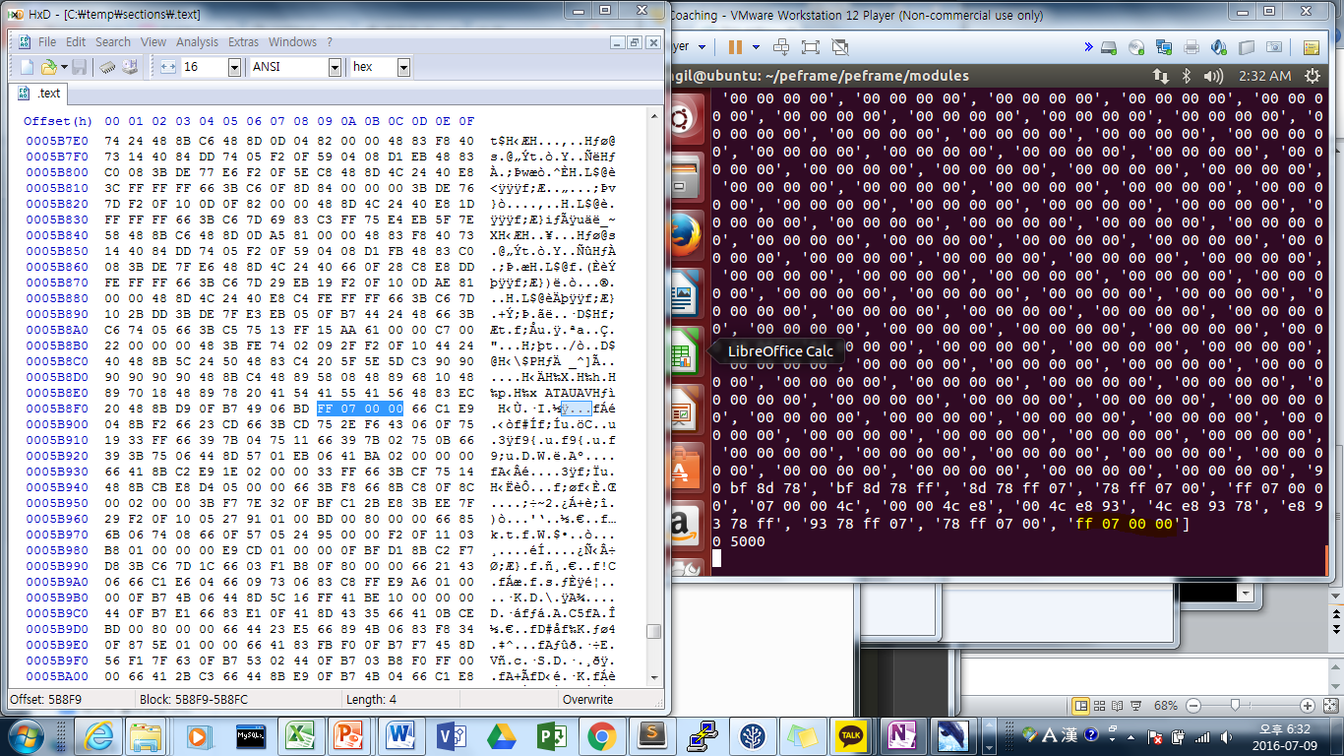
calc.exe .text 추출값

