Slide 1
Zookeeper
PS

Slide 2
Agenda
Distributed System
Zookeeper Overview

Slide 3
Distributed System
多台服务器组成一个整体，可以统一对外处理同一请求
内部服务器都可以相互通信（RPC/HTTP)
客户端到服务端的一次请求到响应结束会经历多台服务器

Slide 4
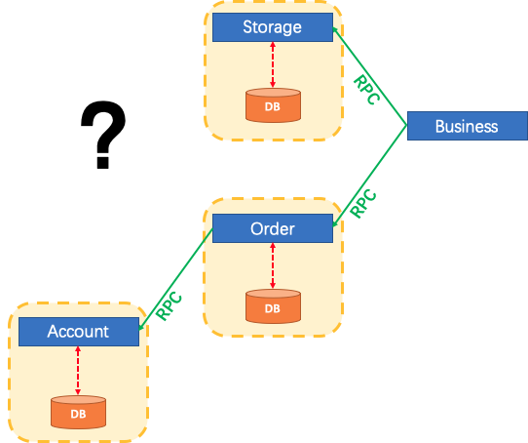
Distributed System

Slide 5
Zookeeper
Apache ZooKeeper is an effort to develop and maintain an open-source server which enables highly reliable distributed coordination.
ZooKeeper is a centralized service for maintaining configuration information, naming, providing distributed synchronization, and providing group services.

Slide 6
Zookeeper Guarantees
顺序一致性： 数据一致性，数据按照顺序，分批入库
原子性： 事务要么成功，要么失败
单一视图：连接集群中ZK任一节点，数据都是一致的
可靠性：每次ZK操作的状态都会存储在服务端
实时性：客户端可以读取到ZK服务端的最新数据
Notes:
Sequential Consistency - Updates from a client will be applied in the order that they were sent.
Atomicity - Updates either succeed or fail. No partial results.
Single System Image - A client will see the same view of the service regardless of the server that it connects to.
Reliability - Once an update has been applied, it will persist from that time forward until a client overwrites the update.
Timeliness - The clients view of the system is guaranteed to be up-to-date within a certain time bound.
https://zookeeper.apache.org/doc/r3.5.5/zookeeperOver.html#sc_dataModelNameSpace

Slide 7
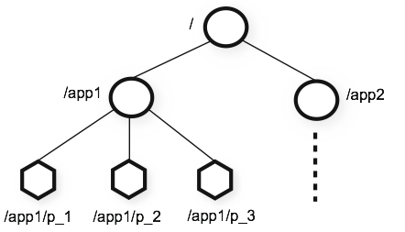
Data Model
The name space provided by ZooKeeper is much like that of a standard file system.
A name is a sequence of path elements separated by a slash (/).
Every node in ZooKeeper's name space is identified by a path.

Slide 8
Data Model
We use the term znode to make it clear that we are talking about ZooKeeper data nodes.
ZooKeeper was designed to store coordination data: status information, configuration, location information, etc., so the data stored at each node is usually small, in the byte to kilobyte range.
Each node in a ZooKeeper namespace can have data associated with it as well as children

Slide 9
Data Model
ZooKeeper also has the notion of ephemeral nodes. These znodes exists as long as the session that created the znode is active.
Znodes maintain a stat structure that includes version numbers for data changes, ACL changes, and timestamps, to allow cache validations and coordinated updates.
节点数据发生化，版本号会改变，修改版本号不符节点会报错

Slide 10
Data Model
Each node has an Access Control List (ACL) that restricts who can do what.

Slide 11
ZNode
Notes:
3-2

Slide 12
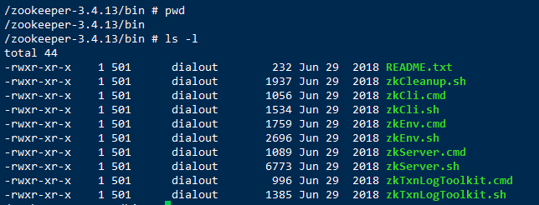
Zookeeper
/bin
Notes:
./zkCli.sh 打开客户端
help命令，输出帮助信息

Slide 13
Zookeeper
/conf
配置文件
/contrib
附加功能

Slide 14
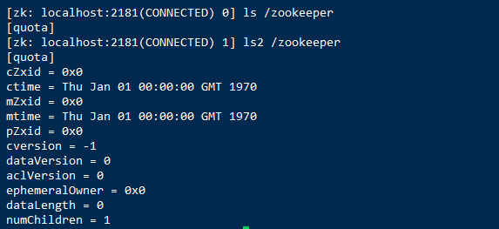
ls & ls2
ls
ls2 = ls + stat
Notes:
cZxid: Create Znode Transaction ID
ctime: Create Time
mZxid: Modify Znode Transaction ID
mtime: Modify Time
pzxid: childer node ID
cversion: create version
dataVersion: data version
aclVersion: ACL version
ephemeralOwner: ephemeral Owner
data length: data length of current node.
numChildren: number of children of current node.

