Slide 1
Zookeeper
PS

Slide 2
Agenda

Slide 3
Zookeeper

Slide 4
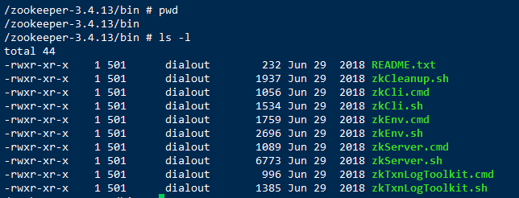
Zookeeper
Notes:
./zkCli.sh 打开客户端
help命令，输出帮助信息

Slide 5
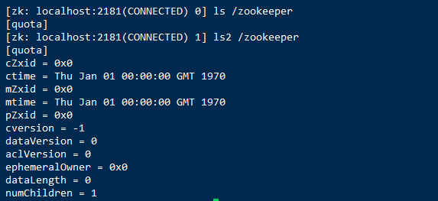
ls & ls2
ls
ls2 = ls + stat
Notes:
cZxid: Create Znode Transaction ID
ctime: Create Time
mZxid: Modify Znode Transaction ID
mtime: Modify Time
pzxid: childer node ID
cversion: create version
dataVersion: data version
aclVersion: ACL version
ephemeralOwner: ephemeral Owner
data length: data length of current node.
numChildren: number of children of current node.

