Slide 1
Asynchronization
PS

Slide 2
Asynchronization
Java Asynchronization
Spring Asynchronization

Slide 3
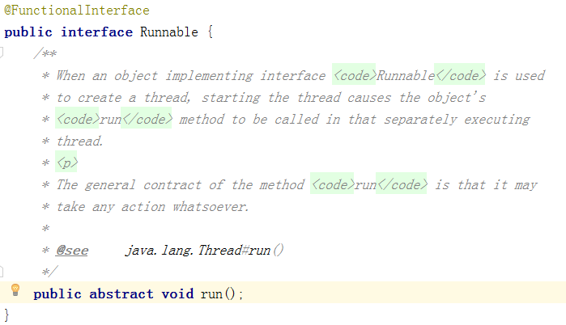
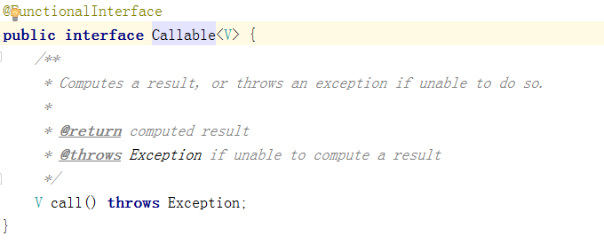
Runnable and Callable
Notes:
https://blog.csdn.net/lovezhaohaimig/article/details/80344299

Slide 4
Runnable and Callable
两者都是接口，Runnable定义了run(), Callable定义了call()
Call()可以抛出异常，而run()不能抛出异常
Callable有返回值
Callable在执行时可通过FutureTask获取任务执行的状态

Slide 5
Runnable and Callable
Callable的call方法实际执行在Runnbale中的run方法
Runnable实例对象需要Thread包装启动
Callable先通过FutureTask（本质还是Runnable）包装，再丢给Thread包装执行

Slide 6
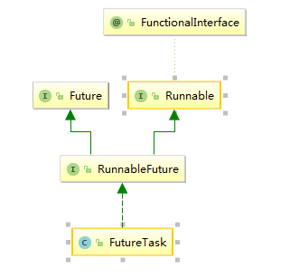
FutureTask
FutureTask是Future接口的唯一一个实现类

Slide 7
CompletableFuture

Slide 8
Notes:
https://docs.spring.io/spring/docs/5.1.5.RELEASE/spring-framework-reference/integration.html#scheduling

Slide 9
深入理解Spring的异步机制
https://www.cnblogs.com/niechen/p/9232914.html

