Slide 1
Spring Security
Authorization

Slide 2
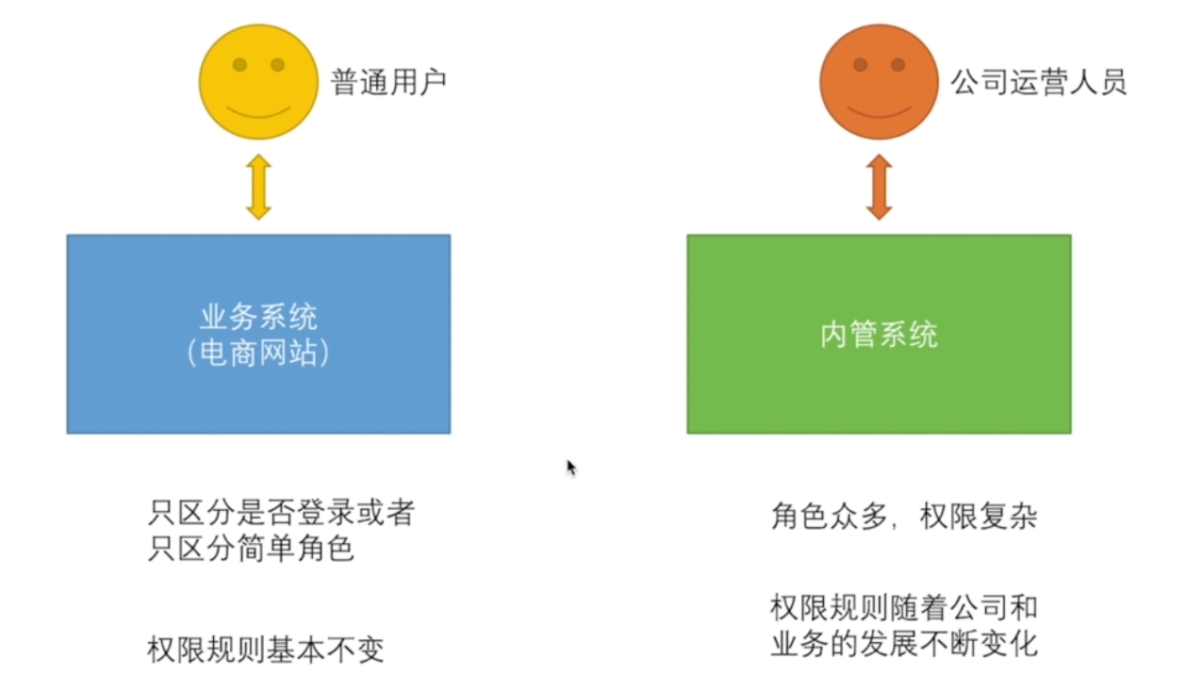
授权场景

Slide 3
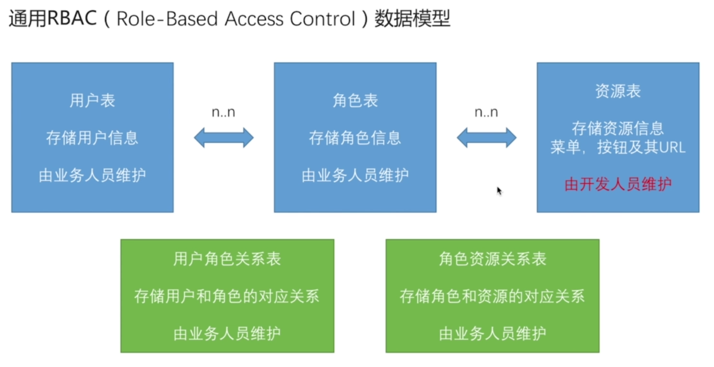
RBAC

Slide 4
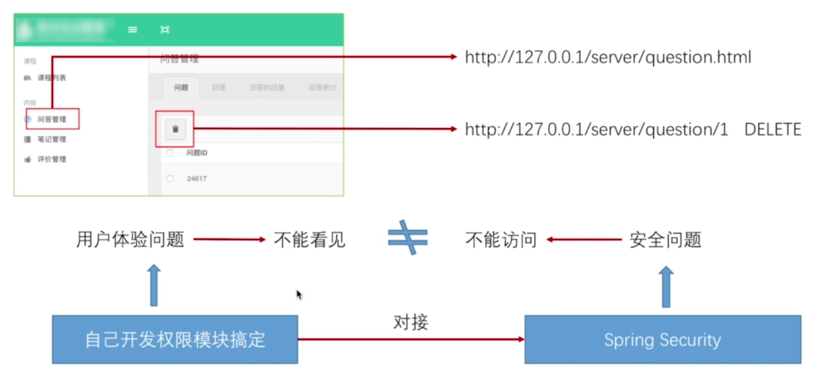
RBAC<---> Spring Security

