Slide 1
Microservices
PS

Slide 2
What is Microservices
In short, the microservice architectural style is an approach to developing a single application as a suite of small services, each running in its own process and communicating with lightweight mechanisms, often an HTTP resource API. These services are built around business capabilities and independently deployable by fully automated deployment machinery. There is a bare minimum of centralized management of these services, which may be written in different programming languages and use different data storage technologies.
Notes:
https://en.wikipedia.org/wiki/Microservices
Microservices – Definition, Principles and Benefits
https://howtodoinjava.com/microservices/microservices-definition-principles-benefits/
https://martinfowler.com/articles/microservices.html
martinfowler

Slide 3
Notes:
https://microservices.io/patterns/index.html
https://microservices.io/patterns/microservices.html
https://microservices.io/patterns/data/database-per-service.html
https://microservices.io/patterns/data/shared-database.html
https://microservices.io/patterns/data/saga.html
https://microservices.io/patterns/data/cqrs.html
https://microservices.io/patterns/data/event-sourcing.html
https://microservices.io/patterns/data/application-events.html
https://microservices.io/patterns/data/api-composition.html

Slide 4
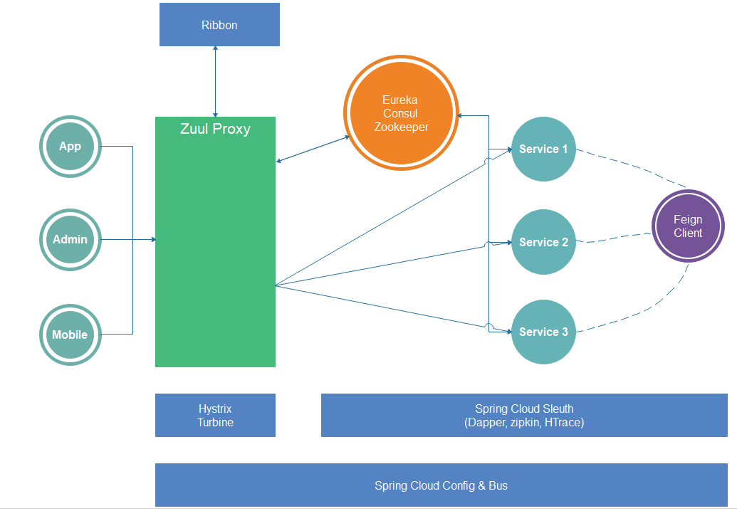
Spring Cloud

