Slide 1
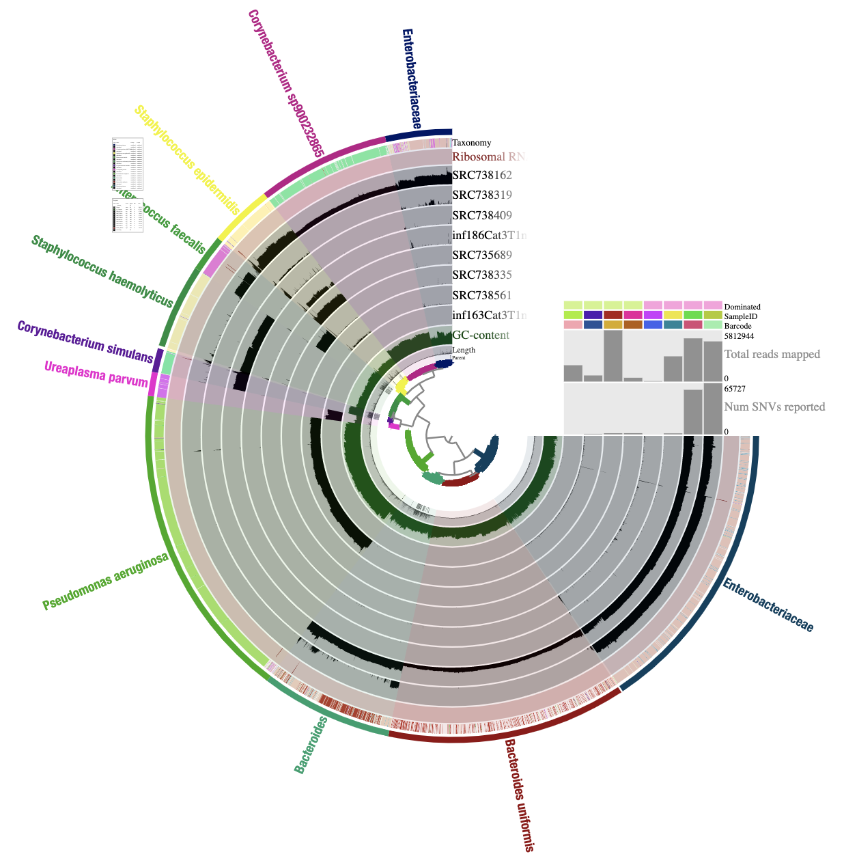
barcode | SampleID | Dominated
inf163Cat3T1n1 | inf163Cat3T1n1 | Single
SRC.735689 | inf124Cat1T1n2 | Single
SRC.738335 | inf135Cat3T1n1 | Single
SRC.738561 | inf150Cat3T1n2 | Single
inf186Cat3T1n1 | inf186Cat3T1n1 | Multiple
SRC.738162 | inf139Cat3T1n4 | Multiple
SRC.738319 | inf133Cat3T1n2 | Multiple
SRC.738409 | inf158Cat3T1n1 | Multiple

