Slide 1
DAIL-SQL Text-to-SQL Empowered by Large Language Models: A Benchmark Evaluation
Authors: Dawei Gao, Haibin Wang, Yaliang Li, Xiuyu Sun, Yichen Qian, Bolin Ding, Jingren Zhou
Published Date: August 2023

Slide 2
Agenda

Slide 3
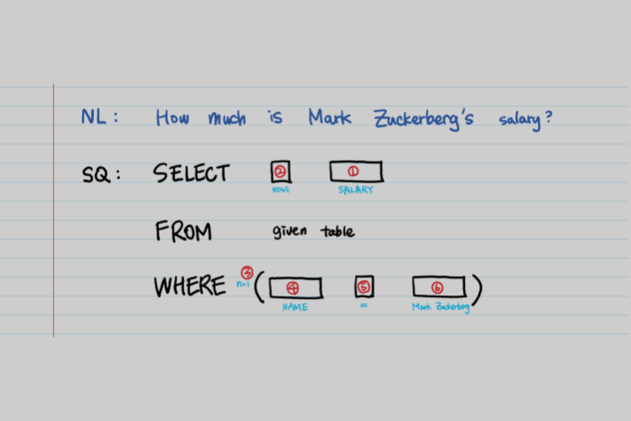
Text2SQL
자연어 질의를 입력하면 대상 데이터베이스에 가장 적합한 SQL을 생성
Steps
Understand intention
Schema selection
Aggregation
Multiple Query (join-on)

Slide 4
DAIL-SQL Approach
Prompt Engineering: Optimizing prompts for better performance.
In-Context Learning: Using examples in prompts to improve accuracy.
Supervised Fine-Tuning: Enhancing LLMs with additional task-specific training data.

Slide 5
Key Contributions
In-Context Learning: Leveraging LLMs to balance performance and token efficiency.
Execution Accuracy: Surpassed SOTA on Spider leaderboard.
Token Efficiency: Achieved high performance with fewer tokens.

Slide 6
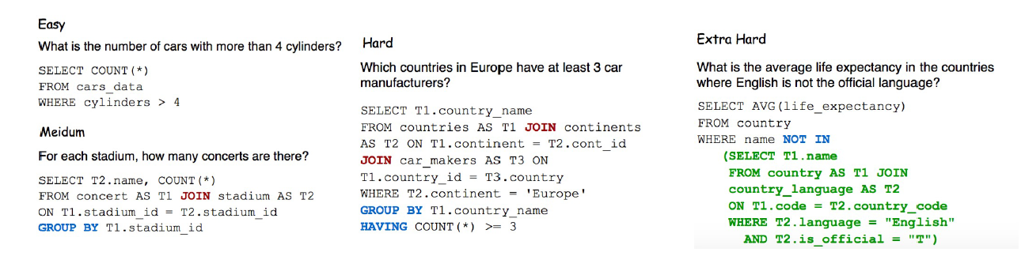
Spider
138개의 domain과 200개의 DB 존재
10,181개의 (question, SQL) 데이터 존재

Slide 7
Feature | Spider | BIRD
Description | Cross-domain, complex semantic parsing dataset | Large-scale, real-world database evaluation
Focus | Generalization across schemas and SQL queries | Practical, real-world scenarios and token efficiency
Dataset Size | 10,181 questions, 5,693 SQL queries, 200 databases | Large, complex databases (real-world)
Domains | Cross-domain | Practical applications, real-world datasets
Evaluation Metrics | Execution Accuracy (EX), Exact Match Accuracy (EM) | Execution Accuracy (EX), Token Efficiency
Challenges | Complex queries, cross-domain generalization | Handling large databases, efficient token usage
Usage | Comprehensive model performance evaluation | Evaluating practicality and efficiency

Slide 8
Summary
Spider Benchmark: Suitable for evaluating a model’s ability to generalize across different database schemas and complex SQL queries, emphasizing accuracy in execution and exact matches.
BIRD Benchmark: Focuses on practical, real-world applications, stressing the importance of token efficiency and handling large-scale databases. It provides a realistic measure of a model's performance in practical scenarios.

