Slide 1
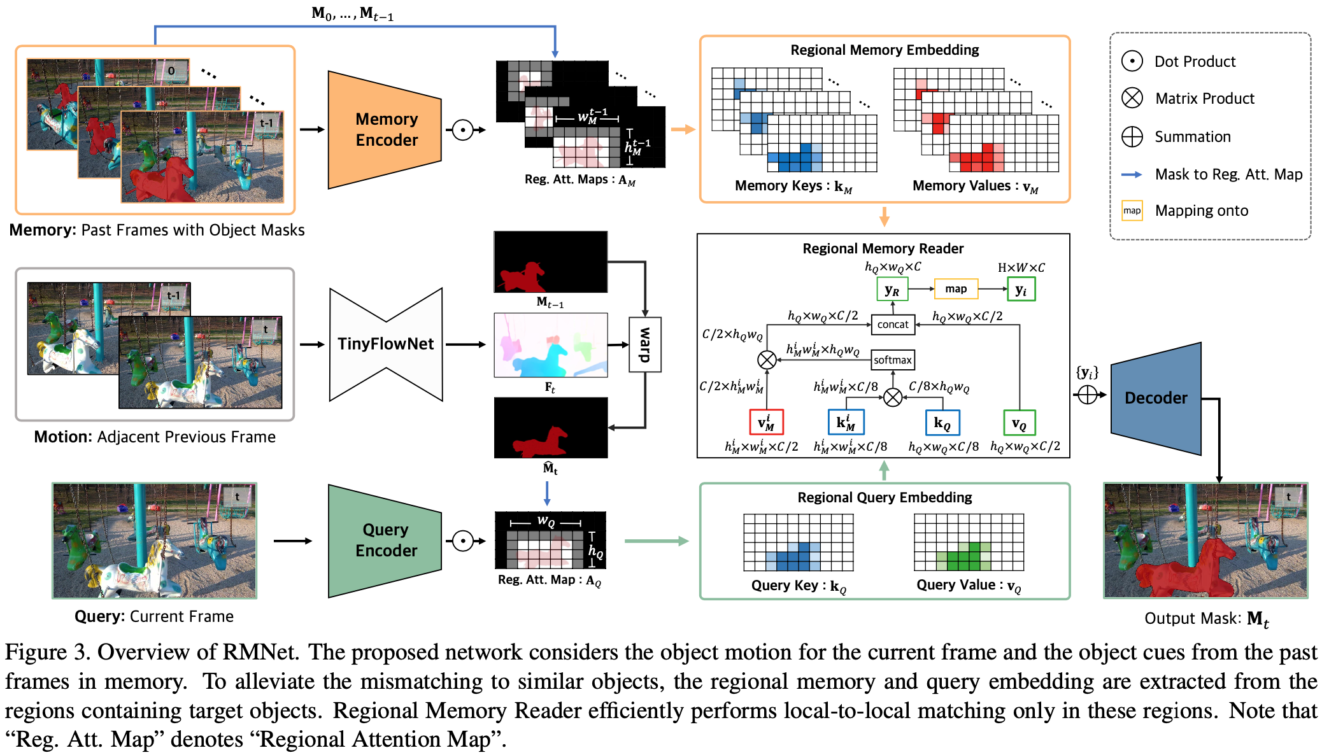
Efficient Regional Memory Network for VOS (CVPR 21)

