Slide 1
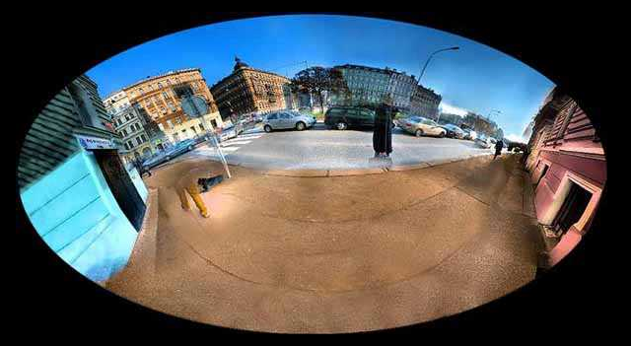
More Mosaic Madness
© Jeffrey Martin (jeffrey-martin.com)
15-463: Computational Photography
Alexei Efros, CMU, Fall 2011
with a lot of slides stolen from
Steve Seitz and Rick Szeliski

Slide 2
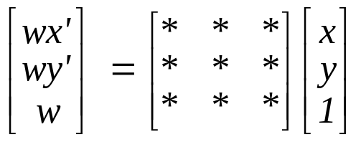
Homography
A: Projective – mapping between any two PPs with the same center of projection
  rectangle should map to arbitrary quadrilateral
  parallel lines aren’t
  but must preserve straight lines
  same as: project, rotate, reproject
called Homography
PP2
p’
H
p
PP1
To apply a homography H
  Compute p’ = Hp (regular matrix multiply)
  Convert p’ from homogeneous to image coordinates

Slide 3
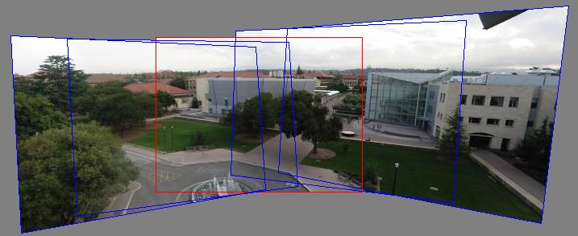
Rotational Mosaics
Can we say something more about rotational mosaics?
i.e. can we further constrain our H?

Slide 4
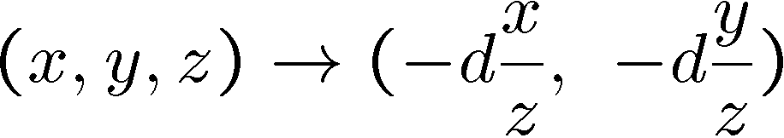
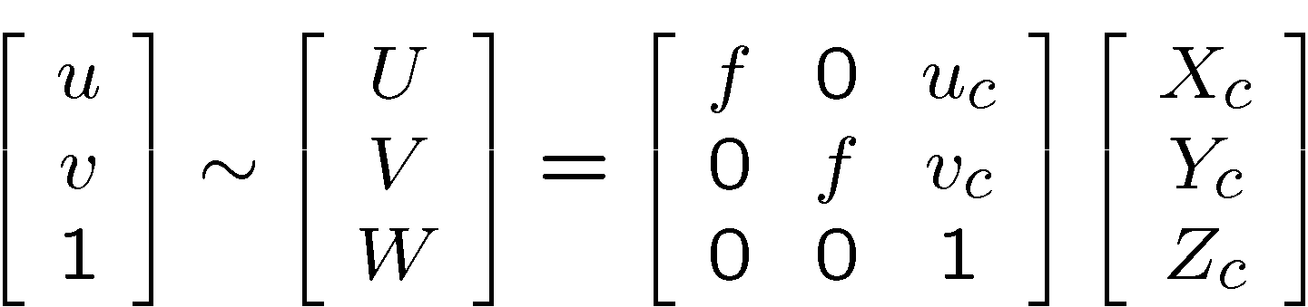
3D → 2D Perspective Projection
(X_{c},Y_{c},Z_{c})
f
u_{c}
u
K

Slide 5
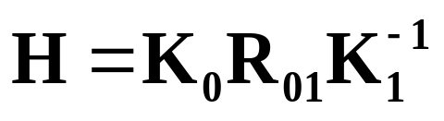
3D Rotation Model
Projection equations
Project from image to 3D ray
(x₀,y₀,z₀) = (u₀-u_{c},v₀-v_{c},f)
Rotate the ray by camera motion
(x₁,y₁,z₁) = R₀₁ (x₀,y₀,z₀)
Project back into new (source) image
(u₁,v₁) = (fx₁/z₁+u_{c},fy₁/z₁+v_{c})
Therefore:
Our homography has only 3,4 or 5 DOF, depending if focal length is known, same, or different.
  This makes image registration much better behaved
(x,y,z)
(u,v,f)
R
(x,y,z)
f
(u,v,f)

Slide 6
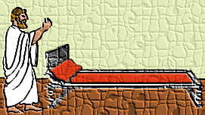
Pairwise alignment
Procrustes Algorithm [Golub & VanLoan]
Given two sets of matching points, compute R
p_{i}’ = R p_{i} with 3D rays
p_{i} = N(x_{i},y_{i},z_{i}) = N(u_{i}-u_{c},v_{i}-v_{c},f)
A = Σ_{i} p_{i} p_{i}’^{T} = Σ_{i} p_{i} p_{i}^{T} R^{T} = U S V^{T} = (U S U^{T}) R^{T}
V^{T} = U^{T} R^{T}
R = V U^{T}

Slide 7
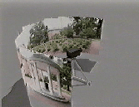
Rotation about vertical axis
What if our camera rotates on a tripod?
What’s the structure of H?

Slide 8
Do we have to project onto a plane?
mosaic PP

Slide 9
Full Panoramas
What if you want a 360° field of view?
mosaic Projection Cylinder

Slide 10


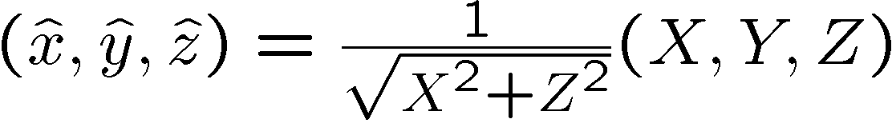





Cylindrical projection
  Map 3D point (X,Y,Z) onto cylinder
Y
Z
X
  Convert to cylindrical coordinates
unit cylinder
  Convert to cylindrical image coordinates
unwrapped cylinder
cylindrical image

Slide 11


Cylindrical Projection
Y
X

Slide 12
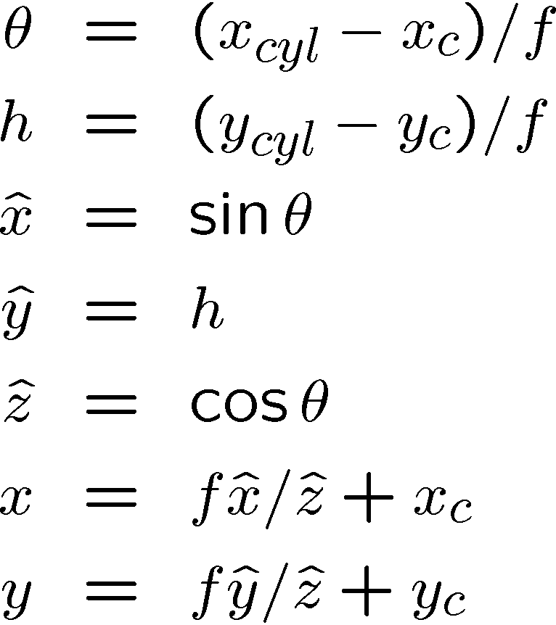
Inverse Cylindrical projection
(X,Y,Z)
(sinθ,h,cosθ)
Y
Z
X

Slide 13
Cylindrical panoramas
Steps
  Reproject each image onto a cylinder
  Blend
  Output the resulting mosaic

Slide 14
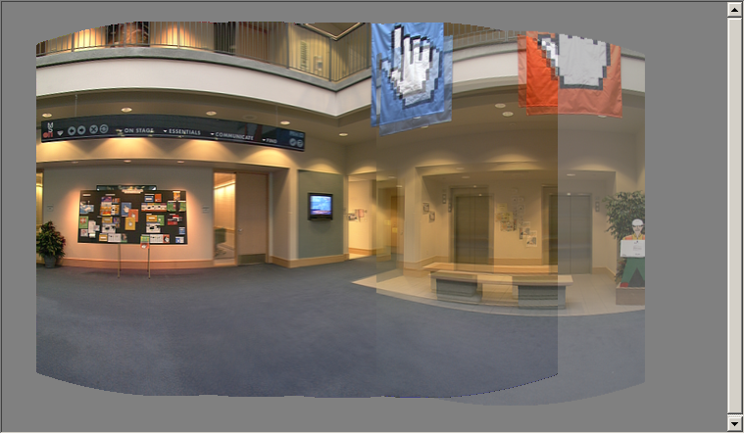
Cylindrical image stitching
What if you don’t know the camera rotation?
  Solve for the camera rotations
    Note that a rotation of the camera is a translation of the cylinder!

Slide 15
Assembling the panorama
Stitch pairs together, blend, then crop

Slide 16
Problem: Drift
Vertical Error accumulation
  small (vertical) errors accumulate over time
  apply correction so that sum = 0 (for 360° pan.)
Horizontal Error accumulation
  can reuse first/last image to find the right panorama radius

Slide 17
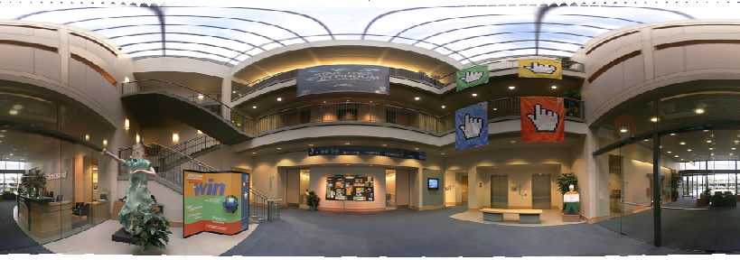
Full-view (360°) panoramas

Slide 18
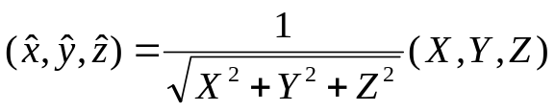
Spherical projection
  Map 3D point (X,Y,Z) onto sphere
Y
Z
X
  Convert to spherical coordinates
  Convert to spherical image coordinates
φ
unwrapped sphere
spherical image

Slide 19

Spherical Projection
Y
X

Slide 20
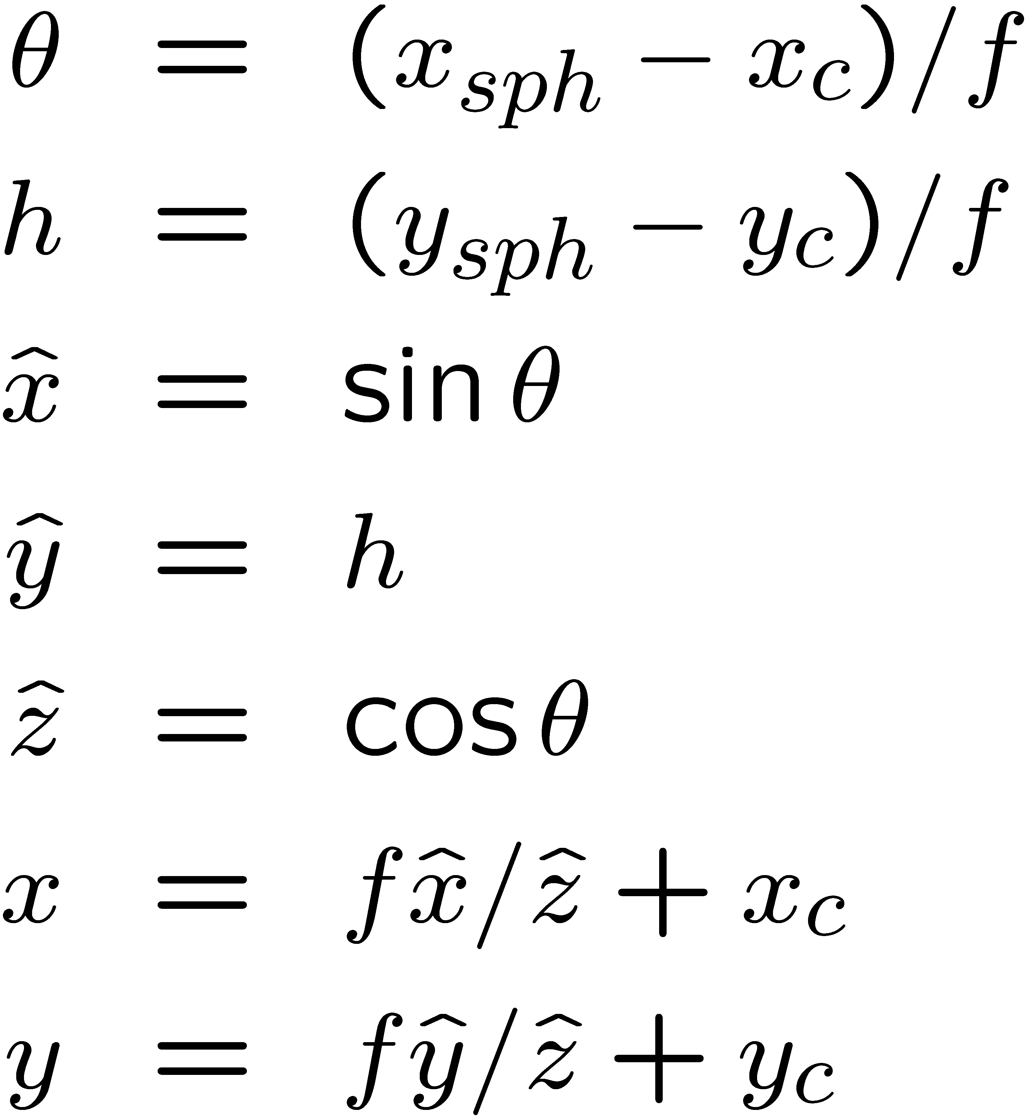
Inverse Spherical projection
φ
(x,y,z)
cos φ
(sinθcosφ,cosθcosφ,sinφ)
sin φ
Y
Z
cos θ cos φ
X

Slide 21
3D rotation
Rotate image before placing on unrolled sphere
φ
(x,y,z)
cos φ
(sinθcosφ,cosθcosφ,sinφ)
sin φ
Y
Z
X
cos θ cos φ
p = R p
_ _
_ _

Slide 22
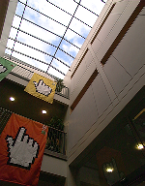
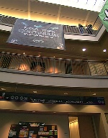
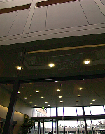


Full-view Panorama
+
+
+
+

Slide 23
Other projections are possible
You can stitch on the plane and then warp the resulting panorama
  What’s the limitation here?
Or, you can use these as stitching surfaces
  But there is a catch…

Slide 24



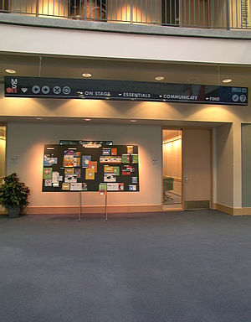
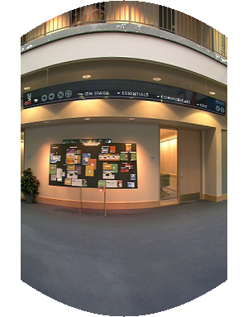
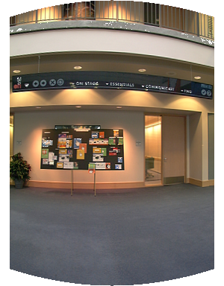
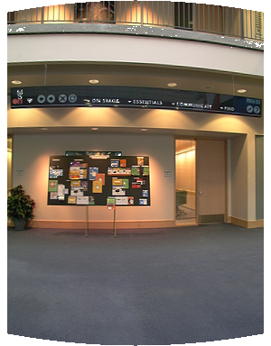
Cylindrical reprojection
top-down view
Focal length – the dirty secret…
Image 384x300
f = 180 (pixels)
f = 280
f = 380
Notes:
Therefore, it is desirable if the global motion model we need to recover is translation, which has only two parameters. It turns out that for a pure panning motion, if we convert two images to their cylindrical maps with known focal length, the relationship between them can be represented by a translation.
Here is an example of how cylindrical maps are constructed with differently with f’s. Note how straight lines are curved.
Similarly, we can map an image to its longitude/latitude spherical coordinates as well if f is given.

Slide 25
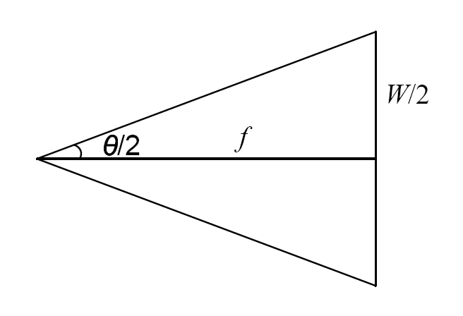
What’s your focal length, buddy?
Focal length is (highly!) camera dependant
  Can get a rough estimate by measuring FOV:
  Can use the EXIF data tag (might not give the right thing)
  Can use several images together and try to find f that would make them match
  Can use a known 3D object and its projection to solve for f
  Etc.
There are other camera parameters too:
  Optical center, non-square pixels, lens distortion, etc.

Slide 26
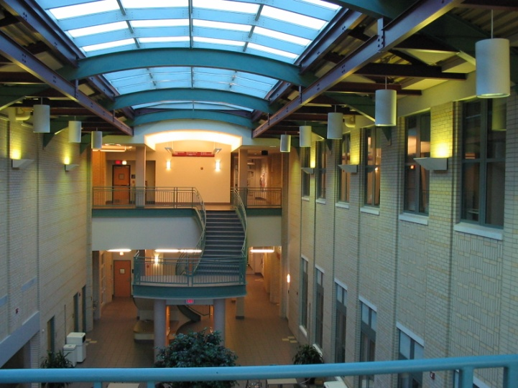
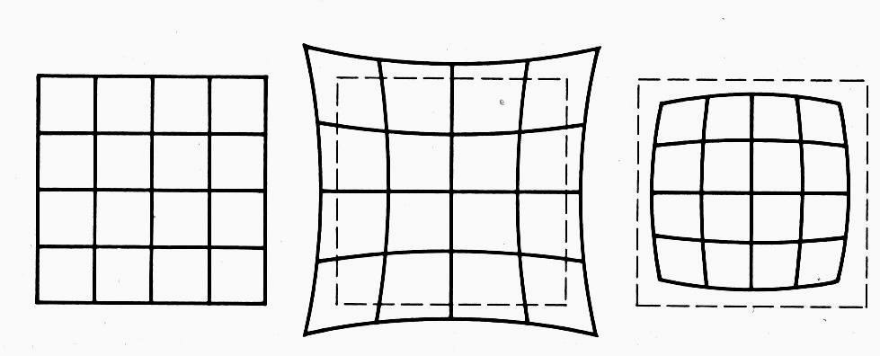
Distortion
No distortion
Pin cushion
Barrel
Radial distortion of the image
  Caused by imperfect lenses
  Deviations are most noticeable for rays that pass through the edge of the lens

Slide 27
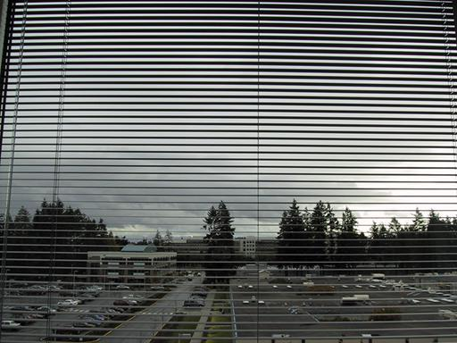
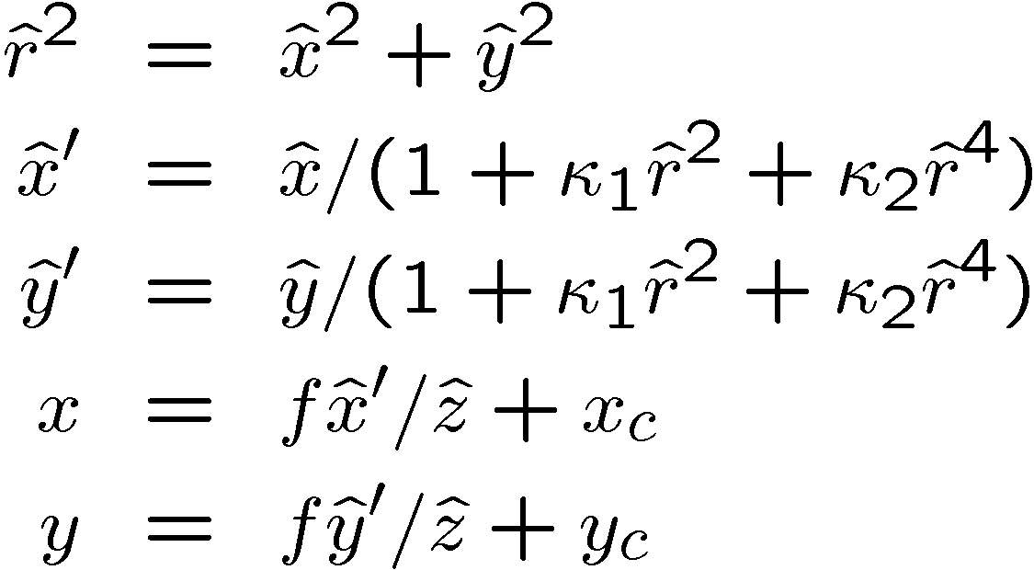
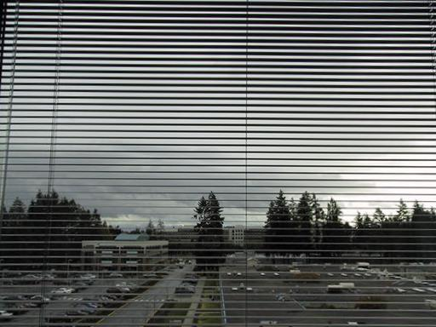
Radial distortion
Correct for “bending” in wide field of view lenses
Use this instead of normal projection

Slide 28

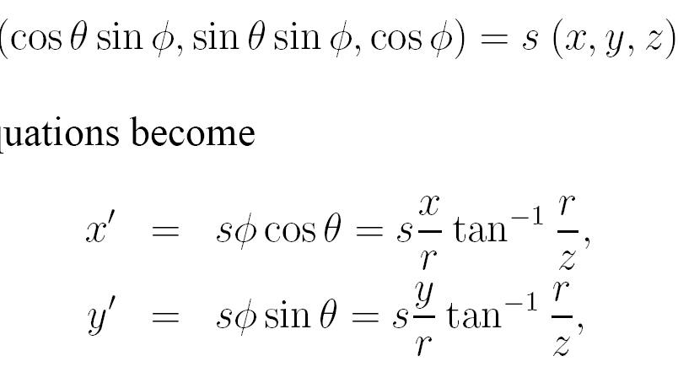
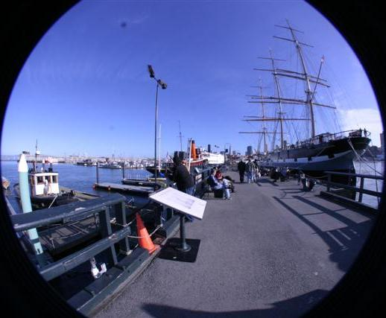
Polar Projection
Extreme “bending” in ultra-wide fields of view

Slide 29
Camera calibration
Determine camera parameters from known 3D points or calibration object(s)
internal or intrinsic parameters such as focal length, optical center, aspect ratio:
what kind of camera?
external or extrinsic (pose) parameters:
where is the camera in the world coordinates?
  World coordinates make sense for multiple cameras / multiple images
How can we do this?

Slide 30
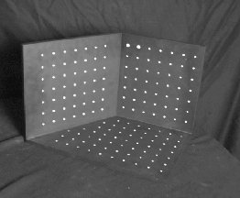
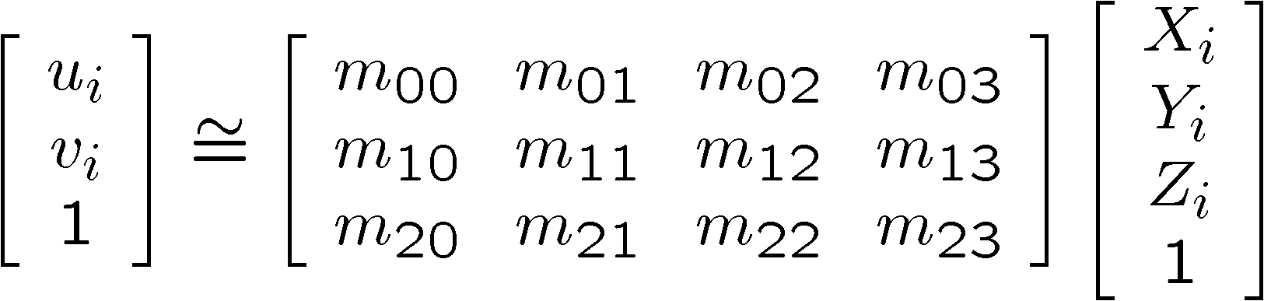
Approach 1: solve for projection matrix
Place a known object in the scene
  identify correspondence between image and scene
  compute mapping from scene to image

Slide 31
Direct linear calibration
Solve for Projection Matrix Π using least-squares (just like in homework)
Advantages:
  All specifics of the camera summarized in one matrix
  Can predict where any world point will map to in the image
Disadvantages:
  Doesn’t tell us about particular parameters
  Mixes up internal and external parameters
    pose specific: move the camera and everything breaks

Slide 32
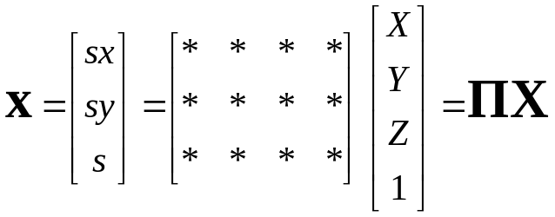




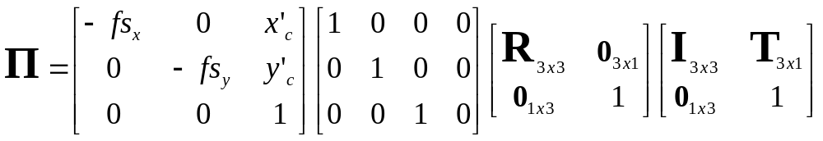
Approach 2: solve for parameters
A camera is described by several parameters
  Translation T of the optical center from the origin of world coords
  Rotation R of the image plane
  focal length f, principle point (x’_{c}, y’_{c}), pixel size (s_{x}, s_{y})
  blue parameters are called “extrinsics,” red are “intrinsics”
Projection equation
  The projection matrix models the cumulative effect of all parameters
  Useful to decompose into a series of operations
identity matrix
intrinsics
projection
rotation
translation
  Solve using non-linear optimization

Slide 33
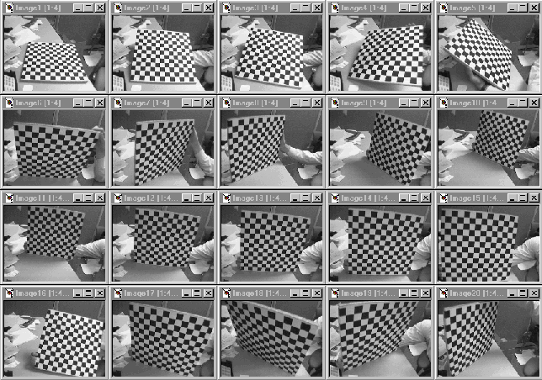
Multi-plane calibration
Images courtesy Jean-Yves Bouguet, Intel Corp.
Advantage
  Only requires a plane
  Don’t have to know positions/orientations
  Good code available online!
    Intel’s OpenCV library: http://www.intel.com/research/mrl/research/opencv/
    Matlab version by Jean-Yves Bouget: http://www.vision.caltech.edu/bouguetj/calib_doc/index.html
    Zhengyou Zhang’s web site: http://research.microsoft.com/~zhang/Calib/

