Slide 1
Tutorial for
Dummy Data Test

Slide 2
Contents
Porting Connectors
Uploading program
Sending Serial Message to STM32
Test
Command List

Slide 3
Porting Connectors

Slide 4
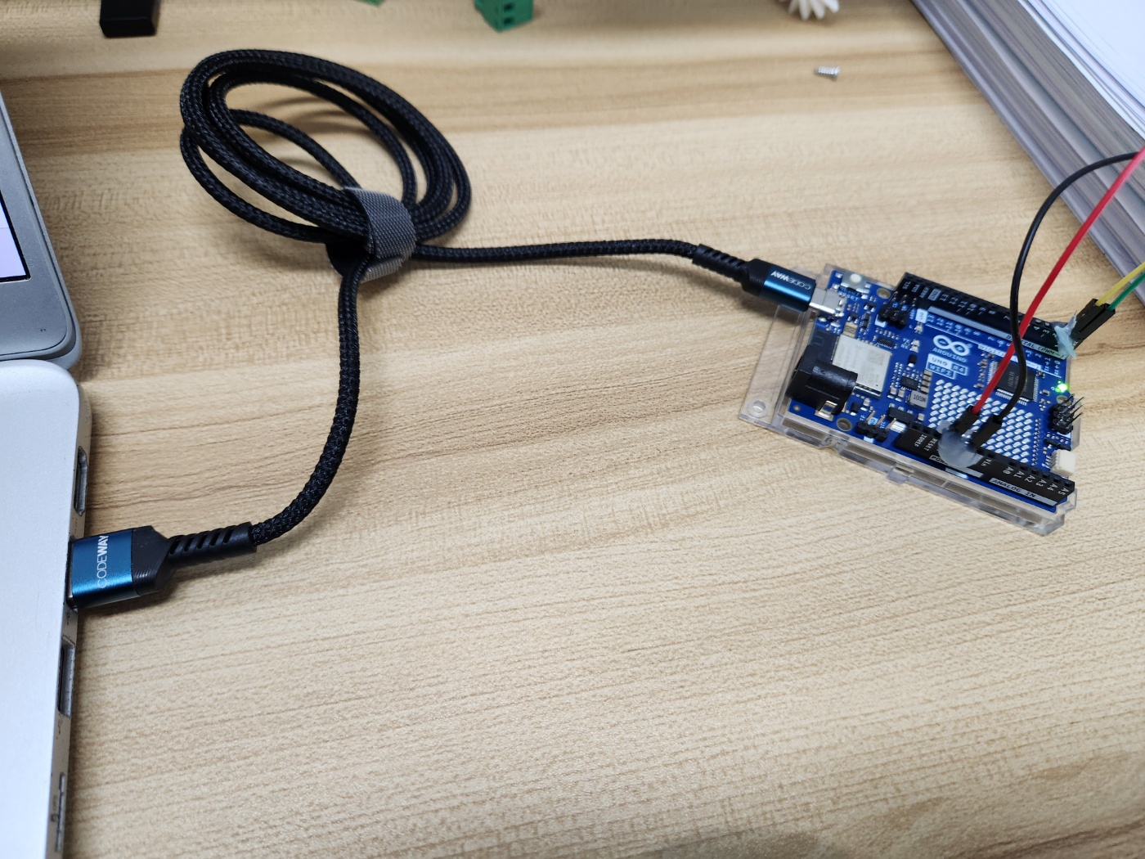
Porting Connectors
1. Arduino Uno R4

Slide 5
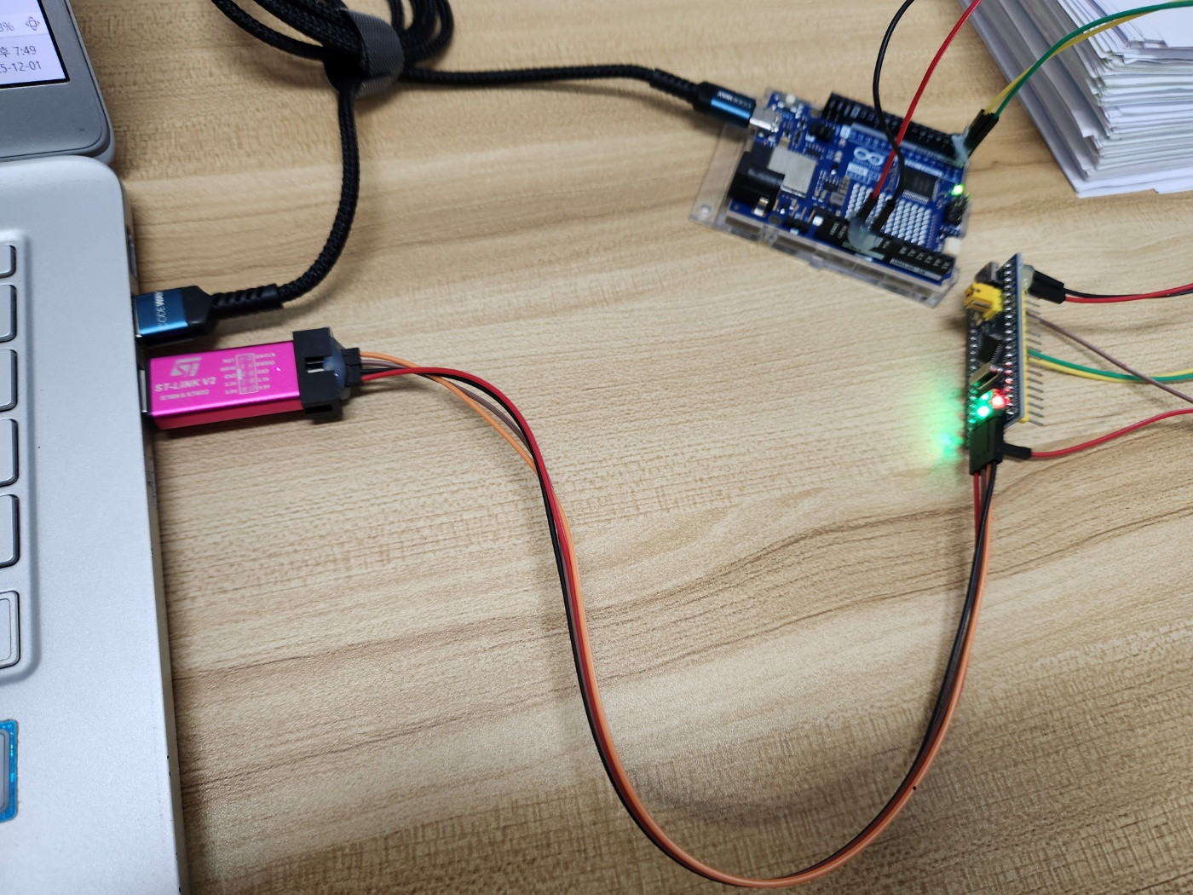
Porting Connectors
2. STM32F103C8T6

Slide 6
Uploading Program

Slide 7
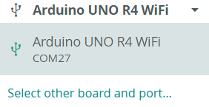
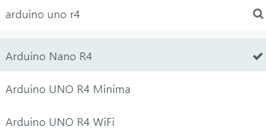
Uploading Program
Select other board and port ...
and
Search ‘Arduino uno r4’.
Choise the Arduino Nano R4
and
Install it.
Arduino Uno R4

Slide 8
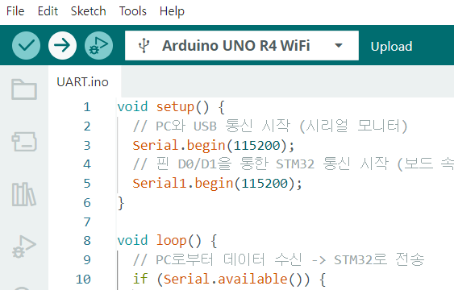
Uploading Program
Arduino Uno R4
Upload the program.
Just click the upload button.

Slide 9
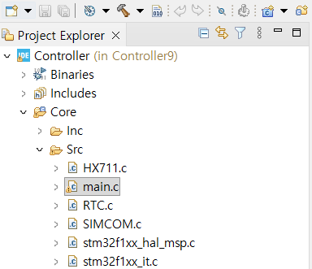
Uploading Program
STM32F103C8T6
Import the project and
Open the main.c

Slide 10
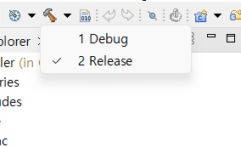
Uploading Program
STM32F103C8T6
Click the build icon’s
drop down menu
and
Click the Release button

Slide 11
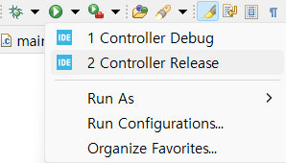
Uploading Program
STM32F103C8T6
Click the run icon’s
drop down menu
and
Click the Release button
If there’s not Release button,
just click the run icon only.

Slide 12
Sending Serial Message to
STM32

Slide 13
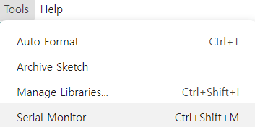
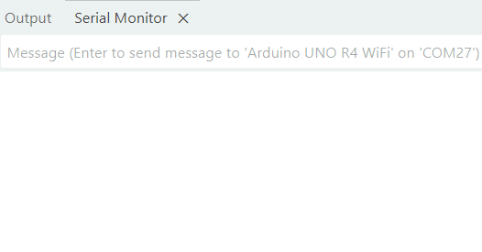
Sending Serial Message to STM32
Tools – Serial Monitor
It will be popped up Serial Monitor

Slide 14
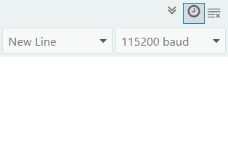
Sending Serial Message to STM32
Set up the serial communication speed(baud rate) to 115200 baud

Slide 15
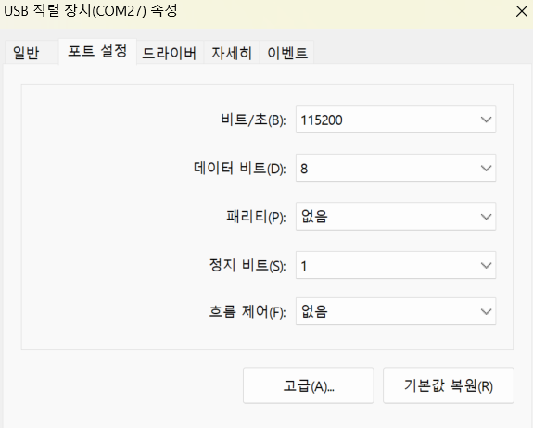
Sending Serial Message to STM32
장치관리자
– 포트(COM & LPT)
– USB 직렬 장치(COM27) 속성
- 비트/초(B) 115200 세팅

Slide 16
Test

Slide 17
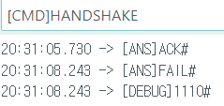
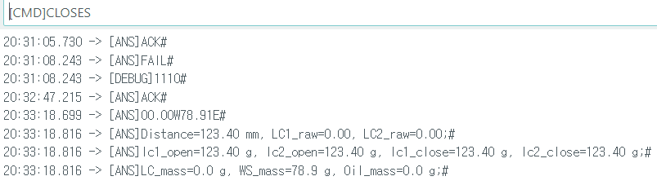
Test
Enter the command
Check response and time log.

Slide 18
Command List

Slide 19
Command List
Command List
Commands | Response Format
[CMD]HANDSHAKE | 20:38:10.811 -> [ANS]ACK# 20:38:13.303 -> [ANS]FAIL# 20:38:13.303 -> [DEBUG]1110#
[CMD]OPENS | 20:38:29.620 -> [ANS]ACK# 20:38:31.112 -> [ANS]OK#
[CMD]CLOSES | 20:38:48.659 -> [ANS]ACK# 20:39:20.157 -> [ANS]O0.00W78.91E# 20:39:20.157 -> [ANS]Distance=123.40 mm, LC1_raw=0.00, LC2_raw=0.00;# 20:39:20.157 -> [ANS]lc1_open=123.40 g, lc2_open=123.40 g, lc1_close=123.40 g, lc2_close=123.40 g;# 20:39:20.157 -> [ANS]LC_mass=0.0 g, WS_mass=78.9 g, Oil_mass=0.0 g;#
[CMD]OPENV | 20:45:34.891 -> [ANS]ACK# 20:45:34.891 -> [ANS]OPEN_VALVE#
[CMD]CLOSEV | 20:45:48.952 -> [ANS]ACK# 20:45:48.952 -> [ANS]CLOSE_VALVE#
[VALID]1234(random number)ENDSTR | 20:48:20.753 -> [ANS]ACK# 20:48:20.753 -> [DEBUG]1234# 20:48:20.753 -> [ANS]OK#
[TEST]MEASURE | 20:48:57.622 -> [ANS]ACK# 20:49:02.416 -> [ANS]Ultra=123.40 cm# 20:49:02.962 -> [ANS]Distance=123.40 mm, LC1_raw=-111.06, LC2_raw=-110.95;# 20:49:02.962 -> [ANS]lc1_test=12.34 g, lc2_test=12.45 g, lc1_open=123.40 g, lc2_open=123.40 g;# 20:49:02.962 -> [ANS]LC_mass=0.0 g, WS_mass=78.9 g, Oil_mass=0.0 g;# 20:49:02.962 -> [DEBUG]WS_height=56.8 mm#

