Slide 1
Hycube Visual Web Interface
Yesma Hinane ZAMOUM

Slide 2
Table of content
General presentation
How does websites works
Means and tools (technologies)
What are frameworks and why do we use them?
Demo

Slide 3
General presentation

Slide 4
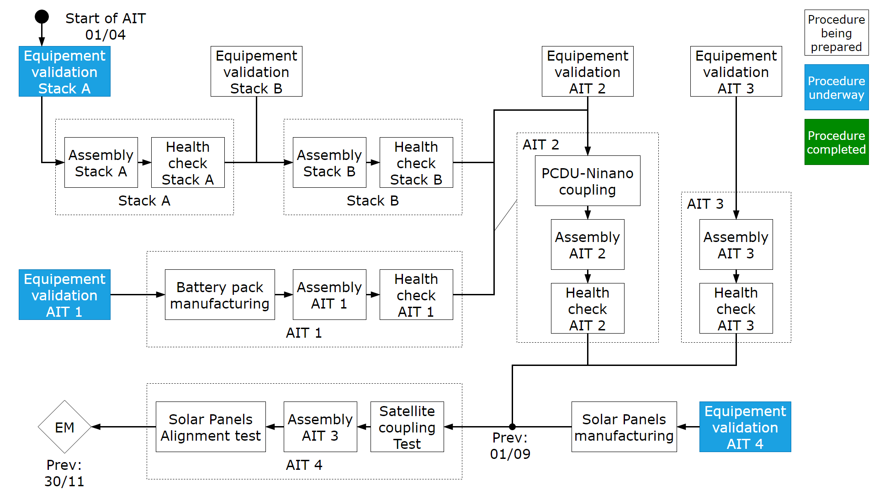
General presentation

Slide 5
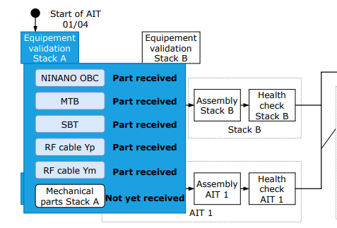
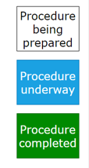
General presentation

Slide 6
How does websites work ?

Slide 7
How does websites work?
Web browser
Web Server
Code files (HTML, CSS, JS)
Front-end / back-end

Slide 8
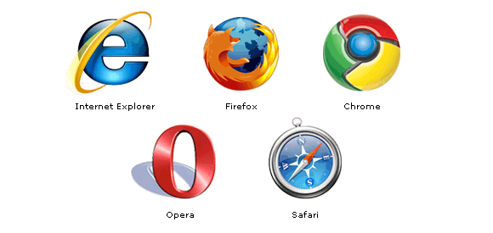
What is a browser ?

Slide 9
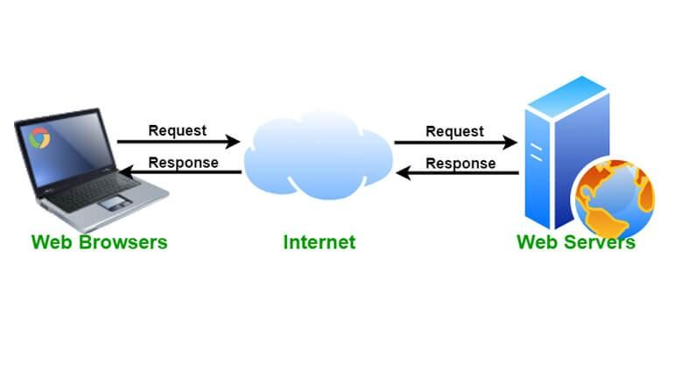
Web server

Slide 10
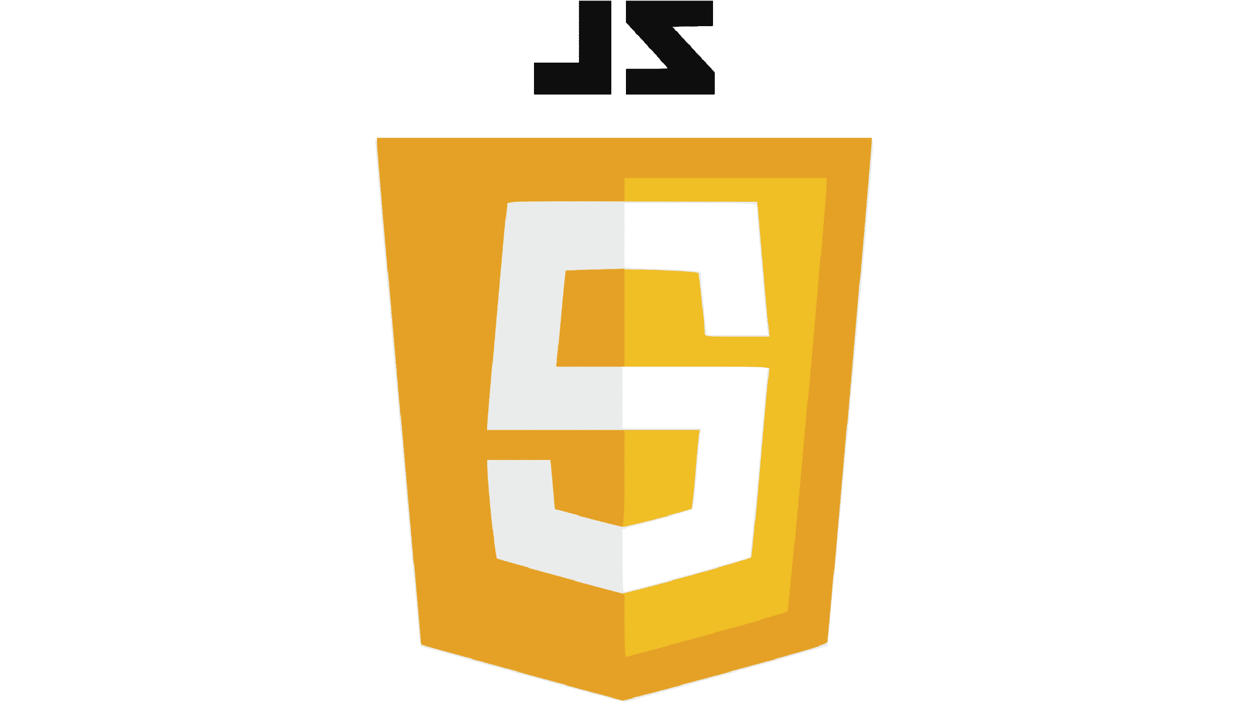
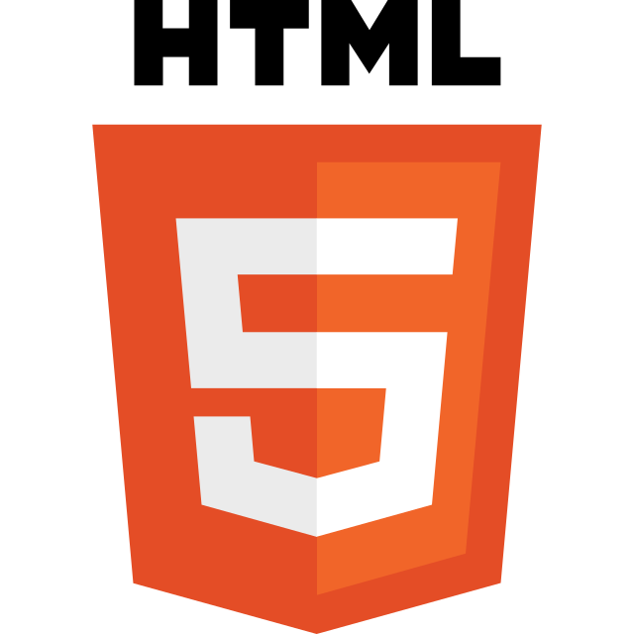
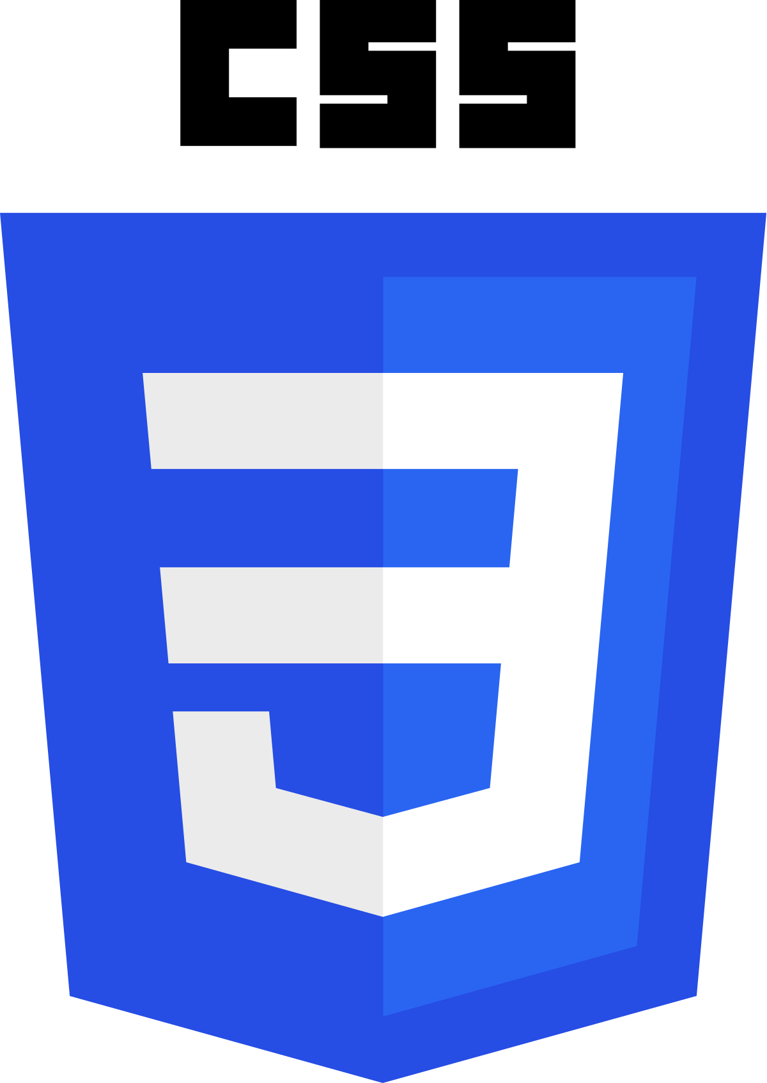
Code files
Hypertext Markup Language
JavaScript
Cascading Style Sheets

Slide 11
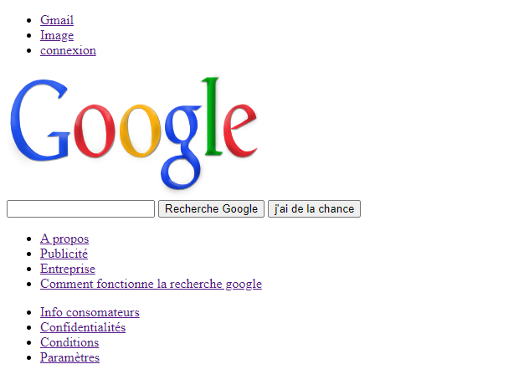
Example 1: Google page with HTML

Slide 12
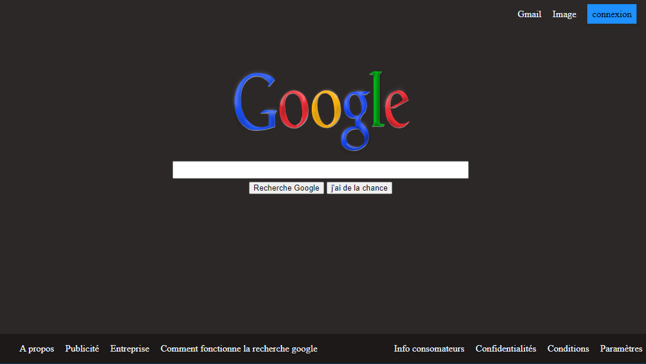
Example 1: Google page with HTML + CSS

Slide 13
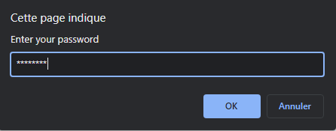
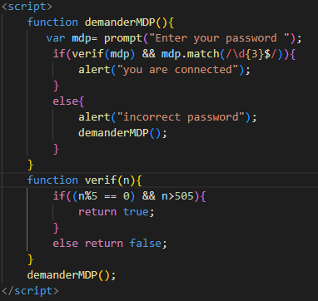
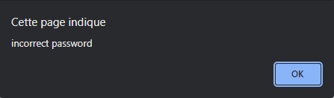
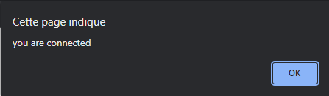
Example 2: password verification with javaScript

Slide 14
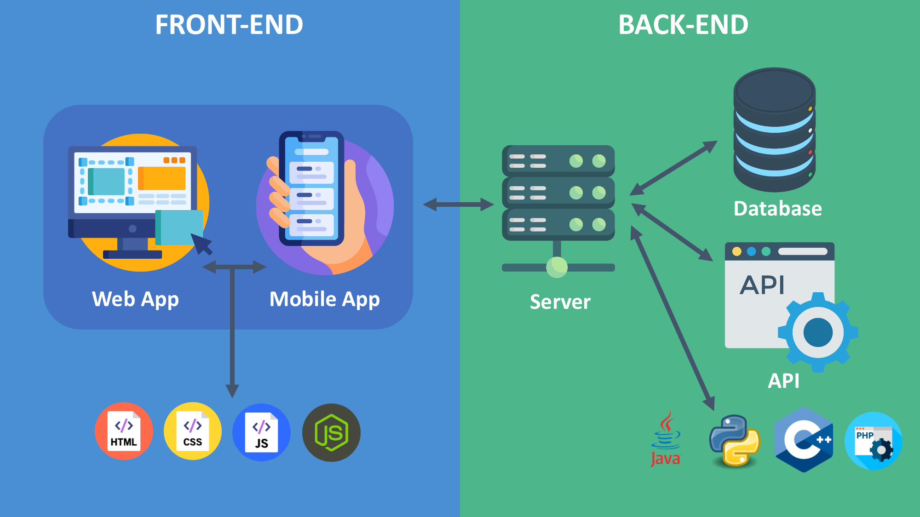
Front-end / back-end

Slide 15
Means and tools

Slide 16
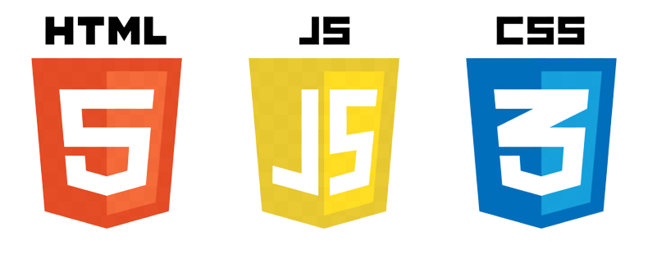

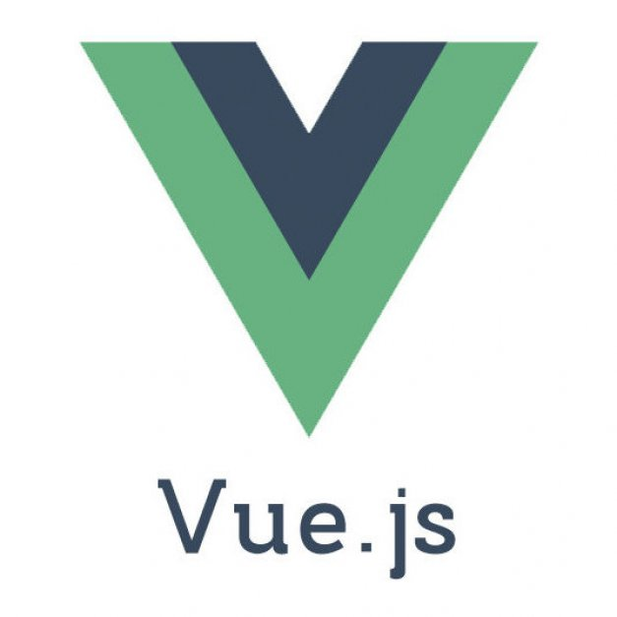

Means and tools

Slide 17
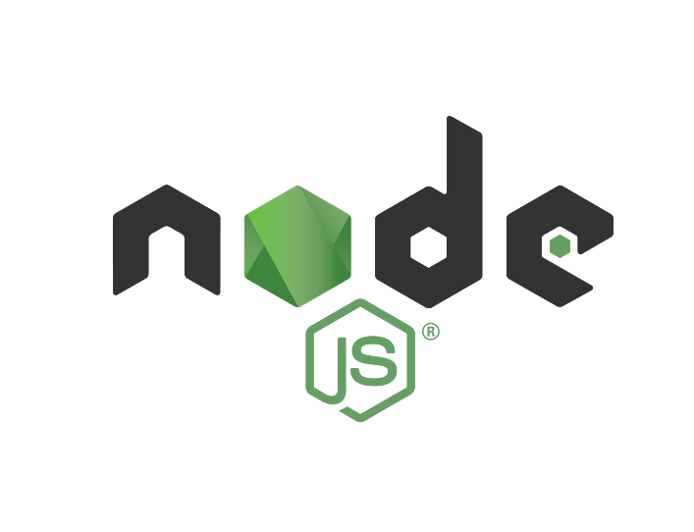

Node js and NPM package
Node.js is what allows javaScript to run on a server
Node Package Manager

Slide 18

JSON (JavaScript Object Notation)
key
value

Slide 19
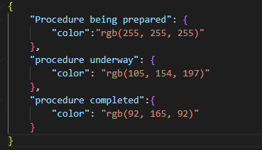
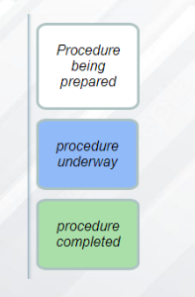
JSON (JavaScript Object Notation)
Json file
Object
Output

Slide 20
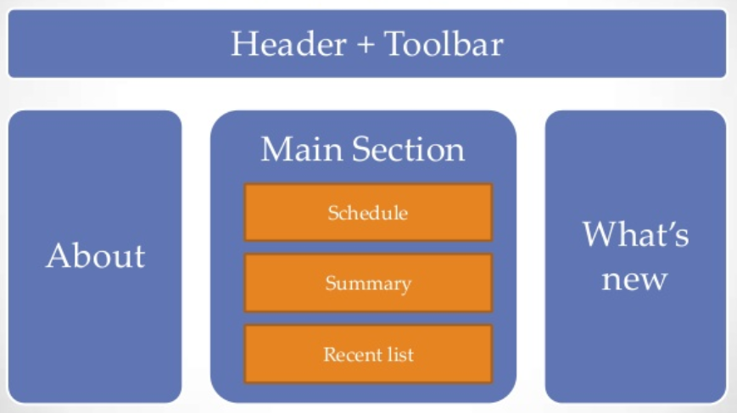
Vue.js framework
javaScript front-end framework
small and efficient
fast at run time
uses pure javaScript
Component

Slide 21
Why do we use frameworks ?

Slide 22
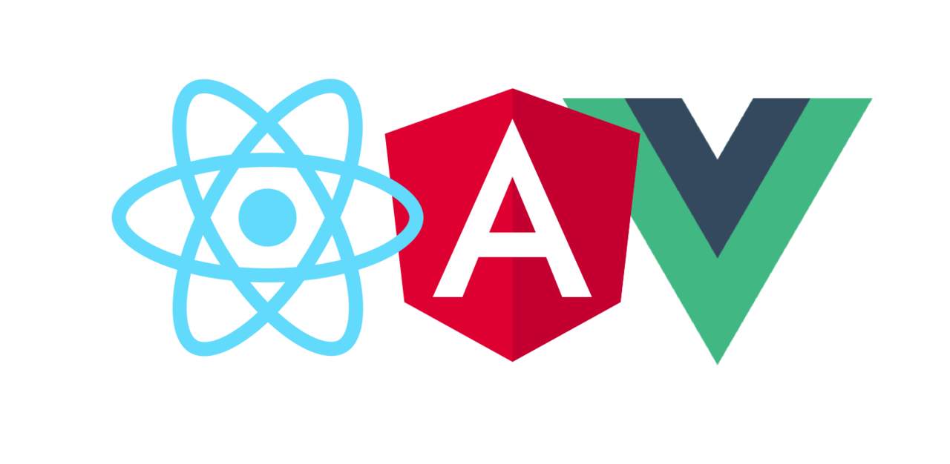
What are frameworks and why do we use them?
React
Vue.js
Angular

Slide 23
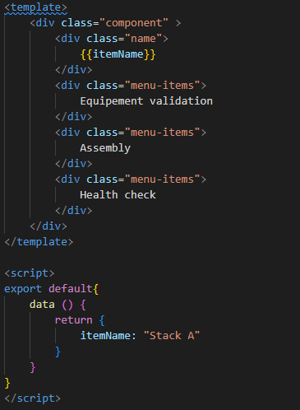
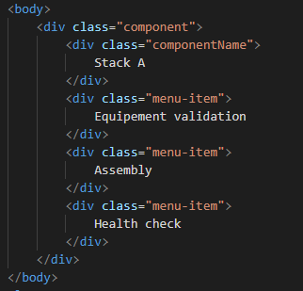
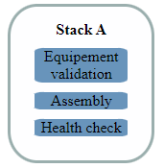
Example 1 : generating one component
Using a framework
Without a framework
Component

Slide 24
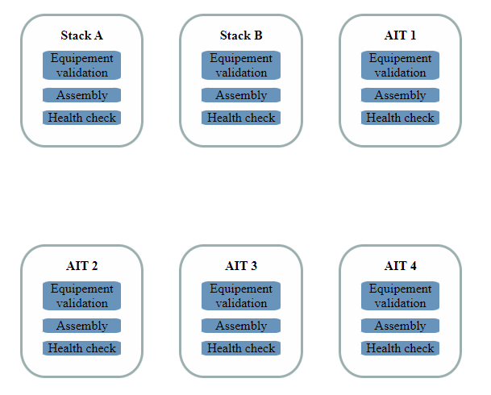
Example 2 : generating multiple components

Slide 25
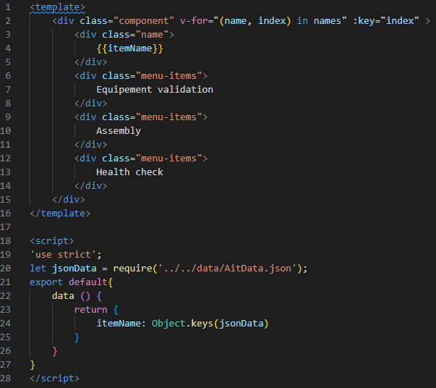
Using a framework

Slide 26
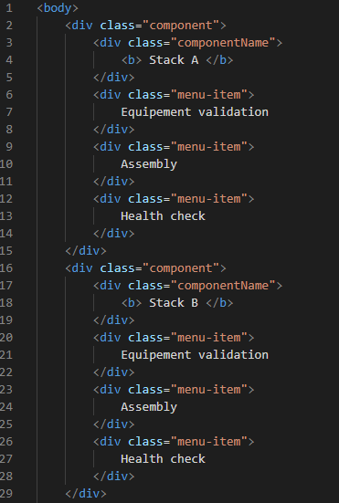
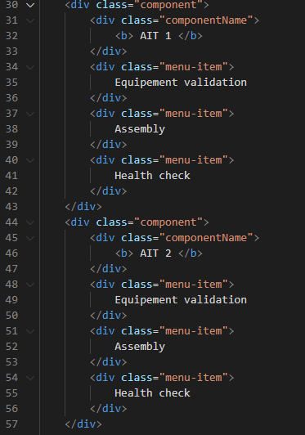
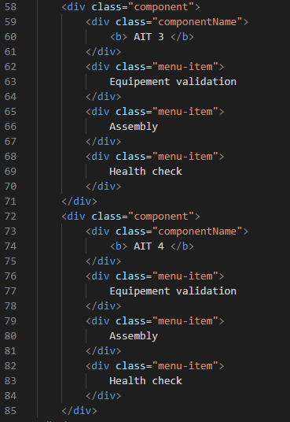
Without using a framework

Slide 27
Demo

Slide 28
Questions ?

