Slide 1
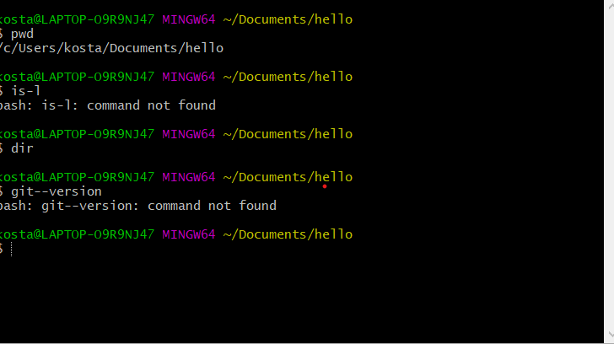

Slide 2
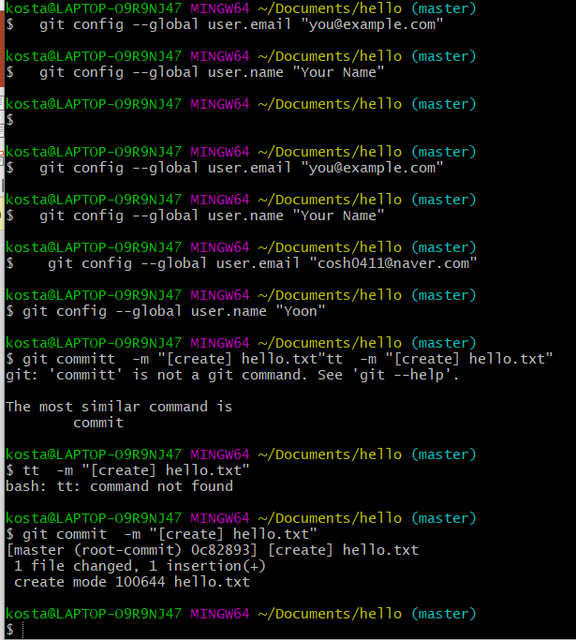
kosta@LAPTOP-O9R9NJ47 MINGW64 ~/Documents/hello (master)
$ git commit -m "[create] hello.txt"
[master (root-commit) 0c82893] [create] hello.txt
1 file changed, 1 insertion(+)
create mode 100644 hello.txt
kosta@LAPTOP-O9R9NJ47 MINGW64 ~/Documents/hello (master)
$ git config--list
git: 'config--list' is not a git command. See 'git --help'.
kosta@LAPTOP-O9R9NJ47 MINGW64 ~/Documents/hello (master)
$ git config --list
diff.astextplain.textconv=astextplain
filter.lfs.clean=git-lfs clean -- %f
filter.lfs.smudge=git-lfs smudge -- %f
filter.lfs.process=git-lfs filter-process
filter.lfs.required=true
http.sslbackend=openssl
http.sslcainfo=C:/Program Files/Git/mingw64/ssl/certs/ca-bundle.crt
core.autocrlf=true
core.fscache=true
core.symlinks=false
pull.rebase=false
credential.helper=manager
user.name=Yoon
user.email=cosh0411@naver.com
core.repositoryformatversion=0
core.filemode=false
core.bare=false
core.logallrefupdates=true
core.symlinks=false
core.ignorecase=true
kosta@LAPTOP-O9R9NJ47 MINGW64 ~/Documents/hello (master)
$ git config --global --list
user.name=Yoon
user.email=cosh0411@naver.com

Slide 3
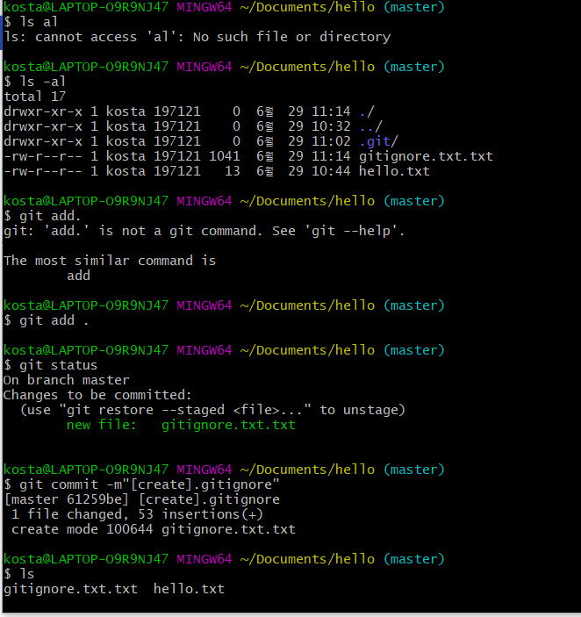
https://www.toptal.com/developers/gitignore

Slide 4
https://git-scm.com/download/gui/win
Git Extensions

Slide 5
Git hub

