Slide 1
SPRING MVC & REST API

Slide 2



Index
01
MVC
REST API
02
03
프로젝트 적용

Slide 3
MVC
Model – View - Controller

Slide 4
MVC
Model
M
data 처리하는 부분. DB연결, data 추출/저장/삭제/업데이트 등의 작업수행
C
Controller
사용자 명령을 받아서 처리하는 부분.
Model, view에 명령 보냄
V
View
화면에 표시되는 부분.
data를 표시하거나 사용자와의 상호작용을 위한 인터페이스 표시 영역.

Slide 5




getHandler()
Handler
Mapping
HandlerExcutionChain
Model
getHandlerAdapter()
Handler
Adapter
handle()
Controller
Dispatcher
Servlet
Service
Client
ModelAndView
Model + ViewName
Model
HttpRequest
DAO
HttpResponse
View
Resolver
resolverViewName()
View
render()
Model
View
HttpServletResponse
Notes:
Front Controller : 모든 요청을 최초로 받아들이는 역할.
SPRING의 경우 dispatcher servlet, Code igniter의 경우 index.php
Dispatcher Servlet : Front controller 역할. Clinet의 요청을 접수하여 URL을 기준으로 요청을 처리할 Controller를 찾고 그 컨트롤러에 처리를 위임하고 결과를 받아서 사용자에게 처리결과가 담긴 화면 제공
Handler Mapping : URL이나 파라미터정보, HTTP 명령 등을 참고로해서 어떤 컨트롤러에게 위임할지를 결정
Handler Adapter : 결정된 controller를 실행시킴
Controller : service에 작업을 위임하고 결과를 받아서 모델과 뷰 정보를 전달
Service, DAO : Model 계층에 속하며 비즈니스 로직 처리를 담당
View resolver : view이름을 받아서 view 객체 생성
View : view와 model의 rendering 작업 수행

Slide 6
getHandler()
Handler
Mapping
HandlerExcutionChain
Model
http://220.230.112.131/users/1
getHandlerAdapter()
Handler
Adapter
handle()
Controller
Dispatcher
Servlet
Service
Client
HttpRequest
ModelAndView
Model + ViewName
Model
DAO
HttpResponse
View
Resolver
resolverViewName()
View
render()
Model
View
HttpServletResponse
Notes:
Client의 요청이 dispatcher servlet으로 전달

Slide 7
[GET] /users/1
@GetMapping (“/users”)
@GetMapping(“/users/{id}”)
@PostMapping (“/users/{id}”)
getHandler()
Handler
Mapping
HandlerExcutionChain
Model
getHandlerAdapter()
Handler
Adapter
handle()
Controller
Dispatcher
Servlet
Service
Client
ModelAndView
Model + ViewName
Model
HttpRequest
DAO
HttpResponse
View
Resolver
resolverViewName()
View
render()
Model
View
HttpServletResponse
Notes:
Dispatcher servlet이 getHandler() 메소드를 실행하여 Handler Mapping 수행

Slide 8
getHandler()
Handler
Mapping
HandlerExcutionChain
Model
getHandlerAdapter()
Handler
Adapter
handle()
Controller
Dispatcher
Servlet
Service
Client
ModelAndView
Model + ViewName
Model
HttpRequest
DAO
HttpResponse
View
Resolver
resolverViewName()
View
render()
Model
View
HttpServletResponse
Notes:
요청에 해당하는 Handler를 찾았다면 Handler를 HandlerExecutionChain 객체에 담아 리턴 [handler object 반환]
*HandlerExcutionChain?

Slide 9
getHandler()
Handler
Mapping
HandlerExcutionChain
Model
getHandlerAdapter()
Handler
Adapter
handle()
Controller
Dispatcher
Servlet
Service
Client
ModelAndView
Model + ViewName
Model
HttpRequest
DAO
HttpResponse
View
Resolver
resolverViewName()
View
render()
Model
View
HttpServletResponse
Notes:
Dispatcher servlet이 getHandlerAdaptor() 메소드를 실행하여 Handler Adaptor 수행

Slide 10
getHandler()
Handler
Mapping
HandlerExcutionChain
Model
Handler
Adapter
handle()
Controller
getHandlerAdapter()
Service
Dispatcher
Servlet
Client
ModelAndView
Model + ViewName
Model
HttpRequest
DAO
HttpResponse
View
Resolver
resolverViewName()
View
render()
Model
View
HttpServletResponse

Slide 11
getHandler()
Handler
Mapping
HandlerExcutionChain
Model
getHandlerAdapter()
Handler
Adapter
handle()
Controller
Dispatcher
Servlet
Service
Client
ModelAndView
Model + ViewName
Model
HttpRequest
DAO
HttpResponse
View
Resolver
resolverViewName()
View
render()
Model
View
HttpServletResponse

Slide 12
getHandler()
Handler
Mapping
HandlerExcutionChain
Model
getHandlerAdapter()
Handler
Adapter
handle()
Controller
Dispatcher
Servlet
Service
Client
ModelAndView
Model + ViewName
Model
HttpRequest
DAO
HttpResponse
View
Resolver
resolverViewName()
View
render()
Model
View
HttpServletResponse

Slide 13
getHandler()
Handler
Mapping
HandlerExcutionChain
Model
getHandlerAdapter()
Handler
Adapter
handle()
Controller
Dispatcher
Servlet
Service
Client
ModelAndView
Model + ViewName
Model
HttpRequest
DAO
HttpResponse
View
Resolver
{ id : hong
name : 홍길동 }
resolverViewName()
View
render()
Model
View
HttpServletResponse

Slide 14
getHandler()
Handler
Mapping
HandlerExcutionChain
Model
getHandlerAdapter()
Handler
Adapter
handle()
Controller
Dispatcher
Servlet
Service
Client
ModelAndView
Model
HttpRequest
Model + ViewName
return “index”;
DAO
HttpResponse
View
Resolver
resolverViewName()
View
render()
Model
View
HttpServletResponse

Slide 15
getHandler()
Handler
Mapping
HandlerExcutionChain
Model
getHandlerAdapter()
Handler
Adapter
handle()
Controller
Dispatcher
Servlet
Service
Client
ModelAndView
Model + ViewName
Model
HttpRequest
DAO
HttpResponse
View
Resolver
resolverViewName()
View
render()
Model
View
HttpServletResponse

Slide 16
getHandler()
Handler
Mapping
HandlerExcutionChain
Model
getHandlerAdapter()
Handler
Adapter
handle()
Controller
Dispatcher
Servlet
Service
Client
ModelAndView
Model + ViewName
Model
HttpRequest
DAO
“index”
HttpResponse
resolverViewName()
View
Resolver
View
render()
Model
View
HttpServletResponse

Slide 17
getHandler()
Handler
Mapping
HandlerExcutionChain
Model
getHandlerAdapter()
Handler
Adapter
handle()
Controller
Dispatcher
Servlet
Service
Client
ModelAndView
Model + ViewName
Model
HttpRequest
DAO
HttpResponse
View
Resolver
resolverViewName()
View
/WEB-INF/views/index.jsp
render()
Model
View
HttpServletResponse

Slide 18
getHandler()
Handler
Mapping
HandlerExcutionChain
Model
getHandlerAdapter()
Handler
Adapter
handle()
Controller
Dispatcher
Servlet
Service
Client
ModelAndView
Model + ViewName
Model
HttpRequest
DAO
HttpResponse
View
Resolver
resolverViewName()
View
render()
View
HttpServletResponse
<div>이름 : ${user.name}</div>
<div>이름 : 홍길동</div>

Slide 19

getHandler()
Handler
Mapping
HandlerExcutionChain
Model
getHandlerAdapter()
Handler
Adapter
handle()
Controller
Dispatcher
Servlet
Service
Client
ModelAndView
Model + ViewName
Model
HttpRequest
DAO
HttpResponse
View
Resolver
resolverViewName()
View
render()
Model
View
HttpServletResponse

Slide 20
getHandler()
Handler
Mapping
HandlerExcutionChain
Model
getHandlerAdapter()
Handler
Adapter
handle()
Controller
Dispatcher
Servlet
Service
Client
ModelAndView
Model + ViewName
Model
HttpRequest
DAO
HttpResponse
resolverViewName()
View
Resolver
View
render()
Model
View
HttpServletResponse

Slide 21
{ REST API }
REpresentational State Transfer API

Slide 22
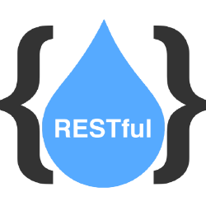






RESOURCE
VERB
Representations
자원
행위
표현
/sports/soccer/players/{playerid}
GET
/sports/soccer/players/{playerid}
GET

Slide 23
프로젝트 적용
네이버 예약서비스

Slide 24
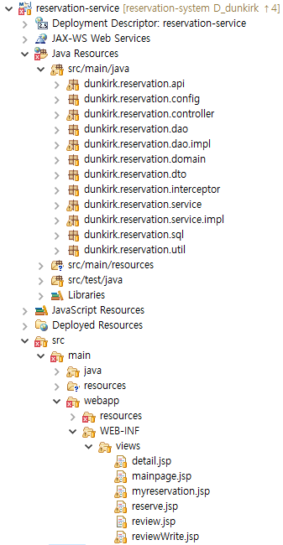
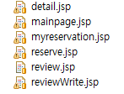




Project Architecture
Application Layering
User Interface Layer
Web Layer
Domain Layer
Service Layer
Data Access Layer

Slide 25

1. Session을 service에서 처리해도 될까?
2. DAO의 비슷한 기능을 하는 메서드들을 분리해야할까?
3. RESTful URI가 무엇일까?
4. 100% 적용할 수 있을까?

Slide 26
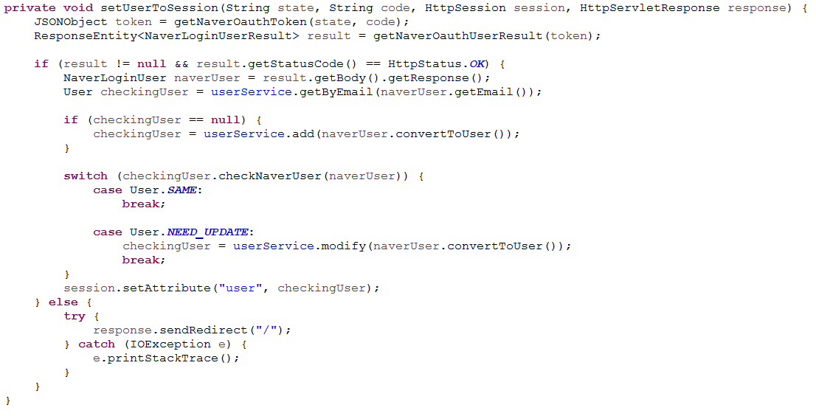
Q. Session을 service에서 처리해도 될까?
LoginService

Slide 27
Session 처리

Slide 28
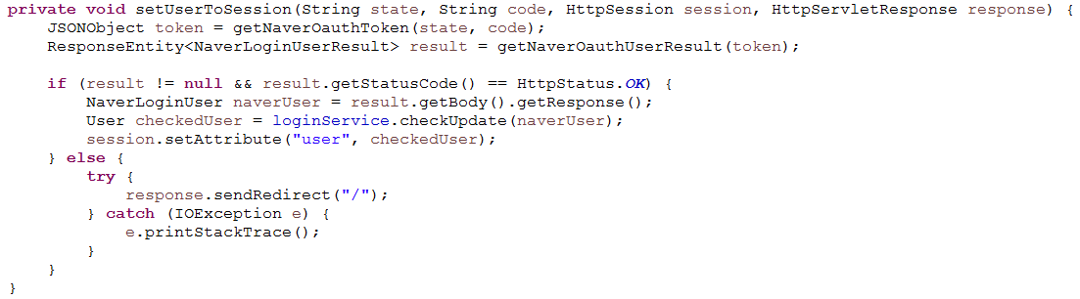
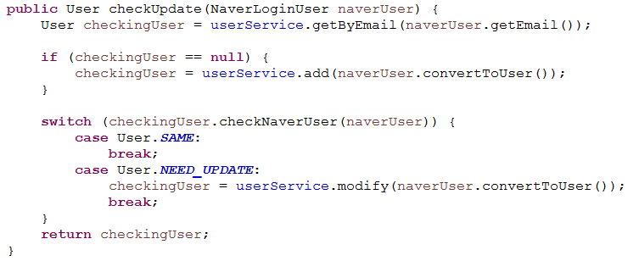
LoginController
LoginService

Slide 29
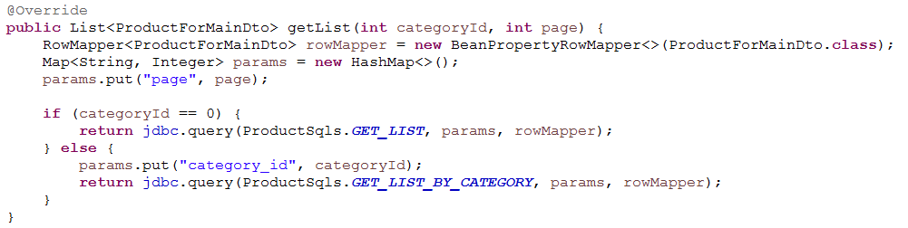
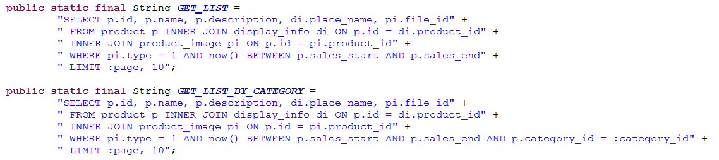
Q. DAO의 비슷한 기능을 하는 메서드들을 분리해야할까?
ProductDao

Slide 30
DAO 단일책임

Slide 31
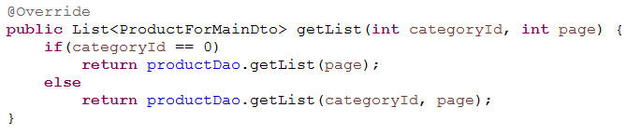
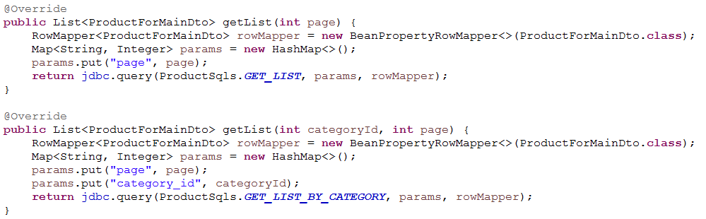
Q. DAO의 비슷한 기능을 하는 메서드들을 분리해야할까?
ProductService
ProductDao

Slide 32
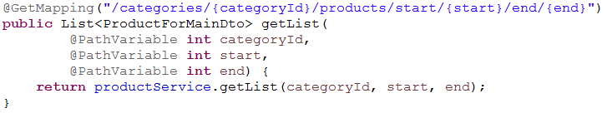
Q. RESTful URI가 무엇일까?
ProductRestController
ProductRestController

Slide 33
Q. 100% 적용할 수 있을까?
ProductRestController
ProductRestController
ProductRestController

Slide 34
Q&A

Slide 35
감사합니다

Slide 36

정태준
원선재
임찬희

Slide 37
Model 1 & Model2
Model1
: 뷰와 로직을 모두 JSP 페이지 하나에서 처리하는 구조
Controller
View
Client
Model
장점 : 단순한 페이지 작성으로 쉽게 구현이 가능하다.
단점 : 재사용성이 떨어지고 유지보수가 어렵다.

Slide 38
Model 1 & Model2
Model2
: 모든 웹 브라우저 요청을 하나의 서블릿(Front controller)이 받아서 처리하는 구조 클라이언트의 요청처리와 응답처리, 비즈니스 로직 처리하는 부분을 모듈화시킨 구조이다.
Controller
Model
Client
View
장점 : 처리작업의 분리로 인해 유지보수와 확장이 용이하다.
단점 : 구조 설계를 위한 시간이 많이 소요되므로 개발 기간이 증가한다.

