Slide 1
Understanding IMU data acquired from May-30-2018 Oshawa Indoor Experiment
Jungwon Kang
Aug 3 2018 *Updated on Aug 20 2018

Slide 2

Objectives
We acquired $a^{𝒢}=(a_{x}^{𝒢}, a_{y}^{𝒢},a_{z}^{𝒢})$ [acc wrt ground frame $𝒢]$
Our localization algorithms need $a^{ℬ}=(a_{x}^{ℬ}, a_{y}^{ℬ},a_{z}^{ℬ})$ [acc wrt body frame $ℬ$]
Therefore, we need to convert the given $a^{𝒢}$ into $a^{ℬ}$.
The flight controller seems to provide us with absolute orientation $R_{𝒢}^{ℬ}$ of the drone, we expect we could get $a^{ℬ}$ by $R_{𝒢}^{ℬ}∙a^{𝒢}$.
X

Slide 3

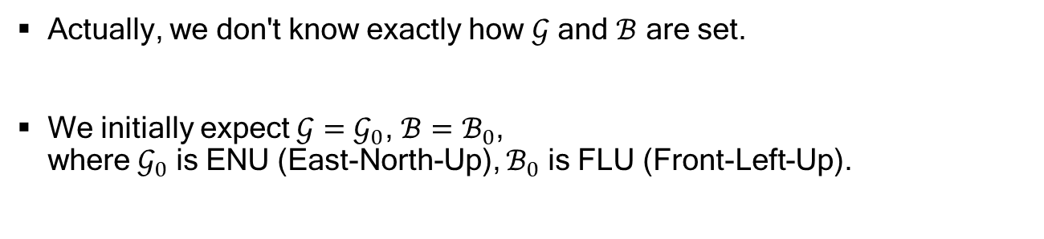






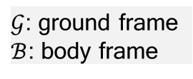
Our Expected $𝒢$ and $ℬ$
$𝒢$: ground frame
$ℬ$: body frame
Actually, we don't know exactly how $𝒢$ and $ℬ$ are set.
We initially expect $𝒢=𝒢_{0}$, $ℬ=ℬ_{0}$, where $𝒢_{0}$ is ENU (East-North-Up), $ℬ_{0}$ is FLU (Front-Left-Up).
North
y
$$a^{𝒢_{0}}=(a_{x}^{𝒢_{0}}, a_{y}^{𝒢_{0}},a_{z}^{𝒢_{0}})$$
$$𝒢_{0}$$
●
East
z
x
$$R_{𝒢}^{ℬ}$$
(from flight controller)
y
x
●
z
$$ℬ_{0}$$
$$a^{ℬ_{0}}=(a_{x}^{ℬ_{0}}, a_{y}^{ℬ_{0}},a_{z}^{ℬ_{0}})$$
Our initially expected $𝒢_{0}$ and $ℬ_{0}$
(Top view)

Slide 4




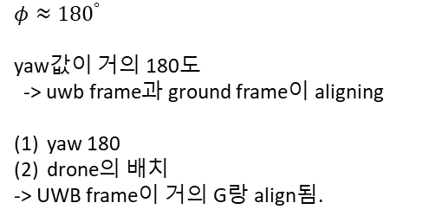

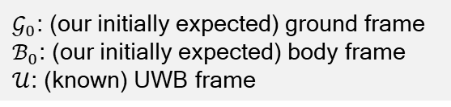
Our Expected $𝒢$ and $ℬ$
In the experiment, we aligned the drone with the UWB frame $𝒰$ → $𝒰$ and $ℬ_{0}$ are aligned. (although aligned axes are different)
Furthermore, we saw $φ≈{180}^{°}$, which means the drone is located in the opposite direction with the ground frame $𝒢_{0}$. → $ℬ_{0}$ and $𝒢_{0}$are aligned.
In conclusion, $𝒰$ and $𝒢_{0}$ are aligned (although there is little misalignment in real).
North
y
x
$$ℬ_{0}$$
$$φ≈{180}^{°}$$
$$𝒢_{0}$$
●
East
z
x
●
y
x
$𝒢_{0}$: (our initially expected) ground frame
$ℬ_{0}$: (our initially expected) body frame
$𝒰$: (known) UWB frame
●
y
$$𝒰$$
$$φ≈{180}^{°}$$
yaw값이 거의 180도
-> uwb frame과 ground frame이 aligning
yaw 180
drone의 배치
-> UWB frame이 거의 G랑 align됨.

Slide 5

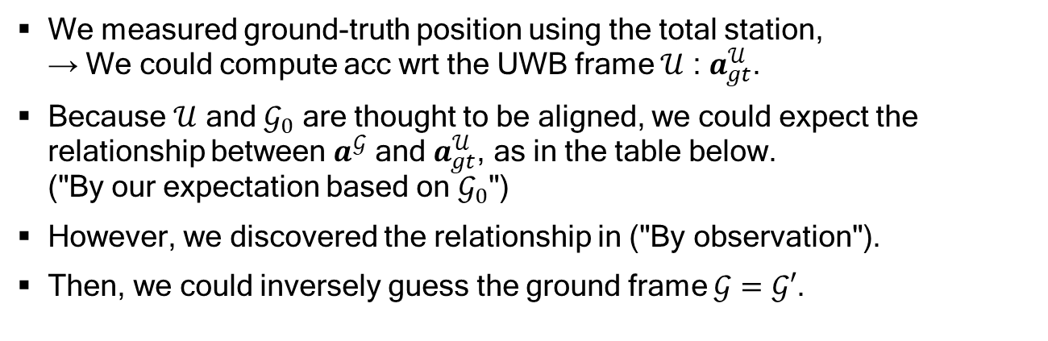

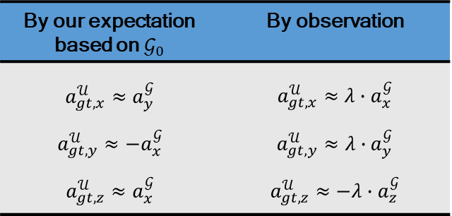





Inferring $𝒢$ from $a_{gt}^{𝒰}$and $a^{𝒢}$
We measured ground-truth position using the total station, → We could compute acc wrt the UWB frame $𝒰$ : $a_{gt}^{𝒰}$.
Because $𝒰$ and $𝒢_{0}$ are thought to be aligned, we could expect the relationship between $a^{𝒢}$ and $a_{gt}^{𝒰}$, as in the table below. ("By our expectation based on $𝒢_{0}$")
However, we discovered the relationship in ("By observation").
Then, we could inversely guess the ground frame $𝒢=𝒢′$.
North
By our expectation based on $𝒢_{0}$ | By observation
$$a_{gt,x}^{𝒰}≈a_{y}^{𝒢}$$ $$a_{gt,y}^{𝒰}≈−a_{x}^{𝒢}$$ $$a_{gt, z}^{𝒰}≈a_{x}^{𝒢}$$ | $$a_{gt,x}^{𝒰}≈λ∙a_{x}^{𝒢}$$ $$a_{gt,y}^{𝒰}≈λ∙a_{y}^{𝒢}$$ $$a_{gt,z}^{𝒰}≈−λ∙a_{z}^{𝒢}$$
y
x
$$ℬ_{0}$$
$$φ≈{180}^{°}$$
$$𝒢_{0}$$
●
East
z
x
●
y
x
Inferred by observation
x
$$λ=0.1 (≈\frac{1}{9.8})$$
Note that $a_{gt}^{𝒰}$ is computed from ground-truth position using total station, and $a^{𝒢}$ is given from flight controller.
●
y
X
$$𝒢′$$
y
$$𝒰$$
z
See appendix to see "By observation".

Slide 6
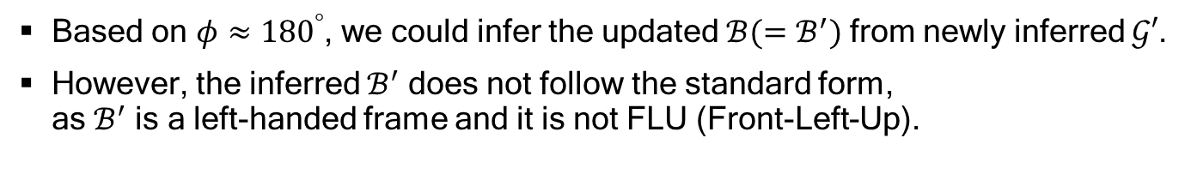





Inferring $ℬ$ from Newly Inferred $𝒢′$
Based on $φ≈{180}^{°}$, we could infer the updated $ℬ(=ℬ^{′})$ from newly inferred $𝒢′$.
However, the inferred $ℬ^{′}$ does not follow the standard form, as $ℬ^{′}$ is a left-handed frame and it is not FLU (Front-Left-Up).
Inferred by $φ≈{180}^{°}$
x
$$ℬ′$$
y
y
X
$$𝒢′$$
z
x
X
●
Body frame following FLU
(right-handed frame)
x
●
y
$$𝒰$$

Slide 7

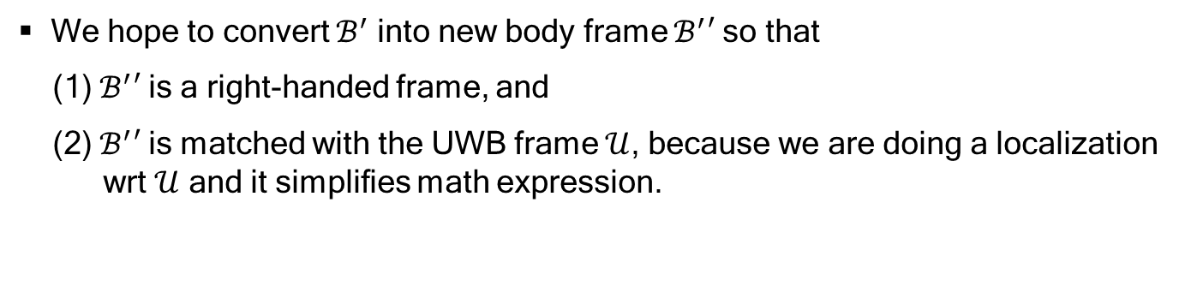





Setting New Body Frame $ℬ′′$
We hope to convert $ℬ^{′}$ into new body frame $ℬ^{′}′$ so that
(1) $ℬ^{′}′$ is a right-handed frame, and
(2) $ℬ^{′}′$ is matched with the UWB frame $𝒰$, because we are doing a localization wrt $𝒰$ and it simplifies math expression.
Left-handed frame
x
Inferred by $φ≈{180}^{°}$
x
converting
$$ℬ′$$
●
y
X
y
y
z
$$𝒢′$$
$$ℬ′′$$
Right-handed frame
x
X
Left-handed frame
x
●
y
$$𝒰$$
Right-handed frame

Slide 8


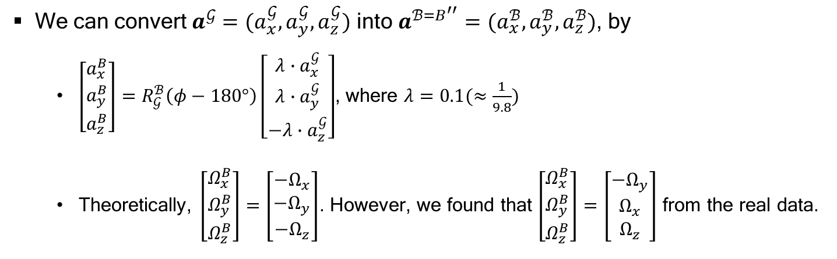



Conclusion
We can convert $a^{𝒢}=(a_{x}^{𝒢}, a_{y}^{𝒢},a_{z}^{𝒢})$ into $a^{ℬ=B^{′′}}=(a_{x}^{ℬ}, a_{y}^{ℬ},a_{z}^{ℬ})$, by
$\left[\begin{matrix}a_{x}^{B} \\ a_{y}^{B} \\ a_{z}^{B}\end{matrix}\right]=R_{𝒢}^{ℬ}\left(φ−180°\right)\left[\begin{matrix}λ∙a_{x}^{𝒢} \\ λ∙a_{y}^{𝒢} \\ −λ∙a_{z}^{𝒢}\end{matrix}\right]$, where $λ=0.1(≈\frac{1}{9.8})$
Theoretically, $\left[\begin{matrix}Ω_{x}^{B} \\ Ω_{y}^{B} \\ Ω_{z}^{B}\end{matrix}\right]=\left[\begin{matrix}{−Ω}_{x} \\ {−Ω}_{y} \\ {−Ω}_{z}\end{matrix}\right]$. However, we found that $\left[\begin{matrix}Ω_{x}^{B} \\ Ω_{y}^{B} \\ Ω_{z}^{B}\end{matrix}\right]=\left[\begin{matrix}{−Ω}_{y} \\ Ω_{x} \\ Ω_{z}\end{matrix}\right]$ from the real data.
$R_{𝒢}^{ℬ}\left(φ−180°\right)$ is expected to be
almost an identity matrix.
This is because axes for acc are
different from axes for gyro.
Left-handed frame
x
x
$$ℬ′$$
●
y
X
y
y
z
$$𝒢′$$
$$ℬ′′$$
x
X
Left-handed frame
Right-handed frame
x
●
●
FLU for gyro
(right-handed frame)
y
$$𝒰$$
Right-handed frame

Slide 9
Appendix. I
Velocity comparison

Slide 10

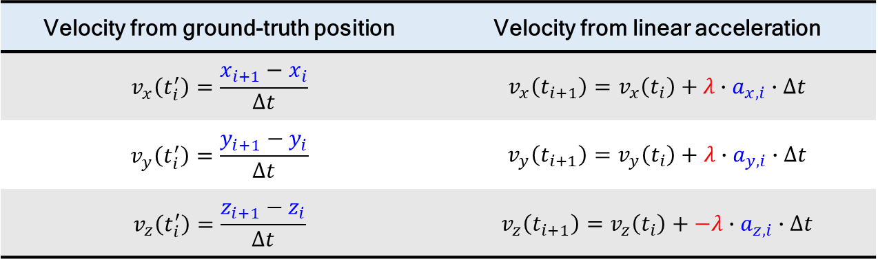



Velocity Comparison
Appendix. I
Velocity from ground-truth position | Velocity from linear acceleration
$$v_{x}\left(t_{i}^{′}\right)=\frac{x_{i+1}−x_{i}}{Δt}$$ | $$v_{x}\left(t_{i+1}\right)=v_{x}\left(t_{i}\right)+λ∙a_{x,i}∙Δt$$
$$v_{y}\left(t_{i}^{′}\right)=\frac{y_{i+1}−y_{i}}{Δt}$$ | $$v_{y}\left(t_{i+1}\right)=v_{y}\left(t_{i}\right)+λ∙a_{y,i}∙Δt$$
$$v_{z}\left(t_{i}^{′}\right)=\frac{z_{i+1}−z_{i}}{Δt}$$ | $$v_{z}\left(t_{i+1}\right)=v_{z}\left(t_{i}\right)+−λ∙a_{z,i}∙Δt$$
Blue letters indicate acquired data.
$λ=0.1$
$i$: data index
$$t_{i}^{′}=\frac{t_{i+1}+t_{i}}{2}$$
$$Δt=t_{i+1}−t_{i}$$

Slide 11



Set 1
Appendix. I
# of data | 26722
Time length (s) | 267.196275
$v_{x}$ (m/s)
$v_{y}$ (m/s)
$v_{z}$ (m/s)
Time(s)
Notes:
graphs are produced from [script2_analysis.m] and [script2_2_draw_graph.m].

Slide 12
Set 2
Appendix. I
# of data | 30835
Time length (s) | 308.336690
$v_{x}$ (m/s)
$v_{y}$ (m/s)
$v_{z}$ (m/s)
Time(s)
Notes:
graphs are produced from [script2_analysis.m] and [script2_2_draw_graph.m].

Slide 13
Set 3
Appendix. I
# of data | 44134
Time length (s) | 441.309840
$v_{x}$ (m/s)
$v_{y}$ (m/s)
$v_{z}$ (m/s)
Time(s)
Notes:
graphs are produced from [script2_analysis.m] and [script2_2_draw_graph.m].

Slide 14
Set 4
Appendix. I
# of data | 22773
Time length (s) | 227.711090
$v_{x}$ (m/s)
$v_{y}$ (m/s)
$v_{z}$ (m/s)
Time(s)
Notes:
graphs are produced from [script2_analysis.m] and [script2_2_draw_graph.m].

Slide 15
Set 5
Appendix. I
# of data | 44414
Time length (s) | 444.109007
$v_{x}$ (m/s)
$v_{y}$ (m/s)
$v_{z}$ (m/s)
Time(s)
Notes:
graphs are produced from [script2_analysis.m] and [script2_2_draw_graph.m].

Slide 16
Appendix. II
Angular velocity from flight controller

Slide 17



Set 1
Appendix. II
$Ω_{x}$ (rad/s)
$Ω_{y}$ (rad/s)
$Ω_{z}$ (rad/s)
Time(s)

Slide 18
Set 2
Appendix. II
$Ω_{x}$ (rad/s)
$Ω_{y}$ (rad/s)
$Ω_{z}$ (rad/s)
Time(s)

Slide 19
Set 3
Appendix. II
$Ω_{x}$ (rad/s)
$Ω_{y}$ (rad/s)
$Ω_{z}$ (rad/s)
Time(s)

Slide 20
Set 4
Appendix. II
$Ω_{x}$ (rad/s)
$Ω_{y}$ (rad/s)
$Ω_{z}$ (rad/s)
Time(s)

Slide 21
Set 5
Appendix. II
$Ω_{x}$ (rad/s)
$Ω_{y}$ (rad/s)
$Ω_{z}$ (rad/s)
Time(s)

Slide 22
Appendix. III
Orientation from flight controller

Slide 23



Set 1
Appendix. III
Roll ($°$)
Pitch ($°$)
Yaw ($°$)
Time(s)

Slide 24
Set 2
Appendix. III
Roll ($°$)
Pitch ($°$)
Yaw ($°$)
Time(s)

Slide 25
Set 3
Appendix. III
Roll ($°$)
Pitch ($°$)
Yaw ($°$)
Time(s)

Slide 26
Set 4
Appendix. III
Roll ($°$)
Pitch ($°$)
Yaw ($°$)
Time(s)

Slide 27
Set 5
Appendix. III
Roll ($°$)
Pitch ($°$)
Yaw ($°$)
Time(s)

Slide 28
Appendix. IV
Orientation from flight controller
+ Height

Slide 29


Set 1
Appendix. IV
Roll ($°$)
Pitch ($°$)
Yaw ($°$)
Height
red: GT
blue: flight controller
Time(s)

Slide 30

Set 2
Appendix. IV
Roll ($°$)
Pitch ($°$)
Yaw ($°$)
Height
red: GT
blue: flight controller
Time(s)

Slide 31
Set 3
Appendix. IV
Roll ($°$)
Pitch ($°$)
Yaw ($°$)
Height
red: GT
blue: flight controller
Time(s)

Slide 32
Set 4
Appendix. IV
Roll ($°$)
Pitch ($°$)
Yaw ($°$)
Height
red: GT
blue: flight controller
Time(s)

Slide 33
Set 5
Appendix. IV
Roll ($°$)
Pitch ($°$)
Yaw ($°$)
Height
red: GT
blue: flight controller
Time(s)

Slide 34
Understanding DJI M100 IMU Gyro Data
Jungwon Kang
2018/08/20

Slide 35
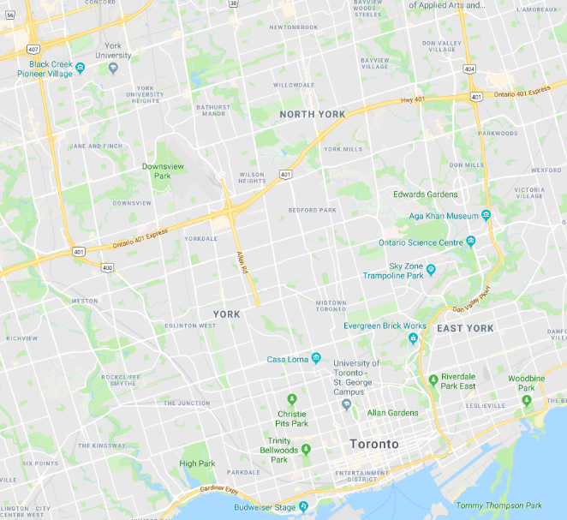
Description
Initially assumed frame
(→ In conclusion, it turned out that the initially assumed frame is the final frame.)
x
z
FLU: Front(x)-Left(y)-Up(z)
[right-handed frame]
x: roll, y: pitch, z: yaw
401 East
●
y
Description of Experiment
Exp1
●
●
Exp2
x
x
Pose (orientation)
y
x
●
x
z
Exp3
●
●
Exp4
z
y
y
●
y
yaw: 0○
(Rot 0)
yaw: 135○
(Rot 135)
Exp5
●
●
Exp6
z
z
We can get orientation (in the form of quaternion) from flight controller.
We strongly guess that the orientation is from IMU and Compass as well.
When x-axis is aligned with 401-East, it gives us zero yaw.
In all ExpX, we changed 0○ to 90○.

Slide 36
Question
1. IMU gyro data (angular velocity) really follows FLU frame?
The answer is yes.
2. Orientation (from flight controller) also follows FLU frame?
The answer is yes.

Slide 37
Rot 0

Slide 38
Rot 0, rotation wrt x (counter-clockwise)
Exp1
2018-08-20-15-59-41_abs_rot0_exp1
It gives (+) angular
velocity value.
average 0
average 0
It reached 90○
Abnormal section
negligible variation

Slide 39
Rot 0, rotation wrt x (clockwise)
Exp2
2018-08-20-16-00-37_abs_rot0_exp2
It gives (-) angular
velocity value.
average 0
average 0
It reached -90○
Abnormal section
negligible variation

Slide 40
Rot 0, rotation wrt y (counter-clockwise)
Exp3
2018-08-20-16-01-10_abs_rot0_exp3
average 0
It gives (+) angular
velocity value.
average 0
Abnormal section
It reached 90○
Abnormal section
Abnormal section

Slide 41
Rot 0, rotation wrt y (clockwise)
Exp4
2018-08-20-16-01-39_abs_rot0_exp4
average 0
It gives (-) angular
velocity value.
average 0
Abnormal section
It reached -90○
Abnormal section

Slide 42
Rot 0, rotation wrt z (counter-clockwise)
Exp5
2018-08-20-16-02-18_abs_rot0_exp5
average 0
average 0
It gives (+) angular
velocity value.
negligible variation
negligible variation
It reached 90○

Slide 43
Rot 0, rotation wrt z (clockwise)
Exp6
2018-08-20-16-02-47_abs_rot0_exp6
average 0
average 0
It gives (-) angular
velocity value.
negligible variation
negligible variation
It reached -90○

Slide 44
Rot 135

Slide 45
Rot 135, rotation wrt x (counter-clockwise)
Exp1
2018-08-20-16-04-22_abs_rot135_exp1
It gives (+) angular
velocity value.
average 0
average 0
It reached 90○
Abnormal section
negligible variation

Slide 46
Rot 135, rotation wrt x (clockwise)
Exp2
2018-08-20-16-04-22_abs_rot135_exp2
It gives (-) angular
velocity value.
average 0
average 0
It reached -90○
Abnormal section
negligible variation

Slide 47
Rot 135, rotation wrt y (counter-clockwise)
Exp3
2018-08-20-16-04-22_abs_rot135_exp3
average 0
It gives (+) angular
velocity value.
average 0
Abnormal section
It reached 90○
Abnormal section
Abnormal section

Slide 48
Rot 135, rotation wrt y (clockwise)
Exp4
2018-08-20-16-06-08_abs_rot135_exp4
average 0
It gives (-) angular
velocity value.
average 0
Abnormal section
It reached -90○
Abnormal section

Slide 49
Rot 135, rotation wrt z (counter-clockwise)
Exp5
2018-08-20-16-06-41_abs_rot135_exp5
average 0
average 0
It gives (+) angular
velocity value.
negligible variation
negligible variation
It reached around 135○

Slide 50
Rot 135, rotation wrt z (clockwise)
Exp6
2018-08-20-16-07-10_abs_rot135_exp6
average 0
average 0
It gives (-) angular
velocity value.
negligible variation
negligible variation
It reached around 45○

