Slide 1
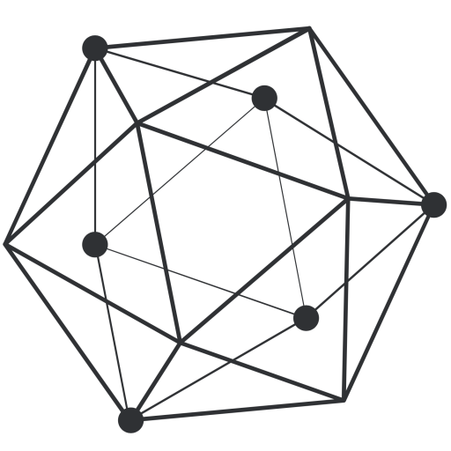
DATA
EXCHANGE
DEMO
BaSE Lab 이상록

Slide 2
CONTENTS
Architecture
Sequence diagram
Conclusion
Reference

Slide 3
Architecture Data Exchange demo Architecture
Composer
REST-API Server
Hyperledger
Composer
Web Client
MySQL
Database
Notes:
‘

Slide 4
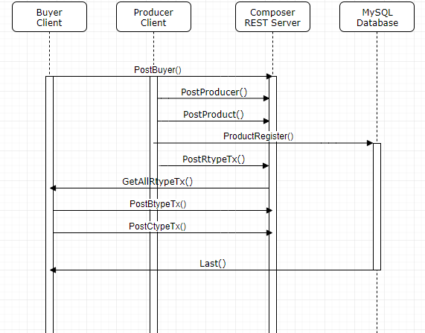
Sequence Diagram data exchange scenario
Notes:
‘

Slide 5
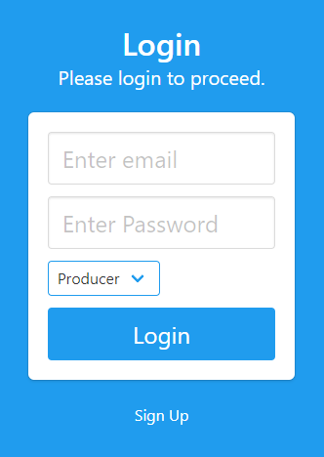
UI 사용법 Login
If you have any account as ‘Buyer’, enter the email and Password and then click the ‘Login’.
If you have any account as ‘Producer’, click the arrow next to ‘Buyer’ text, and click the ‘Producer’ then enter the email and Password and click the ‘Login’.
If you don’t have any account, Click the ‘Sign up’
Notes:
‘

Slide 6
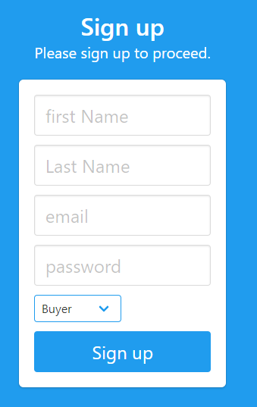
UI 사용법 Sign Up
If you want to make an account as ‘Producer’, click the arrow next to ‘Buyer’ text, and click the ‘Producer’ .
Enter your first name, last name, email, and password, and then click the ‘Sign up’.
Notes:
‘

Slide 7
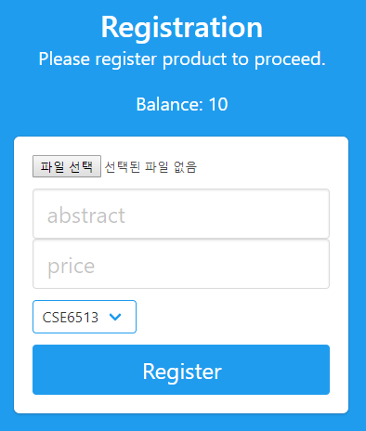
UI 사용법 Register a past test as a Producer
If you want to register the past test data, upload the file by clicking the ‘파일 선택’, and enter the abstract(string) and price(integer), and click the arrow next to a keyword then choose the keyword of your past test, and click the ‘Register’
Notes:
‘

Slide 8
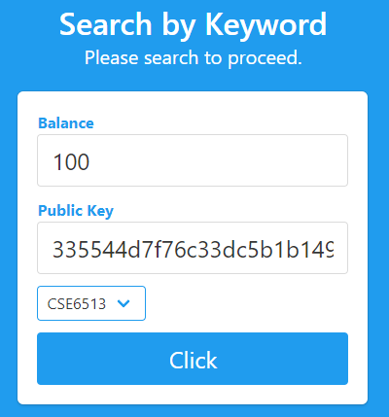
UI 사용법 Search past test by Keyword as a Buyer
You can search the past test by keyword you want, so click the arrow next to a keyword and click the keyword that you are searching for, then click the ‘Click’
Notes:
‘

Slide 9
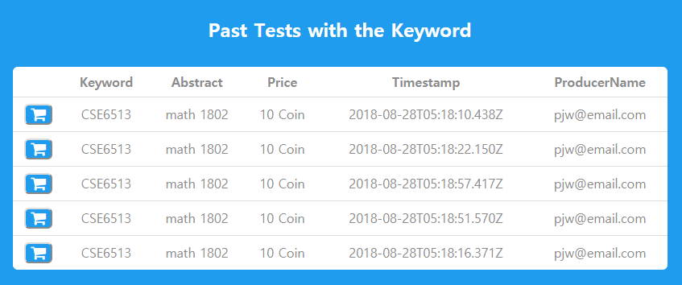
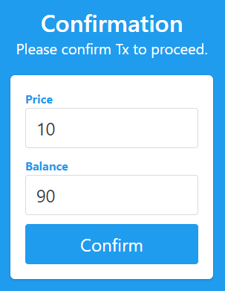
UI 사용법 Buy the past test data as a Buyer
Click the shopping cart icon in the row with the information you want
Click the ‘Confirm’ if your balance is more than the price.
Notes:
‘

Slide 10
Q & A

