Slide 1
적대적 공격 (TARGET: resnet50, vgg16)
원본
IMG
Expectation Over Transformation (EOT)
수정 IMG
Projected Gradient Descent (PGD)
Backward Pass Differentiable Approximation (BPDA)
Delta 값

Slide 2
python –m venv venv
2. .\venv\Scripts\activate
3. pip install –r requirements.txt 4. coco image 다운로드
https://cocodataset.org/#home 5. project 폴더에 input_images 폴더 생성
6. Coco 이미지들 input_images 폴더에 넣기
7. run.py config 설정 변경하면서 실험 진행

Slide 3
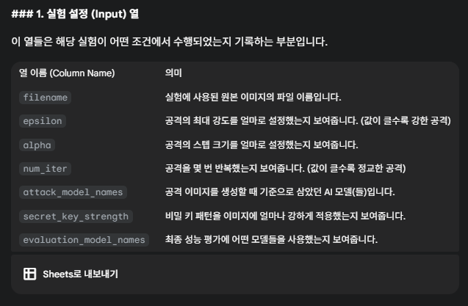

Slide 4
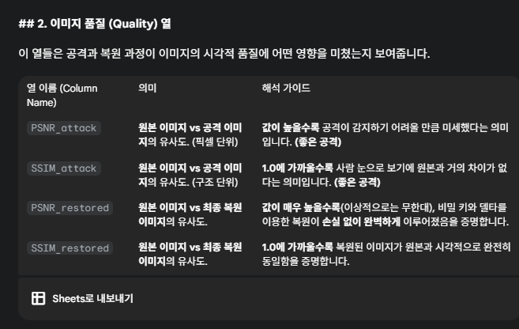

Slide 5
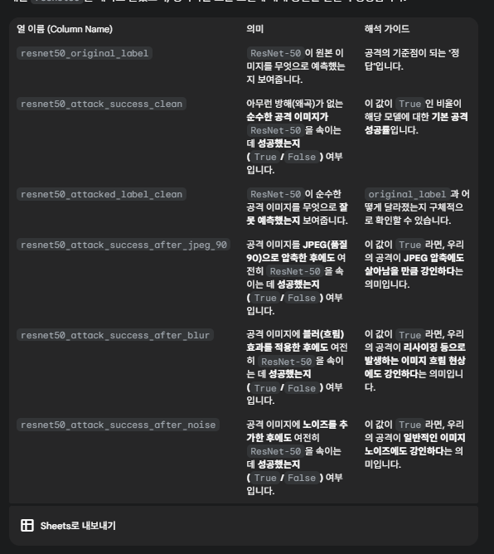

Slide 6
