Slide 1
Paper figures — draft
Overview · data generation · qualitative rollouts

Slide 2
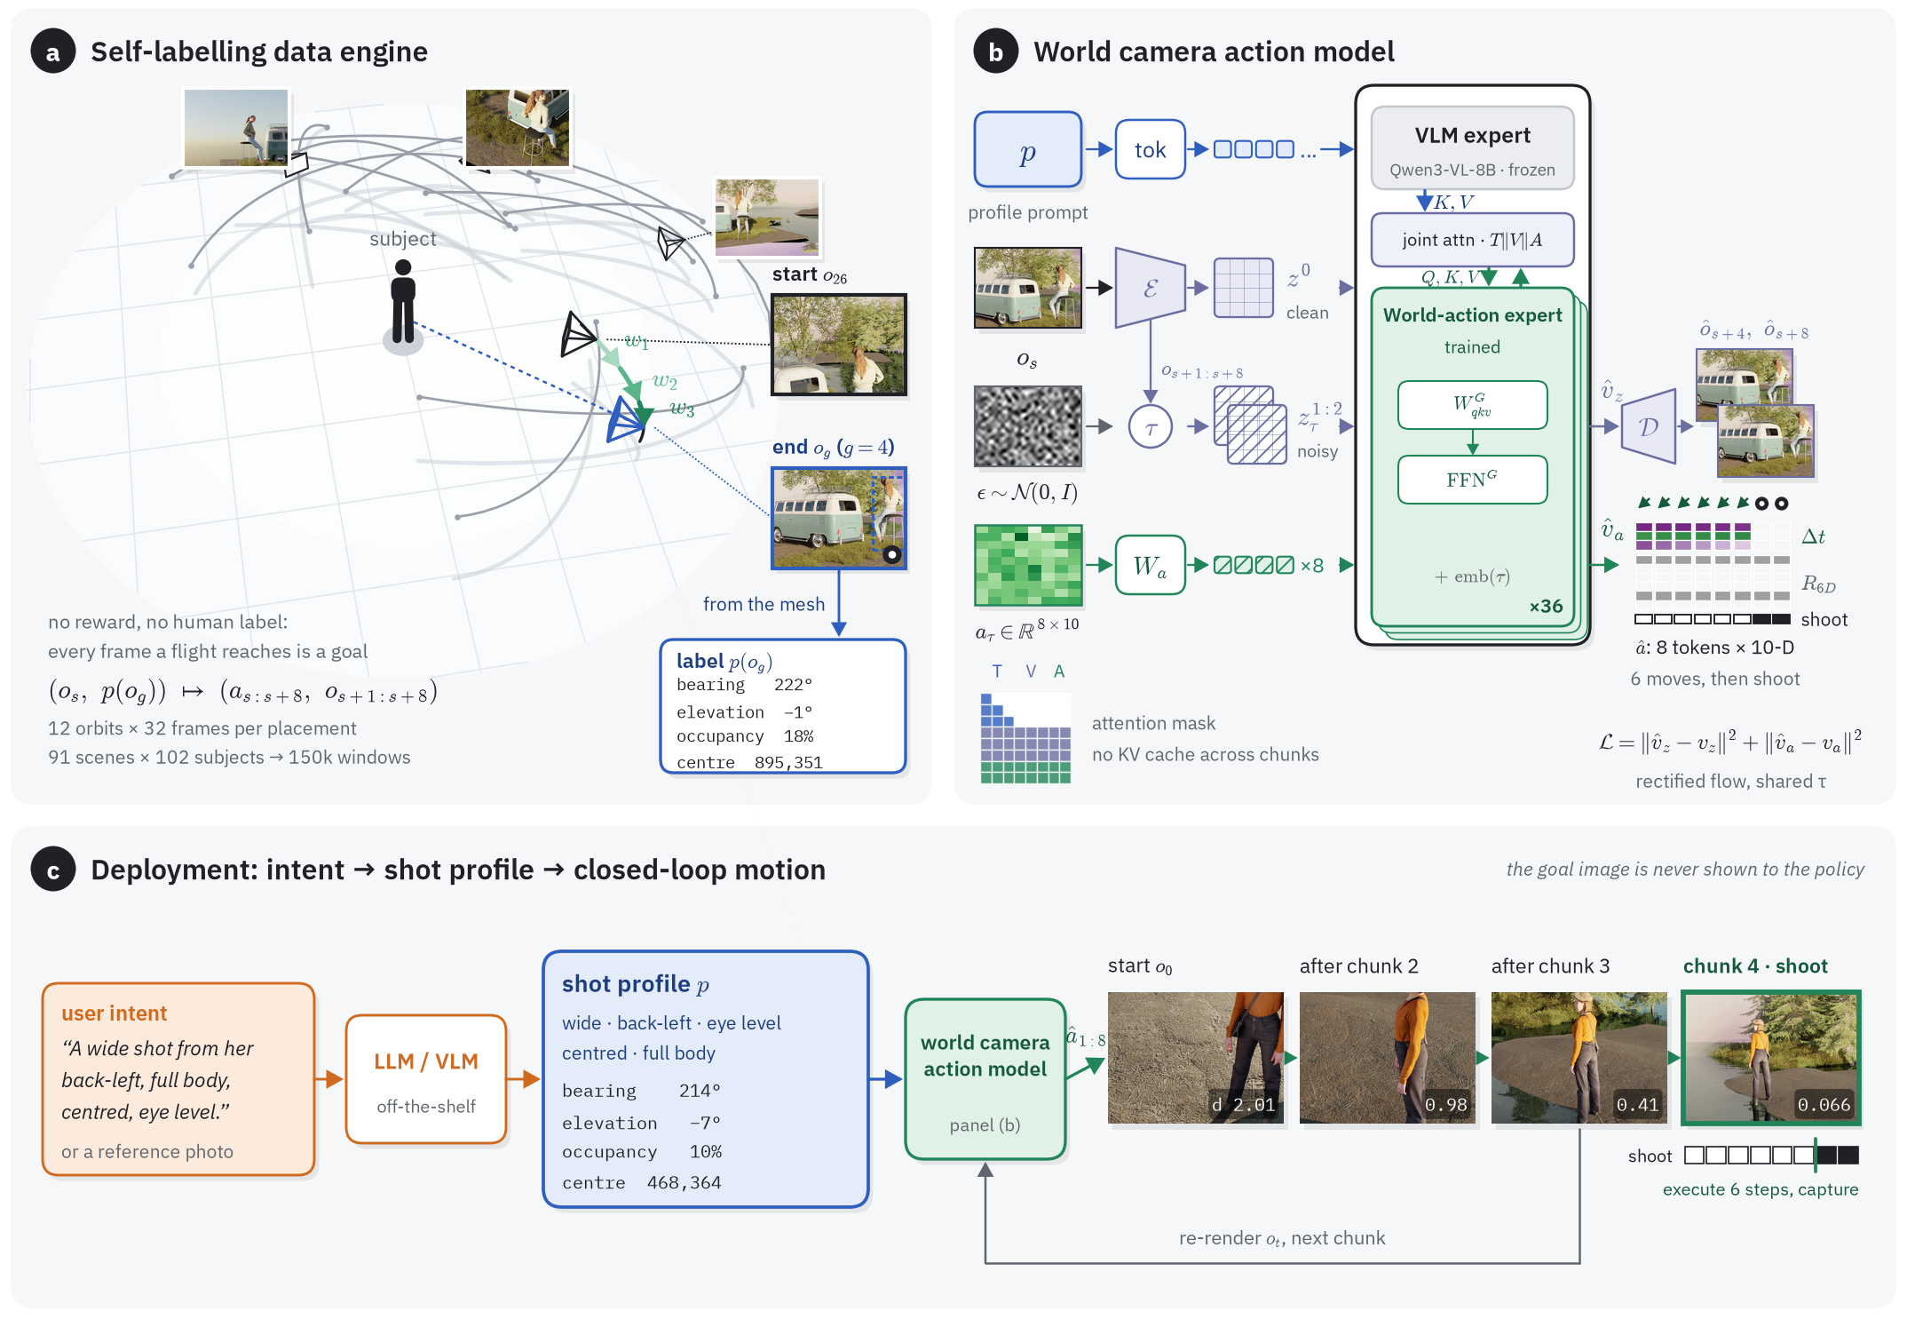
Fig. 2 — Method overview
Data engine
random camera orbits around a placed subject; any frame a flight reaches is a goal, labelled from the projected mesh
World camera action model
frozen Qwen3-VL expert + trained world-action expert in one joint attention; 8 × 10-D action tokens (Δt, R6D, shoot)
Deployment
intent → LLM → shot profile → closed-loop chunks until the model declares shoot
Notes:
figures/overview/make_fig2.py -> fig2_overview.{pdf,svg,png}. Rollout in (c): All-People-Are-Sisters p00 s31 g02, d 2.01 -> 0.066, shoot at step 7 of chunk 4. The user sentence in (c) is illustrative.

Slide 3
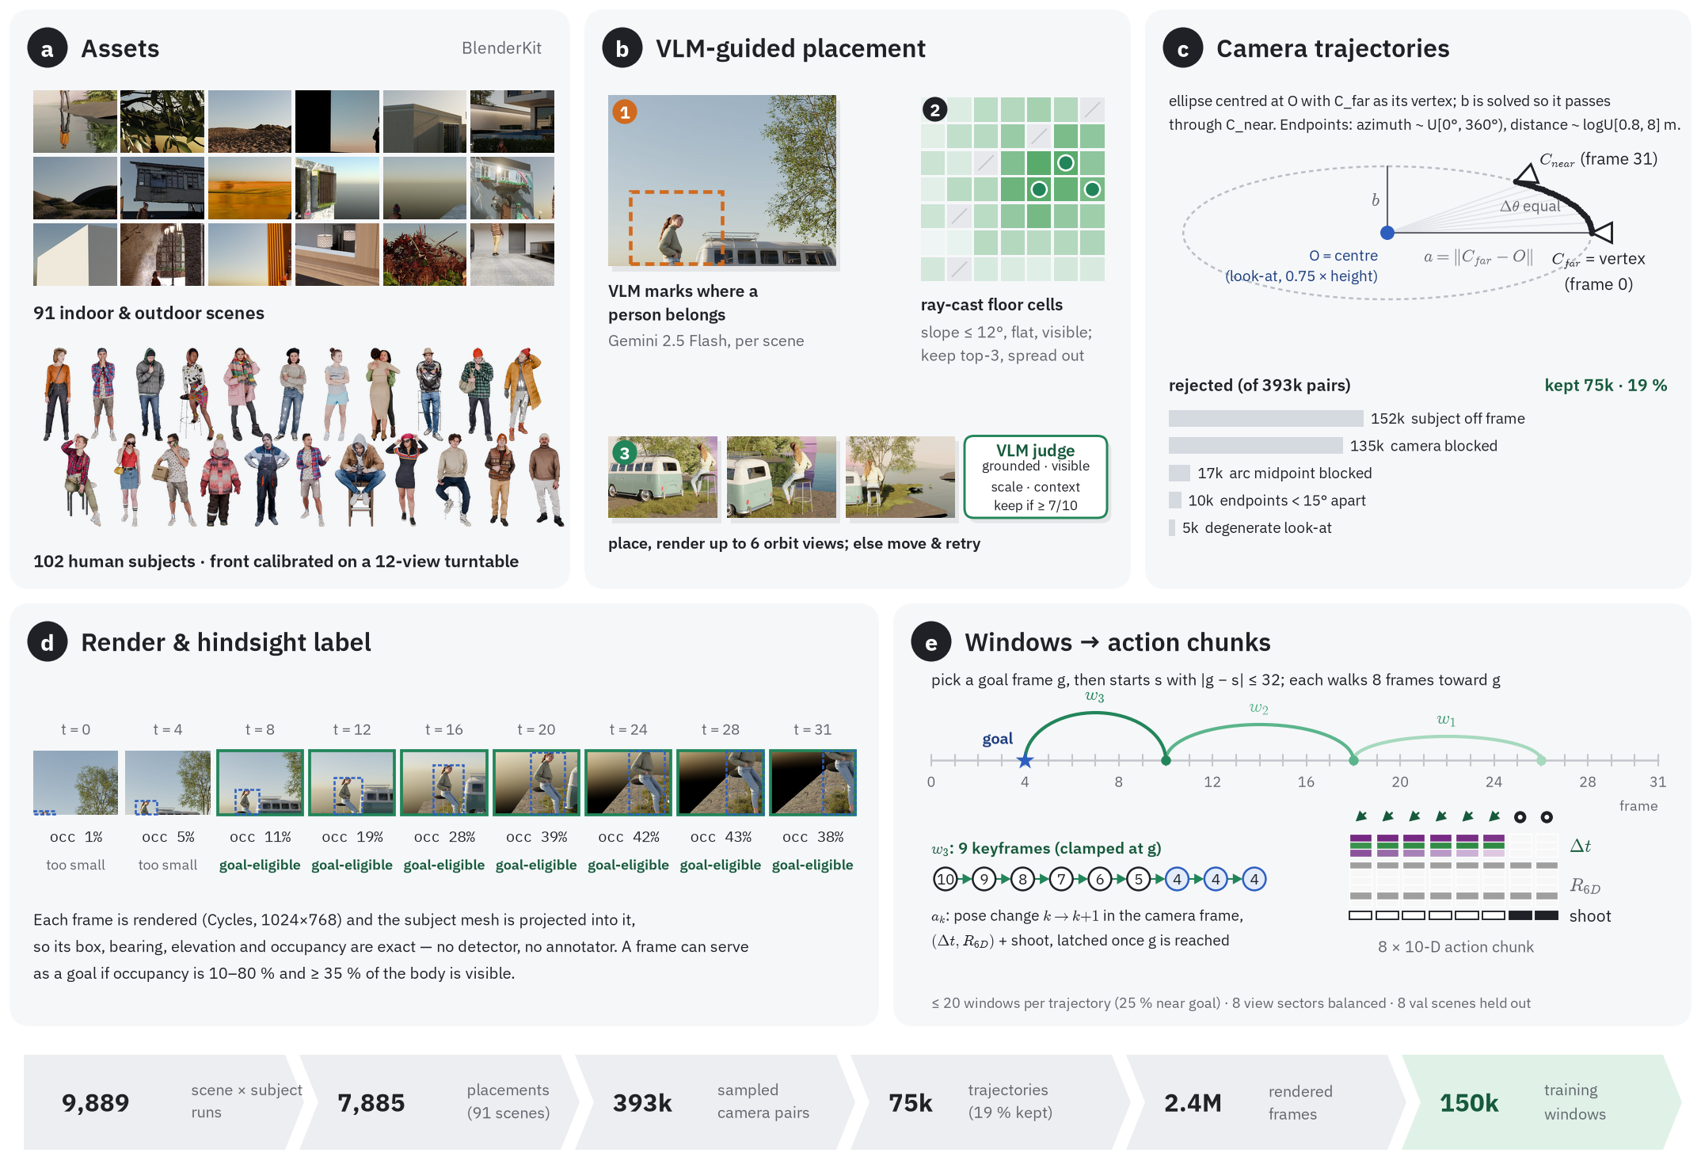
Data-generation pipeline
Funnel
9,889 scene × subject runs → 7,885 placements → 393k camera pairs → 75k trajectories → 2.4M frames → 150k windows
Placement
Gemini interest region, ray-cast floor cells, VLM judge keeps a spot at quality ≥ 7
Trajectory
ellipse centred at the look-at O, C_far as its vertex, through C_near; 32 frames at equal Δθ
Panel (b)
schematic grid in this version
Notes:
figures/datagen/make_fig_datagen.py -> fig_datagen.*. Counts were taken from the data on 2026-10-14.

Slide 4
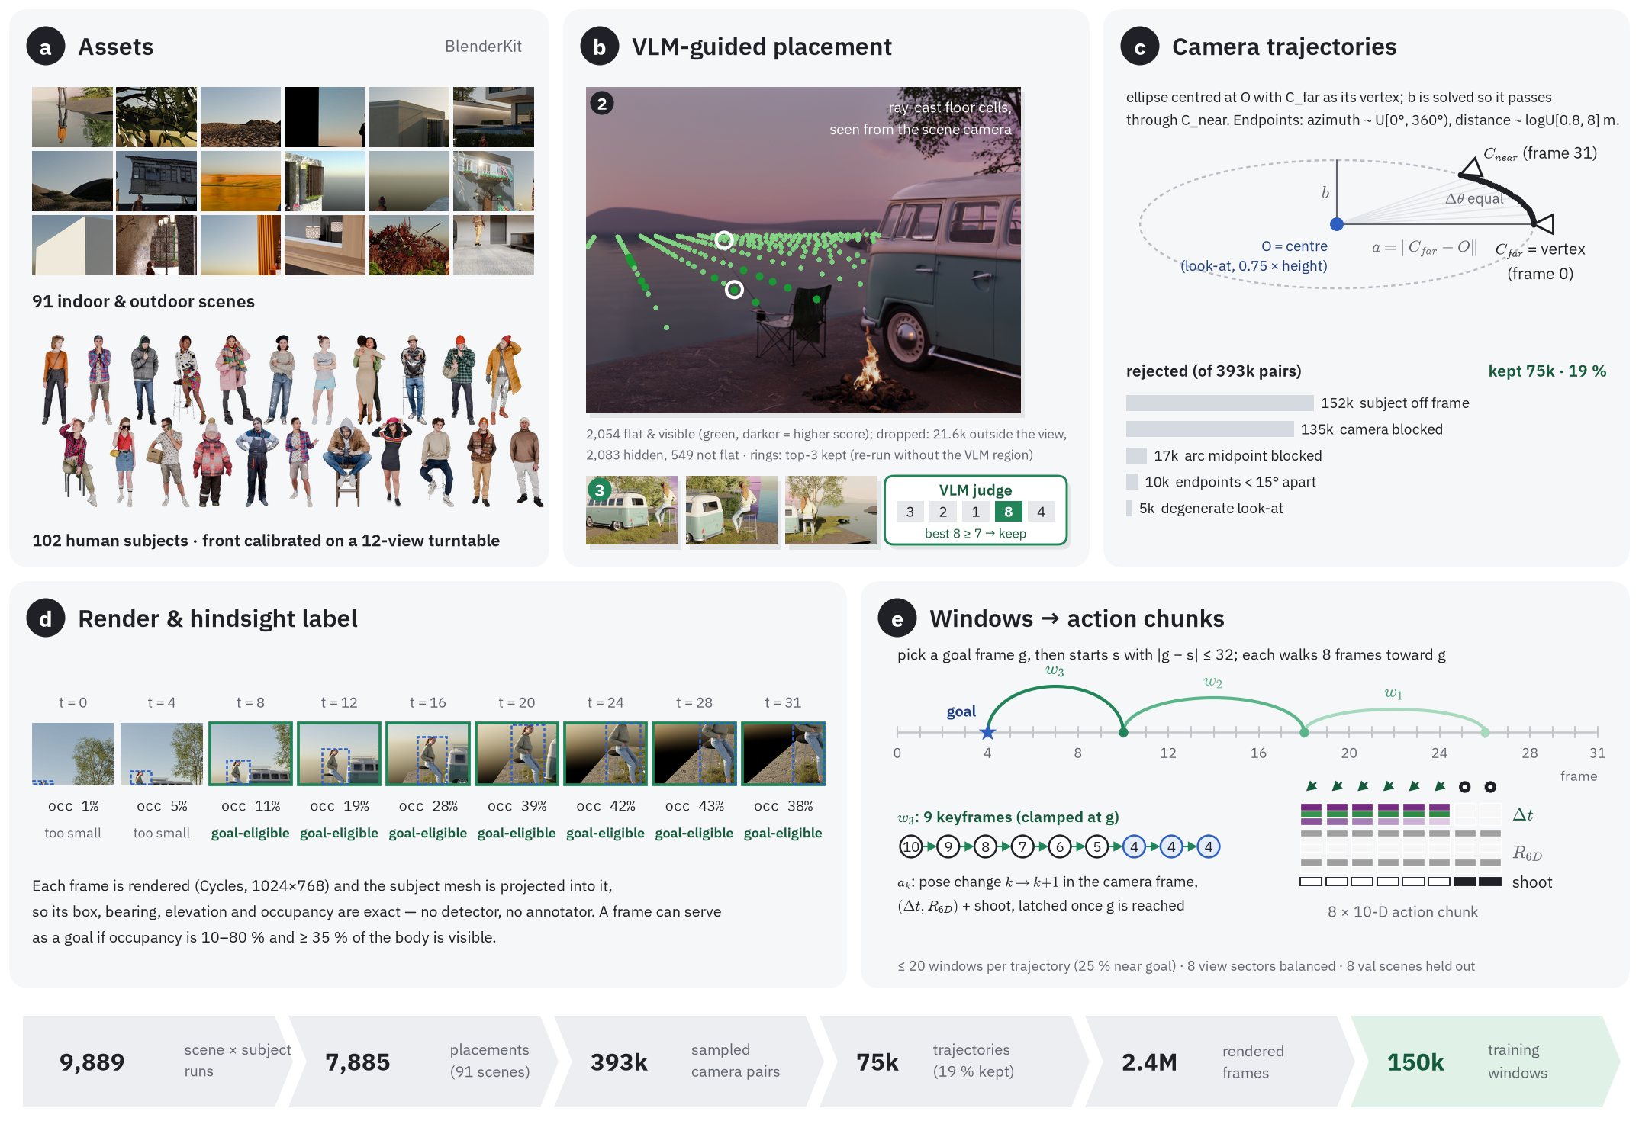
Data-generation pipeline — real floor grid
Panel (b)
a real re-run of the floor search on Chill-Camping: 2,054 flat & visible cells projected into the scene camera's view
VLM judge
the placement run's real view scores 3, 2, 1, 8, 4; best 8 ≥ 7 kept
Caveat
re-run without the Gemini interest region, so two of the top-3 land on the lake surface
Notes:
figures/datagen/make_fig_datagen.py --b real -> fig_datagen_realgrid.*. Grid from figures/datagen/sbatch_placement_grid.sh (job 192374), runs/placement_grid/Chill-Camping__Knit-and-Denim.

Slide 5
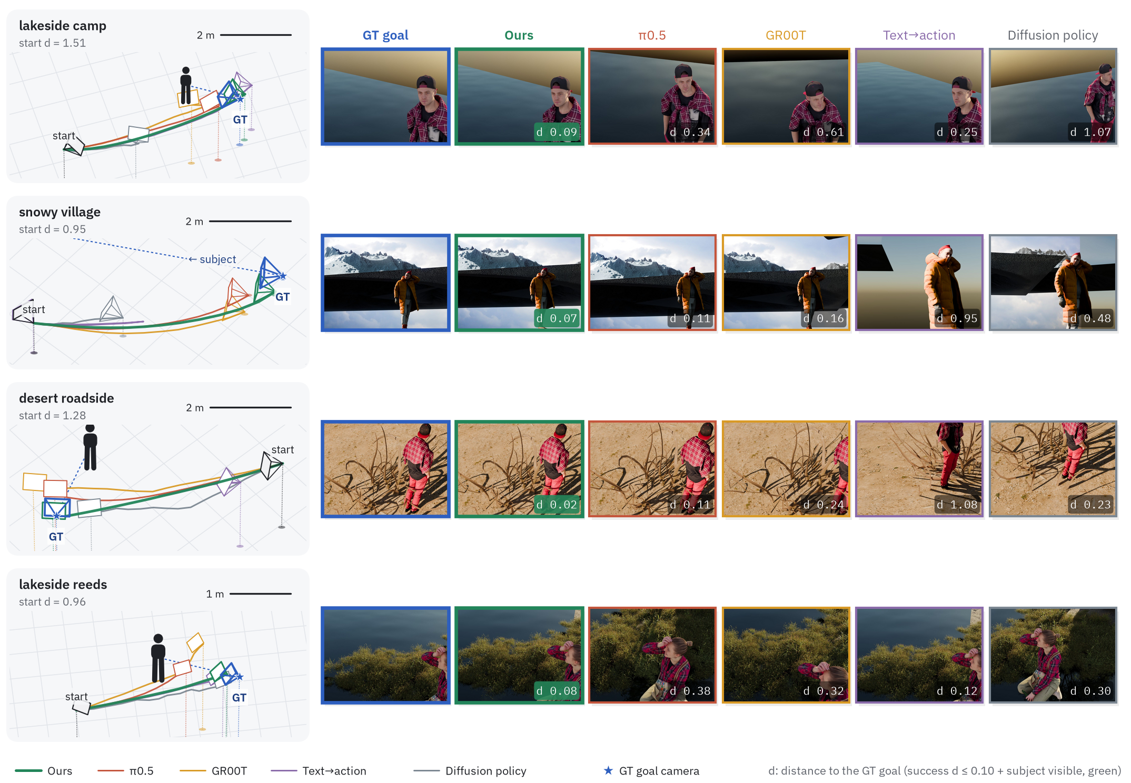
Qualitative rollouts (1/2)
Setting
benchmark v2, same start and goal for all policies; GT goal camera as a blue star
Ours
d 0.09 / 0.07 / 0.02 / 0.08 — every baseline misses (d ≥ 0.11)
Read
3-D paths on the left, last frames and d on the right; green badge = success
Notes:
figures/qualitative/make_fig_rollouts.py --rows 0,1,2,4. Selected examples (Ours succeeds, pi0.5 / GR00T / T2A / DP all miss); image-to-action left out because it is given the GT goal image.

Slide 6
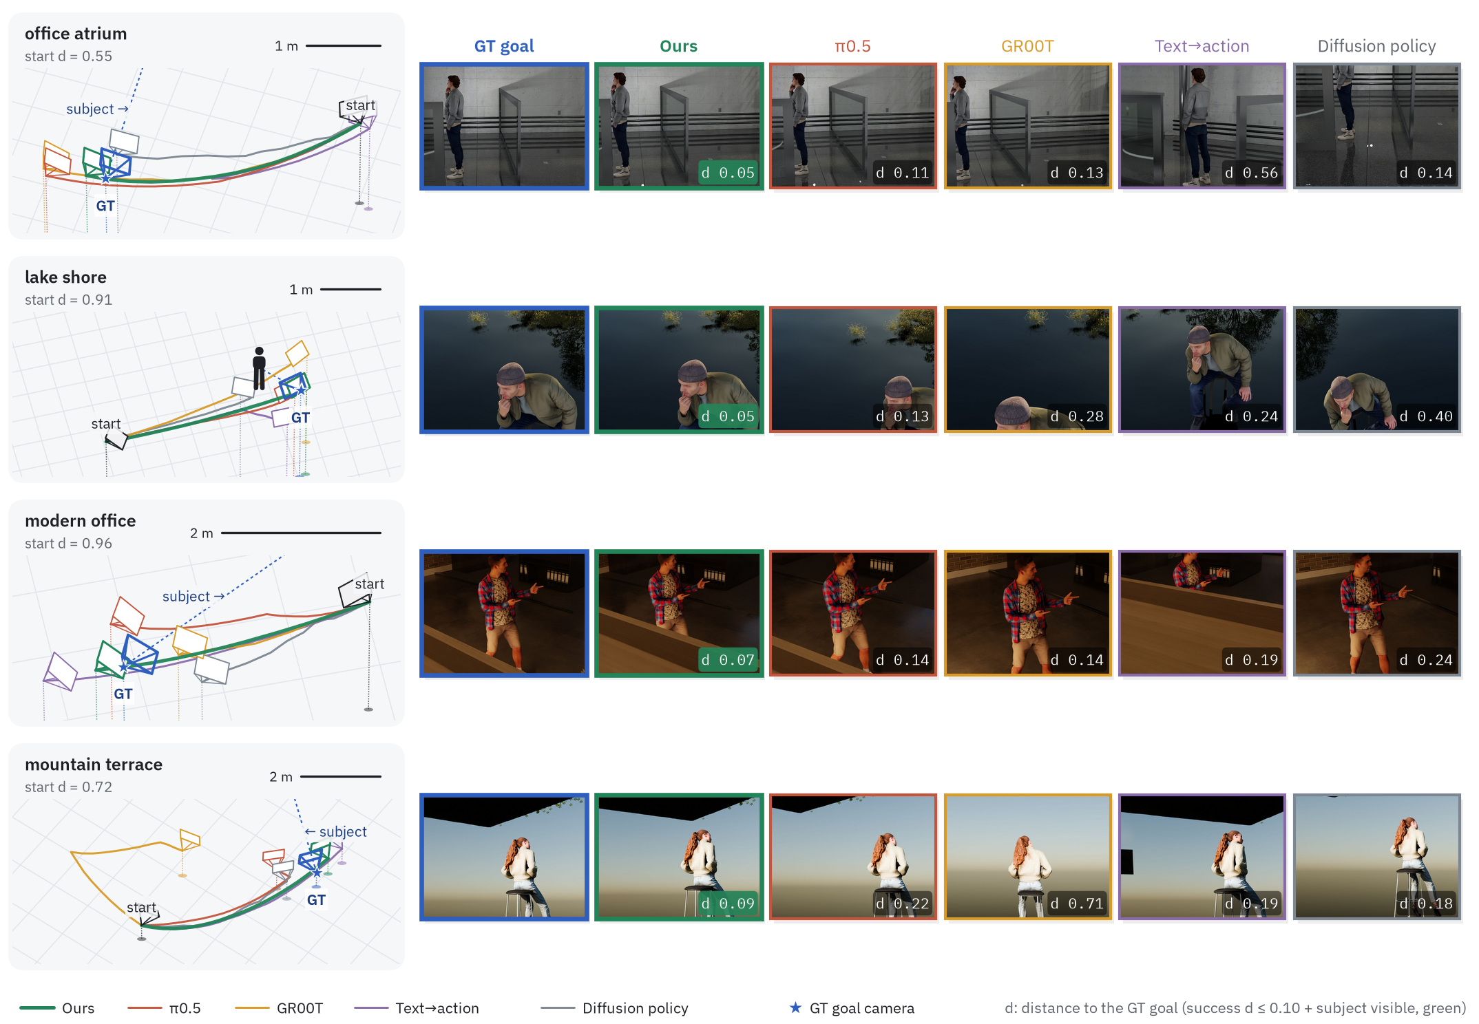
Qualitative rollouts (2/2)
Scenes
office atrium, lake shore, modern office, mountain terrace
Ours
d 0.05 / 0.05 / 0.07 / 0.09
Caption note
selected examples; say so in the paper
Notes:
figures/qualitative/make_fig_rollouts.py --rows 3,5,6,7.

